Slide 1

6.888
Advanced Topics in Networking
Lecture 1: Introduction
Mohammad Alizadeh
Spring 2016
Includes material from lectures by Nick McKeown (Stanford), Jennifer Rexford (Princeton), and George Porter (UCSD)

Slide 2
The Internet: An Exciting Time
One of the most influential inventions
  A research experiment that escaped from the lab
  … to be the global communications infrastructure
Ever wider reach
  Today: 2 billion users, 15 billion devices
  Tomorrow: more users, content, sensors, “things”, 40 billion devices by 2020
Constant innovation
  Web, P2P, video, online shopping, social networks, cloud, …

Slide 3
Transforming Everything
The ways we do business
  E-commerce, advertising, cloud computing, ...
The way we have relationships
  E-mail, IM, Facebook friends, virtual worlds
The way we think about law and govern
  Interstate commerce, national boundaries?
  Censorship and wiretapping
The way we fight
  Cyber-attacks, including nation-state attacks

Slide 4
But what is networking?

Slide 5
A Plethora of Protocol Acronyms?
SNMP
WAP
SIP
IPX
PPP
MAC
LLDP
FTP
UDP
ICMP
HIP
OSPF
RTP
IMAP
IGMP
BGP
PIM
HTTP
ECN
RED
ARP
IP
TCP
RIP
MPLS
RTCP
SMTP
RTSP
BFD
CIDR
NNTP
TLS
NAT
SACK
STUN
DNS
SSH
DHCP
VLAN
VTP
POP
LISP
TFTP
LDP
Notes:
Red: network layer
Green: transport layer
Purple: application layer
Blue: routing
Orange: enterprise/edge networks
Black: other stuff
Most have three or four letters, except IP has just two. But IP is special, as it is the center of the known universe.

Slide 6
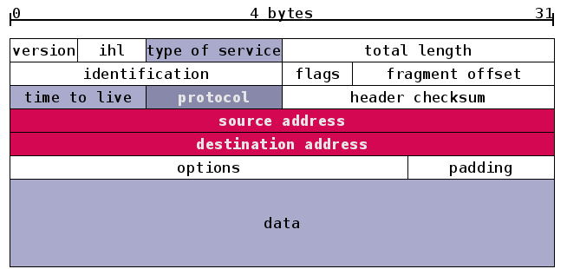
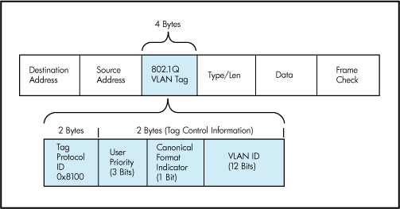
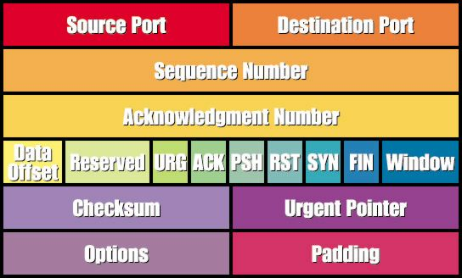
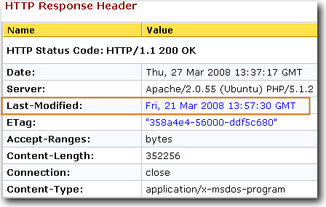
A Heap of Header Formats?
Notes:
Header formats have gotten more colorful in recent years, but they are still awfully boring. Zzzzz…
Have you seen the lego version of the IP and TCP header?

Slide 7
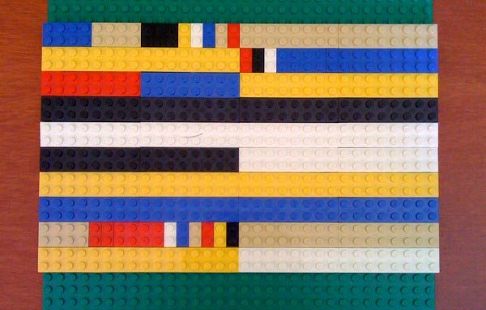
TCP/IP Header Formats in Lego

Slide 8
A Big Bunch of Boxes?
Label
Switched
Router
Load
balancer
Router
Switch
Scrubber
Repeater
Gateway
Intrusion
Detection
System
Bridge
Route
Reflector
Deep
Packet
Inspection
DHCP
server
Packet
shaper
Firewall
NAT
Hub
Packet
sniffer
WAN
accelerator
DNS
server
Base
station
Proxy
Notes:
Ask yourself what is the real difference between these components? Do we need to think of them as distinct?
Can a common piece of hardware support many of these functions?
Do ever need to do more than one of these functions at the same time and place?

Slide 9
An Application Domain?
Notes:
All of the next few slides have an element of truth in them. These are perfectly reasonable ways to think of networking as a “domain” rather than a “discipline”.

Slide 10
A place to apply theory?
Algorithms and data structures
Control theory
Queuing theory
Optimization theory
Game theory and mechanism design
Formal methods
Cryptography
Programming languages
Graph theory
Notes:
Algos and data structures: data plane (longest-prefix match, packet classification), control plane (Dijkstra, Bellman-Ford, spanning tree), DHT, …
Control theory: TCP, load-sensitive routing
Queuing theory: justification for packet switching (i.e., studying statistical multiplexing)
Optimization: design/analysis of protocols like TCP congestion control, tuning protocols for traffic engineering
Game theory: interdomain routing, sharing CPU/bandwidth/power in mobile ad hoc networks
Formal methods: design and validation of protocols
Info theory: inference of network properties from limited measurements
Crypto: secure protocols, analysis of security properties of new/existing protocols
PL: configuration languages, software-defined networking
Graph theory: graph algorithms, metrics for characterizing topologies

Slide 11
A place to build systems?
Distributed systems
Operating systems
Computer architecture
Software engineering
…
Notes:
Distributed systems: how different from networking? Evolved somewhat separately. DS assumes underlying connectivity of some sort. Yet, common issues, and they are more mature than we are.
Operating systems: end-host networking stack
Computer architecture: network interface card, router hardware, etc.
Software engineering: protocol design, understanding requirements, …

Slide 12
So, Why is Networking Cool?
Relevant
  Can impact the real world
  Can measure/build things
Interdisciplinary
  Well-motivated problems + rigorous solution techniques
Widely-read papers
  Many of the most cited papers in CS are in networking
  Congestion control, distributed hash tables, resource reservation, self-similar traffic, multimedia protocols

Slide 13
So, Why is Networking Cool?
Young, relatively immature field
  Tremendous intellectual progress is still needed
  You can help decide what networking really is
Defining the problem is a big part of the challenge
  Recognizing a need, formulating well-defined problem
  … is at least as important as solving the problem.
Lots of platforms for building your ideas
  Testbeds: Emulab, PlanetLab, Orbit, GENI
  Programmability: Click, Mininet, NetFPGA, Switch chips
Notes:
The “lots of platforms” is relevant to the course, where we will leverage these platforms to Do Great Things.

Slide 14
This course
... is about the latest in networking research
Main goal:
Prepare for high quality research in this field
Notes:
These next few slides take the critiques in the previous slides and give them a positive spin. It’s not that the earlier slides were wrong, so much as there being an upside to all this…

Slide 15
We’ll focus mostly on…
Data Center Networking
Software Defined Networking
Two “hot” areas of research
Significant interest in both academia & industry
Lots of opportunities for impact

Slide 16
DCN/SDN Papers at SIGCOMM

Slide 17
Readings & Presentations
We will read 1-2 papers per class
  Every expected to read the papers in advance
  Submit a short review of the required reading by midnight the night before class
  Say something that is not in the paper
Submit reviews here:
  http://people.csail.mit.edu/alizadeh/courses/6.888/review.html
Each student will also present one paper
  Read paper and relevant references
  25 minute talk; instructions on website

Slide 18
Projects
Research project of your choice
Work alone or in groups of two
Project ideas
  Explore your own
  I will also suggest some ideas
  Can involve system implementation, algorithms, theory, …
  Can be related to your research (come talk to me)

Slide 19
Project Timeline
Proposal (1 page) March 1
Midterm Review April 1
Final Presentation May 10 (tentative)
Final Report (6-8 pages) May 18 (tentative)

Slide 20
Grading
Class participation 15%
Paper Reviews 15%
Paper Presentation 20%
Project 50%

Slide 21
Other Logistics
Time/Location
  Tue/Thr 2:30-4pm, room 36-112
Mohammad’s office hours
  Tuesday 5-6pm at 32-G920
Course webpage
  http://people.csail.mit.edu/alizadeh/courses/6.888/
Piazza forum, sign up here:
  https://piazza.com/mit/spring2016/6888/home

Slide 22
Data Center Networking
Notes:
These next few slides take the critiques in the previous slides and give them a positive spin. It’s not that the earlier slides were wrong, so much as there being an upside to all this…

Slide 23
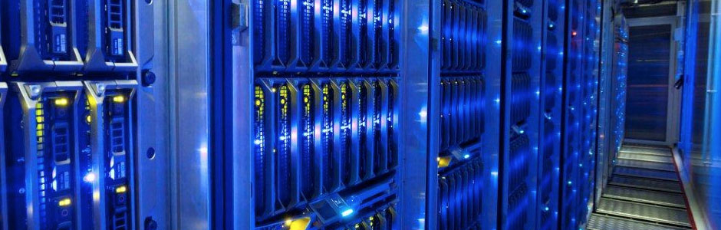
What are Data Centers?
Large facilities with 10s of thousands of networked servers
  Compute, storage, and networking working in concert
  “Warehouse-Scale Computers”
Notes:
Datacenters are large facilities that house tens of thousands of networked servers. These facilities are typically owned by businesses or government organizations and require huge investments to build and operate. Just to give you an idea: a large datacenter that a company like Google or Microsoft might build…
There are different kinds of datacenters: There are specialized datacenters which support a particular application….
There are also cloud datacenters which are more general purpose infrastructure that

Slide 24




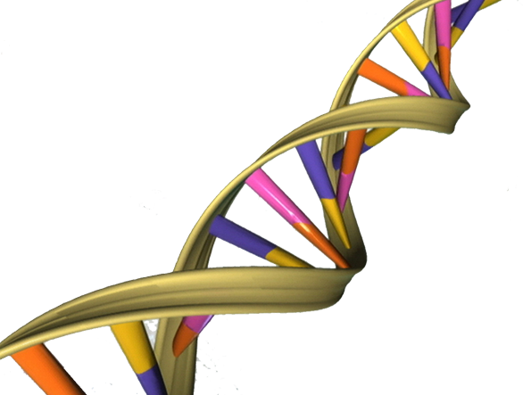


Types of Data Centers
Specialized data centers built for one big app
  Social networking: Facebook
  Web Search: Google, Bing
“Cloud” data centers
  Amazon EC2, Windows Azure
  Google App Engine

Slide 25
Cloud Computing
On-demand
  Use resources when you need it; pay-as-you-go
Elastic
  Scale up & down based on demand
Multi-tenancy
  Multiple independent users share infrastructure
  Security and resource isolation
  SLAs on performance & reliability (sometimes)
Dynamic Management
  Resiliency: isolate failure of servers and storage
  Workload movement: move work to other locations

Slide 26
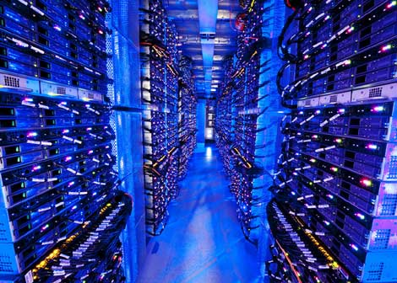
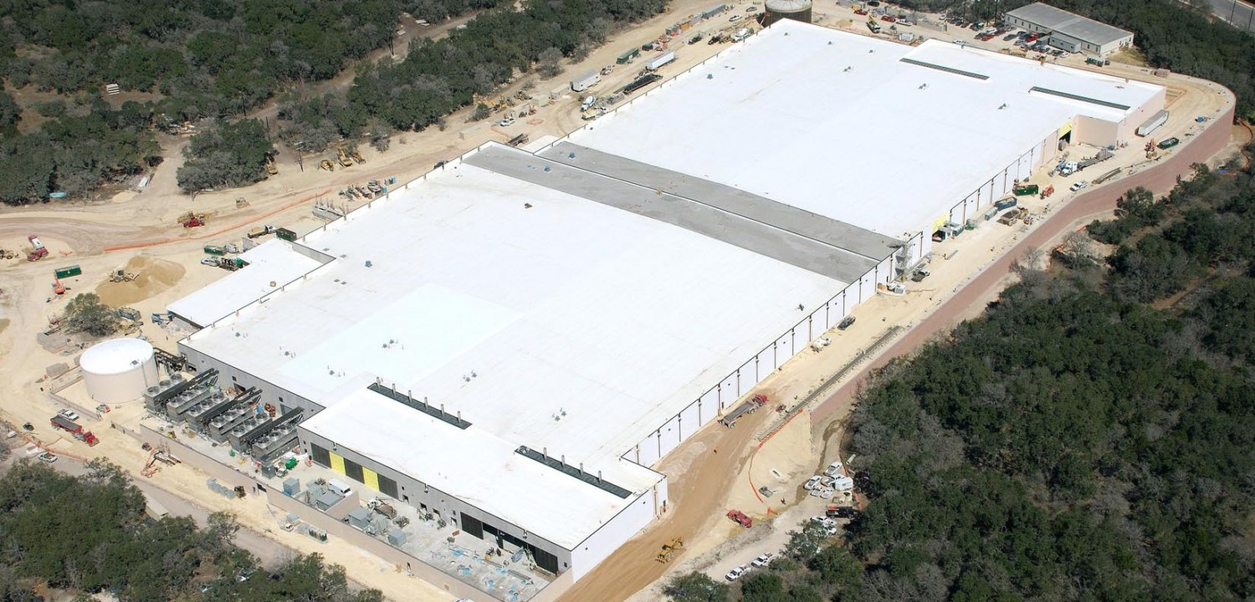
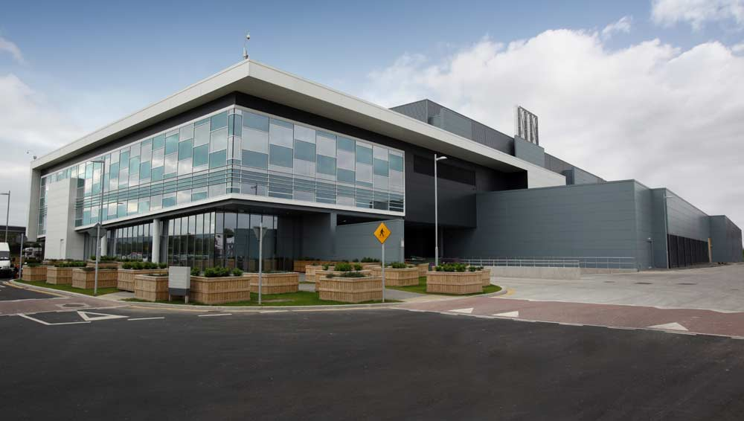
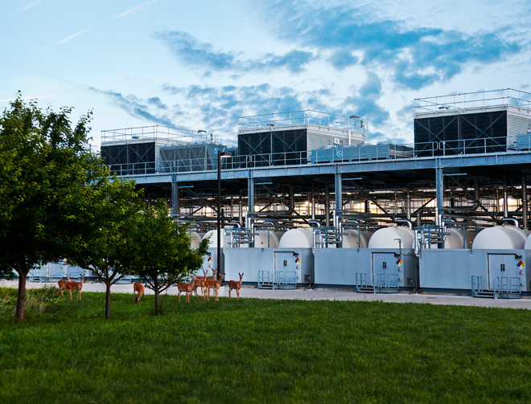
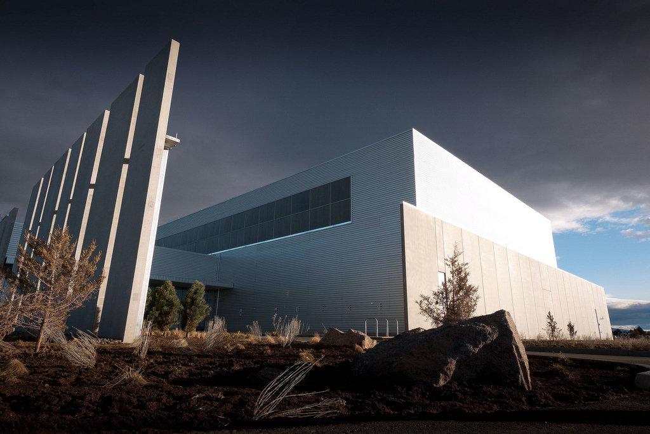
Data Centers with 100,000+ Servers
Microsoft
Microsoft
Google
Facebook

Slide 27
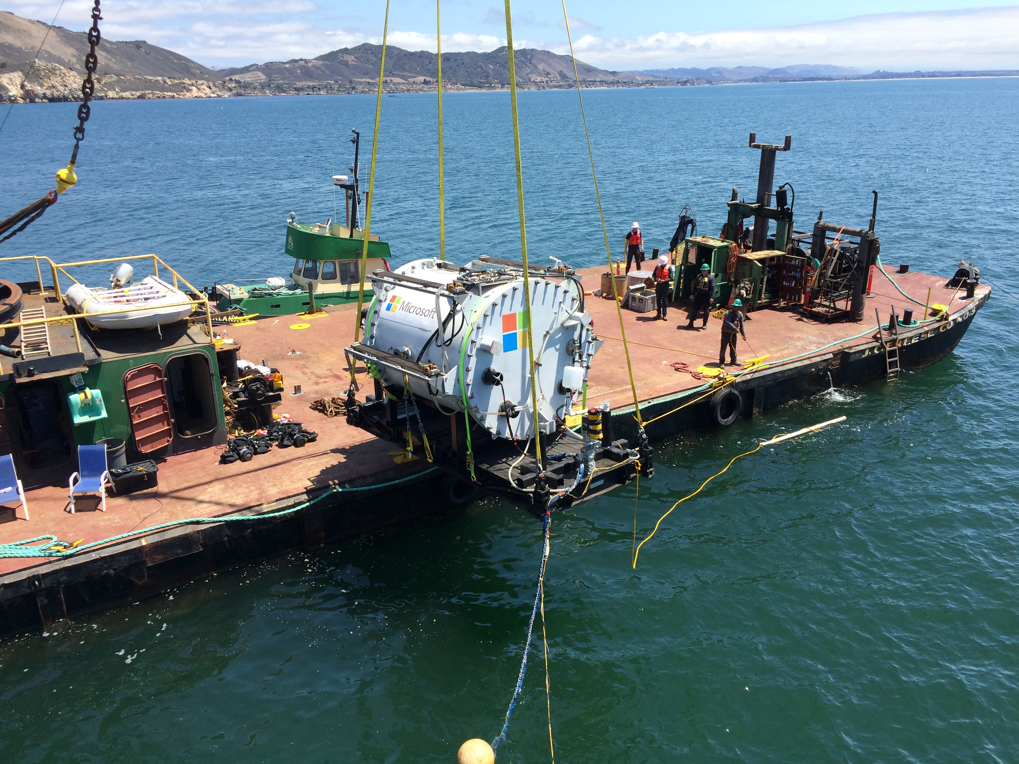

Slide 28



These things are really big
10-100K servers
100s of Petabytes of storage
100s of Terabits/s of Bw (more than core of Internet)
10-100MW of power
(1-2 % of global energy consumption)
100s of millions of dollars
100 billion searches per month
1.15 billion users
120+ million users

Slide 29
Datacenter Traffic Growth
Source: “Jupiter Rising: A Decade of Clos Topologies and Centralized Control in Google’s Datacenter Network”, SIGCOMM 2015.

Slide 30
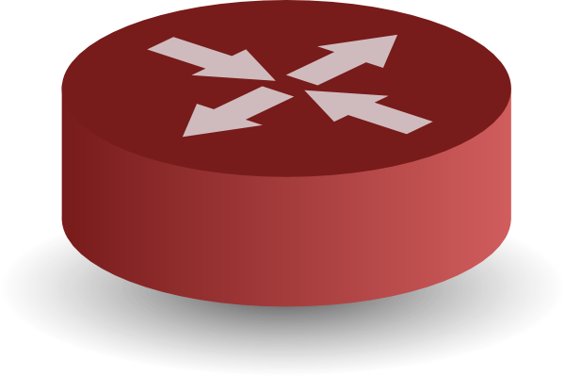
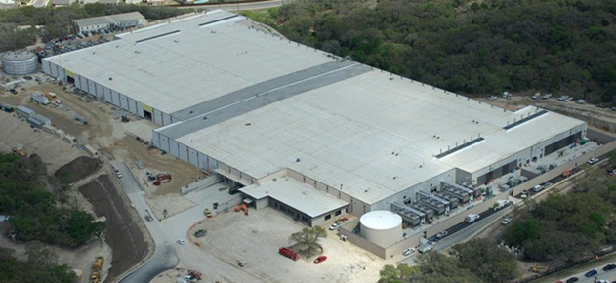


What’s Different about DCNs?
INTERNET
Fabric
Servers

Slide 31
What’s Different about DCNs?
Single administrative domain
No need to be compatible with outside world
Tiny round trip times (microseconds)
Latency/tail latency critical
Massive multipath topologies
Shallow buffers
Backplane for large-scale parallel computation

Slide 32



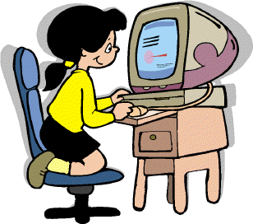

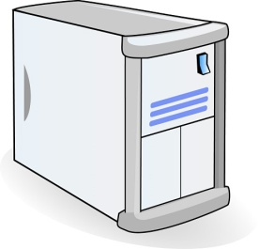

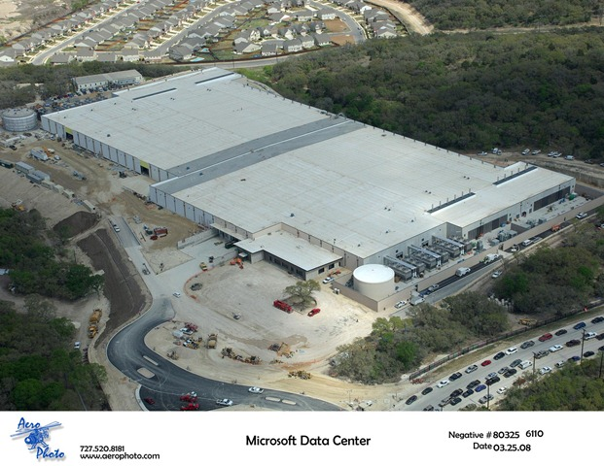

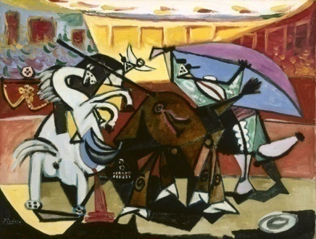
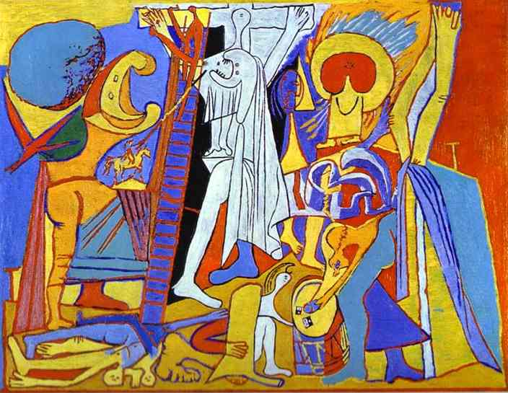

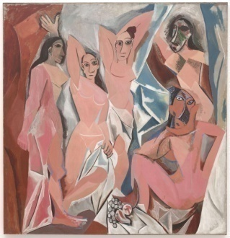




Example: Web Search
TLA
1.
Partition/Aggregate App Structure
Picasso
Art is…
Deadline = 250ms
2. Art is a lie…
3.
…..
Picasso
Strict deadlines
Tail Latency Matters
MLA
………
MLA
1. Art is a lie…
1.
Deadline = 50ms
2.
2. The chief…
…..
3.
…..
3.
“Everything you can imagine is real.”
“Computers are useless.
They can only give you answers.”
“It is your work in life that is the ultimate seduction.“
“Bad artists copy.
Good artists steal.”
“I'd like to live as a poor man
with lots of money.“
“Art is a lie that makes us
realize the truth.
“The chief enemy of creativity is good sense.“
“Inspiration does exist,
but it must find you working.”
Deadline = 10ms
Worker Nodes
Notes:
After the animation, say “this follows what we call the partition/aggregate application structure.
I’ve described this in the context of search, but it’s actually quite general
- “the foundation of many large-scale web applications.”

Slide 33
Data Center Challenges
Massive bisection bandwidth
  Topologies
  Load balancing
  Optics
Ultra-Low latency (<10 microseconds)
  Rate-control or packet scheduling?
  Centralized or distributed?
Managing resources across network & servers
  Multi-tenant performance isolation
  App-aware network scheduling (e.g. for big data)
Next-generation hardware
  RDMA, Rack-Scale Computing

Slide 34

Software Defined Networking
Notes:
These next few slides take the critiques in the previous slides and give them a positive spin. It’s not that the earlier slides were wrong, so much as there being an upside to all this…

Slide 35
Software Defined Network (SDN)
Control
Program
Control
Program
Control
Program
Global Network Map
Control Plane
Control
Packet
Forwarding
Control
Packet
Forwarding
Control
Control
Packet
Forwarding
Packet
Forwarding
Control
Packet
Forwarding
Notes:
Talk about forwarding & control planes

Slide 36
Software Defined Network
A network in which the control plane is
physically separate from the forwarding plane.
and
A single control plane controls
several forwarding devices.
(That’s it)

Slide 37
Software Control Plane
SDN
Forwarding
Forwarding
Forwarding
Forwarding
Intended consequences...
Put network owners and operators in control.
Networks that are more reliable and more secure.
Networks that cost less: simpler, streamlined hardware.
Networks that cost less to operate (fewer features).

Slide 38
An example
Routing

Slide 39
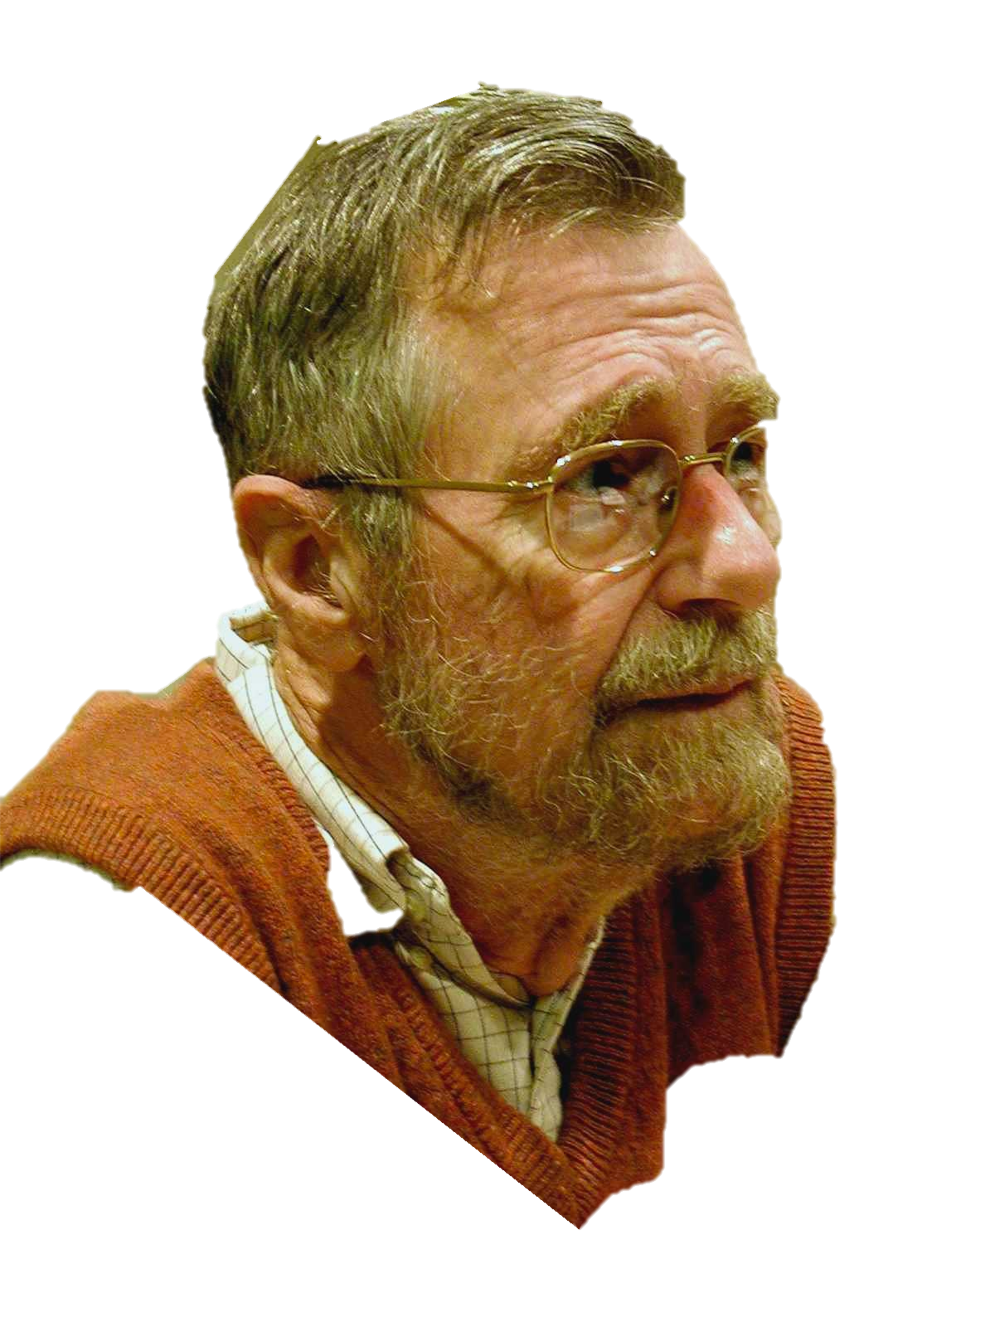
function Dijkstra(Graph, source):
for each vertex v in Graph:
dist[v] := infinity ;
previous[v] := undefined;
dist[source] := 0 ;
Q := the set of all nodes in Graph ;
while Q is not empty: // The main loop
u := vertex in Q with smallest distance in dist[] ;
remove u from Q ;
if dist[u] = infinity:
break ;
for each neighbor v of u:
alt := dist[u] + dist_between(u, v) ;
if alt < dist[v]:
dist[v] := alt ;
previous[v] := u ;
decrease-key v in Q;
return dist[], previous[];
end function
Edsger Dikjstra
1930-2002
Photo: Hamilton Richards

Slide 40
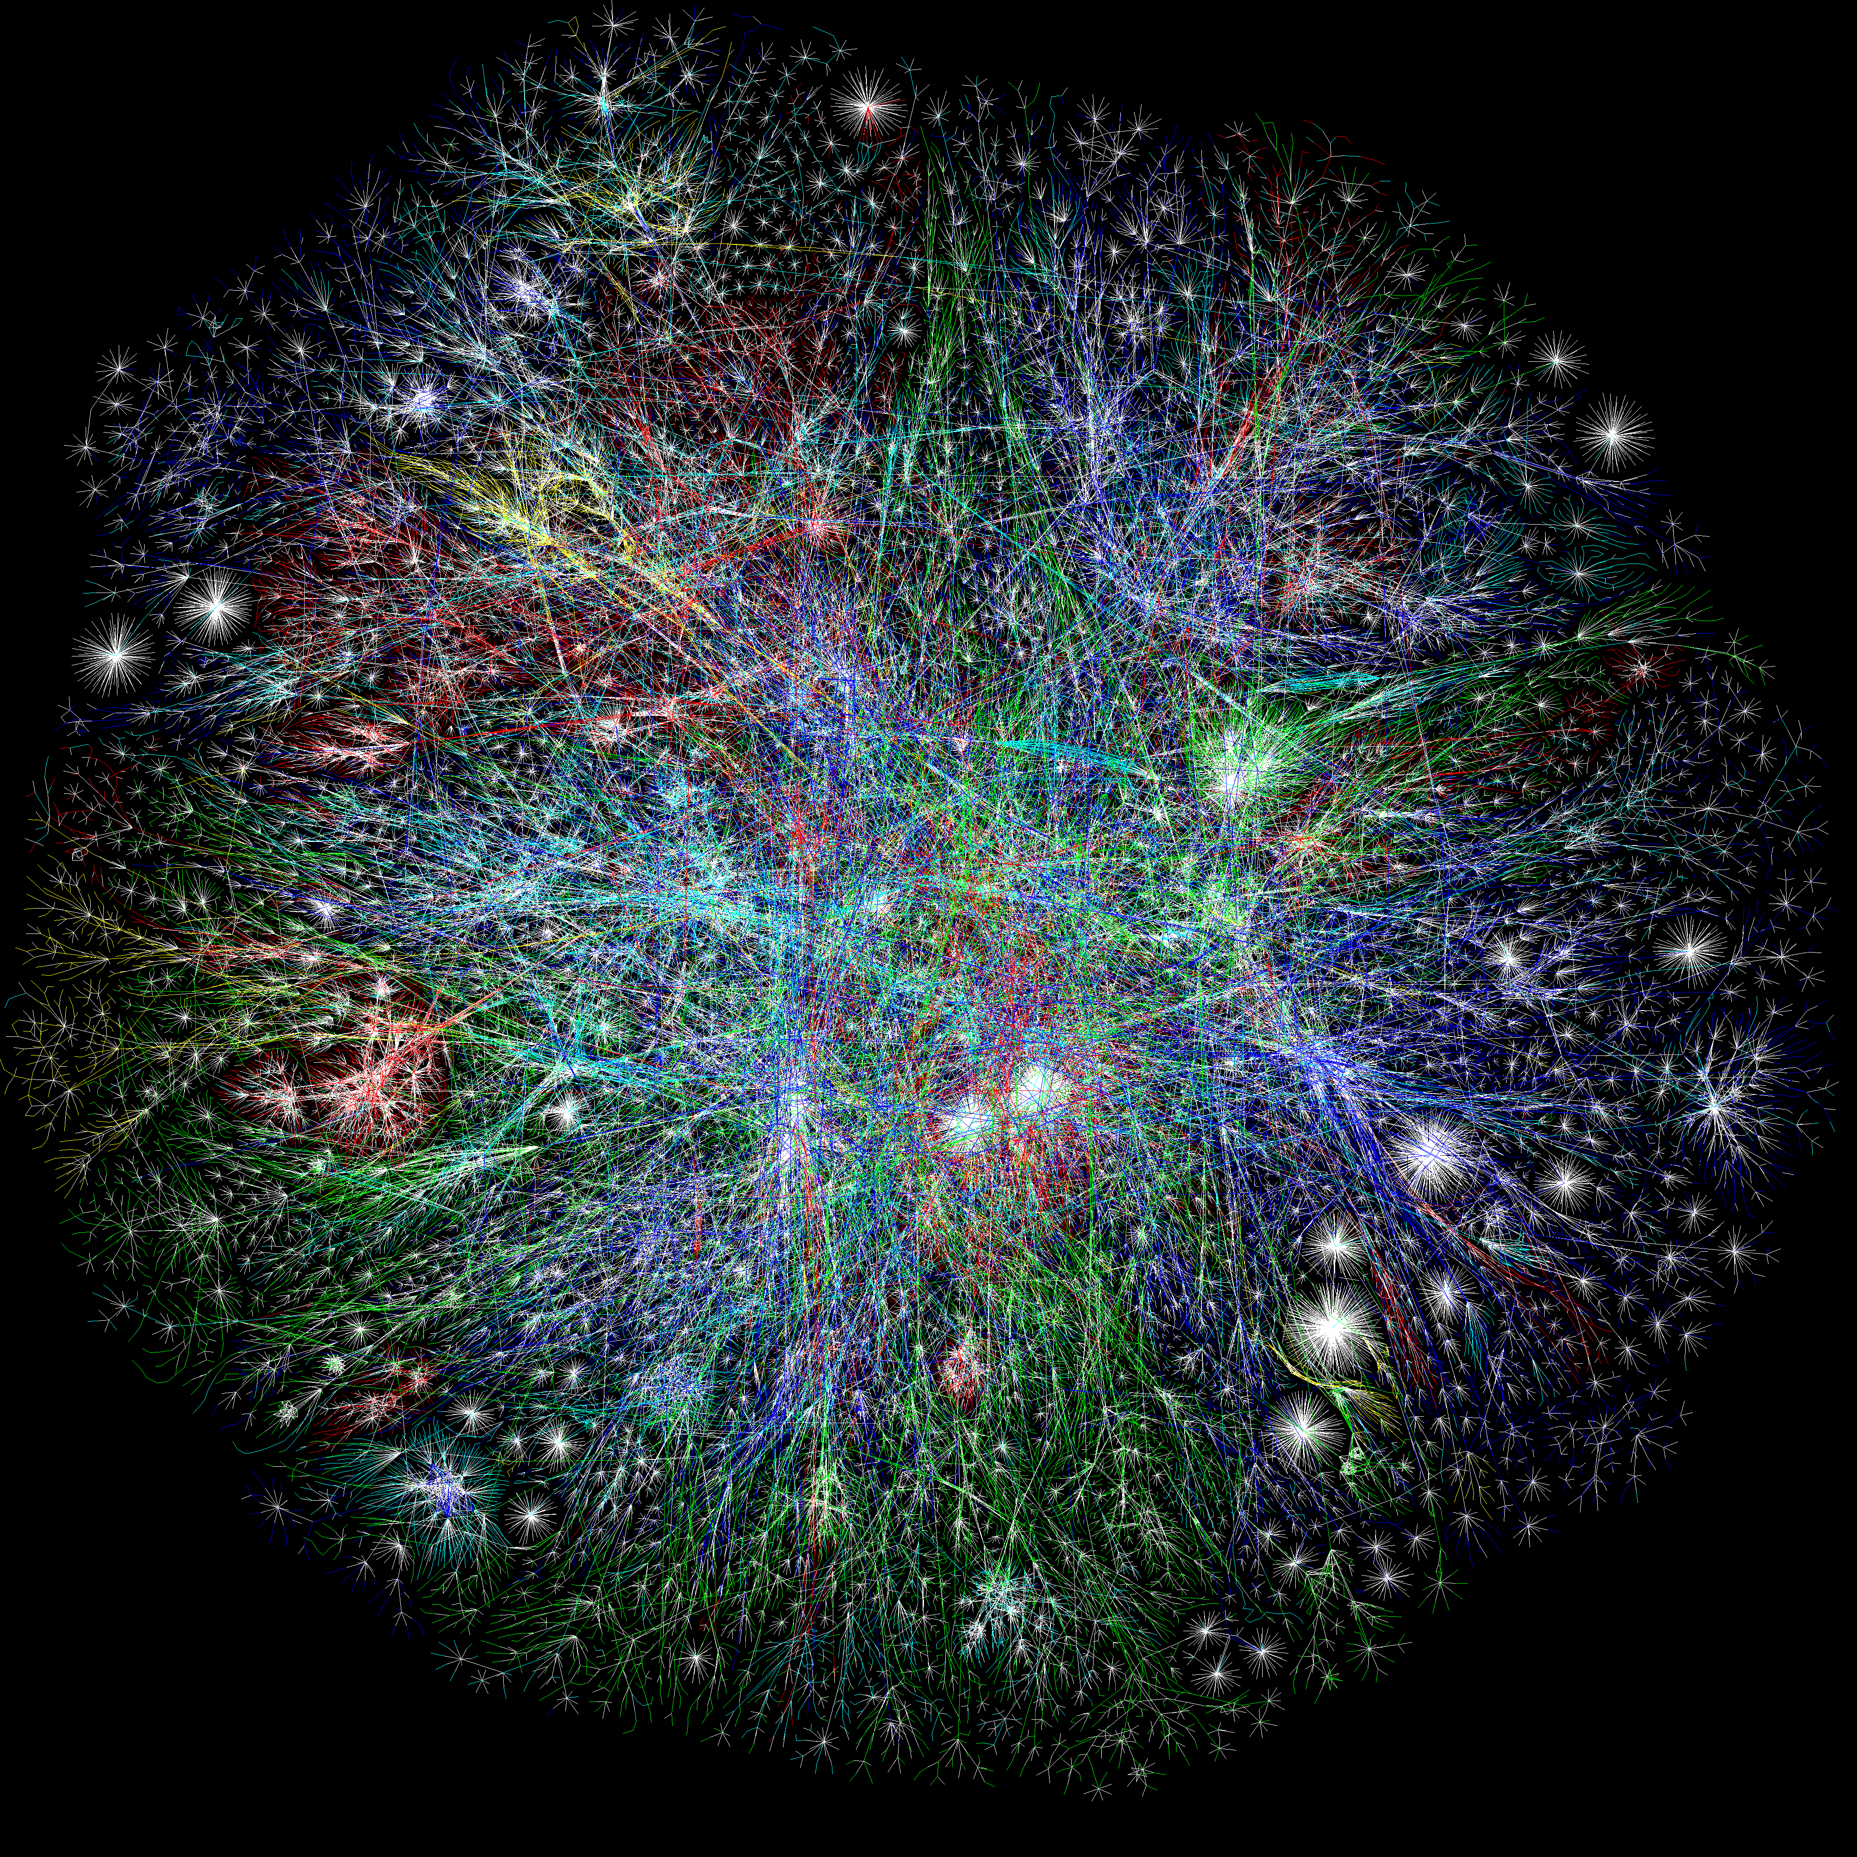
A
B
The Opte Project

Slide 41
Software
Software
Hardware
Software
Hardware
Software
Hardware
Hardware

Slide 42
Figure out which routers and links are present.
Run Dijkstra’s algorithm to find shortest paths.
B
“If a packet is going to B,
then send it to output 3”
Software
Software
Hardware
Data
B
2
Software
1
Hardware
B
“If , send to 3”
Software
Hardware
B
3
Hardware

Slide 43
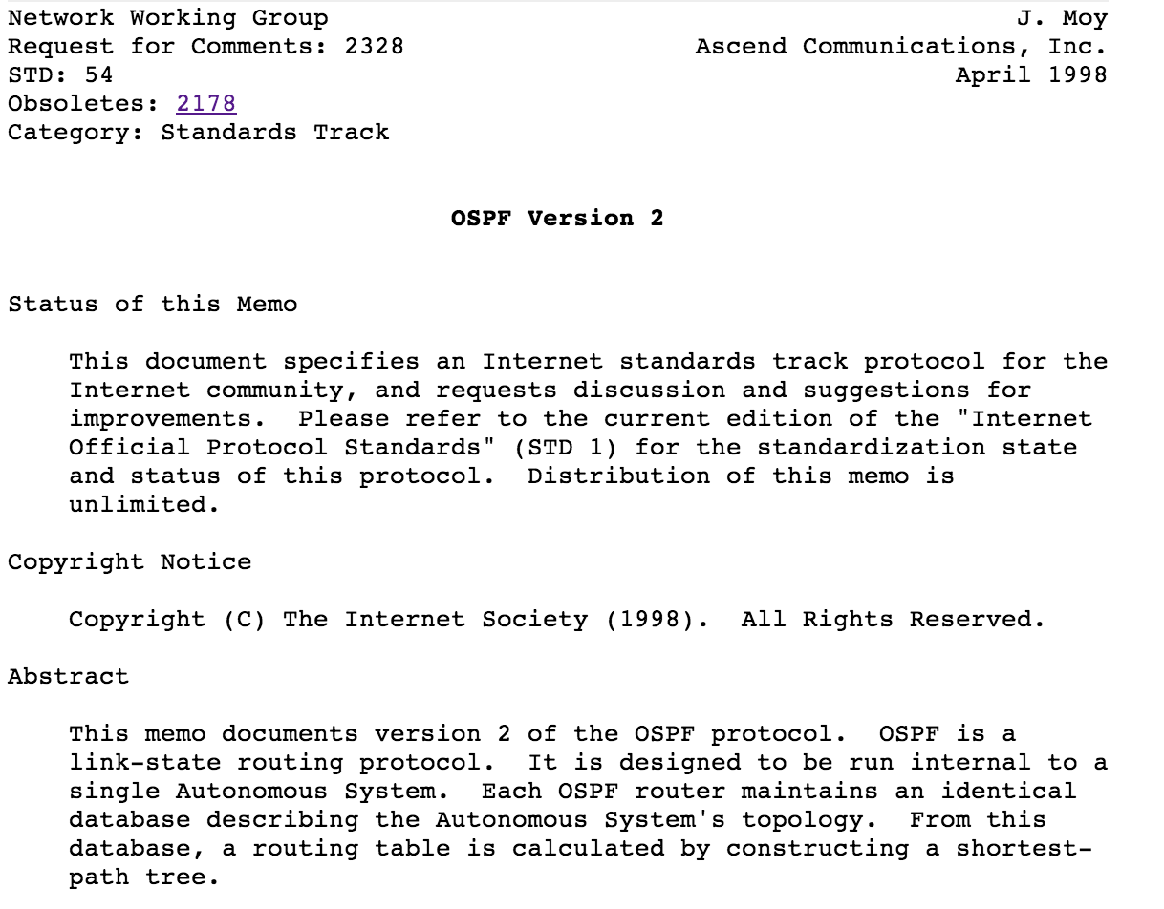
95%
Figure out which routers and links are present.
Run Dijkstra’s algorithm to find shortest paths.
5%
50,000 lines of code
50,000 lines of code
Software
Software
50,000 lines of code
Hardware
Software
Hardware
Software
Hardware
B
Hardware

Slide 44
Dijkstra
IS-IS
BGP
MPLS
Firewall…
Global Network Map
Network OS
Forwarding
Forwarding
Forwarding
Forwarding

Slide 45
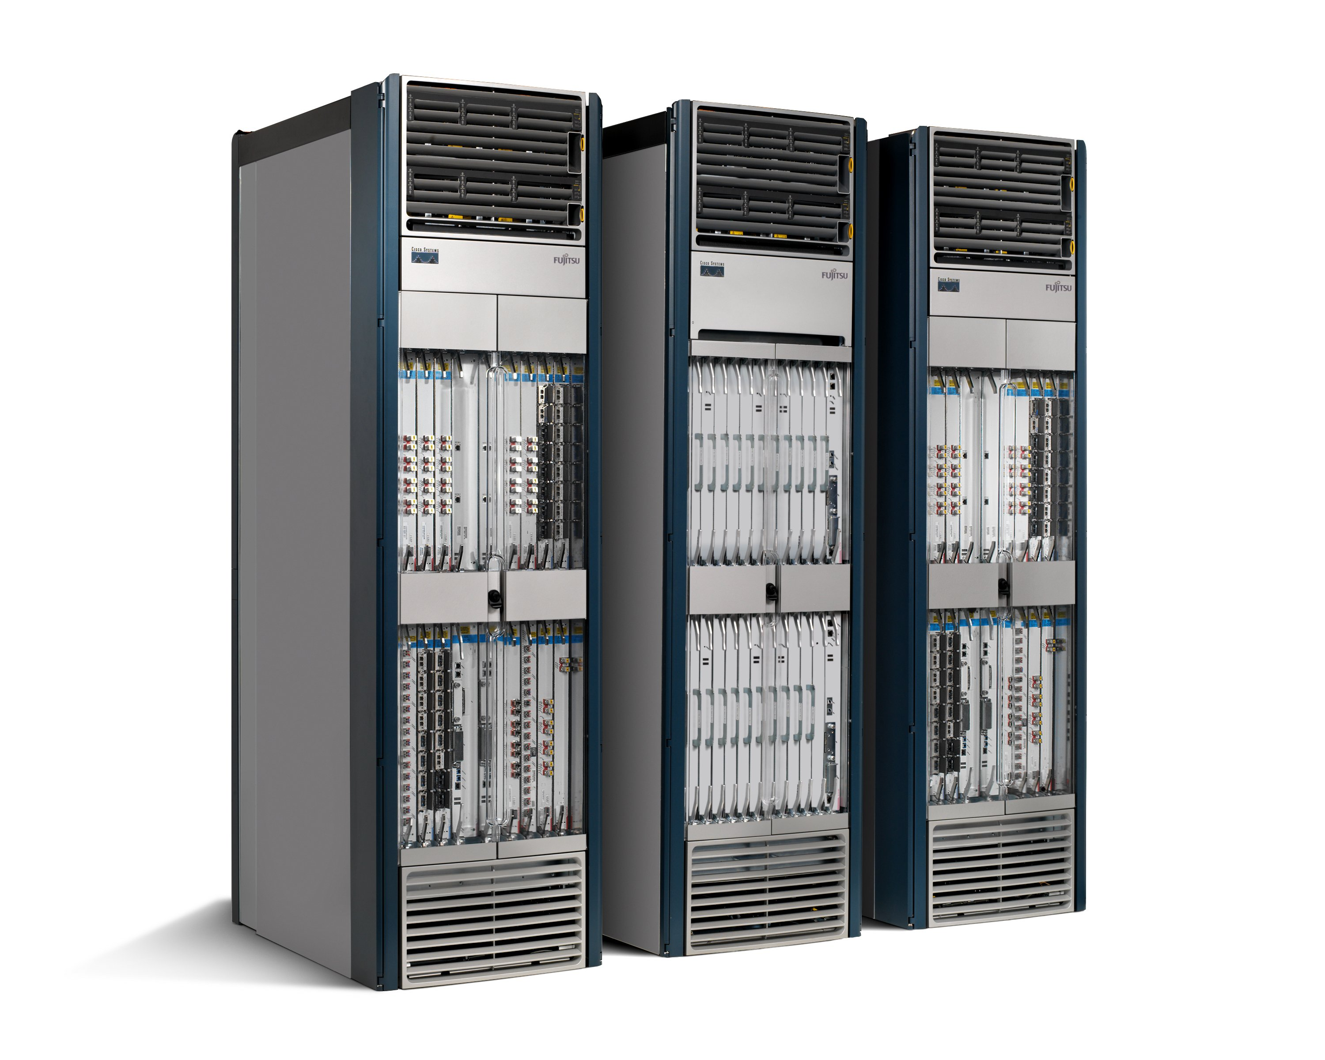
OSPF
Dijkstra
OSPF
Dijkstra
5%
Global Network Map
Network
Map
95%
Network OS
OS
Specialized
Hardware
Packet
Forwarding
Packet
Forwarding
Packet
Forwarding
Packet
Forwarding

Slide 46
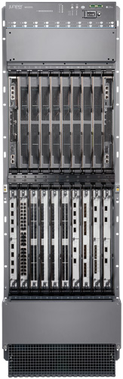
Specialized
Features
Hundreds of protocols
6,500 RFCs
Specialized
Control
Plane
Tens of millions of lines of code.
Closed, proprietary, outdated.
Specialized
Hardware
Billions of gates.
Power hungry and bloated.

Slide 47
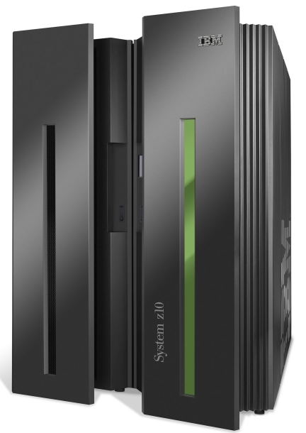
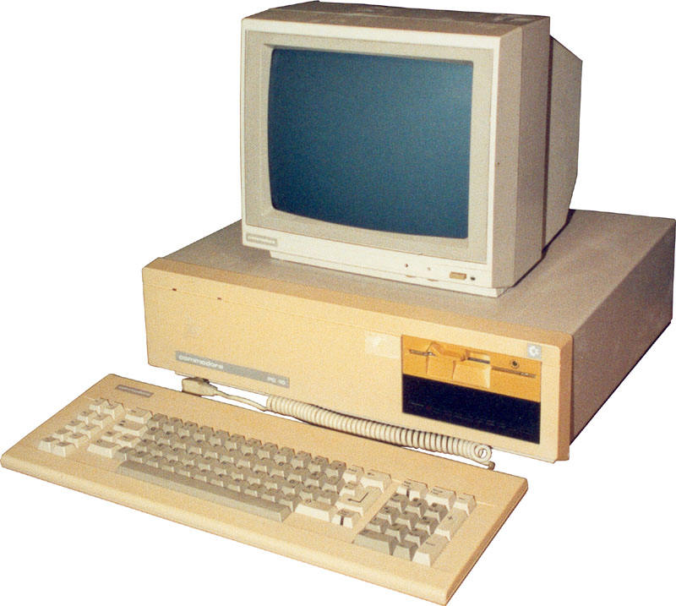
App
App
App
App
App
App
App
App
App
App
App
Specialized
Applications
Open Interface
Windows
(OS)
Linux
Mac
OS
Specialized
Operating
System
or
or
Open Interface
Specialized
Hardware
Microprocessor
Vertically integrated
Closed, proprietary
Slow innovation
Small industry
Horizontal
Open interfaces
Rapid innovation
Huge industry

Slide 48
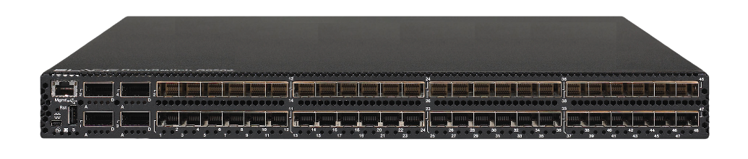
App
App
App
App
App
App
App
App
App
App
App
Specialized
Features
Open Interface
Control
Plane
Control
Plane
Control
Plane
or
or
Specialized
Control
Plane
Open Interface
Specialized
Hardware
Merchant
Switching Chips
Vertically integrated
Closed, proprietary
Slow innovation
Horizontal
Open interfaces
Rapid innovation

Slide 49


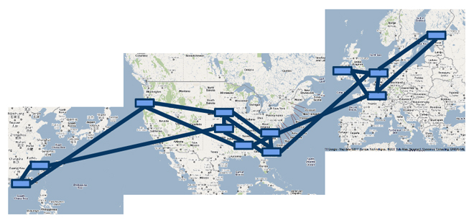

A Major Trend in Networking
Entire backbone
runs on SDN
Bought for $1.2 billion
(mostly cash)

Slide 50
An Opportunity to Rethink
How should future networks be
  Designed
  Managed
  Programmed
What are the right abstractions
  Simple
  Powerful
  Reusable

Slide 51
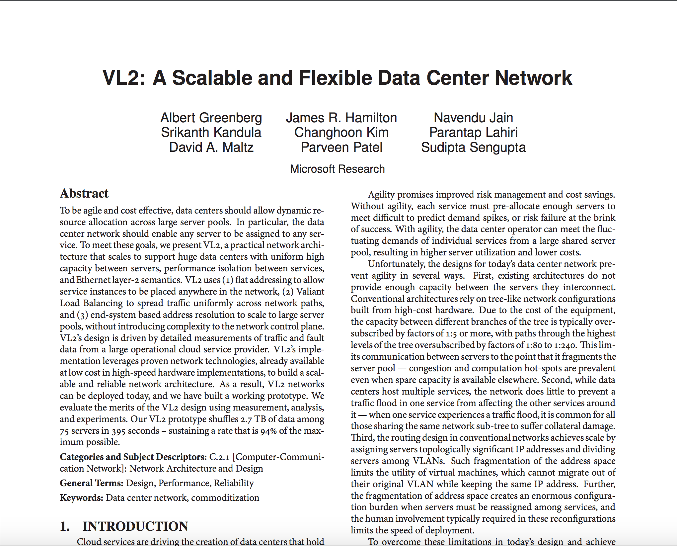
For next time…

