Slide 1

6.888
Lecture 14:
Software Defined Networking
Mohammad Alizadeh
Spring 2016
Many thanks to Nick McKeown (Stanford), Jennifer Rexford (Princeton), Scott Shenker (Berkeley), Nick Feamster (Princeton), Li Erran Li (Columbia), Yashar Ganjali (Toronto)

Slide 2
Outline
What is SDN?
OpenFlow basics
Why is SDN happening now? (a brief history)
4D discussion

Slide 3
What is SDN?

Slide 4
Software Defined Network
A network in which the control plane is
physically separate from the data plane.
and
A single (logically centralized) control plane controls several forwarding devices.

Slide 5
Software Defined Network (SDN)
Control
Program
Control
Program
Control
Program
Global Network Map
Control Plane
Control
Packet
Forwarding
Control
Packet
Forwarding
Control
Control
Packet
Forwarding
Packet
Forwarding
Control
Packet
Forwarding
Notes:
Talk about forwarding & control planes

Slide 6
What You Said
“Overall, the idea of SDN feels a little bit unsettling to me because it is proposing to change one of the main reasons for the success of computer networks: fully decentralized control. Once we introduce a centralized entity to control the network we have to make sure that it doesn’t fail, which I think is very difficult.”

Slide 7


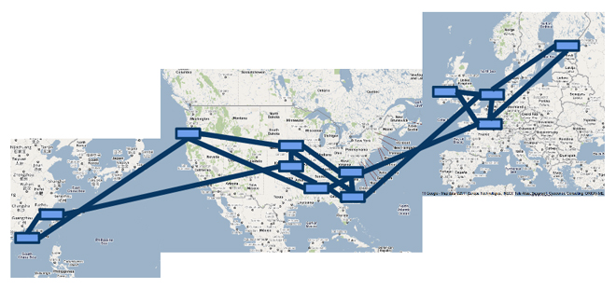

A Major Trend in Networking
Entire backbone
runs on SDN
Bought for $1.2 billion
(mostly cash)

Slide 8
The Networking “Planes”
Data plane: processing and delivery of packets with local forwarding state
  Forwarding state + packet header → forwarding decision
  Filtering, buffering, scheduling
Control plane: computing the forwarding state in routers
  Determines how and where packets are forwarded
  Routing, traffic engineering, failure detection/recovery, …
Management plane: configuring and tuning the network
  Traffic engineering, ACL config, device provisioning, …

Slide 9
Timescales
 | Data | Control | Management
Time-scale | Packet (nsec) | Event (10 msec to sec) | Human (min to hours)
Location | Linecard hardware | Router software | Humans or scripts

Slide 10
Data and Control Planes
Processor
control plane
data plane
Switching
Fabric
Line card
Line card
Line card
Line card
Line card
Line card

Slide 11
Data Plane
Streaming algorithms on packets
  Matching on some header bits
  Perform some actions
Example: IP Forwarding
1.2.3.4
1.2.3.7
1.2.3.156
5.6.7.8
5.6.7.9
host
host
...
host
host
host
...
host
LAN 1
LAN 2
router
router
router
WAN
WAN
1.2.3.0/24
5.6.7.0/24
forwarding table

Slide 12
Control Plane
Compute paths the packets will follow
  Populate forwarding tables
  Traditionally, a distributed protocol
Example: Link-state routing (OSPF, IS-IS)
  Flood the entire topology to all nodes
  Each node computes shortest paths
  Dijkstra’s algorithm

Slide 13
Software
Software
Hardware
Software
Hardware
Software
Hardware
Hardware

Slide 14
Figure out which routers and links are present.
Run Dijkstra’s algorithm to find shortest paths.
B
“If a packet is going to B,
then send it to output 3”
Software
Software
Hardware
Data
B
2
Software
1
Hardware
B
“If , send to 3”
Software
Hardware
B
3
Hardware

Slide 15
Management Plane
Traffic Engineering: setting the weights
  Inversely proportional to link capacity?
  Proportional to propagation delay?
  Network-wide optimization based on traffic?
2
3
1
1
3
2
3
1
5
4
3

Slide 16
Challenges
(Too) many task-specific control mechanisms
  No modularity, limited functionality
Indirect control
  Must invert protocol behavior, “coax” it to do what you want
  Ex. Changing weights instead of paths for TE
Uncoordinated control
  Cannot control which router updates first
Interacting protocols and mechanisms
  Routing, addressing, access control, QoS
The network is
  Hard to reason about
  Hard to evolve
  Expensive

Slide 17
Example 1: Inter-domain Routing
Today’s inter-domain routing protocol, BGP, artificially constrains routes
  Routing only on destination IP address blocks
  Can only influence immediate neighbors
  Very difficult to incorporate other information
Application-specific peering
  Route video traffic one way, and non-video another
Blocking denial-of-service traffic
  Dropping unwanted traffic further upstream
Inbound traffic engineering
  Splitting incoming traffic over multiple peering links

Slide 18
Example 2: Access Control
R1
Chicago (chi)
R2
Data Center
New York (nyc)
Front Office
R5
R3
R4
Two locations, each with data center & front office
All routers exchange routes over all links

Slide 19
Example 2: Access Control
R1
Chicago (chi)
R2
Data Center
New York (nyc)
Front Office
R5
R3
chi-DC
R4
chi-FO
nyc-DC
nyc-FO
chi-DC
chi-FO
nyc-DC
nyc-FO

Slide 20
Example 2: Access Control
R1
Packet filter:
Drop nyc-FO -> *
Permit *
R2
chi
Data Center
Front Office
Packet filter:
Drop chi-FO -> *
Permit *
R5
nyc
R3
chi-DC
R4
chi-FO
nyc-DC
nyc-FO
chi-DC
chi-FO
nyc-DC
nyc-FO

Slide 21
Example 2: Access Control
R1
Packet filter:
Drop nyc-FO -> *
Permit *
R2
chi
Data Center
Front Office
Packet filter:
Drop chi-FO -> *
Permit *
R5
nyc
R3
R4
A new short-cut link added between data centers
Intended for backup traffic between centers

Slide 22
Example 2: Access Control
R1
Packet filter:
Drop nyc-FO -> *
Permit *
R2
chi
Data Center
Front Office
Packet filter:
Drop chi-FO -> *
Permit *
R5
nyc
R3
R4
Oops – new link lets packets violate access control policy!
Routing changed, but
Packet filters don’t update automatically

Slide 23
How SDN Changes the Network
Feature
Feature
Network OS
Feature
Feature
OS
Custom Hardware
Feature
Feature
OS
Feature
Feature
Custom Hardware
OS
Feature
Feature
Custom Hardware
OS
Custom Hardware
Feature
Feature
OS
Custom Hardware
23

Slide 24
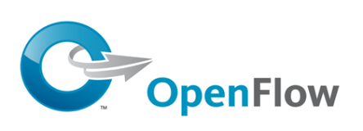
Software Defined Network (SDN)
3. Consistent, up-to-date global network view
2. At least one Network OS
probably many.
Open- and closed-source
Control Program 1
Control Program 2
Network OS
1. Open interface to packet forwarding
Packet
Forwarding
Packet
Forwarding
Packet
Forwarding
Packet
Forwarding
Packet
Forwarding
24

Slide 25
Network OS
Network OS: distributed system that creates a consistent, up-to-date network view
  Runs on servers (controllers) in the network
  NOX, ONIX, Floodlight, Trema, OpenDaylight, HyperFlow, Kandoo, Beehive, Beacon, Maestro, … + more
Uses forwarding abstraction to:
  Get state information from forwarding elements
  Give control directives to forwarding elements

Slide 26
Software Defined Network (SDN)
Control Program A
Control Program B
Network OS
Packet
Forwarding
Packet
Forwarding
Packet
Forwarding
Packet
Forwarding
Packet
Forwarding

Slide 27
Control Program
Control program operates on view of network
  Input: global network view (graph/database)
  Output: configuration of each network device
Control program is not a distributed system
  Abstraction hides details of distributed state

Slide 28
Forwarding Abstraction
Purpose: Standard way of defining forwarding state
  Flexible
    Behavior specified by control plane
    Built from basic set of forwarding primitives
  Minimal
    Streamlined for speed and low-power
    Control program not vendor-specific
OpenFlow is an example of such an abstraction

Slide 29









Software Defined Network
Virtual Topology
Network Hypervisor
Control Program
Global Network View
Network OS

Slide 30





















Virtualization Simplifies Control Program
Abstract Network View
A
A→B drop
B
  Hypervisor then inserts flow entries as needed
A
A→B drop
Global Network View
A→B drop
B
30

Slide 31
Does SDN Simplify the Network?

Slide 32
What You Said
“However, I remain skeptical that such an approach will actually simplify much in the long run. That is, the basic paradigm in networks (layers) is in fact a simple model. However, the ever-changing performance and functionality goals have forced more complexity into network design. I'm not sure if SDN will be able to maintain its simplified model as goals continue to evolve.”

Slide 33
Does SDN Simplify the Network?
Abstraction doesn’t eliminate complexity
  NOS, Hypervisor are still complicated pieces of code
SDN main achievements
  Simplifies interface for control program (user-specific)
  Pushes complexity into reusable code (SDN platform)
Just like compilers….

Slide 34
OpenFlow Basics

Slide 35



OpenFlow Basics
Control Program A
Control Program B
Network OS
OpenFlow Protocol
Ethernet Switch
Control Path
OpenFlow
Data Path (Hardware)
Notes:
35

Slide 36
OpenFlow Basics
Control Program A
Control Program B
Network OS
“If header = p, send to port 4”
Packet
Forwarding
“If header = q, overwrite header with r,
add header s, and send to ports 5,6”
“If header = ?, send to me”
Flow
Table(s)
Packet
Forwarding
Packet
Forwarding

Slide 37
Primitives <Match, Action>
Match arbitrary bits in headers:
  Match on any header, or new header
  Allows any flow granularity
Action
  Forward to port(s), drop, send to controller
  Overwrite header with mask, push or pop
  Forward at specific bit-rate
Header
Data
Match: 1000x01xx0101001x

Slide 38
OpenFlow Rules
Exploit the flow table in switches, routers, and chipsets
Flow 1.
Rule
(exact & wildcard)
Action
Statistics
Flow 2.
Rule
(exact & wildcard)
Action
Statistics
Flow 3.
Rule
(exact & wildcard)
Action
Statistics
Rule
(exact & wildcard)
Flow N.
Default Action
Statistics
Notes:
38

Slide 39
Why is SDN happening now?

Slide 40
The Road to SDN
Active Networking: 1990s
  First attempt make networks programmable
  Demultiplexing packets to software programs, network virtualization, …
Control/Dataplane Separation: 2003-2007
  ForCes [IETF], RCP, 4D [Princeton, CMU], SANE/Ethane [Stanford/Berkeley]
  Open interfaces between data and control plane, logically centralized control
OpenFlow API & Network Oses: 2008
  OpenFlow switch interface [Stanford]
  NOX Network OS [Nicira]
N. Feamster et al., “The Road to SDN: An Intellectual History of Programmable Networks”, ACM SIGCOMM CCR 2014.

Slide 41
SDN Drivers
Rise of merchant switching silicon
  Democratized switching
  Vendors eager to unseat incumbents
Cloud / Data centers
  Operators face real network management problems
  Extremely cost conscious; desire a lot of control
The right balance between vision & pragmatism
  OpenFlow compatible with existing hardware
A “killer app”: Network virtualization

Slide 42
Virtualization is Killer App for SDN
Consider a multi-tenant datacenter
  Want to allow each tenant to specify virtual topology
  This defines their individual policies and requirements
Datacenter’s network hypervisor compiles these virtual topologies into set of switch configurations
  Takes 1000s of individual tenant virtual topologies
  Computes configurations to implement all simultaneously
This is what people are paying money for….
  Enabled by SDN’s ability to virtualize the network

Slide 43
4D

Slide 44
4D
Network-level objectives
Decision
Network-wide views
Dissemination
Direct control
Discovery
Data
Decision: all management and control logic
Dissemination: communicating with routers
Discovery: topology and traffic monitoring
Data: packet handling
routers

Slide 45
What You Said
“The paper reads more like a thought-exercise or meta discussion of the future SDN field than a presentation of research. I am surprised sigcomm published it.”
“some good things about the way the paper was structured was that it mentioned that it had a lot of future work to do and didn't think it was a final solution. By at least addressing that it needs to continue to expand, the authors acknowledge they don't know the merits behind their solution…”

Slide 46
What You Said
“The most compelling aspect of SDN and of the 4D Approach proposed, in my opinion, is the ability to enable innovation. However, SDN taken to the extreme proposed in the 4D approach seems to me to significantly limit scalability and increase complexity.”

Slide 47
What You Said
“My concern is that, previous designs that is aware of the delay of updating network view, take the consideration right on their control (they have control rules and protocol that touch this directly). But SDN tries to hide this nature from the programmers. I am not sure if the design of the software, in the absence of these concerns, will end up with expected results.”

Slide 48
Practical Challenges
Scalability
  Decision elements responsible for many routers
Reliability
  Surviving failures of decision elements and routers
Response time
  Delays between decision elements and routers
Consistency
  Ensuring multiple decision elements behave consistently
Security
  Network vulnerable to attacks on decision elements
Interoperability
  Legacy routers and neighboring domains

Slide 49
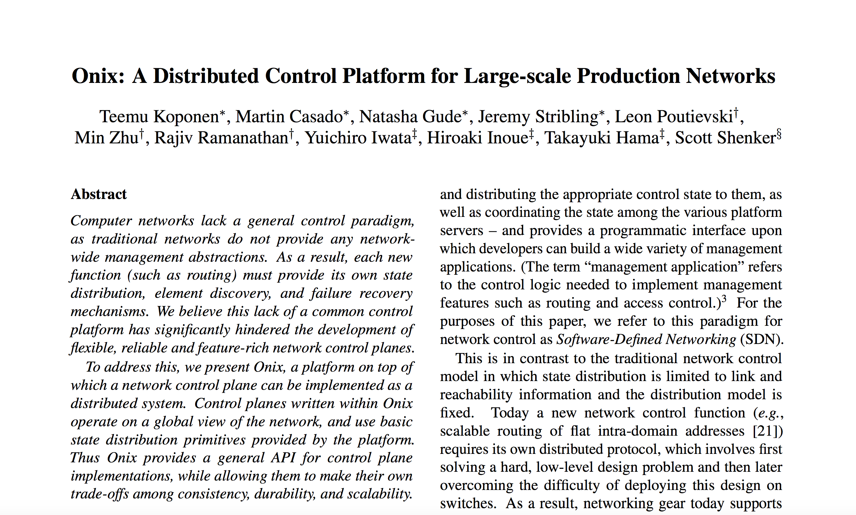
Next Time…

