Slide 1
6.888: Lecture 2 Data Center Network Architectures
Mohammad Alizadeh
Spring 2016
Slides adapted from presentations by Albert Greenberg and Changhoon Kim (Microsoft)

Slide 2
Data Center Costs
Amortized Cost* | Component | Sub-Components
~45% | Servers | CPU, memory, disk
~25% | Power infrastructure | UPS, cooling, power distribution
~15% | Power draw | Electrical utility costs
~15% | Network | Switches, links, transit
The Cost of a Cloud: Research Problems in Data Center Networks. Sigcomm CCR 2009. Greenberg, Hamilton, Maltz, Patel.
*3 yr amortization for servers, 15 yr for infrastructure; 5% cost of money

Slide 3
Server Costs
Ugly secret: 30% utilization considered “good” in data centers
Uneven application fit
Each server has CPU, memory, disk: most applications exhaust one resource, stranding the others
Long provisioning timescales
New servers purchased quarterly at best
Uncertainty in demand
Demand for a new service can spike quickly
Risk management
Not having spare servers to meet demand brings failure just when success is at hand
Session state and storage constraints
If the world were stateless servers, life would be good

Slide 4
Goal: Agility – Any service, Any Server
Turn the servers into a single large fungible pool
Dynamically expand and contract service footprint as needed
Benefits
Increase service developer productivity
Lower cost
Achieve high performance and reliability
The 3 motivators of most infrastructure projects
Notes:
Increase productivity because services can be deployed much faster

Slide 5
Achieving Agility
Workload management
Means for rapidly installing a service’s code on a server
Virtual machines, disk images, containers
Storage Management
Means for a server to access persistent data
Distributed filesystems (e.g., HDFS, blob stores)
Network
Means for communicating with other servers, regardless of where they are in the data center

Slide 6
Conventional DC Network
Internet
CR
CR
DC-Layer 3
. . .
AR
AR
AR
AR
DC-Layer 2
S
S
Key
CR = Core Router (L3)
AR = Access Router (L3)
S = Ethernet Switch (L2)
A = Rack of app. servers
S
S
S
S
. . .
A
A
…
A
A
A
…
A
~ 1,000 servers/pod == IP subnet
Reference – “Data Center: Load balancing Data Center Services”, Cisco 2004

Slide 7
Layer 2 vs. Layer 3
Ethernet switching (layer 2)
Fixed IP addresses and auto-configuration (plug & play)
Seamless mobility, migration, and failover
Broadcast limits scale (ARP)
Spanning Tree Protocol
IP routing (layer 3)
Scalability through hierarchical addressing
Multipath routing through equal-cost multipath
More complex configuration
Can’t migrate w/o changing IP address

Slide 8
Conventional DC Network Problems
CR
CR
~ 200:1
AR
AR
AR
AR
S
S
S
S
~ 40:1
S
S
S
S
. . .
S
S
S
S
~ 5:1
A
A
…
A
A
A
…
A
A
A
…
A
A
A
…
A
Dependence on high-cost proprietary routers
Extremely limited server-to-server capacity

Slide 9
And More Problems …
CR
CR
~ 200:1
AR
AR
AR
AR
S
S
S
S
S
S
S
S
S
S
S
S
A
…
A
A
…
A
A
A
…
A
A
A
…
A
A
A
A
IP subnet (VLAN) #1
IP subnet (VLAN) #2
Resource fragmentation, significantly lowering cloud utilization (and cost-efficiency)

Slide 10
And More Problems …
CR
CR
~ 200:1
AR
AR
AR
AR
Complicated manual L2/L3 re-configuration
S
S
S
S
S
S
S
S
S
S
S
S
A
…
A
A
…
A
A
A
…
A
A
A
…
A
A
A
A
IP subnet (VLAN) #1
IP subnet (VLAN) #2
Resource fragmentation, significantly lowering cloud utilization (and cost-efficiency)

Slide 11
Measurements

Slide 12
DC Traffic Characteristics
Instrumented a large cluster used for data mining and identified distinctive traffic patterns
Traffic patterns are highly volatile
A large number of distinctive patterns even in a day
Traffic patterns are unpredictable
Correlation between patterns very weak
Traffic-aware optimization needs to be done frequently and rapidly

Slide 13
DC Opportunities
DC controller knows everything about hosts
Host OS’s are easily customizable
Probabilistic flow distribution would work well enough, because …
Flows are numerous and not huge – no elephants
Commodity switch-to-switch links are substantially thicker (~ 10x) than the maximum thickness of a flow
?
?
DC network can be made simple

Slide 14
Intuition
Higher speed links improve flow-level load balancing (ECMP)
20×10Gbps
Uplinks
2×100Gbps
Uplinks
Prob of 100% throughput = 3.27%
1
2
20
Prob of 100% throughput = 99.95%
11×10Gbps flows
(55% load)
1
2

Slide 15
What You Said
“In 3.2, the paper states that randomizing large flows won't cause much perpetual congestion if misplaced since large flows are only 100 MB and thus take 1 second to transmit on a 1 Gbps link. Isn't 1 second sufficiently high to harm the isolation that VL2 tries to provide?”

Slide 16
Virtual Layer 2 Switch

Slide 17
VL2 Goals
The Illusion of a Huge L2 Switch
1. L2 semantics
2. Uniform high capacity
3. Performance isolation
A
A
A
…
A
A
…
A
A
A
A
A
A
A
A
A
A
A
A
A
A
A
A
A
…
A
A
…
A
A
A
A
A
A
A
A
A
A
A
A
A

Slide 18
VL2 Design Principles
Randomizing to Cope with Volatility
Tremendous variability in traffic matrices
Separating Names from Locations
Any server, any service
Embracing End Systems
Leverage the programmability & resources of servers
Avoid changes to switches
Building on Proven Networking Technology
Build with parts shipping today
Leverage low cost, powerful merchant silicon ASICs, though do not rely on any one vendor

Slide 19
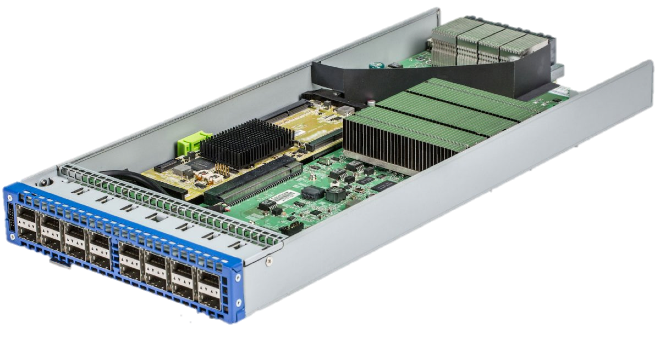
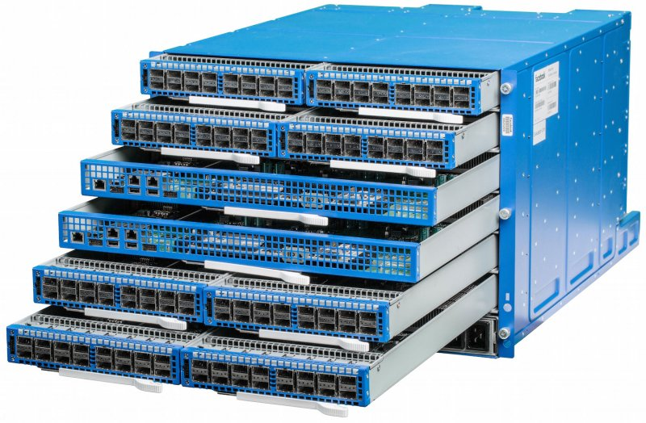
Single-Chip “Merchant Silicon” Switches
Switch ASIC
6 pack
Wedge
Image courtesy of Facebook

Slide 20
Specific Objectives and Solutions
Objective
Approach
Solution
1. Layer-2 semantics
Employ flat addressing
Name-location separation & resolution service
2. Uniform high capacity between servers
Guarantee bandwidth for hose-model traffic
Flow-based random traffic indirection (Valiant LB)
3. Performance Isolation
Enforce hose model using existing mechanisms only
TCP

Slide 21
Discussion

Slide 22
What You Said
“It is interesting that this paper is from 2009. It seems that a large number of the suggestions in this paper are used in practice today.”

Slide 23
What You Said
“For address resolution, why not have applications use hostnames and use DNS to resolve hostnames to IP addresses (the mapping from hostname to IP could be updated when a service moved)? Is the directory system basically just DNS but with IPs instead of hostnames?”
“it was unclear why the hash of the 5 tuple is required.”

Slide 24
Addressing and Routing: Name-Location Separation
Cope with host churns with very little overhead
VL2
Switches run link-state routing and maintain only switch-level topology
Directory Service
…
x → ToR₂
y → ToR₃
z → ToR₄
…
…
x → ToR₂
y → ToR₃
z → ToR₃
…
ToR₁
. . .
ToR₂
. . .
ToR₃
. . .
ToR₄
ToR₃
y
payload
Lookup &
Response
y, z
ToR₄
x
y
z
ToR₃
z
z
payload
payload
Servers use flat names

Slide 25
Addressing and Routing: Name-Location Separation
Cope with host churns with very little overhead
VL2
Switches run link-state routing and maintain only switch-level topology
Directory Service
Allows to use low-cost switches
Protects network and hosts from host-state churn
Obviates host and switch reconfiguration
…
x → ToR₂
y → ToR₃
z → ToR₄
…
…
x → ToR₂
y → ToR₃
z → ToR₃
…
ToR₁
. . .
ToR₂
. . .
ToR₃
. . .
ToR₄
ToR₃
y
payload
Lookup &
Response
y, z
ToR₄
x
y
z
ToR₃
z
z
payload
payload
Servers use flat names

Slide 26
Example Topology: Clos Network
Offer huge aggr capacity and multi paths at modest cost
VL2
Int
. . .
Aggr
. . .
K aggr switches with D ports
. . .
. . . . . .
TOR
. . .
. . . . . . . .
20 Servers
20*(DK/4) Servers

Slide 27
Example Topology: Clos Network
Offer huge aggr capacity and multi paths at modest cost
VL2
Int
. . .
D (# of 10G ports) | Max DC size (# of Servers)
48 | 11,520
96 | 46,080
144 | 103,680
Aggr
. . .
K aggr switches with D ports
. . .
. . . . . .
TOR
. . .
. . . . . . . .
20 Servers
20*(DK/4) Servers

Slide 28
Traffic Forwarding: Random Indirection
Cope with arbitrary TMs with very little overhead
I_{ANY}
I_{ANY}
I_{ANY}
Links used for up paths
Links used for down paths
T₁
T₂
T₃
T₄
T₅
T₆
I_{ANY}
T₃
T₅
y
z
payload
payload
x
y
z

Slide 29
Traffic Forwarding: Random Indirection
Cope with arbitrary TMs with very little overhead
I_{ANY}
I_{ANY}
I_{ANY}
Links used for up paths
Links used for down paths
[ ECMP + IP Anycast ]
Harness huge bisection bandwidth
Obviate esoteric traffic engineering or optimization
Ensure robustness to failures
Work with switch mechanisms available today
T₁
T₂
T₃
T₄
T₅
T₆
I_{ANY}
T₃
T₅
y
z
payload
payload
x
y
z

Slide 30
What you said
“… the heterogeneity of racks and the incremental deployment of new racks may introduce asymmetry to the topology. In this case, more delicate topology design and routing algorithms are needed. ”

Slide 31
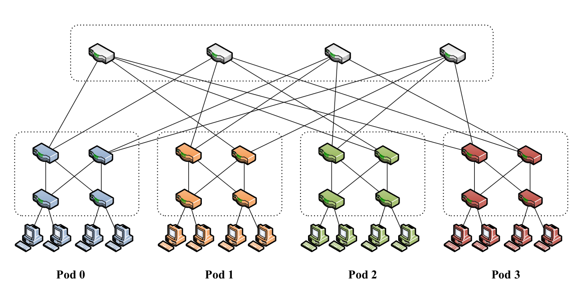
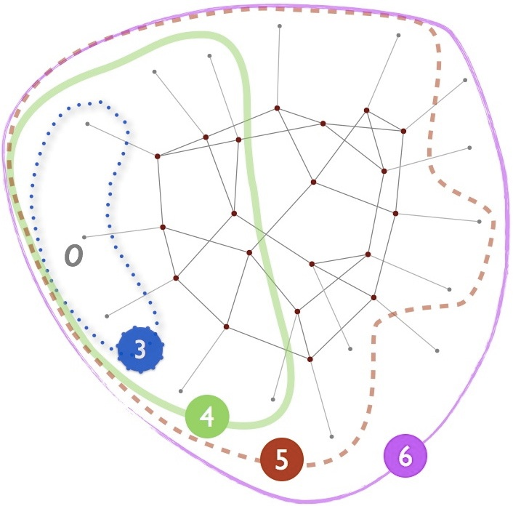
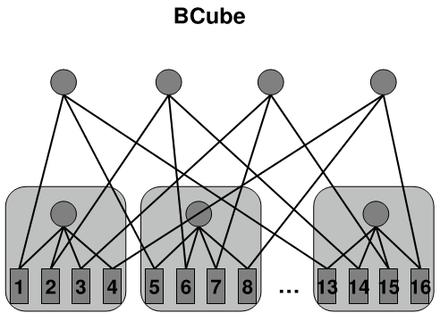
Some other DC network designs…
Fat-tree [SIGCOMM’08]
Jellyfish (random) [NSDI’12]
BCube [SIGCOMM’10]

Slide 32
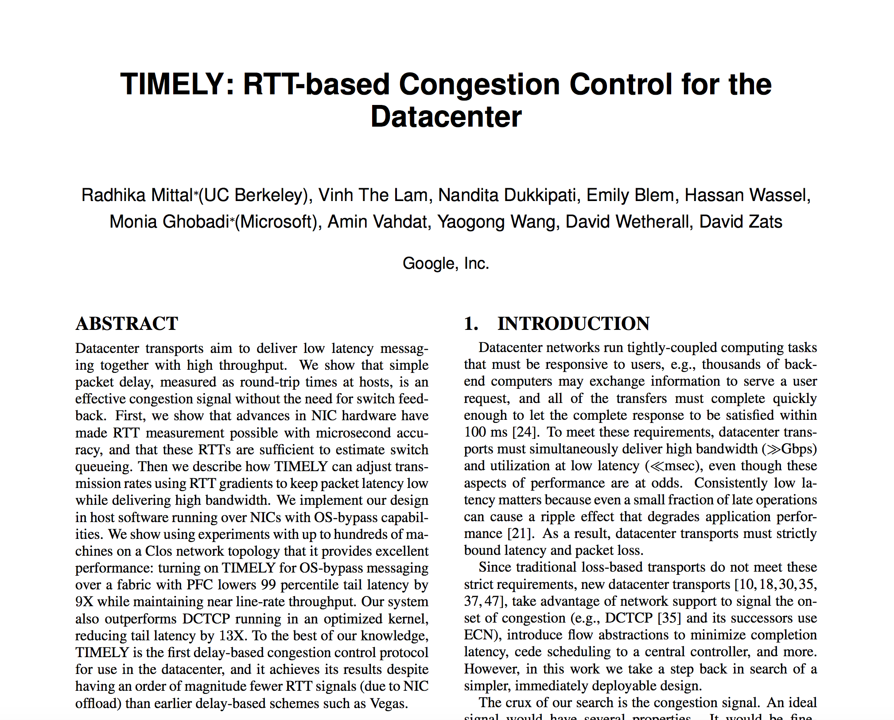
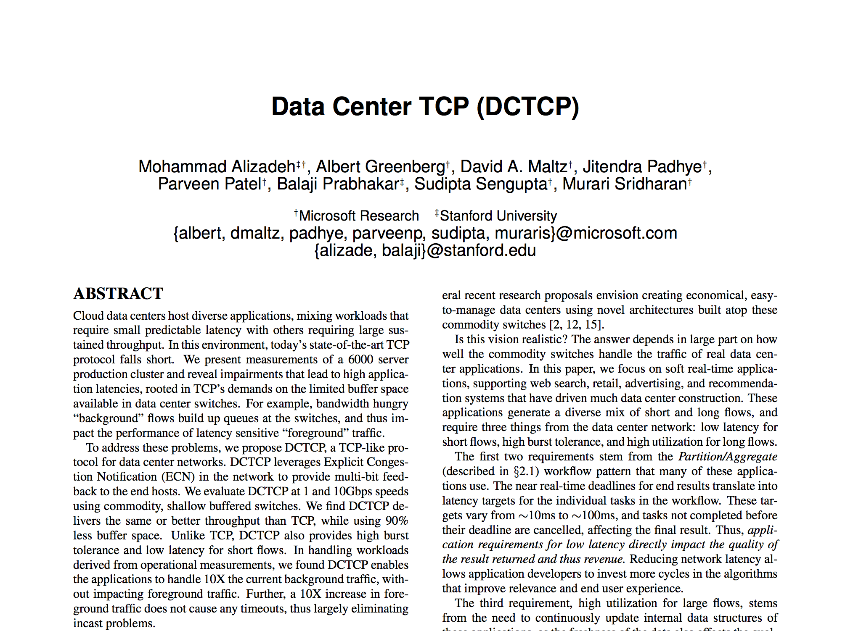
Next time: Congestion Control

