Slide 1

6.888
Lecture 5:
Flow Scheduling
Mohammad Alizadeh
Spring 2016

Slide 2


Datacenter Transport
Goal: Complete flows quickly / meet deadlines
Short flows
(e.g., query, coordination)
Large flows
(e.g., data update, backup)
Low Latency
High Throughput

Slide 3

Low Latency Congestion Control
(DCTCP, RCP, XCP, …)
Keep network queues small (at high throughput)
Implicitly prioritize mice
Can we do better?

Slide 4



The Opportunity
Many DC apps/platforms know flow size or deadlines in advance
Key/value stores
Data processing
Web search
Front end Server
Aggregator
… …
Aggregator
Aggregator
Aggregator
…
…
Worker
Worker
Worker
Worker
Worker
4

Slide 5
What You Said
Amy: “Many papers that propose new network protocols for datacenter networks (such as PDQ and pFabric) argue that these will improve "user experience for web services". However, none seem to evaluate the impact of their proposed scheme on user experience… I remain skeptical that small protocol changes really have drastic effects on end-to-end metrics such as page load times, which are typically measured in seconds rather than in microseconds.”

Slide 6

H1
H1
H2
H2
H3
H3
H4
H4
H5
H5
H6
H6
H7
H7
H8
H8
TX
H9
H9
RX

Slide 7
DC transport =
Flow scheduling on giant switch
Objective?
Minimize avg FCT
Minimize missed deadlines
H1
H1
H2
H2
H3
H3
H4
H4
H5
H5
H6
H6
H7
H7
H8
H8
TX
H9
H9
RX
ingress & egress
capacity constraints

Slide 8
Example: Minimize Avg FCT
Size
Flow A
1
A
Flow B
2
B
B
Flow C
3
C
C
C
arrive at the same time
share the same bottleneck link
Adapted from slide by Chi-Yao Hong (UIUC)

Slide 9
Example: Minimize Avg FCT
A
Fair sharing:
3, 5, 6
mean: 4.67
Shortest flow first:
1, 3, 6
mean: 3.33
B
B
C
C
C
Throughput
Throughput
1
1
A
B
C
A
B
C
B
C
C
Time
Time
3
5
6
1
3
6
Adapted from slide by Chi-Yao Hong (UIUC)

Slide 10
Optimal Flow Scheduling for Avg FCT
NP-hard for multi-link network [Bar-Noy et al.]
  Shortest Flow First: 2-approximation
1
1
2
2
3
3

Slide 11
How can we schedule flows based on flow criticality in a distributed way?
Some transmission order

Slide 12
PDQ
Several slides based on presentation by Chi-Yao Hong (UIUC)

Slide 13
PDQ: Distributed Explicit Rate Control
Sender
Switch
Switch
Receiver
…
Packet
hdr
criticality
rate = 10
Switch preferentially allocates bandwidth to critical flows
5
Traditional explicit rate control
Fair sharing (e.g., XCP, RCP)

Slide 14
Contrast with Traditional
Explicit Rate Control
Traditional schemes (e.g. RCP, XCP) target fair sharing
Sender
Switch
Switch
Receiver
…
Packet
hdr
rate = 10
5
Each switch determines a “fair share” rate based on local congestion: R ⬅ R - k*congestion-measure
Source use smallest rate advertised on their path

Slide 15
Challenges
PDQ switches need to agree on rate decisions
Low utilization during flow switching
Congestion and queue buildup
Paused flows need to know when to start

Slide 16
Challenge:
Switches need to agree on rate decisions
Sender
Switch
Switch
Receiver
…
Packet
hdr
What can go wrong without consensus?
How do PDQ switches reach consensus?
Why is “pauseby” needed?
criticality
rate = 10
pauseby = X

Slide 17
What You Said
Austin: “It is an interesting departure from AQM in that, with the concept of paused queues, PDQ seems to leverage senders as queue memory.”

Slide 18
Challenge:
Low utilization during flow switching
A
B
C
Goal:
How does PDQ avoid this?
1-2 RTTs
Practice:
A
B
C

Slide 19
Early Start:
Seamless flow switching
Start next set of flows
2 RTTs
Throughput
1
Time

Slide 20
Early Start:
Seamless flow switching
Solution:
rate controller at switches
[XCP/TeXCP/D3]
increased queue
Throughput
1
Time

Slide 21
Discussion

Slide 22
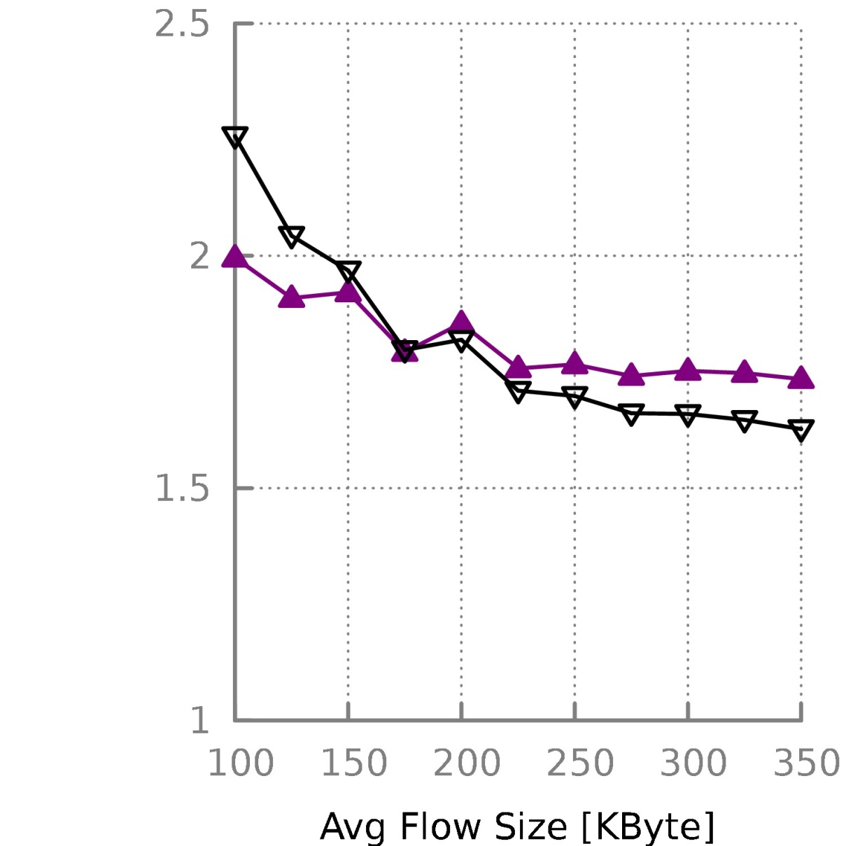
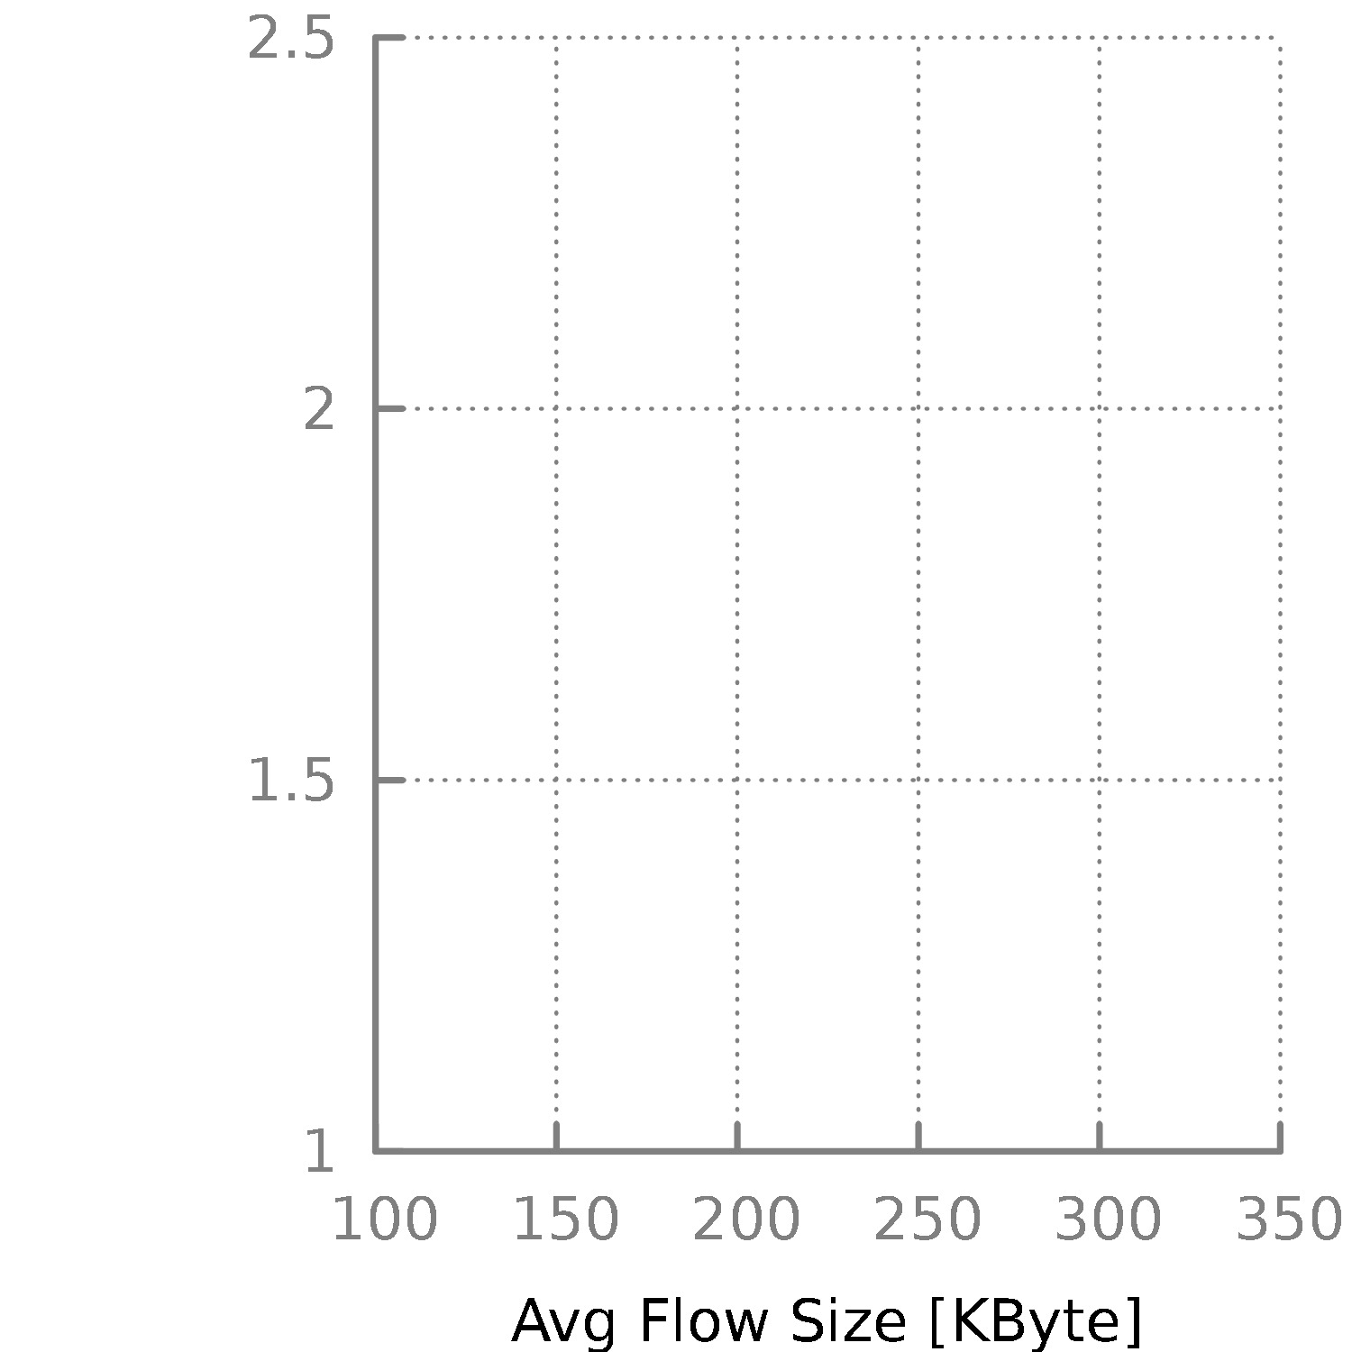
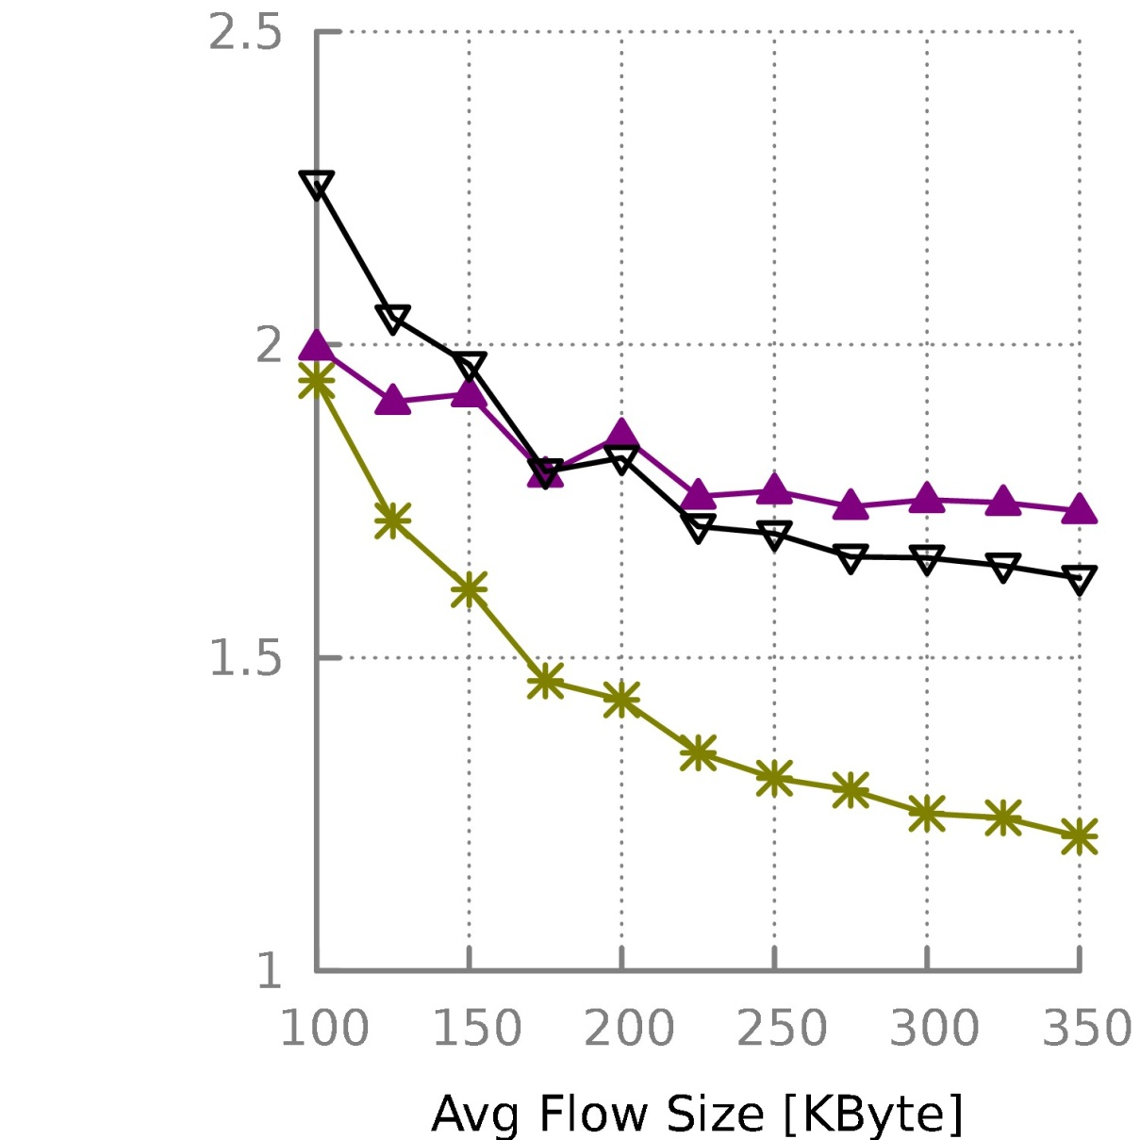
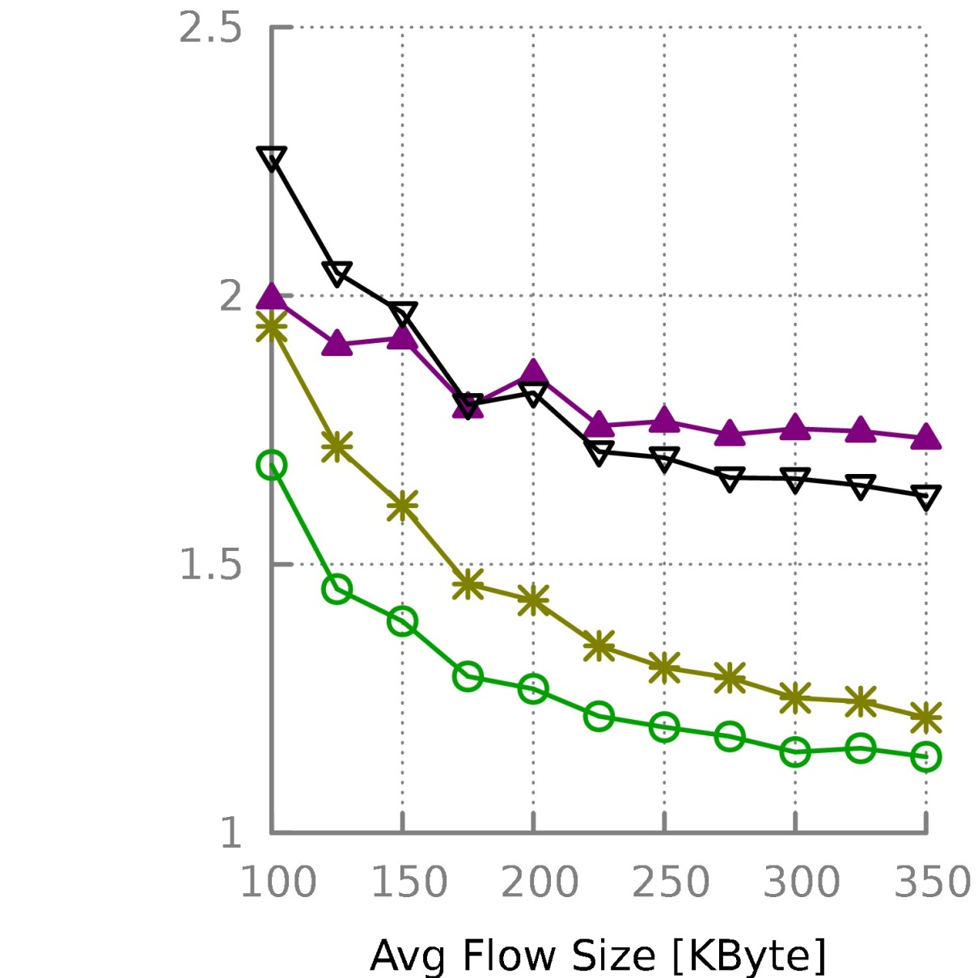
Mean FCT
Mean flow completion time
[Normalized to
a lower bound]
RCP
TCP
Omniscient scheduler controls with zero control feedback delay
PDQ w/o Early Start
PDQ

Slide 23
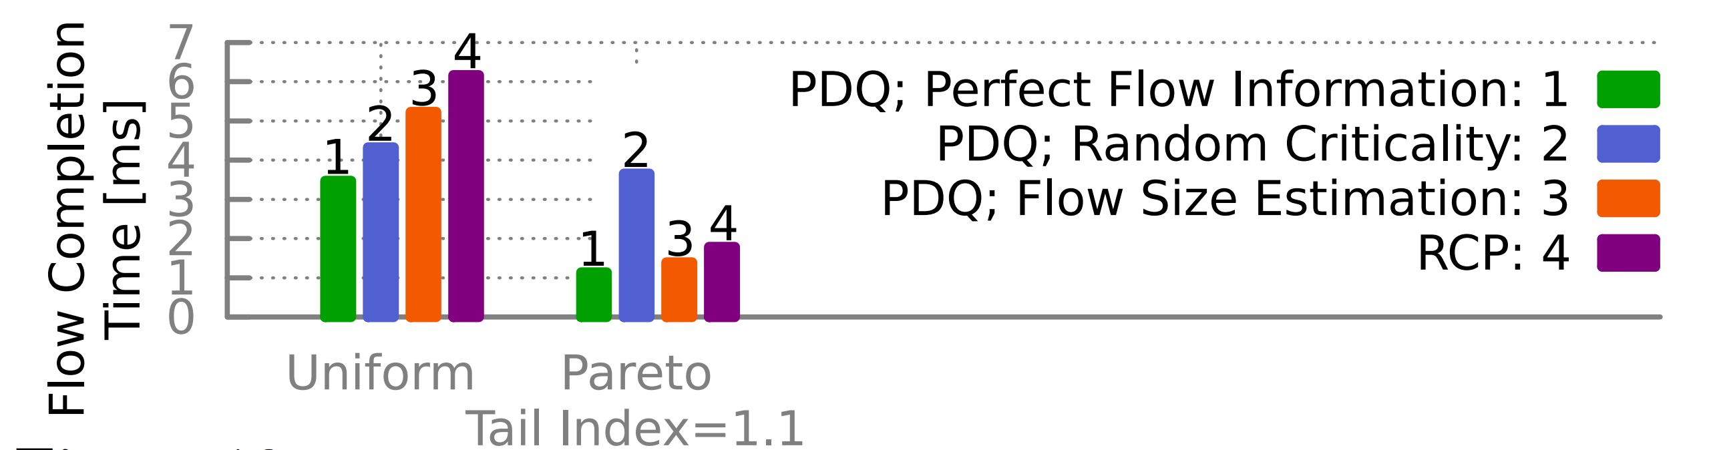
What if flow size not known?
Why does flow size estimation (criticality = bytes sent) work better for Pareto?

Slide 24
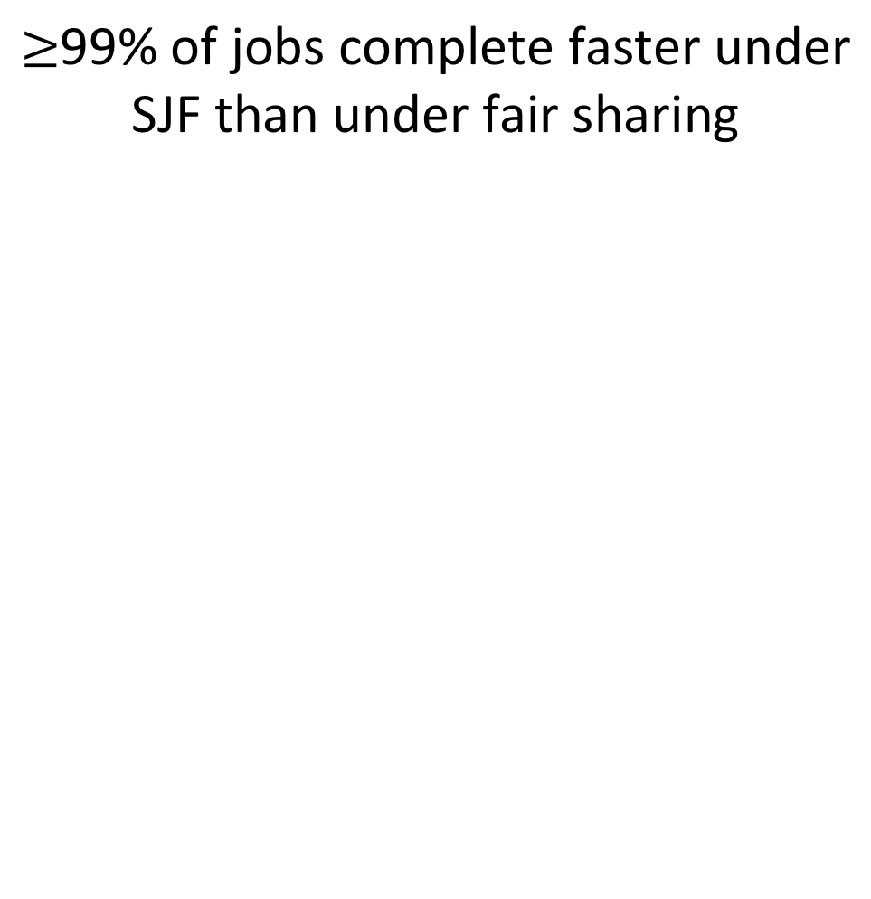
Other questions
  Fairness: can long flows starve?
  Resilience to error: what if packet gets lost or flow information is inaccurate?
  Multipath: does PDQ benefit from multipath?
99% of jobs complete faster under SJF than under fair sharing
[Bansal, Harchol-Balter; SIGMETRICS’01]
Assumption: heavy-tailed flow distribution

Slide 25
pFabric

Slide 26
pFabric in 1 Slide
Packets carry a single priority #
e.g., prio = remaining flow size
pFabric Switches
Send highest priority / drop lowest priority pkts
Very small buffers (20-30KB for 10Gbps fabric)
pFabric Hosts
Send/retransmit aggressively
Minimal rate control: just prevent congestion collapse
Main Idea:
Decouple scheduling from rate control

Slide 27
pFabric Switch
  Boils down to a sort
  Essentially unlimited priorities
  Thought to be difficult in hardware
  Existing switching only support 4-16 priorities
  pFabric queues very small
    51.2ns to find min/max of ~600 numbers
  Binary comparator tree: 10 clock cycles
  Current ASICs: clock ~ 1ns

Slide 28
pFabric Rate Control
What about queue buildup?
Why window control?
Minimal version of TCP algorithm
Start at line-rate
  Initial window larger than BDP
No retransmission timeout estimation
  Fixed RTO at small multiple of round-trip time
Reduce window size upon packet drops
  Window increase same as TCP (slow start, congestion avoidance, …)
After multiple consecutive timeouts, enter “probe mode”
  Probe mode sends min. size packets until first ACK

Slide 29
Why does pFabric work?
Key invariant:
At any instant, have the highest priority packet (according to ideal algorithm) available at the switch.
Priority scheduling
  High priority packets traverse fabric as quickly as possible
What about dropped packets?
  Lowest priority → not needed till all other packets depart
  Buffer > BDP → enough time (> RTT) to retransmit

Slide 30
Discussion

Slide 31
Overall Mean FCT

Slide 32
Mice FCT (<100KB)
Average
99th Percentile

Slide 33
Elephant FCT (>10MB)
Average
Why the gap?
Notes:
Pkt drop rate at 80% load: 4.3%

Slide 34
Loss Rate vs Packet Priority
(at 80% load)
* Loss rate at other hops is negligible
Almost all packet loss is for large (latency-insensitive) flows

Slide 35
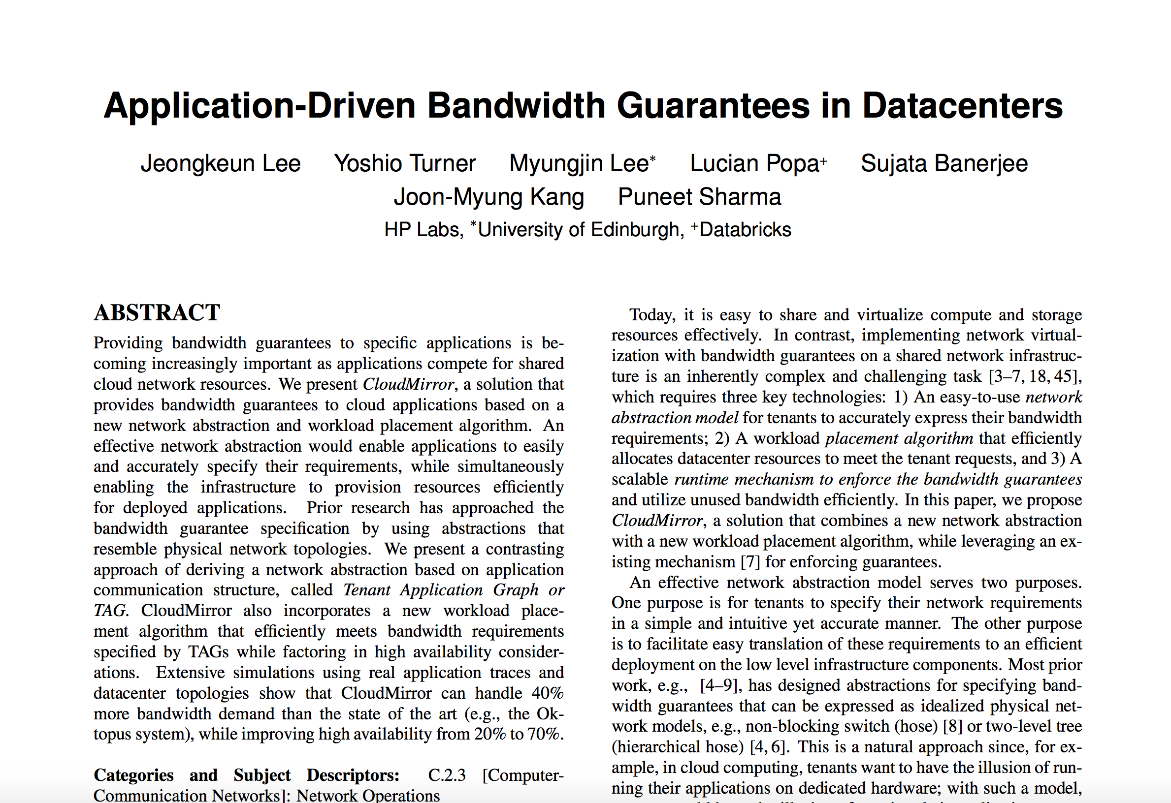
Next Time:
Multi-Tenant Performance Isolation

