Slide 1

6.888
Lecture 6:
Network Performance Isolation
Mohammad Alizadeh
Spring 2016

Slide 2

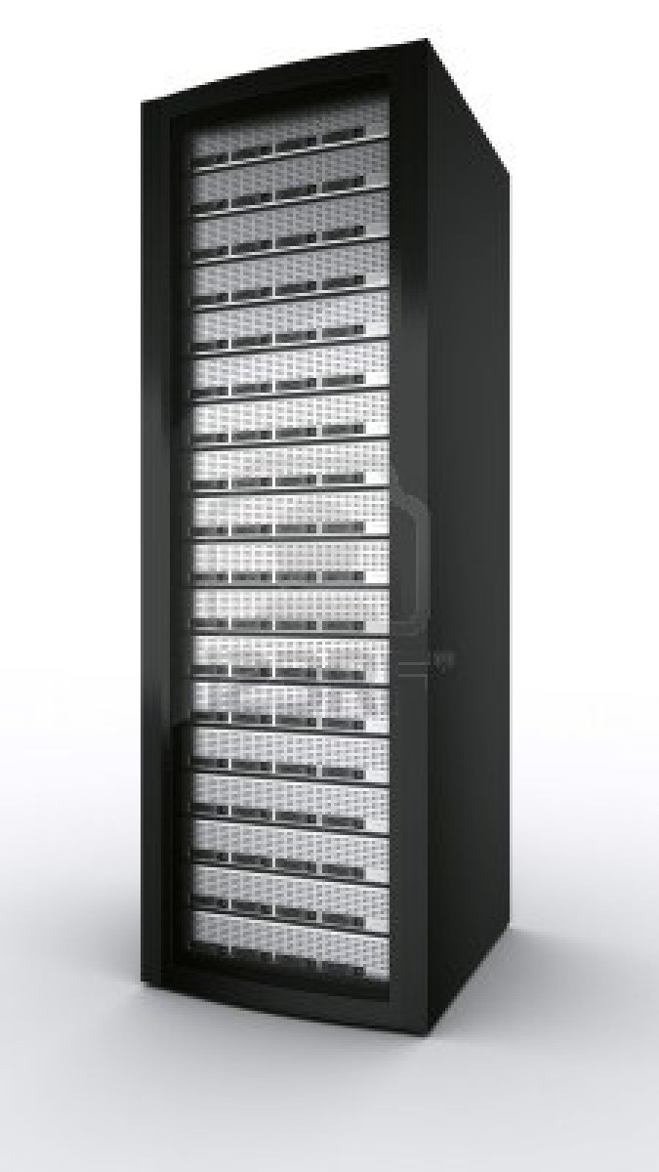





Multi-tenant Cloud Data Centers
Shared infrastructure between multiple tenants/apps
Notes:
To set the context,
In a multi tenant data center, infrastructure is shared among

Slide 3
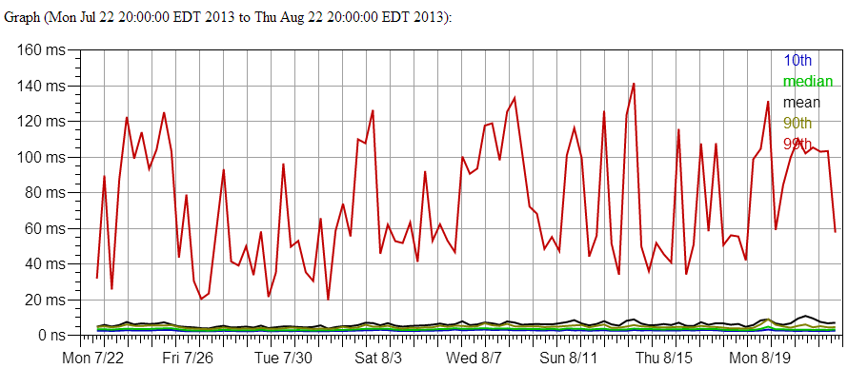
Lack of Performance Predictability
GAE memcache read 100 values
Unpredictable performance, esp. at the tail
3
Notes:
The lack of bandwidth guarantee prevents enterprise application to move to cloud.
Because of congestion in fabric or depends on vm placement and network load, available bandwidth varies dramatically and can affect lower bounds on application performance and increase the costs or affects user experience.

Slide 4
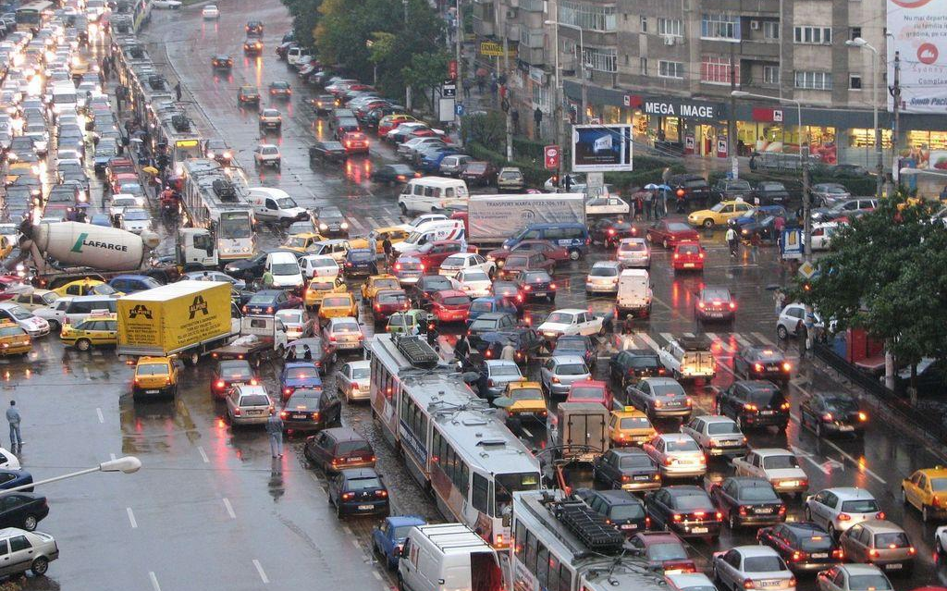
Congestion Kills Predictability
Notes:
Cloud performance sucks. Long tail. Perf interference kills predictability. Noisy neighbours.

Slide 5
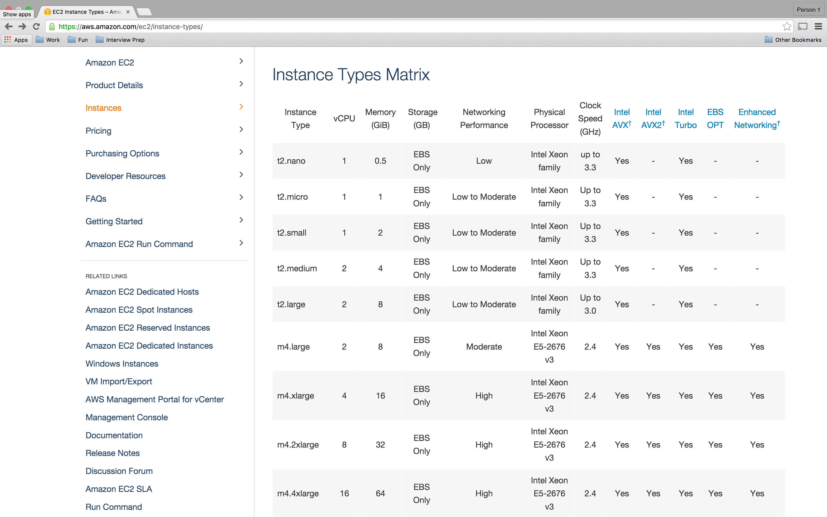
?

Slide 6
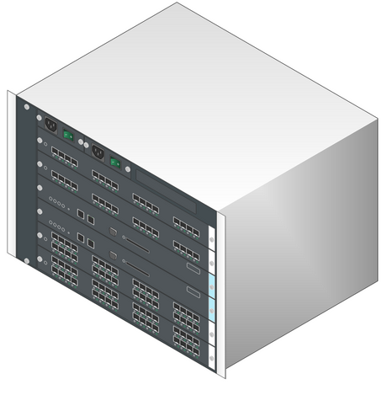
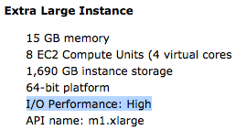

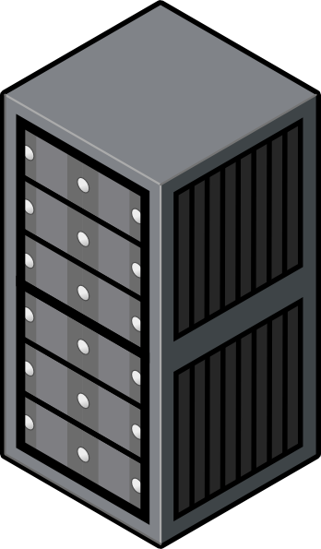
Sharing the Network
…
  2Ghz VCPU
  15GB memory
  1Gb/s network
Hose Model
(Duffield et al., SIGCOMM’99)
…
Customer specifies capacity of the virtual NIC.
No traffic matrix.
Alice’s Switch
Bob’s Switch
…
…
VM1
VM2
VM3
VMn
VM1
VM2
VM3
VMi

Slide 7
Sharing the Network
Tenant selects bandwidth guarantees. Models: Hose, VOC, TAG
Oktopus [SIGCOMM’10]
Hadrian [NSDI’13]
CloudMirror [SIGCOMM’14]
Place VMs, ensuring all guarantees can be met
VM setup
Seawall [NSDI’10]
FairCloud [SIGCOMM’12]
EyeQ [NSDI’13]
ElasticSwitch [SIGCOMM’13]
….
Enforce bandwidth guarantees
& Provide work-conservation
Runtime
Adapted from slide by Lucian Popa

Slide 8
Example Runtime System:
EyeQ (NSDI’13)

Slide 9
Distributed Rate Allocation
(min) Rate Guarantees
10Gb/s pipe
2Gb/s
VM
Shim
Shim
VM
2Gb/s
EyeQ Shim Layer
In the trusted
Domain
(Hypervisor/NIC)
VM
Shim
VM
8Gb/s
2Gb/s
8Gb/s
VM
Shim
VM
Shim
8Gb/s

Slide 10
Distributed Rate Allocation
(min) Rate Guarantees
10Gb/s pipe
2Gb/s
VM
5Gb/s
VM
2Gb/s
5Gb/s
VM
VM
8Gb/s
2Gb/s
8Gb/s
VM
VM
8Gb/s

Slide 11

Distributed Rate Allocation
2Gb/s
VM
5Gb/s
RX Module
VM
2Gb/s
5Gb/s
VM
VM
8Gb/s
2Gb/s
8Gb/s
VM
VM
8Gb/s

Slide 12
Distributed Rate Allocation
2Gb/s
VM
1Gb/s
VM
2Gb/s
1Gb/s
VM
VM
8Gb/s
2Gb/s
8Gb/s
8Gb/s
VM
VM
8Gb/s
Notes:
Wted max-min fiarness with rate guarntees.

Slide 13
Distributed Rate Allocation
2Gb/s
VM
1Gb/s
VM
2Gb/s
1Gb/s
VM
VM
8Gb/s
2Gb/s
8Gb/s
8Gb/s
VM
5Gb/s
VM
8Gb/s

Slide 14
Distributed Rate Allocation
Spare capacity
2Gb/s
VM
1Gb/s
RX Module
VM
2Gb/s
1Gb/s
VM
VM
8Gb/s
2Gb/s
5Gb/s
8Gb/s
VM
5Gb/s
VM
8Gb/s

Slide 15
Distributed Rate Allocation
2Gb/s
VM
2.5Gb/s
VM
2Gb/s
2.5Gb/s
VM
VM
8Gb/s
2Gb/s
5Gb/s
8Gb/s
VM
5Gb/s
VM
8Gb/s

Slide 16

Transmit/Receive Modules
RCP: Rate feedback (R) every 10kB
(no per-source state needed)
2Gb/s
VM
1Gb/s
Rate limit.
Feedback pkt Rate: 1Gb/s
Congestion detectors
VM
2Gb/s
1Gb/s
8Gb/s
VM
2Gb/s
VM
Rate limit.
8Gb/s
VM
Rate limit.
VM
8Gb/s
Per-destination rate limiters:
only if dest. is congested… bypass otherwise

Slide 17
Sharing the Network
Tenant selects bandwidth guarantees. Models: Hose, VOC, TAG
Cloud Mirror
Place VMs, ensuring all guarantees can be met
VM setup
Enforce bandwidth guarantees
& Provide work-conservation
Uses ElasticSwitch
[SIGCOMM’13]
Runtime
Adapted from slide by Lucian Popa

Slide 18
Cloud Mirror
Slides based on presentation by JK Lee (HP)

Slide 19
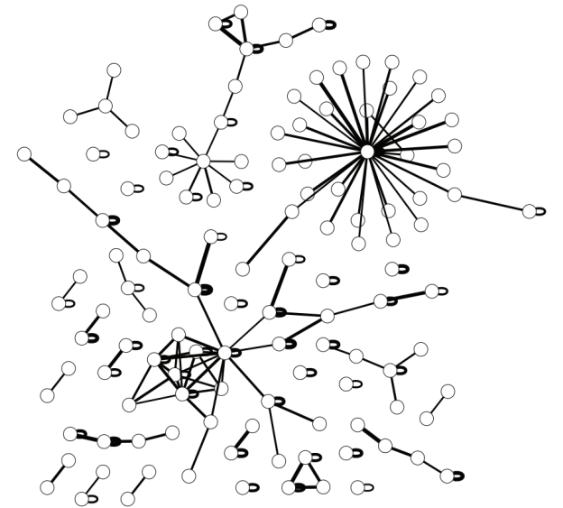

Motivation
Cloud applications are diverse & complex
Bandwidth models like pipe and hose not a good fit
DB
logic
web
web
cache
[Bing.com traffic pattern, Sigcomm’12]

Slide 20
Hose model is unfit
intra-component
(self-edge)
Hose aggregates BW towards different components
  Too coarse-grained
  Prevents accurate and efficient guarantees on infrastructure
inter-component

Slide 21
Hose is too coarse-grained
3-tier web example
Hose model
_{congestion}
web
400
logic
100
DB
500
800
200
…
…
300
Web
Logic
DB
TCP-like fair allocation would yield 300:200

Slide 22

Hose over-provisions physical link bandwidth
2 B N
L₁
L₂
B
2B
B
2B
w
…
w
D
…
D
web
(N)
B
logic
(N)
B
DB
(N)
…
…
…
…
w
w
L
L
D
D
L
L
web (N)
logic (N)
DB (N)
web + logic
DB
N: # VMs in each tier
B: per-VM per-edge bandwidth
Physical deployment example
Hose model reservation at L₂ : 2B · N
logic - DB demand = B · N
2X overprovision by Hose Model

Slide 23
Contributions
Tenant Application Graph (TAG)
  Accurate for complex apps
  Flexible to elastic scaling
  Intuitive
VM Placement Algorithm
  Guarantee bandwidth and high availability
  Efficient for network and compute resources

Slide 24
Tenant Application Graph (TAG)
1. Aggregate pipes (like Hose)
Model simplicity
Multiplexing gain
2. Preserve inter-component
structure (like Pipe)
Accurately capture application demands
Efficiently utilize network resources
DB
DB
DB
logic
logic
logic
web
web
web
mem
mem
mem
Component-level graph

Slide 25
Tenant Application Graph (TAG)
B_{snd}
B_{rcv}
B_{in}
DB
web
web
(N_{w})
B_{snd} B_{rcv}
DB
(N_{D})
What do self-edges mean?
TAG model
B_{snd} = per-VM sending bandwidth
(VM-to-component aggregation)
    B_{rcv} = per-VM receiving bandwidth (component-to-VM aggregation)

Slide 26
Abstract models in TAG
Self-edge ↔ Hose
Directional edge ↔ directional Hose, Virtual Trunk
Virtual Trunk
Virtual Switch
B_{in}
B_{snd}
B_{rcv}
web
(N_{w})
DB
(N_{D})
B_{in}
B_{snd} B_{rcv}
…
…
TAG model
web(N_{w})
DB(N_{D})
Total guarantee of virtual trunk
= min(B_{snd}·N_{w}, B_{rcv}·N_{D})

Slide 27
Questions
How are TAGs constructed?
How to predict bandwidth demands?
What is missing for the TAG model?

Slide 28

CloudMirror operation
Available VM slots
Network topology &
BW reservation state
TAG spec
host1 10
host2 50
host3 25
Web
(N)
B B
DB
(N)
VM placement
BW reservation
Admission control

Slide 29
Discussion

Slide 30
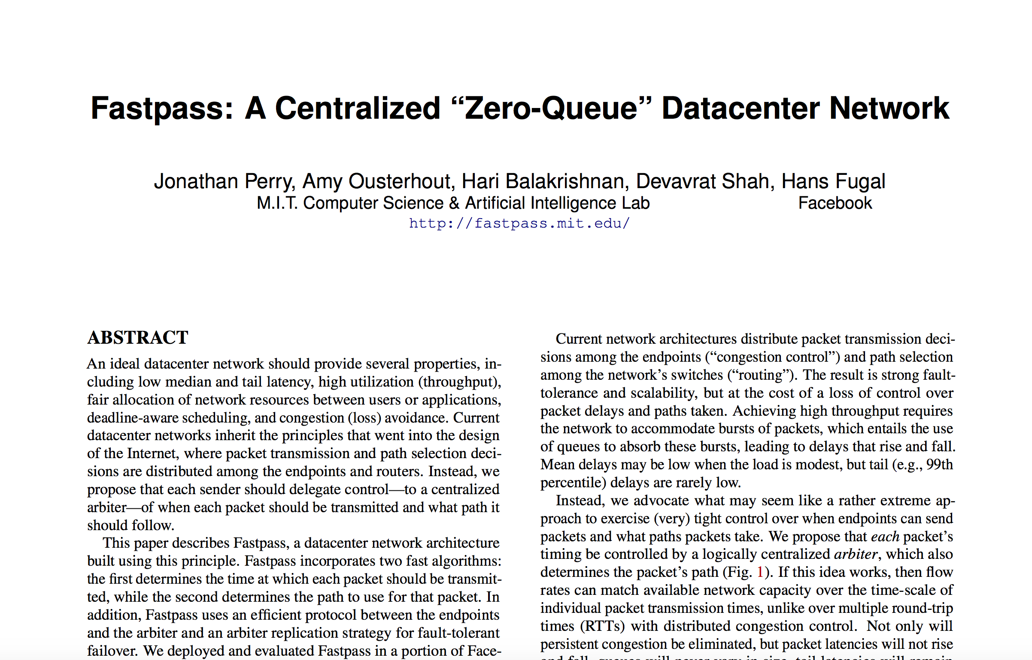
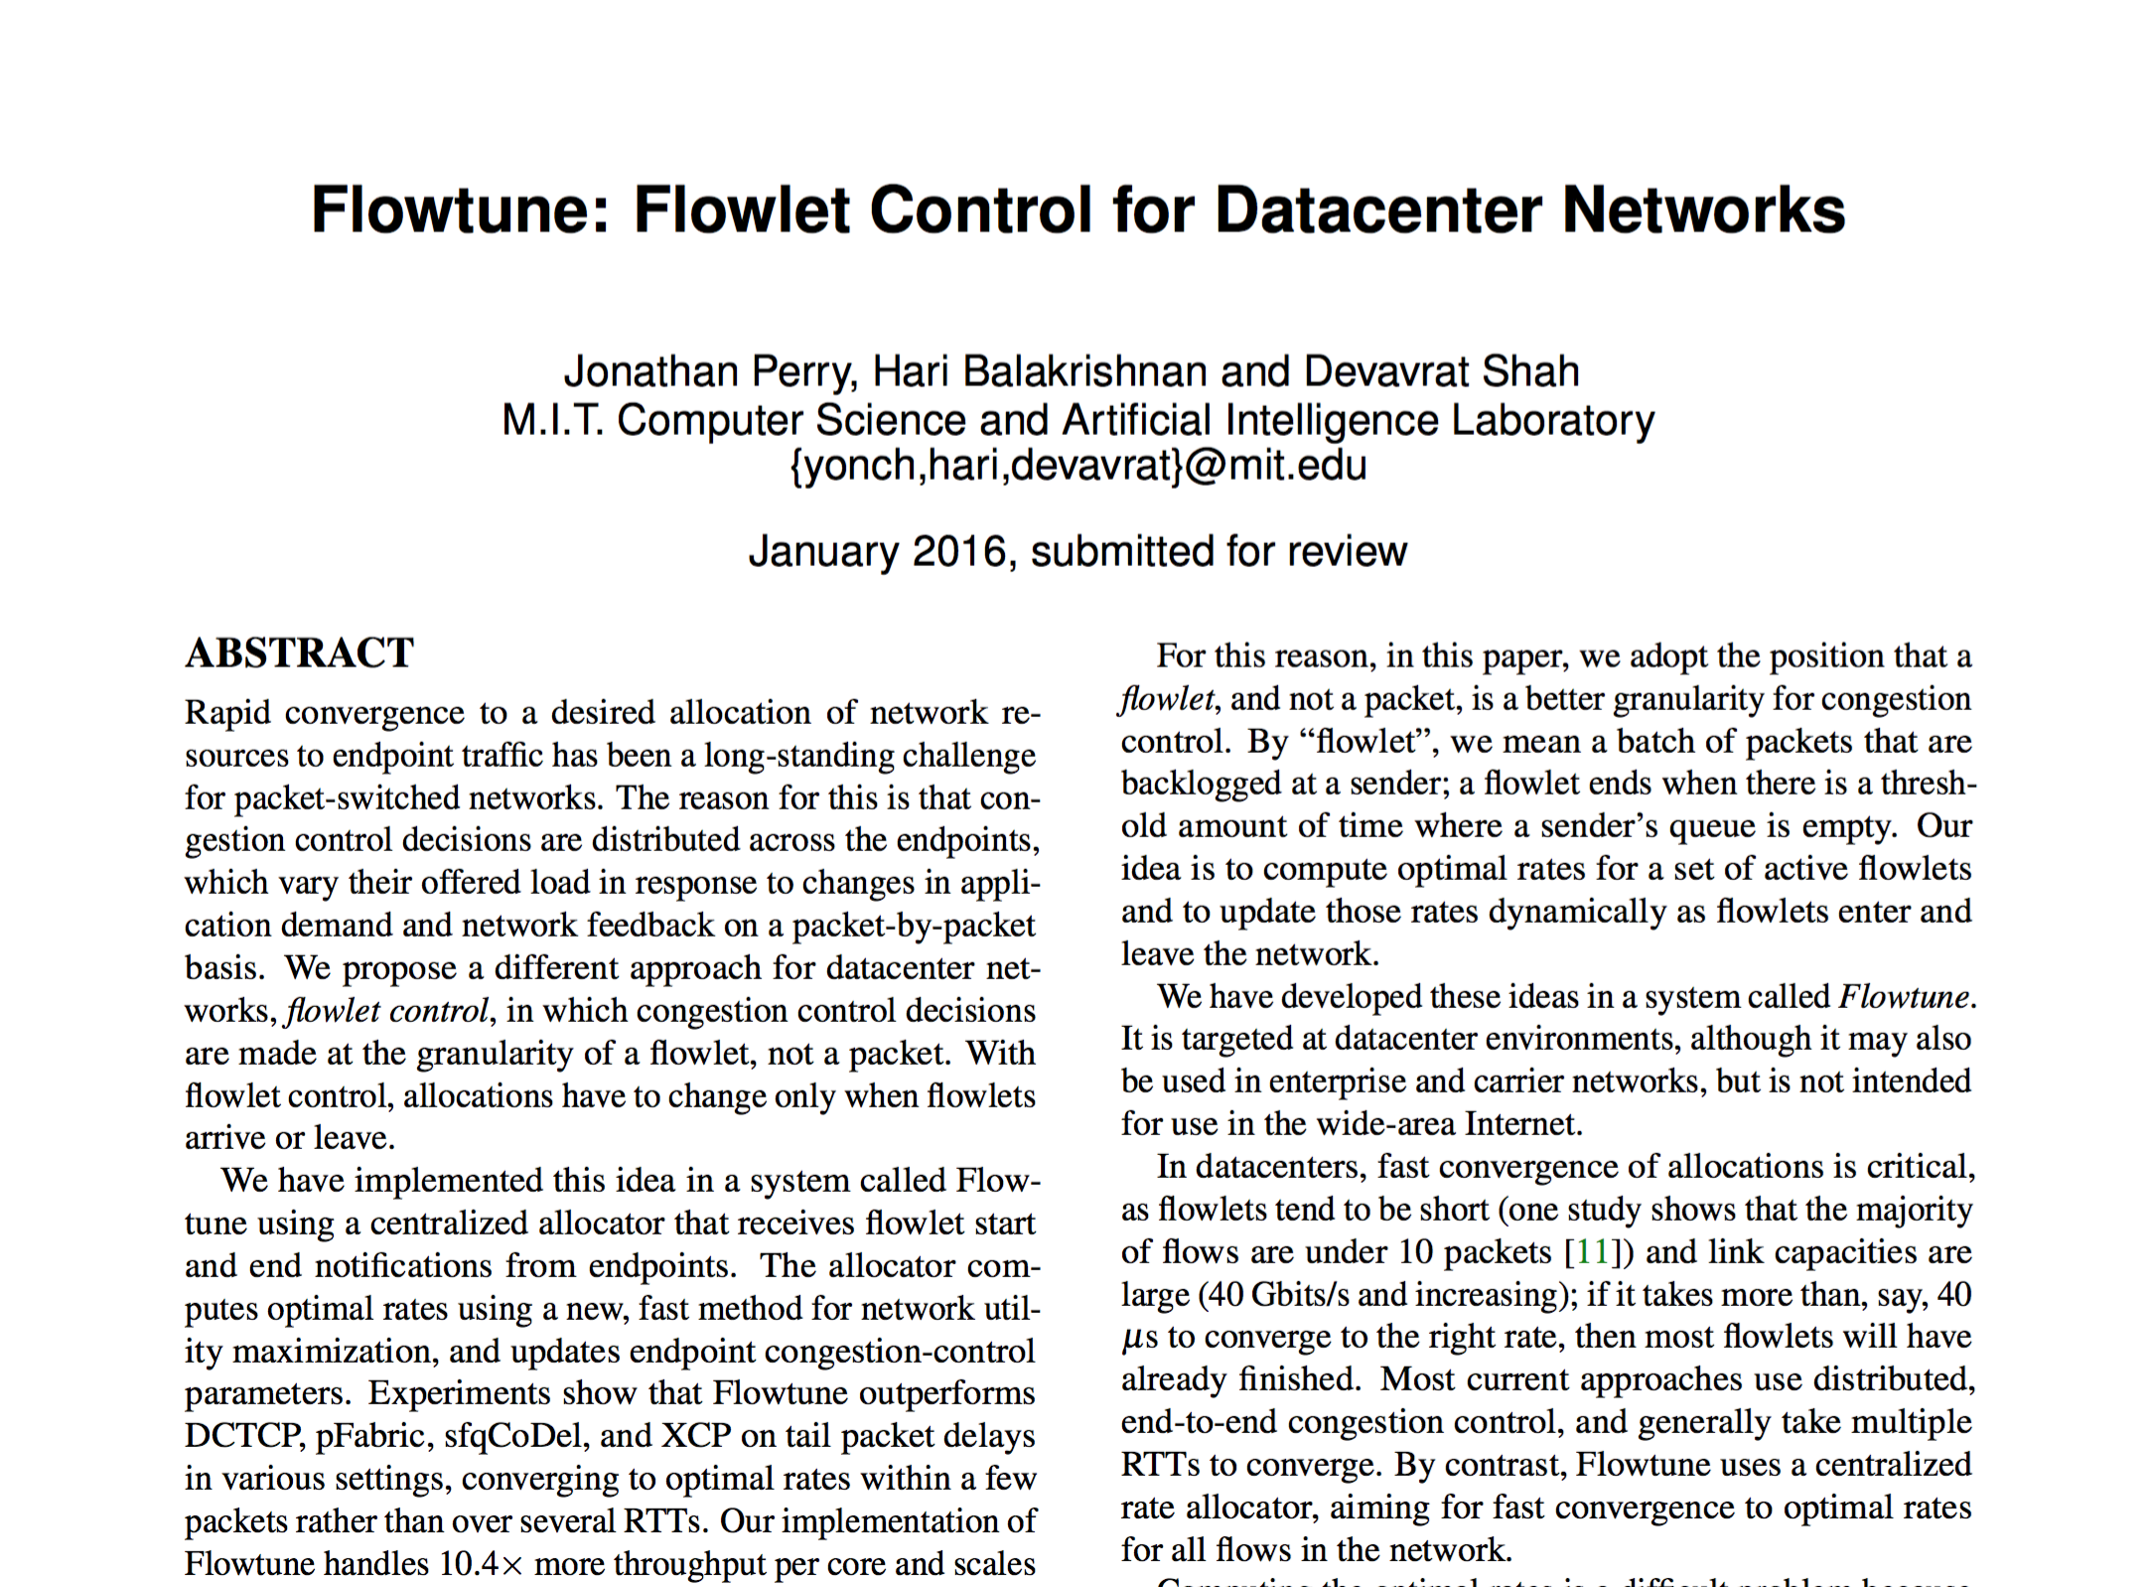
Next Time: Centralized Arbitration

