Slide 1

6.888
Lecture 8:
Networking for Data Analytics
Mohammad Alizadeh
Spring 2016
Many thanks to Mosharaf Chowdhury (Michigan) and Kay Ousterhout (Berkeley)

Slide 2





“Big Data”
Huge amounts of data being collected daily
Wide variety of sources
Web, mobile, wearables, IoT, scientific
Machines: monitoring, logs, etc
Many applications
Business intelligence, scientific research, health care

Slide 3
Big Data Systems
BlinkDB
Storm
Spark-Streaming
Pregel
GraphLab
GraphX
DryadLINQ
Spark
Dremel
MapReduce
Hadoop
Dryad
Hive
2005
2010
2015

Slide 4
Data Parallel Applications
Multi-stage dataflow
  Computation interleaved with communication
Computation Stage (e.g., Map, Reduce)
  Distributed across many machines
  Tasks run in parallel
Communication Stage (e.g., Shuffle)
  Between successive computation stages
Reduce Stage
A communication stage cannot complete until all the data have been transferred
Shuffle
Map Stage
Notes:
Yes, big data applications can differ a lot, ranging from SQL queries to machine learning algorithms.
But they are quite similar as well.
Deep down, most big data applications are multi-stage dataflows with interleaved computation and communication stages.
Let’s take the simplest example, a MapReduce application.
It has two computation stages Map and Reduce, and in between there is a communication stage called shuffle.
Computation tasks run in parallel distributed throughout the cluster.
The shuffle stage transfers outputs of all map tasks to the reduce tasks, creating an many-to-many communication pattern.
Note that the shuffle has a unique collective behavior.
It cannot complete all the data have been transferred to the next computation stage.
Modern data-parallel applications consist of many such stages, not just two.
But the collective behavior of communication is still very common.

Slide 5
Questions
How to design the network for data parallel applications?
What are good communication abstractions?
Does the network matter for data parallel applications?
What are the bottlenecks for these applications?

Slide 6
Efficient Coflow Scheduling with Varys
Slides by Mosharaf Chowdhury (Michigan), with minor modifications

Slide 7
Existing Solutions
Flow: Transfer of data from a source to a destination
WFQ
CSFQ
D³
DeTail
PDQ
pFabric
GPS
RED
ECN
XCP
RCP
DCTCP
D²TCP
FCP
1980s
1990s
2000s
2005
2010
2015
Per-Flow Fairness
Flow Completion Time
Independent flows cannot capture the collective communication behavior common in data-parallel applications
Notes:
We have seen hundreds, if not thousands, of proposals to try to address the performance issues using flow as a basic abstraction.
In the early days, it was all about fair allocation.
Recently, as datacenters became more widely used, it’s all about improving flow completion time.
These are just a few; there are way too many proposals I’m not showing on this slide.
Today I’m going to show that while these are not incorrect, they are quite inefficient in the context of big data analytics.
Flows fundamentally cannot capture the collective communication behavior seen in of data-parallel applications.

Slide 8
Cof low
Communication abstraction for data-parallel applications to express their performance goals
Minimize completion times,
Meet deadlines

Slide 9
Broadcast
Single Flow
Aggregation
All-to-All
Parallel Flows
Shuffle
Notes:
Using coflows as building blocks, we can now represent the entire dataflow as a sequence of computation stages and coflows.
In this example, we have three coflows a shuffle, an aggregation, and a broadcast.
An all-to-all communication pattern, as seen in many graph analytics and linear algebra platforms, is also a coflow.
Similarly, the parallel flows pattern, as used by replication flows when we write data or read from remote machines is also a coflow.
In fact, the simple flow abstraction we have used forever is also a coflow with just one flow.
However, in a shared cluster, there are many different jobs from many different users and frameworks coexisting.
What happens when all of these applications start using coflows?

Slide 10
How to schedule coflows
online …
… for faster
#1 completion
of coflows?
… to meet
#2 more
deadlines?
1
1
2
2
.
.
.
.
.
.
N
N
Datacenter
Notes:
We end up with datacenter with tens or hundreds of coflows instead of tens or hundreds of thousands of flows that the network has no clue of how they relate to each other.
Given coflows from all these different frameworks, we can now reformulate network optimization as an application-aware network scheduling problem with different objectives.
Today, I’m going to talk about how to schedule coflows to minimize the average completion time so that on average jobs complete faster.

Slide 11
Benefits of
Inter-Coflow Scheduling
Coflow 1
Coflow 2
6 Units
Link 2
3 Units
2 Units
Link 1
Fair Sharing
Smallest-Flow First^{1,2}
The Optimal
L2
L2
L2
L1
L1
L1
2
time
4
6
2
time
4
6
2
time
4
6
Coflow1 comp. time = 5
Coflow2 comp. time = 6
Coflow1 comp. time = 5
Coflow2 comp. time = 6
Coflow1 comp. time = 3
Coflow2 comp. time = 6
1. Finishing Flows Quickly with Preemptive Scheduling, SIGCOMM’2012.
2. pFabric: Minimal Near-Optimal Datacenter Transport, SIGCOMM’2013.
Notes:
Let us see the potentials of inter-coflow scheduling through a simple example.
We have two coflows: coflow1 in black with one flow on link1 and coflow2 with two flows.
Each block represent a unit of data.
Assume, it takes a unit time time to send each unit of data.
Let’s start with considering what happens today.
In this plot, we have time in the X-axis and the links on Y-axis.
Link1 will be almost equally shared between the two flows from two different coflows and the other link will be used completely by coflow2’s flow.
After, 6 time units, both coflows will finish.
Recently, there has been a lot of focus on minimizing flow completion times by prioritizing flows of smaller size.
In that case, the orange flow in link1 will be prioritized over the black flow.
After 3 time units, the orange flow will finish.
Note that coflow2 hasn’t finished yet, because it still has 3 more data units from its flow on link2.
Eventually, when all flow finishes, the coflow completion times remain the same even thought the flow completion time has improved.
The optimal solution for minimizing application-level performance, in this case, would be to let the black coflow finish first.
As a result, we can see application-level performance improvement for coflow1 without any impact on the other coflow.
In fact, it is quite easy to show that significantly decreasing flow completion times might still not result in any improvement in user experience.

Slide 12
Benefits of
is NP-Hard
Inter-Coflow Scheduling
Coflow 1
Coflow 2
6 Units
Link 2
3 Units
2 Units
Link 1
Fair Sharing
Flow-level Prioritization¹
The Optimal
Concurrent Open Shop Scheduling¹
  Examples include job scheduling and caching blocks
  Solutions use a ordering heuristic
L2
L2
L2
L1
L1
L1
2
time
4
6
2
time
4
6
2
time
4
6
Coflow1 comp. time = 6
Coflow2 comp. time = 6
Coflow1 comp. time = 6
Coflow2 comp. time = 6
Coflow1 comp. time = 3
Coflow2 comp. time = 6
1. Finishing Flows Quickly with Preemptive Scheduling, SIGCOMM’2012.
2. pFabric: Minimal Near-Optimal Datacenter Transport, SIGCOMM’2013.
1. A Note on the Complexity of the Concurrent Open Shop Problem, Journal of Scheduling, 9(4):389–396, 2006
Notes:
The inter-coflow scheduling problem has its roots in the concurrent open shop scheduling problem.
In fact, data-parallel job scheduling or memory caching all fall under the umbrella of this problem.
It has also been applied to schedule concurrent accesses to multiple memory controllers in chip multiprocessor systems.
Like many other scheduling problems, it is also an NP-Hard problem and the solution approach is similar to other scheduling heuristics.
One must come up with an ordering of coflows and the effectiveness of the ordering heuristic determines the goodness of the solution.
Now, unlike this simplistic example, flows do not run on independent links in a cluster.

Slide 13
Inter-Coflow Scheduling
is NP-Hard
Coflow 1
Coflow 2
6 Units
Link 2
3 Units
2 Units
Link 1
Input Links
Output Links
Concurrent Open Shop Scheduling with Coupled Resources
  Examples include job scheduling and caching blocks
  Solutions use a ordering heuristic
  Consider matching constraints
1
1
6
2
2
2
3
3
3
Datacenter
Notes:
So, we must bring the network fabric into the picture.
In this example, we have 3-machine fabric.
Each machine’s incoming and outgoing links are shown are the ingress and egress ports of the fabric.
Each input port has virtual output queues for each output port.
So the flows on link1 in our example may be going from input port 1 to output port 1 and the flow in link2 is going from input port 2 to output port 2.
In essence, the performance a coflow depends on its allocation on both input and output ports of the fabric.
In fact, we have discovered a brand-new scheduling problem called the concurrent open shop scheduling with coupled resources problem.
We have also provided the first characterization of this problem, showing some unique characteristics of this new scheduling problem.
Quite unsurprisingly, this is also NP-Hard.

Slide 14
Varys
Employs a two-step algorithm to minimize coflow completion times
Ordering heuristic | Keep an ordered list of coflows to be scheduled, preempting if needed
Allocation algorithm | Allocates minimum required resources to each coflow to finish in minimum time
Notes:
We propose a simple two-step greedy scheduling algorithm that breaks the problem into its natural breaking points.
As coflows arrive and leave the network online, we continuously maintain an ordered list of coflows and allocate rates to individual flows of a coflow.
In the next few slides, I’ll go over this two-step algorithm.

Slide 15
Allocation Algorithm
Finishing flows faster than the bottleneck cannot decrease a coflow’s completion time
Allocate minimum flow rates such that all flows of a coflow finish together on time
A coflow cannot finish before its very last flow
Notes:
Once we have determined an order of coflows, the next step is to determine the rate of its individual flows.
Recall, that a coflow cannot finish until all its flows have finish.
Which means that finishing flows earlier than a coflow’s bottleneck cannot decrease its completion time.
Hence, we allocate minimum rates to each flows of a coflow so that they either finish together with the bottlenecks or they all finish at the deadline, if a deadline is provided.
Similar to our earlier example, we take the extra bandwidth from one coflow and give to the next coflow in our ordered list so that the next one can also proceed toward its completion without hurting the completion time of the previous one.
Note that we must ensure that capacity isn’t wasted between the ordering and rate allocation steps.
I’ll skip the details of work conserving backfilling in this talk.

Slide 16
Varys Architecture
Centralized master-slave architecture
  Applications use a client library to communicate with the master
Actual timing and rates are determined by the coflow scheduler
Sender
Receiver
Driver
Put
Get
Reg
Varys Daemon
Varys Daemon
Varys Daemon
Varys Master
Network Interface
Topology
Monitor
Usage
Estimator
(Distributed) File System
Coflow Scheduler
TaskName
Comp. Tasks calling
Varys Client Library
f
1. Download from http://varys.net
Notes:
Varys’s architecture is similar to that of many cluster frameworks we see in current clusters.
It has a centralized master that reschedules on coflow arrivals and departures.
While the senders and receivers express their intent, the actual timing and rates are determined by the master.
The master can be a source of coordination overheads.
However, our evaluation on up to 100 machine clusters show that we can easily handle even O(100)ms coflows.
Beyond that, we’ll need switch support and changes to the entire network.
This is, of course, a valid path, but I’m not confidant of the deployability of such approaches that calls for fork-lift upgrades of millions of dollars of investments.

Slide 17
Discussion

Slide 18
Making Sense of Performance in Data Analytics Frameworks
Slides by Kay Ousterhout (Berkeley), with minor modifications

Slide 19
Network
Load balancing: VL2 [SIGCOMM ‘09], Hedera [NSDI ’10], Sinbad [SIGCOMM ’13]
Application semantics: Orchestra [SIGCOMM ’11], Baraat [SIGCOMM ‘14], Varys [SIGCOMM ’14]
Reduce data sent: PeriSCOPE [OSDI ‘12], SUDO [NSDI ’12]
In-network aggregation: Camdoop [NSDI ’12]
Better isolation and fairness: Oktopus [SIGCOMM ’11], EyeQ [NSDI ‘12], FairCloud [SIGCOMM ’12]
Disk
Themis [SoCC ‘12], PACMan [NSDI ’12], Spark [NSDI ’12], Tachyon [SoCC ’14]
Stragglers
Scarlett [EuroSys ‘11], SkewTune [SIGMOD ‘12], LATE [OSDI ‘08], Mantri [OSDI ‘10], Dolly [NSDI ‘13], GRASS [NSDI ‘14], Wrangler [SoCC ’14]

Slide 20
Missing: what’s most important to
end-to-end performance?
Network
Load balancing: VL2 [SIGCOMM ‘09], Hedera [NSDI ’10], Sinbad [SIGCOMM ’13]
Application semantics: Orchestra [SIGCOMM ’11], Baraat [SIGCOMM ‘14], Varys [SIGCOMM ’14]
Reduce data sent: PeriSCOPE [OSDI ‘12], SUDO [NSDI ’12]
In-network aggregation: Camdoop [NSDI ’12]
Better isolation and fairness: Oktopus [SIGCOMM ‘11]), EyeQ [NSDI ‘12], FairCloud [SIGCOMM ’12]
Disk
Themis [SoCC ‘12], PACMan [NSDI ’12], Spark [NSDI ’12], Tachyon [SoCC ’14]
Stragglers
Scarlett [EuroSys ‘11], SkewTune [SIGMOD ‘12], LATE [OSDI ‘08], Mantri [OSDI ‘10], Dolly [NSDI ‘13], GRASS [NSDI ‘14], Wrangler [SoCC ’14]

Slide 21
Widely-accepted mantras:
Network and disk I/O are bottlenecks
Stragglers are a major issue with
unknown causes
Network
Load balancing: VL2 [SIGCOMM ‘09], Hedera [NSDI ’10], Sinbad [SIGCOMM ’13]
Application semantics: Orchestra [SIGCOMM ’11], Baraat [SIGCOMM ‘14], Varys [SIGCOMM ’14]
Reduce data sent: PeriSCOPE [OSDI ‘12], SUDO [NSDI ’12]
In-network aggregation: Camdoop [NSDI ’12]
Better isolation and fairness: Oktopus [SIGCOMM ‘11]), EyeQ [NSDI ‘12], FairCloud [SIGCOMM ’12]
Disk
Themis [SoCC ‘12], PACMan [NSDI ’12], Spark [NSDI ’12], Tachyon [SoCC ’14]
Stragglers
Scarlett [EuroSys ‘11], SkewTune [SIGMOD ‘12], LATE [OSDI ‘08], Mantri [OSDI ‘10], Dolly [NSDI ‘13], GRASS [NSDI ‘14], Wrangler [SoCC ’14]

Slide 22
This work
How can we quantify performance bottlenecks?
Blocked time analysis
(2) Do the mantras hold?
Takeaways based on three workloads run with Spark
Notes:
We examine the mantras, and make two contributions

Slide 23
Blocked time analysis
(1) Measure time when tasks are blocked on the network
tasks
(2) Simulate how job completion time would change

Slide 24
(1) Measure the time when tasks are blocked on the network
network read
compute
disk write
Original task runtime
: time to handle one record
: time blocked on network
: time blocked on disk
compute
Best case
task runtime if network were infinitely fast

Slide 25
(2) Simulate how job completion time would change
time
Task 0
Task 2
2 slots
: time blocked on network
Task 1
t_{o}: Original job completion time
Task 0
Task 2
2 slots
Task 1
t_{n}: Job completion time with infinitely fast network
Incorrectly computed time: doesn’t account for task scheduling

Slide 26
Takeaways based on three Spark workloads:
Network optimizations
can reduce job completion time by at most 2%
CPU (not I/O) often the bottleneck
<19% reduction in completion time from optimizing disk
Many straggler causes can be identified and fixed

Slide 27
When does the network matter?
Network important when:
Computation optimized
Serialization time low
Large amount of data sent over network

Slide 28
Discussion

Slide 29
What You Said
“I very much appreciated the thorough nature of the "Making Sense of Performance in Data Analytics Frameworks" paper.”
“I see their paper as more of a survey on the performance of current data analytics platforms as opposed to a paper that discusses fundamental tradeoffs between compute and networking resources. I think the question of whether current “data-analytics platforms” are network bound or CPU bound depends heavily on the implementation, and design assumptions. As a result, I see their work as somewhat of a self-fulfilling prophecy.”

Slide 30
What You Said
“The paper admits its bias in primarily studying instrumented Spark servers. It uses traces from real-world services to back up its conclusions across other types and scales of services, and is reasonably convincing in this analysis. It is easy to agree with the conclusion that services should be more heavily instrumented.”

Slide 31
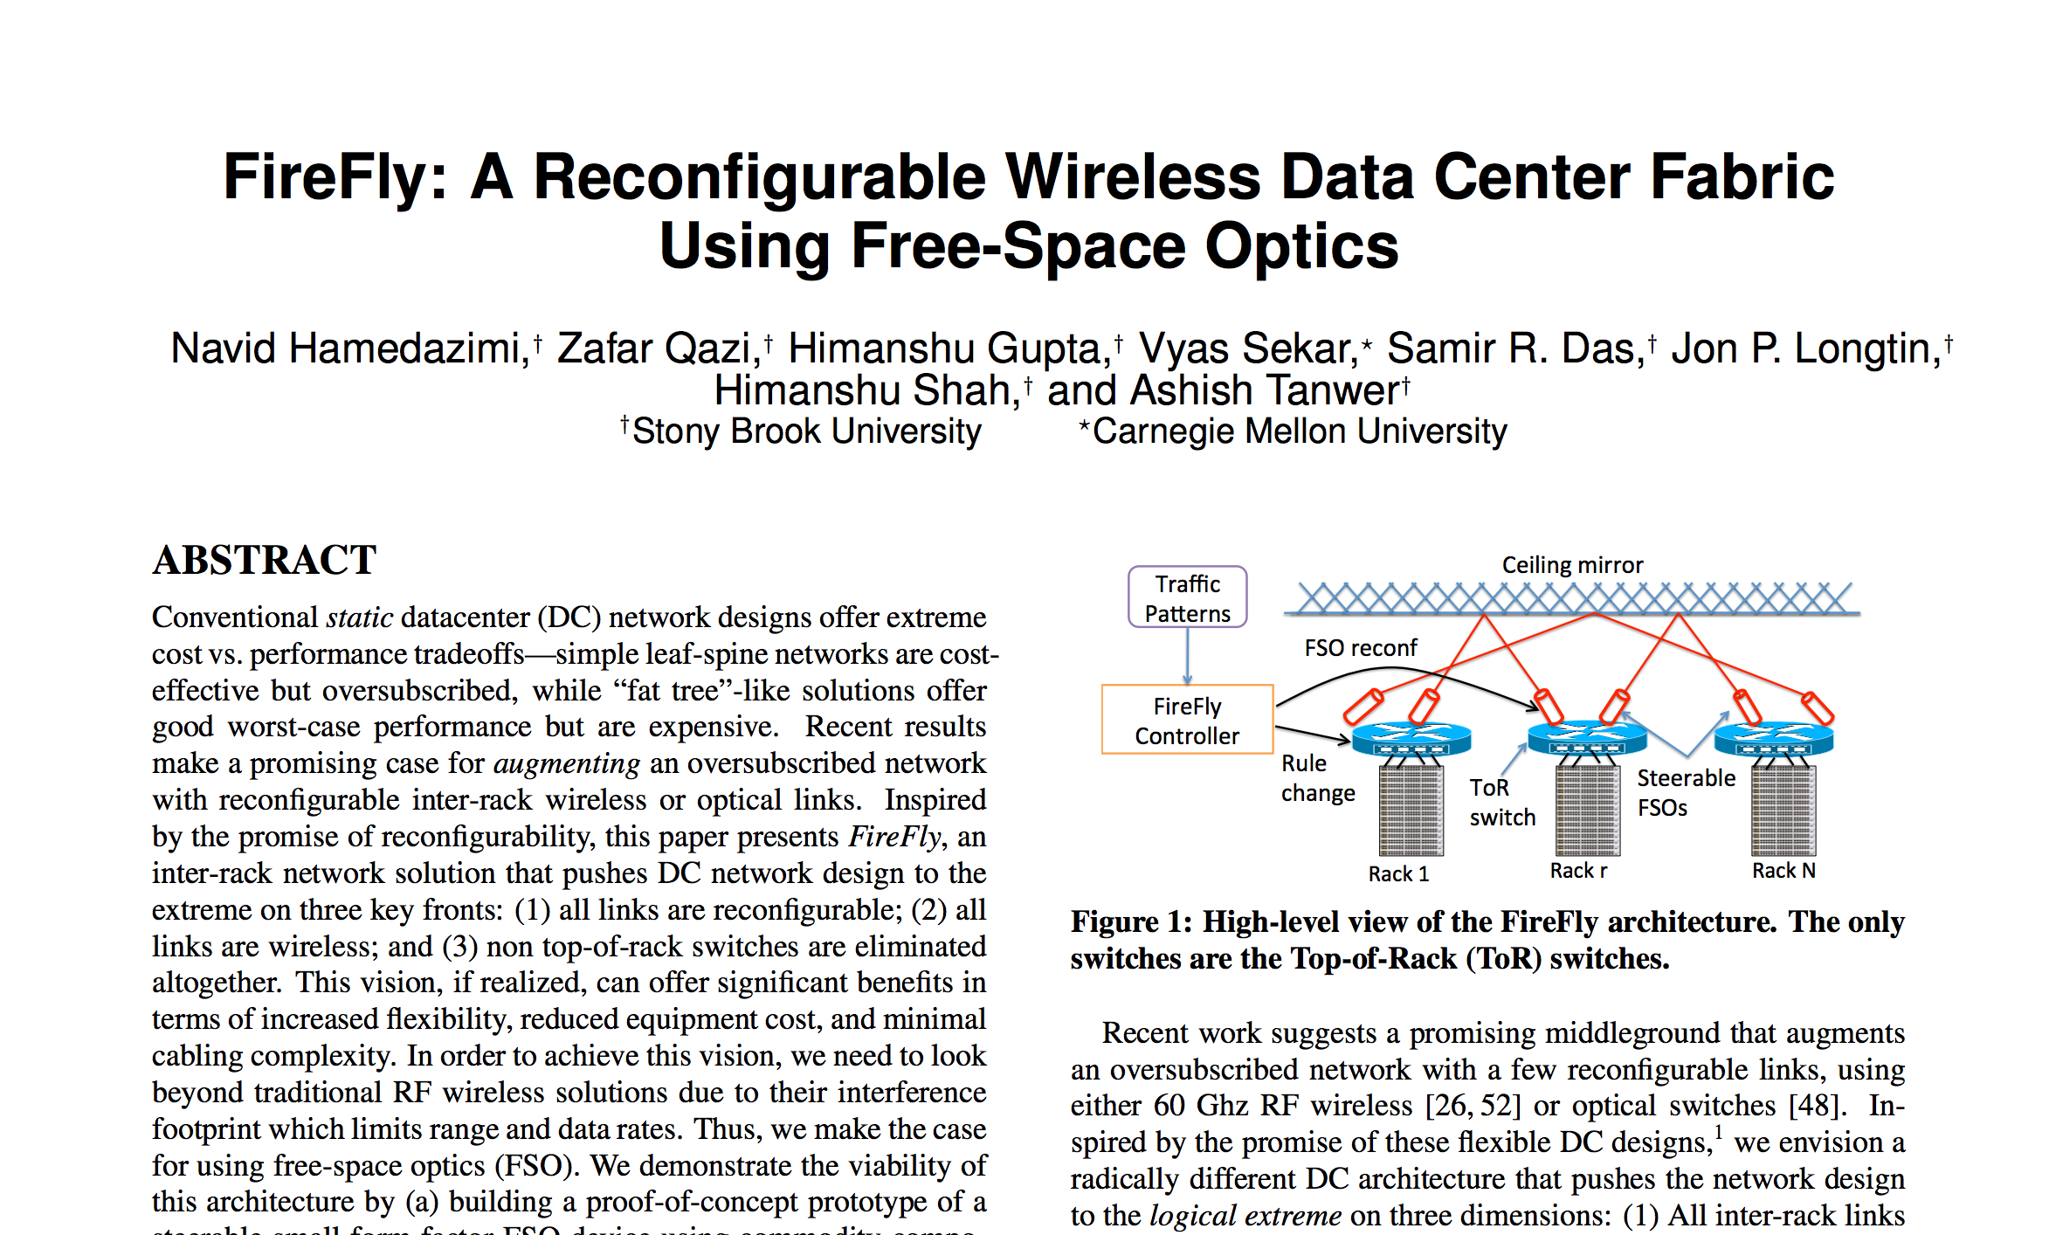
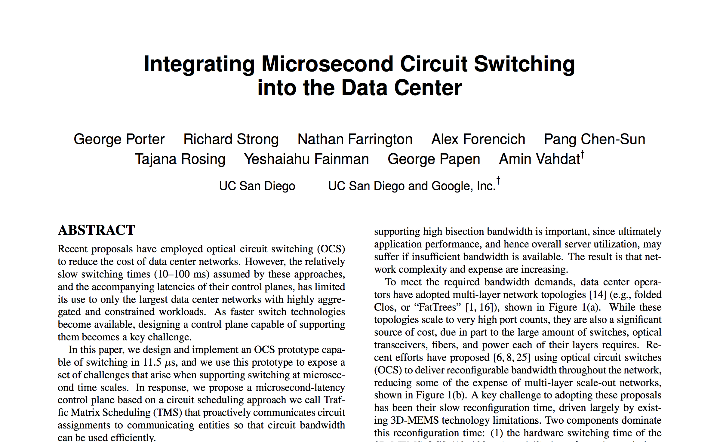
Next Time:
Wireless/Optical Data Centers

