Slide 1

6.888
Lecture 9:
Wireless/Optical Datacenters
Mohammad Alizadeh and Dinesh Bharadia
Spring 2016
Many thanks to George Porter (UCSD) and Vyas Sekar (Berkeley)

Slide 2

Datacenter Fabrics
Spine
Leaf
1000s of server ports
Scale out designs (VL2, Fat-tree)
Little to no oversubscription
Cost, power, complexity

Slide 3
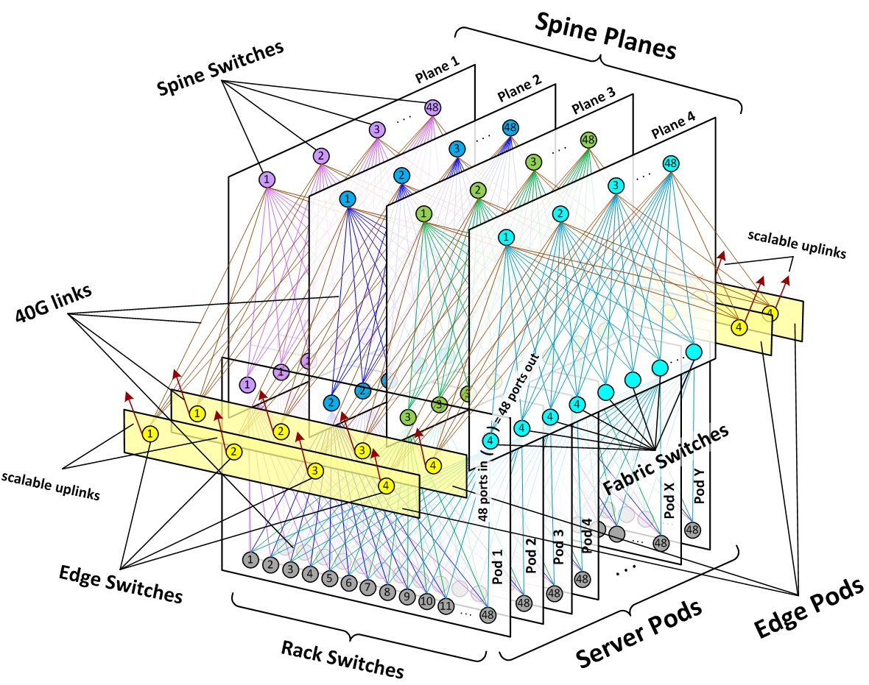
Multiple switching layers
(Why?)
https://code.facebook.com/posts/360346274145943/introducing-data-center-fabric-the-next-generation-facebook-data-center-network/

Slide 4
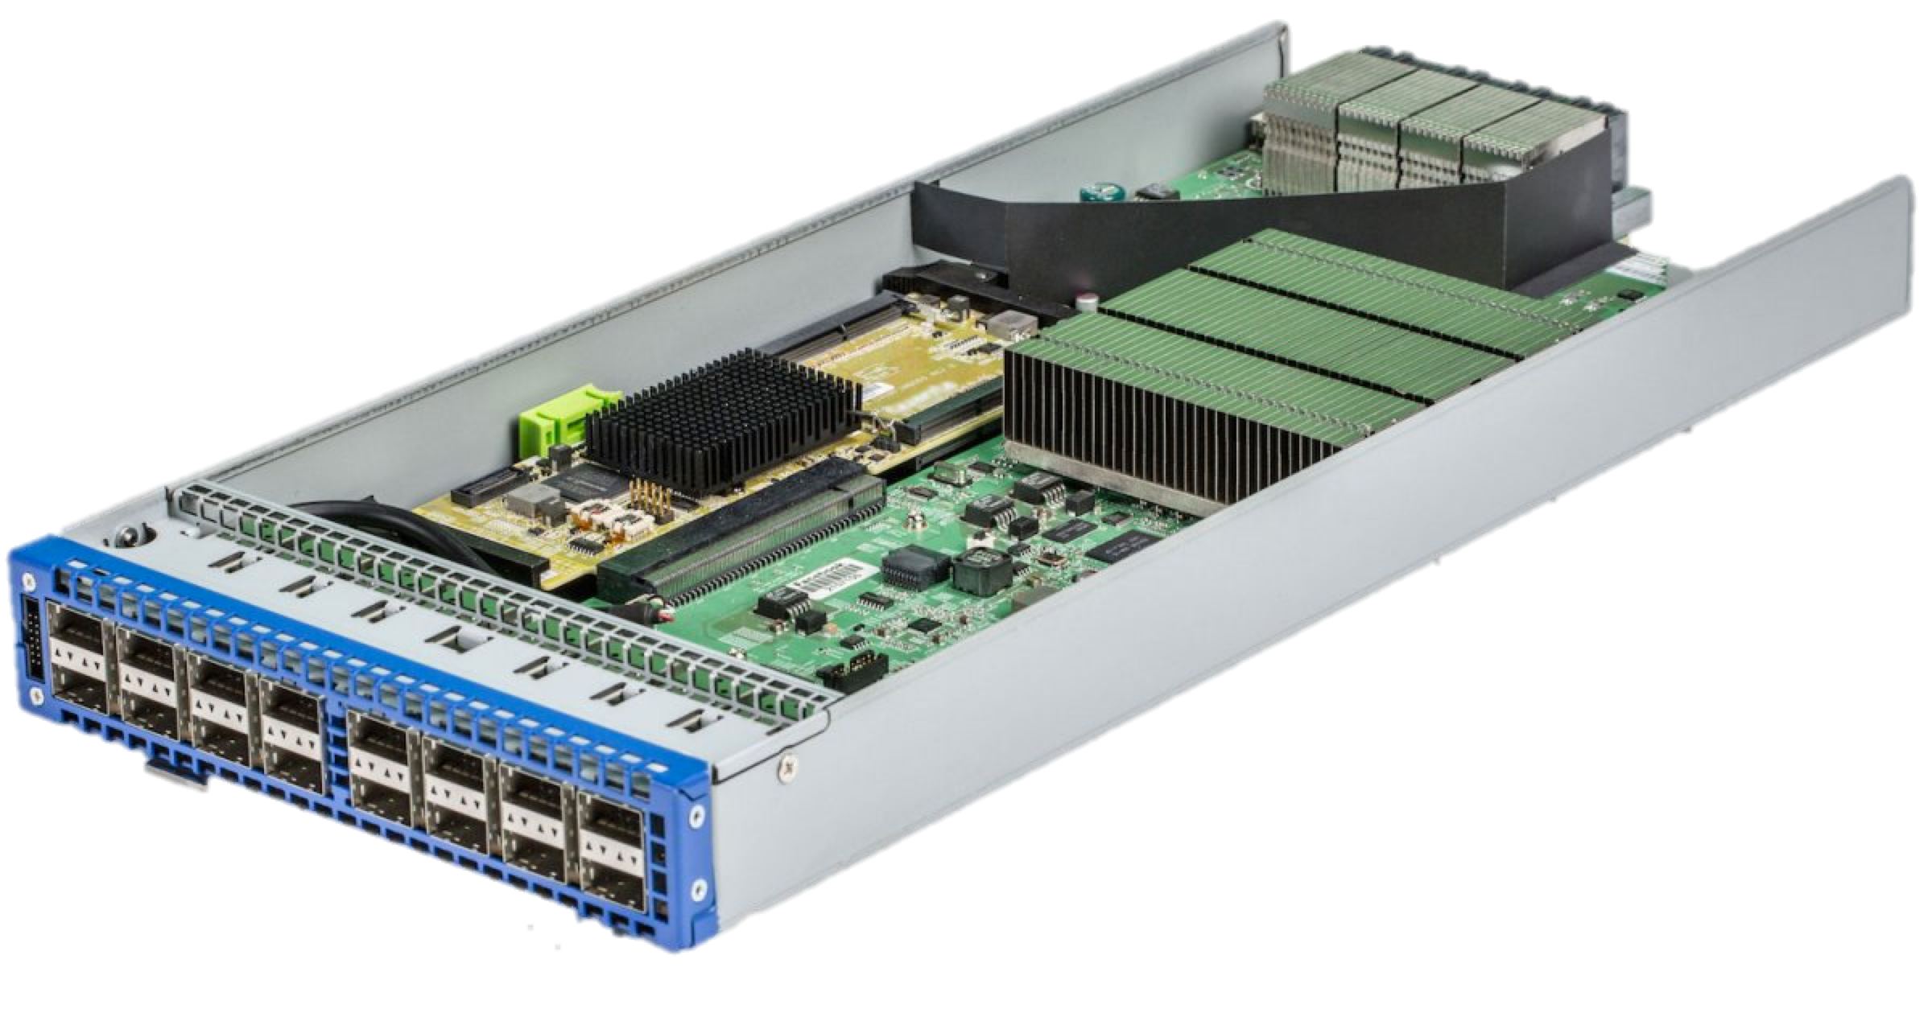
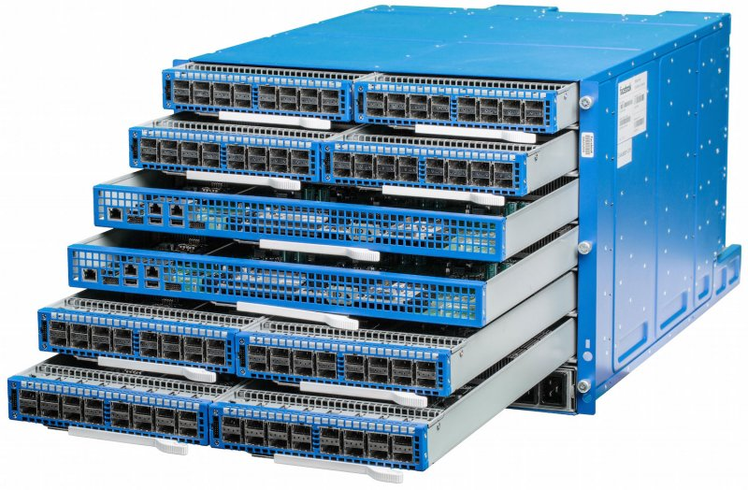
Building Block:
Merchant Silicon Switching Chips
Switch ASIC
6 pack
Facebook Wedge
Limited radix: 16x40Gbps
High power: 17 W/port
Image courtesy of Facebook

Slide 5
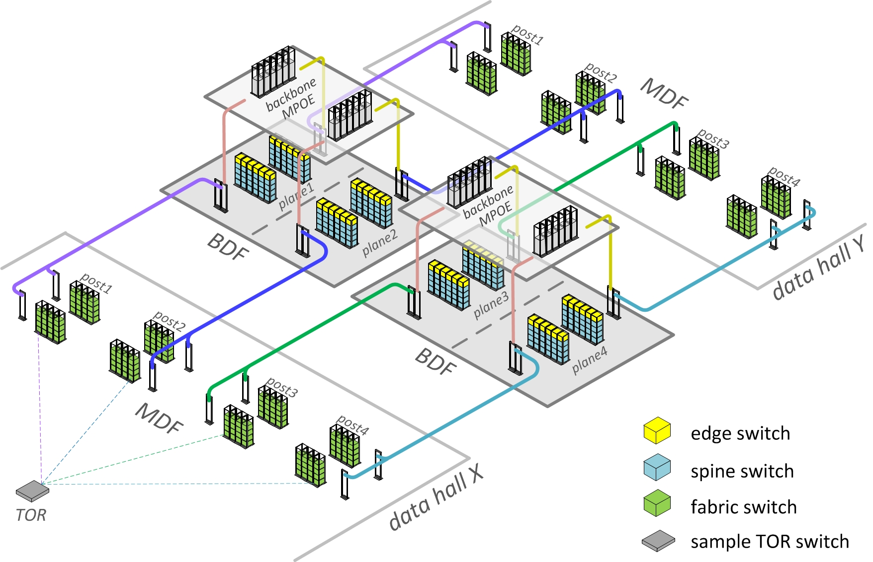
Long cables
(fiber)
https://code.facebook.com/posts/360346274145943/introducing-data-center-fabric-the-next-generation-facebook-data-center-network/

Slide 6
Scale-out packet-switch fabrics
Large number of switches, fibers, optical transceivers
Power hungry
Hard to expand
Notes:
This has really strong implications for the design of these data center networks. One such network is a multirooted tree, shown here.
<describe picture>
** No oversubscription: apps get good performance
** Add a host, need to add switching and core transceivers (SMF+expensive)
** Red box: source of significant cost/power

Slide 7
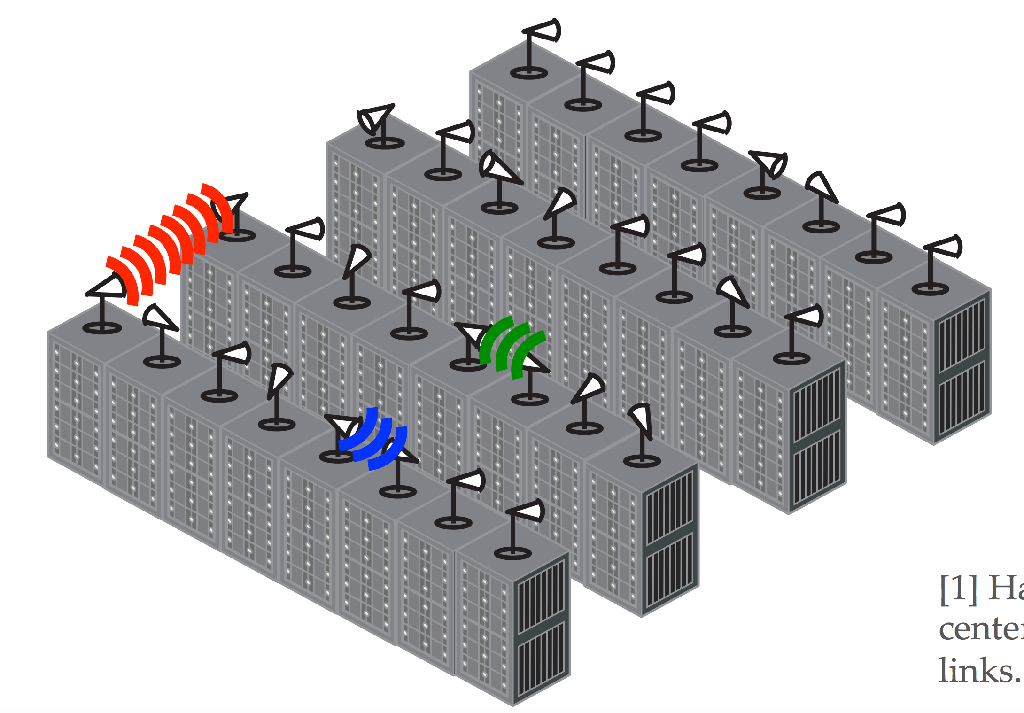
Beyond Packet-Switched DC Fabrics
Optical circuit switching
[Helios, cThrough, Mordio, ReacTor, …]
60 GHz RF
[Flyways, MirrorMirror]
Fig. from presentation by Xia Zhou
Free-space Optics
[FireFly]
Steerable
Links

Slide 8
Integrating Microsecond Circuit Switching into the Data Center
Slides based on presentation by George Porter (UCSD)

Slide 9
Key idea:
Hybrid Circuit/Packet Networks
Why build hybrid switch?

Slide 10
Circuit vs. Packet Switching
Observation: Correlated traffic ➔ Circuits
Electrical Packet
Optical Circuit
$500/port
10 Gb/s fixed rate
12 W/port
Transceivers (OEO)
Buffering
Per-packet switching
In-band control
$500/port
Rate free (10/40/100/400/+)
240 mW/port
No transceivers
No buffering
Duty cycle overhead
Out-of-band control
Notes:
Benefits:
Decouple control and data plane speeds
No buffering
(for optical circuits) no transceivers or O/E/O conversion
Mention Tom Issenhuth’s comments from the OIDA workshop

Slide 11
Disadvantages of Circuits
Despite advantages, circuits present different service model:
  Point-to-point connectivity
  Must wait for circuit to be assigned
  Circuit “down” while being reconfigured
}
affects throughput, latency
}
affects network duty cycle;
overall efficiency

Slide 12
Stability Increases with Aggregation
Inter-Data Center
Where is the
Sweet Spot?
Inter-Pod
Inter-Rack
Enough Stability
Enough Traffic
Inter-Server
Inter-Process
Inter-Thread

Slide 13
Mordia OCS model
S₀
S₀
S₁
S₁
→
S₂
S₂
S₃
S₃
…
…
S_{k}
S_{k}
Directly connects inputs to outputs
Reconfiguration time: 10us
  “Night” time (Tn): no traffic during reconfiguration
  “Day” time (Td): circuits/mapping established
Duty cycle: Td / (Td+Tn)
Bi-partite graph
Notes:
Putting aside the technology, assume the following OCS model

Slide 14
Previous approaches: Hotspot Scheduling
Assign circuits
to elephants
3. Reconfig
X
1. Observe
2. Compute
3. Reconfig
X
1. Observe
2. Compute
3. Reconfig
X
Time
1. Observe
2. Compute
Notes:
Goal of S is to find “elephant” flows
** Look as pipeline diagram
Need faster, so let’s make it faster… but how??

Slide 15
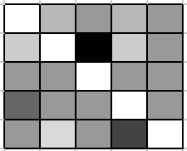
Limitations of Hotspot Scheduling
3. Reconfig
1. Observe
3
1. Observe
3
TM(t)
1. Observe
3
Time
Goal
3. Reconfig
1. Observe
2
3
3
3
3
3
3
3
3
3
TM(t)
1. Observe
2
3
3
3
3
3
3
3
3
3
1. Observe
2
3
3
3
3
3
3
3
3
3
1. Observe
2
3
3
Time
Notes:
We need a new scheduler, and a new way of handling the assignment of flows much quicker

Slide 16
Traffic Matrix Scheduling
Birkhoff von-Neumann Decomposition
Notes:
Birkhoff von-Neumann is one such approach
Decouple to step 1 AND 4
Ti can be smaller than time to measure TM, can be ~100us

Slide 17

BvN Decomposition
T has to be
doubly-stochastic
k’ could be large
( in worst case)
Suppose: T is a scaled doubly-stochastic matrix

Slide 18
Scheduling
circuit switch configuration: bipartite graph matching
Traffic Matrix: T
1
4
1
4
4
1
4
1
1
4
n = 5 nodes
time

Slide 19
Scheduling
configuration of circuit switch modeled as bipartite graph matching
Traffic Matrix: T
1
4
1
4
4
1
4
1
1
4
n = 5 nodes
time

Slide 20
Scheduling
configuration of circuit switch modeled as bipartite graph matching
Traffic Matrix: T
1
0
1
0
0
1
0
1
1
0
n = 5 nodes
time
reconfiguration delay

Slide 21
Scheduling
configuration of circuit switch modeled as bipartite graph matching
Traffic Matrix: T
1
0
1
0
0
1
0
1
1
0
n = 5 nodes
time

Slide 22
Scheduling
configuration of circuit switch modeled as bipartite graph matching
Traffic Matrix: T
0
0
0
0
0
0
0
0
0
0
n = 5 nodes
time

Slide 23
Scheduling
maximize throughput in time-window W
Traffic Matrix: T
1
4
1
4
4
1
??
4
1
1
4
n = 5 nodes
W
time

Slide 24
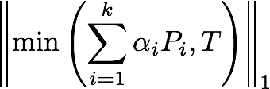
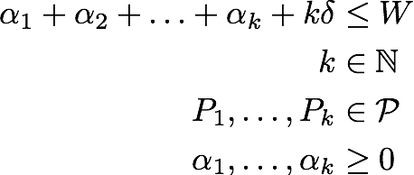
Problem Statement
maximize
s.t.
number of matchings
permutation matrices
duration

Slide 25
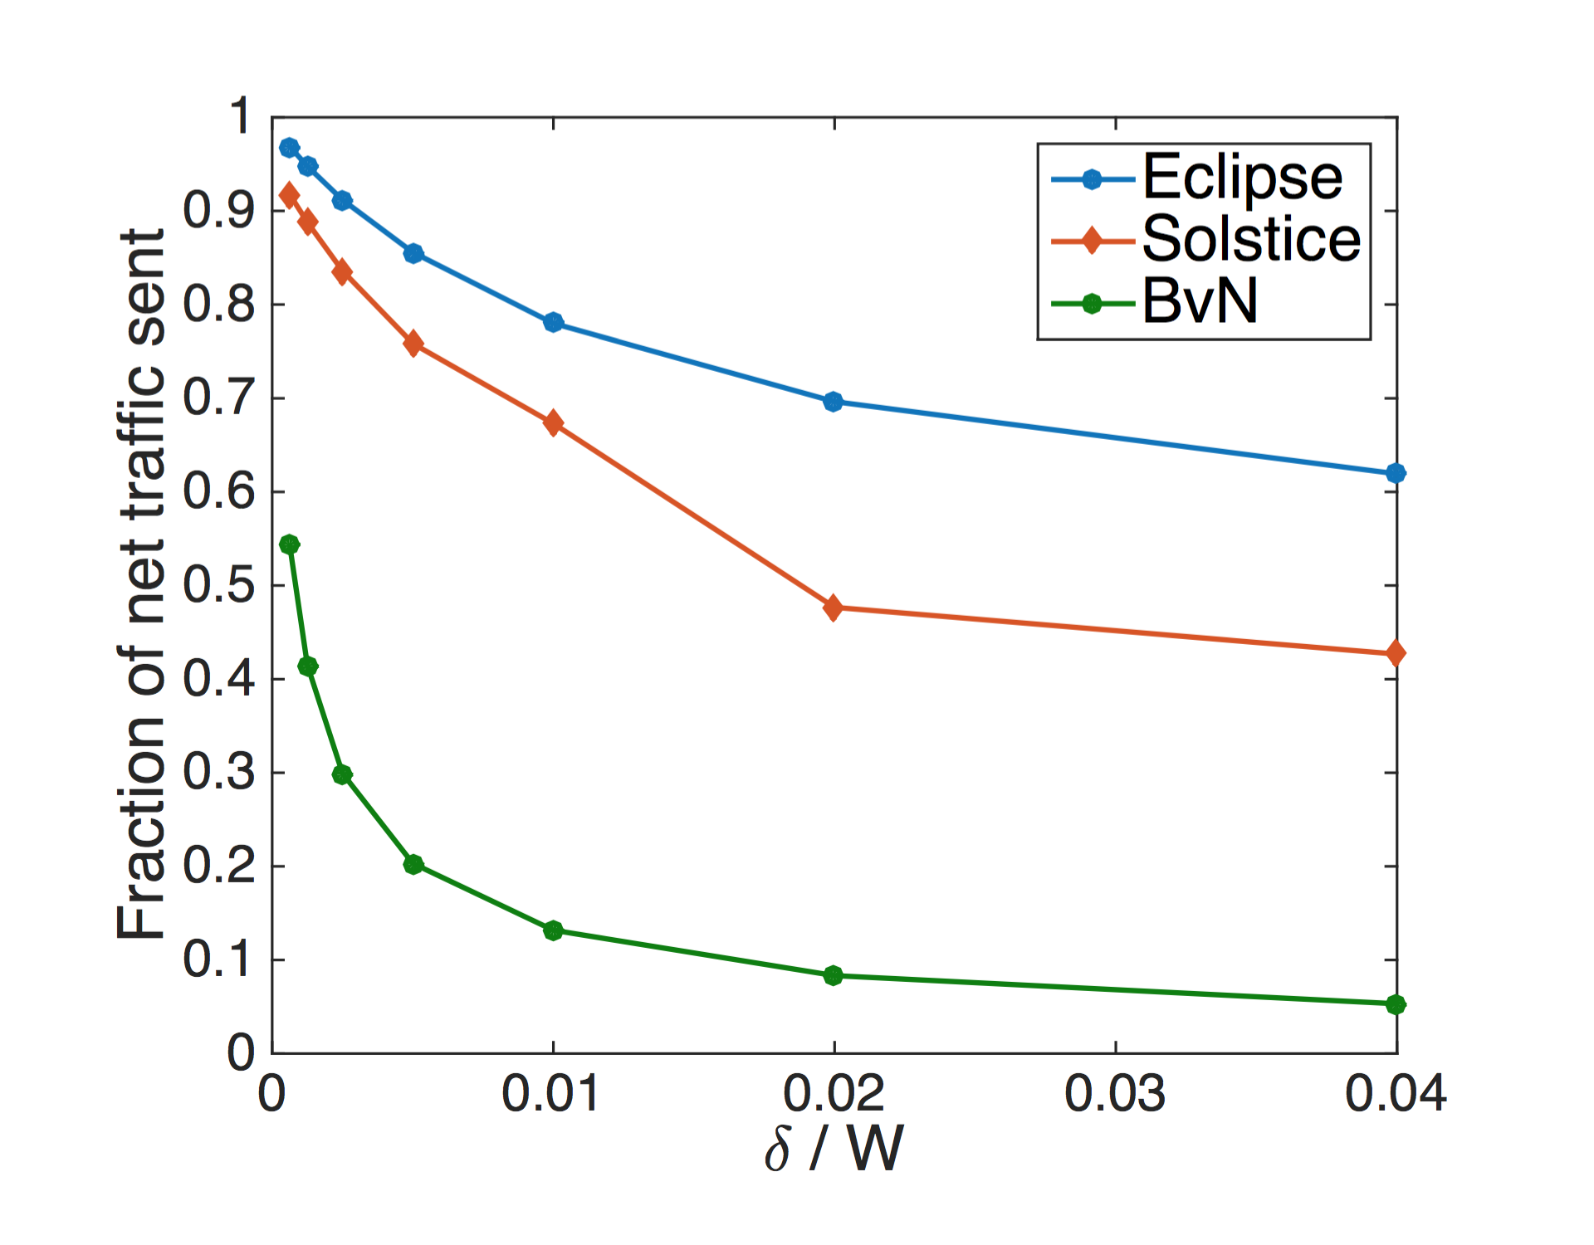
Eclipse: Greedy Algorithm
(with provable guarantees)
Venkatakrishnan et al., “Costly Circuits, Submodular Schedules, Hybrid Switch Scheduling for Data Centers”, To appear in SIGMETRICS 2016.

Slide 26
Discussion

Slide 27
Firefly
Slides based on presentation by Vyas Sekar (CMU)

Slide 28

Why FSO instead of RF?
RF (e.g. 60GHZ)
FSO (Free Space optical)
Wide beam ➔
Faster steering of beams
High interference
Limited active links
Limited Throughput
Narrow beam ➔
Slow steering of beams
Zero interference
No limit on active links
High Throughput
Notes:
Why can’t we use traditional RF in our work? The main reason is that traditional RF uses a wide beam which is very difficult to narrow. This results in high interference on top of the racks which limits bandwidth, range, and number of active links.
Free space optical links on the other hand give us excellent throughput over long ranges. Plus, they are easy to narrow which eliminates interference and thus allows many active links.

Slide 29
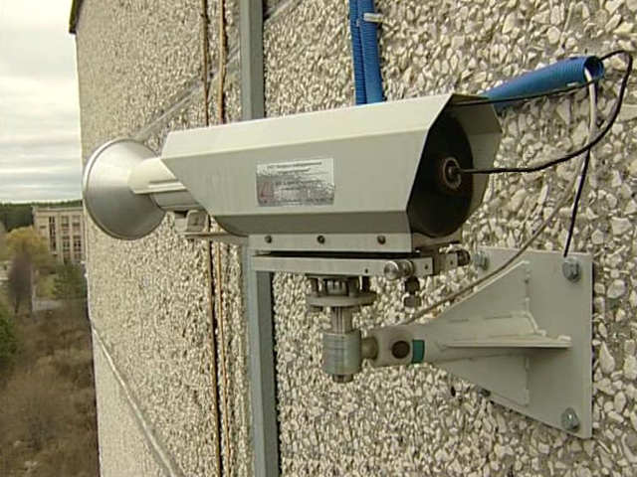
Today’s FSO
Cost: $15K per FSO
Size: 3 ft³
Power: 30w
Non steerable
Current: bulky, power-hungry, and expensive
Required: small, low power and low expense
Notes:
If you look at the market, the current FSO’s are
expensive, 15k for a single FSO
they take LOTS of space,
they need massive amount of power
and they are not STEERABLE

Slide 30
Why Size, Cost, Power Can be Reduced?
Traditional use : outdoor, long haul
  High power
  Weatherproof
Data centers: indoor, short haul
Feasible roadmap via commodity fiber optics
  E.g. Small form transceivers (Optical SFP)

Slide 31
FSO Design Overview
fiber optic cables
Diverging beam
Lens focal distance
Parallel beam
lens
Focusing lens
Collimating lens
Large core fiber optic cables
SFP
  large cores (> 125 microns) are more robust
Notes:
ere is the design of a FSO using COMMODITY SFP in FireFly. SFP’s normally are connected using fiber optic cables.
Directly launching the beam from SFP into air results in unacceptable divergence and loss of signal at receiver.
We can stop the divergence of the beam using an optical lens. We put the SFP at the lens focal distance, and we get a collimated parallel beam
At the receiver, we focus this collimated beam into the SFP using another lens
However SFPs are supposed to directly be connected to switch motherboard so putting them at top of the rack is inconvienent
To better manage the system, we launch and receive the optical signal into fiber optic cables
Based on our experiments, we find “big core” 125nm and up fibers would work, SO THAT WE CAN GATHER SUFFICIENT LIGHT

Slide 32
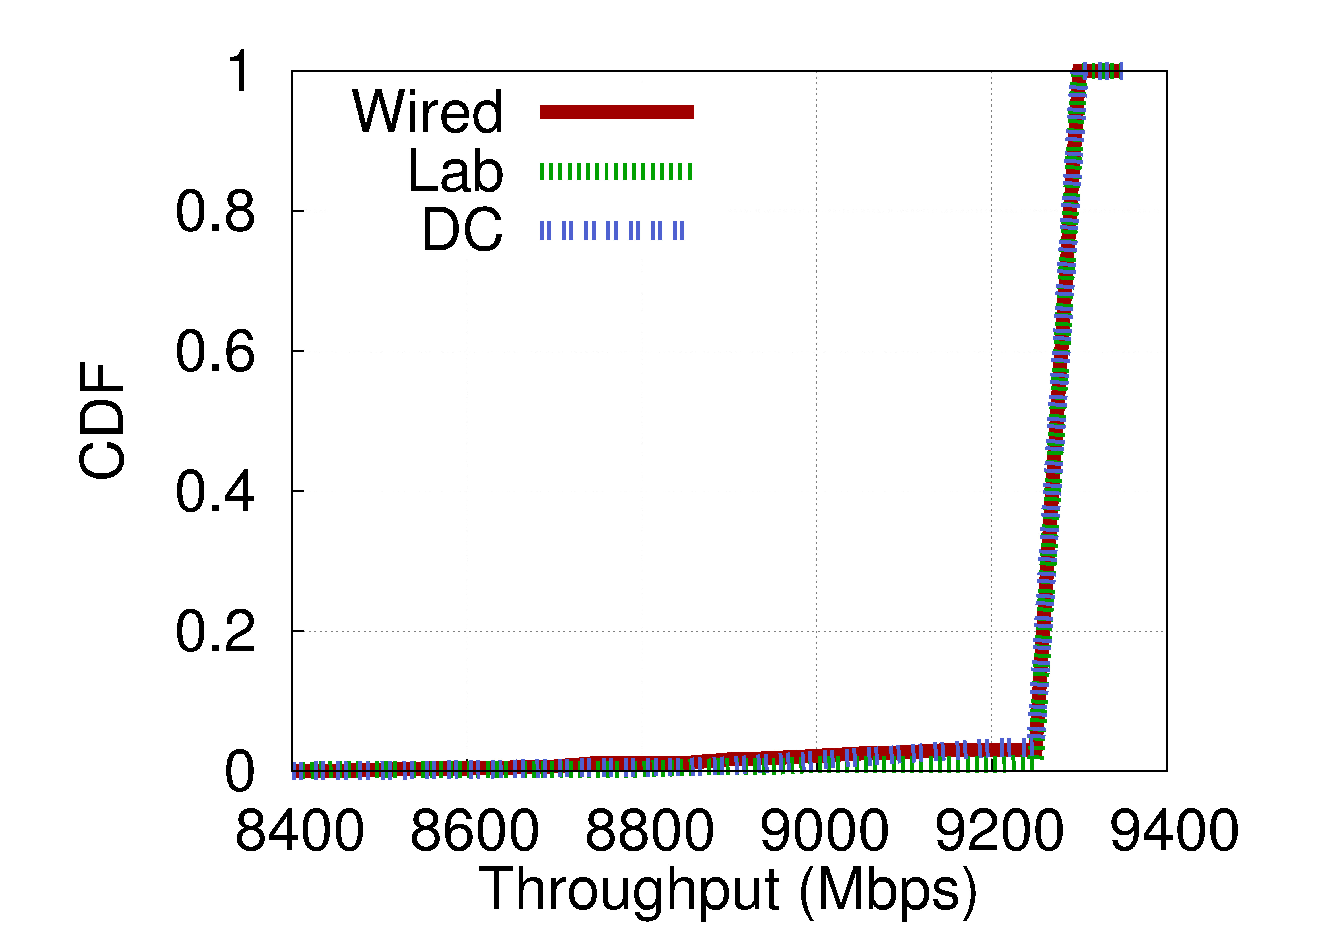

FSO Link Performance
Effect of vibrations, etc.
6mm movement tolerance
Range up to 24m tested
6 mm
6 mm
FSO link is as robust as a wired link
Notes:
We build our prototype and we measured its performacen, we first measured how sensitive our link is to movement to see how much vibration, bumps into racks, etc. would affect the link. We find out that the link is fairly robust and it can tolerate movement of up to 0.7mm in each direction.
We tested the link range in an actual data center and it worked up to 24 meters. However, this is because in our data center this was the farthest distance. It should in theory work for distances of up to few hundred meters.
We then measure the throughput. Here is the chart of throughput of the link vs throughput of the link on wire, where x is the throughput and y is the cumulative distribution of the throughput. As you can see there is no difference between the wired link and FSO link in throughput.
So in conclusion, FSO link is robust and it almost behave almost exactly as a wired connection.

Slide 33
Steerability
Shortcomings of current FSOs
Cost
Size
Power
Not Steerable
FSO design
using SFP
Via Switchable mirrors
or Galvo mirrors
Shortcomings of current FSOs
Notes:
This LINK DESIGN takes care of cost energy and size problem
but we still need to make this links Steerable. We explore two technologies. Switchable mirrors and galvo mirrors.
Say different two different design give us two different options innetwork design

Slide 34
Steerability via Switchable Mirror
Switchable Mirror: glass mirror
Electronic control, low latency
Ceiling mirror
SM in “mirror”
mode
B
C
A
Notes:
Before we talk about switchable mirrors, lets talk about another issue: if we put all this FSO’s on top of the racks, we will have line of sight problems.
We borrow an idea from prior work and solve the line of sight problem by turning the ceiling into a mirror.
We then can add flexibility by using switchable mirrors. These are mirrors which can be turned into glass and back to mirror by passing a small electric current, we can add several of them for each FSOs each aligned in a different direction.
This pros of these mirrors is that they have electronic control and fairly short switching time in order of several ms. By using a few of them per FSO, we can then steer the link, by switching off all the mirrors
except one. E.g. in this picture, we can steer the link to receiver 2 by switching off all the mirrors except this one

Slide 35
Steerability via Galvo Mirror
Galvo Mirror: small rotating mirror
Very low latency
Ceiling mirror
Galvo Mirror
B
C
A
Notes:
Another technology that we are exploring are galvo mirrors they are in essential small rotating mirror where mirror can be rotated in a cone of 45 degrees
We only need one per FSO
They are very reliable and have very fast response time (few hundred microseconds to switch a link) Now again in our example, if we want to steer the link to receiver 2
We just have to rotate this mirror to get the link

Slide 36
How to design FireFly network?
Goals: Robustness to current and future traffic
Budget & Physical Constraints
Design parameters
  Number of FSOs?
  Number of steering mirrors?
  Initial mirrors’ configuration
Performance metric
  Dynamic bisection bandwidth
36
Notes:
DYNAMIC GRAPH
New NETWORK DESIGN
NEW ASSEssMENT measure
What is our goal? To build a network which is robust to the current and future traffic patters
What is our constraints, we have budget constraints, the price of this network should be reasonable and we have physical space constraints, how many FSO’s we can feet at top of our racks.
Since we don’t have a network graph our design problem doesn’t fit into any of the traditional network design paradigms. How can we define our problem then? what are design parameters?
The first and most obvious one is how many FSO do we need?
Second is how many steering mirrors, be it Galvo or switchable mirrors do we need?
And the third is that how can we should initially configure our mirrors
Now we have our design parameters but since again we don’t have a network graph, we can’t use traditional assessment metrics s.a. bisection bandwidth in network design?
We define a new metric, dynamic bisection bandwidth which can be used for other augmented architectures as well. You can find the details in the paper.

Slide 37
Discussion

Slide 38
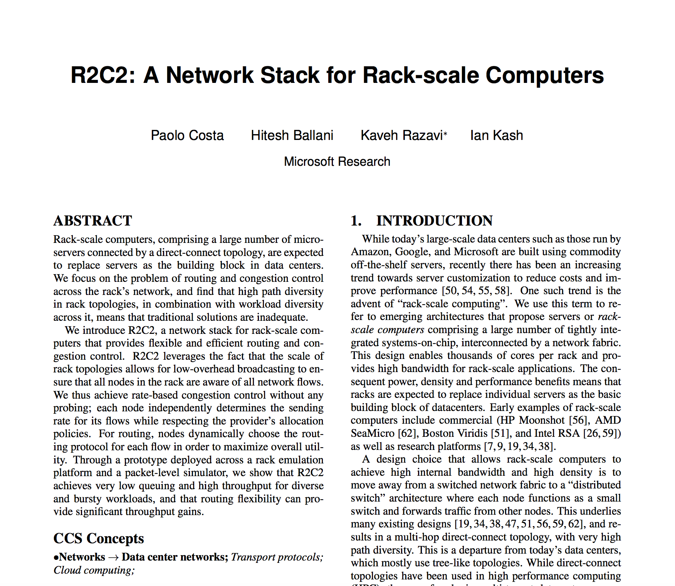
Next Time: Rack-Scale Computing

