Slide 1

Packet Transport Mechanisms for Data Center Networks
Mohammad Alizadeh
NetSeminar (April 12, 2012)
Stanford University

Slide 2

Data Centers
Huge investments: R&D, business
  Upwards of $250 Million for a mega DC
Most global IP traffic originates or terminates in DCs
  In 2011 (Cisco Global Cloud Index):
    ~315ExaBytes in WANs
    ~1500ExaBytes in DCs
Notes:
Cisco forcasts: in 2011: ~300ExaBytes/year in IP WAN networks, ~1.5ZettaBytes/year in DC (forcasts show similar growth at 32% CAGR until 2015)
Facebook IPO: in 2011 out of $806m total cost of revenue, $606m was spent on DC

Slide 3
This talk is about packet transport
inside the data center.

Slide 4


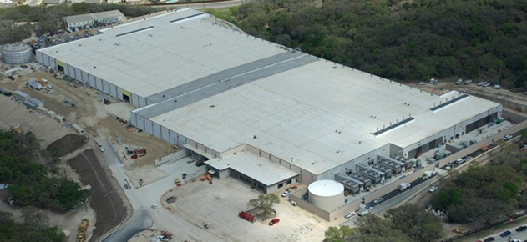


INTERNET
Fabric
Servers

Slide 5
Layer 3
TCP
INTERNET
Fabric
Layer 3: DCTCP
Layer 2: QCN
Servers
Notes:
“Specifically, when your computer communicates with a server in some data center, it most-likely uses the TCP for packet transport”
There is also a lot of communication that needs to happen between the servers inside the data center – In fact, more than 75% of all data center traffic stays within the data center. I'm going to be talking about 2 algorithms that have been designed for this purpose: DCTCP & QCN. In the interest of time, I will be focusing mostly on DCTCP, but will discuss some of the main ideas in QCN as well.

Slide 6
TCP in the Data Center
TCP is widely used in the data center (99.9% of traffic)
But, TCP does not meet demands of applications
  Requires large queues for high throughput:
    Adds significant latency due to queuing delays
    Wastes costly buffers, esp. bad with shallow-buffered switches
Operators work around TCP problems
  Ad-hoc, inefficient, often expensive solutions
  No solid understanding of consequences, tradeoffs
Notes:
TCP has been the dominant transport protocol in the Internet for 25 years and is widely used in the data center as well.
However, it was not really designed for this environment and does not meet the demands of data center applications.

Slide 7
Roadmap: Reducing Queuing Latency
Baseline fabric latency (propagation + switching): 10 – 100μs
TCP:
~1–10ms
DCTCP & QCN:
~100μs
HULL:
~Zero Latency
Notes:
"With TCP, queuing delays can be in the milliseconds; more than 3 orders or magnitude larger than the baseline"

Slide 8
Data Center TCP
with Albert Greenberg, Dave Maltz, Jitu Padhye, Balaji Prabhakar, Sudipta Sengupta, Murari Sridharan
SIGCOMM 2010

Slide 9
Case Study: Microsoft Bing
A systematic study of transport in Microsoft’s DCs
  Identify impairments
  Identify requirements
Measurements from 6000 server production cluster
More than 150TB of compressed data over a month
Notes:
So I would like to next talk a little bit about a measurement study that was done during an internship at Microsoft in 2009. Our goal was to do a systematic...

Slide 10






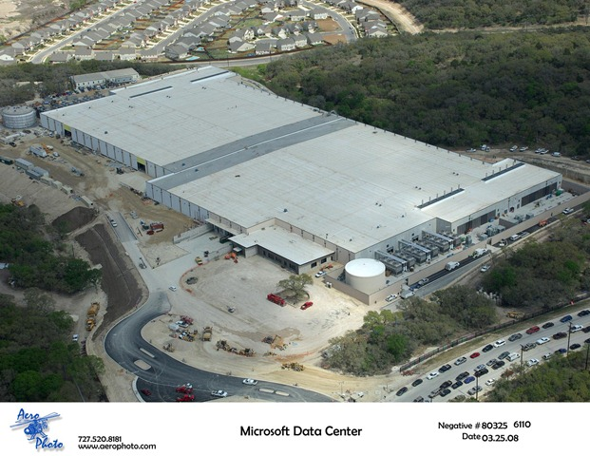









Search: A Partition/Aggregate Application
TLA
1.
Picasso
Art is…
Deadline = 250ms
2. Art is a lie…
3.
…..
Strict deadlines (SLAs)
Missed deadline
  Lower quality result
Picasso
MLA
………
MLA
1. Art is a lie…
1.
Deadline = 50ms
2.
2. The chief…
…..
3.
…..
3.
“Everything you can imagine is real.”
“Computers are useless.
They can only give you answers.”
“It is your work in life that is the ultimate seduction.“
“Bad artists copy.
Good artists steal.”
“I'd like to live as a poor man
with lots of money.“
“Art is a lie that makes us
realize the truth.
“The chief enemy of creativity is good sense.“
“Inspiration does exist,
but it must find you working.”
Deadline = 10ms
Worker Nodes
Notes:
After the animation, say “this follows what we call the partition/aggregate application structure.
I’ve described this in the context of search, but it’s actually quite general
- “the foundation of many large-scale web applications.”

Slide 11


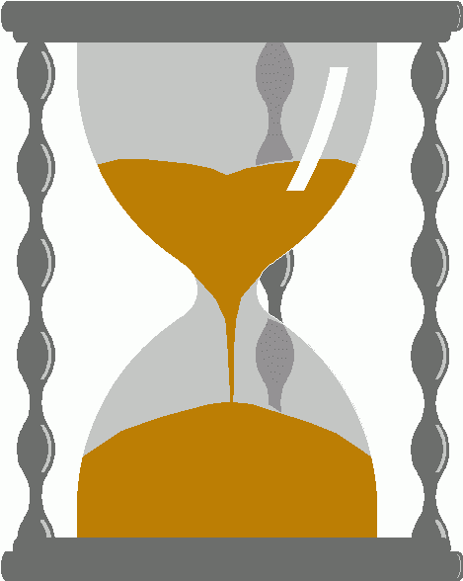
Incast
Synchronized fan-in congestion:
  Caused by Partition/Aggregate.
Worker 1
Aggregator
Worker 2
Worker 3
RTO_{min} = 300 ms
Worker 4
TCP timeout
Vasudevan et al. (SIGCOMM’09)
Notes:
Also, this kind of application generates traffic patterns that are particularly problematic for TCP.

Slide 12
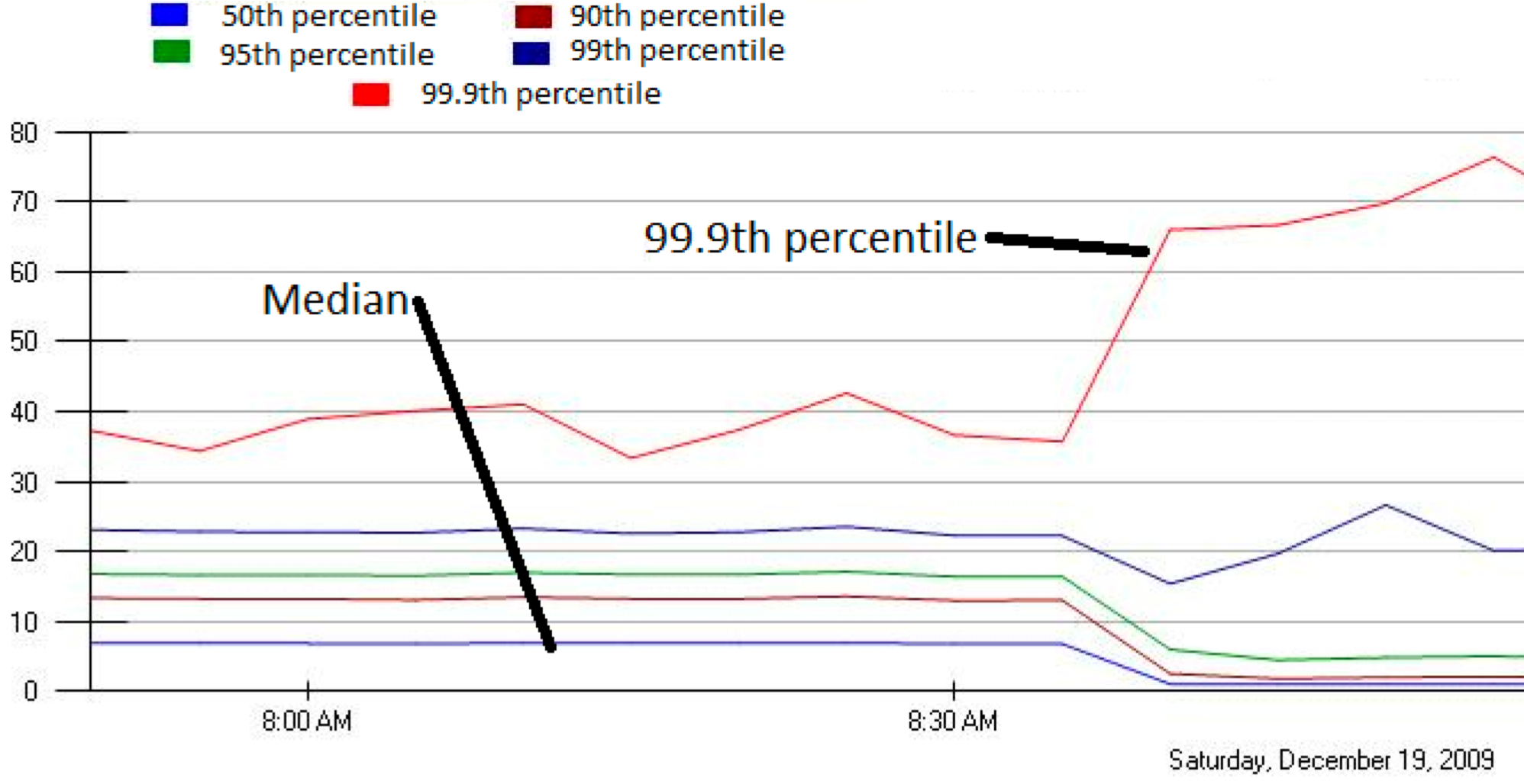
Incast in Bing
MLA Query Completion Time (ms)
Requests are jittered over 10ms window.
Jittering switched off around 8:30 am.
Jittering trades off median against high percentiles.
Notes:
1. Incast really happens – see this actual screenshot from production tool
2. People care, they’ve solved it at application by jittering.
3. They care about the 99.9th percentile, 1-1000 customers

Slide 13



Data Center Workloads & Requirements
Partition/Aggregate
(Query)
Short messages [50KB-1MB]
(Coordination, Control state)
Large flows [1MB-100MB]
(Data update)
High Burst-Tolerance
Low Latency
High Throughput
The challenge is to achieve these three together.

Slide 14
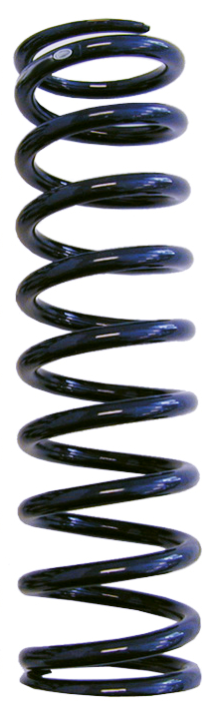
Tension Between Requirements
High Throughput
High Burst Tolerance
Low Latency
We need:
Low Queue Occupancy & High Throughput
Deep Buffers:
Queuing Delays
Increase Latency
Shallow Buffers:
Bad for Bursts &
Throughput
Notes:
Deep Buffers – bad for latency
Shallow Buffers – bad for bursts & throughput
Reduce RTO_{min} – no good for latency
AQM – Difficult to tune, not fast enough for incast-style micro-bursts, lose throughput in low stat-mux

Slide 15
TCP Buffer Requirement
Bandwidth-delay product rule of thumb:
  A single flow needs C×RTT buffers for 100% Throughput.
B < C×RTT
B ≥ C×RTT
B
Buffer Size
B
100%
100%
Throughput
Notes:
Now in the case of TCP, the question of how much buffering is needed for high throughput has been studied and is known in the literature as the buffer sizing problem.
End with: “So we need to find a way to reduce the buffering requirements.”

Slide 16

Reducing Buffer Requirements
Appenzeller et al. (SIGCOMM ‘04):
  Large # of flows: is enough.
Window Size
(Rate)
Buffer Size
Throughput
100%
Notes:
Now, there are previous results that show in some circumstances, we don't need big buffers.

Slide 17
Reducing Buffer Requirements
Appenzeller et al. (SIGCOMM ‘04):
  Large # of flows: is enough
Can’t rely on stat-mux benefit in the DC.
  Measurements show typically only 1-2 large flows at each server
Key Observation:
  Low Variance in Sending Rates → Small Buffers Suffice.
Both QCN & DCTCP reduce variance in sending rates.
  QCN: Explicit multi-bit feedback and “averaging”
  DCTCP: Implicit multi-bit feedback from ECN marks

Slide 18
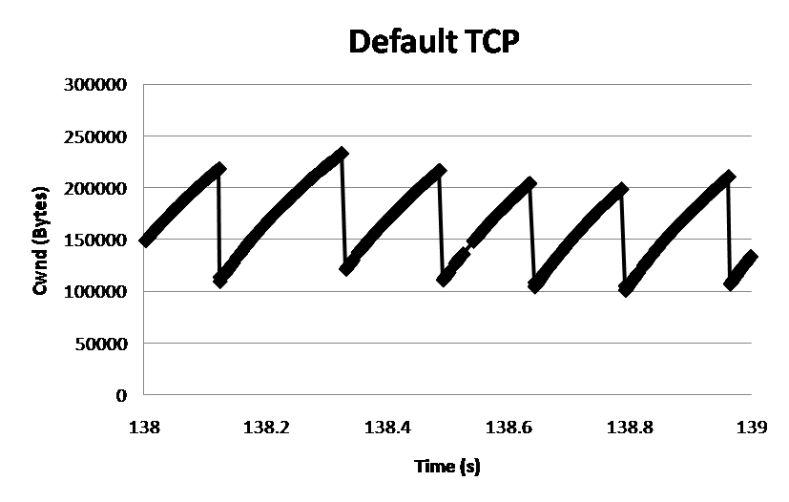
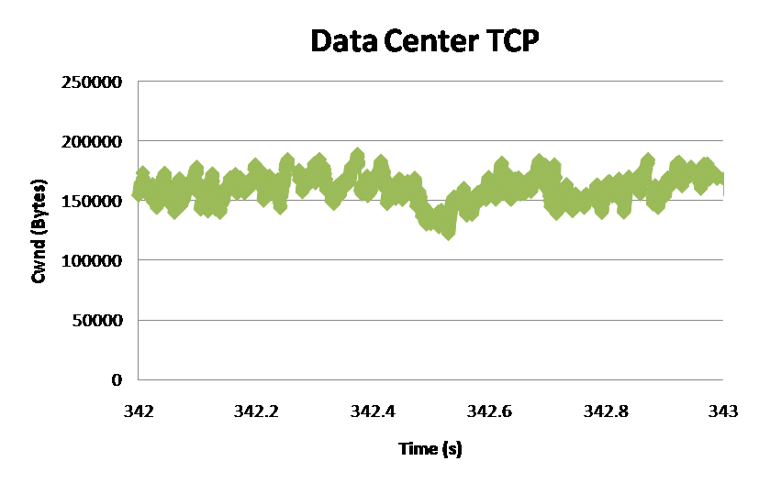
DCTCP: Main Idea
How can we extract multi-bit feedback from single-bit stream of ECN marks?
  Reduce window size based on fraction of marked packets.
ECN Marks | TCP | DCTCP
1 0 1 1 1 1 0 1 1 1 | Cut window by 50% | Cut window by 40%
0 0 0 0 0 0 0 0 0 1 | Cut window by 50% | Cut window by 5%
Notes:
Start with: “How can we extract multi-bit information from single-bit stream of ECN marks?”
- Standard deviation: TCP (33.6KB), DCTCP (11.5KB)

Slide 19
DCTCP: Algorithm
B
K
Don’t
Mark
Switch side:
  Mark packets when Queue Length > K.
Mark
  Sender side:
  Maintain running average of fraction of packets marked (α).
Adaptive window decreases:
  Note: decrease factor between 1 and 2.
Notes:
very simple marking mechanism
not all the tunings other aqms have
on the source side, the source is tryign to estimate the fraction of packets getting marked
using the obs that there is a stream of ecn marks coming back – more info in the stream than in any single bit
trying to maintain smooth rate variations to operate well even when using shallow buffers, and only a few flows (no stat mux)
F over the last RTT. In TCP there is always a way to get the next RTT from the window size. Comes from the self-clocking of TCP.
Only changing the decrease. Simplest version – makes a lot of sense. So generic could apply it to any algorithm – CTCP, CUBIC – how to cut its window leaving increase part to what it already does. Have to be careful here.

Slide 20
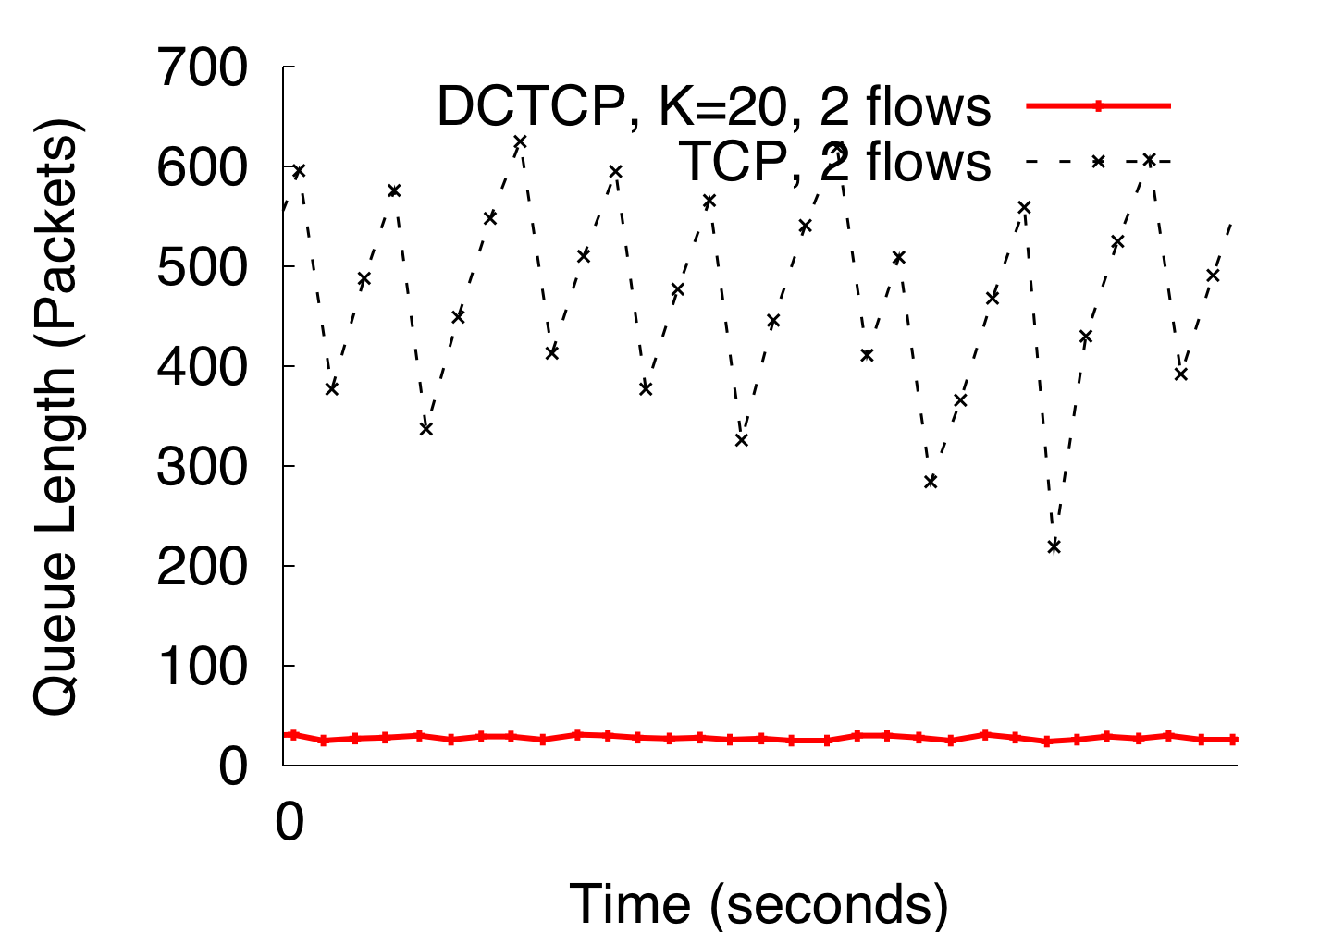
DCTCP vs TCP
(Kbytes)
Setup: Win 7, Broadcom 1Gbps Switch
Scenario: 2 long-lived flows,
ECN Marking Thresh = 30KB
Notes:
Not ns2.

Slide 21
Evaluation
Implemented in Windows stack.
Real hardware, 1Gbps and 10Gbps experiments
  90 server testbed
  Broadcom Triumph 48 1G ports – 4MB shared memory
  Cisco Cat4948 48 1G ports – 16MB shared memory
  Broadcom Scorpion 24 10G ports – 4MB shared memory
Numerous micro-benchmarks
  – Throughput and Queue Length
  – Multi-hop
  – Queue Buildup
  – Buffer Pressure
Bing cluster benchmark
– Fairness and Convergence
– Incast
– Static vs Dynamic Buffer Mgmt

Slide 22
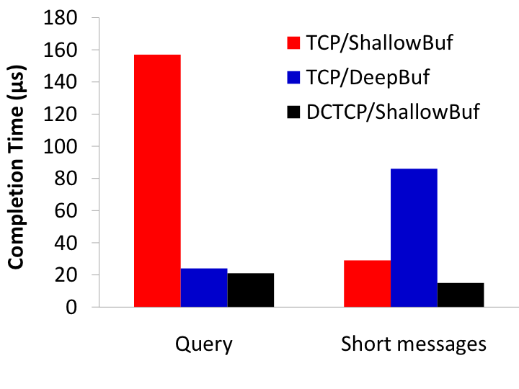
Bing Benchmark
incast
Deep buffers fixes incast, but makes latency worse
DCTCP good for both incast & latency
Completion Time (ms)
Query Traffic
(Bursty)
Short messages
(Delay-sensitive)

Slide 23
Analysis of DCTCP
with Adel Javanmrd, Balaji Prabhakar
SIGMETRICS 2011

Slide 24
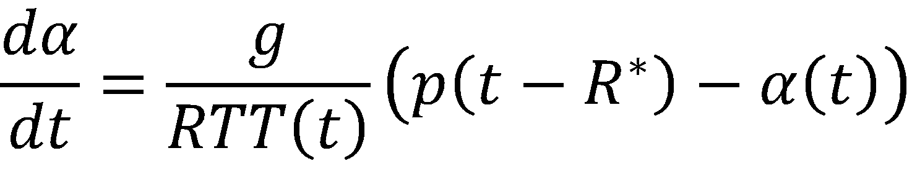
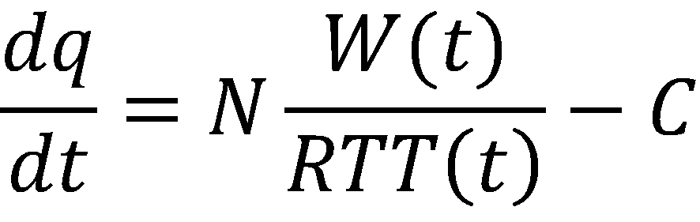
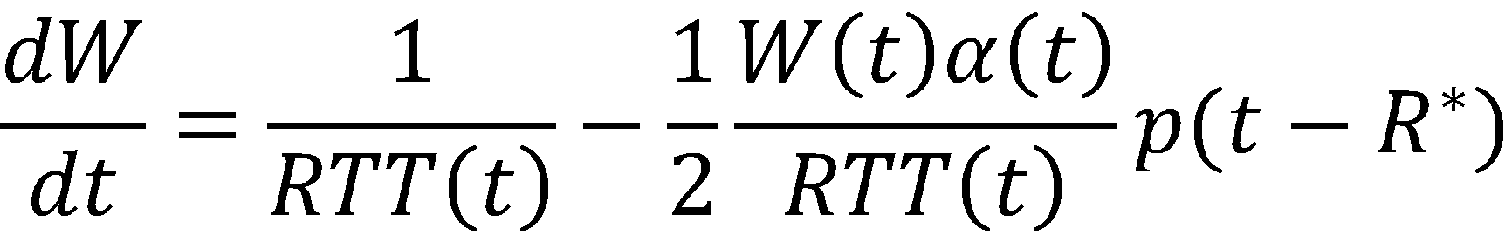
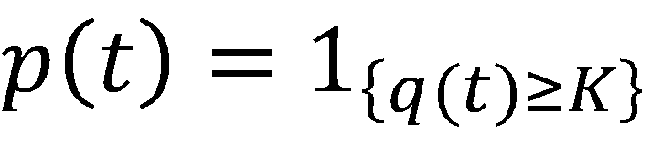
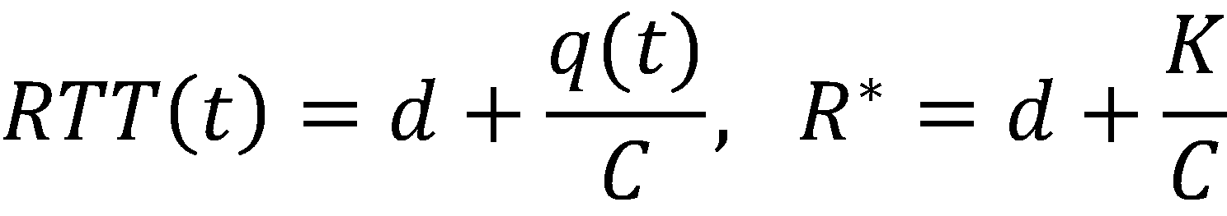
DCTCP Fluid Model
p(t – R*)
p(t)
Delay
α(t)
LPF
N/RTT(t)
C
W(t)
−
AIMD
×
+
q(t)
1
0
K
Source
Switch

Slide 25
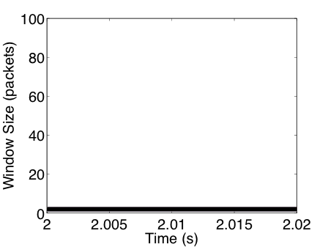
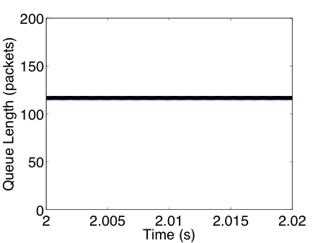
Fluid Model vs ns2 simulations
N = 2
N = 10
N = 100
Parameters: N = {2, 10, 100}, C = 10Gbps, d = 100μs, K = 65 pkts, g = 1/16.

Slide 26
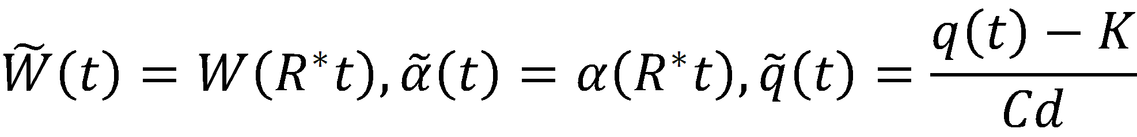
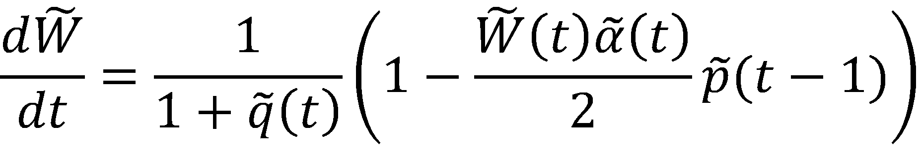
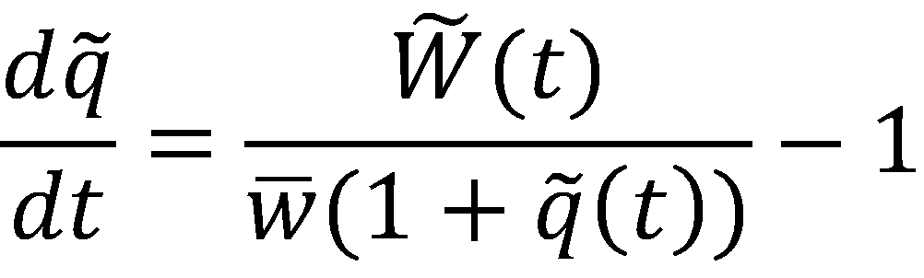
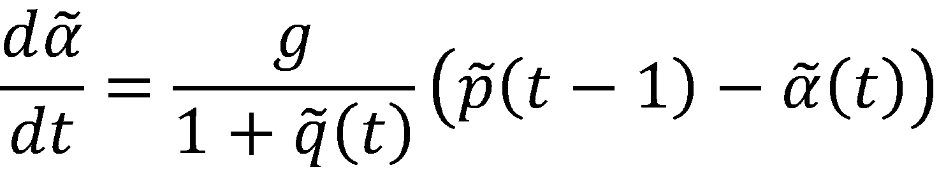
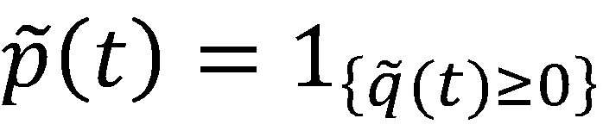
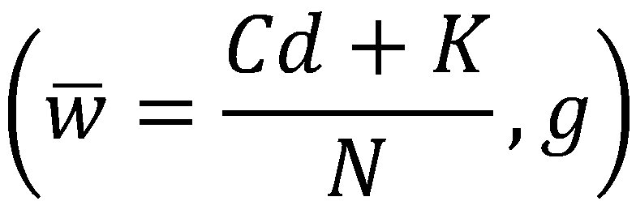
Normalization of Fluid Model
We make the following change of variables:
The normalized system:
The normalized system depends on only two parameters:

Slide 27
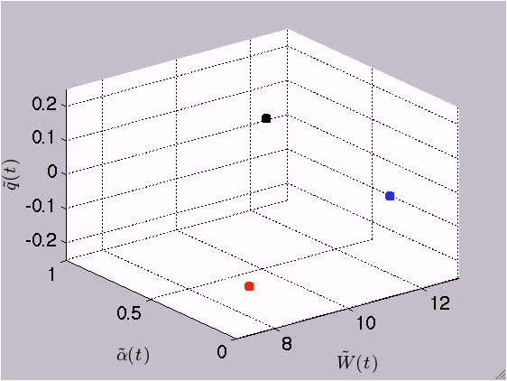
Equilibrium Behavior:
Limit Cycles
System has a periodic limit cycle solution.
Example:

Slide 28
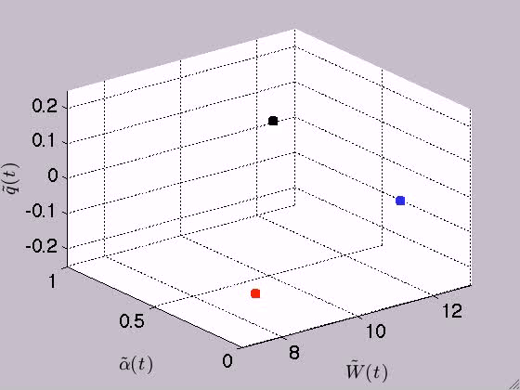
Equilibrium Behavior:
Limit Cycles
System has a periodic limit cycle solution.
Example:

Slide 29
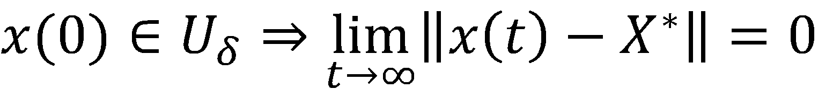
Stability of Limit Cycles
Let X* = set of points on the limit cycle. Define:
A limit cycle is locally asymptotically stable if δ > 0 exists s.t.:

Slide 30
Poincaré Map
x₁
x₂
x₂ = P(x₁)
x*_{α} = P(x*_{α})
Stability of Poincaré Map ↔ Stability of limit cycle

Slide 31
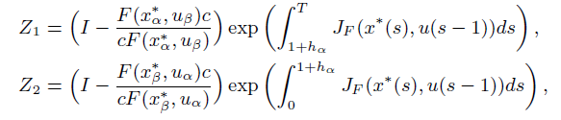
Stability Criterion
Theorem: The limit cycle of the DCTCP system:
is locally asymptotically stable if and only if ρ(Z₁Z₂) < 1.
J_{F} is the Jacobian matrix with respect to x.
T = (1 + h_{α})+(1 + h_{β}) is the period of the limit cycle.
Proof: Show that P(x*_{α} + δ) = x*_{α} + Z₁Z₂δ + O(|δ|²).
We have numerically checked this condition for:

Slide 32
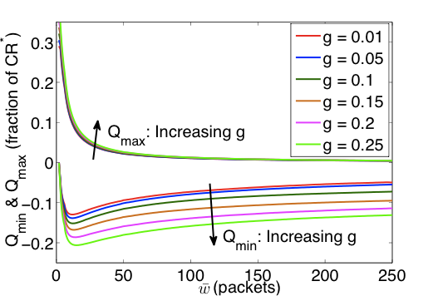



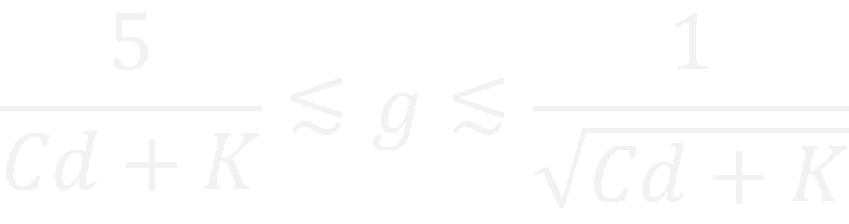
Parameter Guidelines
How big does the marking
threshold K need to be to
avoid queue underflow?
K
B
Notes:
Without getting into details, one can also derive a range for the parameters based on stability and convergence rate considerations.

Slide 33
HULL:
Ultra Low Latency
with Abdul Kabbani, Tom Edsall, Balaji Prabhakar, Amin Vahdat, Masato Yasuda
To appear in NSDI 2012

Slide 34
What do we want?
TCP
Incoming Traffic
C
TCP:
~1–10ms
DCTCP
K
Incoming Traffic
C
DCTCP:
~100μs
~Zero Latency
How do we get this?

Slide 35
Phantom Queue
Key idea:
  Associate congestion with link utilization, not buffer occupancy
  Virtual Queue (Gibbens & Kelly 1999, Kunniyur & Srikant 2001)
Switch
Bump on Wire
Link
Speed C
Marking Thresh.
γC
γ < 1 creates
“bandwidth headroom”

Slide 36
Throughput & Latency vs. PQ Drain Rate
Throughput
Switch latency (mean)

Slide 37
The Need for Pacing
TCP traffic is very bursty
  Made worse by CPU-offload optimizations like Large Send Offload and Interrupt Coalescing
  Causes spikes in queuing, increasing latency
Example. 1Gbps flow on 10G NIC
65KB bursts every 0.5ms

Slide 38
Throughput & Latency
vs. PQ Drain Rate
(with Pacing)
Throughput
Switch latency (mean)

Slide 39
The HULL Architecture
Phantom Queue
Hardware
Pacer
DCTCP Congestion Control

Slide 40
More Details…
Large Flows
Small Flows
Link (with speed C)
Host
Large
Burst
NIC
Switch
Pacer
DCTCP CC
Application
PQ
LSO
Empty Queue
γ x C
ECN Thresh.
Hardware pacing is after segmentation in NIC.
Mice flows skip the pacer; are not delayed.

Slide 41
Dynamic Flow Experiment
20% load
9 senders → 1 receiver (80% 1KB flows, 20% 10MB flows).
Load: 20% | Switch Latency (μs) |  | 10MB FCT (ms)
 | Avg | 99th | Avg | 99th
TCP | 111.5 | 1,224.8 | 110.2 | 349.6
DCTCP-30K | 38.4 | 295.2 | 106.8 | 301.7
DCTCP-PQ950-Pacer | 2.8 | 18.6 | 125.4 | 359.9
~93% decrease
~17% increase

Slide 42
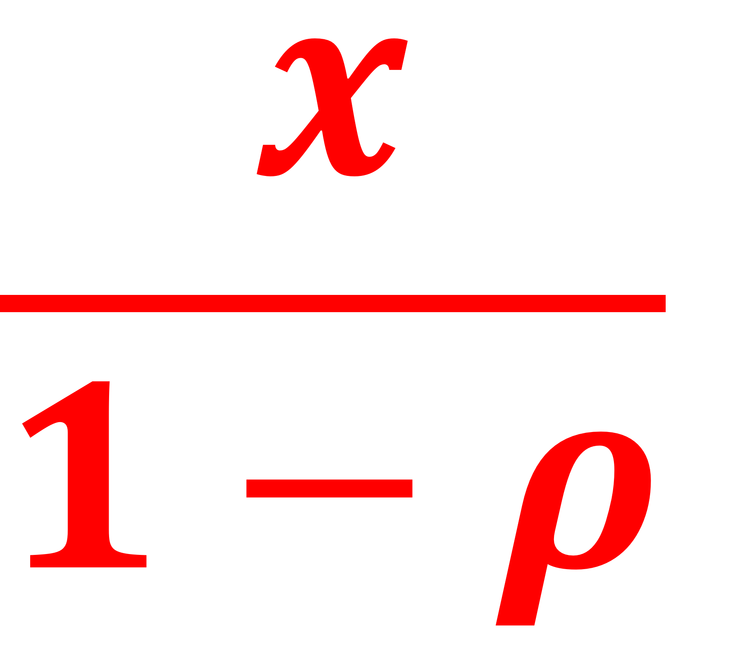
Slowdown due to bandwidth headroom
Processor sharing model for elephants
  On a link of capacity 1, a flow of size x takes
  on average to complete (ρ is the total load).
Example: (ρ = 40%)
Slowdown = 50%
Not 20%
1
0.8

Slide 43
Slowdown: Theory vs Experiment
DCTCP-PQ800
DCTCP-PQ900
DCTCP-PQ950

Slide 44
Summary
QCN
  IEEE802.1Qau standard for congestion control in Ethernet
DCTCP
  Will ship with Windows 8 Server
HULL
  Combines DCTCP, Phantom queues, and hardware pacing to achieve ultra-low latency

Slide 45
Thank you!

