Slide 1
U & I:
Users & Information Lab
Sept 2008  Alice Oh  alice.oh@cs.kaist.edu
Notes:
Now I’m going to talk about my thesis work in generating multiple perspectives in baseball summaries.

Slide 2
Introduction
Alice Haeyun Oh, 오혜연
1996 – S.B. MIT
2000 – S.M. CMU
2008 – Ph.D. MIT
Work experience at Oracle & HP Labs

Slide 3
U & I Lab
Intersection of Users and Information
Discover & Model Multiple Dimensions of Information to Re-define Relevance & Usefulness of Information for a User (Group of Users)
Information
  web content
Users
  you & me & everyone else

Slide 4
Goal
Find web content for a user
  clip
  blog
  reply
  email
  save
  I like this!

Slide 5
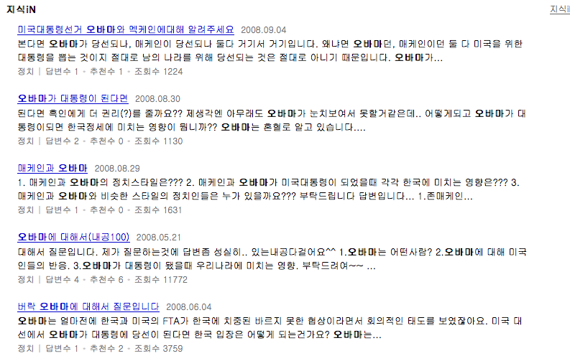
Current Search Technology

Slide 6
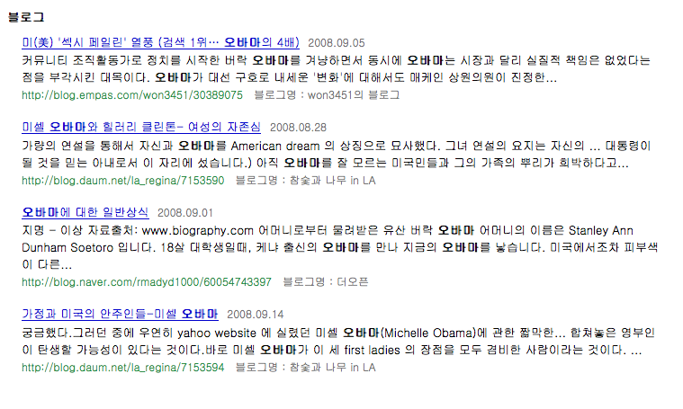
Current Search Technology

Slide 7
Info: The more the better?
다다익선?
과유불급
Information Overload

Slide 8
Current Trends in NL
From “hard” definition of information (e.g. Google)
To “soft” definition of information
  opinion
  attitude
  emotion
  perspective

Slide 9
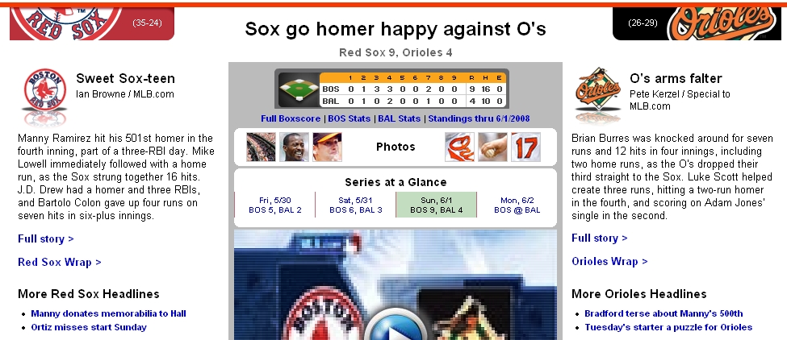
Baseball Domain
Notes:
Another motivation for this work can be seen on mlb.com where, for every Major League Baseball game, the website offers two articles, written from each team’s perspective, such that the user can just click on the one that suits her preference. So whether it’s to give the users a more complete view or a choice, there is enough justification to consider this problem of perspective an important one for the AI and NLP communities to start paying more attention.

Slide 10
Research Projects
Other “Soft” Metrics
  Opinion (positive/negative)
Other Modalities
  Video/Audio
  Blogs
Other domains
  Financial
  Political
  Fun

Slide 11
Ex. Master’s Project
Detect the perspective (democrat/republican) of an article on Obama
Look at hundreds of articles on Internet on Obama
Build a probabilistic model of Obama
Learn features of a “democrat” article
Learn features of a “republican” article
Read a random article, decide whether it is D/R

Slide 12
Ex. Master’s Project
Turn a republican-perspective document into a democrat-perspective document
Learn rules from corpus
Change lexicon
Change sentence structure
Change photos

Slide 13
Ph.D. Topics
Other “soft” dimensions of information & users
  Attitude: Positive vs. Negative
  Type: Information vs. Entertainment
Multimedia
  Video analysis
  Multimedia generation
Interesting Domains
  Financial
  E-Commerce

Slide 14
Interested in?
Information & Search
People
Human-Computer Interaction
Natural Language Processing
Cognitive Science & Psychology
Corpus-Based Statistical Learning

Slide 15
Skills & Knowledge
Java, Python, Perl
English (written & spoken)
User experiment
Linguistics (computational)
Machine learning algorithms

Slide 16
Philosophy
Always be open to new ideas
You can learn from anyone
Reinvent yourself every day
Communication is important

