Slide 1
Grounding Linguistic Analysis in Control Applications
S.R.K. Branavan
February 8, 2012

Slide 2

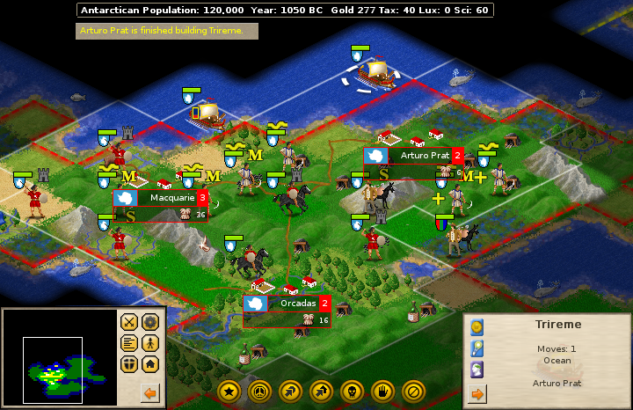
Language and Control Applications
Windows help document
Microsoft Windows
Right click "My Computer" on the desktop, and click the Manage menu option.
Click Services after expanding "Services and applications"
Game user guide
Strategy game
...
Cities built on or near water sources can irrigate to increase their crop yields.
...
Notes:
Let me start with some examples of the kind of language analysis and control applications we are interested in.
Here we have text from two documents, along with the corresponding control application.
The first text is an extract from a help document, that tells us how to configure a particular service in Windows, and the control application in this case it the Windows operating system itself. Here, our text analysis goal would be to translate the help instructions from the text into the corresponding GUI actions in Windows.
The second example is the complex strategy game called Civilization II, along with text from the user manual of that game.
This text gives us advice about what game actions might be good in which game scenarios. So our goal is to automatically extract this advice from the text, and use it to bias game action selection to win the game.

Slide 3
Our Goal
Leverage language-control connection to:
Learn language analysis from control feedback
Improve control performance using textual information
Text interpretation can enable novel automation
Notes:
Overall, our goal in connecting language and control applications is twofold:
First we want to learn language analysis without relying on manual supervision – that is, we want to learn by leveraging feedback signals inherent to the control application.
Second we want to improve control performance using information automatically extracted from the text.
If we can do this, we would be able to automate a range of applications that currently require human involvement.
One of the things we need to address to achieve this goal, is the question of semantics.

Slide 4
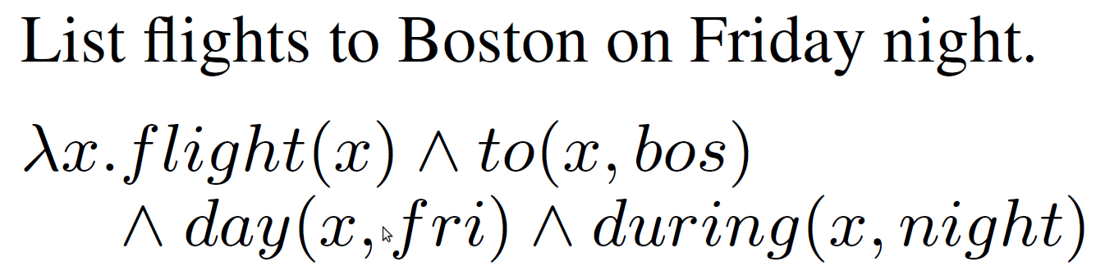
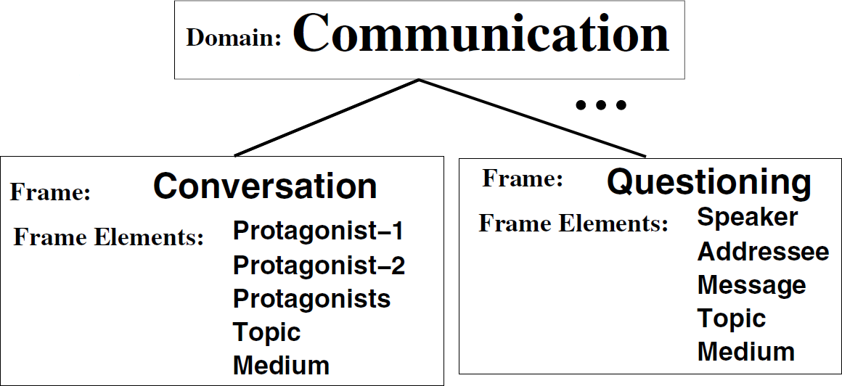
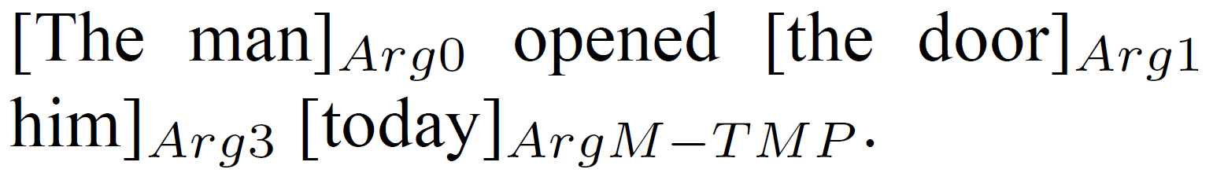
Semantic Interpretation: Traditional Approach
Map text into an abstract representation
(Typical papers on semantics)
Notes:
The traditional approach to semantic interpretation has been to map text into some abstract representation - for example first-order logic, or semantic frames. And a multitude of such representations exist today. While these representations are based on linguistic or human notions of semantics, there is little consensus about their general applicability.

Slide 5
Semantic Interpretation: Our Approach
Map text to control actions
Text
Control actions
Build your city on grassland with a river running through it if possible.
MOVE_TO (7,3)
BUILD_CITY ()
...
Enables language learning from control feedback
Notes:
We are going to take somewhat different view of semantic interpretation and allow the control application to dictate our representation of semantics. In fact, we’re going to map text into control actions, and treat the control actions as our semantic representation.
This tight coupling of text interpretation with the control application gives us a significant advantage in terms of learning – that is, we can use the performance of the control application as the supervision signal for learning language, thus reducing or removing the need for manual supervision.
Let’s look at an example to see how this works

Slide 6
Learning from Control Feedback
Control actions
Higher
game
score
✓
MOVE_TO (7,3)
BUILD_CITY ()
Text
Build your city on grassland with a river running through it if possible.
(7, 3) is grassland
with a river
Control actions
Lower
game
score
✗
MOVE_TO (5,1)
BUILD_CITY ()
(5, 1) is a desert
Learn Language via Reinforcement Learning
Notes:
This text fragment is from a user guide for the strategy game Civ 2.
It’s tell us that we should build cities on grassland close to rivers if possible.
Lets consider two different mappings of this text into control actions.
The first mapping, which is the correct one, moves the player to a location with grassland and rivers, and builds a city; while the second interpretation is incorrect, and builds a city in a desert.
Since we assume the text gives us useful advice, the correct interpretation must result in higher game scores; and in this example, we can use the game score as a supervision signal for learning language interpretation.

Slide 7
Challenges
Situational Relevance
Relevance of textual information depends on control state
“Cities built on or near water sources can irrigate to increase their crop yields, and cities near mineral resources can mine for raw materials.”
Abstraction
Text can describe abstract concepts in the control application
“Build your city on grassland.”
“Water is required for irrigation.”
Incompleteness
Text does not provide complete information about the control application
“Build your city on grassland with a river running through it if possible.”
(what if there are no rivers nearby?)
Notes:
Beyond this question of semantics, there are several other challenges to the effective grounding of text in control. And here are three of the primary challenges that we are going to address in this work.
The first challenge is situational relevance. Basically, the usefulness of text is often going to depend on the world or control application. For example, this text here talks about irrigating land, and mining for raw materials. So if our goal is to increase raw materials, the first part of this text is not really useful. So we need to be able to identify the text that is useful in the current control context.
The second challenge is abstraction – instead of describing concrete objects and actions, text will often talk about abstract concepts in the world. For example, the second sentence is talking about an abstract, precondition relationship between water and irrigation. Thus, we need to be able to ground text against such abstract concepts.
The third challenge is incompleteness – being written for human readers, text will often assume a certain amount of background knowledge, and not provide all the information required for effective control. So here, this example advises that cities should be built near a river, but doesn’t say anything about cities built near the sea. So our algorithms need to leverage information from text when it is available, but also operate effectively when it is not.

Slide 8

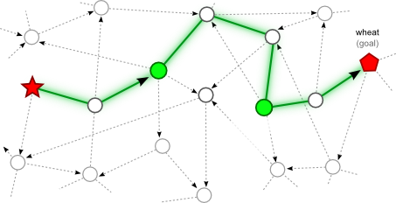
Contributions
Learn language analysis from control feedback
Improve control performance using text information
Instruction
Interpretation
Complex
Game-play
High-level
Planning

Slide 9
General Setup
Input:
Text documents
Interactive access to control application
Prior knowledge:
Text provides information useful for the control application
Goal:
Learn to interpret the text and learn effective control
Notes:
In all three of these cases, we’re going to operate in the following general setup. We will be given a collection of text documents, along with interactive access to the corresponding control application.
We will assume little or no prior knowledge about either the language or the control application, except that the text contains information useful for the control application.
And our goal is to learn to interpret the text, and at the same time learn effective control behaviour using the text.

Slide 10
Outline
Step-by-step imperative instructions
- Learning from control feedback
High-level strategy descriptions
- Situational relevance
- Incompleteness
- Learning from control feedback
General descriptions of world dynamics
- Abstractions
- Situational relevance
- Incompleteness
- Learning from control feedback
Notes:
Now lets look at each of the three scenarios. The first scenario is going to be the simplest of the three, with the text providing step-by-step descriptions of the control actions we need to take. Here our primary challenge is to learn only from control feedback. In the second scenario, the text contains high-level strategy descriptions – so it tells us what actions might be useful in which control states. In contrast to the first case, we are not given step-by-step instructions, and we also need to address the challenges of situational relevance and incompleteness. The final scenario is where the text contains general descriptions of the dynamics of the world – so unlike the first two cases, we’re not given any information about actions at all. And here we need to address all of the challenges I’ve talked about so far. Note that I’ve only listed the primary challenges here - we’ll see the specific challenges for each case separately.

Slide 11
Outline
Step-by-step imperative instructions
- Learning from control feedback
High-level strategy descriptions
- Situational relevance
- Incompleteness
- Learning from control feedback
General descriptions of world dynamics
- Abstractions
- Situational relevance
- Incompleteness
- Learning from control feedback
Notes:
Now lets look at each of the three scenarios. The first scenario is going to be the simplest of the three, with the text providing step-by-step descriptions of the control actions we need to take. Here our primary challenge is to learn only from control feedback.

Slide 12
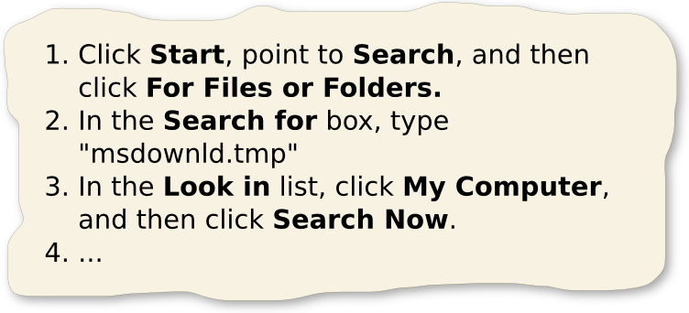

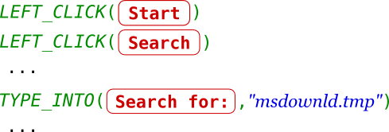
Interpreting Instructions to Actions
Instructions:
step-by-step
descriptions of commands
Input
Target environment:
where commands
need to be executed
Command sequence
executable in the
environment
Output
Notes:
As I just mentioned, the input text in this scenario provides step-by-step instructions. These instructions describe the commands we need to execute in the Windows user interface, which is our target environment.
And our goal is to translate the text instructions into the correct sequence of output user interface commands.

Slide 13
Instruction Interpretation: Challenges
Segment text to chunks that describe individual commands
Learn translation of words to environment commands
Reorder environment commands
Notes:
13
To correctly interpret these text instructions, we need to address three specific challenges.
Each sentence in the text can describe multiple commands in the environment. So our first challenge is to segment the text into chunks that describe individual commands.
The second challenge is to translate each text segment into the corresponding environment command.
As can be seen from the example here, the order in which commands are described in the text can be different from their correct execution order. So the final challenge is to correctly reorder the translated commands.

Slide 14
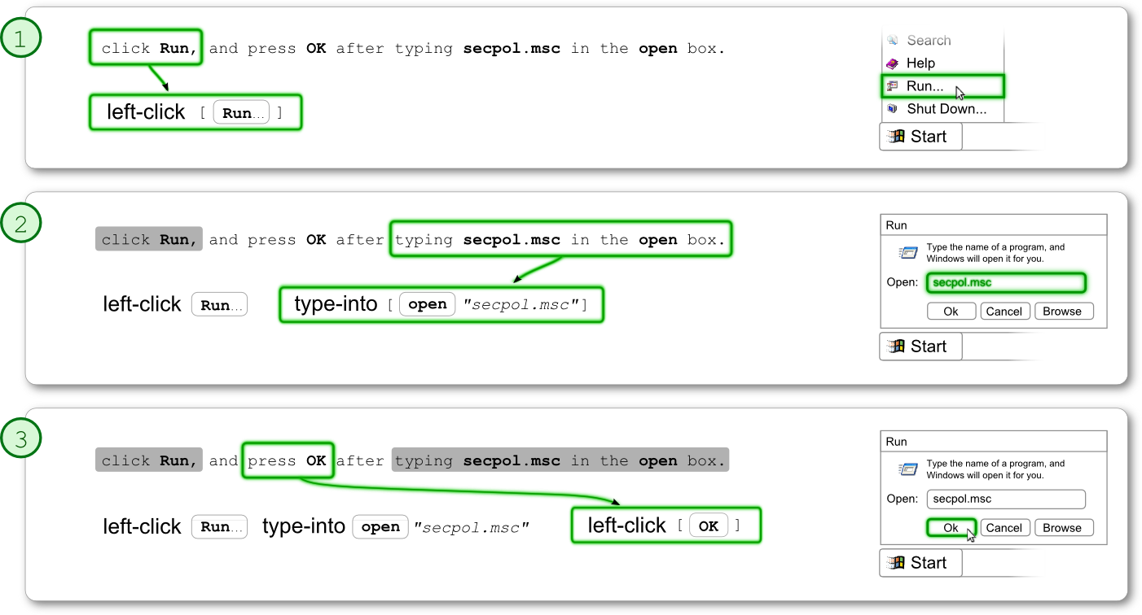
Instruction Interpretation: Representation
Markov Decision Process - select text segment, translate & execute:
Notes:
We address these challenges by formalizing text interpretation as a Markov decision process, where at each step we select the next segment of text to translate, translate the segment into a command, and execute it in the environment. We repeat this selection, translation & execution process until the entire text has been mapped to commands.

Slide 15
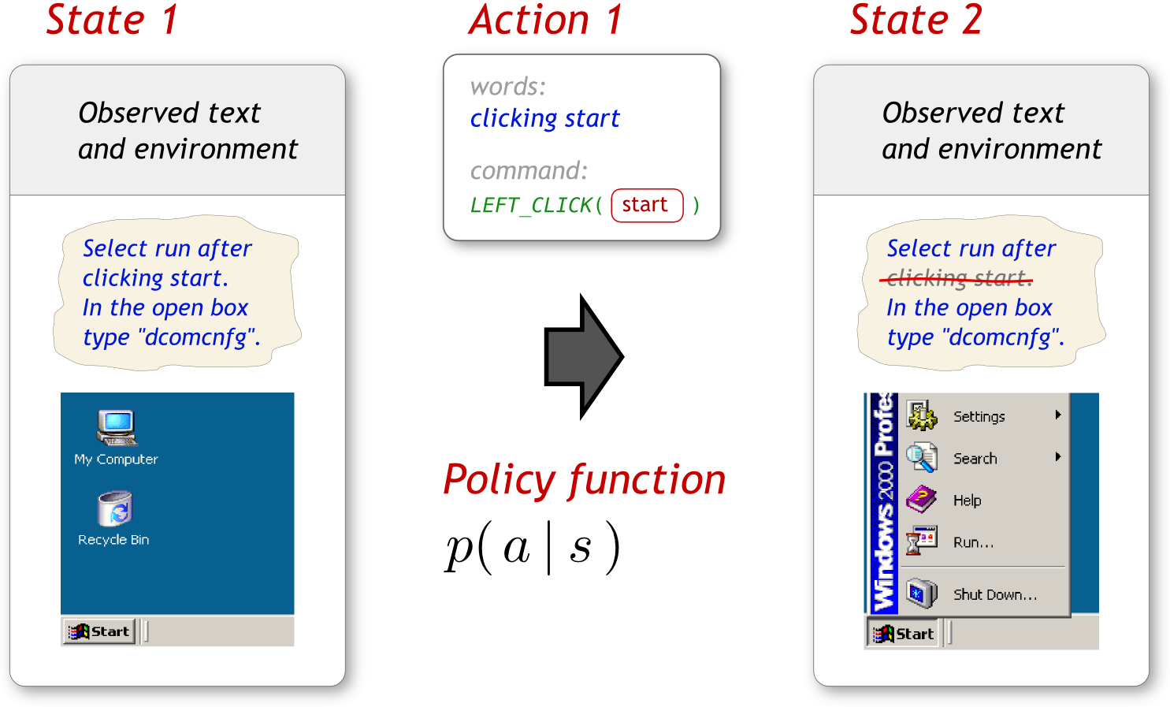
Instruction Interpretation: Representation
State s = Observed Text + Observed Environment
Action a = Word Selection + Environment Command
15
Notes:
15
Specifically, we define the state s of the MDP as the observed text and the state of the target environment. We define the MDP action as the selection of a word span, and its translation into an environment command. Action selection is done according to a policy function. The selected action is applied to the MDP state by executing the command in the environment, which changes the user interface state, and by crossing out the selected words from the text. In this formulation, our text interpretation goal is equivalent to the goal of learning an optimal policy function.

Slide 16
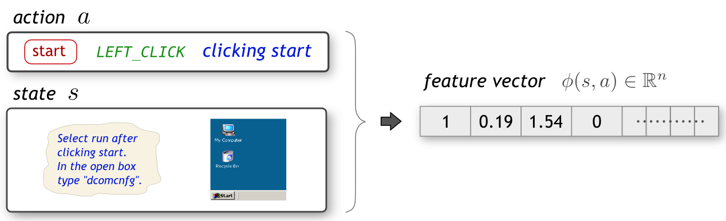


Model Parameterization
Represent each action with a feature vector:
- real valued feature function on state and action
Define policy function as a log-linear distribution:
- parameters of model
16
Notes:
16
To learn this policy function, we first represent it as a log-linear distribution, where the MDP action and state are encoded as a real-valued feature vector. Here, theta are the parameters of the log-linear model which we need to learn. As I mentioned at the beginning, we want to learn text interpretation using a feedback or reward signal from the control application. So from where do we get this reward signal?

Slide 17
Reward Signal
Ideal:
Test for task completion
Alternative Indication of Error:
Text specifies objects not visible on the screen
Approximation:
If a sentence matches no GUI labels, a preceding action is wrong
17
Notes:
17
The ideal reward signal in this scenario, would be to test if the task described in the text was completed successfully. But this is a challenging problem on its own right. So we are going to use an alternative – we are going to emulate the way in which a typical lay human would identify that
they had made a mistake while following an instruction document -- that is, by testing whether the remaining instruction text matches any text labels in the environment. We compute a real-valued reward based on this intuition. While this reward can be very noisy, it is still a powerful source of supervision.

Slide 18
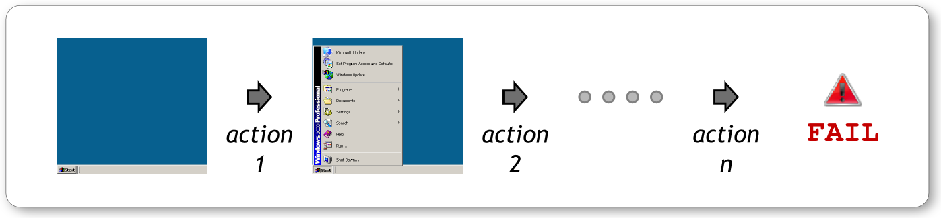
Learning Using Reward Signal: Challenges
1. Reward can be delayed
⇒ How can reward be propagated to individual actions
Reward
2. Number of candidate action sequences is very large
⇒ How can this space be effectively searched?
Use Reinforcement Learning
18
Notes:
18
Of course, learning from a reward signal has its own challenges – in particular, we receive reward at the end of executing a sequence of actions, so we need a way of propagating the reward to the individual actions. Secondly, since the space of possible action sequences is exponential, we need an effective way to handle the search space. We address these challenges by formulating our task in the reinforcement learning framework, which is a principled method for learning from such reward signals.

Slide 19
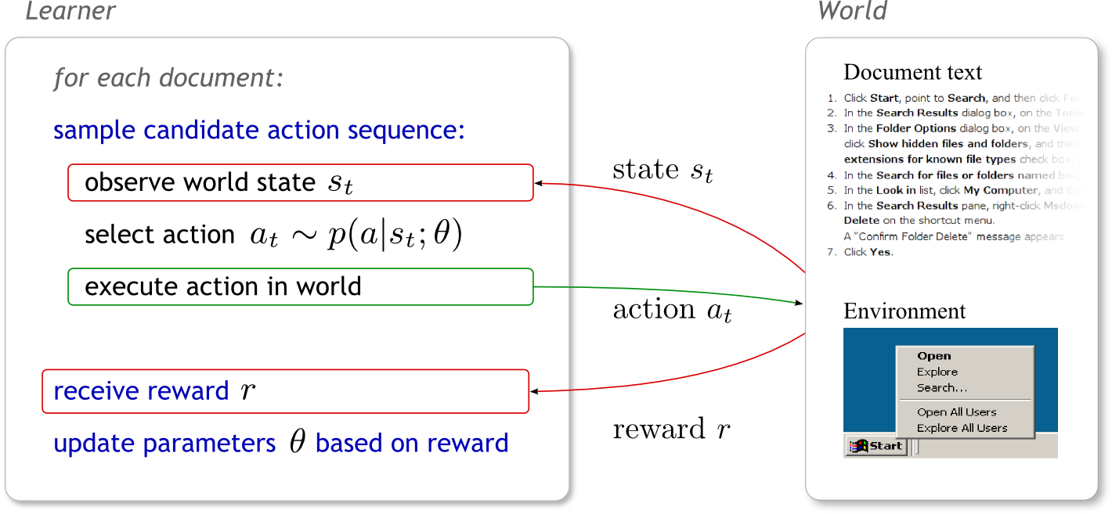
Learning Algorithm
Goal: Find θ that maximizes the expected reward
Method: Policy gradient algorithm (stochastic gradient ascent on θ)‏
19
Notes:
19
Specifically, we apply the standard policy gradient algorithm for reinforcement learning to estimate model parameters. This algorithm performs stochastic gradient ascent to find the model parameters that maximize expected reward. The algorithm itself is straightforward, and operates as follows. For each document, it samples an action sequence by repeatedly observing the current state, selecting an action according to the policy function, and executing the action in the environment. After the actions have been executed, it computes the reward signal, and uses it to update model parameters.

Slide 20
Example Features
Features on words and environment command
Edit distance between word and object label
Binary feature on each (word, command) pair
Binary feature on each (word, object type) pair
Features on environment objects
Object is visible
Object is in foreground
Object was previously interacted with
Object became visible after last action
Features on words
Word type
Distance from last used word
Total number of features: 4438
20
Notes:
20
For completeness, here are some features from our model. To allow the model to ground text in the environment, there are features that combine the text with attributes of the environment state. So far, I’ve told you about the interpretation task, our model, and how its learnt. Now lets see how well it performs

Slide 21
Windows Configuration Application
Windows 2000 help documents
from support.microsoft.com
Total # of documents | 128
Train / development / test | 70 / 18 / 40
Total # of words | 5562
Vocabulary size | 610
Avg. words per sentence | 9.93
Avg. sentences per document | 4.38
Avg. actions per document | 10.37
21
Notes:
21
We test our method on a set of help documents collected from Microsoft’s support website, some statistics of which you can see here.
For these documents, we use Windows 2000 as our target environment.

Slide 22
Results: Command Accuracy
Majority heuristic
Control feedback
Manual supervision
% commands correctly mapped
Notes:
22
And here are the results – here we’re evaluating the percentage of commands that are predicted correctly from the instructions.
Starting at the top, we have two heuristics, both of these scan the text left to right, and find the first user interface widget with a label matching the text. Then the first heuristic randomly either left clicks, right clicks, double clicks, or types on the widget. The second heuristic always left clicks on the widget. Then we have the two surprising results – our method which learns only from control feedback, gets 79% of the commands right, performing just as well as a fully supervised equivalent. So while environment reward is noisy, it is still a very powerful source of supervision.

Slide 23
Results: Document Accuracy
Random action
Majority action
Environment Reward
Full Supervision
% documents correctly mapped
Notes:
23

Slide 24
Outline
Step-by-step imperative instructions
- Learning from control feedback
High-level strategy descriptions
- Situational relevance
- Incompleteness
- Learning from control feedback
General descriptions of world dynamics
- Abstractions
- Situational relevance
- Incompleteness
- Learning from control feedback
Notes:
Ok, so that was the first scenario, where we looked at how it is possible to learn from control feedback. Now lets look at the second scenario where the text contains high-level strategy descriptions.

Slide 25

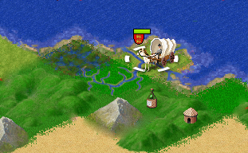



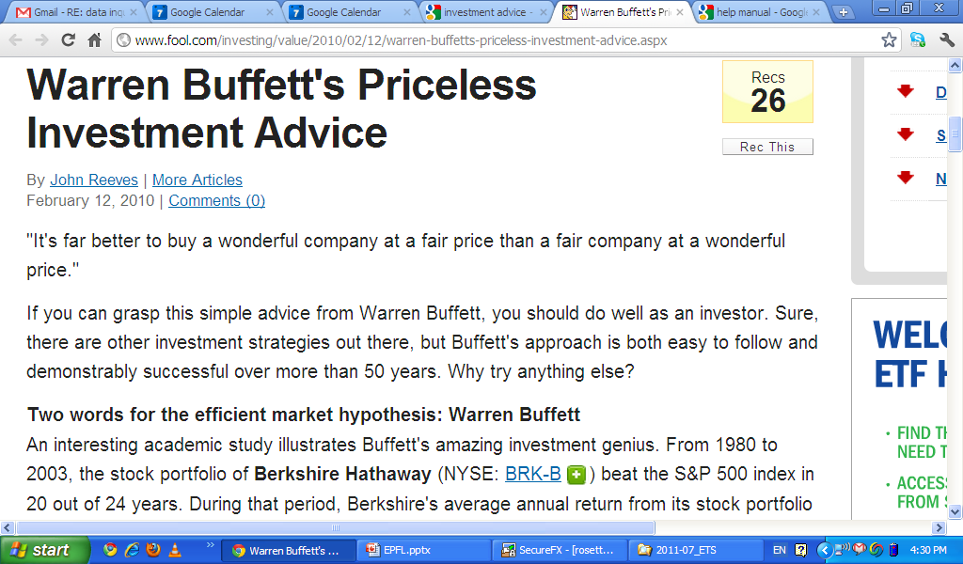

Solving Hard Decision Tasks
Civilization II Player’s Guide
You start with two settler units. Although settlers are capable of performing a variety of useful tasks, your first task is to move the settlers to a site that is suitable for the construction of your first city. Use settlers to build the city on grassland with a river running through it
Notes:
Now this scenario is very common in the world – where you can find text giving you strategic advice about more or less any topic – from industrial tasks, to investment management to game play.

Slide 26
Solving Hard Decision Tasks
Objective: Maximize a utility function
Challenge: Finding optimal solution hard
Large decision space
Expensive simulations
Traditional solution: Manually encoded domain-knowledge
Our goal: Automatically extract required domain knowledge from text
Notes:
In all these cases, the objective is to maximize some given utility function – for example, in investment management you would try to maximize investment value, and in games you want to maximize your game score.
Of course, in any complex system, finding the optimal solution for this maximization is extremely hard – because of the large decision space, and the cost of trying out different solutions. Which is of course why people find the text advice is so useful.
In the computational setting, the traditional approach to this challenge has been to manually encode human domain knowledge into an algorithm.
What we want to do, is to enable our algorithms to automatically extract and use the domain knowledge directly from text.

Slide 27
Adversarial Planning Problem
Civilization II : Complex multiplayer strategy game
(branching factor ≈ 10²⁰)
Traditional Approach: Monte-Carlo Search Framework
Learn action selection policy from simulations
Very successful in complex games like Go and Poker
Notes:
And we’re going to do this in the context of a complex strategy game called Civilization 2. And to give you an idea of it’s complexity, in our experiments, the empirical branching factor for the game is 10^20. The traditional approach to playing such complex games is Monte-Carlo search – this is a simulation based decision framework, that has been very successfully applied to games like Go and Poker. We are going to incorporate language analysis into this framework. Before looking at how that can be done, we need to understand the challenges involved in interpreting strategy guides.

Slide 28
Leveraging Textual Advice: Challenges
1. Find sentences relevant to given game state.
Game state
Strategy document
You start with two settler units. Although settlers are capable of performing a variety of useful tasks, your first task is to move the settlers to a site that is suitable for the construction of your first city. Use settlers to build the city on grassland with a river running through it if possible. You can also use settlers to irrigate land near your city. In order to survive and grow …
city
settler
Notes:
The first challenge is due to the general characteristics of strategy guides. These documents don't actually provide step-by-step instructions. Rather, they give advice on what actions might be useful in various scenarios. For example, here we can see part of a game state, and some text from the game’s strategy guide. The game state shows one game unit called a settler, standing on land near a city. Now if we want advice on what to do with this particular unit, we'll have to read through the whole manual and find sentences that talk about settlers near cities -

Slide 29
Leveraging Textual Advice: Challenges
1. Find sentences relevant to given game state.
Game state
Strategy document
You start with two settler units. Although settlers are capable of performing a variety of useful tasks, your first task is to move the settlers to a site that is suitable for the construction of your first city. Use settlers to build the city on grassland with a river running through it if possible. You can also use settlers to irrigate land near your city. In order to survive and grow …
city
settler
Notes:
for example, this highlighted sentence here. It says "use settlers to irrigate land near your city".

Slide 30
Leveraging Textual Advice: Challenges
1. Find sentences relevant to given game state.
Game state
Strategy document
You start with two settler units. Although settlers are capable of performing a variety of useful tasks, your first task is to move the settlers to a site that is suitable for the construction of your first city. Use settlers to build the city on grassland with a river running through it if possible. You can also use settlers to irrigate land near your city. In order to survive and grow …
city
settler
settler
Notes:
Now, if the settler is not standing near a city, a different sentence might be more relevant. So our first challenge is to identify sentences that give advice relevant to the current game state.

Slide 31
Leveraging Textual Advice: Challenges
2. Label sentences with predicate structure.
Move the settler to a site suitable for building a city, onto grassland with a river if possible.
move_settlers_to ()
?
settlers_build_city ()
?
Move the settler to a site suitable for building a city, onto grassland with a river if possible.
move_settlers_to ()
Label words as action, state or background
Notes:
The second challenge is to identify the predicate structure of sentences. What do I mean by this? Lets look at this text here - "Move the settler to a site suitable for building a city..." it says. Now if we ignore the structure of the sentence, and only look at the words "settler", "move", "build", "city", it might not be clear what the sentence tells us - should we move the settler? or should we build a city with the settler?.
On the other hand, if like in the second text, we look at the syntactic structure of the sentence, and identify the words that describe the action, then mapping the advice into a game action would be easier. So our second challenge is to label sentence words as describing either the action, the state in which to take that action or as background words.

Slide 32
Leveraging Textual Advice: Challenges
2. Label sentences with predicate structure.
Move the settler to a site suitable for building a city, onto grassland with a river if possible.
move_settlers_to ()
?
settlers_build_city ()
?
Move the settler to a site suitable for building a city, onto grassland with a river if possible.
move_settlers_to ()
Label words as action, state or background
Notes:
The second challenge is to identify the predicate structure of sentences. What do I mean by this? Lets look at this text here - "Move the settler to a site suitable for building a city..." it says. Now if we ignore the structure of the sentence, and only look at the words "settler", "move", "build", "city", it might not be clear what the sentence tells us - should we move the settler? or should we build a city with the settler?.
On the other hand, if like in the second text, we look at the syntactic structure of the sentence, and identify the words that describe the action, then mapping the advice into a game action would be easier. So our second challenge is to label sentence words as describing either the action, the state in which to take that action or as background words.

Slide 33
Leveraging Textual Advice: Challenges
2. Label sentences with predicate structure.
Move the settler to a site suitable for building a city, onto grassland with a river if possible.
move_settlers_to ()
?
settlers_build_city ()
?
Move the settler to a site suitable for building a city, onto grassland with a river if possible.
move_settlers_to ()
Label words as action, state or background
Notes:
The second challenge is to identify the predicate structure of sentences. What do I mean by this? Lets look at this text here - "Move the settler to a site suitable for building a city..." it says. Now if we ignore the structure of the sentence, and only look at the words "settler", "move", "build", "city", it might not be clear what the sentence tells us - should we move the settler? or should we build a city with the settler?.
On the other hand, if like in the second text, we look at the syntactic structure of the sentence, and identify the words that describe the action, then mapping the advice into a game action would be easier. So our second challenge is to label sentence words as describing either the action, the state in which to take that action or as background words.

Slide 34
Leveraging Textual Advice: Challenges
3. Guide action selection using relevant text
Build the city on plains or grassland with a river running through it if possible.
a₁ – move_settlers_to (7,3)
a₂ – settlers_build_city ()
S
a₃ – settlers_irrigate_land ()
Notes:
The third challenge is to guide action selection using the text we identified as relevant to the game state. Remember that our action selection needs to be effective even when the text has no relevant information. So these are the three challenges we need to address. Now we also want to set ourselves the one final challenge of learning all this without any annotations

Slide 35
Learning from Game Feedback
Goal: Learn from game feedback as only source of supervision.
Key idea: Better parameter settings will lead to more victories.
Game manual
a₁
Model
params:
θ₁
You start with two settler units. Although settlers are capable of performing a variety of useful tasks, your first task is to move the settlers to a site that is suitable for the construction of your first city. Use settlers to build the city on plains or grassland with a river running through it if possible. In order to survive and grow …
End result
a₂
won
S
a₃
Game manual
a₁
Model
params:
θ₂
You start with two settler units. Although settlers are capable of performing a variety of useful tasks, your first task is to move the settlers to a site that is suitable for the construction of your first city. Use settlers to build the city on plains or grassland with a river running through it if possible. In order to survive and grow …
a₂
End result
S
a₃
lost
Notes:
We want to learn from only game feedback - so no annotations at all. Here's a one-slide summary to give you some intuition on how we're going to learn. The key idea is that since the text has useful advice on how to win the game, better interpretations will lead to more victories. So say we have two different sets of model parameters - theta one and two. If using theta 1 to identify relevant text, and play the game leads to victory more often than using theta 2, then theta 1 is a better. We will leverage this simple idea to learn the parameters of our model.

Slide 36
Model Overview
Monte-Carlo Search Framework
Learn action selection policy from simulations
Very successful in complex games like Go and Poker.
Our Algorithm
Learn text interpretation from simulation feedback
Bias action selection policy using text
Notes:
So far, we have looked at the task, why it's hard, and how we're going to learn our model. Before we go any further, let me take a short detour, and briefly describe the framework in which our method will operate - the MC search framework.

Slide 37
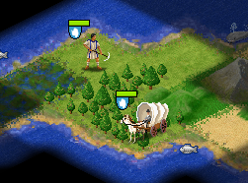
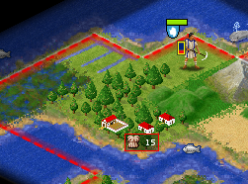
Monte-Carlo Search
Select actions via simulations, game and opponent can be stochastic
Actual Game
Simulation
Copy
game
State 1
State 1
Copy
Irrigate
???
Game lost
Notes:
I said earlier that MC search is a simulation based method. The idea itself is simple. On the left here is a actual game state for which we want to select the best possible action. So take a copy of the game state into another instance of the game. In this "simulated game", we select a random action, and then play till the end of the game. Now in all our experiments, we are going to play against the built-in AI of the game, so playing a simulated game is straightforward. The simulated games are called "rollouts".
At the end of each rollout, we check if we won or lost. Civ II also gives you a "game score", which is a noisy approximation of how well you're doing. So instead of playing till the end, you can also stop after a fixed number of steps, and look at the game score.

Slide 38
Monte-Carlo Search
Try many candidate actions from current state & see how well they perform.
Current game state
State 1
Rollout depth
Game scores
0.1
0.4
1.2
3.5
3.5
3.5
3.5
Notes:
MC search simply runs many rollouts, looks at the game score - or utility - at the end of the rollout, and selects the action that produced the best average utility. This action is then played in the game.

Slide 39

Monte-Carlo Search
Try many candidate actions from current state & see how well they perform.
Learn feature weights from simulation outcomes
Current game state
State 1
5
1
0
1
1
0
1
= 0.1
15
0
1
0
0
1
0
= 0.4
Rollout depth
37
1
0
1
0
0
0
= 1.2
. . . . . . . . .
- feature function
- model parameters
Game scores
0.1
0.4
1.2
3.5
Notes:
Of course, when we have a branching factor as large as 10^20, randomly selecting actions in the rollouts is not going win us any games. Instead, we can learn an action selection policy. In particular, we can learn a linear approximation to predict the expected utility of a rollout starting at state s and action a. Essentially we can learn an approximation of the action-value function Q(s,a). For example, we can represent state s, and action a as a real valued feature vector of their attributes, and learn Q via linear regression. We can use this learnt Q function to select actions.
So that's a short summary of MC search. One important point to note is that there is no separate training and testing - learning happens online during game play itself.

Slide 40
Model Overview
Monte-Carlo Search Framework
Learn action selection policy from simulations
Our Algorithm
Bias action selection policy using text
Learn text interpretation from simulation feedback
Notes:
So that's a brief overview of the MC search framework. Now let's see how we can guide the action-selection policy - that is the Q function approximation - using the text, and how we can learn text interpretation from the game simulation feedback.

Slide 41

Modeling Requirements
Identify sentence relevant to game state
Label sentence with predicate structure
Estimate value of candidate actions
Build cities near rivers or ocean.
Build cities near rivers or ocean.
Build cities near rivers or ocean.
Irrigate :
-10
Build cities near rivers or ocean.
Fortify :
-5
. . . .
Build city :
25
Notes:
There are three things that we want our model to do - first, we want it to be able to identify the text sentence that is most relevant to the current game state. Second, we want to label the words of the sentence with a predicate structure - that is, we want to label words as describing either the action to be taken, the state context of the action, or as background. Finally, we want to compute the expected utility of candidate actions, i.e., the action-value approximation, biased by the selected sentence. Lets first look at how we model each of these things and then see how they fit together in a single model.

Slide 42


Sentence Relevance
1
2
Identify sentence relevant to game state and action
3
State , candidate action , document
Sentence is selected as relevant
- weight vector
Log-linear model:
- feature function
Notes:
The first thing we want to do is to identify the sentence most relevant to the current game state and candidate action. We model this decision - that is the probability of a sentence y_i being relevant given game state s, action a and document d - as a log-linear distribution. u here is the weight vector, and \phi the feature function.

Slide 43

Predicate Structure
1
2
Select word labels based on sentence + dependency info
3
E.g., “Build cities near rivers or ocean.”
Word index , sentence , dependency info
Predicate label = { action, state, background }
- weight vector
Log-linear model:
- feature function
Notes:
The second thing we want to do is to label the words of a sentence with a predicate structure. That is, we want to label each word as either state description, action description, or background. Again, we model this word-by-word labeling decision as a log-linear distribution. This decision is conditioned on the word being labeled, the sentence, and the dependency parse information of the sentence. Again, v is the weight vector, and \psi the feature function.

Slide 44


Final Q function approximation
1
2
Predict expected value of candidate action
3
State , candidate action
Document , relevant sentence , predicate labeling
- weight vector
Linear model:
- feature function
Notes:
Finally, we want to predict the expected utility of each candidate action a. This we're going to model as a linear approximation over the state, action, and all the textual information we have from the other two model components - the document, relevant sentence and predicate labeling. Here w is the weight vector, and f the feature function
Now so far, we've seen the three components of our model, and they look like three separate models that will be trained separately. But remember that we don't have any annotations - we want to learn everything from a single game feedback signal. So we're first going to create a single coherent model from these components..

Slide 45
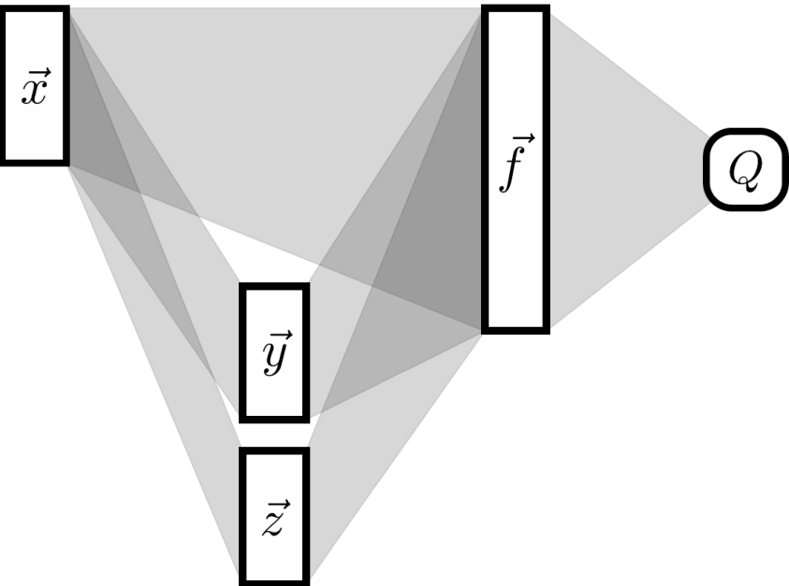

Model Representation
Multi-layer neural network: Each layer represents a different stage of analysis
Q function approximation
Input:
game state, candidate action, document text
Predicted action value
Select most relevant sentence
Predict sentence predicate structure
Notes:
When we simply connect together the exact models that I just described to you, what we get is a single neural network, and we can estimate all model parameters jointly. The first layer of this network simply represents the attributes of the current game state, candidate action, and document sentences. Then nodes in these two layers represent the sentence relevance decision, and the predicate labeling decisions. The third layer is simply a set of fixed feature functions, and the final layer is a linear approximation of the action-value function. Note that if we drop the two linguistic layers here in the middle, we'll have a linear model that doesn't use any text information. In fact, that's going to be one of our baselines.

Slide 46
Parameter Estimation
Objective: Minimize mean square error between
predicted utility
and observed utility
Game rollout
25
State
Action
Predicted utility:
Observed utility:
Method: Gradient descent – i.e., Backpropagation.
Notes:
So that's our model, now how can we learn it's parameters? Remember, we're using our model to predict the expected utility of candidate actions. Now while it's expensive, we can also use the simulation rollouts to observe noisy samples of an action's utility in the game. So we can learn the parameters by minimizing the error between the predicted and the observed utilities. And that's going to be our objective function - we're going to minimize the mean square error. This can be done by gradient descent, in the case of our neural network that becomes the backpropagation algorithm. And this gives us this set of straightforward parameter updates.

Slide 47
Features
State features:
- Amount of gold in treasury
- Government type
- Terrain surrounding current unit
Action features:
- Unit type (settler, worker, archer, etc)
- Unit action type
Text features:
- Word
- Parent word in dependency tree
- Word matches text label of unit

Slide 48


Experimental Domain
Game:
Complex, stochastic turn-based strategy game Civilization II.
Branching factor: 10²⁰
Document:
Official game manual of Civilization II
At the start of the game, your civilization consists of a single band of wandering nomads. This is a settlers unit. Although settlers are capable of performing a variety of useful tasks, your first task is to move the settlers unit to a site that is suitable for the construction of your first city. Finding suitable locations in which to build cities, especially your first city, is one of the most important decisions you make in the
Text Statistics:
Sentences: | 2083
Avg. sentence words: | 16.7
Vocabulary: | 3638
Notes:
Ok, so now we know all about the task, the framework and the model, the only thing left is to see how well the method performs. The control application we're going to test on is the complex, stochastic strategy game Civ II. We use the official game manual as our strategy guide. Here are some stats from the text, and as you can see it's fairly long, and uses a fairly large vocabulary.

Slide 49
Experimental Setup
Game opponent:
Built-in AI of Game.
Domain knowledge rich AI, built to challenge humans.
Primary evaluation:
Games won within first 100 game steps.
Averaged over 200 independent experiments.
Avg. experiment runtime: 1.5 hours
Secondary evaluation:
Full games won.
Averaged over 100 independent experiments.
Avg. experiment runtime: 4 hours
Notes:
We're going to evaluate our method - and baselines - by playing against the built-in AI of the game. This is an AI built using lots of domain knowledge to challenge human players. Since a full game of civ can be pretty long, so our primary evaluation is going to measure how often we win within the first 100 steps of the game. If the game continues beyond 100 steps, it's considered a loss. This win rate is averaged over 200 independent experiments each. To verify the validity of these experiments, we're also going to run some full games - this time, the win rate is averaged over 100 games each.

Slide 50
Results
Built-in AI
0%
Full model
% games won in 100 turns, averaged over 200 runs.
Notes:
So how well do we do? Our method wins 53% of the games. Notice that the built-in AI playing against itself wins no games within 100 steps. So if players are evenly matched we get 0 wins in this evaluation, not 50% wins.

Slide 51
Does Text Help ?
Built-in AI
0%
Linear Q fn. approximation,
No text
Game only
Full model
% games won in 100 turns, averaged over 200 runs.
Notes:
What happens if we don't use any text information? The linear approximation that doesn't use text wins only 17% of games. Now that's a linear approximation, and our method is non-linear. So you should be thinking that perhaps the improvement is simply because of the richer representation.

Slide 52
Text vs. Representational Capacity
Built-in AI
0%
Game only
Non-Linear Q fn. approximation,
No text
Latent variable
Full model
% games won in 100 turns, averaged over 200 runs.
Notes:
Well, not really - a non-linear approximation without text wins 26% of the games.

Slide 53
Linguistic Complexity vs. Performance Gain
Built-in AI
0%
Game only
Latent variable
Sentence relevance
Full model
% games won in 100 turns, averaged over 200 runs.
Notes:
And finally, Sentence relevance alone with no predicate labeling gets us 46% wins. So both sentence relevance and predicate labeling are important to performance, but relevance a bit more than predicate structure.

Slide 54
Results: Sentence Relevance
Problem: Sentence relevance depends on game state.
States are game specific, and not known a priori!
Solution: Add known non-relevant sentences to text.
E.g., sentences from the Wall Street Journal corpus.
Results: 71.8% sentence relevance accuracy…
Surprisingly poor accuracy given game win rate!
Notes:
So far, we've looked at model performance from the game side. Now lets see what sentence relevance is doing. Evaluating sentence relevance is not straightforward, because relevance depends on the actual observed game state, and there's no way to say beforehand which states will be encountered in a particular game. So we're going to add to our text, sentences that we know are irrelevant, and see how well our method ignores them - we're going to add in randomly selected sentences from the wall street journal. Surprisingly, we get only 72% accuracy! - even though separating game strategy from wall street journal shouldn't be all that difficult. In reality, what's happening is rather interesting.

Slide 55
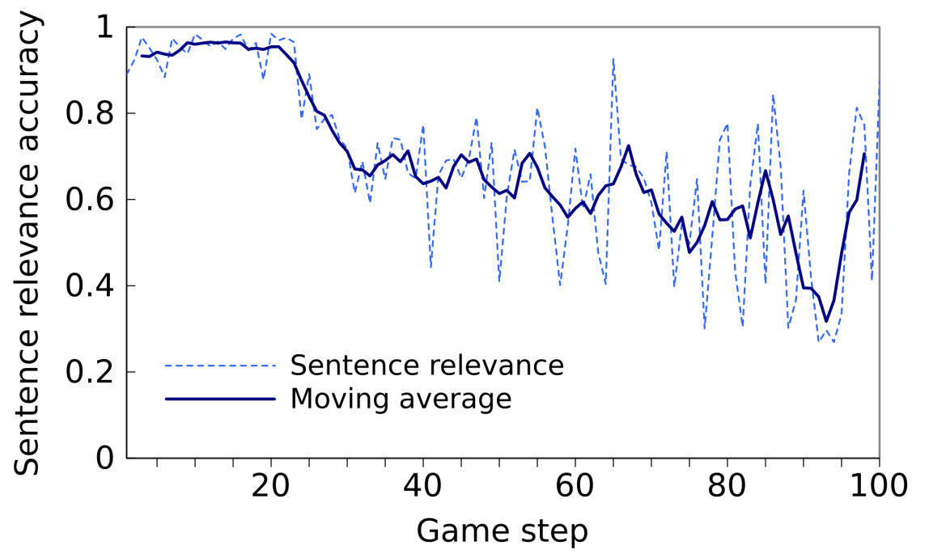
Results: Sentence Relevance
Sentence relevance accuracy
Notes:
During the initial steps of the game, we get high accuracy - in the high 90's, and then it drops off. This is because of two reasons - first, the game manual is written for first time players, and only provides advice about the initial part of the game, and second the beginning is the hardest for MC search, because victory is far away, and game feedback is going to be noisy and high variance. For these reasons, text features are most useful at the beginning.

Slide 56
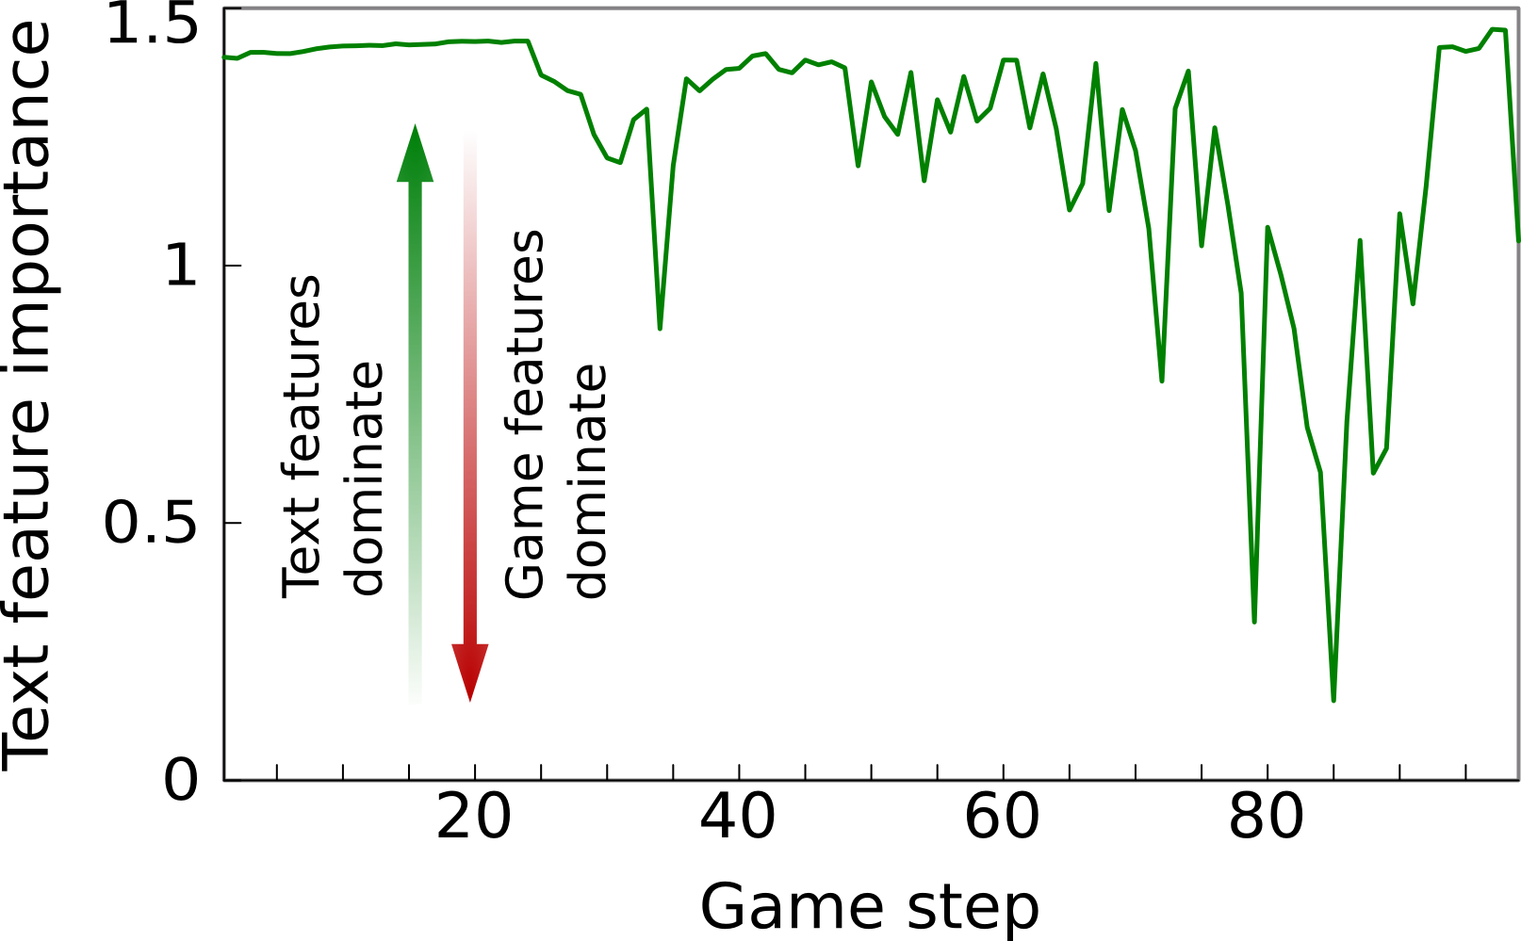
Results: Sentence Relevance
Sentence relevance accuracy
Game features
Text feature importance
Text features
Notes:
During the initial steps of the game, we get high accuracy - in the high 90's, and then it drops off. This is because of two reasons - first, the game manual is written for first time players, and only provides advice about the initial part of the game, and second the beginning is the hardest for MC search, because victory is far away, and game feedback is going to be noisy and high variance. For these reasons, text features are most useful at the beginning. In fact, if we look at how the final layer of the network weights text and game features, we can see that the importance of text features drops off after the beginning of the game. In fact, we can switch off text features after 50 game steps, and see no performance drop in the game.

Slide 57
Results: Full Games
Game only
Latent variable
Full model
Percentage games won, averaged over 100 runs
Notes:
Finally, here's how well the methods perform on complete games - i.e., if we don't stop them after 100 steps. The numbers are clearly better, and so is the relative performance.
So that’s all for interpreting strategy guides.

Slide 58
Outline
Step-by-step imperative instructions
- Learning from control feedback
High-level strategy descriptions
- Situational relevance
- Incompleteness
- Learning from control feedback
General descriptions of world dynamics
- Abstractions
- Situational relevance
- Incompleteness
- Learning from control feedback
Notes:
Now lets briefly look at the final scenario – interpreting descriptions of world dynamics.

Slide 59
Solving Hard Planning Tasks
Objective: Compute plan to achieve given goal
Challenge: Exponential search space
Traditional solution: Analyze domain structure to induce sub-goals
Our goal: Use precondition information from text to guide sub-goal induction
Notes:
We’re going to look at this scenario in the context of hard planning tasks – where our objective is to find a plan to achieve a given goal.
In any complex domain, this is extremely challenging because of the exponential search space for planning. One traditional solution to this problem is to analyze the structure of the domain, and use that information to predict sub-goals or waypoints that lead to the final goal.
What we want to do, is to use information from text, to guide the selection of subgoals.

Slide 60
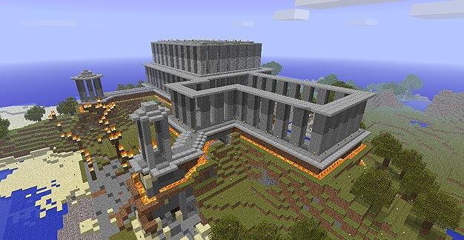
Solving Hard Planning Tasks
Minecraft : Virtual world allowing tool creation and complex construction.
Notes:
And we are going to do this in the complex virtual world called Minecraft. This virtual world allows users to collect various resources, craft tools, and the tools to make complex objects.

Slide 61
Example Precondition Relations
Text
Preconditions
Seeds planted in farmland will grow to become wheat which can be harvested.
seeds
wheat
farmland
wheat
Notes:
Let me first give you an example of the information we want to extract from text. So here we have some text that talks about wheat farming – and it tell us that seeds and farmland are preconditions for growing wheat. And it is these precondition relations we would like to extract from text. The idea is that if our planning goal is to grow wheat, we can use this knowledge of preconditions to predict that seeds and farmland are potential subgoals for growing wheat.

Slide 62
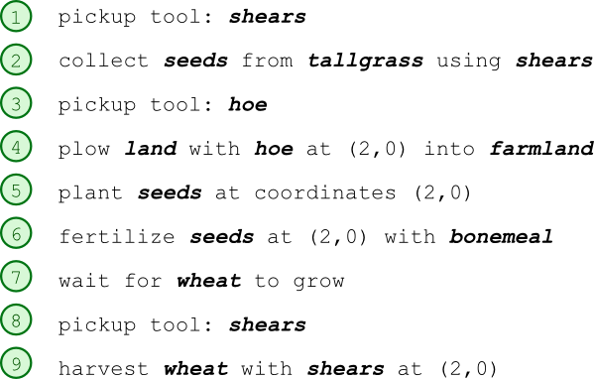
Challenge
Difference in level of abstraction
Text
Plan
Seeds planted in farmland will grow to become wheat which can be harvested.
Preconditions
seeds
wheat
farmland
wheat
Notes:
The challenge in doing this is the difference in level of abstraction between the precondition relations, and the actual planning operations. So here on the right, we can see an example of actions involved in farming wheat in Minecraft. So while the text describes high-level relations between objects in the world, the corresponding plan is much more detailed. And connecting the abstract precondition relations to the low-level plan operations is our primary challenge here.

Slide 63
Model
Text
Log-linear model
Model precondition descriptions
Precondition relations
Planning
target goal
Model object relations
in world, and ground
preconditions.
Log-linear model
Sub-goal sequence
Low-level planner (FF)
Plan
Learn model parameters from planning feedback
Notes:
We’re going to address this challenge by explicitly modeling both the text descriptions of preconditions, as well as the corresponding relations between objects in the world. And here, very briefly is our model. This model has two components – the first predicts precondition relations from the given text.
The second component does two things – first, it models relations between object in the world, and second, given the text preconditions and the target goal, predicts a high-level plan composed of a sequence of subgoals. This subgoal sequence is then given to a standard low-level planner for conversion to an actual plan. And all the parameters of this model can be learned based on whether the low-level planner was able to complete the given task or not.

Slide 64
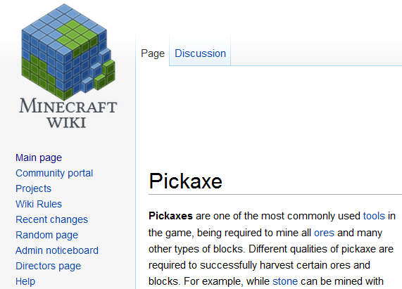
Experimental Domain
World:
Minecraft virtual world
Documents:
User authored wiki articles
Text Statistics:
Pickaxes
Pickaxes are one of the most commonly used tools in the game, being required to mine all ores and many other types of blocks. Different qualities of pickaxe are required to successfully
Sentences: | 242
Vocabulary: | 979
Planning task Statistics:
Tasks: | 98
Avg. plan length: | 35
Notes:
We apply this model to a set of 98 planning tasks in the Minecraft virtual world, using user authored online articles as our source of textual information.

Slide 65
Results
Method | % plans solved
Low-level planner (FF) | 40.8
No text | 69.4
Full model | 80.2
Manual text connections | 84.7
Notes:
And here is how our method performs in terms of plans solved. As a measure of difficulty, a standard low-level planner is able to complete 41% of the tasks on it’s own. In contrast, our method completes 80% of all tasks. Compare that to 69% solutions when we remove the text component of our model – so this is a method that predicts subgoals based only on observations of the domain. The final number here is an absolute ceiling for our method’s performance – if we manually extract the precondition relations from text, and provide that information to our method, it solves 85% of the tasks.
So that’s how well our method uses text to guide high-level planning.

Slide 66
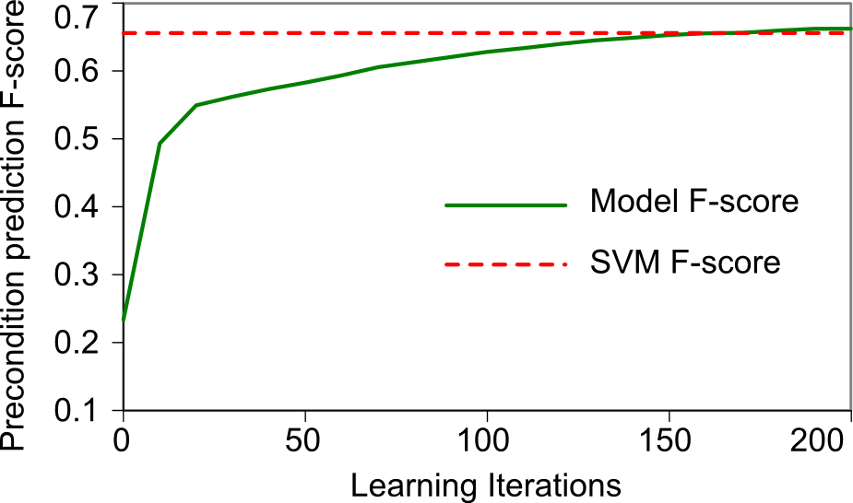
Results: Text Analysis
Notes:
Now let’s see how well it performs in terms of prediction preconditions from text. The vertical axis in this graph is the F-score of precondition predictions evaluated against manual annotations. On the horizontal axis is the number of learning iterations of our method. And the green line here is how well our method performs. Compare that to the dotted red line, which is the performance of an SVM classifier trained on manual annotations. So while learning only from the planning feedback, our method again learns language analysis rivaling a supervised baseline.

Slide 67
Related Work
Instruction interpretation
Learned from manual supervision
Game playing
Action selection based only on game state
High-level planning
Based on analysis of world dynamics
Notes:
Before I conclude, let me briefly touch on prior work in the areas of instruction interpretation, game playing and high-level planning. While there is a long history of work in these areas, prior work in instruction interpretation has focused on learning from manual supervision – either from annotations or parallel data. In game playing, and planning the focus has been on using information about the game or planning world to make optimal choices.

Slide 68
Contributions
Learn language analysis from control feedback
Improve control performance using text information
Instruction
Interpretation
Complex
Game-play
High-level
Planning
Notes:
In contrast to such prior work, we show that text interpretation can be learned without any manual supervision, by leveraging feedback signals inherent to the control application. We also demonstrate that information automatically extracted from text can be used to significantly improve control performance compared to methods that don’t have access to language. Starting from little or no prior knowledge about either language or the control domain, our method are able to simultaneously and effectively achieve both of these outcomes.

