Slide 1
6.853: Topics in Algorithmic Game Theory
Lecture 14
Fall 2011
Constantinos Daskalakis

Slide 2
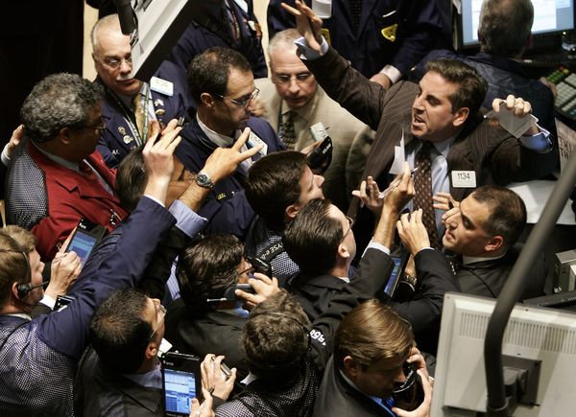


Markets

Slide 3
“Economics is a science which studies human behavior as a relationship between ends and scarce means which have alternative uses.”
Lionel Robbins (1898 – 1984)

Slide 4
How are scarce resources assigned to alternative uses?

Slide 5





Slide 6
How are scarce resources assigned to alternative uses?
Prices!
Parity between demand and supply
equilibrium prices

Slide 7
the beginnings of a mathematical theory

Slide 8
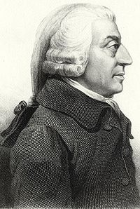
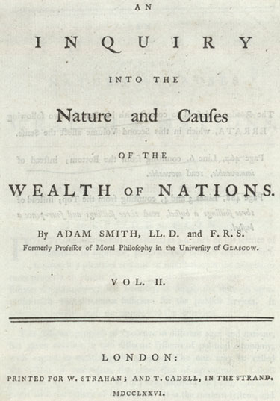
Adam Smith (1723-1790)
The Wealth of Nations (1776): the “invisible hand of the economy”
“By pursuing his own interest he frequently promotes that of the society more effectually than when he really intends to promote it.”
“It is not from the benevolence of the butcher, the brewer, or the baker, that we expect our dinner, but from their regard to their own interest.”

Slide 9
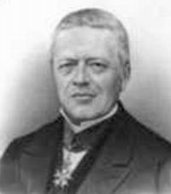
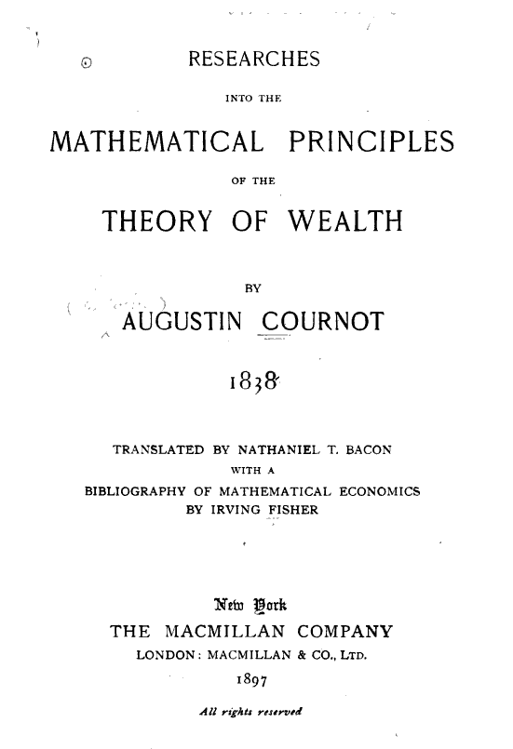
Augustin Cournot (1801-1877)

Slide 10
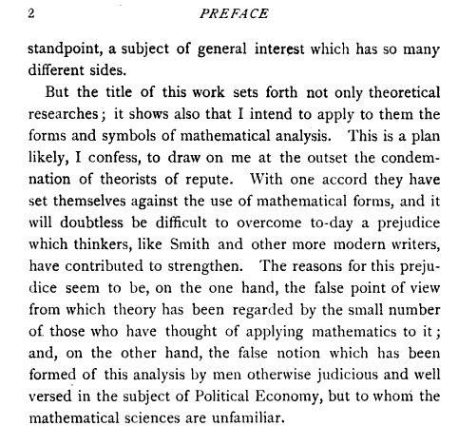

Slide 11
Cournot’s Contributions:
notion of a demand function
D = F(p), where p is the price; F(.) is assumed continuous, and it is taken as an empirical proposition that the demand function is decreasing
analysis of a monopoly:
- profit-maximizing producer with cost f(D), for production D; discusses decreasing, constant and increasing cost functions
- equations determining equilibrium price
duopoly model:
two rival producers of a homogeneous product
unlimited competition,
communication of markets on single commodity, …

Slide 12
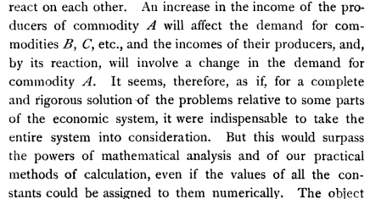
question left unanswered by Cournot…

Slide 13
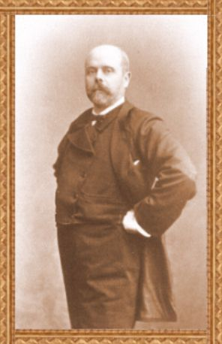
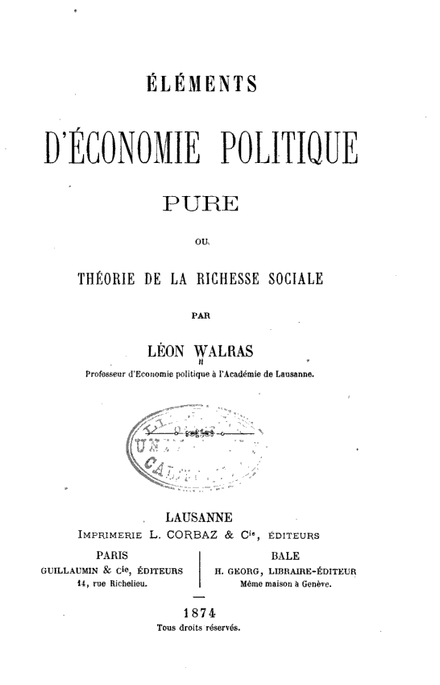
Leon Walras (1834-1910)
Elements of Pure Economics, or the theory of social wealth, 1874

Slide 14
Leon Walras (1834-1910)
- goal was to solve the problem that was left open by Cournot, i.e. characterize the price equilibrium of a market with many commodities;
- gave system of simultaneous equations for price equilibrium:
informal argument for the existence of an equilibrium based on the assumption that an equilibrium exists whenever the number of equations equals the number of unknowns
- recognized the need for dynamics leading to an equilibrium
tâtonnement: price adjustment mechanism

Slide 15
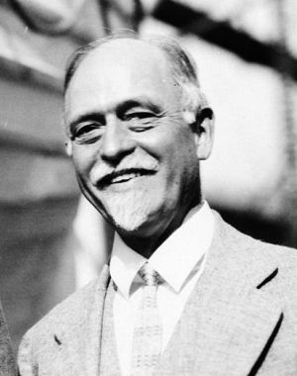
Irving Fisher (1867-1947)
hydraulic apparatus for solving markets with 3 traders with money and a producer of 3 commodities

Slide 16
Irving Fisher (1867-1947)
First computational approach!
1891

Slide 17
[ Irving Fisher (1867-1947)
Stock Market Crash of 1929:
"Stock prices have reached what looks like a permanently high plateau."
[Shortly before the crisis]
Market is “only shaking out of the lunatic fringe”
[October 21, 1929 (8 days before black Tuesday)]
]

Slide 18
[….]

Slide 19
Arrow-Debreu-McKenzie Theorem
One of the most celebrated theorems in Mathematical Economics.
Established the existence of a market equilibrium under very general conditions using Brouwer/Kakutani’s fixed point theorem.
it is hence highly non-constructive!

Slide 20
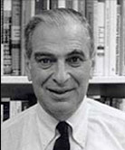
Kenneth Arrow
Nobel Prize, 1972

Slide 21
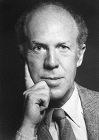
Gerard Debreu
Nobel Prize, 1983

Slide 22
Exchange Market Model (without production)
Consider a marketplace with:
traders (or agents)
goods (or commodities)
assumed to be infinitely divisible
Utility function of trader i:
non-negative reals
consumption set for trader i
specifies trader i’s utility for bundles of goods
Endowment of trader i:
amount of goods trader comes to the marketplace with

Slide 23
Exchange Market Model (without production)
Suppose the goods in the market are priced according to some price vector .
Under this price vector, each trader would like to sell some of her endowment and purchase an optimal bundle using her income from what s/he sold; thus she solves the following program:
Program_{i}(p)
Note: If u_{i} is continuous and is compact, then the above program has a well-defined optimum value.

Slide 24
Competitive (or Walrasian) Market Equilibrium
Def: A price vector is called a competitive market equilibrium iff there exists a collection of optimal solutions to Program_{i}(p), for all i = 1,…, n, such that the total supply meets the total demand, i.e.
total demand
total supply

Slide 25
Arrow-Debreu Theorem 1954
Theorem [Arrow-Debreu 1954]: Suppose
(i) is closed and convex
(ii) (all coordinates positive)
(iii a)
(iii b)
(iii c)
Then a competitive market equilibrium exists.

Slide 26
Market Clearing
Nonsatiation + quasi-concavity
➔
at equilibrium every trader spends all her budget, i.e. if x_{i}(p) is an optimal solution to Program_{i}(p) then
➔
every good with positive price is fully consumed

Slide 27
A market with no equilibrium
Alice has oranges and apples, but only likes apples.
Bob only has oranges, and likes both oranges and apples.
- if oranges are priced at 0, then Bob’s demand is not well-defined.
- if oranges are priced at > 0, then Alice wants more apples than there are in the market.

Slide 28
Proof of the Arrow-Debreu Theorem
Steps (details on the board)
simplifying assumption: u_{i} is strictly concave
(i) w.l.o.g. can assume that the are compact
argument on the board; the idea is that we can replace with
without missing any equilibrium, and without introducing spurious ones
(ii) by compactness and strict concavity:
  for all p, there exists a unique maximizer x_{i}(p) of Program_{i}(p)
(iii) by the maximum theorem: x_{i}(p) is continuous on p
(iv) rest of the argument on the board

Slide 29
Utility Functions
Linear utility function (goods are perfect substitutes)
Leontief (or fixed-proportion) utility function
e.g. buying ingredients to make a cake
e.g. rate allocation on a network
Cobb-Douglas utility function
Interpretation: the per-unit fraction of buyer i’s income used in purchasing good j is proportional to a_{ij}. i.e. at optimality x_{ij} p_{j} =c a_{ij}.

Slide 30
Utility Functions
CES utility functions:
Convention: - If u_{ij} =0, then the corresponding term in the utility function is always 0.
- If u_{ij} > 0, x_{j}=0, and ρ<0, then u_{i}(x)=0 no matter what the other x_{j}’s are.
linear utility form
Leontief utility form
Cobb-Douglas form
elasticity of substitution:

Slide 31
Homework
CES utility functions:
show it is concave (2 points)

Slide 32
Fisher’s Model
Suppose all endowment vectors are parallel…
➔ relative incomes of the traders are independent of the prices.
Equivalently, we can imagine the following situation:
n traders, with specified money m_{i}
k divisible goods owned by seller; seller has q_{j} units of good j
Arrow-Debreu Thm ➔
(under the Arrow-Debreu conditions) there exist prices that the seller can assign on the goods so that the traders spend all their money to buy optimal bundles and supply meets demand

Slide 33
Fisher’s Model with CES utility functions
Buyers’ optimization program (under price vector p):
Global Constraint:

Slide 34
Eisenberg-Gale’s Convex Program
The space of feasible allocations is:
But how do we aggregate the trader’s optimization problems into one global optimization problem?
e.g., choosing as a global objective function the sum of the traders’ utility functions won’t work…

