Slide 1
6.896: Topics in Algorithmic Game Theory
Lecture 8
Constantinos Daskalakis

Slide 2
2 point Exercise
5. NASH ➔ BROUWER (cont.):
- Final Point:
We defined BROUWER for functions in the hypercube. But Nash’s function is defined on the product of simplices. Hence, to properly reduce NASH to BROUWER we first embed the product of simplices in a hypercube, then extend Nash’s function to points outside the product of simplices in a way that does not introduce approximate fixed points that do not correspond to approximate fixed points of Nash’s function.

Slide 3
Last Time…

Slide 4
The PPAD Class [Papadimitriou ’94]
“A directed graph with an unbalanced node (indegree ≠ outdegree) must have another unbalanced node”
Suppose that an exponentially large graph with vertex set {0,1}^{n} is defined by two circuits:
possible previous
node id
P
node id
node id
N
node id
possible next
END OF THE LINE:
Given P and N: If 0^{n} is an unbalanced node, find another unbalanced node. Otherwise say “yes”.
PPAD =
{ Search problems in FNP reducible to END OF THE LINE}

Slide 5
The Directed Graph
{0,1}^{n}
0^{n}
...
= solution

Slide 7
Other Combinatorial Arguments of Existence

Slide 8
four arguments of existence
“If a directed graph has an unbalanced node it must have another.”
PPAD
“If a graph has a node of odd degree, then it must have another.”
PPA
“Every directed acyclic graph must have a sink.”
PLS
“If a function maps n elements to n-1 elements, then there is a collision.”
PPP

Slide 9
The Class PPA [Papadimitriou ’94]
“If a graph has a node of odd degree, then it must have another.”
Suppose that an exponentially large graph with vertex set {0,1}^{n} is defined by one circuit:
possible neighbors
node id
C
{ node id₁ , node id₂}
ODD DEGREE NODE:
Given C: If 0^{n} has odd degree, find another node with odd degree. Otherwise say “yes”.
PPA =
{ Search problems in FNP reducible to ODD DEGREE NODE}

Slide 10
The Undirected Graph
{0,1}^{n}
0^{n}
...
= solution

Slide 11
The Class PLS [JPY ’89]
“Every DAG has a sink.”
Suppose that a DAG with vertex set {0,1}^{n} is defined by two circuits:
node id
C
{node id₁, …, node id_{k}}
node id
F
FIND SINK:
Given C, F: Find x s.t. F(x) ≥ F(y), for all y ∈ C(x).
PLS =
{ Search problems in FNP reducible to FIND SINK}

Slide 12
The DAG
{0,1}^{n}
= solution

Slide 13
The Class PPP [Papadimitriou ’94]
“If a function maps n elements to n-1 elements, then there is a collision.”
Suppose that an exponentially large graph with vertex set {0,1}^{n} is defined by one circuit:
node id
C
node id
COLLISION:
Given C: Find x s.t. C( x )= 0^{n}; or find x ≠ y s.t. C(x)=C(y).
PPP =
{ Search problems in FNP reducible to COLLISION }

Slide 14
1 point

Slide 15
Hardness Results

Slide 16
Inclusions we have already established:
Our next goal:

Slide 17
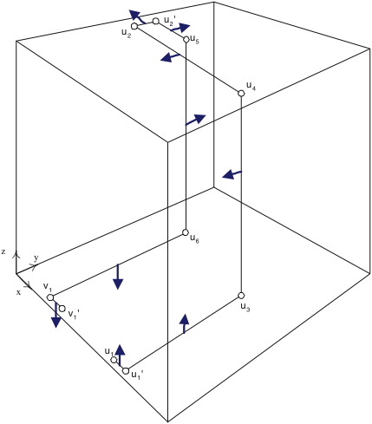
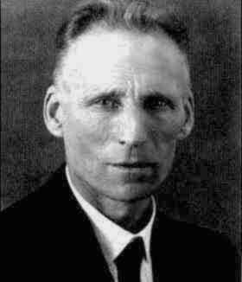
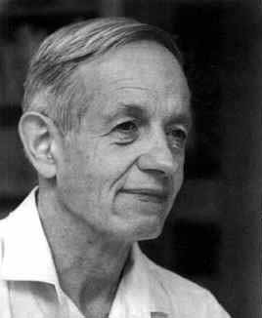
The PLAN
DGP = Daskalakis, Goldberg, Papadimitriou
CD = Chen, Deng
[Pap ’94]
[DGP ’05]
0^{n}
Embed PPAD graph in [0,1]³
...
Generic PPAD
[DGP ’05]
4-player
NASH
[DGP ’05]
[DP ’05]
3-player
NASH
[DGP ’05]
[DGP ’05]
[CD’05]
[CD’06]
2-player
NASH
p.w. linear
BROUWER
multi-player
NASH
3D-SPERNER

Slide 18
This Lecture
DGP = Daskalakis, Goldberg, Papadimitriou
CD = Chen, Deng
[Pap ’94]
[DGP ’05]
0^{n}
Embed PPAD graph in [0,1]³
...
Generic PPAD
[DGP ’05]
4-player
NASH
[DGP ’05]
[DP ’05]
3-player
NASH
[DGP ’05]
[DGP ’05]
[CD’05]
[CD’06]
2-player
NASH
p.w. linear
BROUWER
multi-player
NASH
3D-SPERNER

Slide 19
First Step
Embed PPAD graph in [0,1]³
0^{n}
...
Generic PPAD
our goal is to identify a piecewise linear, single dimensional subset of the cube, corresponding to the PPAD graph; we call this subset L

Slide 20
Non-Isolated Nodes map to pairs of segments
0^{n}
...
Generic PPAD
Non-Isolated Node
pair of segments
main
auxiliary

Slide 21
Non-Isolated Nodes map to pairs of segments
0^{n}
...
Generic PPAD
Non-Isolated Node
pair of segments
also, add an orthonormal path connecting the end of main segment and beginning of auxiliary segment
breakpoints used:

Slide 22
Edges map to orthonormal paths
0^{n}
...
Generic PPAD
Edge between and
orthonormal path connecting the end of the auxiliary segment of u with beginning of main segment of v
breakpoints used:

Slide 23
Exceptionally 0^{n} is closer to the boundary…
0^{n}
...
Generic PPAD
This is not necessary for the embedding of the PPAD graph, but will be useful later in the definition of the Sperner instance…

Slide 24
Finishing the Embedding
0^{n}
...
Generic PPAD
Call L the orthonormal line defined by the above construction.
Claim 1:
Two points p, p’ of L are closer than 3⋅2^{-m} in Euclidean distance only if they are connected by a part of L that has length 8⋅2^{-m} or less.
Claim 2:
Given the circuits P, N of the END OF THE LINE instance, and a point x in the cube, we can decide in polynomial time if x belongs to L.
Claim 3:

Slide 25
Reducing to 3-d Sperner
3-d SPERNER
Instead of coloring vertices of the triangulation (the points of the cube whose coordinates are integer multiples of 2^{-m}), color the centers of the cubelets; i.e. work with the dual graph.

Slide 26
Boundary Coloring
legal coloring for the dual graph (on the centers of cubelets)
N.B.: this coloring is not the envelope coloring we used earlier; also color names are permuted

Slide 27
Coloring of the Rest
Rest of the coloring:
All cubelets get color 0, unless they touch line L.
The cubelets surrounding line L at any given point are colored with colors 1, 2, 3 in a way that “protects” the line from touching color 0.

Slide 28
Coloring around L
2
1
⋅
3
3
colors 1, 2, 3 are placed in a clockwise arrangement for an observer who is walking on L
two out of four cubelets are colored 3, one is colored 1 and the other is colored 2

Slide 29
The Beginning of L at 0^{n}
notice that given the coloring of the cubelets around the beginning of L (on the left), there is no point of the subdivision in the proximity of these cubelets surrounded by all four colors…

Slide 30
Color Twisting
out of the four cubelets around L which two are colored with color 3 ?
- in the figure on the left, the arrow points to the direction in which the two cubelets colored 3 lie
- observe also the way the twists of L affect the location of these cubelets with respect to L
IMPORTANT directionality issue:
the picture on the left shows the evolution of the location of the pair of colored 3 cubelets along the subset of L corresponding to an edge (u, v) of the PPAD graph…
at the main segment corresponding to u the pair of cubelets lies above L, while at the main segment corresponding to v they lie below L

Slide 31
Color Twisting
the flip in the location of the cubelets makes it impossible to locally decide where the colored 3 cubelets should lie!
Claim1: This is W.L.O.G.
to resolve this we assume that all edges (u,v) of the PPAD graph join an odd u (as a binary number) with an even v (as a binary number) or vice versa
for even u’s we place the pair of 3-colored cubelets below the main segment of u, while for odd u’s we place it above the main segment
convention agrees with coloring around main segment of 0^{n}

Slide 32
Proof of Claim of Previous Slide
- Duplicate the vertices of the PPAD graph
- If node u is non-isolated include an edge from the 0 to the 1 copy
non-isolated
- Edges connect the 1-copy of a node to the 0-copy of its out-neighbor

Slide 33
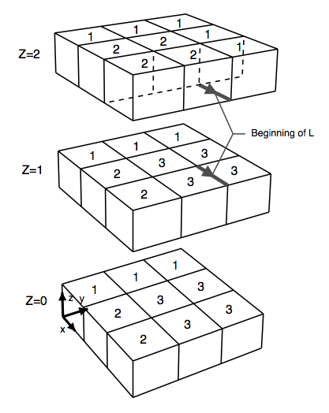
Finishing the Reduction
A point in the cube is panchromatic iff it is the corner of some cubelet (i.e. it belongs to the subdivision of mutliples of 2^{-m}), and all colors are present in the cubelets containing this point.
Claim 1: A point in the cube is panchromatic in the described coloring iff it is:
- an endpoint u₂’ of a sink vertex u of the PPAD graph, or
- an endpoint u₁ of a source vertex u ≠0^{n} of the PPAD graph.
Claim 2: Given the description P, N of the PPAD graph, there is a polynomial-size circuit computing the coloring of every cubelet .

