Slide 1
6.896: Topics in Algorithmic Game Theory
Lecture 13b
Constantinos Daskalakis

Slide 2
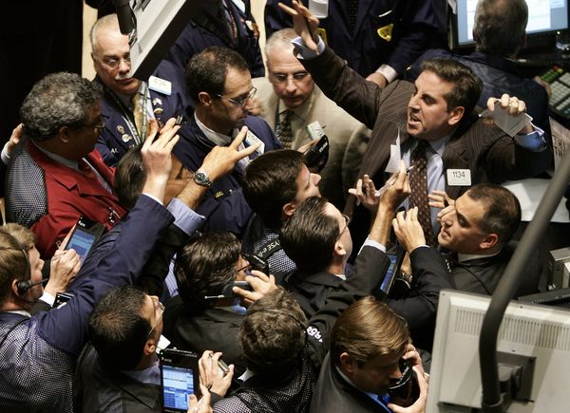
Markets

Slide 3
“Economics is a science which studies human behavior as a relationship between ends and scarce means which have alternative uses.”
Lionel Robbins (1898 – 1984)

Slide 4
How are scarce resources assigned to alternative uses?

Slide 6
How are scarce resources assigned to alternative uses?
Prices!
Parity between demand and supply
equilibrium prices

Slide 7
the beginnings of a mathematical theory

Slide 8
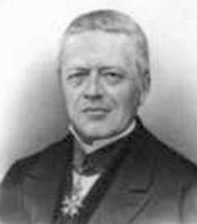
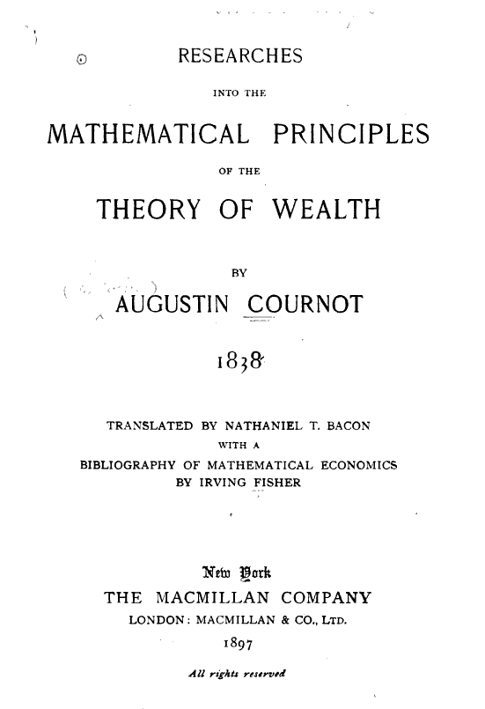
Augustin Cournot (1801-1877)

Slide 9
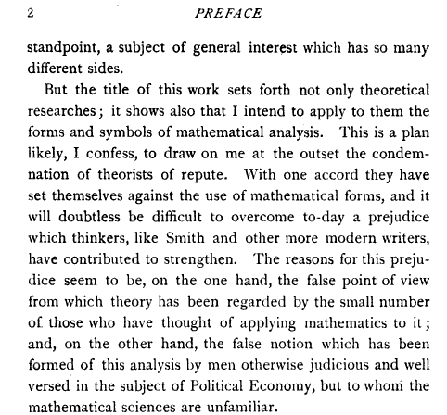

Slide 10
Cournot’s Contributions:
notion of a demand function
D = F(p), where p is the price; F(.) is assumed continuous, and it is taken as an empirical proposition that the demand function is decreasing
analysis of a monopoly:
- profit-maximizing producer with cost f(D), for production D; discusses decreasing, constant and increasing cost functions
- equations determining equilibrium price
duopoly model:
two rival producers of a homogeneous product
unlimited competition,
communication of markets on single commodity, …

Slide 11
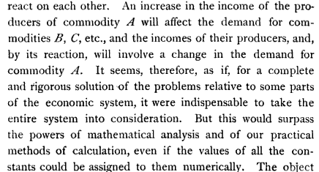
question left unanswered by Cournot…

Slide 12
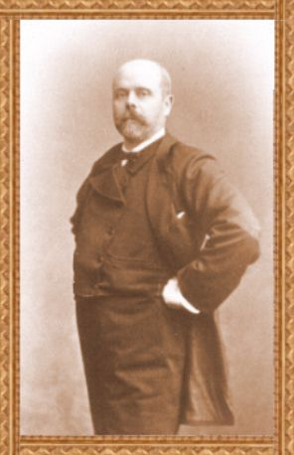
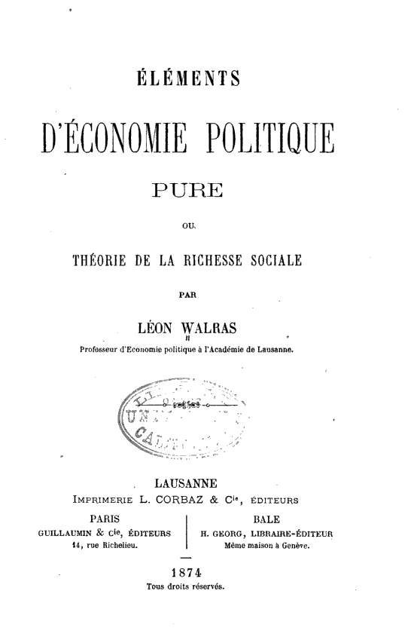
Leon Walras (1834-1910)
Elements of Pure Economics, or the theory of social wealth, 1874

Slide 13
Leon Walras (1834-1910)
- goal was to solve the problem that was left open by Cournot, i.e. characterize the price equilibrium of a market with many commodities;
- gave system of simultaneous equations for price equilibrium:
informal argument for the existence of an equilibrium based on the assumption that an equilibrium exists whenever the number of equations equals the number of unknowns
- recognized the need for dynamics leading to an equilibrium
tâtonnement: price adjustment mechanism

Slide 14
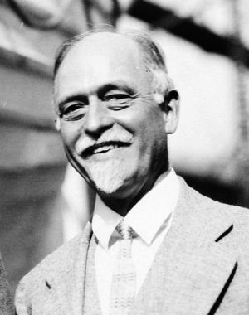
Irving Fisher (1867-1947)
hydraulic apparatus for solving markets with 3 traders with money and a producer of 3 commodities

Slide 15
Irving Fisher (1867-1947)
First computational approach!
1891

Slide 16
[ Irving Fisher (1867-1947)
Stock Market Crash of 1929:
"Stock prices have reached what looks like a permanently high plateau."
[Shortly before the crisis]
Market is “only shaking out of the lunatic fringe”
[October 21, 1929 (8 days before black Tuesday)]
]

Slide 17
[….]

Slide 18
Arrow-Debreu-McKenzie Theorem
One of the most celebrated theorems in Mathematical Economics.
Established the existence of a market equilibrium under very general conditions using Brouwer/Kakutani’s fixed point theorem.
it is hence highly non-constructive!

Slide 19
Kenneth Arrow
Nobel Prize, 1972

Slide 20
Gerard Debreu
Nobel Prize, 1983

Slide 21
Exchange Market Model (without production)
Consider a marketplace with:
traders (or agents)
goods (or commodities) assumed to be infinitely divisible
Utility function of trader i:
non-negative reals
consumption set for trader i
specifies trader i’s utility for bundles of goods
Endowment of trader i:
amount of goods trader comes to the marketplace with

Slide 22
Exchange Market Model (without production)
Suppose the goods in the market are priced according to some price vector .
Under this price vector, each trader would like to sell some of her endowment and purchase an optimal bundle using her income from what s/he sold; thus she solves the following program:
Program_{i}(p)
Note: If u_{i} is continuous and is compact, then the above program has a well-defined optimum value.

Slide 23
Competitive (or Walrasian) Market Equilibrium
Def: A price vector is called a competitive market equilibrium iff there exists a collection of optimal solutions to Program_{i}(p), for all i = 1,…, n, such that the total demand meets the total supply, i.e.
total demand
total supply

Slide 24
Arrow-Debreu Theorem 1954
Theorem [Arrow-Debreu 1954]: Suppose
(i) is closed and convex
(ii) (all coordinates positive)
(iii a)
(iii b)
(iii c)
Then a competitive market equilibrium exists.

