Slide 1
6.896: Probability and Computation
Spring 2011
lecture 19
Constantinos (Costis) Daskalakis
costis@mit.edu

Slide 2
the evolutionary process

Slide 3
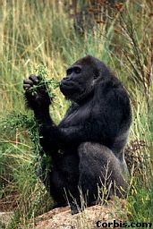
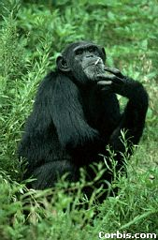
the “tree of life”
- 3 million years
ACCGT…
ACGGT…
AACGT…
ACTGT…
TCGGT…
TCCGT…
TCGGA…
time
ACCGT…
ACTGT…
TCCGA…
ACCTT…
today
TCAGA…
GCCGA…

Slide 4
the “tree of life”
: common ancestor
- 3 million years
ACCGT…
: present day organisms
ACGGT…
AACGT…
ACTGT…
TCGGT…
TCCGT…
TCGGA…
time
ACCGT…
ACTGT…
TCCGA…
ACCTT…
today
TCAGA…
GCCGA…

Slide 5
the computational problem
- 3 million years
?
TCGGA…
time
ACCGT…
ACTGT…
ACCTT…
today
TCAGA…
GCCGA…

Slide 6
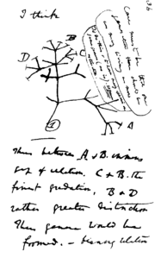
Darwin’s Finches

Slide 7
phylogenetic reconstruction algorithms

Slide 8
reconstruction algorithms
combinatorial methods
non sequence-based:
use knowledge of the subtree on subsets of a small number of leaves, e.g. “quartet methods” exploit knowledge of the topology on subsets of 4 leaves
sequence-based:
e.g. “maximum parsimony” searches for a binary tree, whose leaves are the present-day species, and a labeling of its internal nodes with sequences, so that the sum of hamming distances over all edges is minimized
distance-based:
use knowledge of some notion of evolutionary distance between pairs of present-day species, e.g. “neighbor-joining”
statistical methods
- assume a Markovian evolutionary model, and do statistical inference of the model from the samples, e.g. via maximum-likelihood, a distance method, a quartet method, etc.

Slide 9
Quartet Methods
Observation: there are 3 possible trees on a set of 4 species
A
C
A
B
B
D
C
D
A
C
these are the three possible quartets over A, B, C, D
D
B
Theorem:
If we know the quartet induced by a tree on every subset of 4 leaves, then we can deduce the whole tree.
[see proof in supplementary material]

Slide 10
a simple Markov model on a tree

Slide 11
Evolution of Aligned Sequences
r
-
+
…
p_{ra}
0. Tree T = (V, E) on n leaves (unknown)
a
-
+
p_{rc}
1. State Space: Σ= {-1, +1}
-1: Purines (A,G)
+1: Pyrimidines (C,T)
p_{ab}
b
-
-
p_{a3}
+
+
c
2. Mutation Probabilities on edges (also unknown)
p_{b1}
p_{b2}
p_{c4}
p_{c5}
3. Choose uniform spin at the root;
+
+
-
-
-
+
-
-
+
-
trickle-down;
repeat
1
2
3
4
5
Lemma: Equivalent to taking independent samples from the Ising model (with appropriate temperatures related to mutation probabilities).

Slide 12
The Phylogenetic Reconstruction Problem
Input: k independent samples of the process at the leaves of an n leaf tree – but tree not known!
Task: fully reconstruct the model,
i.e. find tree and mutation probabilities
Goal: complete the task efficiently
use small sequences (i.e. small k)
s(1)
s(2)
s(3)
s(4)
s(5)
-
-
+
+
+
-
-
-
+
+
+
+
-
-
+
-
-
+
+
+
+
-
-
+
+
In other words: Given k samples from the Ising model on an unknown tree, observed only at the leaves of the tree, can we reconstruct the tree?
p_{rc}
p_{b2}
+
p_{ra}
p_{c5}
p_{a3}
A: need at least k = Ω(log n) (see supplementary material)
A: k = poly(n) always sufficient (next lecture)
Notes:
And what about using smaller smaller sequences?

Slide 13
Can we perform reconstruction using shorter than poly(n) sequences?
A: Yes, if “temperature” (equivalently the mutation probability) is sufficiently low”.

Slide 14
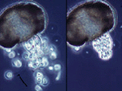
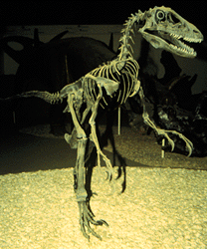
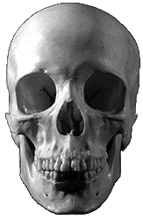
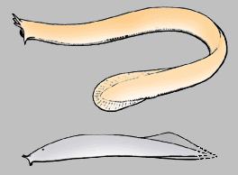
Phylogenetics Physics
?
mutation probability
temperature
?
[Daskalakis-Mossel-Roch 06]
The phylogenetic reconstruction problem
can be solved from very short sequences
The Ising model on the tree exhibits long-range order
phylogeny
statistical physics

Slide 15
The Underlying Phase Transition: Root Reconstruction in the Ising Model
LOW TEMP
HIGH TEMP
bias
no bias
Correlation of the leaves’ states with root state persists independently of height
Correlation goes to 0 as height of tree grows
“typical”
boundary
p < p*
“typical”
boundary
p > p*
The transition at p* was proved by:
[Bleher-Ruiz-Zagrebnov’95], [Ioffe’96],[Evans-Kenyon-Peres-Schulman’00],
[Kenyon-Mossel-Peres’01],[Martinelli-Sinclair-Weitz’04], [Borgs-Chayes-Mossel-R’06].
Also, “spin-glass” case studied by [Chayes-Chayes-Sethna-Thouless’86]. Solvability for
p* was first proved by [Higuchi’77] (and [Kesten-Stigum’66]).

Slide 16
Physics Phylogenetics
Statistical physics
Phylogeny
[DMR’05]
Low Temp
k = Θ(logn)
p = p*
[Mossel’03]
High Temp
k = Θ(poly(n))
Resolution of Steel’s Conjecture
The point of this result is that phylogenetic reconstruction can be done with O(log n) sequences IFF the underlying Ising model exhibits long-range order.

Slide 17
next time: proof that poly(n) sequences suffice
lecture after next: root reconstruction problem on the tree

