Slide 1
6.896: Probability and Computation
Spring 2011
lecture 23
Constantinos (Costis) Daskalakis
costis@mit.edu

Slide 2



Phylogenetic Reconstruction
Theorem [Lecture 21] :
independent samples from the CFN model
suffice to reconstruct the unrooted underlying tree, where
weighted depth of underlying tree.
Corollary:
If 0<c₁ < p_{e} <c₂<1/2, then k = poly(n) samples always suffice.
Notes:
D_* = \max_e { length of shortest leaf-to-leaf path through that edge }

Slide 3
how about tree reconstruction from shorter sequences?

Slide 4
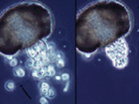

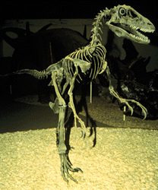
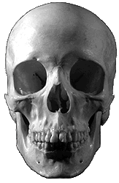
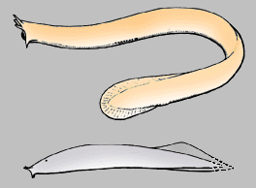
Steel’s Conjecture
?
?
[Daskalakis-Mossel-Roch ’06]
The phylogenetic reconstruction problem
can be solved from O(log n) sequences
The Ancestral Reconstruction Problem is solvable
phylogenetics
statistical physics

Slide 5
The Ancestral Reconstruction Problem
LOW TEMP
HIGH TEMP
bias
no bias
Correlation of the leaves’ states with root state persists independently of height
Correlation goes to 0 as height of tree grows
“typical”
boundary
p < p*
p > p*
“typical”
boundary
The transition at p* was proved by:
[Bleher-Ruiz-Zagrebnov’95], [Ioffe’96],[Evans-Kenyon-Peres-Schulman’00],
[Kenyon-Mossel-Peres’01],[Martinelli-Sinclair-Weitz’04], [Borgs-Chayes-Mossel-R’06].
Also, “spin-glass” case studied by [Chayes-Chayes-Sethna-Thouless’86]. Solvability for
p* was first proved by [Higuchi’77] (and [Kesten-Stigum’66]).

Slide 6
Solvability of the Ancestral Reconstruction problem
(an illustration)
[the simulations that follow are due to Daskalakis-Roch 2009]

Slide 7

Setting Up
For illustration purposes, we represent DNA by a black-and-white picture: each pixel corresponds to one position in the DNA sequence of a species.
During the course of evolution, point mutations accumulate in non-coding DNA. This is represented here by white noise.

Slide 8

Accumulating Mutations
For illustration purposes, we represent DNA by a black-and-white picture: each pixel corresponds to one position in the DNA sequence of a species.
During the course of evolution, point mutations accumulate in non-coding DNA. This is represented here by white noise.

Slide 10

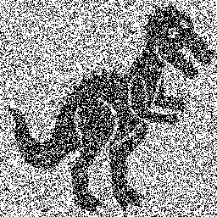
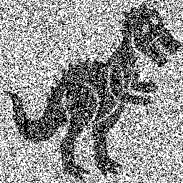
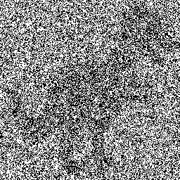
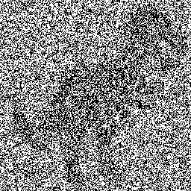
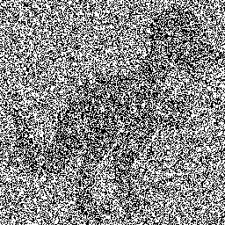
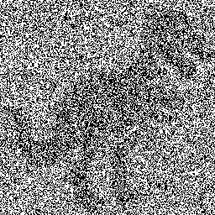
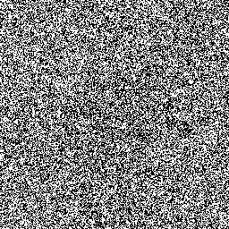
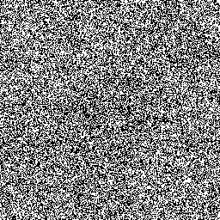
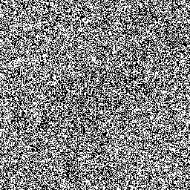
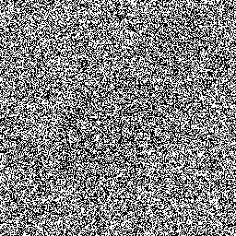
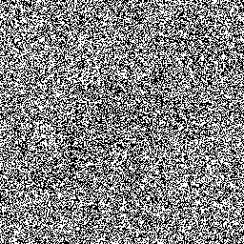
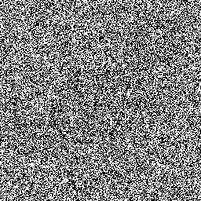
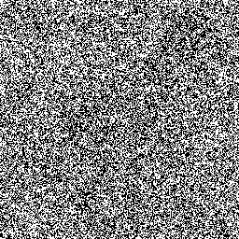
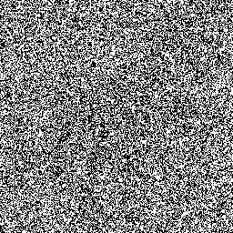
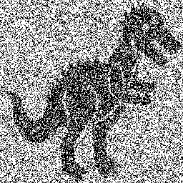
Low Temperature (p<p*) Evolution
30mya
20mya
10mya
today
click anywhere to see the result of the pixel-wise majority vote

Slide 11
Ancestral Reconstruction for
Tree Reconstruction from short sequences

Slide 12



Short Sequences ➔ Local Information
Theorem [e.g. DMR ’06]:
For all M, samples from the CFN model suffice
to obtain distance estimators , such that the following is satisfied for all pairs of leaves with high probability:
Corollary: Can reconstruct the topology of the tree close to the leaves.
Bottleneck: Deep quartets. All paths through their middle edge are long and hence required distances are noisy, if k is O(log n).

Slide 14
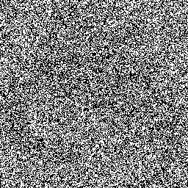
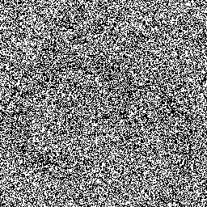
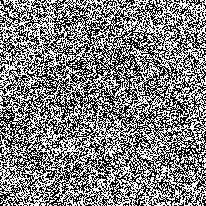
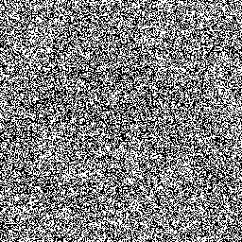
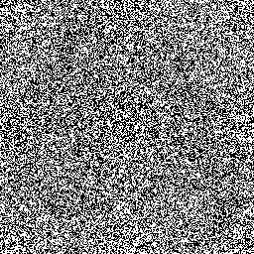
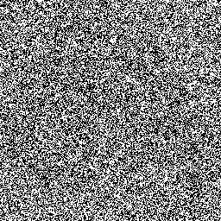
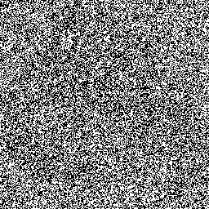
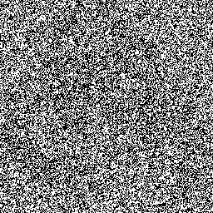
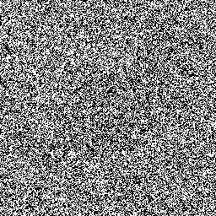
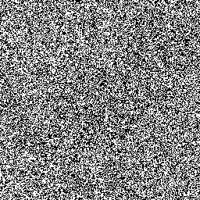
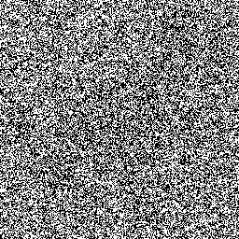
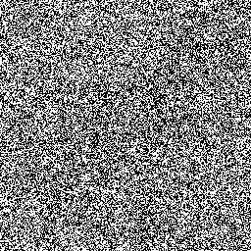
Deep Reconstruction
40mya
?
?
30mya
?
20mya
10mya
…
…
…
today
Which 2 of 3 families of species are the closest?

Slide 16
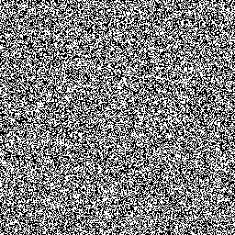
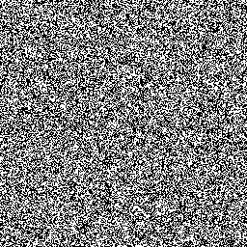
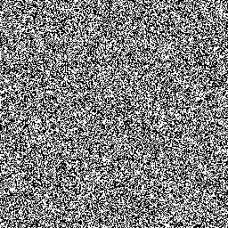
Naïve Deep Reconstruction
?
?
?
…
…
…
⊕
=
?
⊕
=
In the old technique, we used one representative DNA sequence from each family, and do a pair-wise comparison.
In this case, the result is too noisy to decide.
⊕
=

Slide 18
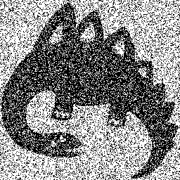
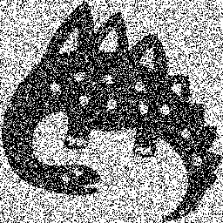
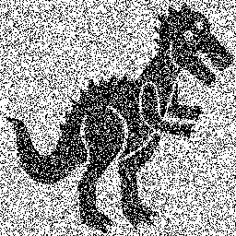
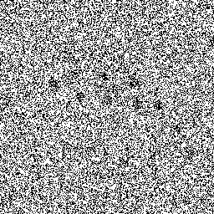
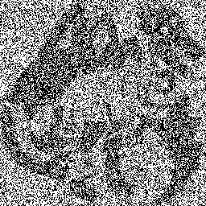
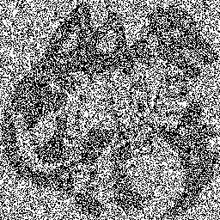
Using Ancestral Reconstruction
?
?
?
…
…
…
New
Old
⊕
=
?
⊕
=
In the new technique, we first perform a pixel-wise majority vote on each family, and then do a pair-wise comparison.
The result is much easier to interpret.
⊕
=

