Slide 1
Part II: Revenue-optimal Mechanisms
June 8, 2014
Yang Cai, UC Berkeley and McGill University
Reference: Yang Cai, Constantinos Daskalakis and Matt Weinberg: Optimal Multi-Dimensional Mechanism Design: Reducing Revenue to Welfare Maximization, FOCS 2012. http://arxiv.org/abs/1207.5518

Slide 2


Contents
[1] General Setting
[2] Problem with the basic approach
[3] New method
[4] Conclusion

Slide 3
[1] General Setting
General Valuation
Combinatorial feasibility constraint

Slide 4







[Background] Auctions: Set-up (General)
Bidders
Items
1
Auctioneer
1
…
…
i
j
…
…
m
n
Bidders:
have values on “items” and bundles of “items”.
Valuation aka type encodes that information.
Common Prior: Each is sampled independently from .
  Every bidder and the auctioneer knows
Additive: Values for bundles of items = sum of values for each item
Non-additive Types：
Notes:
Economics usually makes the following two standard assumptions about bidder types.
Say what additive is

Slide 5
[Background] Auctions: Set-up (General)
Auctioneer
Auctioneer:
needs to decide some allocation A ⊆ [m] x [n].
(possibly combinatorial) constraints on what allocations are feasible.
Some set system describes what allocations are OK.
Notes:
Economics usually makes the following two standard assumptions about bidder types.

Slide 6

[Background] Auctions: Execution
Each Bidder:
Auctioneer:
Uses as input: the auction, own type, beliefs about behavior of other bidders;
Bids;
Goal: Optimize own utility (= expected value minus expected price).
Designs auction, specifying allocation and price rules;
Asks bidders to bid;
Implements the allocation and price rule specified by the auction;
Goal: Find an auction that:
Encourages bidders to bid truthfully (w.l.o.g.)
Maximizes revenue, subject to 1)
Notes:
Don’t say input out loud.

Slide 7



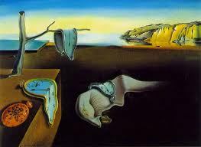
Example 1: selling paintings
1
1
…
…
i
j
…
…
m
n
Setting in Part I, e.g. Items are paintings.
Valuation: additive
Feasibility Constraint: No painting should be given to more than one bidder
so:
Notes:
MDMDP is a very general. Some concrete examples that are modeled by MDMDP.

Slide 8
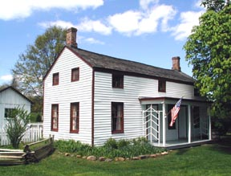
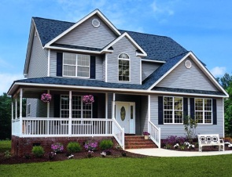
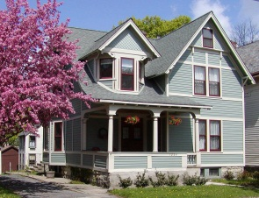
Example 2: selling houses
1
1
…
…
i
j
…
…
m
n
Items are houses.
Valuation: additive
Feasibility Constraint:Each house can be allocated to at most one bidder + Each bidder can receive at most one house
so:

Slide 9
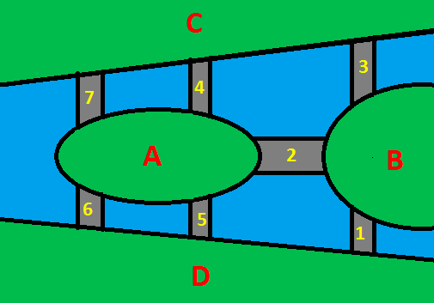
Example 3: building bridges (public good)
1
…
i
…
m
Items are possible locations for building a bridge L = {l₁, l₂, …,l_{n}}.
Valuation: Submodular
If a location is “given” to one bidder, it is “given” to all bidders (as every bidder will use a bridge if it is built).
so:
Notes:
REMOVE maybe

Slide 10
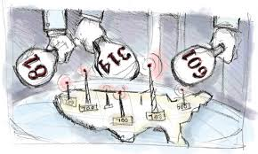
Example 4: selling spectrum
1
…
i
…
m
Items are spectrums.
Valuation: non additive (general)
Feasibility Constraint: No spectrum should be given to more than one bidder + can’t allocate all spectrums to the large companies + many more...
might be an arbitrary set system.

Slide 11

Same Solution?
Will the same solution work in the general setting?

Slide 12
CHAPTER2
[1] General Setting
[2] Problem with the basic approach
[3] New Method
[4] Conclusion

Slide 13
?
[2] Problems with the basic approach
Q: Is the reduced form of an auction still useful?
It is still well defined, but a bidder can’t even compute her utility based on the reduced form.

Slide 14
What Goes Wrong?
Example: There are 2 items and 1 bidder. The bidder has the following valuation:
t({1,2}) = 1, t({1}) = t({2}) = t( ) = 0
Consider two different allocations:
Allocation 1: Give the bidder both items w.p. ½, nothing w.p. ½.
Allocation 2: Give the bidder a single item uniformly at random.
Problem: The same reduced form, but very different value.
Notes:
Slower on assumptions

Slide 15
Succinct LP formulation
Variables: | “Allocation probabilities” “Prices”
---
--------------
Constraints: | Truthfulness Constraints Feasibility Constraints
Not bidder i’s utility
Can’t guarantee BIC
Objective: | Expected Revenue
Notes:
Say what feasibility means

Slide 16
Can we fix this?
Trouble with general types: reduced form of auction is useless.
  Solution: a new implicit description of auctions via “swap value.”
Implicit Form:
: E[t_{i}( )]
i
reported type
i
real type
: E [ price_{i} ] ] ]
i
reported type

Slide 17
Implicit Form
Example: There are 2 items and 1 bidder. The bidder has the two types A and B:
A({1,2}) = 1 and 0 for any other set.
B values each item 1 and is additive.
Consider the following allocation rule:
Report A: Give the bidder both items w.p. ½, nothing w.p. ½.
Report B: Give the bidder a single item uniformly at random.
π(A, A)= ½, π(A,B) = 0, π(B, A)=1, π(B,B)=1
Notes:
Slower on assumptions

Slide 18
Is implicit form useful?
For bidders:
  YES! Can compute utility.
  Can write BIC constraint.
For the auctioneer:
  Even given the optimal feasible implicit form, how to implement it?
  What does the mechanism look like?
Notes:
Slower on assumptions

Slide 19
Structure of the feasible Implicit Forms
Notes:
First show a characterization later show you how to use it for separation oracle

Slide 20
Set of Feasible Implicit Forms
Implicit form is a collection functions:
Can view it as a vector:
Let’s call set of feasible implicit forms:

Slide 21

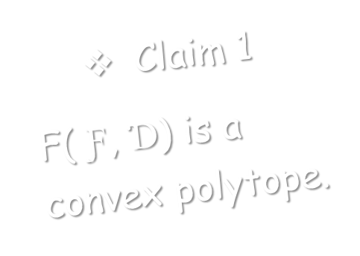
Set of Feasible Implicit Forms
Proof: Easy!

Slide 22
Set of Feasible Implicit Forms
?
Q:
Is there a simple allocation rule implementing the corners?
Notes:
As in part I, the next thing we need to understand is the corners.

Slide 23
Characterization of the Corners
is the implicit form of some allocation rule M
--- (1)
--- (2)
--- (3)
--- (4)

Slide 24
Characterization of the Corners
virtual welfare maximizing implicit form when virtual
value functions are the f_{i}’s
--- (4)
expected virtual welfare of M
--- (5)
f_{i}(t’_{i}) is a valuation function!
interpretation: virtual valuation for type t’_{i}

Slide 25
Characterization of the Corners
virtual welfare maximizing implicit form when virtual
value functions are the f_{i}’s
?
  Q: Can you name an algorithm doing this?
--- (4)
A: YES, the welfare maximizing allocation rule ( w/ virtual value functions f_{i}, i=1,..,m )
= : welfare-maximizer ( { f_{i} } )
expected virtual welfare of M
--- (5)
interpretation: virtual valuation for type t’_{i}

Slide 26
Characterization Theorem
Theorem [C.-Daskalakis-Weinberg]:
is a Convex Polytope whose corners are implementable by virtual welfare maximizing allocation rules.
Corollary: Any feasible implicit form can be implemented as a distribution over virtual welfare maximizing allocation rules.

Slide 27
Is implicit form useful?
For the auctioneer:
  Even given the optimal feasible implicit form, how to implement it?
    Decompose it into Corners, then implement the corners using virtual welfare maximizing allocation rules!
  What does the mechanism look like?
Notes:
Slower on assumptions

Slide 28
How does the Optimal Mechanism Look Like?
Let be the optimal implicit form and .
is the corner that can be implemented by welfare-maximizer ( { f_{i}^{(k)} } ).
The Mechanism looks like the following
?
How do we compute the optimal implicit form?
The seller samples a virtual transformation { f_{i}^{(k)} } w.p. p_{k}
Bidders submit their types t
The seller transform the real type t_{i} to “virtual” type f_{i}^{(k)}(t_{i}) for every bidder i
Use the to “virtual” welfare maximizing allocation
Notes:
Say it similar to Myerson

Slide 29
CHAPTER3
[1] General Setting
[2] Problem with the basic approach
[3] New Method
[4] Conclusion

Slide 30
Succinct LP (General)
Variables: | “Implicit Forms” “Prices”
Constraints: | Truthfulness Constraints Feasibility Constraints
Objective: | Expected Revenue
??
Separation oracle?

Slide 31
Checking Feasibility For Implicit Forms
Notes:
不要boring

Slide 32
Separation Oracle?
Given an alg. that optimizes any linear function over P, can turn it into an separation oracle for P using ellipsoid.
Usually, the other way.
  - Ellipsoid+ Separation Oracle = Optimization
Why would you want to do that?
  - Want to optimize over P P’
One idea:
Separation Ξ 0ptimization
[Grötschel, Lovász, Schrijver ’80, Karp Papadimitriou ’80]
U

Slide 33
Separation Oracle?
?
Can we optimize?
Almost…
[Characterization]:
“Corners are implementable by virtual welfare maximizing allocation rules.”
One idea:
Separation Ξ 0ptimization
[Grötschel, Lovász, Schrijver ’80, Karp Papadimitriou ’80]

Slide 34
Separation and Optimization
Can we compute the corners?
  Can we efficiently compute these corners exactly for arbitrary and types?
  The setting of Part I (additive + multi-item auction): YES!
  The setting of Example 2 (additive + matching): Unclear ... BUT, can efficiently compute virtual welfare-maximizing allocation for each type profile.
  General question: For an arbitrary and arbitrary types, if given an alg. that computes virtual welfare-maximizing allocation for any type profile, can we use it to compute the corners?
Separation Ξ Optimization
Computing these corners → Separation Oracle [GLS, KP]
Notes:
I have shown you a long list of papers, but the message I really want to convey is …

Slide 35
Can we compute the corners given Alg. A_{F}?
  Trivial method:
    For every , use A_{F} to compute the virtual welfare maximizing allocation for every profile, then take expectation to get the corresponding implicit form/corner.
    Exact but running time = Θ(#profiles) = Θ(D) = exponential!
  Semi-trivial method:
    For every ， sample k profiles from D. Then use the trivial method to compute the corner on these profiles to approximate the real corner.
    Runs in time polynomial in k and gets within additive ε = poly(1/k).
    Doesn’t give anything without ɛ exponentially small. [GLS, KP]
Notes:
Slower on assumptions

Slide 36
Separation and Optimization
Approximate Separation Oracle with A_{F}
  Sample k = poly(input size) type profiles from D , and create a uniform distribution D’ over these sampled profiles.
  F(F, D)≈F(F, D’)
    Intuitively, for any mechanism M, the induced implicit form in F(F, D) is “close” to the induced implicit form in F(F, D’) w.h.p.
  For every direction , use the trivial method to compute the corresponding corner in F(F, D’). Takes poly(k) time.
  Use GLS to convert it to a separation oracle for F(F, D’)
Separation Ξ Optimization
  Can’t apply GLS directly.
  Novel techniques give an efficient approximate separation oracle.
Notes:
I have shown you a long list of papers, but the message I really want to convey is …

Slide 37
  [C.-Daskalakis-Weinberg] MD Version of “optimization ≡ separation”:
  Given max-welfare algorithm for allocation constraints F, can find an approximate separation oracle for F(F, D) (and vice versa).
Notes:
Explain more on why we are not done. Only marginals I can’t run an auction.
Maybe explain FPRAS?

Slide 38
Succinct LP (General)
Variables: | “Implicit Forms” “Prices”
Constraints: | Truthfulness Constraints Feasibility Constraints Implicit forms in F(F,D)
Objective: | Expected Revenue

Slide 39
Real LP We Solve (General)
Variables: | “Implicit Forms” “Prices”
Constraints: | Truthfulness Constraints Feasibility Constraints Implicit forms in F(F,D’)
Objective: | Expected Revenue
Separation oracle! ✔

Slide 40
Finishing the Proof
Let be the optimal solution of the LP, M* be the corresponding mechanism.
Because F(F, D)≈F(F, D’), Rev_{D’} (M*)≈OPT.
Also, because of F(F, D)≈F(F, D’), if we use M* on the real dist. D, the corresponding implicit form and Rev_{D} (M*)≈Rev_{D’} (M*).
Thus, Rev_{D} (M*)≈OPT.
M* is feasible w.p. 1, ε-BIC and ε-revenue-optimal.
Notes:
Slower on assumptions

Slide 41
Final Result
[C.-Daskalakis-Weinberg ’13]:
Even for general valuation functions and arbitrary allocation constraints, if given access to a (virtual) welfare-maximizing algorithm, there is a FPRAS for finding the revenue-optimal mechanism, and the mechanism runs in polynomial time.
Notes:
Change it to SODA ’13 like before
Nuts and bolts
Put on the slide

Slide 42
Let’s wrap up

Slide 43
Summary
We give a REDUCTION FROM designing a revenue-optimal auction (mechanism design) to computing a welfare-optimal allocation (algorithm design).
  Arbitrary allocation constraints.
  General valuations.
  Can this reduction be applied to other objectives? YES! In Part III (Matt).
Notes:
This is the first known non-linear objective that can be exactly optimized.

Slide 44
Thank you for your attention!
Summary
  Open Problems
  Q1: For what valuations and feasibility constraints can we design an efficient A_{F}？
    For submodular functions,we can’t unless P=NP , even in the one bidder multi-item auction setting [CDW ’13].
  Q2: Understand the structure of the virtual transformations.
    The structure is well understood in Myerson’s work. For multidimensional settings, special cases are studied [AFHH ’13, HH ’14], but no general result is known.
THE END
Notes:
This is the first known non-linear objective that can be exactly optimized.

