Slide 1
Automatically Generating Wikipedia Articles: A Structure-Aware Approach
Christina Sauper & Regina Barzilay
MIT

Slide 2
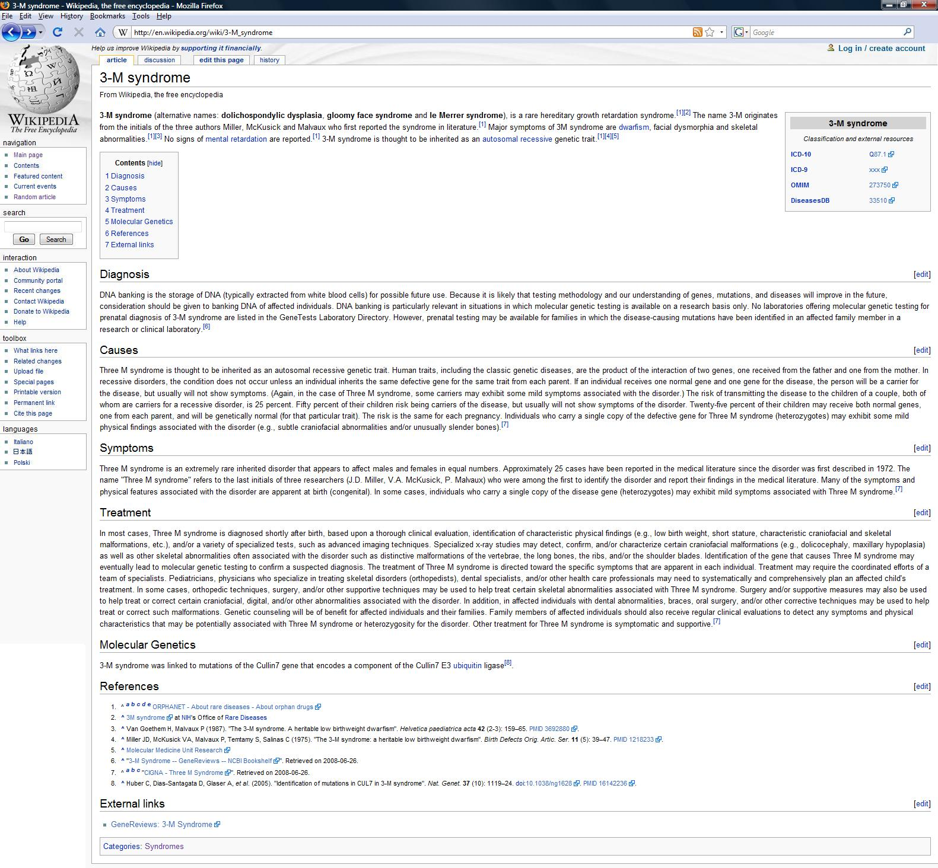
Causes
Three M syndrome is thought to be inherited as an autosomal recessive genetic trait. Human traits, including the classic genetic diseases, are the product of the interaction of two genes, one received from the father and one from the mother. In recessive disorders, the condition does not occur unless an individual inherits the same defective gene for the same trait from each parent. If an individual receives one normal gene and one gene for the disease, the person will be a carrier for the disease, but usually will not show symptoms.

Slide 3
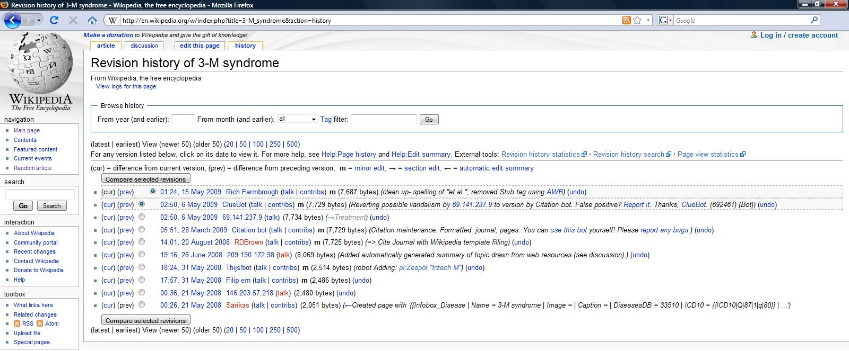
19:16, 26 June 2008 209.190.172.98 (talk) (8,069 bytes)
Added automatically generated summary of topic drawn from web resources (see discussion).

Slide 4
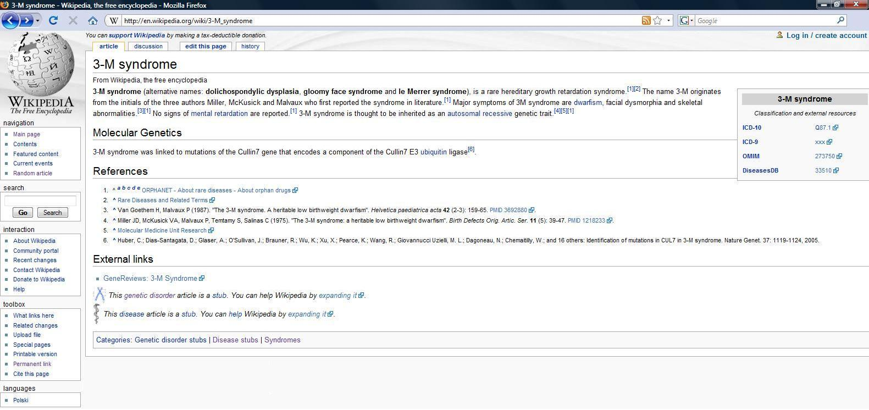
3-M syndrome
From Wikipedia, the free encyclopedia
3-M syndrome (alternative names: dolichospondylic dysplasia, gloomy face syndrome and le Merrer syndrome), is a rare hereditary growth retardation syndrome.^{[1][2]} The name 3-M originates from the initials of the three authors Miller, McKusick and Malvaux who first reported the syndrome in literature.^{[1]} Major symptoms of 3M syndrome are dwarfism, facial dysmorphia and skeletal abnormalities.^{[3][1]} No signs of mental retardation are reported.^{[1]} 3-M syndrome is thought to be inherited as an autosomal recessive genetic trait.^{[4][5][1]}
Molecular Genetics
3-M syndrome was linked to mutations of the Cullin7 gene that encodes a component of the Cullin7 E3 ubiquitin ligase^{[6]}.

Slide 5
01:24, 15 May 2009 Rich Farmbrough (talk | contribs) m (7,687 bytes)
clean up- spelling of "et al.", removed Stub tag using AWB
Notes:
One of many examples where articles have been promoted to full article status

Slide 6
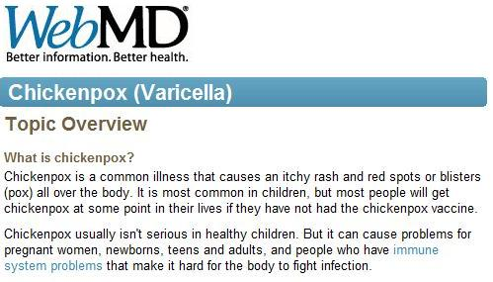
Generating Overview Articles
Goal:
Generate multi-paragraph overview articles
Biography for Matt Damon
Mini Biography
Matt Damon was born in 1970. His father, Kent Damon, a tax preparer, and his mother, Nancy Carlsson-Paige, a college professor, are now divorced. His older brother, Kyle (b. 1967), is a sculptor. Matt's first film role was a one-line part in Mystic Pizza (1988). Hollywood's power brokers realized his potential as a serious actor when they saw him play a Gulf War vet-turned-heroin addict in Courage Under Fire (1996).
Singapore
Singapore (Chinese: 新加坡; pinyin: Xīnjiāpō; Malay: Singapura; Tamil: சிங்கப்பூர், Cingkappūr), officially the Republic of Singapore, is an island city-state located at the southern tip of the Malay Peninsula, lying 137 kilometres (85 mi) north of the equator, south of the Malaysian state of Johor and north of Indonesia's Riau Islands. At 710.2 km² (274.2 sq mi),^{[7]} Singapore, a microstate and the smallest nation in Southeast Asia, is by orders of magnitude larger than Monaco and Vatican City. These, as well as San Marino, are the only other surviving sovereign city-states.
Notes:
Can we automate it?
Currently, all of these are generated by human editors, so there are coverage issues.
***

Slide 7
Generating Overview Articles
Goal:
Generate multi-paragraph overview articles
Related methods:
Multi-document summarization
New challenges:
Coherence issues for long articles
Breadth of information must be covered
Large number of potential sources to select from
Our approach: Use content templates

Slide 8
Template Creation
Articles on similar topics have similar structures
Template specifies content and ordering
Barzilay & Lee 2004; Elsner & Charniak 2007; Chen et. al. 2009
Chickenpox
Chickenpox or chicken pox is a highly contagious illness caused by primary infection with varicella zoster virus (VZV). It generally starts with a vesicular skin rash appearing in two or three waves, mainly on the body and head rather than the hands and becoming itchy raw pockmarks, small open sores which heal mostly without scarring.
Pathophysiology
Chickenpox is usually acquired by the inhalation of airborne respiratory droplets from an infected host. The highly contagious nature of VZV explains the epidemics of chickenpox that spread through schools as one child who is infected quickly spreads the virus to many classmates.
Signs and Symptoms
Chickenpox is a highly infectious disease that spreads from person to person by direct contact or by air from an infected person's coughing or sneezing. Touching the fluid from a chickenpox blister can also spread the disease. A person with chickenpox is infectious from one to five days before the rash appears.
Prevention
A varicella vaccine was first developed by Michiaki Takahashi in 1974 derived from the Oka strain. It has been available in the U.S. since 1995 to inoculate against the disease. Some countries require the varicella vaccination or an exemption before entering elementary school.
Treatment
Although there have been no formal clinical studies evaluating the effectiveness of topical application of calamine lotion, a topical barrier preparation containing zinc oxide and one of the most commonly used interventions, it has an excellent safety profile.
Chickenpox
Chickenpox or chicken pox is a highly contagious illness caused by primary infection with varicella zoster virus (VZV). It generally starts with a vesicular skin rash appearing in two or three waves, mainly on the body and head rather than the hands and becoming itchy raw pockmarks, small open sores which heal mostly without scarring.
Pathophysiology
Chickenpox is usually acquired by the inhalation of airborne respiratory droplets from an infected host. The highly contagious nature of VZV explains the epidemics of chickenpox that spread through schools as one child who is infected quickly spreads the virus to many classmates.
Signs and Symptoms
Chickenpox is a highly infectious disease that spreads from person to person by direct contact or by air from an infected person's coughing or sneezing. Touching the fluid from a chickenpox blister can also spread the disease. A person with chickenpox is infectious from one to five days before the rash appears.
Prevention
A varicella vaccine was first developed by Michiaki Takahashi in 1974 derived from the Oka strain. It has been available in the U.S. since 1995 to inoculate against the disease. Some countries require the varicella vaccination or an exemption before entering elementary school.
Treatment
Although there have been no formal clinical studies evaluating the effectiveness of topical application of calamine lotion, a topical barrier preparation containing zinc oxide and one of the most commonly used interventions, it has an excellent safety profile.
Scarlet fever
Scarlet fever is a disease caused by an erythrogenic exotoxin released by Streptococcus pyogenes. The term Scarlatina may be used interchangeably with Scarlet Fever, though it is commonly used to indicate the less acute form of Scarlet Fever that is often seen since the beginning of the twentieth century.
Diagnosis
Diagnosis of scarlet fever is clinical. The blood test shows marked leukocytosis with neutrophilia and conservated or increased eosinophils, high erythrocyte sedimentation rate (ESR) and C-reactive protein (CRP), and elevation of antistreptolysin O titer. Blood culture is rarely positive, but the streptococci can usually be demonstrated in throat culture.
Symptoms
The rash is the most striking sign of scarlet fever. It usually begins looking like a bad sunburn with tiny bumps, and it may itch. The rash usually appears first on the neck and face, often leaving a clear unaffected area around the mouth. It spreads to the chest and back, then to the rest of the body.
Treatment
Other than the occurrence of the diarrhea, the treatment and course of scarlet fever are no different from those of any strep throat. In case of penicillin allergy, clindamycin or erythromycin can be used with success. Patients should no longer be infectious after taking antibiotics for 24 hours..
Scarlet fever
Scarlet fever is a disease caused by an erythrogenic exotoxin released by Streptococcus pyogenes. The term Scarlatina may be used interchangeably with Scarlet Fever, though it is commonly used to indicate the less acute form of Scarlet Fever that is often seen since the beginning of the twentieth century.
Diagnosis
Diagnosis of scarlet fever is clinical. The blood test shows marked leukocytosis with neutrophilia and conservated or increased eosinophils, high erythrocyte sedimentation rate (ESR) and C-reactive protein (CRP), and elevation of antistreptolysin O titer. Blood culture is rarely positive, but the streptococci can usually be demonstrated in throat culture.
Symptoms
The rash is the most striking sign of scarlet fever. It usually begins looking like a bad sunburn with tiny bumps, and it may itch. The rash usually appears first on the neck and face, often leaving a clear unaffected area around the mouth. It spreads to the chest and back, then to the rest of the body.
Treatment
Other than the occurrence of the diarrhea, the treatment and course of scarlet fever are no different from those of any strep throat. In case of penicillin allergy, clindamycin or erythromycin can be used with success. Patients should no longer be infectious after taking antibiotics for 24 hours..
Chronic fatigue syndrome
The defining symptoms of fibromyalgia are chronic, widespread pain, fatigue, and heightened pain in response to pressure. Other symptoms may include tingling of the skin, prolonged muscle spasms, weakness in the limbs, nerve pain, functional bowel disturbances, and chronic sleep disturbances.
Diagnosing CFS
There are no medical tests or physical signs to diagnose CFS, so testing is used to rule out other potential causes for symptoms. The most widely used clinical and research description of CFS is the CDC definition published in 1994. Using different case definitions may influence the types of patients selected and there is research to suggest subtypes of patients or disease exist.
Causes
The mechanisms and pathogenesis of chronic fatigue syndrome are unknown. Research studies have examined and hypothesized about the possible biomedical and epidemiological characteristics of the disease, including oxidative stress, genetic predisposition, infection by viruses and pathogenic bacteria, hypothalamic-pituitary-adrenal axis, immune dysfunction as well as mental and psychosocial factors.
Symptoms
The most commonly used diagnostic criteria and definition of CFS for research and clinical purposes was published by the United States Centers for Disease Control and Prevention (CDC). The CDC definition of CFS requires two of the following criteria be fulfilled.
Prognosis
A systematic review of 14 studies of the outcome of untreated people with CFS found that "the median full recovery rate was 5% (range 0–31%) and the median proportion of patients who improved during follow-up was 39.5% (range 8–63%). Return to work at follow-up ranged from 8 to 30% in the three studies that considered this outcome."
Chronic fatigue syndrome
The defining symptoms of fibromyalgia are chronic, widespread pain, fatigue, and heightened pain in response to pressure. Other symptoms may include tingling of the skin, prolonged muscle spasms, weakness in the limbs, nerve pain, functional bowel disturbances, and chronic sleep disturbances.
Diagnosing CFS
There are no medical tests or physical signs to diagnose CFS, so testing is used to rule out other potential causes for symptoms. The most widely used clinical and research description of CFS is the CDC definition published in 1994. Using different case definitions may influence the types of patients selected and there is research to suggest subtypes of patients or disease exist.
Causes
The mechanisms and pathogenesis of chronic fatigue syndrome are unknown. Research studies have examined and hypothesized about the possible biomedical and epidemiological characteristics of the disease, including oxidative stress, genetic predisposition, infection by viruses and pathogenic bacteria, hypothalamic-pituitary-adrenal axis, immune dysfunction as well as mental and psychosocial factors.
Symptoms
The most commonly used diagnostic criteria and definition of CFS for research and clinical purposes was published by the United States Centers for Disease Control and Prevention (CDC). The CDC definition of CFS requires two of the following criteria be fulfilled.
Prognosis
A systematic review of 14 studies of the outcome of untreated people with CFS found that "the median full recovery rate was 5% (range 0–31%) and the median proportion of patients who improved during follow-up was 39.5% (range 8–63%). Return to work at follow-up ranged from 8 to 30% in the three studies that considered this outcome."
Notes:
Citations – barzilay & lee, chen et al 2009, elsner & charniak 2007?
Because our data is relatively easy, we use a simple technique

Slide 9
Template Creation
Create an article template automatically using existing articles as examples
Cluster section titles
Select largest clusters
Order based on examples
Example articles
Section clusters
Template
Chronic fatigue syndrome
The defining symptoms of fibromyalgia are chronic, widespread pain, fatigue, and heightened pain in response to pressure. Other symptoms may include tingling of the skin, prolonged muscle spasms, weakness in the limbs, nerve pain, functional bowel disturbances, and chronic sleep disturbances.
Diagnosing CFS
There are no medical tests or physical signs to diagnose CFS, so testing is used to rule out other potential causes for symptoms. The most widely used clinical and research description of CFS is the CDC definition published in 1994. Using different case definitions may influence the types of patients selected and there is research to suggest subtypes of patients or disease exist.
Causes
The mechanisms and pathogenesis of chronic fatigue syndrome are unknown. Research studies have examined and hypothesized about the possible biomedical and epidemiological characteristics of the disease, including oxidative stress, genetic predisposition, infection by viruses and pathogenic bacteria, hypothalamic-pituitary-adrenal axis, immune dysfunction as well as mental and psychosocial factors.
Symptoms
The most commonly used diagnostic criteria and definition of CFS for research and clinical purposes was published by the United States Centers for Disease Control and Prevention (CDC). The CDC definition of CFS requires two of the following criteria be fulfilled.
Prognosis
A systematic review of 14 studies of the outcome of untreated people with CFS found that "the median full recovery rate was 5% (range 0–31%) and the median proportion of patients who improved during follow-up was 39.5% (range 8–63%). Return to work at follow-up ranged from 8 to 30% in the three studies that considered this outcome."
Chickenpox
Chickenpox or chicken pox is a highly contagious illness caused by primary infection with varicella zoster virus (VZV). It generally starts with a vesicular skin rash appearing in two or three waves, mainly on the body and head rather than the hands and becoming itchy raw pockmarks, small open sores which heal mostly without scarring.
Pathophysiology
Chickenpox is usually acquired by the inhalation of airborne respiratory droplets from an infected host. The highly contagious nature of VZV explains the epidemics of chickenpox that spread through schools as one child who is infected quickly spreads the virus to many classmates.
Signs and Symptoms
Chickenpox is a highly infectious disease that spreads from person to person by direct contact or by air from an infected person's coughing or sneezing. Touching the fluid from a chickenpox blister can also spread the disease. A person with chickenpox is infectious from one to five days before the rash appears.
Prevention
A varicella vaccine was first developed by Michiaki Takahashi in 1974 derived from the Oka strain. It has been available in the U.S. since 1995 to inoculate against the disease. Some countries require the varicella vaccination or an exemption before entering elementary school.
Treatment
Although there have been no formal clinical studies evaluating the effectiveness of topical application of calamine lotion, a topical barrier preparation containing zinc oxide and one of the most commonly used interventions, it has an excellent safety profile.
Scarlet fever
Scarlet fever is a disease caused by an erythrogenic exotoxin released by Streptococcus pyogenes. The term Scarlatina may be used interchangeably with Scarlet Fever, though it is commonly used to indicate the less acute form of Scarlet Fever that is often seen since the beginning of the twentieth century.
Diagnosis
Diagnosis of scarlet fever is clinical. The blood test shows marked leukocytosis with neutrophilia and conservated or increased eosinophils, high erythrocyte sedimentation rate (ESR) and C-reactive protein (CRP), and elevation of antistreptolysin O titer. Blood culture is rarely positive, but the streptococci can usually be demonstrated in throat culture.
Symptoms
The rash is the most striking sign of scarlet fever. It usually begins looking like a bad sunburn with tiny bumps, and it may itch. The rash usually appears first on the neck and face, often leaving a clear unaffected area around the mouth. It spreads to the chest and back, then to the rest of the body.
Treatment
Other than the occurrence of the diarrhea, the treatment and course of scarlet fever are no different from those of any strep throat. In case of penicillin allergy, clindamycin or erythromycin can be used with success. Patients should no longer be infectious after taking antibiotics for 24 hours..

Slide 10
Our Method
This talk
Candidate Retrieval
(Yahoo!)
Joint Selection
Candidate Excerpts
query
Disease template
Final article
Diagnosis
query
Causes
Symptoms
…
query
…

Slide 11
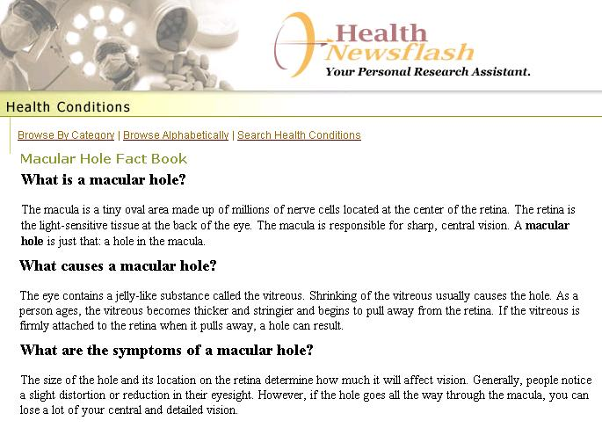
Joint Selection: Input
For each section,
About 60 excerpts obtained via candidate retrieval
Candidate excerpts for Causes
Candidate excerpts for Treatment
Macular Hole
Conventional Treatment:
A surgical procedure called vitrectomy is often used to treat holes that go all the way through the macula. The vitreous is removed to prevent it from pulling on the retina. It is replaced with a gas bubble that eventually fills with natural fluids.
Following surgery, patients must usually keep their faces down for two or three weeks. This position allows the bubble to press against the macula and seal the hole. At the end of the 2-3 week period of strict face-down positioning, the patient is then permitted to resume a more normal upright posture. The air bubble itself, however, may take anywhere from 6-8 weeks following surgery to completely disappear. The air bubble is gradually resorbed by the body, and the vitreous cavity is then filled with liquid produced by cells in the front of the eye.
Vitrectomy can lead to complications, most commonly an increase in how fast cataracts develop. Other less common complications include infection and retinal detachment either during surgery or afterward.

Slide 12
Joint Selection: Output
For each section
Exactly one excerpt, chosen jointly across sections
Together, these represent a complete article
Diagnosis
DNA banking is the storage of DNA (typically extracted from white blood cells) for possible future use. Because it is likely that testing methodology and our understanding of genes, mutations, and diseases will improve in the future, consideration should be given to banking DNA of affected individuals. DNA banking is particularly relevant in situations in which molecular genetic testing is available on a research basis only.
Causes
Three M syndrome is thought to be inherited as an autosomal recessive genetic trait. Human traits, including the classic genetic diseases, are the product of the interaction of two genes, one received from the father and one from the mother. In recessive disorders, the condition does not occur unless an individual inherits the same defective gene for the same trait from each parent. If an individual receives one normal gene and one gene for the disease, the person will be a carrier for the disease, but usually will not show symptoms.
Symptoms
Three M syndrome is an extremely rare inherited disorder that appears to affect males and females in equal numbers. Approximately 25 cases have been reported in the medical literature since the disorder was first described in 1972. The name "Three M syndrome" refers to the last initials of three researchers (J.D. Miller, V.A. McKusick, P. Malvaux) who were among the first to identify the disorder and report their findings in the medical literature.
Treatment
The treatment of Three M syndrome is directed toward the specific symptoms that are apparent in each individual. Treatment may require the coordinated efforts of a team of specialists. Pediatricians, orthopedists, dental specialists, and/or other health care professionals may need to systematically and comprehensively plan an affected child's treatment. In some cases, orthopedic techniques, surgery, and/or other supportive techniques may be used to help treat certain skeletal abnormalities associated with Three M syndrome.
Notes:
I’m going to explain the algorithm, but first I’ll present the training data

Slide 13
Training Data
No manual annotation required with Wikipedia data
Select existing articles from a given category
Retrieve candidates for each section using our candidate retrieval method
Mark examples based on similarity to original
Positive examples: cosine similarity > threshold
Original article
Retrieved candidates
Chickenpox is usually acquired by the inhalation of airborne respiratory droplets from an infected host. The highly contagious nature of VZV explains the epidemics of chickenpox that spread through schools as one child who is infected quickly spreads the virus to many classmates.
The average child develops 250 to 500 small, itchy, fluid-filled blisters over red spots on the skin. The blisters often appear first on the face, trunk, or scalp and spread from there. Appearance of the small blisters on the scalp, found in 80% of cases, clinches the diagnosis.
0.56
The cause of chicken pox is the varicella-zoster virus (VZV).. Chickenpox is highly contagious, and the chickenpox virus can be transmitted by numerous methods including airborne transmission, direct contact, and droplet transmission.
0.87
3-M syndrome is a rare hereditary growth retardation syndrome. The name 3-M originates from the initials of the three authors Miller, McKusick and Malvaux who first reported the syndrome. Major symptoms are dwarfism, facial dysmorphia and skeletal abnormalities.
0.12

Slide 14
Excerpt Selection: Desiderata
Select one excerpt per section
Maximize fit into each section
Prohibit excessive redundancy
Diagnosis
Causes
Symptoms
Treatment
Formulate as an Integer Linear Programming (ILP) optimization problem

Slide 15
Excerpt Selection: Objective
i-1
i
Objective:
Minimize total rank of selected excerpts
x_{i,j} = 1 if excerpt j is chosen for section i; 0 otherwise
…
…
x_{i,j} = 1
j
x_{i,j+1} = 0
j+1
Notes:
How to translate the variables into ILP
explain x_ij, binary indicator variable. Want to give 1 or 0.
Sum all the ranks of selected variables.
Move j j+1 to side; x=1 x=0 closer

Slide 16
Ranking Excerpts
For each section i, rank excerpts e
Features ϕ:
Unigrams, bigrams, word position
Length, sentence types
Title mentions
Counts of dates, pronouns
Count of similar excerpts
score_{j} (e) = ϕ(e) · w_{i}
Ranked Excerpts
Candidate Excerpts
ϕ(e) – features
Diagnosis
w_{i} – weights for section i
1
2
3
4
Treatment
1
2
3
4
5

Slide 17
Excerpt Selection: Objective
Objective:
Minimize total rank of selected excerpts
Notes:
But if we select nothing, the rank will be 0! Therefore…

Slide 18
Excerpt Selection: Exclusivity
Objective:
Minimize total rank of selected excerpts
Constraints:
Exclusivity
exactly one excerpt per section
Treatment
Treatment
Treatment
1
1
1
2
2
2
3
3
3
4
4
4

Slide 19
Excerpt Selection: Redundancy
Objective:
Minimize total rank of selected excerpts:
Constraints:
Exclusivity
exactly one excerpt per topic
Redundancy
similarity between each pair of selected excerpts < 0.5
1
0.75
1
2
0.25
2

Slide 20
ILP Optimization
ILP has been applied previously in summarization
Marciniak & Strube 2005; Clarke & Lapata 2007; McDonald 2007
Traditional approach:
Disjoint learning; constraints during inference
Our approach:
Joint learning
Fold ILP into learning process
Perceptron ranking framework

Slide 21
Training
Iterate over articles in training set:
Generate an entire article using current weights
Compare the generated article with the training example
Adjust weights for incorrect sections as in perceptron
Training data
Generated data
a
...... ……
a
w
w
b
e
b
...... ……
e
w
w
c
f
c
...... ……
f
d
...... ……
d
Notes:
Add training time

Slide 22
Implementation Details
Iterative training procedure
Compute ILP during each step of each iteration
Concern: ILP is slow (NP hard)
In practice, manageable
Generate article: 1-2 sec.
Train: 6 hours

Slide 23
Evaluation Setup
Compare against existing articles
Automatic evaluation with Rouge-1
Similar to DUC evaluation
90% train / 10% test
 | # Articles | Avg. article size
American Film Actors | 2,150 | 13.7 sent.
Diseases | 523 | 16.8 sent.

Slide 24
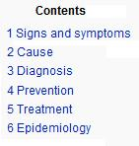
Oracle
For each section in original article, select best candidate section
Does not follow template; may have more or fewer sections
Wikipedia article
Candidates
Oracle article
1
1
2
3
2
3
3
4
4
5
…
5
6
6
Notes:
Is rouge applicable here? Typically in summarization, summary is taken from input documents. But we have no idea if it will be the case here

Slide 25
Evaluation: Oracle

Slide 26
Evaluation: Full Model

Slide 27
Baselines: Search
Search
First paragraphs of the first search result
“macular hole”
Macular Hole - Causes, Symptoms & Treatment
Macular Hole Facts plus the Latest News on Macular Hole Treatments...
A macular hole is just that: a hole in the macula. What causes a …
http://healthnewsflash.com/conditions/macular_hole.htm - Cached
Facts About Macular Hole [NEI Health Information]
Publication about macular hole, a small break in the macula, which is located
in the center of the eye's retina. ... What causes a macular hole? …
http://www.nei.nih.gov/health/macularhole - Cached
Similar to lead-based summarization techniques
Notes:
Hard baseline to beat

Slide 28
Evaluation: Search
Search alone is not sufficient
Notes:
No organized resources, really bad. Even when there are, our system performs better

Slide 29
Baselines: No Template
Search
First paragraphs of the first search result
No Template
Cluster by topic, then use single classifier (vs. per section)
“macular hole”
0.83
0.90
0.90
0.72
0.25
0.95
0.95
0.34
0.86
0.90
…
0.85
0.85
Similar to biographical summarization techniques
Zhou et al., 2004; Biadsy et al., 2008
Notes:
Ignore all sections; just 1 selector instead of 4

Slide 30
Evaluation: No Template
Structure helps performance
Notes:
We again see that our system performs better across the domains, however the difference is more substantial in diseases

Slide 31
Baselines: Disjoint
Search
First paragraphs of the first search result
No Template
Single classifier with topic clustering
Disjoint
Separate training for section classifiers
Diagnosis
Causes
Symptoms
Treatment
1
1
1
1
1
1
1
1
2
2
2
2
3
3
3
3
4
4
4
4

Slide 32
Evaluation: Disjoint
Joint learning helps performance
Notes:
Consistent performance gain by using joint training

Slide 33
Analysis of editor reaction: Method
Goal:
Observe long-term reader response to articles
Method:
Replace 15 Wikipedia stubs with system outputs
Monitor edits to evaluate article quality
Revision history of Felty’s syndrome
16:33, 15 February 2009 Stevenfruitsmaak m (5,404 bytes) (→Complications: c/e)
00:00, 15 January 2009 AnjaManix (5,405 bytes)
14:08, 23 December 2008 212.20.74.230 (5,380 bytes) (cs iw)
02:32, 16 December 2008 Kilbad (5,357 bytes) (→Causes: removing space)
02:32, 16 December 2008 Kilbad m (5,358 bytes) (→Diagnosis: removing spaces)
01:00, 16 December 2008 Arcadian (5,362 bytes) (ref)
00:58, 16 December 2008 Arcadian (5,252 bytes) (→Treatment: refs)

Slide 34
Analysis of editor reaction: Results
Common edit types:
Intra-wiki links
“Pellagra, a similar condition”
Grammar
“following discontinuing Didronel” → “following discontinuation of Didronel”
Content changes
Removed promotional text taken from a drug manufacturer’s website
Type | Count
Total Articles | 15
Promoted | 13
Edit Types
Intra-wiki links | 41
Grammar | 22
Content changes | 4
… | …
Total Edits | 93

Slide 35
Conclusions
Structure is important when creating long overview articles
Constraints may be enforced during joint learning
Automatically generated articles are useful first drafts for editors
Amyoplasia
Amyoplasia is a generalized lack in the newborn of muscular development and growth, with contracture and deformity at most joints. It is the most common form of arthrogryposis.^{[1]}
It is characterized by quadrimelic involvement and replacement of sketetal muscle by dense fibrous tissue and fat. Studies involving Amyoplasia have revealed similar findings of the muscle tissue due to various causes including that seen in sacral agenesis and diseases of the anterior horn cell. So amyoplasia may not describe just one group of patients but may be an intermediate common pathway rather than the primary cause of the contractures.
Accounts for over 1/3 of the cases of arthrogryposis. Sporadic inheritance.
Cogan syndrome
Cogan syndrome is a rare disorder characterized by recurrent inflammation of the front of the eye (the cornea) and often fever, fatigue, and weight loss, episodes of dizziness, and hearing loss. It can lead to deafness or blindness if untreated. The classic form of the disease was first described by D.G. Cogan in 1945.
History
In 1945 ophthalmologist David Glendenning Cogan (1908-1993) first described the "nonsyphilitic interstitial keratitis and vestibuloauditory symptoms" that would later bear his name.^{[1]} In 1963, the atypical form of Cogan syndrome was first described.^{[2]}
Diagnosis
While the ESR, WBC, C-reactive protein test may be abnormal and
Felty’s syndrome
Felty's syndrome is a disorder characterized by the combination of rheumatoid arthritis, splenomegaly and neutropenia.^{[1]}
Diagnosis
Felty's syndrome is defined by the presence of three conditions: rheumatoid arthritis, an enlarged spleen (splenomegaly), and an abnormally low white blood count. It affects less than 1% of patients with rheumatoid arthritis.^{[2]}
Causes
The cause of Felty's syndrome is unknown. It is more common in
List of articles:
http://people.csail.mit.edu/csauper/wiki.html

