Slide 1
An Effective Coreset Compression Algorithm for Large Scale Sensor Networks
Dan Feldman, Andrew Sugaya
Daniela Rus
MIT

Slide 2
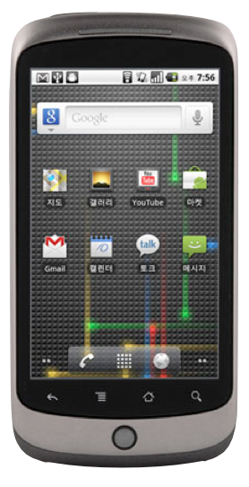

Data
Data
Data
Data
=
Data
Data
Data

Slide 3
How much data?

Slide 5
1 GPS Packet
=
100 bytes
(latitude, longitude, time)

Slide 6
1 GPS Packet
=
100 bytes
every 10 seconds

Slide 7
~40 Mb / hour
or
~1 Gb / day

Slide 8
~1 Gb / day
per device

Slide 9
~300 million
smart phones
sold in 2010
http://mobithinking.com/mobile-marketing-tools/latest-mobile-stats

Slide 10
For
100 million devices

Slide 11
For
100 million devices
~ 100 petabytes
per day

Slide 12
~ 100 thousand
terabytes
per day

Slide 13
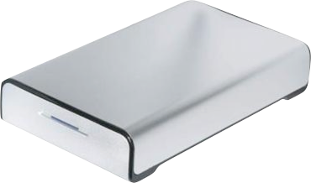

Slide 14
2 terabytes each

Slide 15

x50000 / day

Slide 16
A lot of data.

Slide 17
GPS-points Data
iPhones can collect high-frequency GPS traces
GPS-point = (latitude, longitude, time)
latitude | longitude | time
1.295783 | 103.7816 | 8:44:57
1.295785 | 103.7816 | 8:44:59
1.295782 | 103.7816 | 8:45:00
1.295782 | 103.7816 | 8:45:01
1.29579 | 103.7817 | 8:45:04
1.295802 | 103.7817 | 8:45:05
1.295915 | 103.7818 | 8:45:08
1.29598 | 103.7819 | 8:45:09
1.296015 | 103.7819 | 8:45:10
1.296057 | 103.782 | 8:45:11
… | … | …
Notes:
Give a brief overview of the presentation. Describe the major focus of the presentation and why it is important.
Introduce each of the major topics.
To provide a road map for the audience, you can repeat this Overview slide throughout the presentation, highlighting the particular topic you will discuss next.

Slide 18
Example

Slide 19

3-D Visualization
$(x, y)$axes: (latitude, longitude)
$z$ axis: time

Slide 20
Challenges
Storing data on iPhone is expensive
Transmission data is expensive
Hard to interpret raw data
Dynamic real-time streaming data
Notes:
Give a brief overview of the presentation. Describe the major focus of the presentation and why it is important.
Introduce each of the major topics.
To provide a road map for the audience, you can repeat this Overview slide throughout the presentation, highlighting the particular topic you will discuss next.

Slide 21
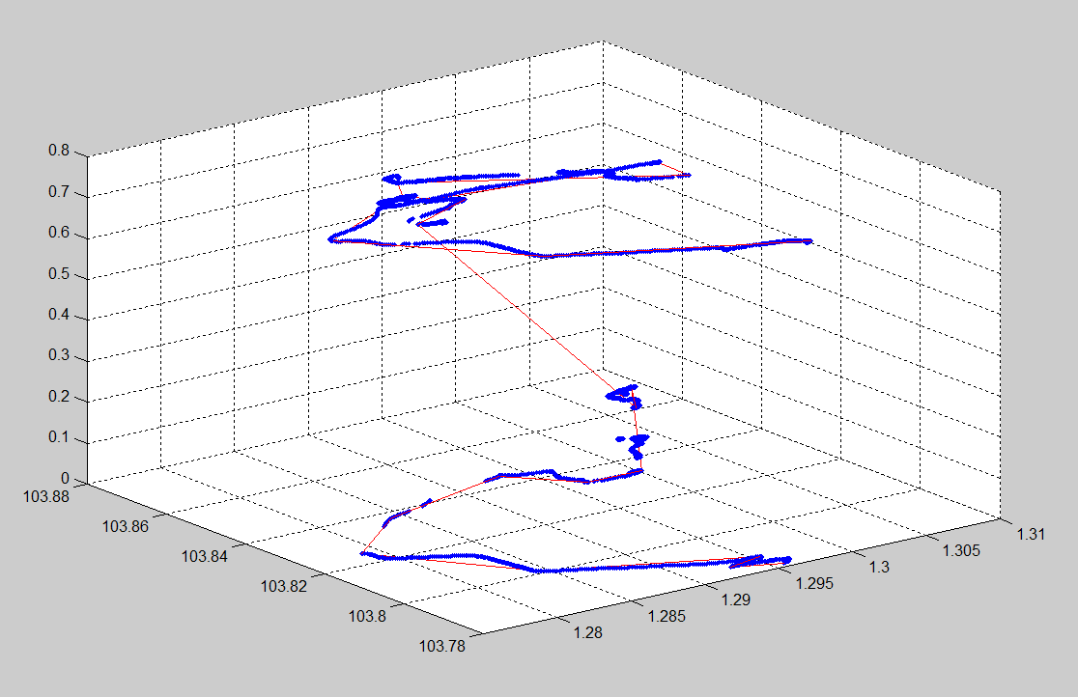


Key Insight:
Identify Critical Points
Approximate the n points by k << n semantically meaningful connected segments
$$n = 5000$$
$$k =20$$

Slide 22
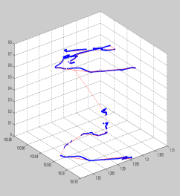

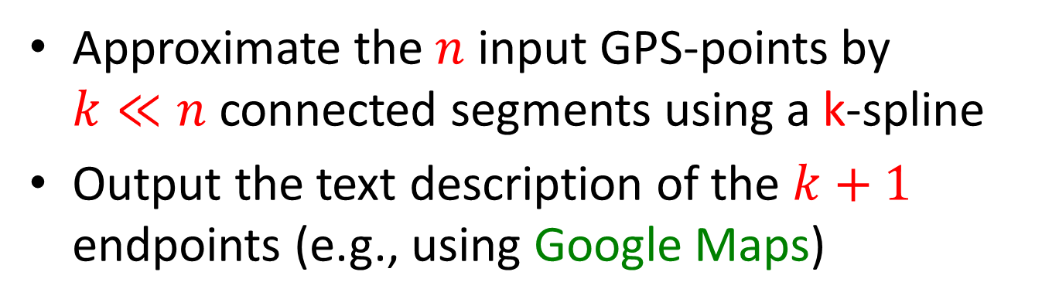


Our Approach
Approximate the $n$ input GPS-points by $k≪n$ connected segments using a k-spline
Output the text description of the $k+1$ endpoints (e.g., using Google Maps)
time | latitude | longitude
8:44:57 | 1.295783 | 103.7816
8:44:59 | 1.295785 | 103.7816
8:45:00 | 1.295782 | 103.7816
8:45:01 | 1.295782 | 103.7816
8:45:04 | 1.29579 | 103.7817
8:45:05 | 1.295802 | 103.7817
8:45:08 | 1.295915 | 103.7818
8:45:09 | 1.29598 | 103.7819
8:45:10 | 1.296015 | 103.7819
8:45:11 | 1.296057 | 103.782
… | … | …
Central Expy, Singapore
Ayer Rajah Expy, Singapore
Chin Swee Rd, Singapore
261 Outram Rd, Singapore 169057
1 St Andrew's Rd, Singapore 178957
390A Havelock Rd, Singapore 169664
5A Raffles Ave, Singapore 039801
7 Raffles Blvd, Singapore 039595
N Buona Vista Rd, Singapore
5 Lower Kent Ridge Rd, Singapore
4 Medical Dr, Singapore 117594
20 Leonie Hill, Singapore
113 Devonshire Rd, Singapore 239878
121 Devonshire Rd, Singapore 239882
15 Grange Rd, Singapore
27 Grange Rd, Singapore 239700
Natl Youth Council, Singapore
25K Paterson Rd, Singapore 238517
321 Orchard Rd, Singapore 238866
220 Orchard Rd, Singapore 238852
$$n = 5000$$
$$k =20$$
$$k+1 =21$$

Slide 23
Solution overview
Semantically compress data points
  Use coresets
Fit lines to the semantic points
  Use splines on coreset
Reverse geo-cite to get directions

Slide 24



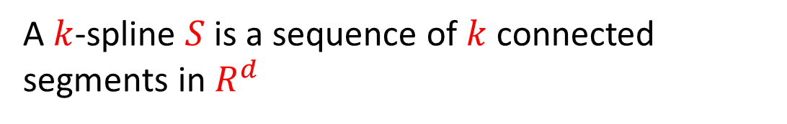
Definition: $k$-Spline
A $k$-spline $S$ is a sequence of $k$ connected segments in $R^{d}$
$$k=4$$
$$d=2$$

Slide 25


Definition: $s(t)$
$s\left(t\right):= \left\{\begin{aligned}s \\ ∞\end{aligned}\begin{aligned}\text{if} ∃s∈S \text{such} \text{that} s=({t,x}_{1},x_{2},⋯) \\ otherwise\end{aligned}\right.$

Slide 26
Definition: $s(t)$
$s\left(t\right):= \left\{\begin{aligned}s \\ ∞\end{aligned}\begin{aligned}\text{if} ∃s∈S \text{such} \text{that} s=(t,x_{1},x_{2},⋯) \\ otherwise\end{aligned}\right.$

Slide 27

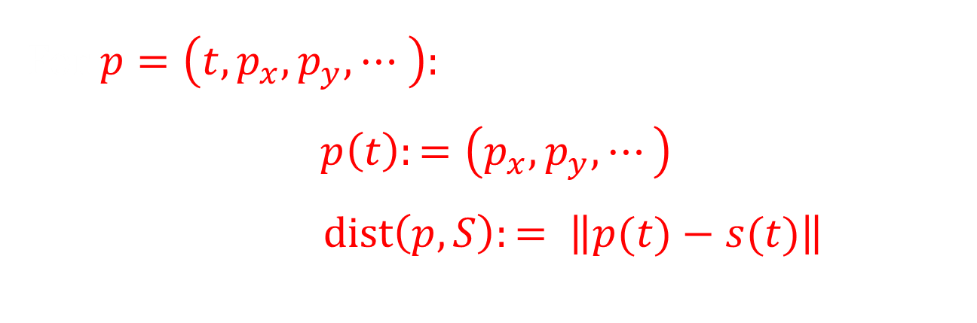
Distance to a Point $p∈R^{d}$
For $p=\left({t,p}_{x}, p_{y}, ⋯ \right)$:
$$p\left(t\right):=\left(p_{x}, p_{y},⋯\right)$$
$dist\left(p, S\right):= \left\|p(t)−s(t)\right\|$

Slide 28


Distance to a Set $P⊆R^{d}$
  $Dist\left(P, S\right)≔\max_{p∈P} \left\|p(t)−s(t)\right\|$

Slide 29



Optimal $k$-spline
  $Dist\left(P, S\right)≔\max_{p∈P} \left\|p(t)−s(t)\right\|$
$Opt\left(P, k\right)≔\min_{S} Dist(P,S)$ over every k-spline $S$

Slide 30

Optimal $k$-spline
  $Dist\left(P, S\right)≔\max_{p∈P} \left\|p(t)−s(t)\right\|$
$Opt\left(P, k\right)≔\min_{S} Dist(P,S)$ over every k-spline $S$
$S^{∗}$ is an optimal $k$-spline of $P$ if :
$Dist(P,S^{∗})=Opt(P,k)$

Slide 31
Problem Statement
Input: set P of n data points in R^{d} and integer k
Output: optimal k-spline for P that provides semantic compression for large data set P

Slide 32
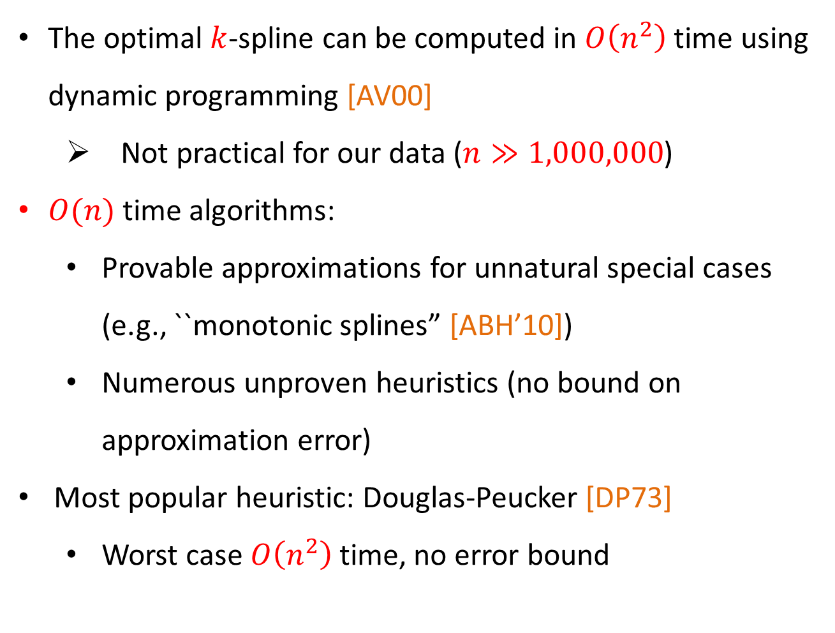
Related Work

Slide 33
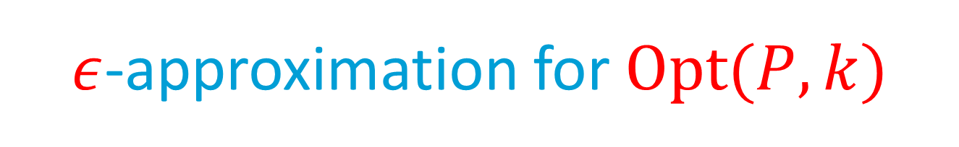
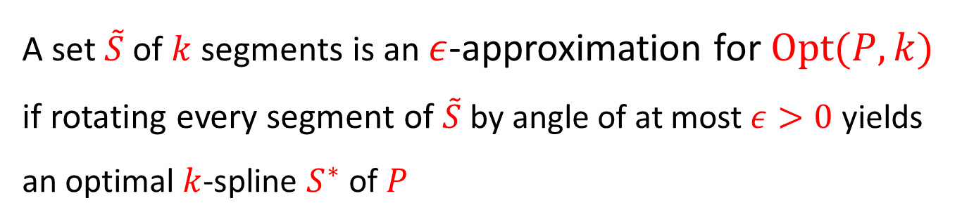

Slide 34
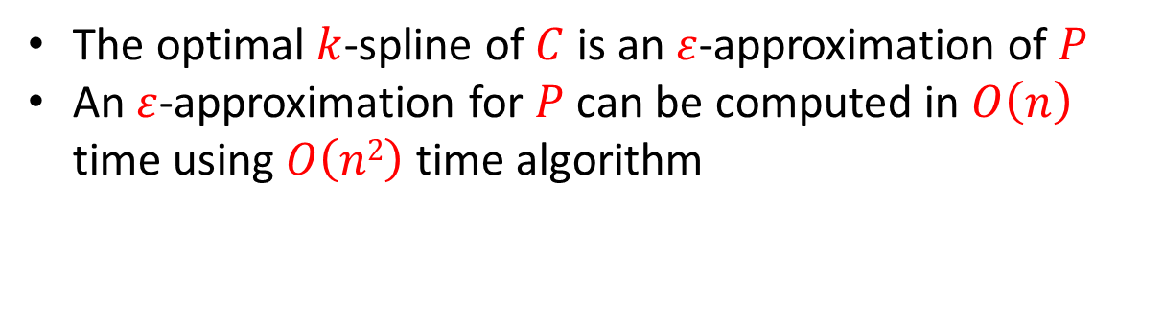
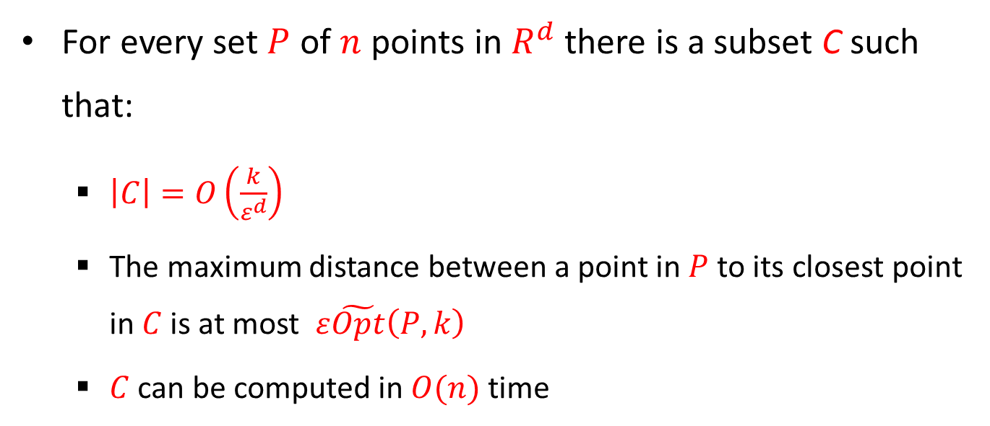
Our Main Compression Theorem
For every set $P$ of $n$ points in $R^{d}$ there is a subset C such that:
  $\left|C\right|=O\left(\frac{k}{ε^{d}}\right)$
  The maximum distance between a point in $P$ to its closest point in $C$ is at most $ε\tilde{Opt}\left(P,k\right)$
  $C$ can be computed in $O(n)$ time
Example application
The optimal $k$-spline of $C$ is an $ε$-approximation of $P$
An $ε$-approximation for $P$ can be computed in $O\left(n\right)$ time using $O\left(n2\right)$ time algorithm

Slide 35
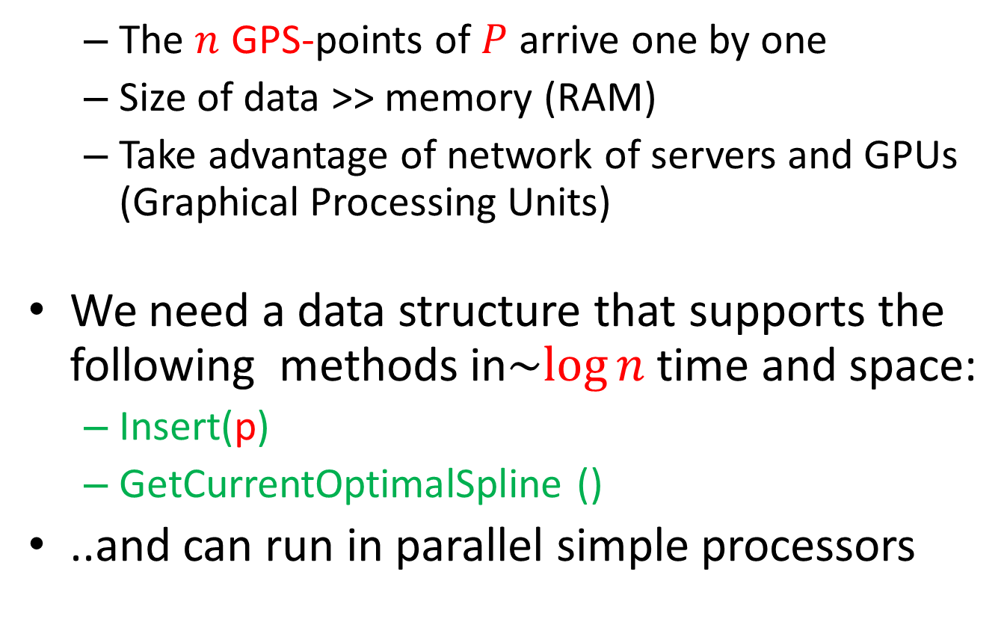
Streaming and Parallel Computation

Slide 36
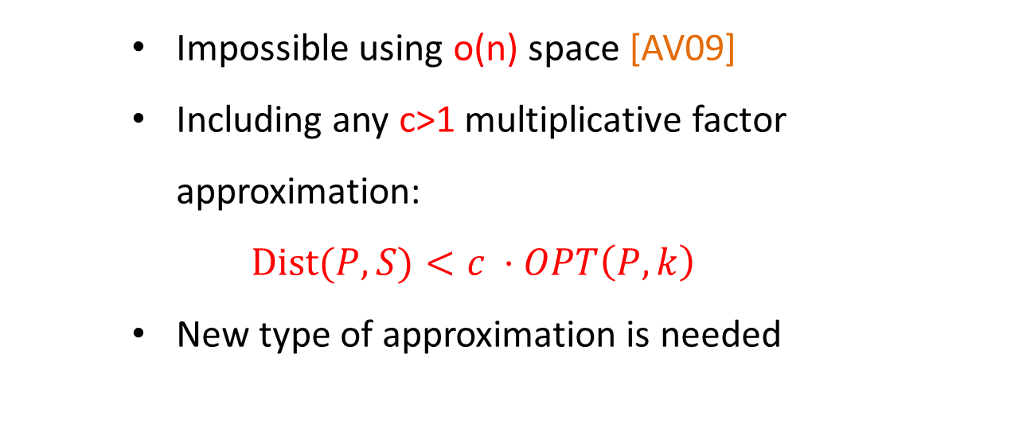
Previous Work for streaming

Slide 37
Streaming Compression using merge & reduce
p₁
p₂
p₃
p₄
p₅
p₆
p₇
p₈
p₉
p₁₀
p₁₁
p₁₂
p₁₃
p₁₄
p₁₅
p₁₆
Notes:
37

Slide 38
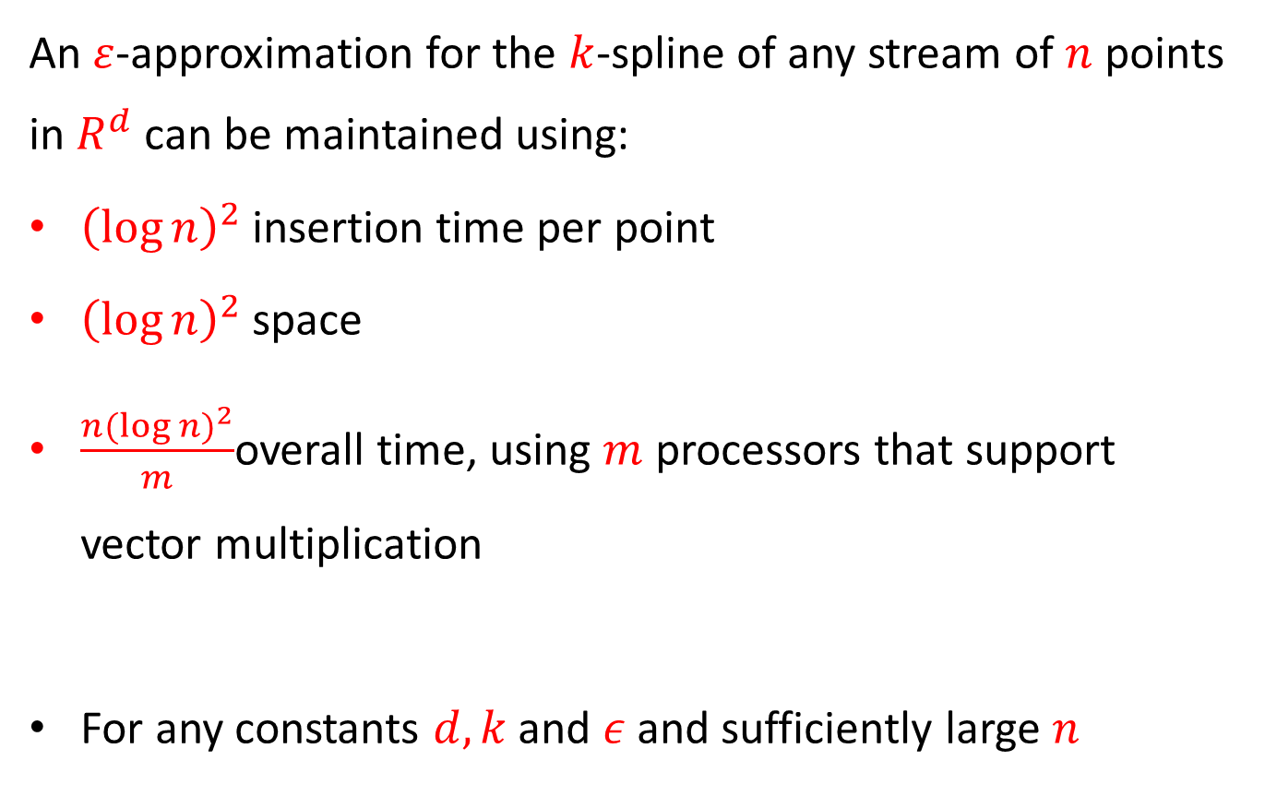
Our Main Streaming Theorem

Slide 39
Parallel computation
p₁
p₂
p₃
p₄
p₅
p₆
p₇
p₈
p₉
p₁₀
p₁₁
p₁₂
p₁₃
p₁₄
p₁₅
p₁₆
Notes:
39

Slide 40


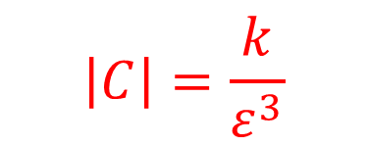

Summary
time | latitude | longitude
8:44:57 | 1.295783 | 103.7816
8:44:59 | 1.295785 | 103.7816
8:45:00 | 1.295782 | 103.7816
8:45:01 | 1.295782 | 103.7816
8:45:04 | 1.29579 | 103.7817
8:45:05 | 1.295802 | 103.7817
8:45:08 | 1.295915 | 103.7818
8:45:09 | 1.29598 | 103.7819
8:45:10 | 1.296015 | 103.7819
8:45:11 | 1.296057 | 103.782
… | … | …
$$\left|C\right|=\frac{k}{ε^{3}}$$
$$\left|P\right|= n$$
Central Expy, Singapore
Ayer Rajah Expy, Singapore
Chin Swee Rd, Singapore
261 Outram Rd, Singapore 169057
1 St Andrew's Rd, Singapore 178957
390A Havelock Rd, Singapore 169664
5A Raffles Ave, Singapore 039801
7 Raffles Blvd, Singapore 039595
N Buona Vista Rd, Singapore
5 Lower Kent Ridge Rd, Singapore
4 Medical Dr, Singapore 117594
20 Leonie Hill, Singapore
113 Devonshire Rd, Singapore 239878
121 Devonshire Rd, Singapore 239882
15 Grange Rd, Singapore
27 Grange Rd, Singapore 239700
Natl Youth Council, Singapore
25K Paterson Rd, Singapore 238517
321 Orchard Rd, Singapore 238866
220 Orchard Rd, Singapore 238852
$k$-spline
$k+1$ points

Slide 41

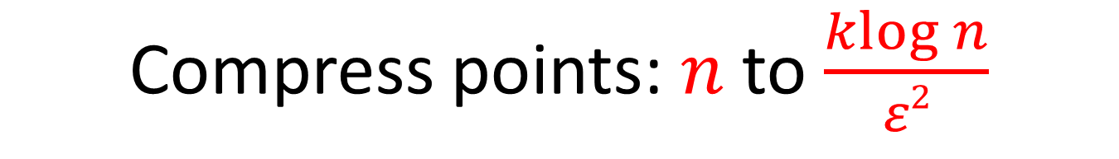
Compress points:$n$ to $\frac{klog n}{ε2}$

Slide 42
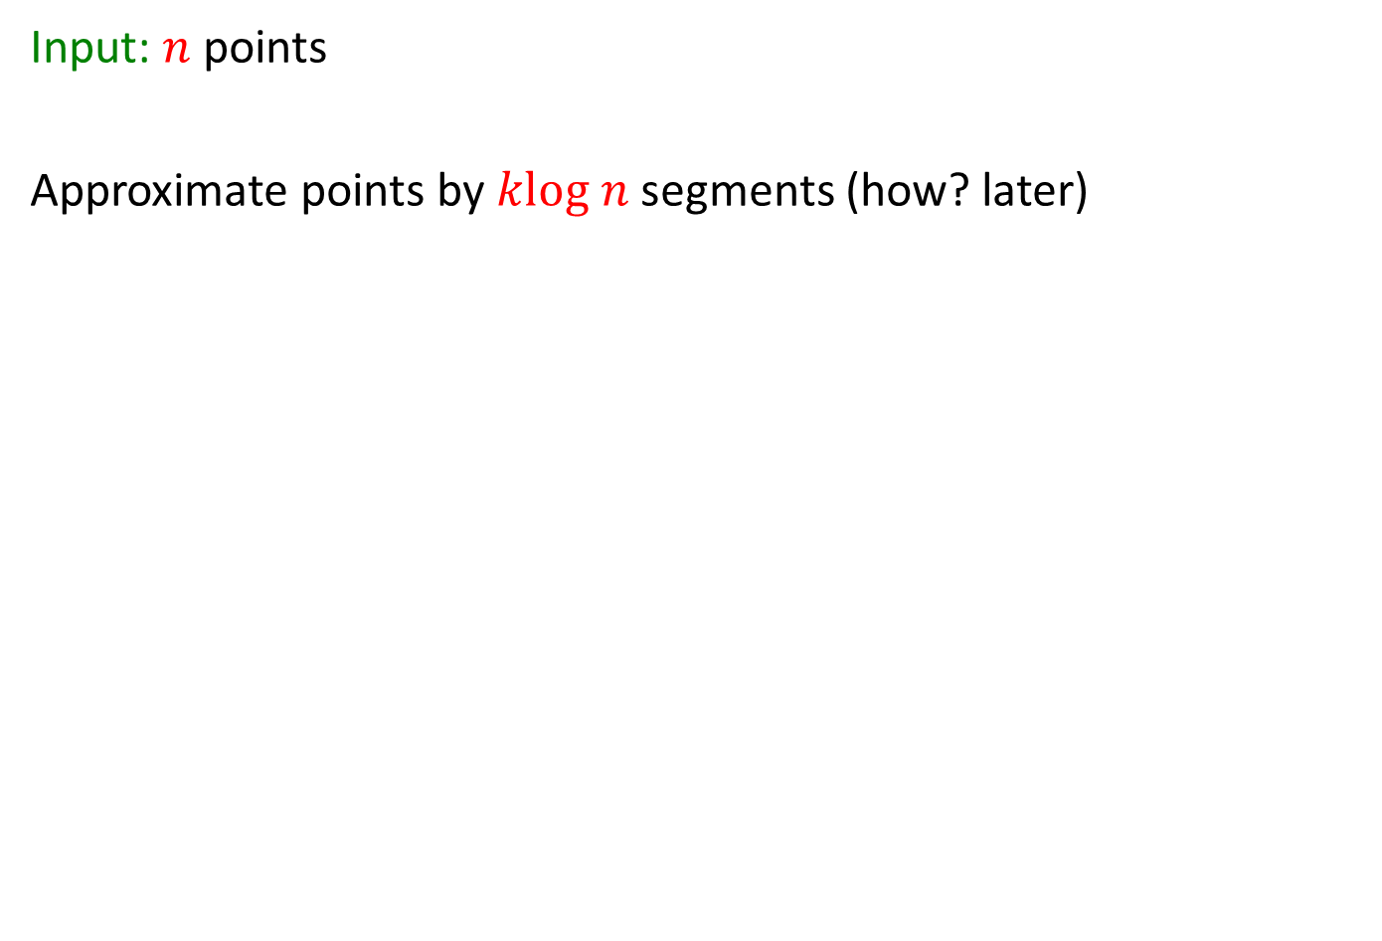
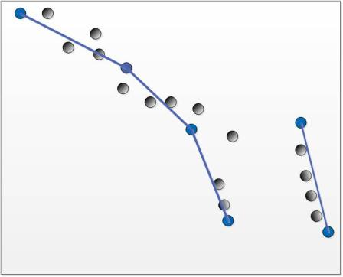
Compress points:$n$ to $\frac{klog n}{ε2}$

Slide 43
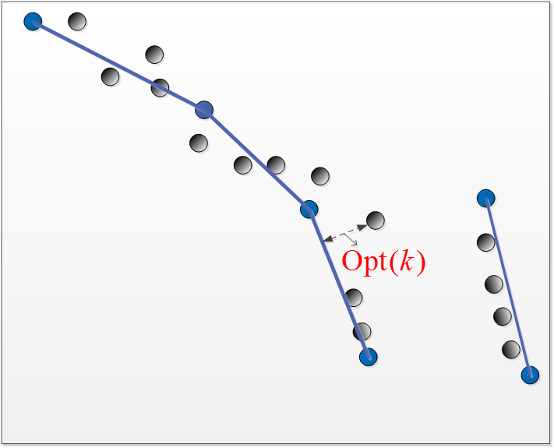
Compress points:$n$ to $\frac{klog n}{ε2}$

Slide 44
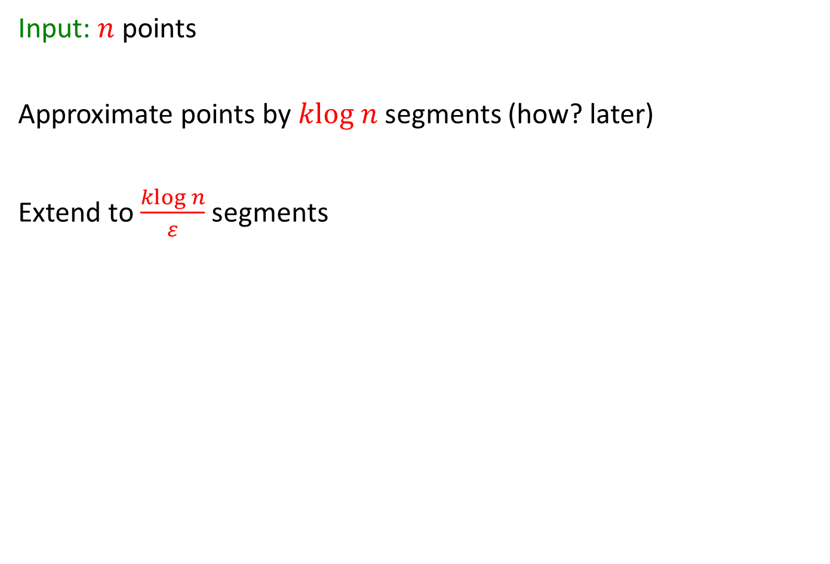
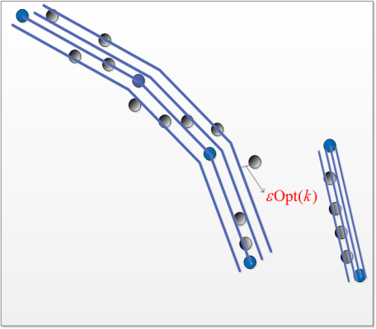
Compress points:$n$ to $\frac{klog n}{ε2}$

Slide 45
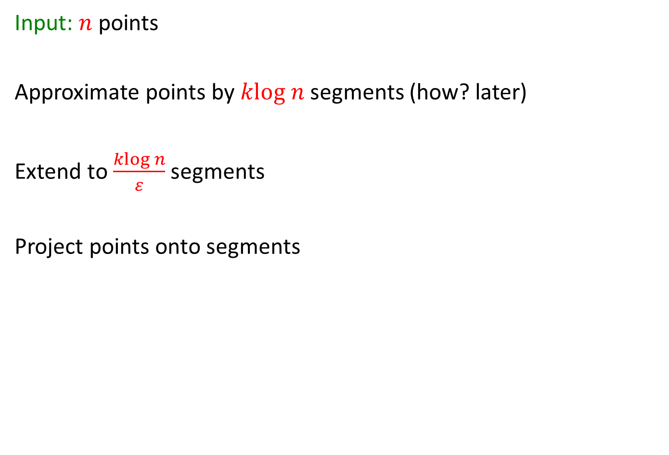
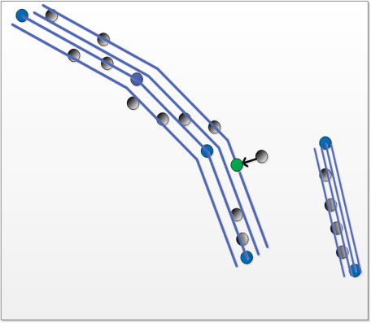
Compress points:$n$ to $\frac{klog n}{ε2}$

Slide 46
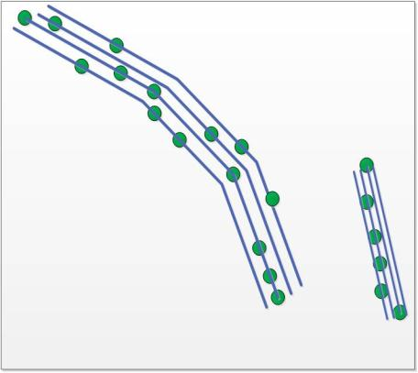
Compress points:$n$ to $\frac{klog n}{ε2}$

Slide 47
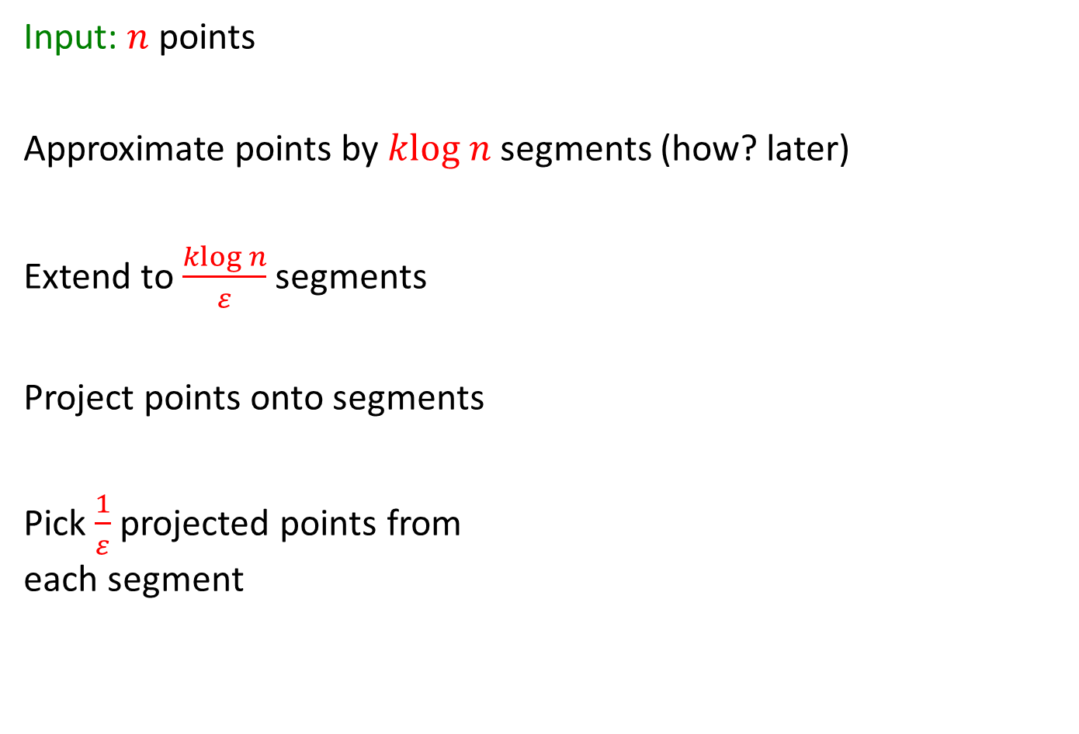
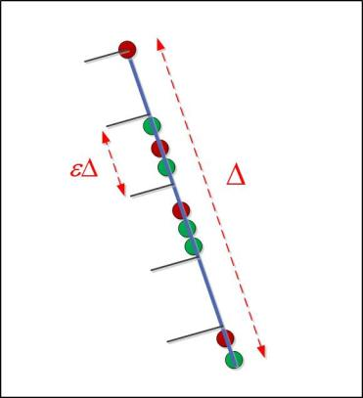
Compress points:$n$ to $\frac{klog n}{ε2}$

Slide 48
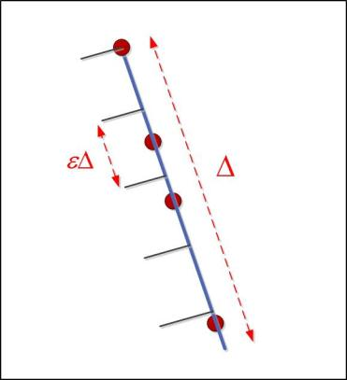
Compress points:$n$ to $\frac{klog n}{ε2}$

Slide 49

Compress points:$n$ to $\frac{klog n}{ε2}$

Slide 50
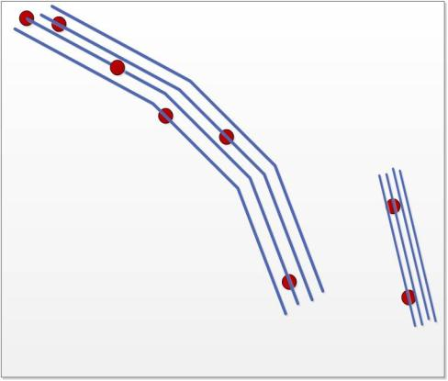
Compress points:$n$ to $\frac{klog n}{ε2}$

Slide 51
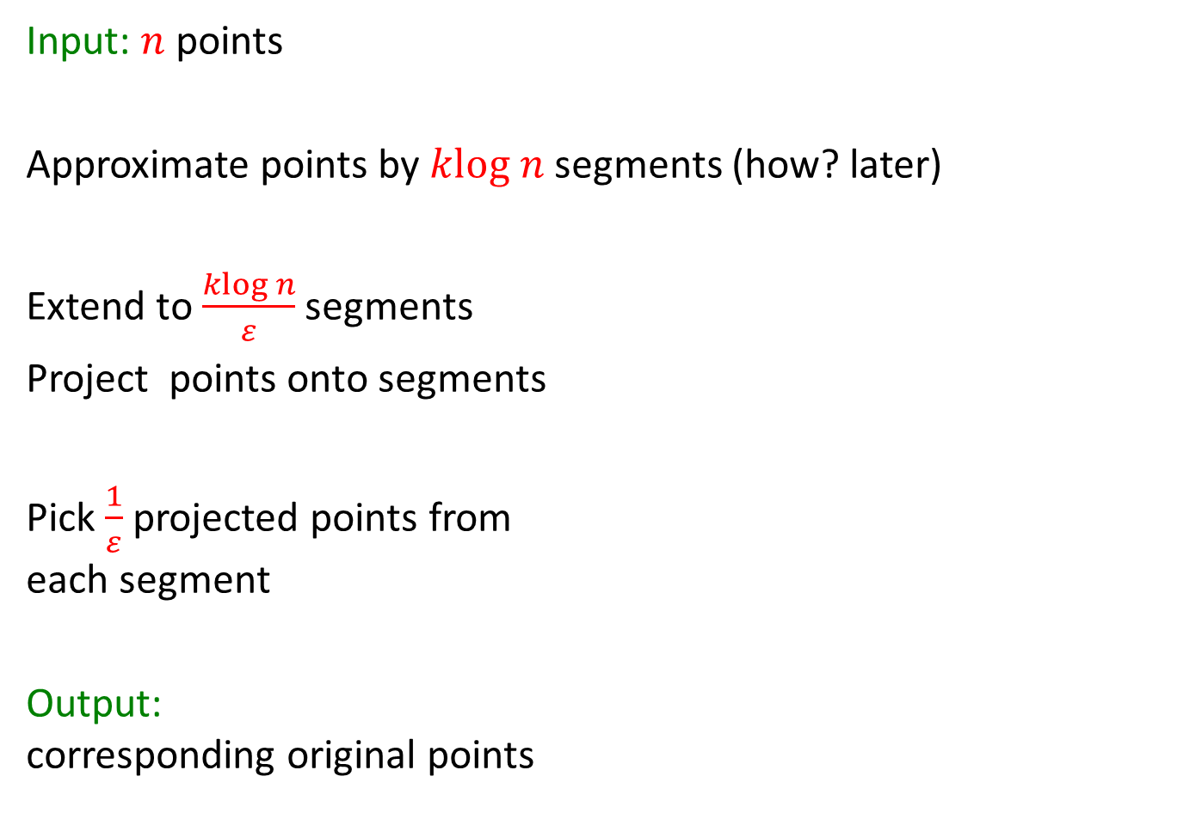
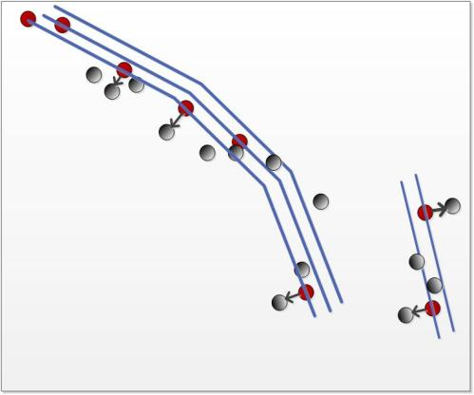
Compress points:$n$ to $\frac{klog n}{ε2}$

Slide 52
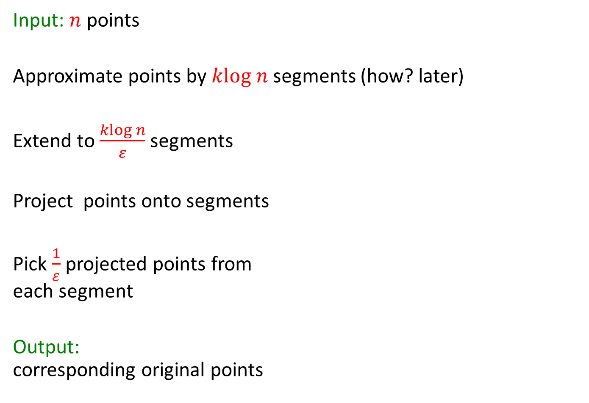
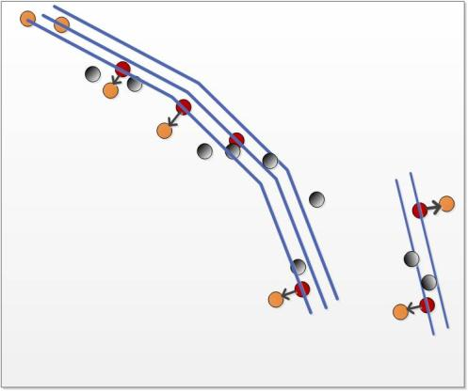
Compress points:$n$ to $\frac{klog n}{ε2}$

Slide 53
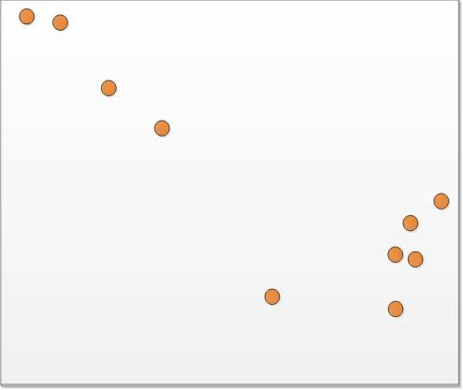
Compress points:$n$ to $\frac{klog n}{ε2}$

Slide 54
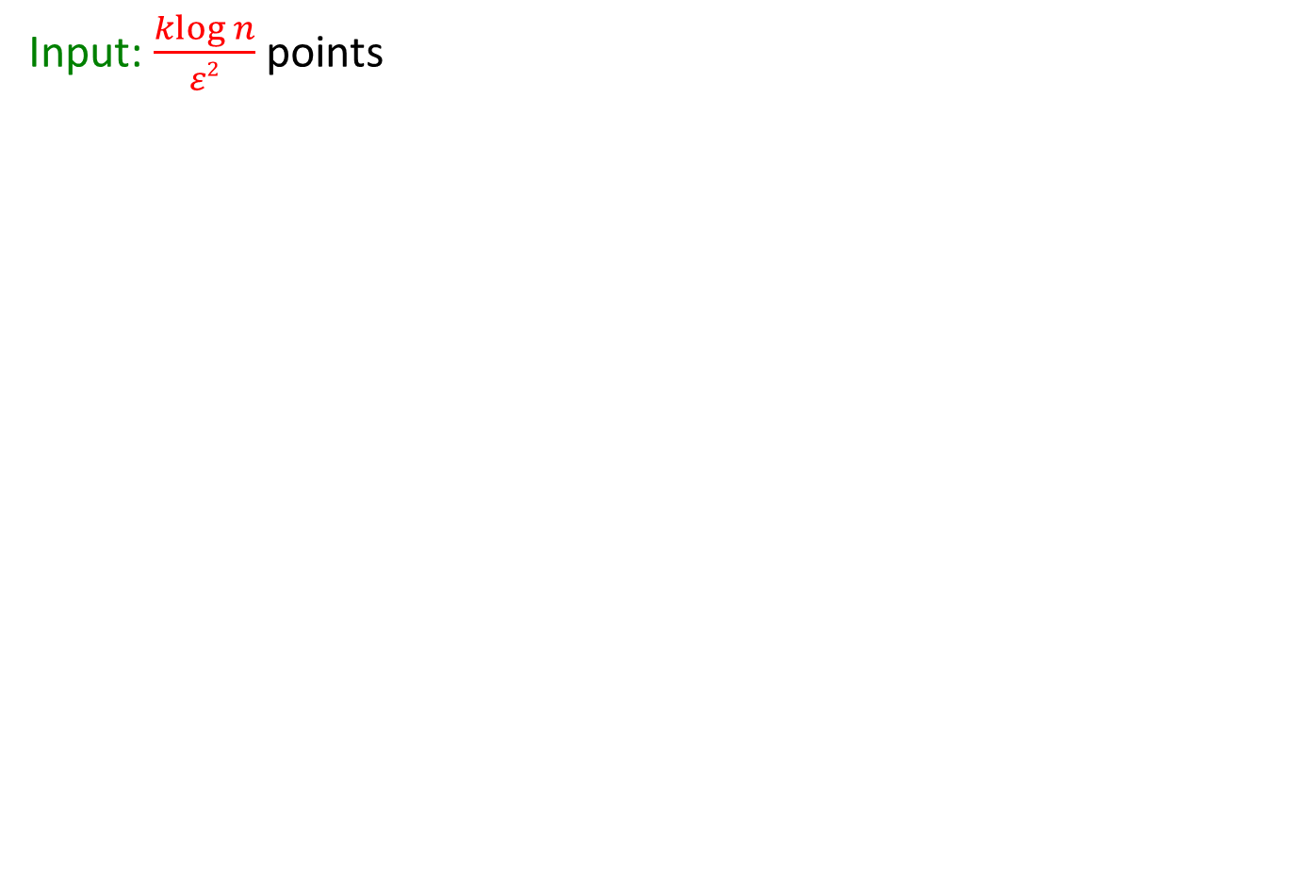

Compress points: $\frac{klog n}{ε2}$ to $\frac{k}{ε2}$

Slide 55
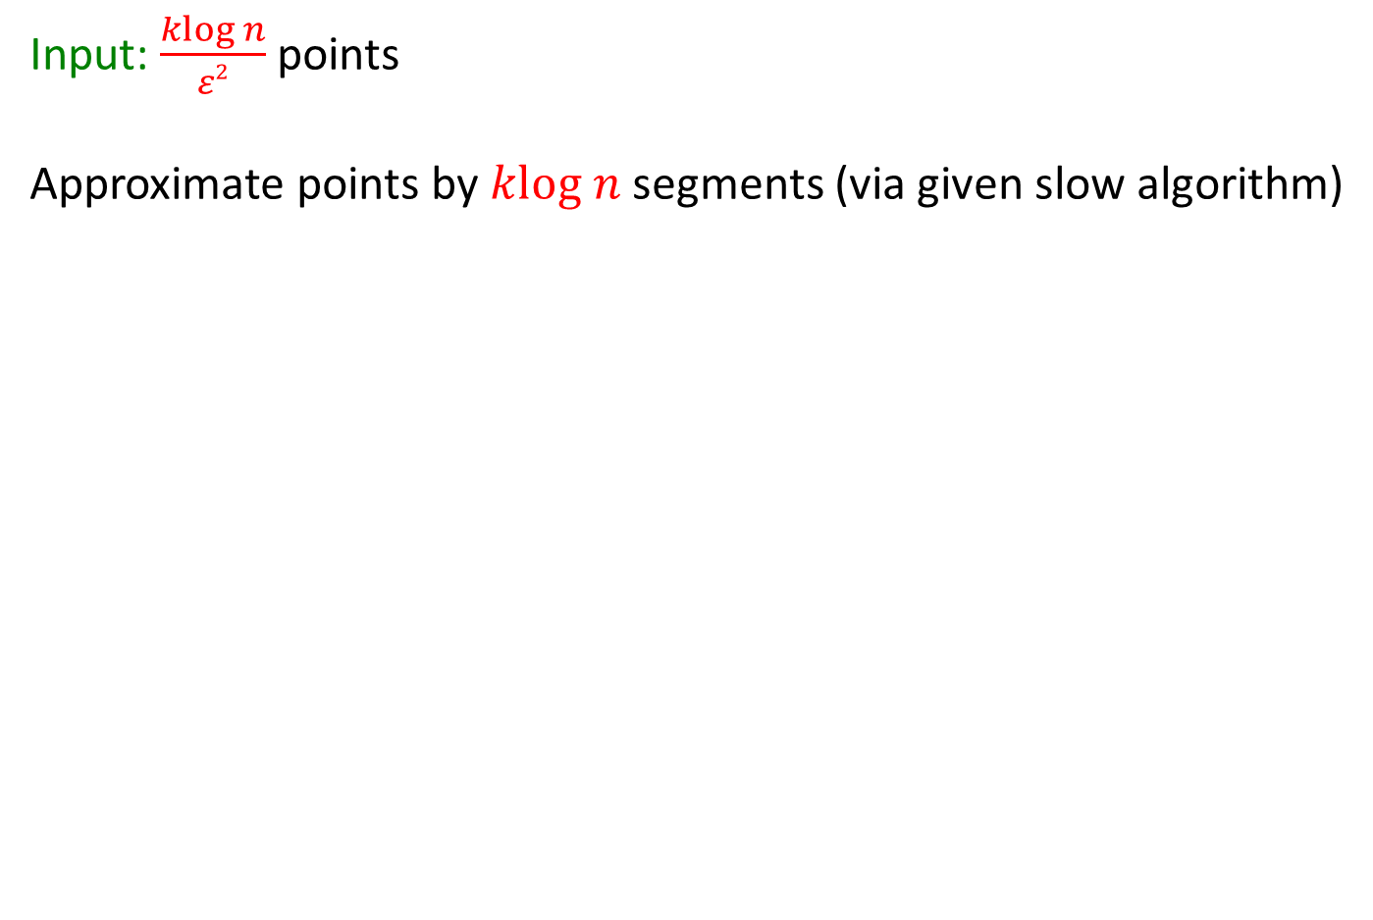
Compress points: $\frac{klog n}{ε2}$ to $\frac{k}{ε2}$

Slide 56
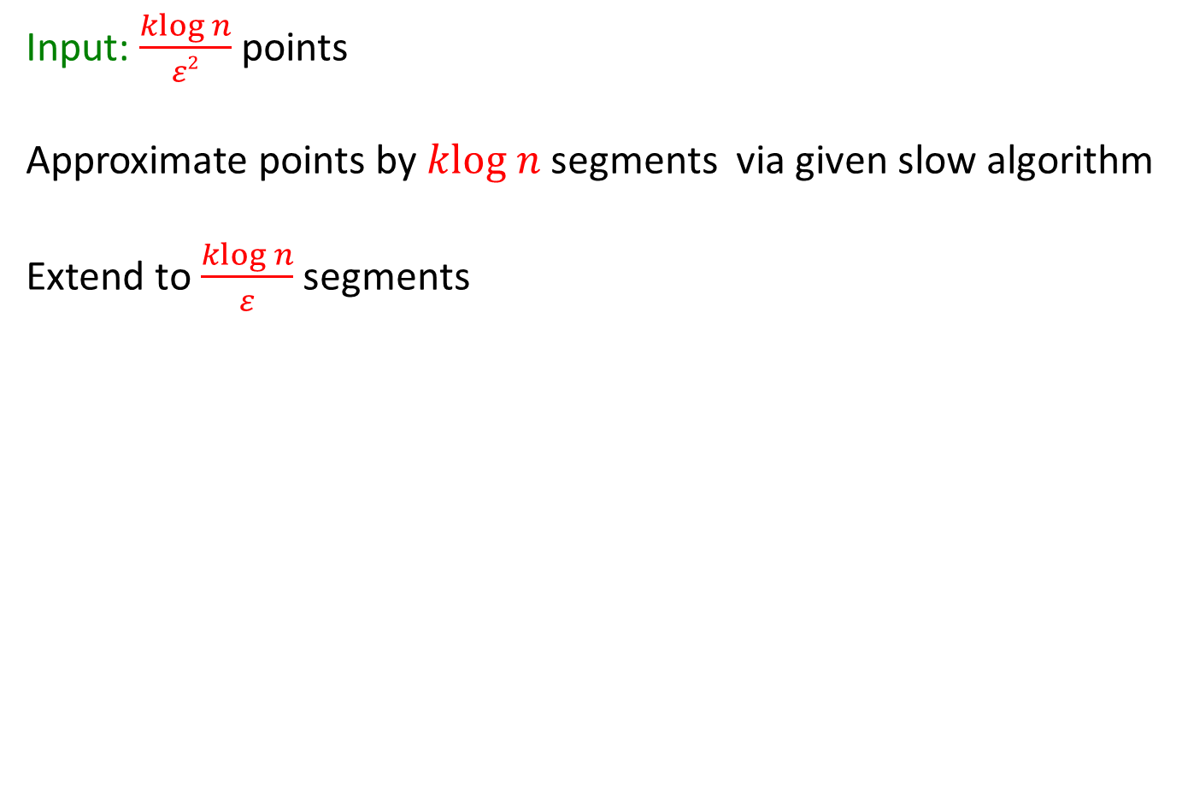
Compress points: $\frac{klog n}{ε2}$ to $\frac{k}{ε2}$

Slide 57
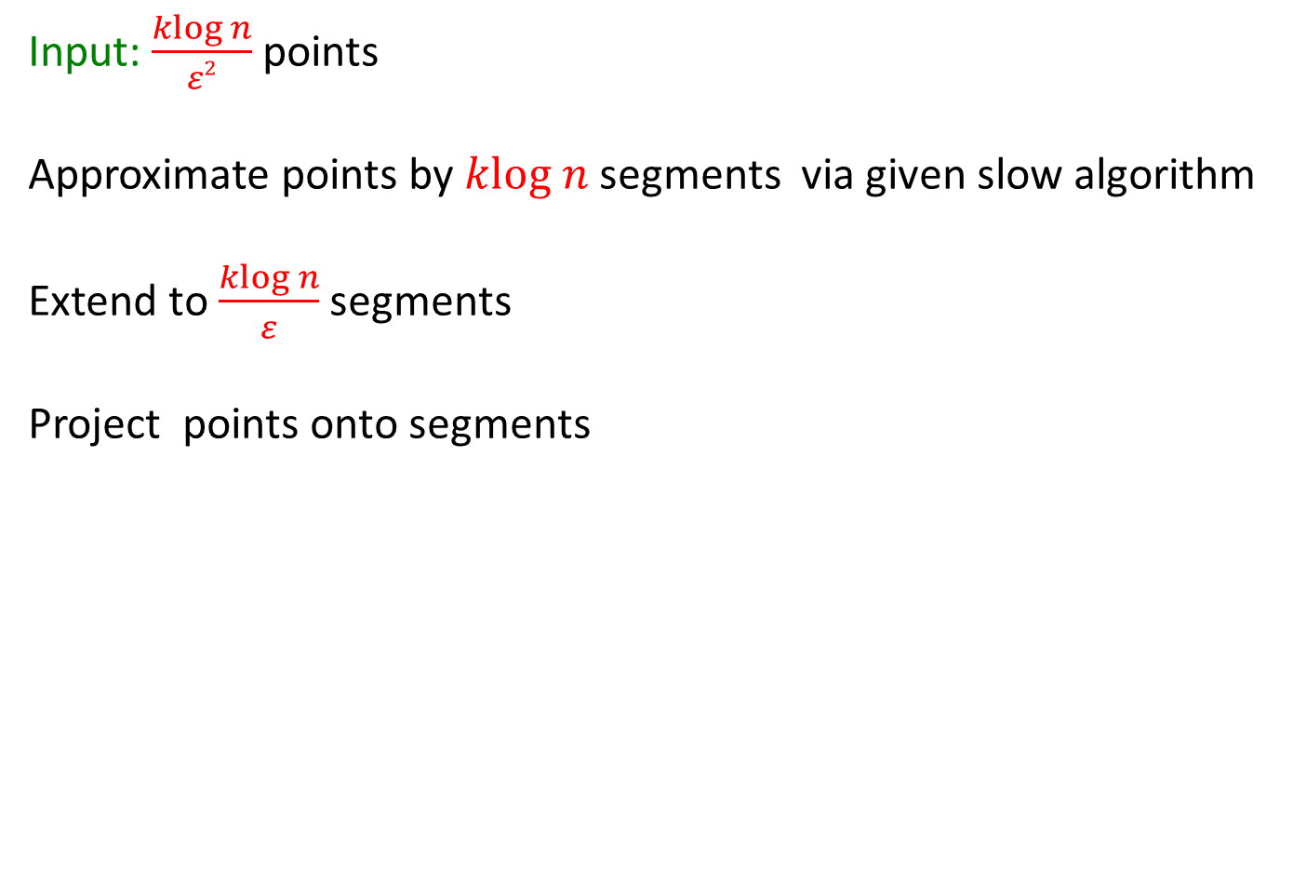
Compress points: $\frac{klog n}{ε2}$ to $\frac{k}{ε2}$

Slide 58
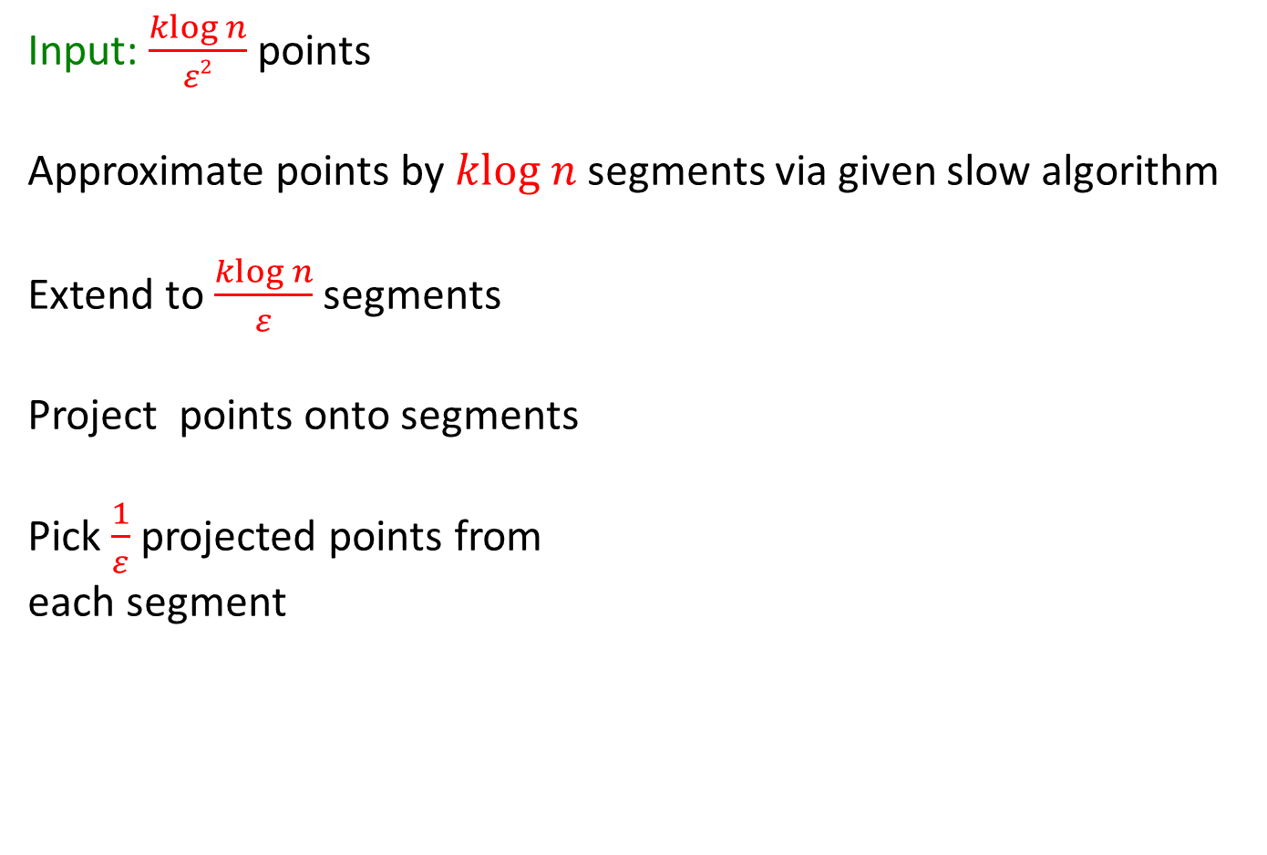
Compress points: $\frac{klog n}{ε2}$ to $\frac{k}{ε2}$

Slide 59
Compress points: $\frac{klog n}{ε2}$ to $\frac{k}{ε2}$

Slide 60
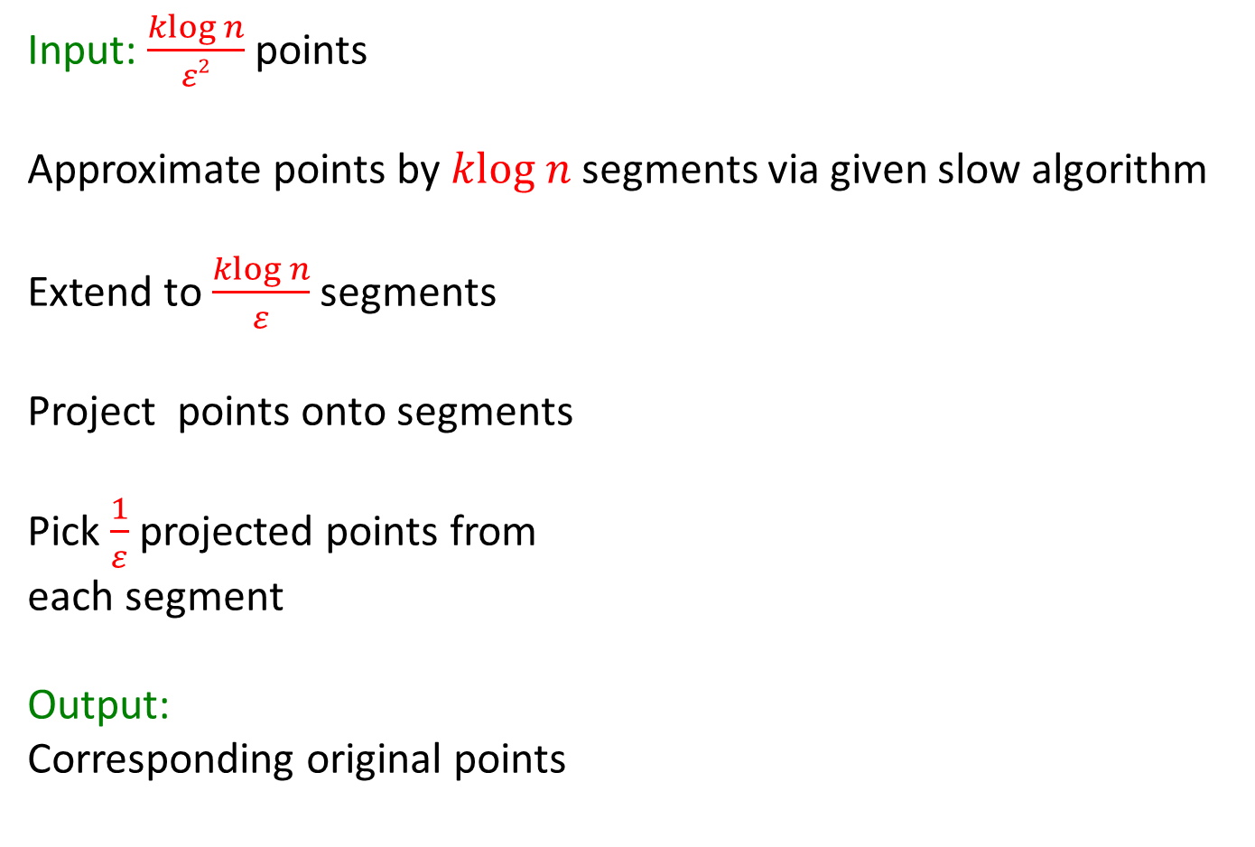
Compress points: $\frac{klog n}{ε2}$ to $\frac{k}{ε2}$

Slide 61
Compress points: $\frac{klog n}{ε2}$ to $\frac{k}{ε2}$

Slide 62

Approximating Points by $klog n$ segments

Slide 63
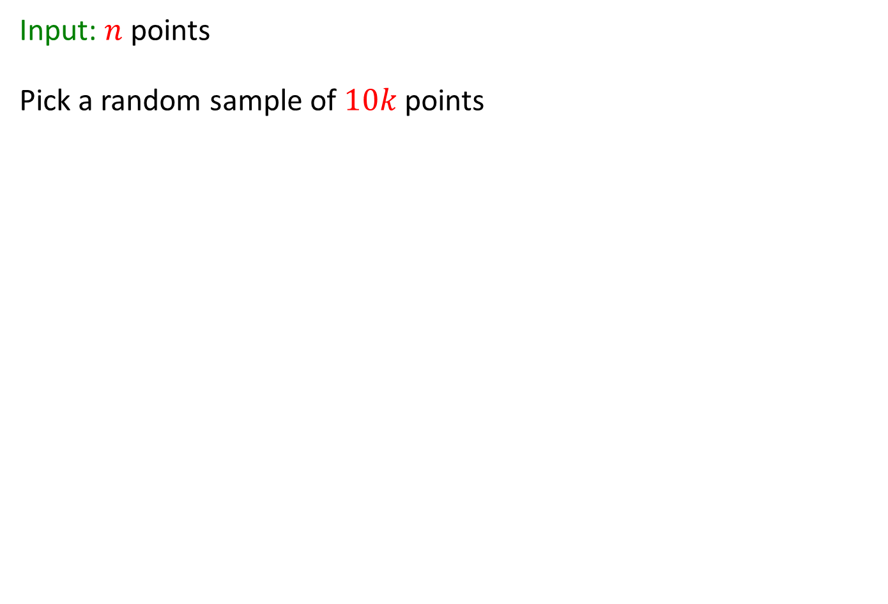
Approximating Points by $klog n$ segments

Slide 65
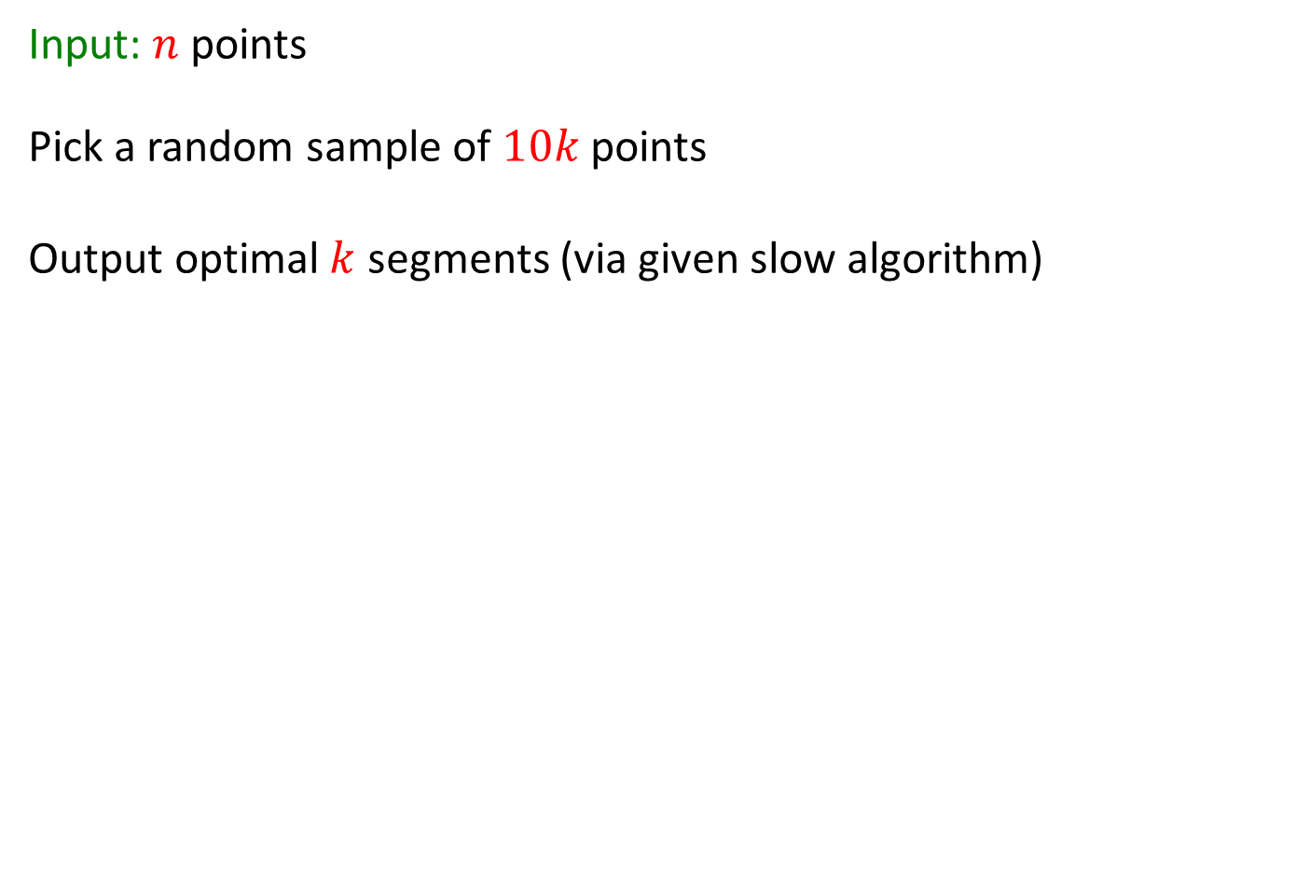
Approximating Points by $klog n$ segments

Slide 66
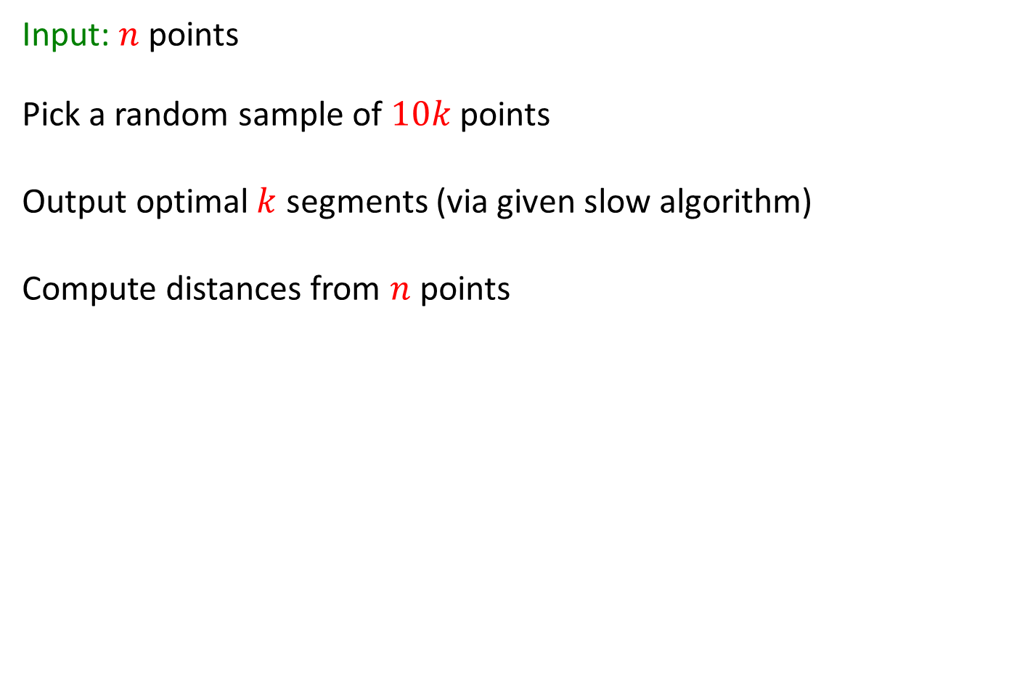
Approximating Points by $klog n$ segments

Slide 67
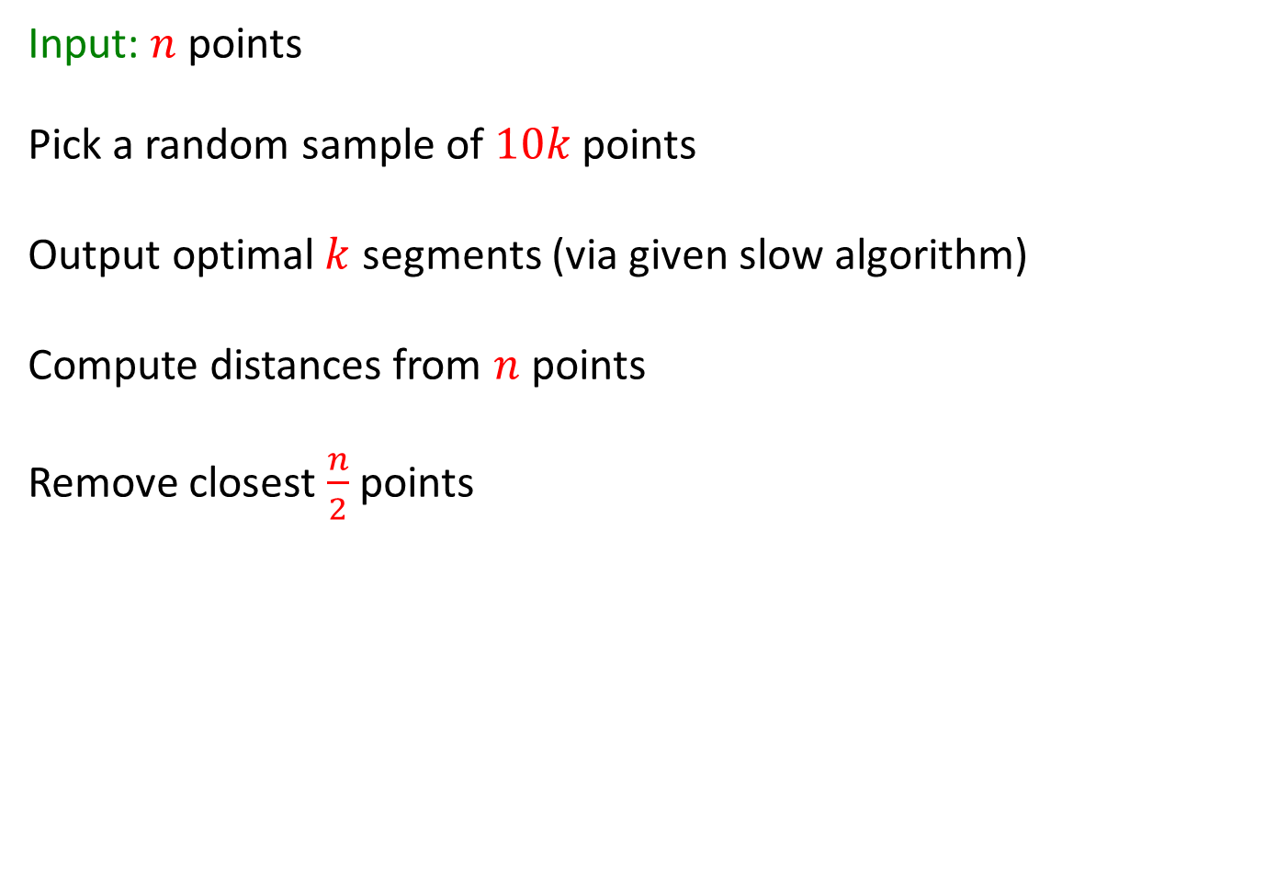
Approximating Points by $klog n$ segments

Slide 68
Approximating Points by $klog n$ segments

Slide 69
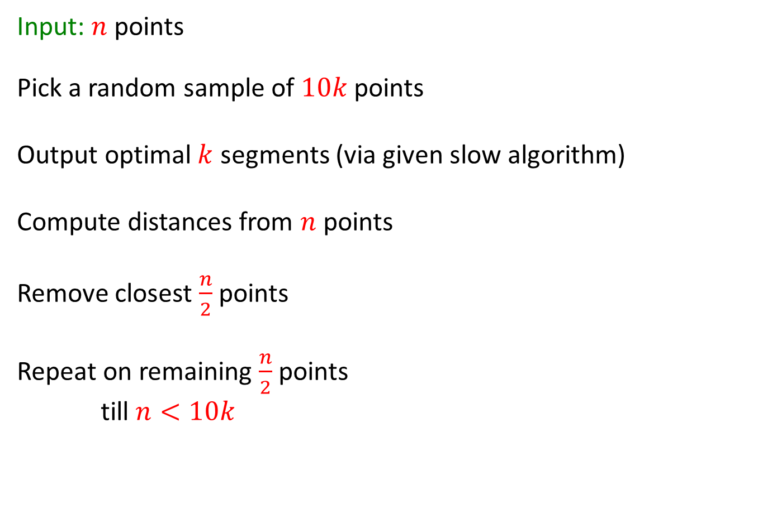
Approximating Points by $klog n$ segments

Slide 70
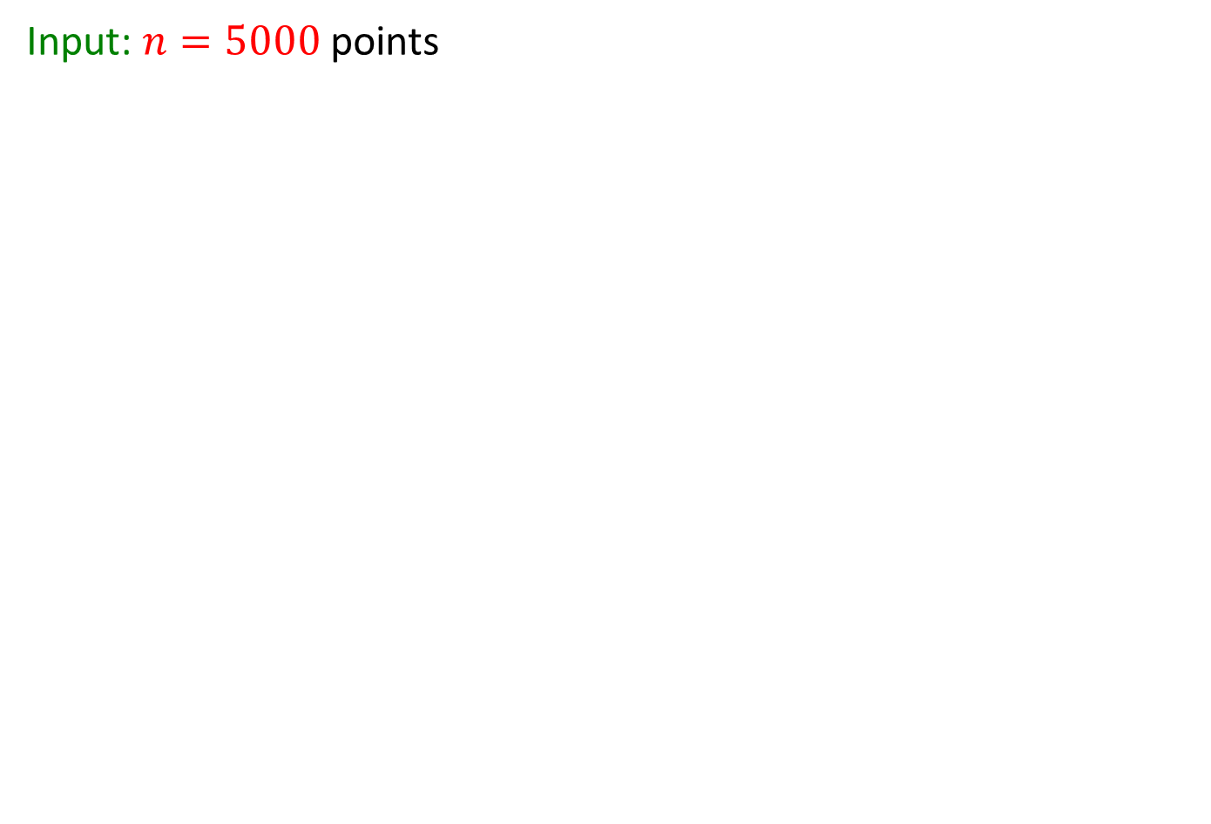

Approximating Points by $50$ segments

Slide 71
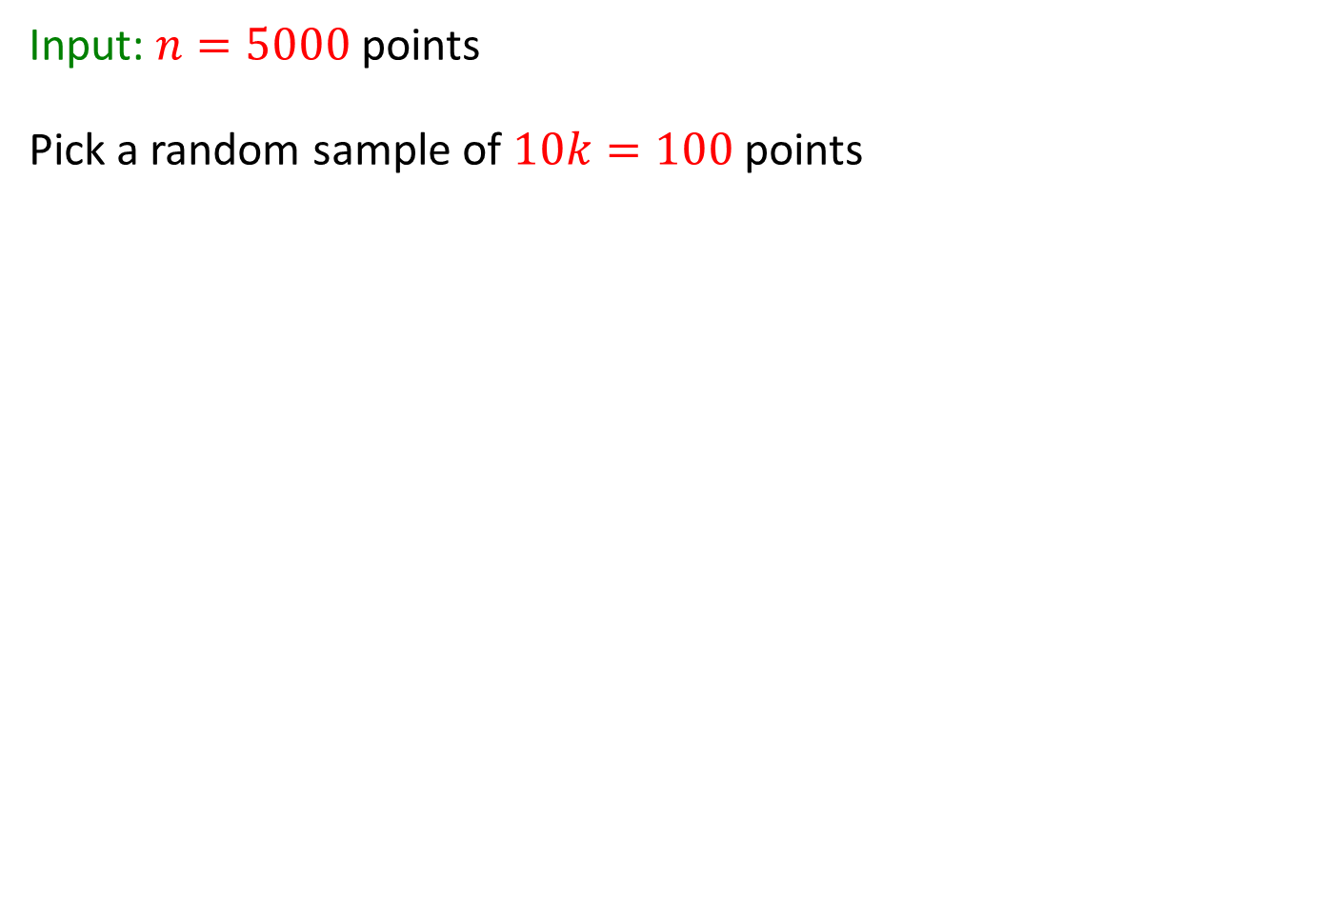
Approximating Points by $50$ segments

Slide 72
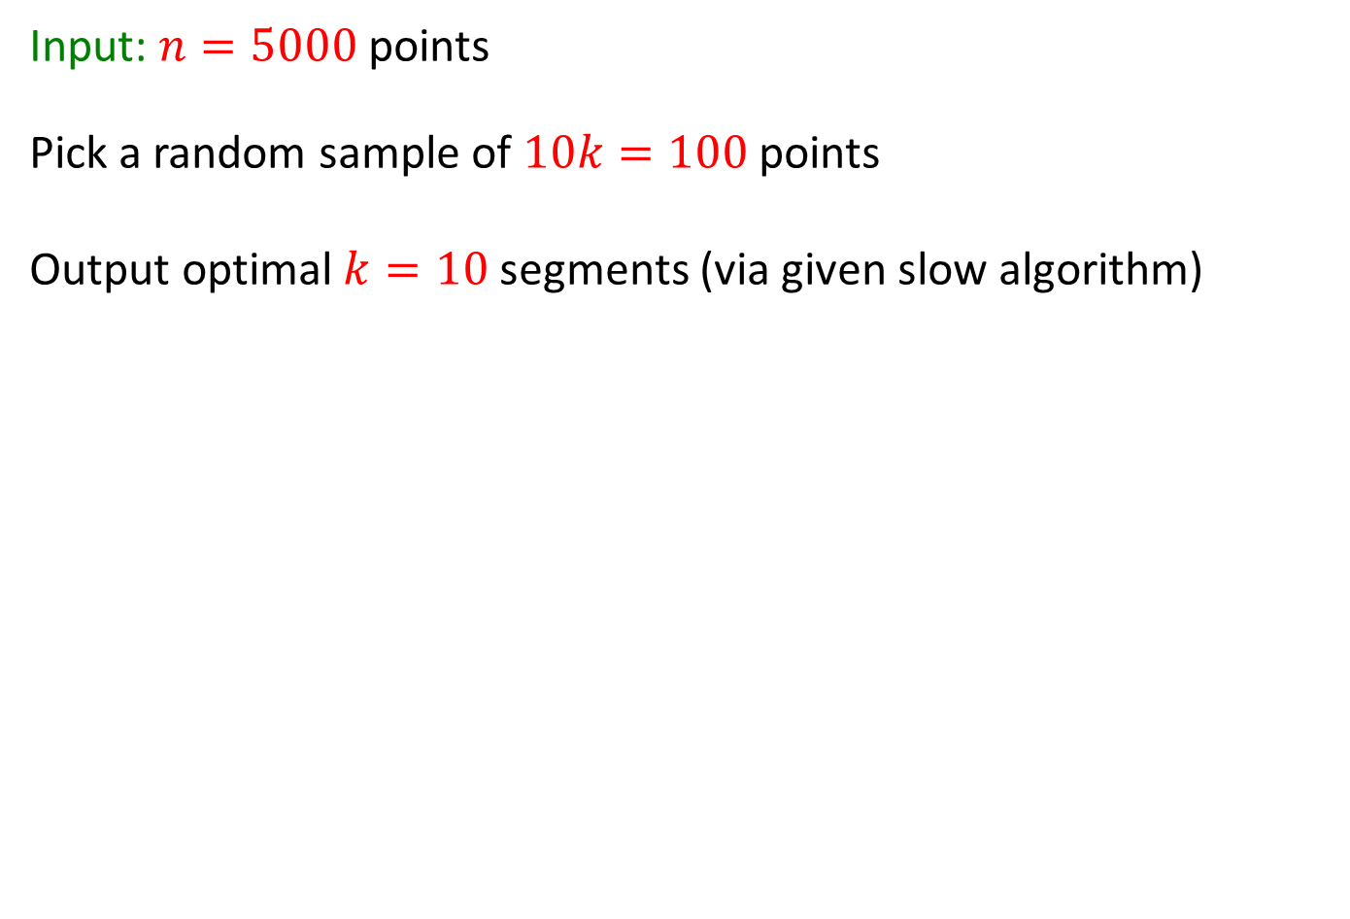
Approximating Points by $50$ segments

Slide 73
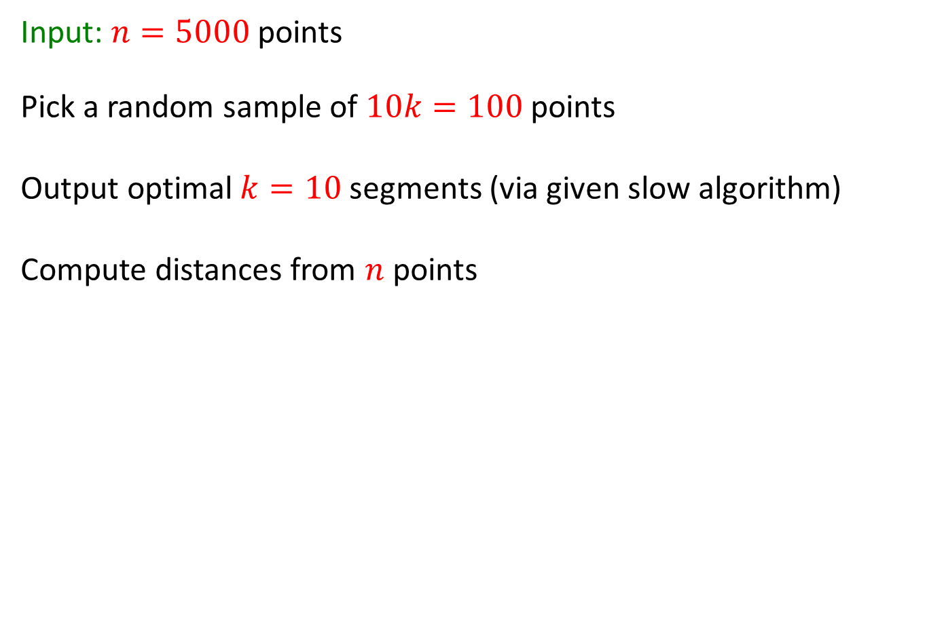
Approximating Points by $50$ segments

Slide 74

Approximating Points by $50$ segments

Slide 75
Approximating Points by $50$ segments

Slide 76

Approximating Points by $50$ segments

Slide 77

Compress points: $5000$to$300$

Slide 78

Compress points: $5000$to$300$

Slide 79

Compress points: $5000$to$300$

Slide 80

Compress points: $5000$to$300$
Input: $n=5000$ points
Approximate points by $50$ segments
Extend to $80$ segments
Project points onto segments

Slide 81
Compress points: $5000$to$300$

Slide 82
Compress points: $5000$to$300$

Slide 83

Compress points: $5000$to$300$

Slide 84

Compress points: $5000$to$300$

Slide 85



Optimal $10$-spline of:
$$P$$
$$C$$
5000 points
300 points

Slide 86

Running time
The “slow” optimization algorithm is applied only on small samples or $C$
The bottleneck is removing half of $P$ in every iteration
Total time: $n+\frac{n}{2}+\frac{n}{4}+… = O\left(n\right)$
Distances can be computed using matrix multiplication ➔ GPU and Parallel computations

Slide 87

Space
$k$-spline for each one of the $O\left(\log{n}\right)$ iterations ➔ $O\left(k\log{n}\right)$ segments
Grids of size $O\left(1/ε\right)$ for each segment
$\left|C\right|=O\left(\frac{klog n}{ε^{2}}\right)$

Slide 88
Tested Data sets
Name | No. of Users | Time Extent | Data Size ~ | Source
Subject in Singapore | 1 | 2 Days | 300k | Probe device and iPhone application
Taxi-Cabs in San-Francisco | 500 | 4 Months | 300MB | Public data (“Crowdad”)
Taxi-Cabs in Boston | 25 | 4 Years | 15GB | MIT

Slide 89

The Experiment
Input: A set $P$ of $n$ points
Compute “optimal” $k$-spline $S$ using heuristic.
Compute maximum distance $Dist(P,S)$ from the points to the $k$-spline
Compute compression $C$ for $P$
Compute optimal $\tilde{S}$ of $C$
Compute Dist(P, $\tilde{S}$)
Compression ratio: $\frac{\left|C\right|}{\left|P\right|}$
Error: $\frac{Dist\left(P,\tilde{S}\right)}{Dist\left(P,S\right)}−1$

Slide 90




Optimal $k$-spline of:
$$P$$
$$C$$
Compression ratio: $\frac{\left|C\right|}{\left|P\right|}$
Error: $\frac{Dist\left(P,\tilde{S}\right)}{Dist\left(P,S\right)}−1$

Slide 91
Experiments:
Subject in Singapore
Error Ratio
Compression Ratio

Slide 92
Experiments:
500 San-Francisco Taxi-cabs

Slide 93

Website
Data Display
Coreset Display
Visualization of Result of Algorithm - A Coreset

Slide 94
Contribution
Semantic compression of data from sensors
Line simplification using
  One pass over data
  Logarithmic space (for massive data sets)
  Linear time
  Provable bounded error

