Slide 1



Trajectory Clustering for Motion Prediction
Cynthia Sung, Dan Feldman, Daniela Rus
October 8, 2012
Notes:
12.5

Slide 2
Trajectory Clustering
Background
Noise
Sampling frequency
Inaccurate control

Slide 3
Related Work
Background
SLAM
[Ranganathan and Dellaert, 2011; Cummins and Newman, 2009; Durrant-Whyte and Bailey, 2006; Fox et al, 2006; Choset and Nagatani 2001]
Tracking, Interception, Avoidance
[Joseph et al, 2011; Rubagotti et al, 2011; Vasquez et al, 2009; Bennewitz et al, 2004; Chakravarthy and Ghose, 1998]
De-noising
[Hönle et al, 2010; Barla et al, 2005; Cao et al, 2006; Lerman, 1980; Douglas and Peucker, 1973; Bellman, 1960]
Trajectory clustering
[Ying et al, 2011; Chen et al, 2010; Sacharidis et al, 2008; Lee et al, 2007; Nanni et al, 2006; Fu et al, 2005; Keogh & Pazzani, 2000; Agrawal et al, 1993]

Slide 4


Trajectory Clustering
Trajectory Clustering
Problem: Given a trajectory T, find a set of motion patterns R such that T can be approximated by a sequence of elements from R
2
2
2
$$p$$
1
1
1
$$t$$

Slide 5
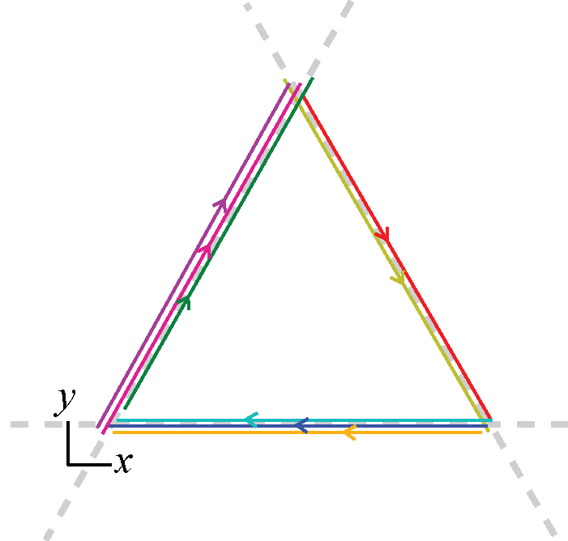
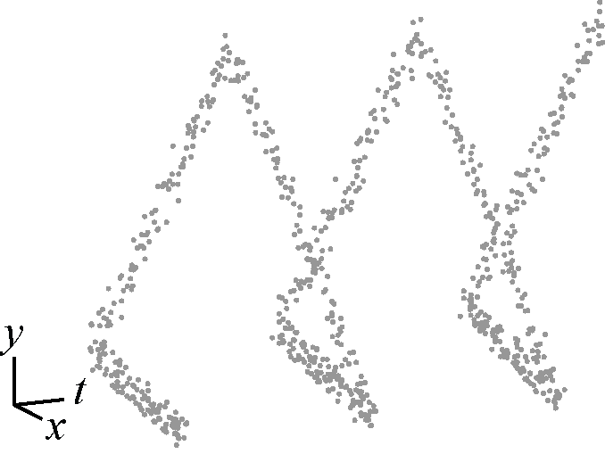
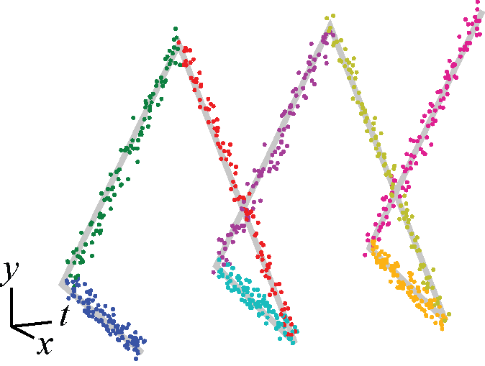
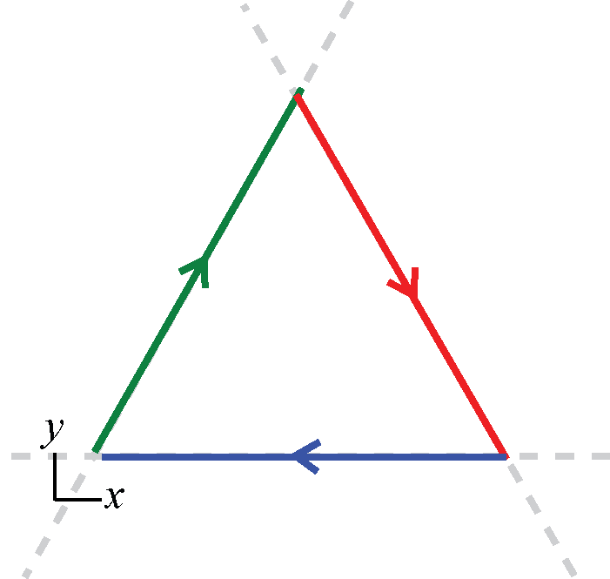
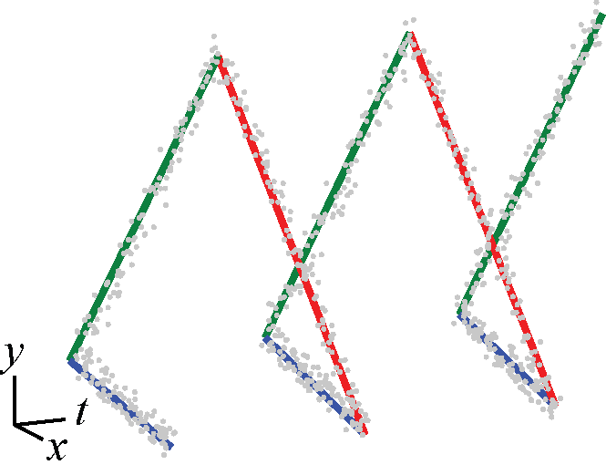
Clustering Overview
Algorithm Overview
Original Trajectory
Line Simplification
k-lines Projection
Interval Clustering
Final Approximation

Slide 6

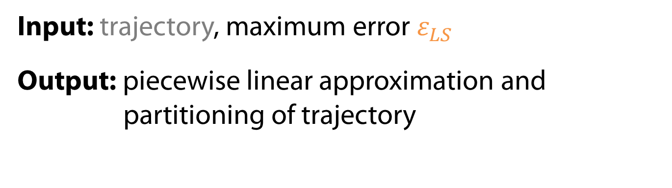




1: Line simplification
Algorithm Overview
Input: trajectory, maximum error $ε_{LS}$
Output: piecewise linear approximation and partitioning of trajectory
$$p$$
$$p$$
$$ε_{LS}$$
$$t$$
$$t$$
[Hönle et al, 2010; Douglas and Peucker, 1973]

Slide 7
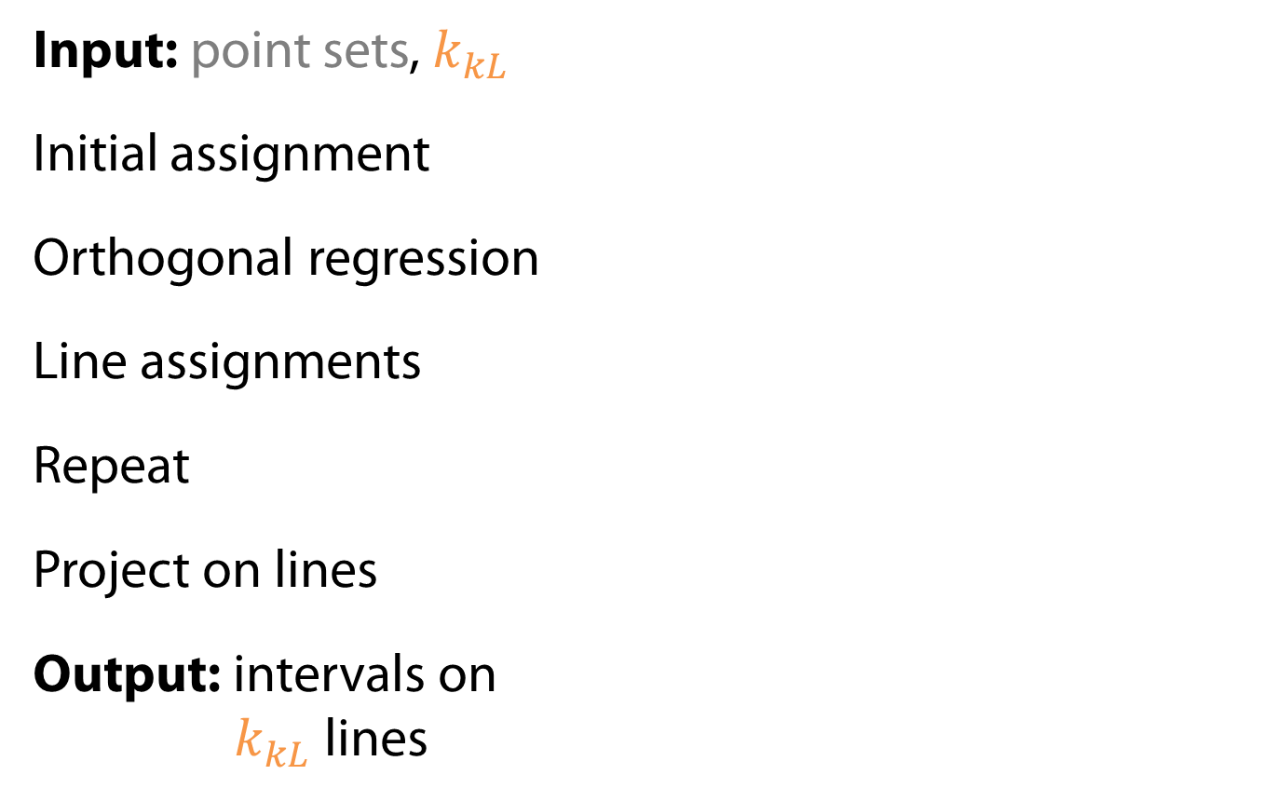
2: k-lines projection
Algorithm Overview
Input: point sets, $k_{kL}$
Initial assignment
Orthogonal regression
Line assignments
Repeat
Project on lines
Output: intervals on
$k_{kL}$ lines

Slide 8

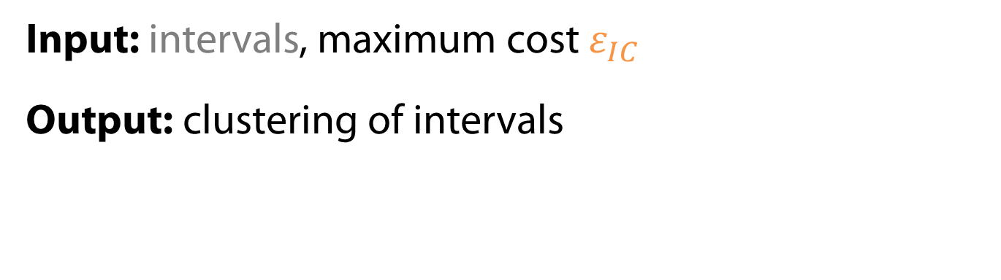



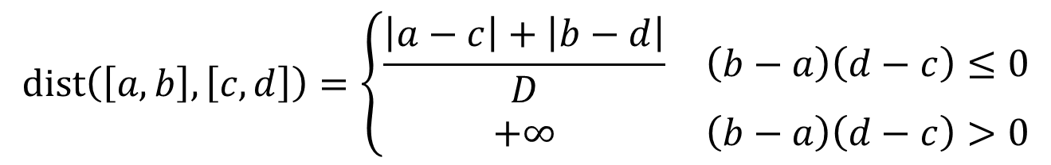
3: Interval Clustering
Algorithm Overview
Input: intervals, maximum cost $ε_{IC}$
Output: clustering of intervals
$$dist\left(\left[a,b\right],\left[c,d\right]\right)=\left\{\begin{matrix}\frac{\left|a−c\right|+\left|b−d\right|}{D} & \left(b−a\right)\left(d−c\right)≤0 \\ +∞ & \left(b−a\right)\left(d−c\right)>0\end{matrix}\right.$$
$$\left|a−c\right|$$
$$\left|b−d\right|$$
$$D$$
$$dist=+∞$$
[Lymberopoulos et al, 2009]

Slide 9



Final Representation
Algorithm Overview
Input: line segments (step 1), clustering (step 3)
Output: motion patterns
$$∆t$$
$$∆t$$
$$∆t$$
$$∆t$$
$$∆t$$
$$∆t$$

Slide 10
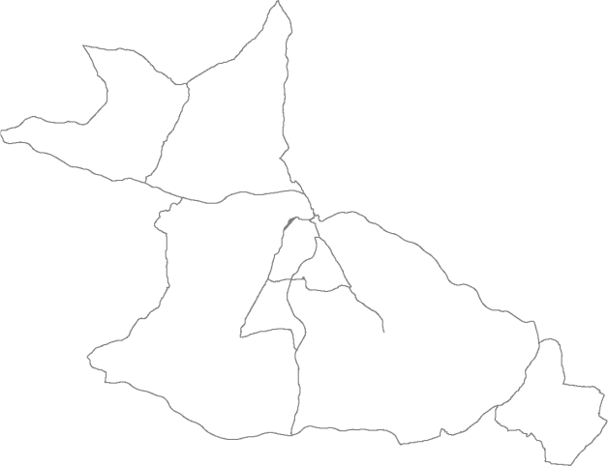
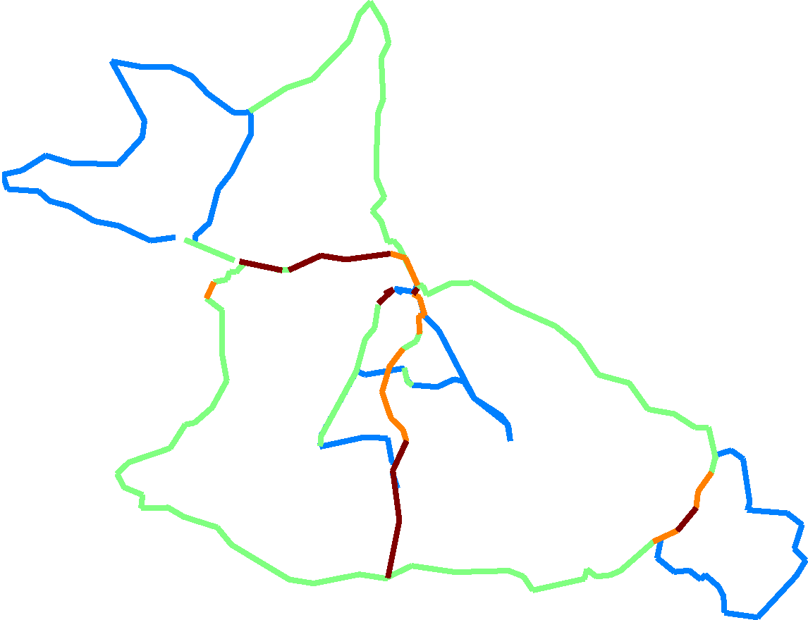
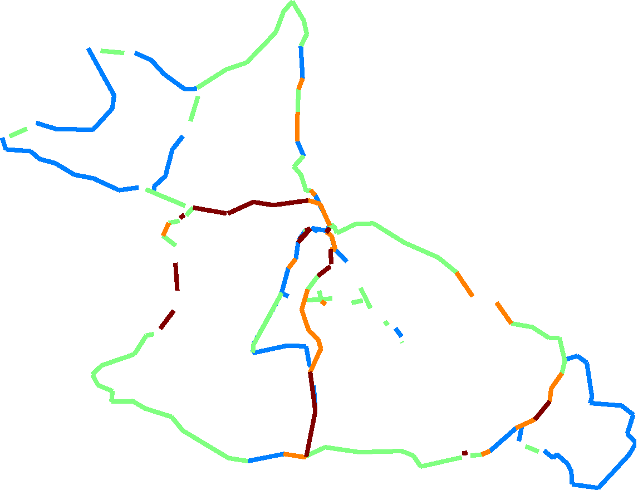
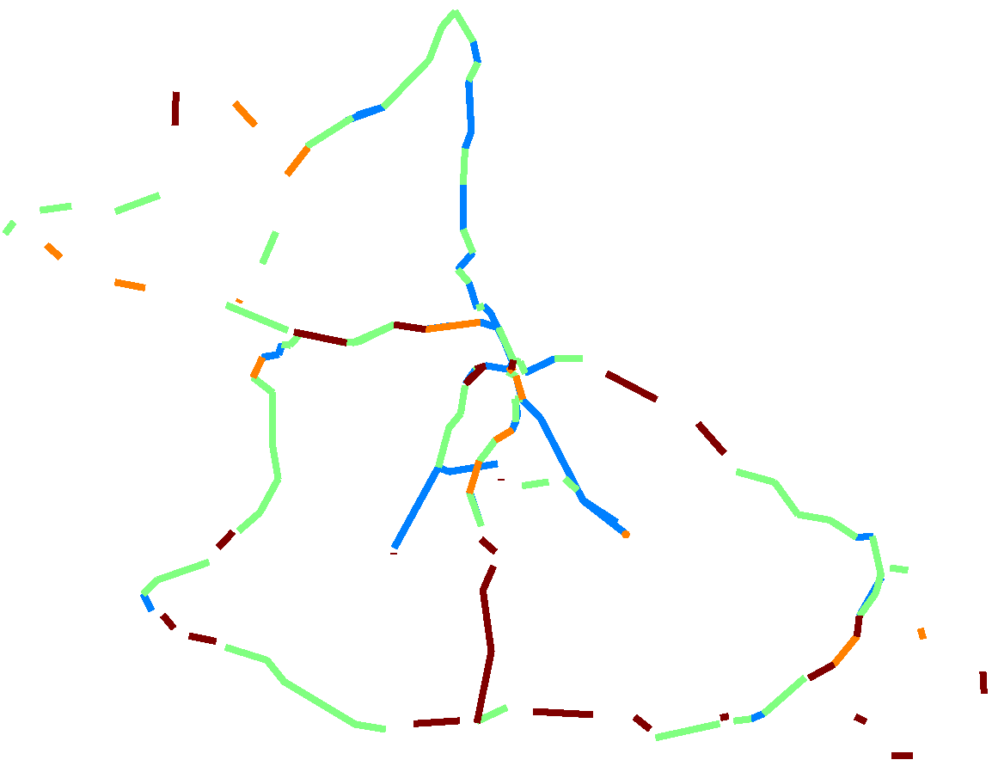

Frequency Plots
Results
Original Trajectory
Manual Clustering
frequency
Our Algorithm
Purity: 84.9%
k-means
Purity: 68.6%
Data source: Oxford Mobile Robotics Group

Slide 11
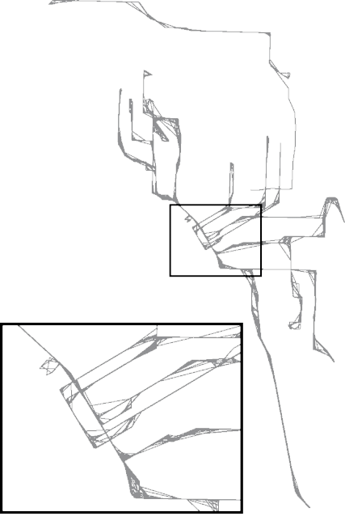
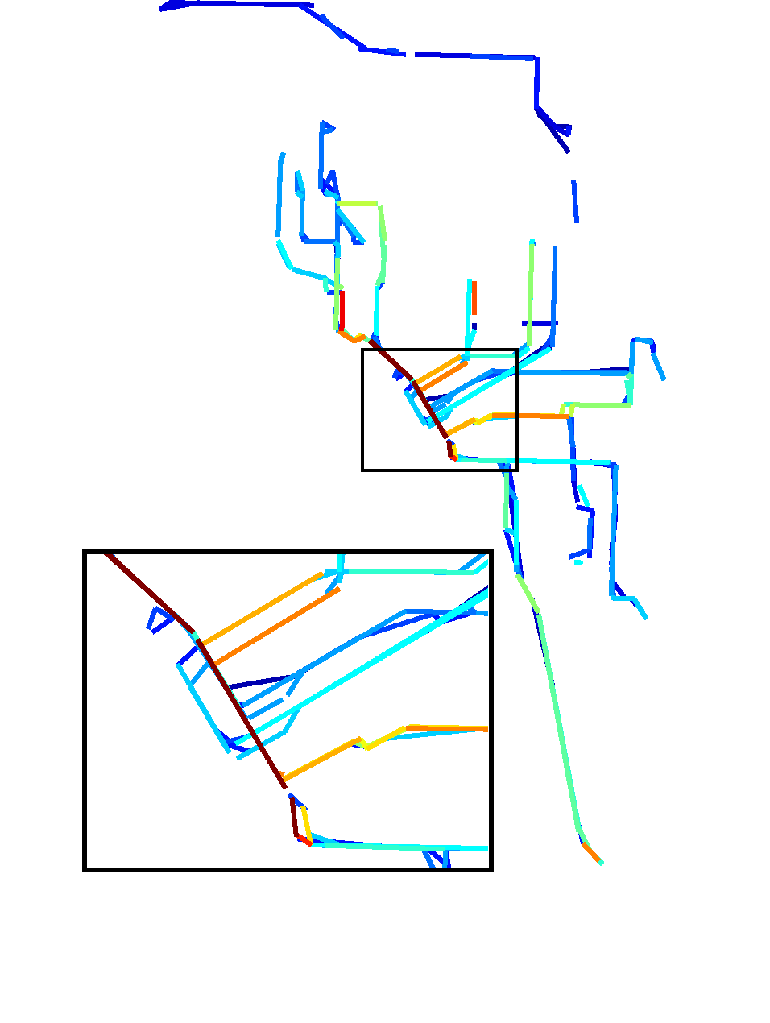
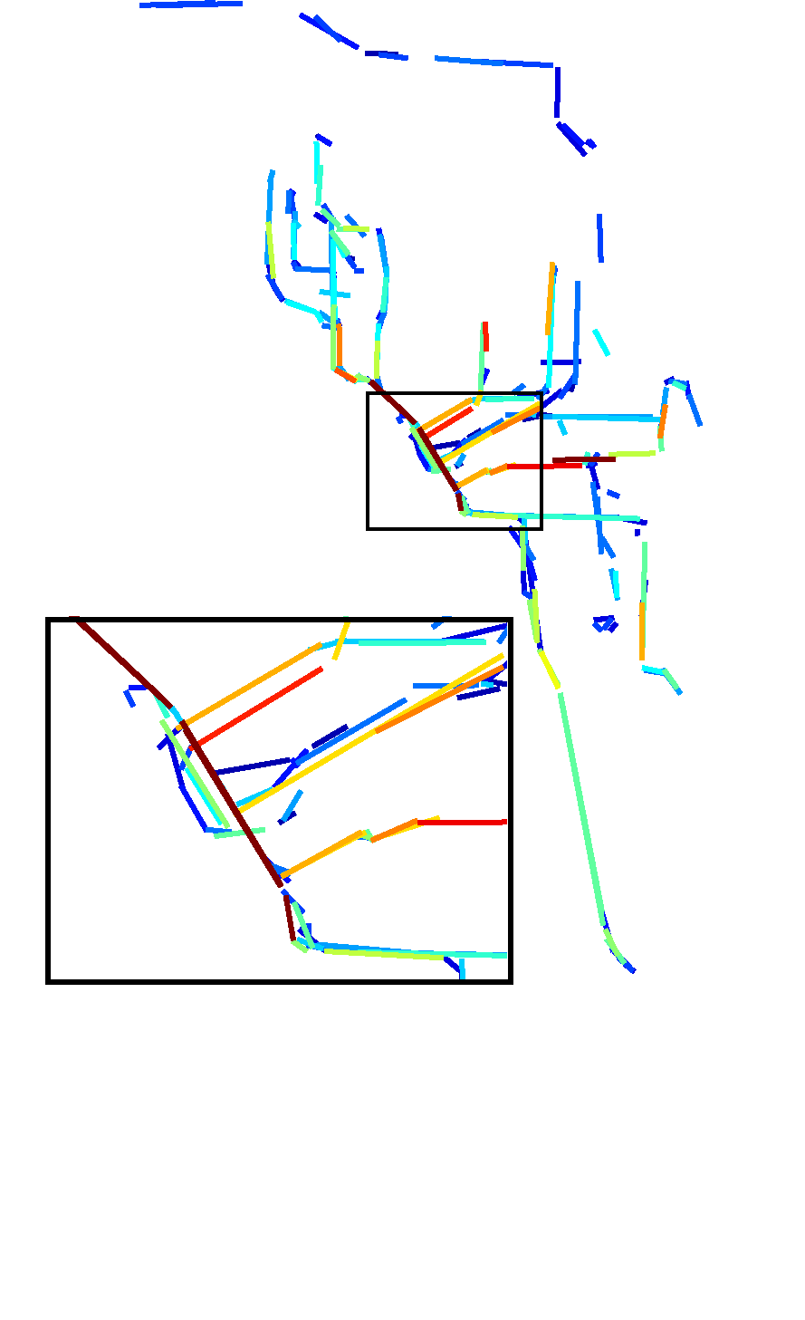
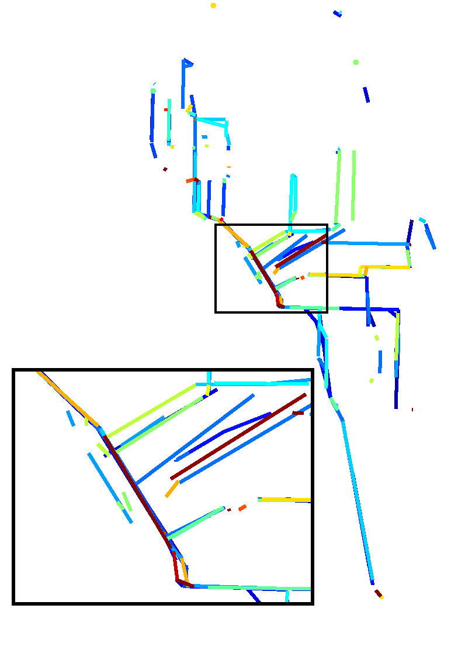
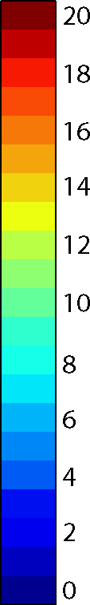
Frequency Plots
Results
frequency
Original
Trajectory
Manual
Clustering
Our Algorithm
Purity: 75.9%
k-means
Purity: 54.5%
Data source: CRAWDAD data set rice/ad hoc city

Slide 12
Application to Interception
Simulations
Find motion patterns in the observed trajectory
Fit a Hidden Markov Model (HMM) to the pattern sequence
Predict future motion
Plan a path to the predicted interception point with the object

Slide 13
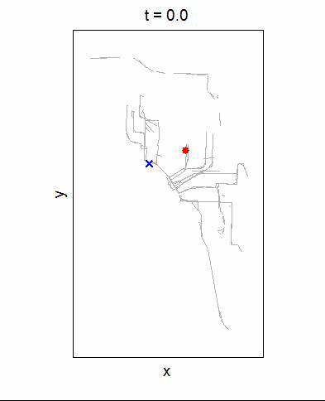
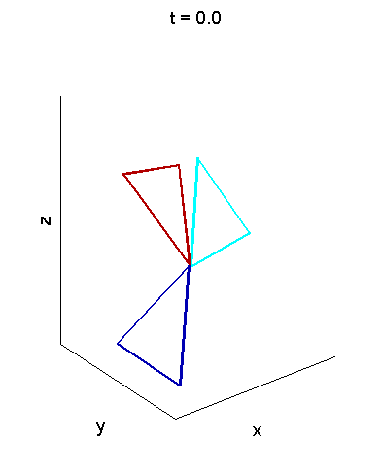
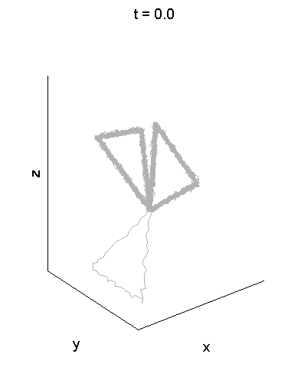
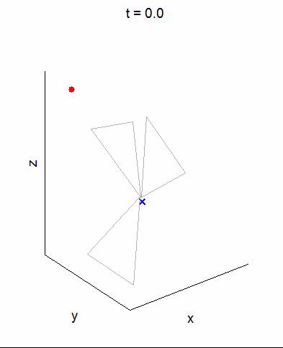


Comparisons of Interception Planning
Simulations
N = 100
$$∆t$$
Q1 | 0.8 | 0.3
Q2 | 12.7 | 1.4
Q3 | 15.5 | 13.4
Data-driven motion prediction
Data-driven motion prediction
Constant velocity assumption
Constant velocity assumption

Slide 14
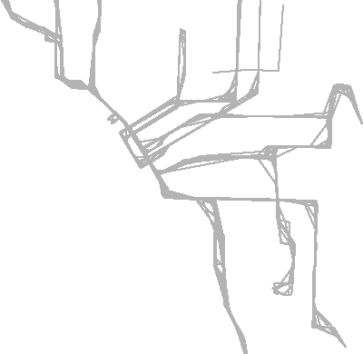
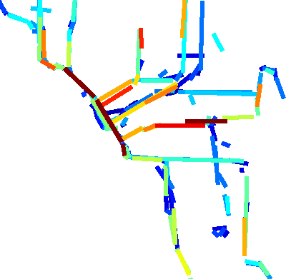
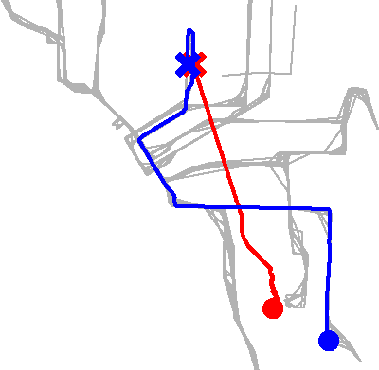
Data-Driven Interception Planning
Summary
Novel trajectory clustering algorithm
Applicable to high dimensional trajectories
Higher quality approximation than
current methods
Simulations demonstrate benefits to interception planning
Support for this project has been provided in part by the Future Urban Mobility project of the Singapore-MIT Alliance for Research and Technology (SMART) Center, with funding from Singapore’s National Research Science Foundation, by the Foxconn Company, by ONR MURI grants N00014-09-1-1051 and N00014-09-1-1031, and by NSF award IIS-1117178.

