Slide 1

FarmBeats: An IoT System for Data-Driven Agriculture
Deepak Vasisht, Zerina Kapetanovic, Jong-ho Won, Xinxin Jin,
Ranveer Chandra, Ashish Kapoor, Sudipta N. Sinha, Madhusudhan Sudarshan, Sean Stratman

Slide 2
Why Agriculture?
Agricultural output needs to double by 2050 to meet the demands
– United Nations¹
¹: United Nations Second Committee (Economic & Financial), 2009

Slide 3
Why Agriculture?
Agricultural output needs to double by 2050 to meet the demands
– United Nations¹
But…
Water levels are receding
Arable land is shrinking
Environment is being degraded
¹: United Nations Second Committee (Economic & Financial), 2009

Slide 4
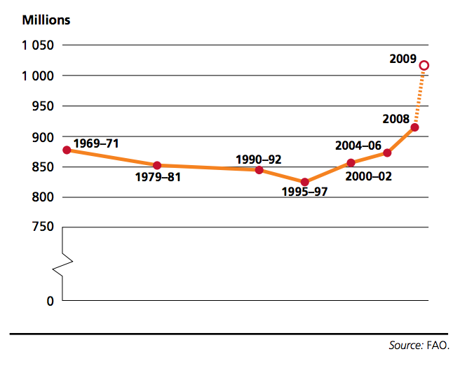
Why Agriculture?
Agricultural output needs to double by 2050 to meet the demands
– United Nations
Number of World’s Hungry People

Slide 5
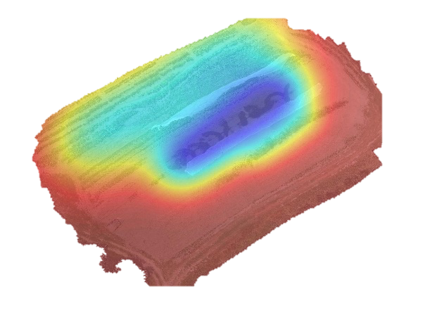
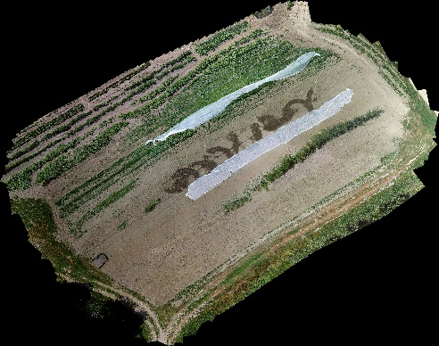
Solution: Data-Driven Agriculture
Ag researchers have shown that it:
Reduces waste
Increases productivity
Ensures sustainability

Slide 6
But…
According to USDA, high cost of manual data collection prevents farmers from using data-driven agriculture

Slide 7



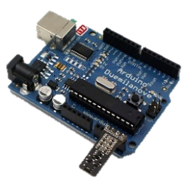
IoT System for Agriculture

Slide 8
Problem 1: No Internet Connectivity
Most farms don’t have any internet coverage
Even if connectivity exists, weather related outages can disable networks for weeks

Slide 9
Problem 2: No Power on the Farm
Farms do not have direct power sources
Solar power is highly prone to weather variability

Slide 10
Problem 3: Limited Resources
Need to work with sparse sensor deployments
  Physical constraints due to farming practices
  Too expensive to deploy and maintain

Slide 11
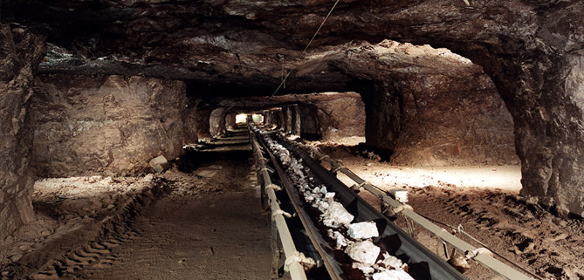
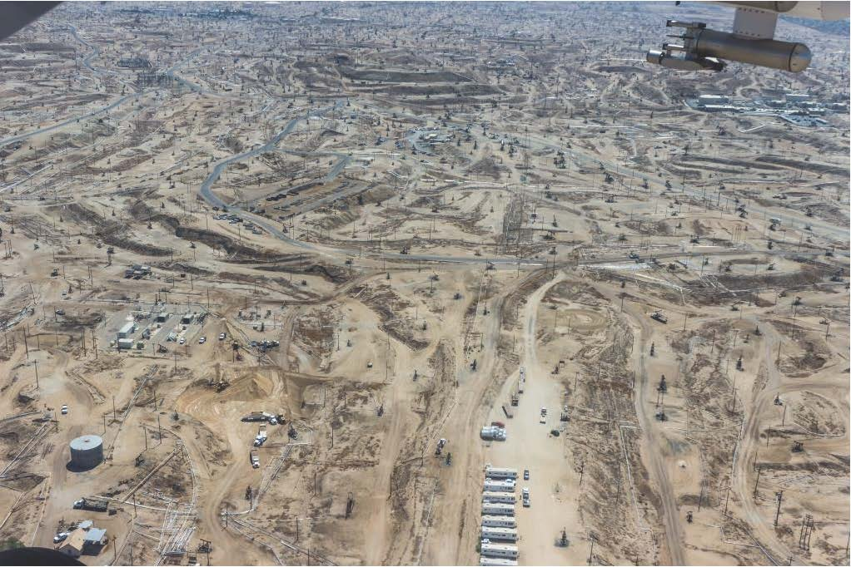
Beyond Agriculture
Mining
Oil Fields
How can one design an IoT system in challenging
resource-constrained environments?

Slide 12
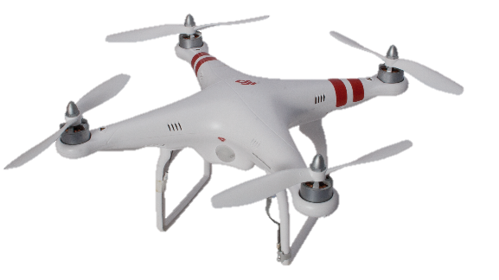
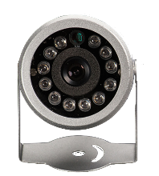
In this talk
FarmBeats: An end-to-end IoT system that enables seamless data collection for agriculture
FarmBeats
Farm Services

Slide 13
In this talk
FarmBeats: An end-to-end IoT system that enables seamless data collection for agriculture
Solves three key challenges:
  Internet Connectivity
  Power Availability
  Limited Sensor Placement
Deployed in two farms in NY and WA for over six months

Slide 14
Challenge: Internet Connectivity
(Farmer’s home/office)
Cloud

Slide 15
Challenge: Internet Connectivity
(Farmer’s home/office)
Cloud
Sensors
Few miles away
Obstructed by crops, canopies, etc

Slide 16
Idea: Use TV White Spaces
Can provide long-range connectivity
Can travel through crops and canopies, because of low frequencies
Large chunks are available in rural areas=> can support large bandwidth

Slide 17
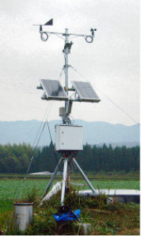
Idea: Use TV White Spaces
Base Station
Weak Connectivity
Prone to outages
TV White Spaces
Few miles
(Farmer’s home/office)
Cloud
Wi-Fi, BLE
Sensors

Slide 18
Idea: Compute Locally and Send Summaries
PC on the farm delivers time-sensitive services locally
Combines all the sensor data into summaries
2-3 orders of magnitude smaller than raw data
Cloud delivers long-term analytics and cross-farm analytics

Slide 19
FarmBeats Design
Base Station
TV White Spaces
Few miles
Gateway PC
(Farmer’s home/office)
Cloud
Sensors

Slide 20
In this talk
FarmBeats: An end-to-end IoT system that enables seamless data collection for agriculture
Solves three key challenges:
  Internet Connectivity
  Limited Sensor Placement
  Power Availability
Deployed in two farms in NY and WA for over six months

Slide 21
Challenge: Limited Resources
Need to work with sparse sensor deployments
  Physical constraints due to farming practices
  Too expensive to deploy and maintain
How do we get coverage with a sparse sensor deployment?

Slide 22
Idea: Use Drones to Enhance Spatial Coverage
Drones are cheap and automatic
Can cover large areas quickly
Can collect visual data
Combine visual data from the drones with the sensor data from the farm

Slide 23
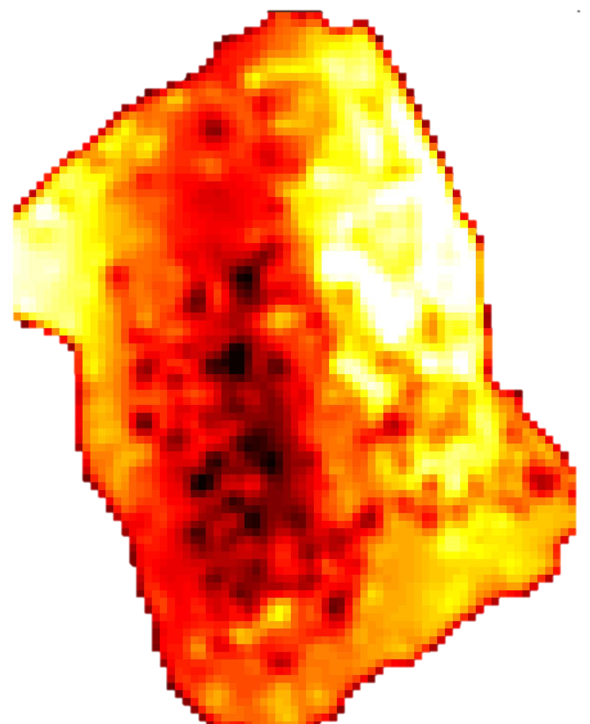
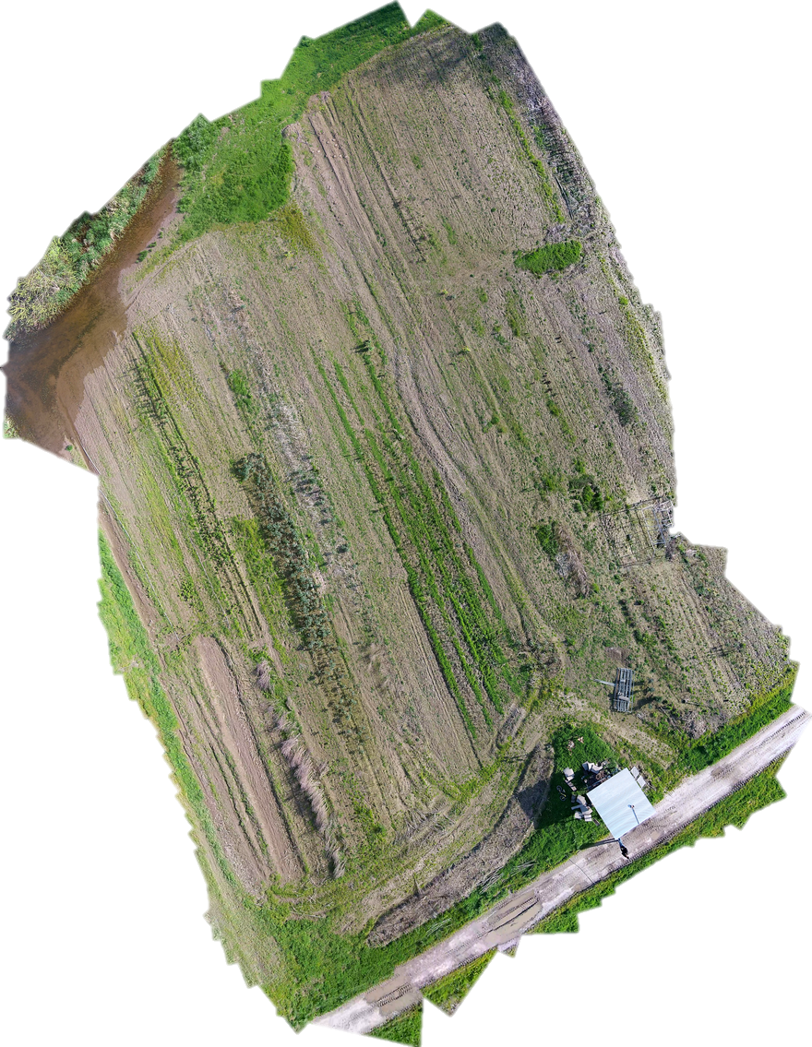
Idea: Use Drones to Enhance Spatial Coverage
Drone Video
Panoramic Overview
Precision Map
Sparse Sensor Data

Slide 24
Formulate as a Learning Problem
Training Data
Prediction
Panoramic Overview

Slide 25
Model Insights
Spatial Smoothness: Areas close to each other have similar sensor values
Visual Smoothness: Areas that look similar have similar sensor values values

Slide 26






Model
$$i=1 to N$$
Training Phase: Learn K and W
Test Phase: Generate outputs for unknown areas
Features (visual)
$$x_{i}$$
Kernel (Model visual similarity)
Output (say, moisture)
$$y_{i}$$
Spatial Smoothness
$$K$$

Slide 27
Using Sparse Sensor Data
Drone Video
Panoramic Overview
Precision Map
100 kB summary
FarmBeats can use drones to expand the sparse sensor data and create summaries for the farm
Sensor Data

Slide 28
In this talk
FarmBeats: An end-to-end IoT system that enables seamless data collection for agriculture
Solves three key challenges:
  Internet Connectivity
  Limited Sensor Placement
  Power Availability
Deployed in two farms in NY and WA for over six months

Slide 29
Challenge: Power Availability is Variable
Farm
Battery dies due to cloudy/rainy/snowy weather
TV White Spaces
Gateway
(Farmer’s home/office)
Cloud

Slide 30
Challenge: Power Availability is Variable
Solar powered battery saw up to 30% downtime in cloudy months
Miss important data like flood monitoring
How do we deal with weather-based power variability?

Slide 31
Idea: Weather is Predictable
Use weather forecasts to predict solar energy output
Ration the load to fit within power budget

Slide 32

Idea: Weather is Predictable
$γ$: Duty Cycle ratio, $T_{on}$: On time in each cycle, $T_{off}$: Off time
$γ=\frac{T_{on}}{T_{off}}$
Constraints:
  Power Neutrality: $γP≤C$
  Minimum Transfer Time: $T_{on}≥T_{connect}+T_{transfer}$

Slide 33



Solution: Weather is predictable
$$γ$$
  Minimum Transfer Time: $T_{on}=γT_{off}≥T_{connect}+T_{transfer}$
Optimal for minimum latency
  Power Neutrality: $γP≤C$
FarmBeats can use weather forecasts to duty cycle the base station, with minimum latency
$$T_{off}$$

Slide 34
In this talk
FarmBeats: An end-to-end IoT system that enables seamless data collection for agriculture
Solves three key challenges:
  Internet Connectivity
  Limited Sensor Placement
  Power Availability
Deployed in two farms in NY and WA for over six months

Slide 35
Deployment
Six months deployment in two farms: Upstate NY (Essex), WA (Carnation)
The farm sizes were 100 acres and 5 acres respectively
Sensors:
  DJI Drones
  Particle Photons with Moisture, Temperature, pH Sensors
  IP Cameras to capture IR imagery as well as monitoring
Cloud Components: Azure Storage and IoT Suite

Slide 36
Deployment Statistics
Used 10 sensor types, 3 camera types and 3 drone versions
Deployed >100 sensors and ~10 cameras
Collected >10 million sensor measurements, >0.5 million images, 100 drone surveys
Resilient to week long outage from a thunderstorm

Slide 37
FarmBeats: Usage
Farm
TV White Spaces
Gateway
(Farmer’s home/office)
Cloud

Slide 38
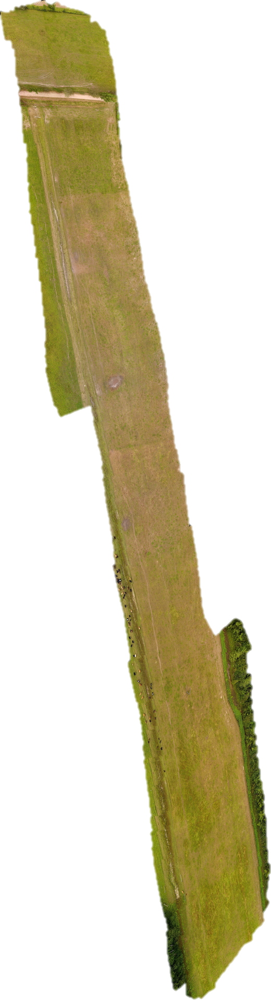
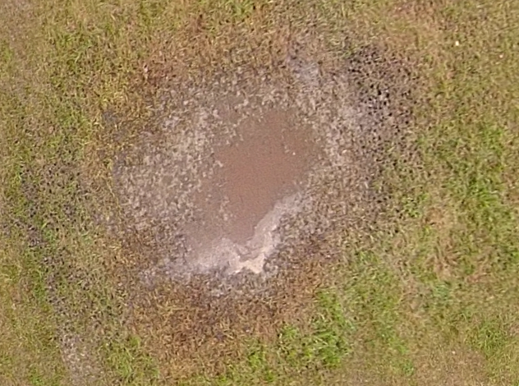
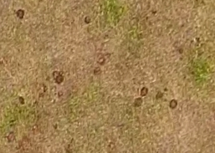
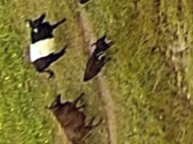
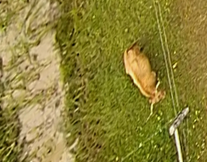
Example: Panorama
Water puddle
Cow excreta
Cow Herd
Stray cow

Slide 39
Precision Map: Panorama Generation

Slide 40
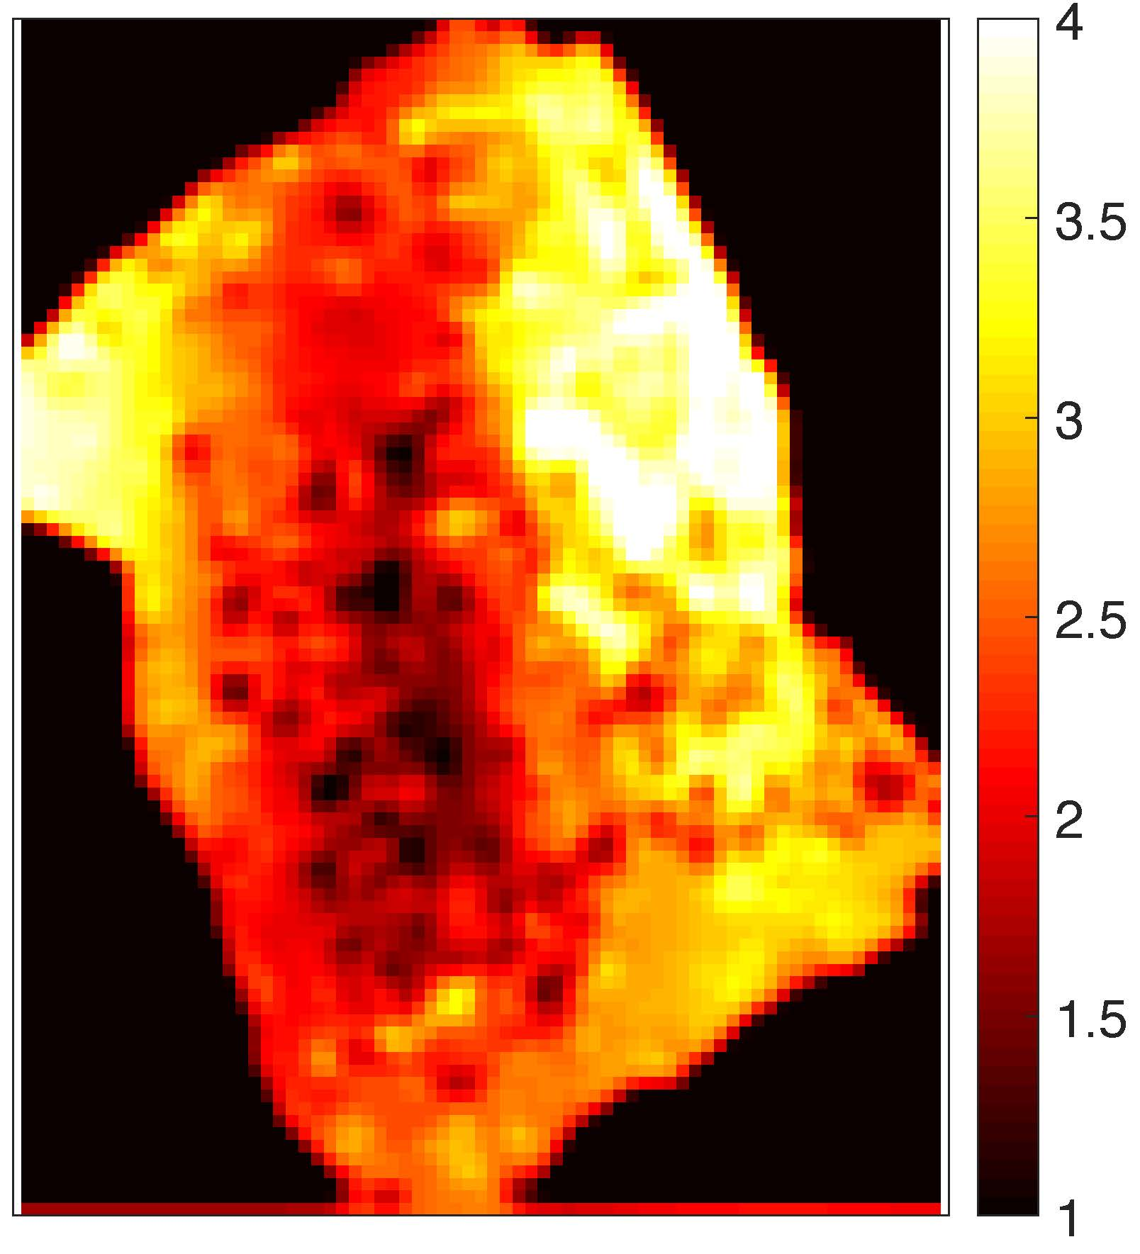
Precision Map : Moisture

Slide 41
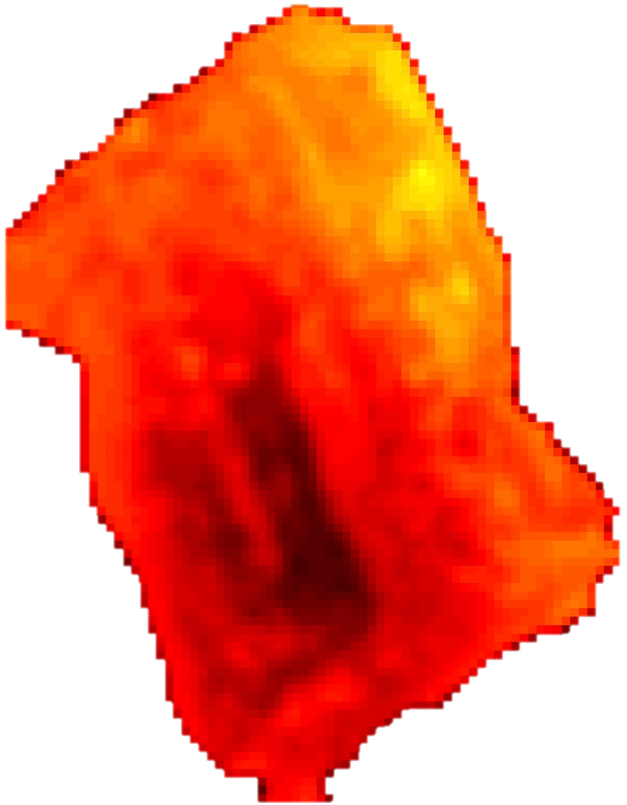
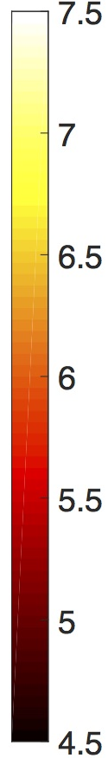
Precision Map : pH

Slide 42
Precision Map: Accuracy
FarmBeats can accurately expand coverage by orders of magnitude using a sparse sensor deployment

Slide 43
Weather-Aware Duty Cycling
No Duty Cycling

Slide 44
Weather-Aware Duty Cycling
FarmBeats Duty Cycling
Reduced downtime from 30% to 0% for month long data (September)

Slide 45
Related Work
Wireless Sensor Networks: Sensor networks for agriculture (Baggio `05, Sanchez et al `11, Lee et al `10,…), LPWAN technologies (LoRA, SIGFOX, …)
Agriculture: Precision agriculture (Bratney et al `99, Mueller et al `12, Cassman et al `99,..), Nutrient measurement (Kim et al `09, Hanson et al `07)
ICTD: Information access and user interfaces (Zhao et al `10, Doerflinger et al 2012)

Slide 46
Conclusion
FarmBeats: First end to end IoT system for environments constrained by:
    Limited internet connectivity
    Power Variability
    Sparse Sensor Deployment
Acts as a tool to enhance farm and farmer productivity
Used by farmers for applications beyond precision farming

Slide 47
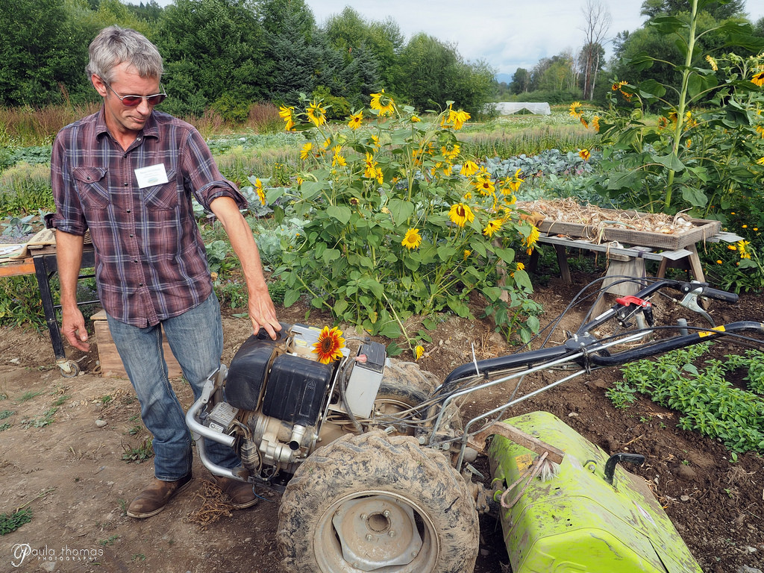
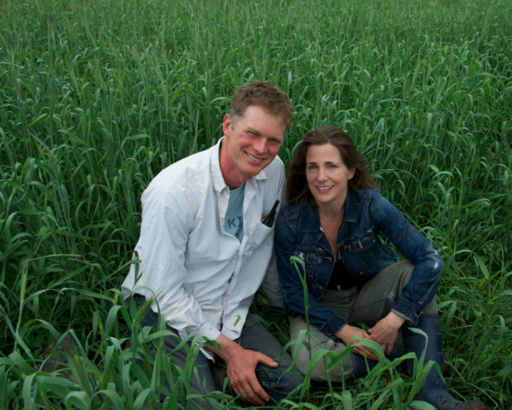
Thank you!
Sean Stratman, Dancing Crow Farm, WA
Mark & Kirstin Kimball, Essex Farm, NY

