Slide 1


A Subspace Method for Fast Locally Injective Harmonic Mapping
Eden Fedida Hefetz¹, Edward Chien², Ofir Weber¹
¹ Bar-Ilan University, Israel
² CSAIL MIT, USA

Slide 2
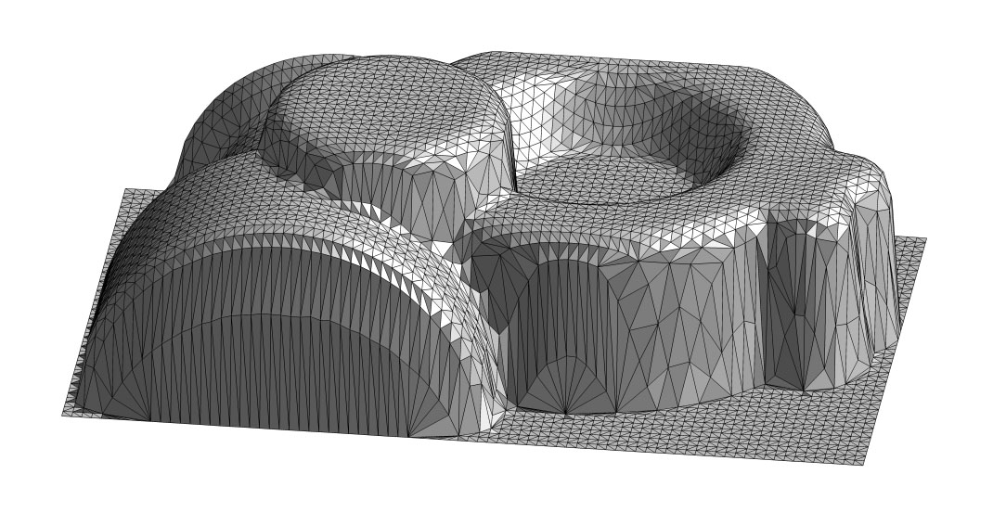
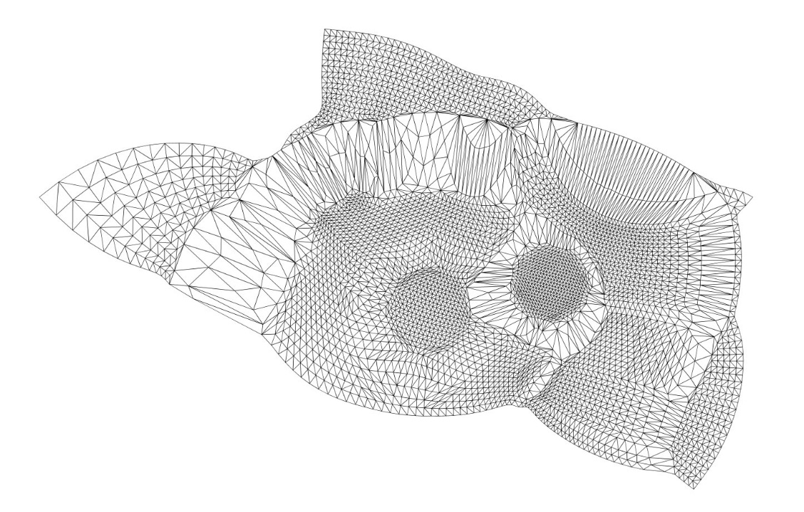
The Problem: Mesh Parametrization
Useful for:
texture application
remeshing
vector/directional field design
and more…

Slide 3

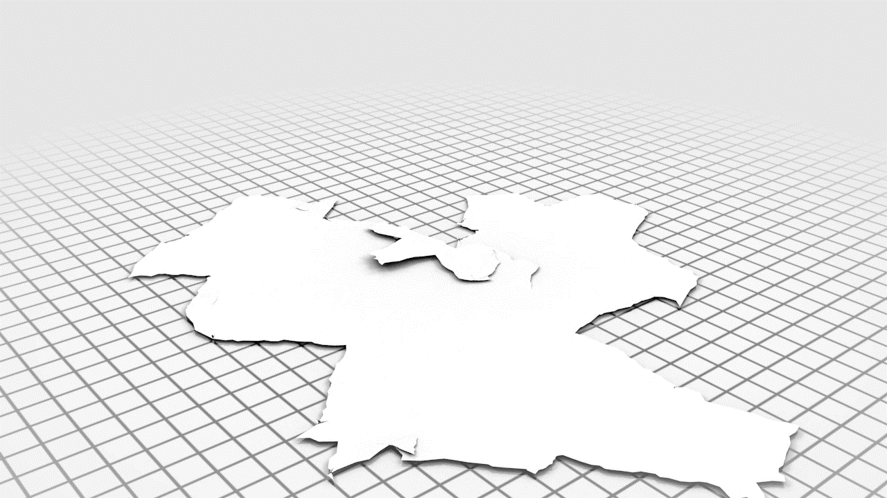
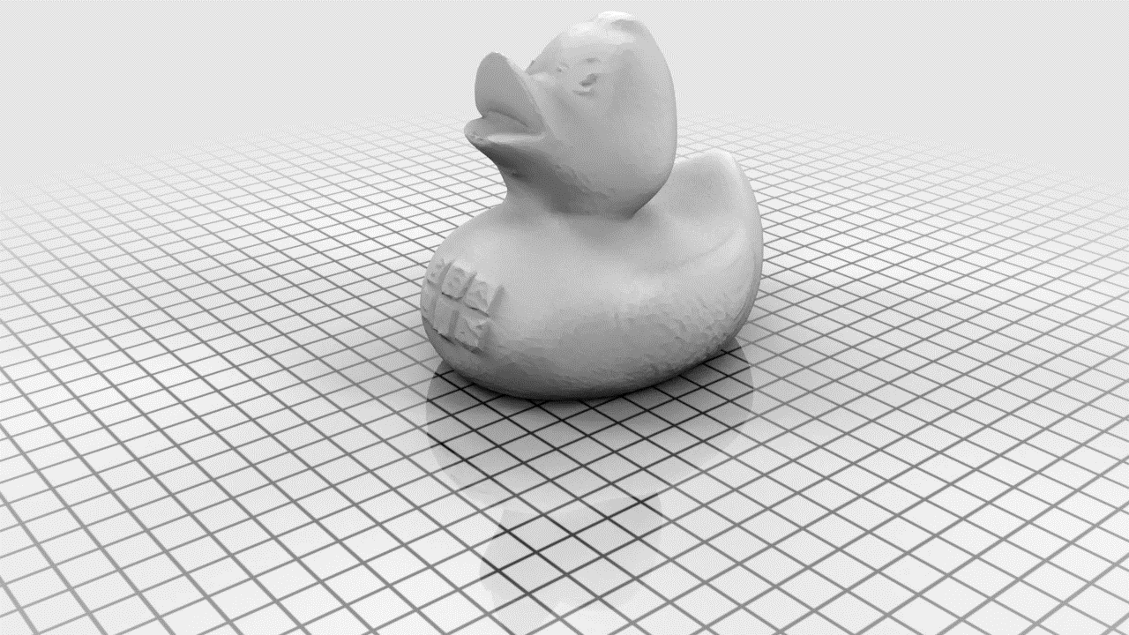
Credit: Hans-Christian Ebke
Quad Remeshing Example

Slide 4

Positioning Our Work
Linear methods (convex quadratic energies) fast but no guarantees
  LSCM [Lévy et al. ‘02], Angle-Based [Zayer et al. ‘07], Conformal Flattening [Ben-Chen et al. ‘08], etc.
Recent nonconvex energy-based methods slower, but more robust
  CM [Schtengel et al.], Killing [Claici et al.], SLIM [Rabinovich et al.], AQP [Kovalsky et al.], etc.
We aim for the speed of a linear method and the robustness of a nonconvex method
  Conformal Harmonic Piecewise linear
  Leverages injectivity condition from Harmonic Global Parametrization (HGP) [Bright et al. ‘17]

Slide 5
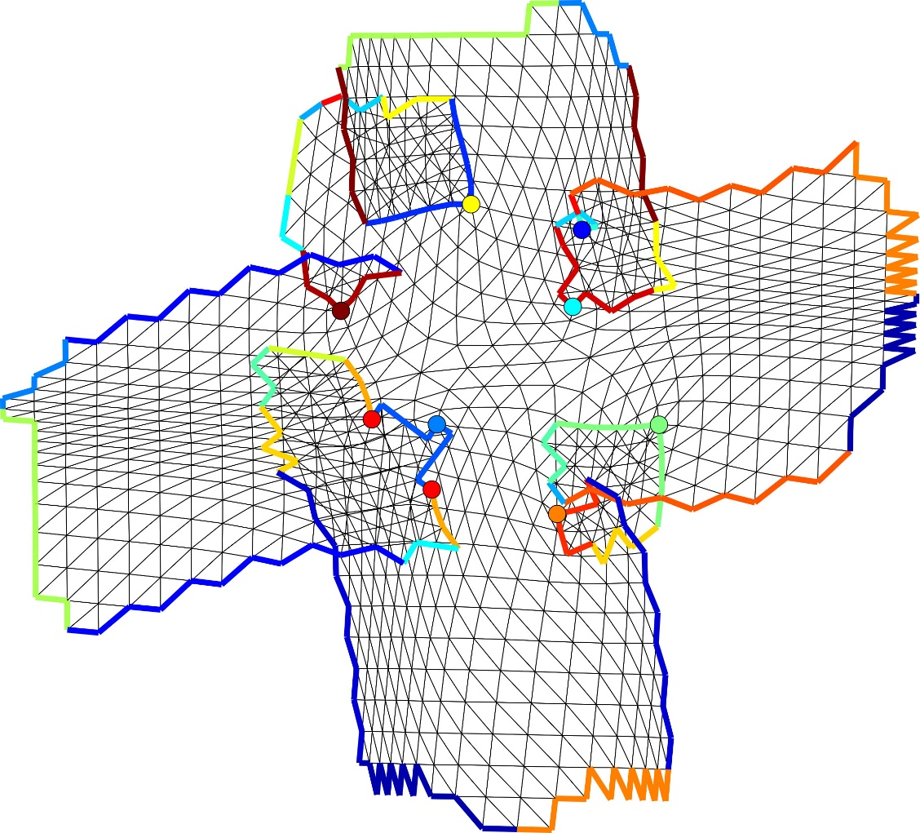
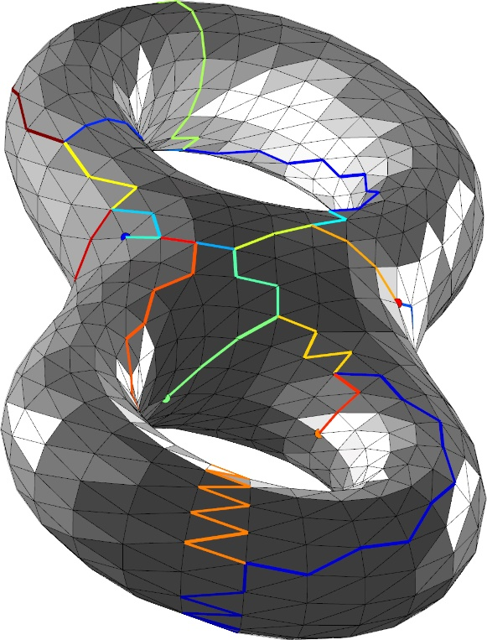
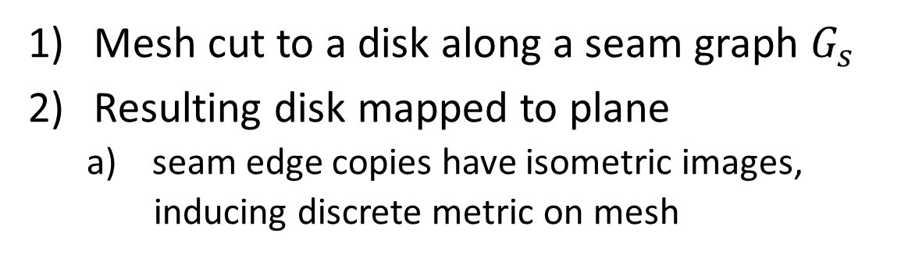
Global Parametrization
Mesh cut to a disk along a seam graph $G_{s}$
Resulting disk mapped to plane
  seam edge copies have isometric images,
  inducing discrete metric on mesh
  local injectivity necessary for many applications

Slide 6
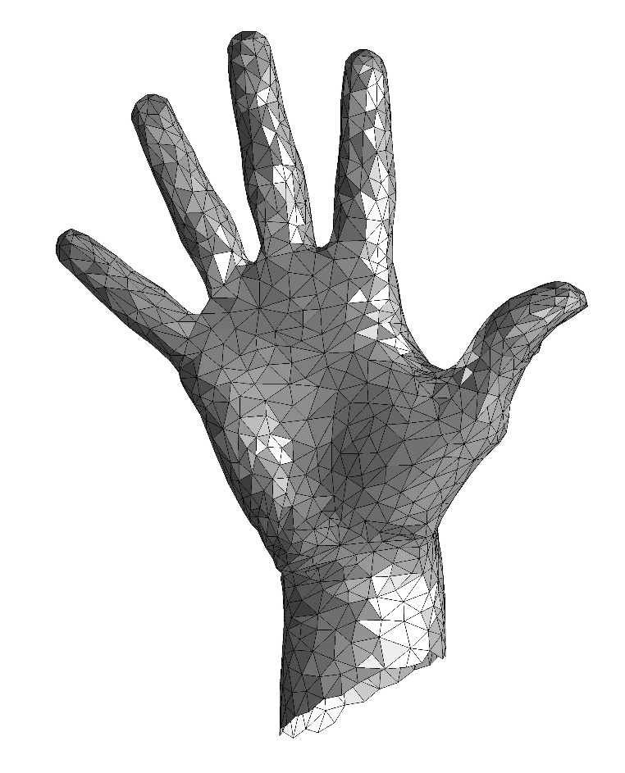
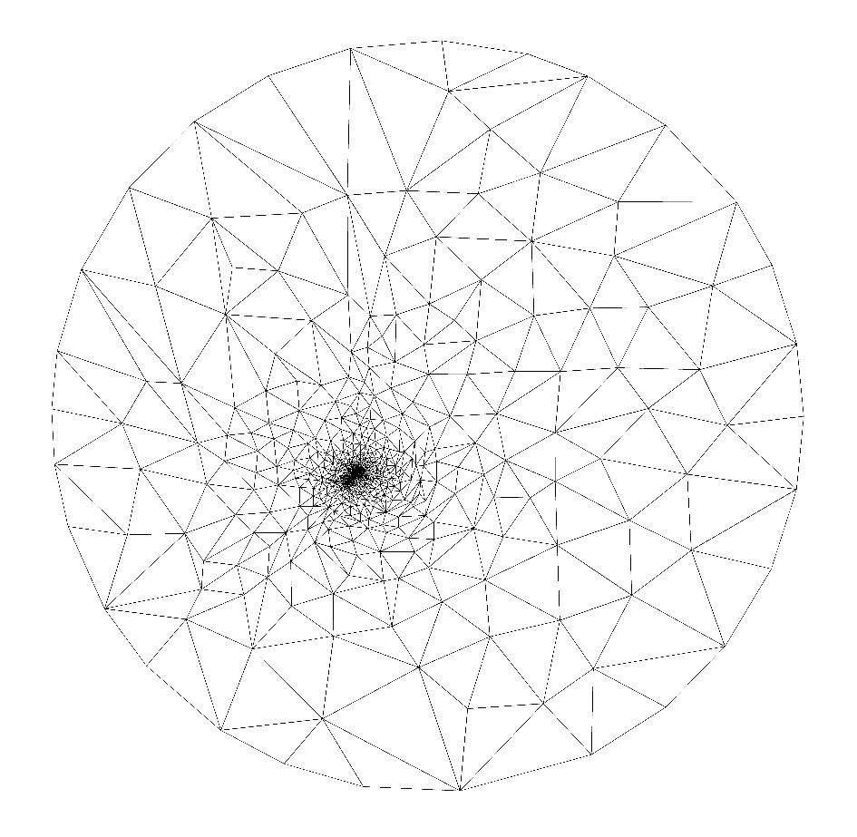
Tutte’s Harmonic System
Mesh disk with vertices V and boundary vertices B.
Arbitrary positive weights
Vertex images under parametrization
Guarantee: if B vertices placed as vertices of convex polygon
  → resulting map is globally bijective

Slide 7

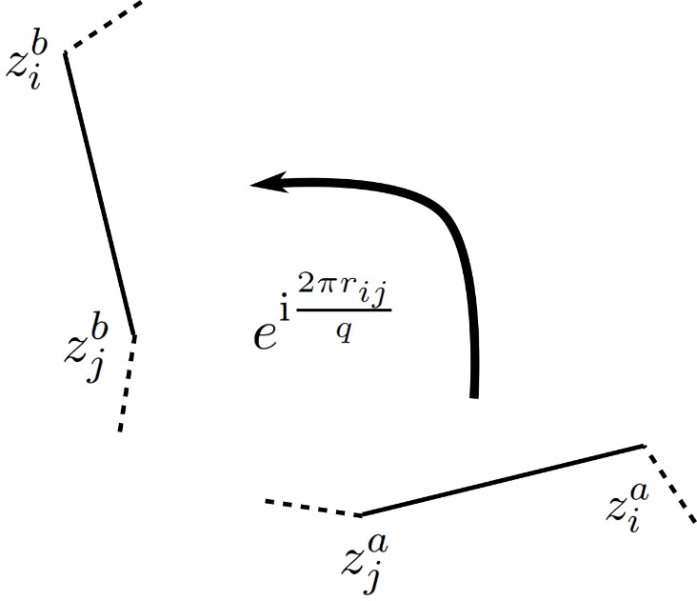

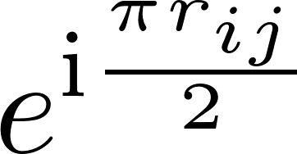
An Analogous System
An analogous system for global parametrization:
(Cone structure given)
Harmonicity for non-cone vertices of $G_{s}$ on next slide…

Slide 8
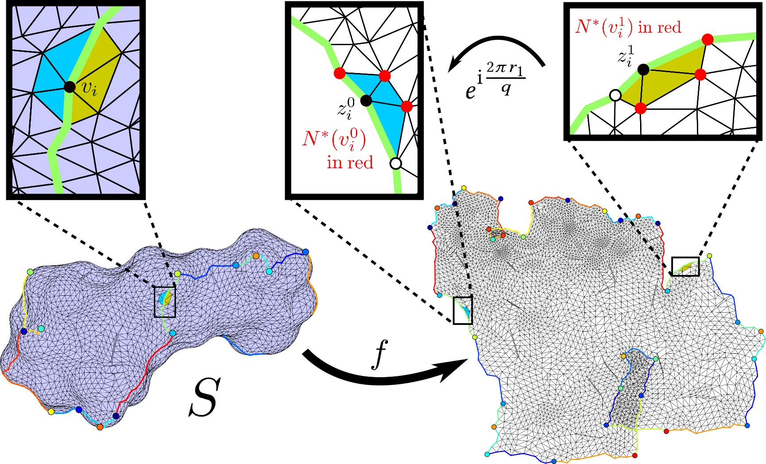
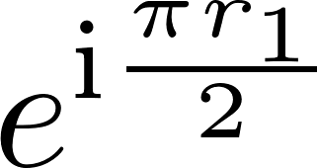

An Analogous System
System inspired by [Aigerman et al. 2015]

Slide 9
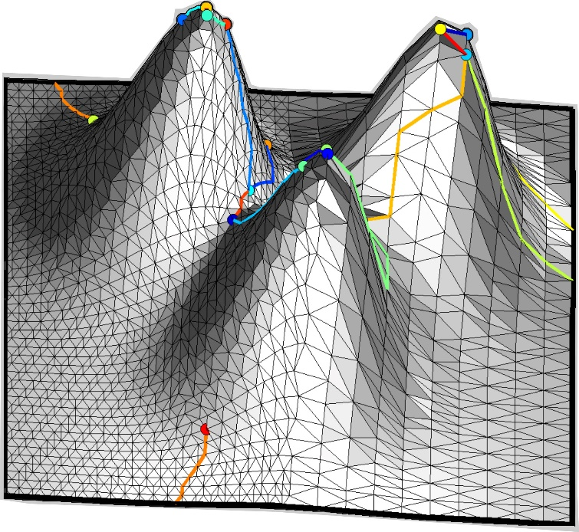
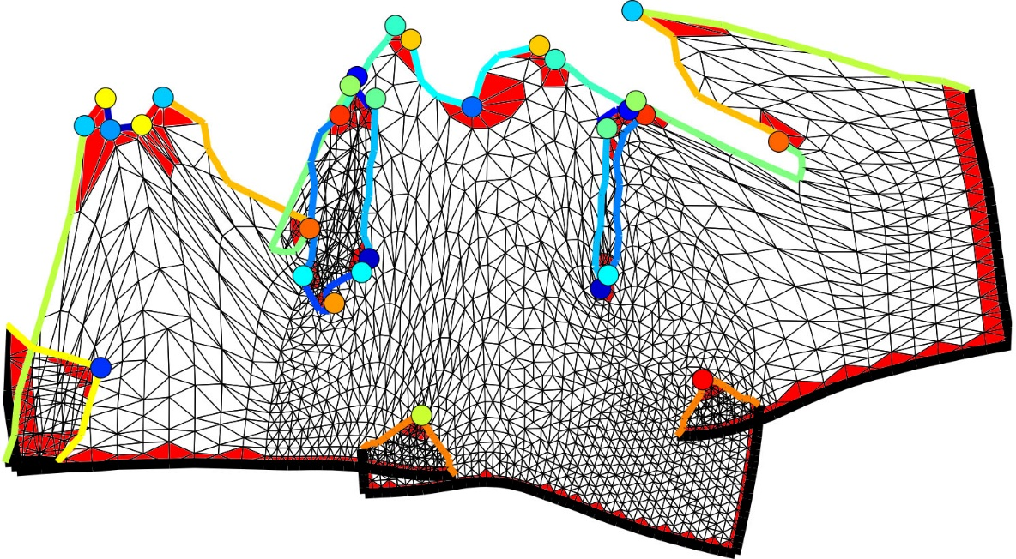
Local injectivity guarantee
Main theoretical result of HGP: Given a solution to our system,
  if the boundary and cone triangles are well-behaved
  → resulting map is locally injective
System not explicitly solved; harmonic constraints enforced softly with biharmonic energy

Slide 10
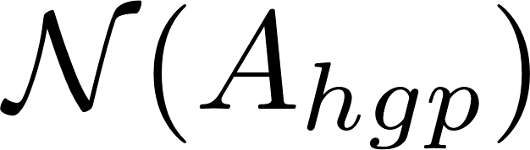
Contributions/Method Summary
Piecewise linear maps
Jacobians
Just cone and boundary triangles!
low-dimensional; explicit basis with interpolation conditions
[Lipman 2012]
Allows use of selected inversion! → Speed equivalent to 1-2 linear solves
(Genus 0)

Slide 11
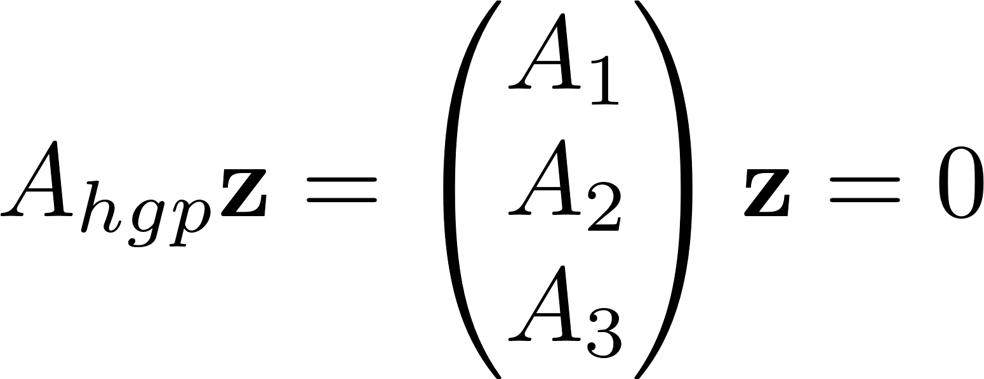

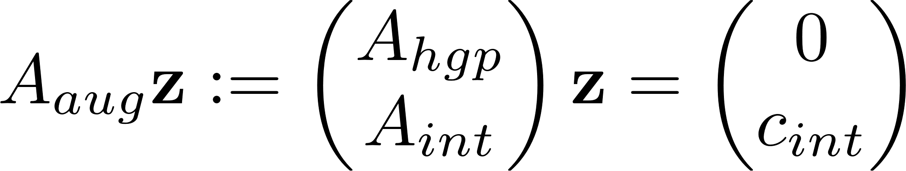
System Analysis for Genus 0
For HGP system:
  denote bdy vertices, cones, and bdy components
Additional interpolation conditions complete the system
“augmented system”

Slide 12
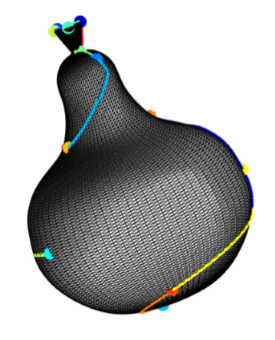
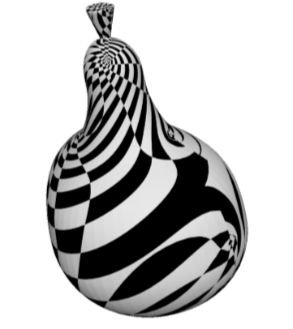
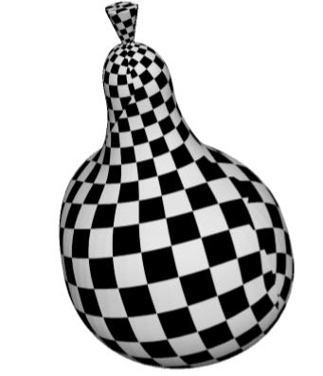
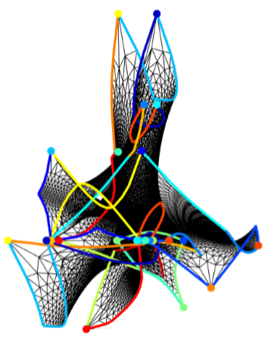
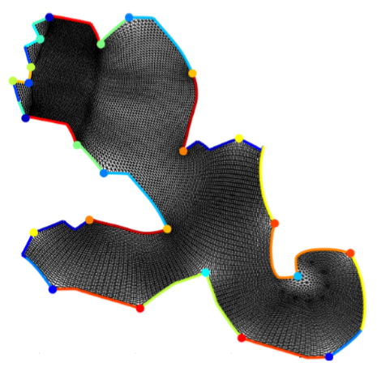
Interpolation Conditions
In sphere case, specify position of a copy of all but one cone
(w/ boundaries, additional positions to specify)

Slide 13
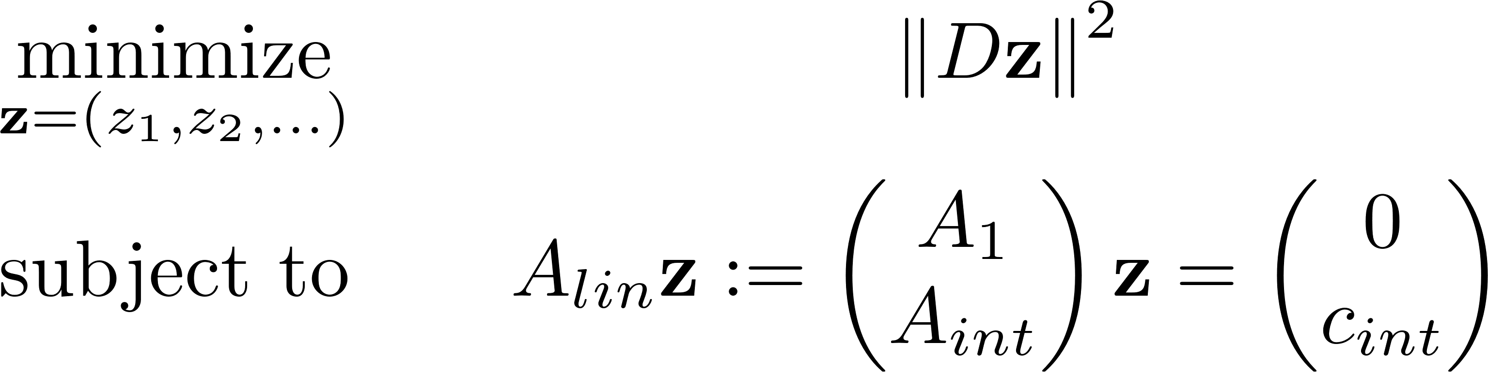
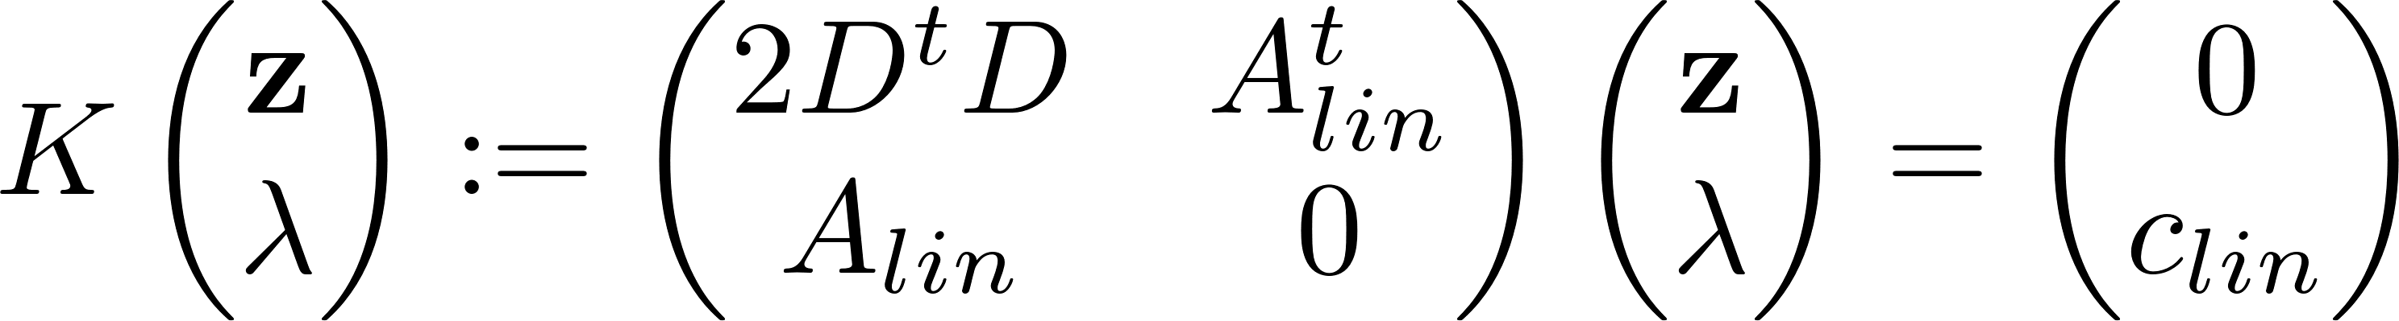

Reformulating as a KKT system
We prove the system is equivalent to the following optimization:
Gives rise to a linear KKT system:
Detailed arguments show K invertible, and thus invertible
Dirichlet energy!

Slide 14

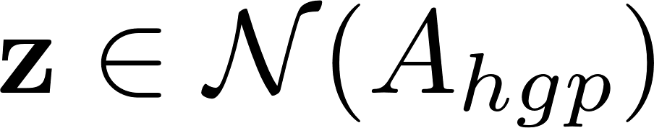
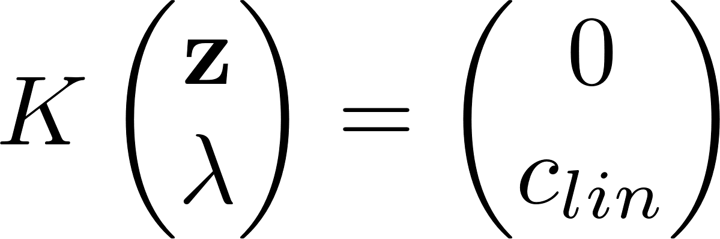
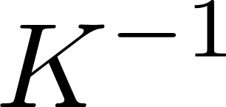

Use of Selected Inversion
For a solution , we get
For , extract a column of
By HGP injectivity guarantee, only need to extract entries near cones and boundaries
Cleverly uses a block LDL^t decomposition of K; outperforms direct methods for null space basis construction
Guide for PARDISO use in App. D

Slide 15
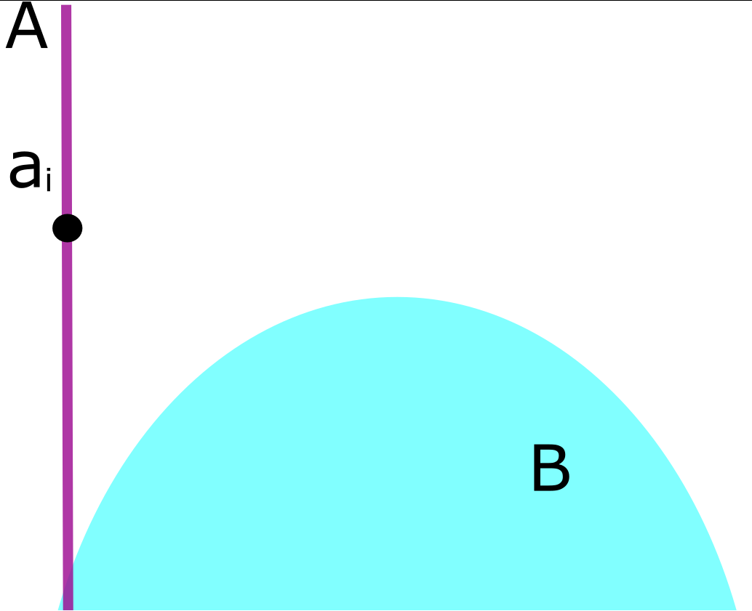
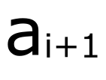


Alternating (Tangential) Projections
MAP | ATP
$$H_{i}$$
A is “global” linear space consisting of Jacobians for maps
B is “local” convex space given by convexification frames [Lipman ‘12]

Slide 16
Alternating (Tangential) Projections
MAP | ATP
[Von Neumann 1950]
[Hefetz et al. 2017]
[Bauschke and Borwein 1993]
A is “global” linear space consisting of Jacobians for maps
B is “local” convex space given by convexification frames [Lipman ‘12]

Slide 17
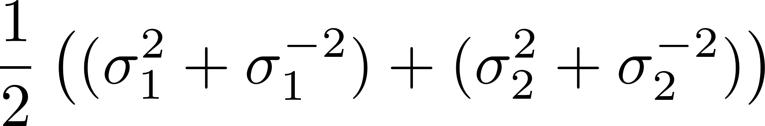
Projected Newton
Symmetric Dirichlet energy is optimized
Nonconvex, so need to project Hessians to the PSD cone
Analytic formulae from [Chen & Weber 2017]

Slide 18
Results!
Comparable quality to HGP results
Fairly robust results: 66 of 77 successful on a benchmark
One order of magnitude faster than HGP; comparable to 1-2 linear solves (next slide)

Slide 19
Timing Results

Slide 20
Algorithm Parts Timing

Slide 21
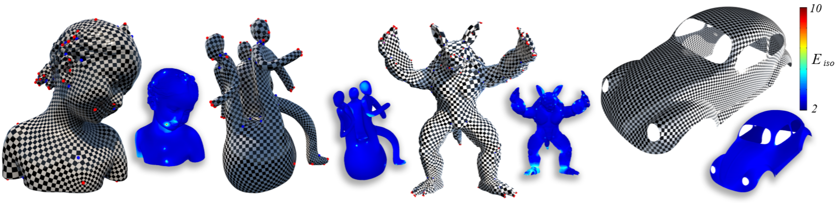
Thank you! Questions?

