Slide 1
InfoShape Task-Based Neural Data Shaping Via Mutual Information
Homa Esfahanizadeh
William Wu, Manya Ghobadi, Regina Barzilay, Muriel Médard
Massachusetts Institute of Technology (MIT)

Slide 2
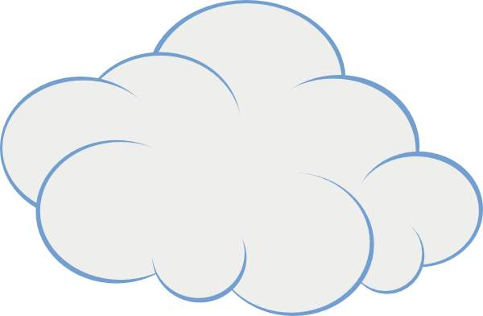
Significance and Challenges of Data Sharing
There is shortage of publicly available training data for many critical machine learning (ML) tasks
Due to privacy concerns for acquisition and release of data from multiple data-owners
Data owners
Downstream computational job (e.g., training an ML model for covid or not)
Privacy concerns (e.g., diabetes or not)

Slide 3
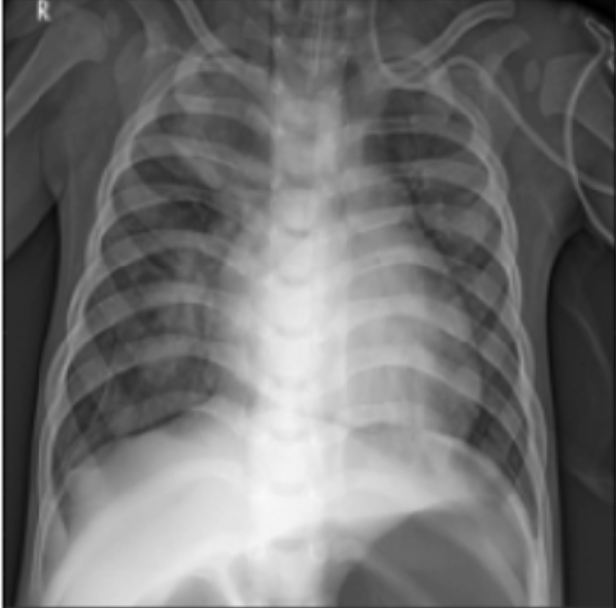
Privacy Preserving Codes
Mutual Information: Measure of “information” obtained about one random variable by observing another random variable [Shannon 48].
Goal: Designing a lossy encoder that transforms data according to two objectives:
InfoShape Encoder $$T(x)$$
Privacy Goal
Low $I(T\left(x\right);S(x))$ $S(x)$ is private label
Eve (Adversary)
S$(x)=?$
Utility Goal
Alice (Data-Owner)
Bob (ML Developer) $$L(x)=?$$
High $I(T\left(x\right);L(x))$ $L(x)$ is public label

Slide 4
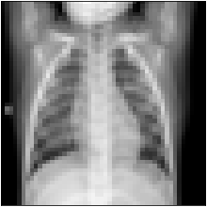
Our Solution: Task-Based Lossy Encoder
InfoShape: a task-based encoder that removes unnecessary sensitive information from training data while maintaining enough relevant information for a particular ML training task.
$$\max_{T}{I\left(T\left(x\right);L\left(x\right)\right)−λ I(T\left(x\right);S(x))}$$
$S(x)$ is private label
$L(x)$ is public label
Reward
Performance Estimations
Encoder
$$I(T\left(x\right);L(x))$$
$$x$$
$$T(x)$$
$$I(T\left(x\right);S(x))$$
Training Job
$$×−λ$$

Slide 5
Obtaining Mutual Information (MI) by Optimization
Donsker-Varadhan representation of MI [Donsker 83]:
Numerical optimization and a regularization term to help with stability [Belghazi 18, Choi 21]:
$$H(α|β)$$
𝐻(𝛼|𝛽)
$$H(β|α)$$
𝐻(𝛽|𝛼)
$$H(α)$$
$$H(β)$$
$$I(α;β)$$
$$I\left(α;β\right)={\text{sup}}_{F:Ω→R} E_{P(α,β)}\left[F\left(X,Y\right)\right]−\log{E_{P\left(α\right)×P(β)}[exp({F(X,Y))}]}$$
$$I\left(α;β\right)={\text{sup}}_{F:Ω→R} E_{P(α,β)}\left[F\left(X,Y\right)\right]−\log{E_{P\left(α\right)×P\left(β\right)}\left[exp⁡({F(X,Y))}\right]}−0.1{\left(\log{E_{P\left(α\right)×P\left(β\right)}}\left[exp⁡({F(X,Y))}\right]\right)}^{2}$$

Slide 6
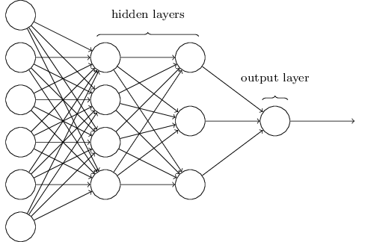
Mutual Information Estimation Using Neural Networks
$$I\left(α;β\right)={\text{sup}}_{F:Ω→R} E_{P(α,β)}\left[F\left(X,Y\right)\right]−\log{E_{P\left(α\right)×P\left(β\right)}\left[exp⁡({F(X,Y))}\right]}$$
$$−0.1{\left(\log{E_{P\left(α\right)×P\left(β\right)}}\left[exp⁡({F(X,Y))}\right]\right)}^{2}$$
Optimization can be numerically solved via SGD
Expectations can be replaced with statistical average
The sufficiently rich set of functions can be modeled with all possible functions that can be realized by a neural network $F_{φ}$, $φ∈Φ$
$$α$$
$$F_{φ}\left(α,β\right)$$
$$β$$

Slide 7
Training Procedure of the Task-Specific Encoder
A neural network with parameter $θ$, i.e., $T_{θ}$, is trained to maximize
$$I(T_{θ}\left(x\right);L(x))−λ I\left(T_{θ}\left(x\right);S\left(x\right)\right)$$
$S(x)$ is private label
$L(x)$ is public label
Reward $I(T_{θ}(x),L(x))−λ I\left(T_{θ}\left(x\right),S\left(x\right)\right)$
Encoder
$$T_{θ}$$
$$\max_{φ}{∑\left[F_{φ}\left(T_{θ}(x_{i}),L(x_{i})\right)\right]−\log{∑[exp({F_{φ}({T_{θ}(x}_{i}),{L(x}_{j}))}]}}$$
$$x$$
$$T_{θ}(x)$$
$$\max_{φ}{∑\left[F_{φ}\left(T_{θ}(x_{i}),S(x_{i})\right)\right]−\log{∑[exp({F_{φ}({T_{θ}(x}_{i}),{S(x}_{j}))}]}}$$
$$×−λ$$

Slide 8
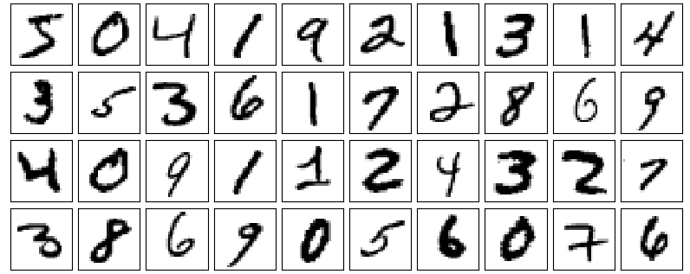
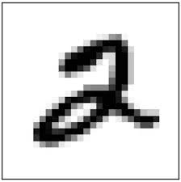
Results: Description of Dataset and ML Training Task
Digit MNIST Dataset includes 70,000 samples:
Each sample $x$ is a $28×28$ image, i.e., a handwritten digit in $\{0,1,…,9\}$.
Public label $L(x)$: If $x$is even or odd.
Private label $S(x)$: If $x>4$or not.
InfoShape Architecture
784 nodes
50 nodes
10 nodes

Slide 9
Estimation of MI at Different Training Epochs
Mutual information (MI) between the encoded sample and public label at different encoder training epochs
$$I\left(X;L\left(X\right)\right)≈0.59$$
Goes up with training
$$I\left(T_{random}\left(X\right);L\left(X\right)\right)≈0.21$$
MI between the encoded sample and private label at different encoder training epochs
$$I\left(X;S\left(X\right)\right)≈0.57$$
$$I\left(T_{random}\left(X\right);S\left(X\right)\right)≈0.22$$
Goes down with training

Slide 10
Generalization Accuracy of Classifiers
Predictive accuracy of public label
Predictive accuracy of private label
AUC: $0.999 → 0.973$
AUC: $0.999 → 0.527$

Slide 11
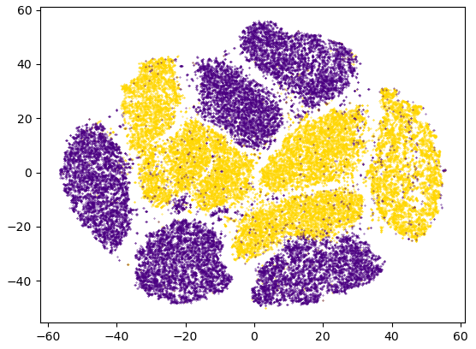
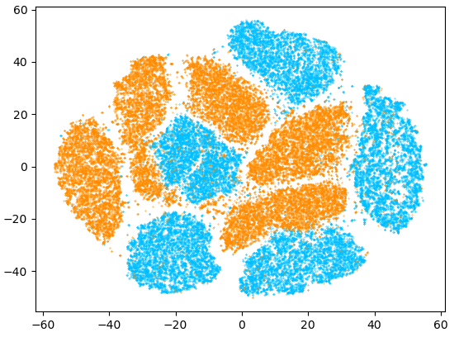
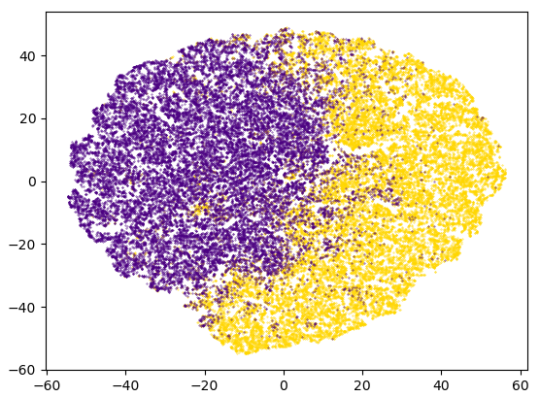
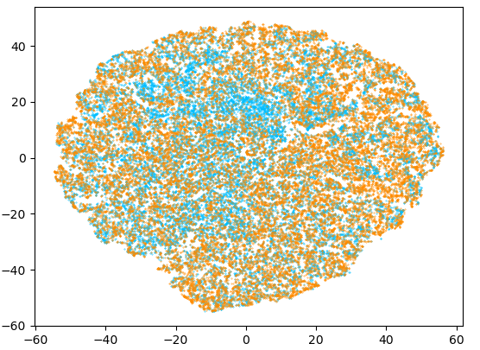
Visualizations Before and After InfoShape Encoding
Two-dimensional representation of samples before and after InfoShape encoding, using t-SNE approach:
Colored based on public label
Colored based on private label
Original samples
InfoShape encoded samples
Even
Odd
$$>4$$
$$≤4$$

Slide 12
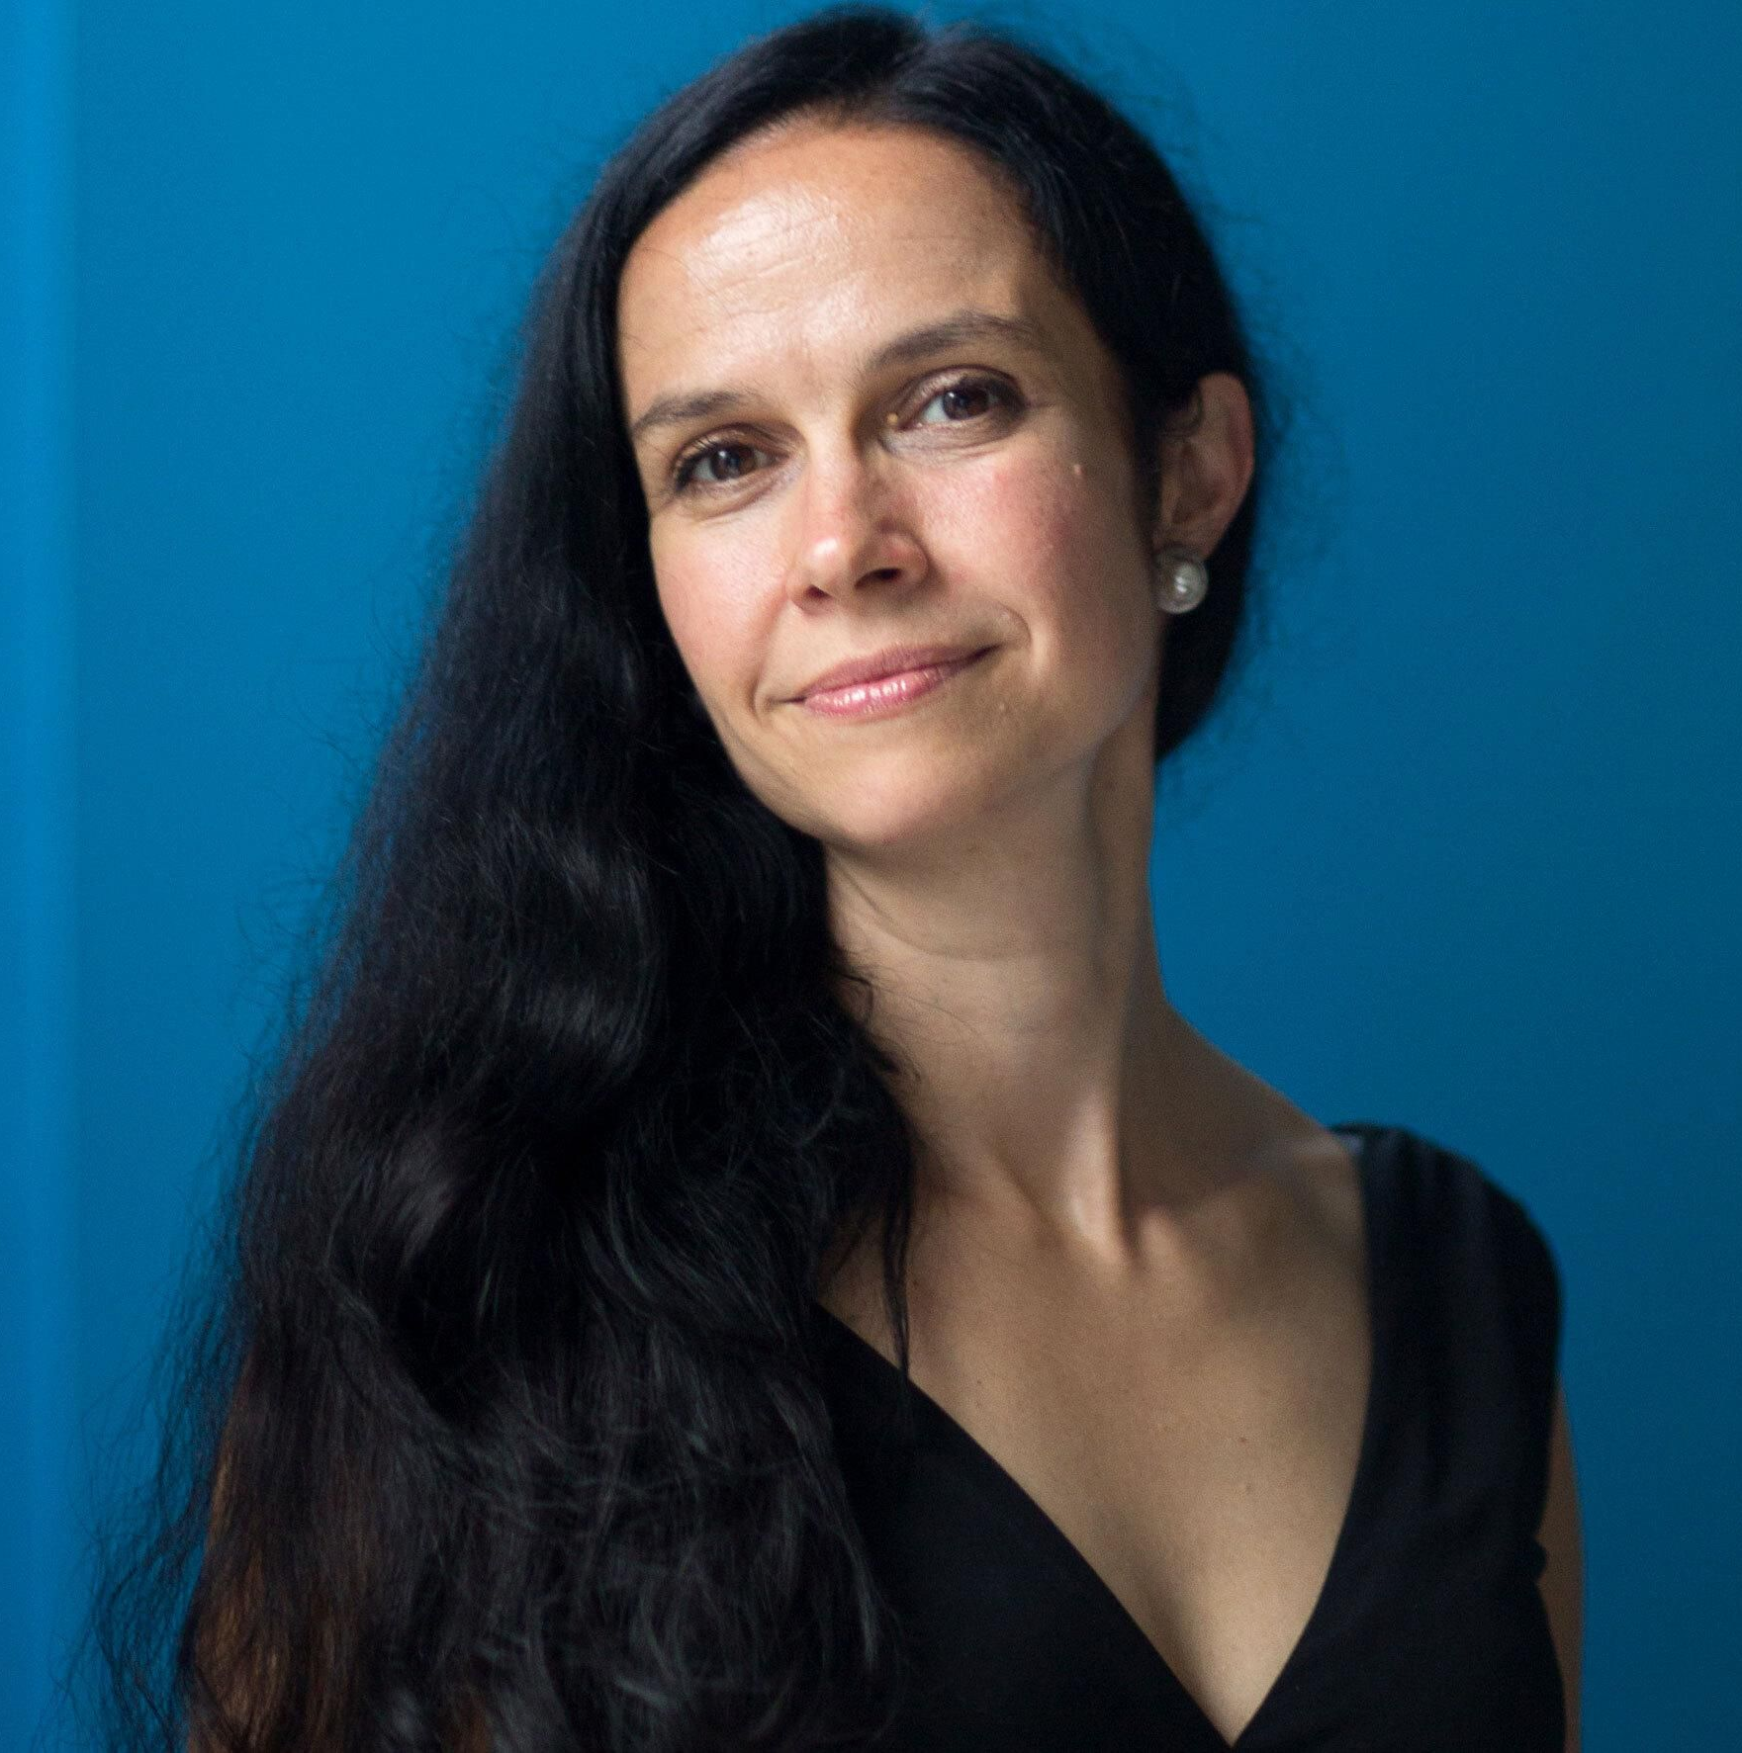
Summary and Conclusion
InfoShape: a neural network trained using neural MI estimations to tackle the critical privacy-utility trade-off problem in data sharing.
GitHub Repository
William Wu
Manya Ghobadi
Regina Barzilay
Muriel Médard
Main References:
[1] Claude E. Shannon, “A mathematical theory of communication.,” Bell System Technical Journal, 1948.
[2] M. Donsker and S. Varadhan “Asymptotic evaluation of certain Markov process expectations for large time,” Communications on Pure and Applied Mathematics,1983.
[3] I. Belghazi, S. Rajeswar, A. Baratin, R. D. Hjelm, and A. C. Courville, “MINE: mutual information neural estimation,” PMLR, 2018.
[4] K. Choi and S. Lee, “Regularized mutual information neural estimation,” Openreview, 2021.

