Slide 1
TopoOpt: Co-optimizing Network Topology and Parallelization Strategy for Distributed Training Jobs
Weiyang (Frank) Wang, MIT CSAIL
Moein Khazraee, Zhizhen Zhong, Manya Ghobadi, Zhihao Jia, Dheevatsa Mudigere, Ying Zhang, Anthony Kewitsch

Slide 2
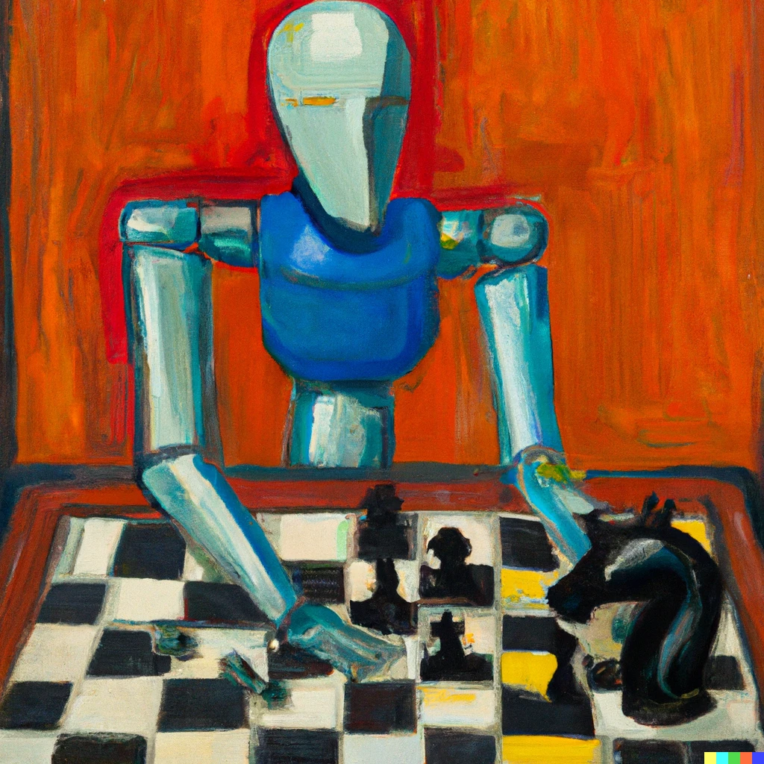
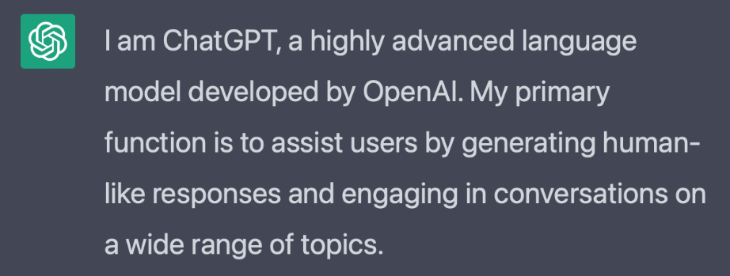
The era of large deep neural networks (DNNs)
GPT-4
Large Language Model
Deep Learning Recommendation Model
Recommendation Model
DALL.E 2
Image Generation Model
The growth of large DNN models creates demands efficient distributed DNN training systems

Slide 3
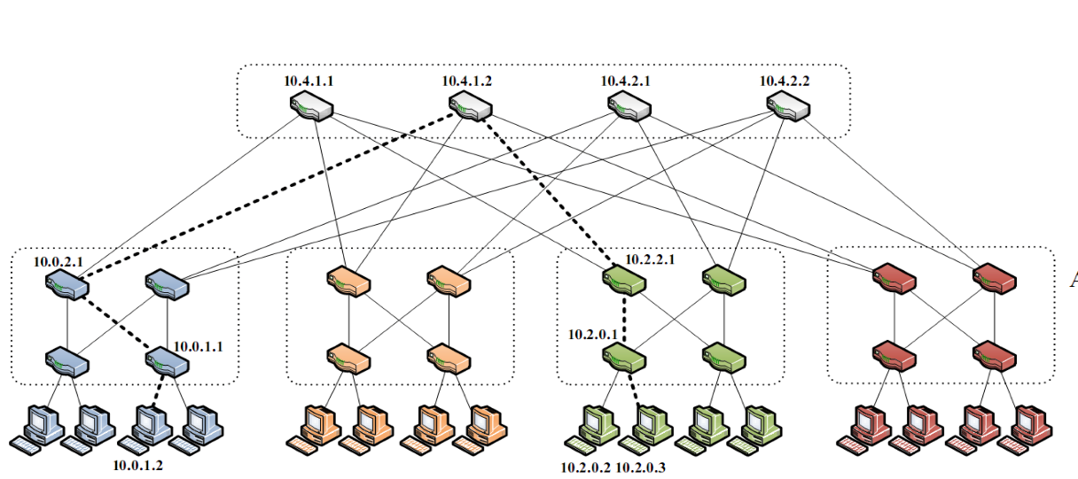
State-of-the-art training clusters: Fat-Tree network topology
Fat-Trees provide uniform bandwidth and latency between server pairs
Ideal when the workload is unpredictable and consists mostly of short transfers
Fat-Tree networks are not the best network topology for DNN training!
A Scalable, Commodity Data Center Network Architecture
Mohammad Al-Fares et al., SIGCOMM ‘08

Slide 4
Network is becoming a bottleneck of DNN training
Fat-Tree based DNN training infrastructures are facing a network bottleneck
Network Bottleneck: the amount of time spent on communication only
Network Overhead (%)
Number of GPU servers

Slide 5
Previous work on distributed DNN training optimization does not consider physical topology
Compression and encoding
Qsgd [NeurIPS ’17]
Schedulers
Themis [NSDI ‘20]
Asynchronous transmit
DC-ASGD [PMLR ‘17]
Computation
+
Communication
Parallelization strategy
FlexFlow [MLSys ’19]
Collective communication
BytePS [OSDI ‘20]
Hyper parameters
ASHA [MLSys ‘20]
Network topology
?

Slide 6
Reconfiguring physical network topology
Topology A
Topology A
Topology A

Slide 7
Reconfiguring physical network topology
Topology A
Topology B
Topology C

Slide 8
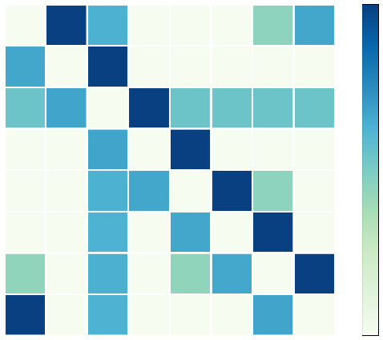
DNNs training traffic has different properties
100%
0
Source Server
4
7
0
4
7
Destination Server
(a) Vision
0

Slide 9
DNNs training traffic has different properties
100%
0
0
0
0
Source Server
Source Server
Source Server
Source Server
…
4
4
4
4
7
7
7
7
0
4
7
0
4
7
0
4
7
0
4
7
Destination Server
Destination Server
Destination Server
Destination Server
(a) Vision
…
0
Iteration 1
Iteration 2
Iteration 3
Iteration 4
Key observations:
Traffic patterns are predictable, and do not change across training iterations

Slide 10
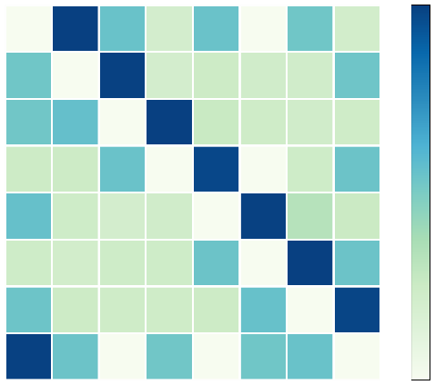
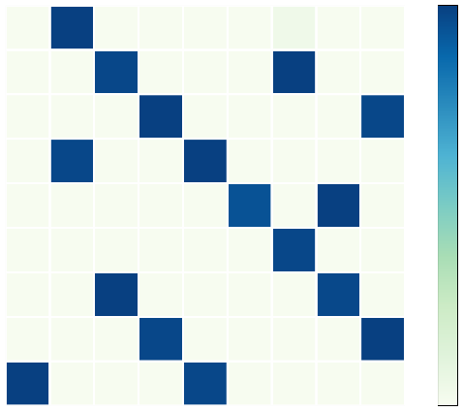
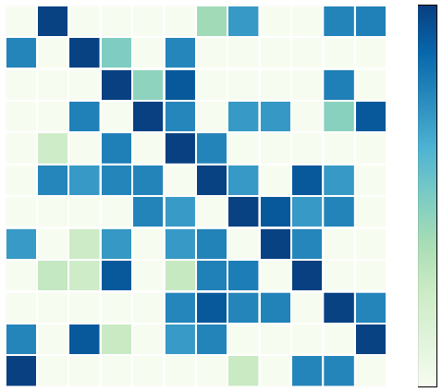
DNNs training traffic has different properties
0
0
0
100%
0
Source Server
Source Server
4
Source Server
4
4
Source Server
4
7
7
7
8
11
0
4
7
0
4
7
0
4
8
0
4
7
11
Destination Server
Destination Server
Destination Server
Destination Server
(a) Vision
(b) Image processing
(c) Object Tracking
(d) Speech Recognition
0
Key observations:
Traffic patterns are predictable, and do not change across training iterations
Traffic patterns are model-dependent

Slide 11
TopoOpt
The first system to leverage reconfigurable network, to co-optimize network topology and parallelization strategy for distributed training
TopoOpt achieves 3.4x faster training time for DNN training

Slide 12
Co-optimization challenge: Huge search space for optimal DNN training
The configuration space is huge!
Search space explodes!
Missing potential solutions!
Network Topology &
Communication
DNN Parallelization Strategy

Slide 13
Alternating optimization framework to co-optimize DNN parallelization strategy and network topology
Strategy Optimization
Parallelization Strategy Search
Parallelization strategy
Topology and routing
Traffic Demand Extraction
TopologyFinder Algorithm
Topology Optimization

Slide 14
Alternating optimization framework to co-optimize DNN parallelization strategy and network topology
Traffic Demand Extraction
TopologyFinder Algorithm
Topology Optimization
What algorithm should we use to find the topology in this framework?

Slide 15
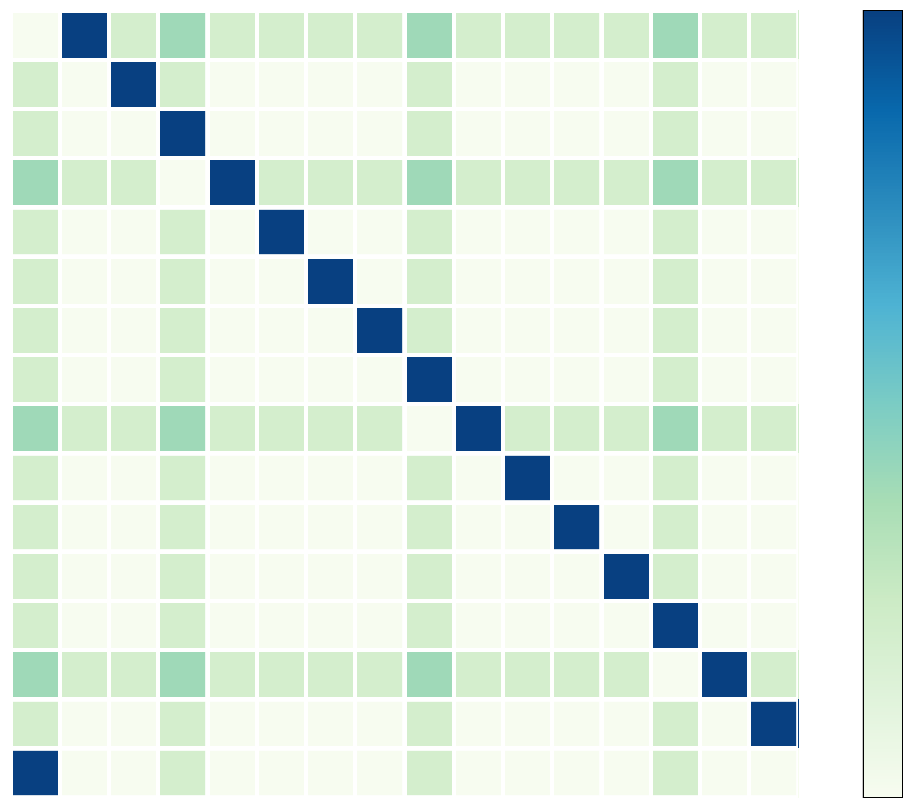
Characteristics of DNN training traffic
0
100%
5
AllReduce Transfers
10
Model Parallel
Transfers
15
0
0
5
10
15

Slide 16
Challenge: finding a good network topology for both AllReduce and Model-Parallel transfers
0
= One link
Degree (d) = 3, unidirectional
15
1
14
2
0
100%
13
3
5
AllReduce Transfers
12
4
10
Model Parallel
Transfers
11
5
10
6
15
0
9
8
7
0
5
10
15
8 hops!

Slide 17
Meeting the requirements of both AllReduce and Model-Parallel transfers
Degree (d) = 3, unidirectional
0
100%
Transfer Type | Characteristics | Network Requirement
 | Large, Sparse | Ample Bandwidth
 | Small, Dense | Low hop-count
5
AllReduce Transfers
10
Model Parallel
Transfers
15
0
0
5
10
15

Slide 18
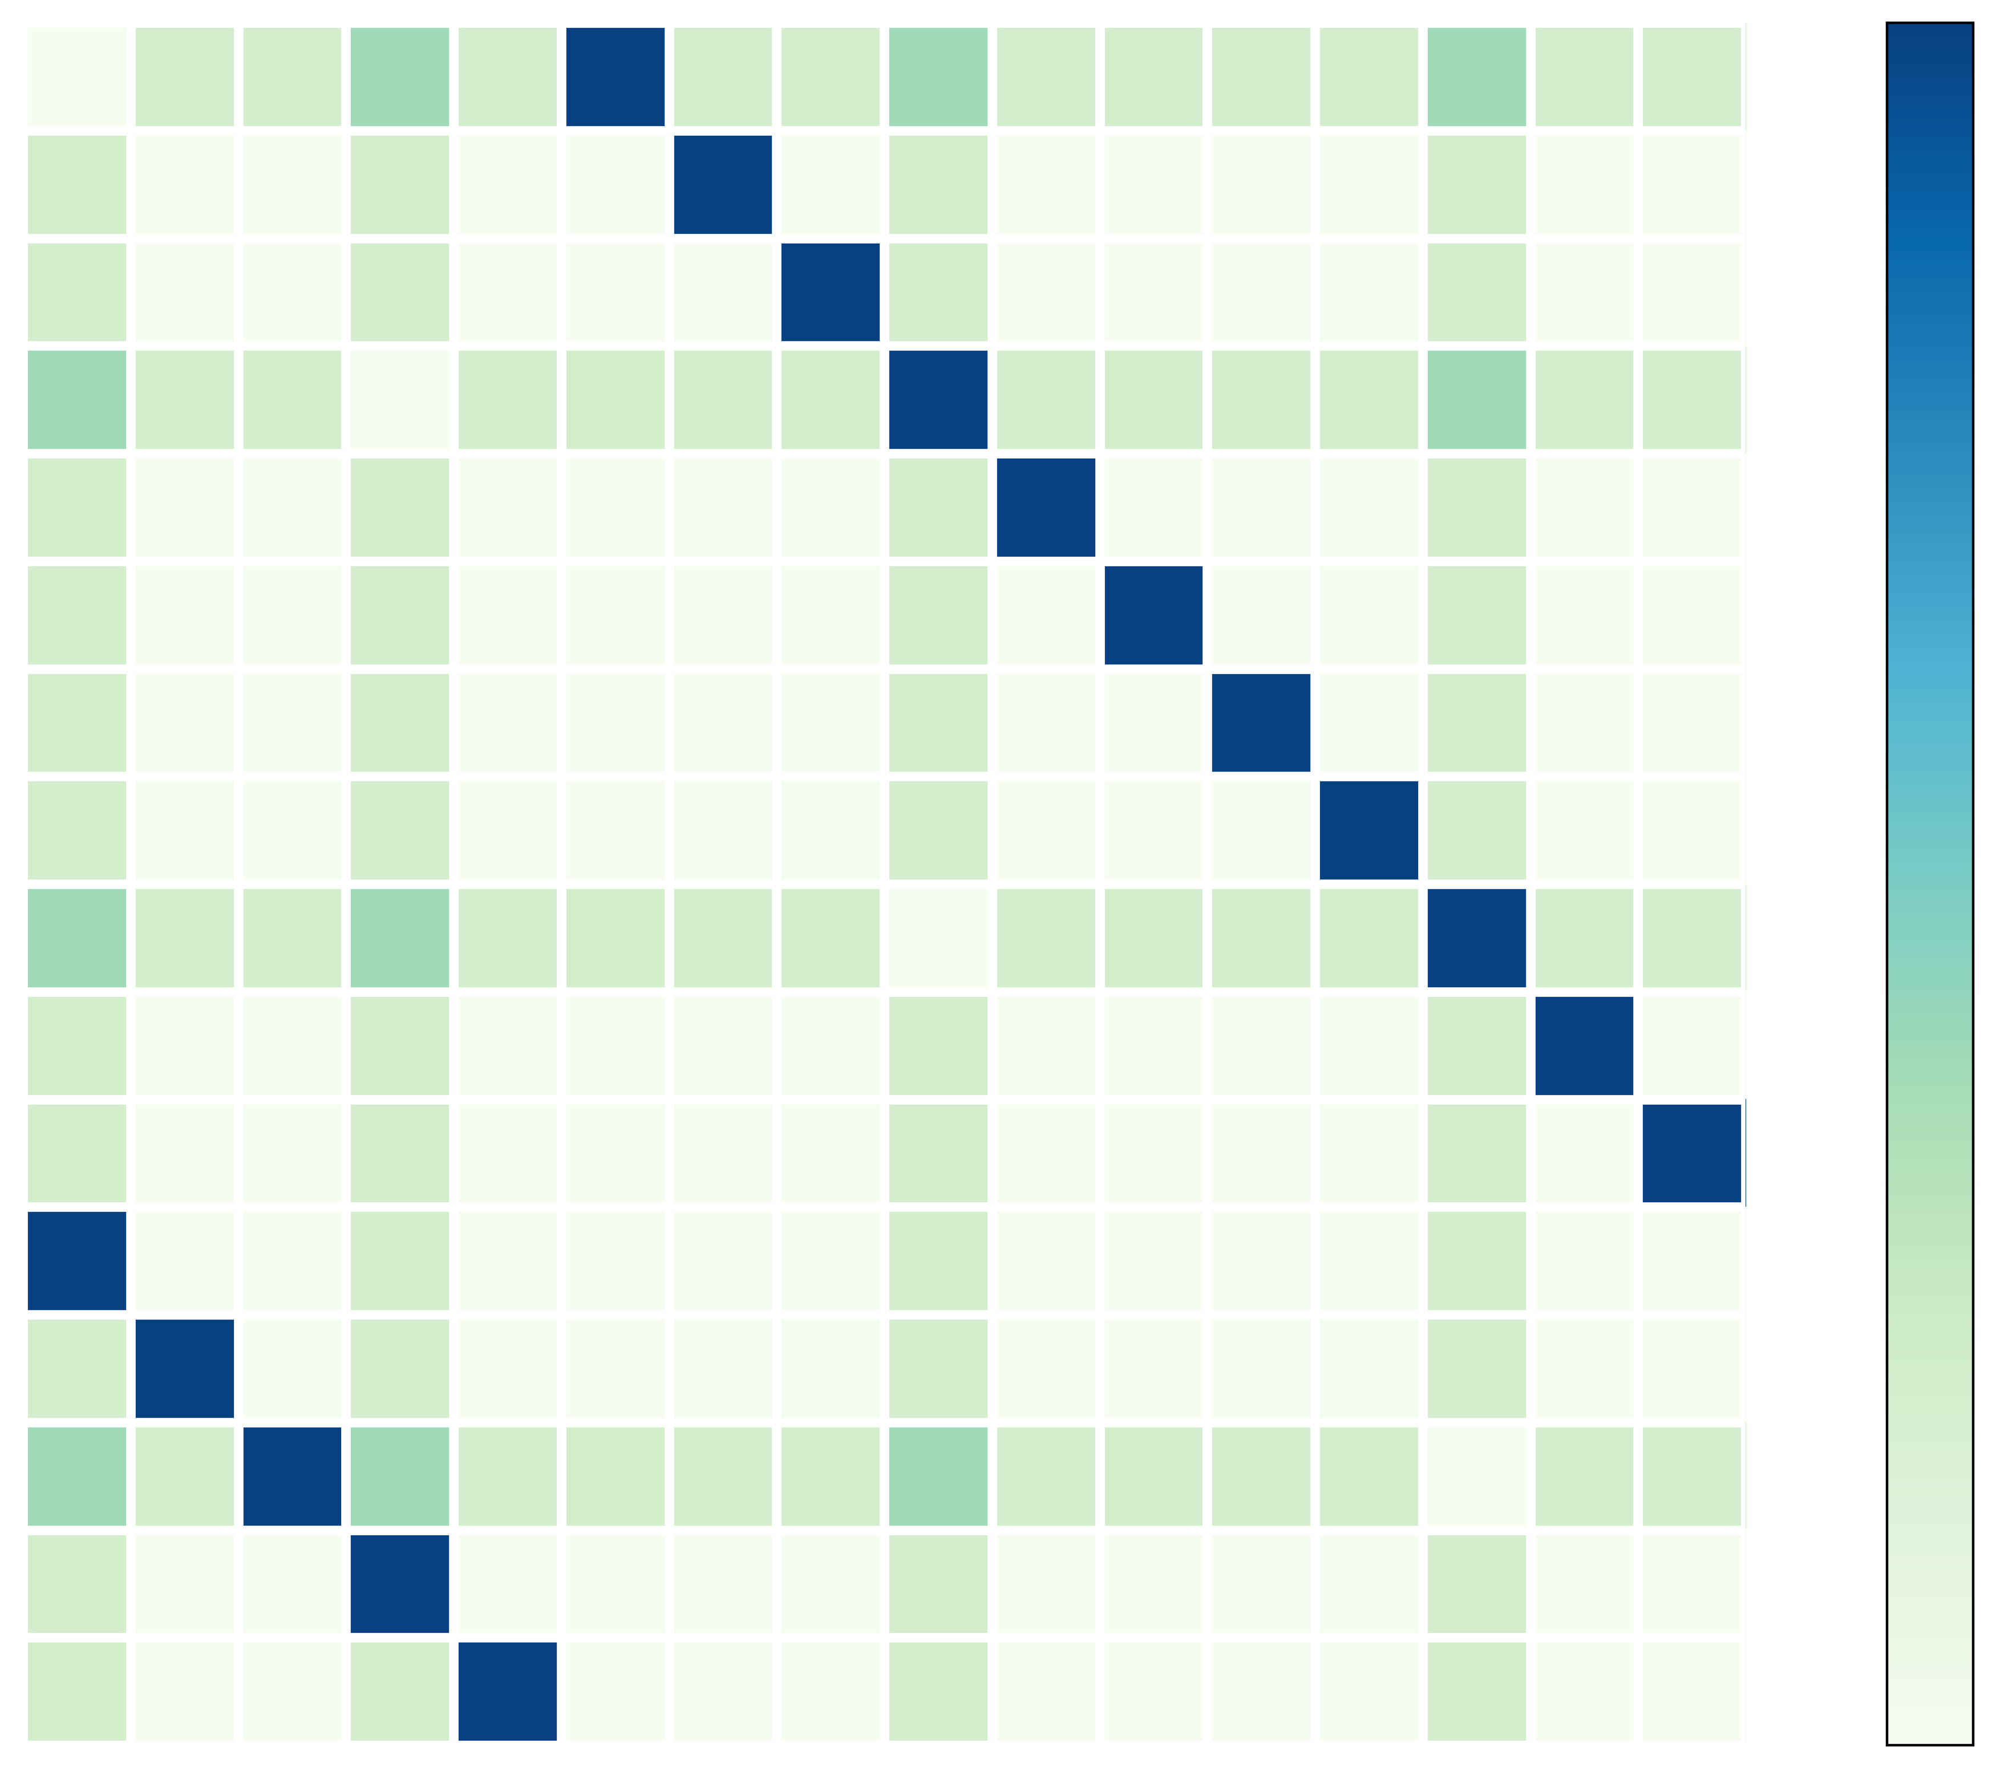
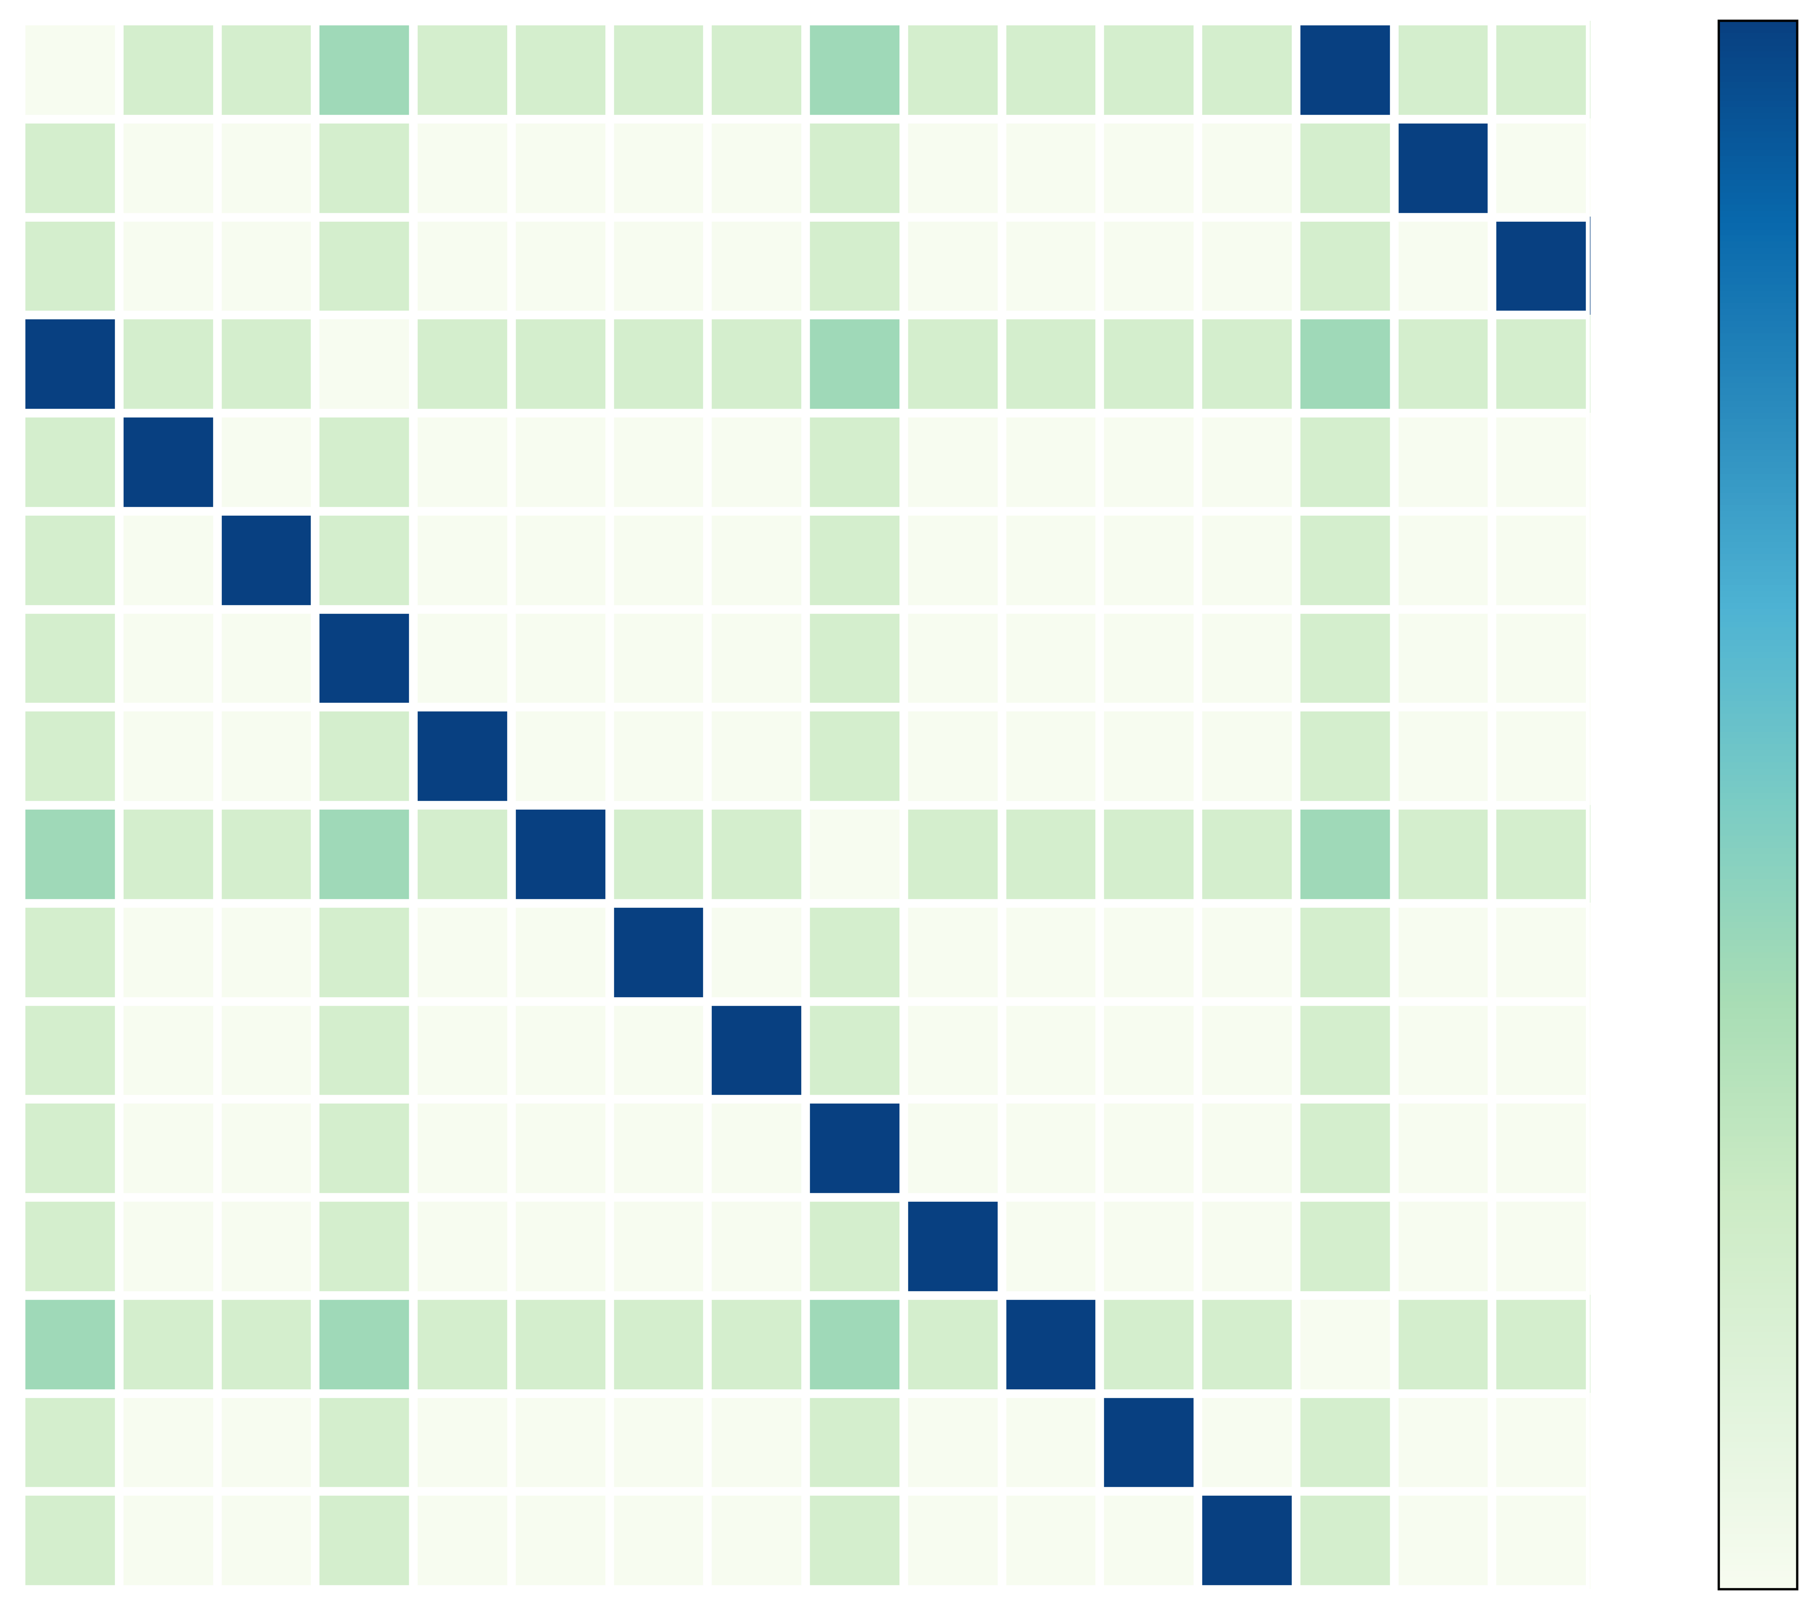
Key idea: mutate the traffic matrix
Slide 18
0
0
0
5
5
5
10
10
10
15
15
15
0
5
10
15
0
5
10
15
0
5
10
15
15
0
1
15
0
1
15
0
1
14
2
14
2
14
2
13
3
13
3
13
3
12
4
12
4
12
4
11
5
11
5
11
5
10
6
10
6
10
6
9
8
7
9
8
7
9
8
7
AllReduce transfers are mutable. Model-Parallel transfers are not mutable.

Slide 19
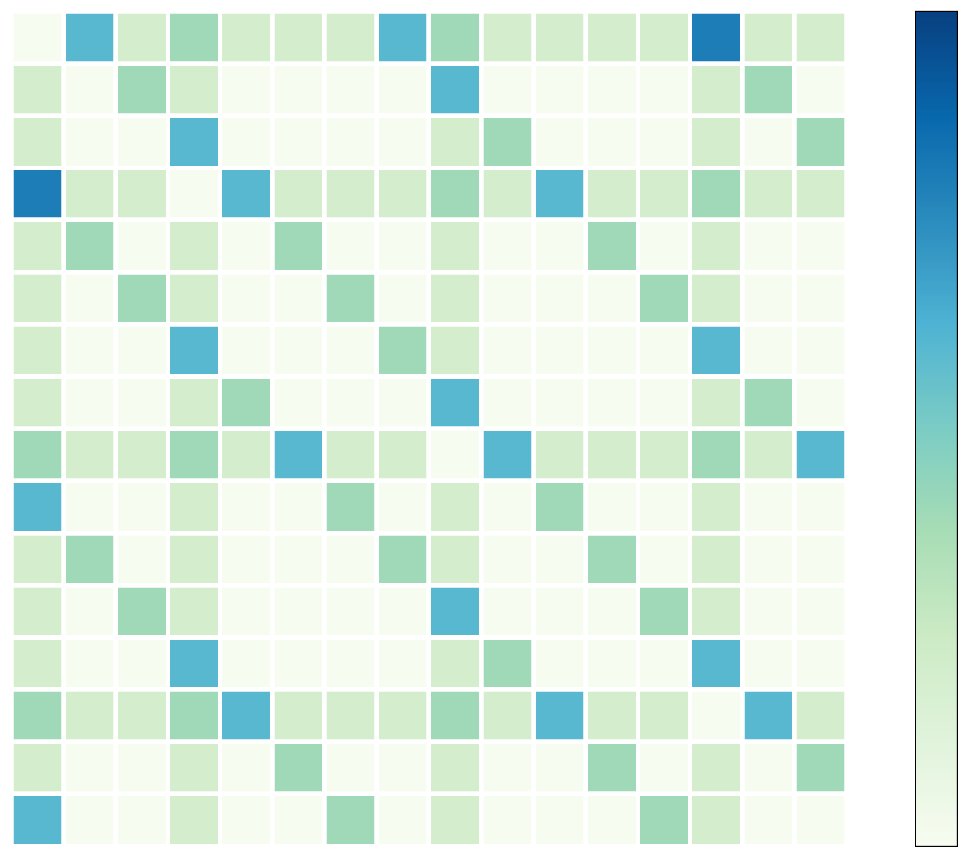
Splitting AllReduce traffic
Slide 19
0
0
0
15
0
15
1
1
15
1
14
14
2
14
2
2
5
13
13
3
13
3
3
12
12
4
12
4
4
10
5
11
5
11
11
5
10
10
6
10
6
6
15
9
9
7
9
7
8
7
8
0
5
10
15
8
Leverage the mutability of AllReduce transfers to achieve high bandwidth for AllReduce & low hop-count for Model-Parallel!

Slide 20
Key technique: Regular permutations
$n$ total accelerator, each with degree $d$
0
0
0
0
15
1
15
1
The possible set of $δ$ are the positive integers less than $n$, such that $\gcd\left(δ, n\right)=1$
Among all possible $δ$ distances, choose a set of them within the degree to minimize the cluster diameter
The technique of permuting labels work for other AllReduce algorithms as well
15
1
15
1
14
2
14
2
14
2
14
2
13
3
13
3
13
-> $O\left(n\right)$ search space!
13
3
3
12
$$δ=1$$
4
12
$$δ=5$$
4
12
4
12
4
11
5
11
5
11
5
11
5
10
6
10
6
10
6
10
6
9
8
7
9
8
7
9
8
7
9
8
7
Irregular permutations
Regular permutations – every server connects to another one with a fixed distance $δ$
TopoOpt bounds the cluster diameter to $O(d⋅\sqrt[d]{n})$
$O(n!)$ different permutations

Slide 21
TopoOpt uses optical switches
Optical Switch₁
Optical Switch_{d}
Server₁
Server₂
Server_{n-1}
Server_{n}

Slide 22
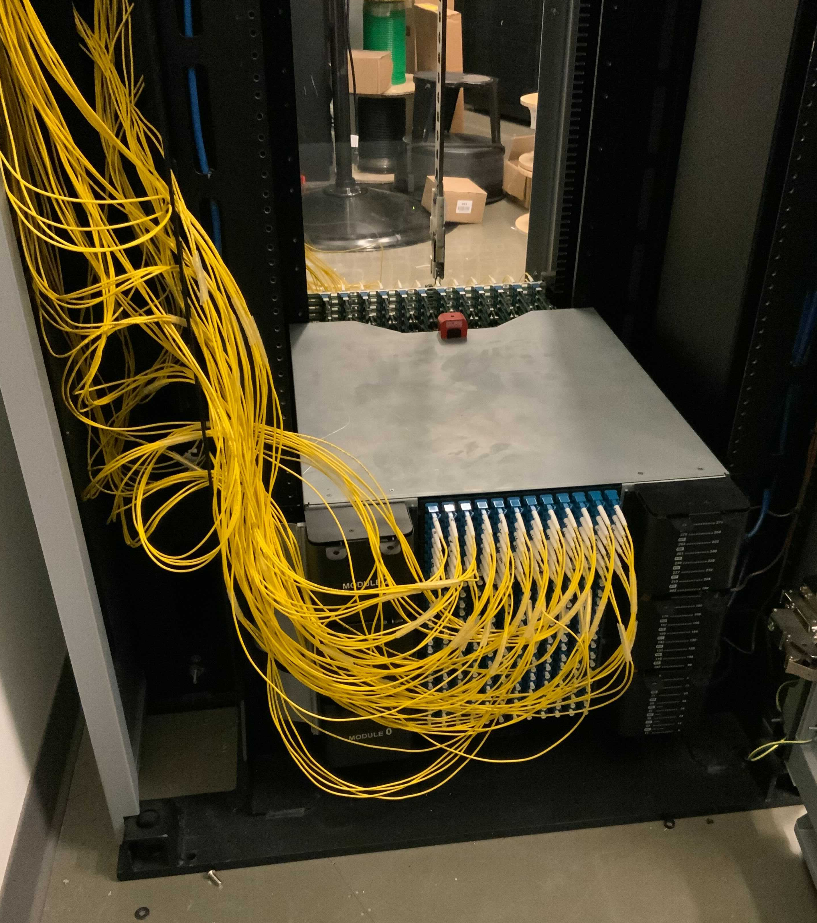
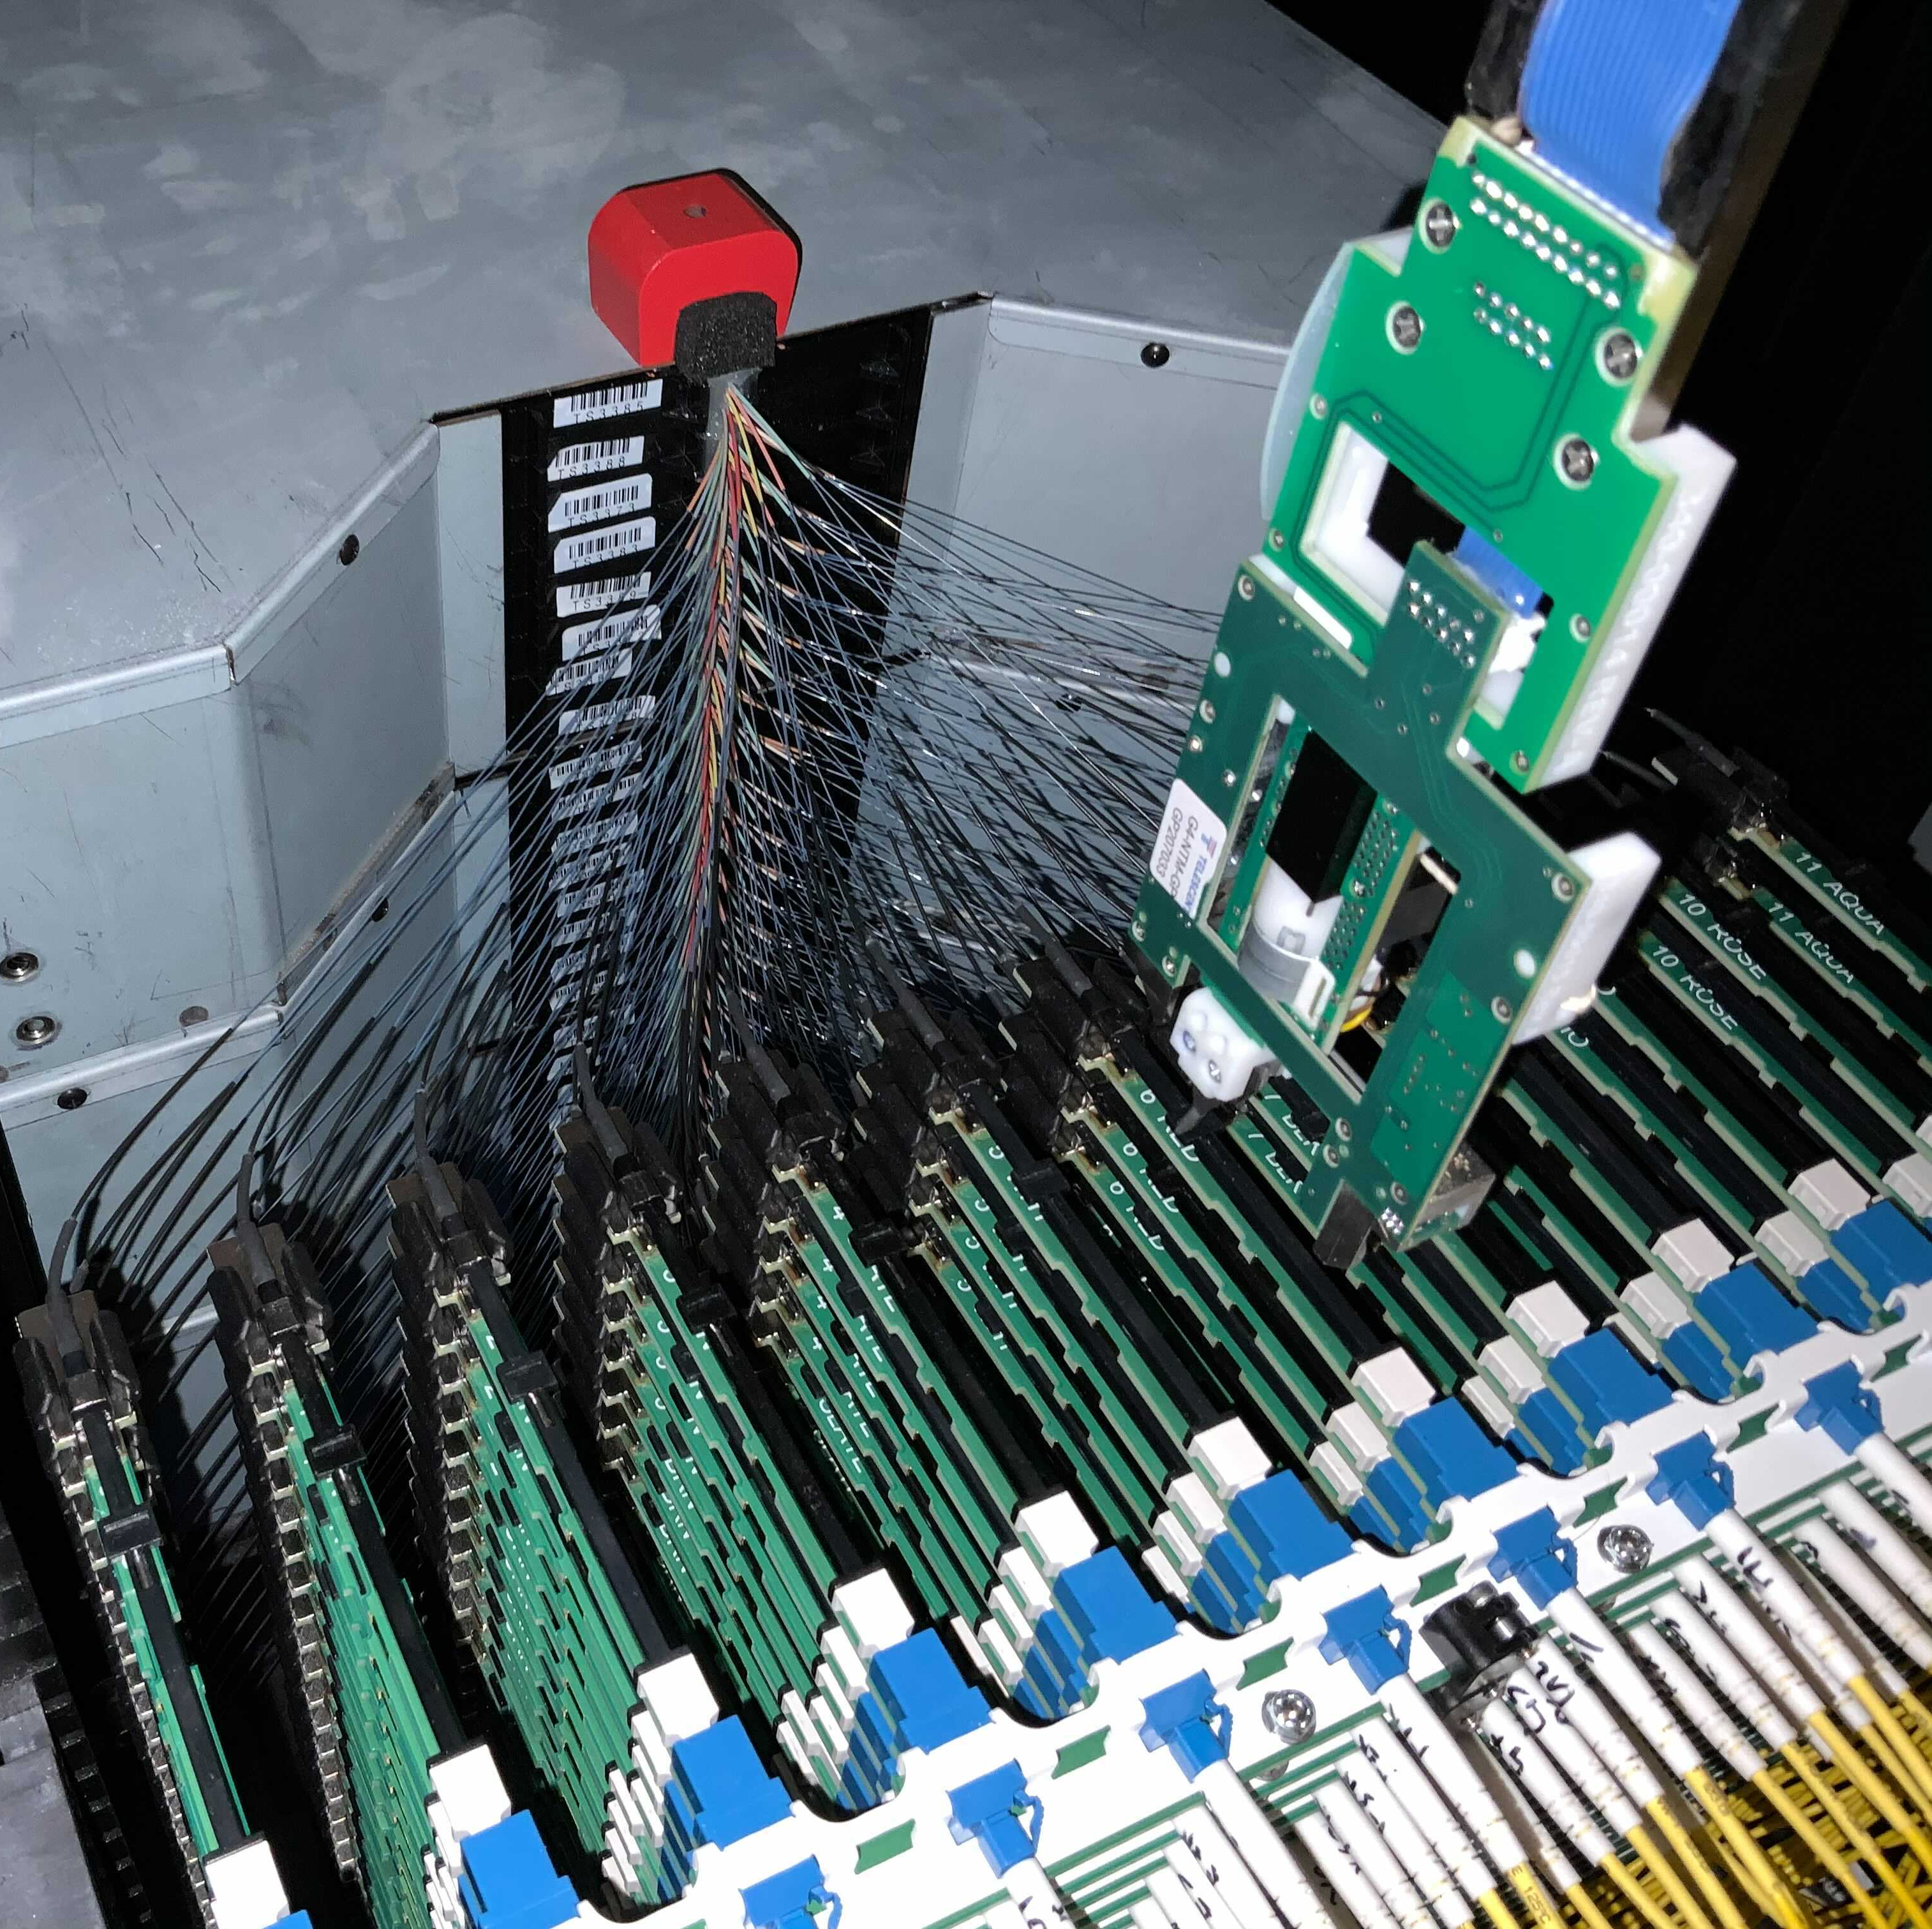
TopoOpt uses optical switches
Fully functional 12-node, degree 4 testbed integrated with NCCL
Front View
Back View
0
Transmit Side
11
1
Robot Control
Optical Switch₁
Optical Switch_{d}
10
2
9
3
Robot's arm
Side View
Robot’s
Gripper
Server₁
Server₂
Server_{n-1}
Server_{n}
8
4
7
5
6
Receive Side

Slide 23
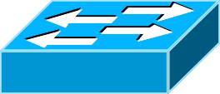
Evaluation
We evaluate TopoOpt with large scale simulation and a small-scale prototype
Artifact code can be found at http://TopoOpt.csail.mit.edu
Costs 3.4x!
Ideal n-port switch
$$d×B=800 Gbps$$
Optical Switch₁
Optical Switch₂
Optical Switch_{d-1}
Optical Switch_{d}
S1
S2
Sn-1
Sn
Ideal Switch
$$B=100 Gbps$$
d = 8 interfaces
Server₁
Server₂
Server_{n-1}
Server_{n}
n = 432
TopoOpt
$$200 Gbps$$
S1
S2
S3
S4
Sn-3
Sn-2
Sn-1
Sn
Fat-Tree

Slide 24
Slide 24
Simulation – tail completion time
Running several jobs together on a 432 node, d = 8, 100Gbps TopoOpt system, compared to several other options
Idea Switch
Fat-tree
TopoOpt
Other experiments with varying bandwidth, reconfiguration delay and testbed results are in the paper!
Demo
99%-ile Iteration Time (s)
Load
TopoOpt achieves up to 3.4x faster 99%-tile latency compared to cost-equivalent Fat-trees

Slide 25
Summary
Optical Switch₁
Optical Switch_{d}
TopoOpt: the first system to co-optimize DNN training with demand-aware network topology
Server₁
Server₂
Server_{n-1}
Server_{n}
15
0
1
1
Leverages the mutability of DNN training traffic to search and construct the best topology
14
2
13
3
13
12
4
11
5
5
10
6
6
9
7
7
8
7
99%-ile Iteration Time (s)
Achieves up to 3.4x faster 99%-ile training iteration time compared to cost equivalent Fat-trees
Load

