Slide 1
Ensuring High-Quality Randomness in Cryptographic Key Generation
Henry Corrigan-Gibbs, Wendy Mu, Dan Boneh - Stanford
Bryan Ford - Yale
20th ACM Conference on Computer and Communications Security
6 November 2013

Slide 2
n = pq
Image courtesy NASA Johnson Space Center

Slide 3
n = pq
n’ = pq’

Slide 4
n = pq
n’ = pq’

Slide 5
[Heninger et al. USENIX Sec ’12]
[Lenstra et al. CRYPTO ’12]
If keys are the same
→ Can read neighbor’s traffic
If keys share a factor
→ Anyone can factor RSA modulus
gcd(n, n’) = gcd(pq, pq’) = p
100,000s of vulnerable keys
n = pq
n = pq’

Slide 6
Common Failure Modes
1) App never reads strong random values
bytes = Hash(time(), get_pid(), pwd);
[CVE-2001-0950, CVE-2001-1467, CVE-2005-3087, CVE-2006-1378, CVE-2008-0141, CVE-2008-2108, CVE-2009-3278]
2) App misuses random values
bytes = read_block(‘/dev/random’);
// ...
bytes = Hash(time());
[CVE-2001-1141, CVE-2003-1376, CVE-2008-0166, CVE-2011-3599]
Notes:
Type 1: Fail to try
Type 2: Try and fail
Can happen at OS, library, app layers

Slide 7
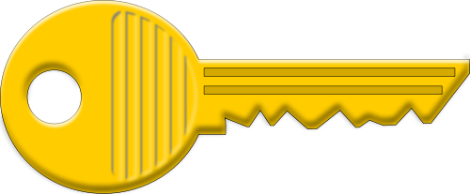
State of the art
Does this key incorporate strong randomness?

Slide 8
State of the art
?!?!?!

Slide 9
State of the art
?!?!?!
CA

Slide 10
Goal
Does this key incorporate strong randomness?
CA

Slide 11
Entropy Authority (EA)
Device
Random values
bytes = read_from_EA();
// ...
// ...
bytes = Hash(time());

Slide 12
Entropy Authority (EA)
Device
Random values
Proof does not reveal the device’s secrets
Incorporate local and remote randomness into secrets
, proof
Check proof,
Sign pk
EA

Slide 13
Goal
EA’s signature
EA
CA vouches for identity
EA vouches for randomness
Notes:
Mention what a self-signed cert is

Slide 14
System Goals
Output public key is as “random” as possible
key_entropy =
max(device_entropy, ea_entropy);
If device uses strong randomness source, it is no worse off by running the protocol
– Does not leak secrets to EA

Slide 15
Outline
Motivation
Threat Model
Protocol
Evaluation

Slide 16
Outline
Motivation
Threat Model
Protocol
Evaluation

Slide 17
Threat model
Adversary: can eavesdrop on everything except for a one-time “set-up phase”
Device: tries to generate correctly formed key drawn from distribution with low min-entropy
– Device is correct otherwise
Captures many real-world randomness threats
Notes:
----- Meeting Notes (10/29/13 09:42) -----
Remove min-entropy

Slide 18
Preliminaries
Homomorphic commitments [Pedersen, Crypto ‘91]
Commitment to x: C(x) = g^{x}h^{r}
Given C(x) and C(y), can compute C(x+y)
ZK proof of knowledge for multiplication
Given C(x), C(y), z, prove in zero knowledge that z = xy mod Q
bool Verify(π, C(x), C(y), z)

Slide 19
Outline
Motivation
Threat Model
Protocol
Evaluation

Slide 20
Prevents device from setting x = –x’
C(x), C(y)
x’, y’
C(p) = C(x)g^{x’+δx}
Find δs to make
p = x+x’+δ_{x}
q = y+y’+δ_{y}
RSA primes.
π = Prove(n=pq).
Prevents device from setting δ_{x} = –x’
n, δ_{x}, δ_{y}, π
Check δs are small Verify(π, C(p), C(q), n), sign public key
σ(n)
Notes:
If it doesn’t fit on one slide…

Slide 21
Security Properties
If the device uses strong randomness
EA learns no useful info about the secrets
If the device uses strong randomness OR the EA is correct:
Device ends up with a strong key
Even if the EA is untrustworthy, device is better off running the protocol

Slide 22
Claim 1: If device uses strong randomness, EA learns no useful info
Randomized commitments leak no info
C(x), C(y)
x’, y’
Zero-knowledge proof leaks no info
δs are O(log p), so they don’t leak “much”
n, δ_{x}, δ_{y}, π
Notes:
If it doesn’t fit on one slide…

Slide 23
Claim 2: Correct EA will never sign a key sampled from a distribution with low min-entropy
C(x), C(y)
Given x, x’, y, y’, there are only a few valid keys
x’, y’
n, δ_{x}, δ_{y}, π
Notes:
If it doesn’t fit on one slide…

Slide 24
Claim 2: Correct EA will never sign a key sampled from a distribution with low min-entropy
C(x), C(y)
A faulty device’s only option is to pick a “tricky” x and y
x’, y’
We prove that no such “tricky” values exist
n, δ_{x}, δ_{y}, π
Notes:
If it doesn’t fit on one slide…

Slide 25
Multiple Entropy Authorities

Slide 26
Outline
Motivation
Threat Model
Protocol
Evaluation

Slide 27
Key Generation Time
Wall-clock time (in seconds) to generate a key on a Linksys E2500-NP home router.
EA is modern Linux server 5000 km away (80ms RTT)
Less than 2x slowdown for RSA
Less than 2 seconds for EC-DSA
 | No proto | Proto | Proto+net | Slowdown
RSA 2048 | 59.16 | 96.93 | 101.57 | 1.7x
EC-DSA 224 | 0.45 | 0.84 | 1.61 | 3.6x

Slide 28
Computational Overhead
Slowdown tends to 4x for EC-DSA keys
Overhead diminishes for RSA keys

Slide 29
Computational Bottlenecks
Protocol cost
RSA-2048 key on Linksys E2500-NP home router

Slide 30
Related Work
Hedged PKC [Bellare et al., ASIACRYPT ’09]
Better random values
Hardware RNG
Entropics [Mowery et al. Oakland ’13]
Juels-Guajardo Protocol [PKC ‘02]
Defends against kleptography
Requires heavier primitives (24x more big exponentiations)
Notes:
Strong = sampled from distribution with many bits of min-entropy

Slide 31
Today
?!?!?!?!

Slide 32
With our protocol
EA

Slide 33
Conclusion
Using “entropy authorities” is a practical way to prevent weak cryptographic keys
Other parts of the stack need help too
Signing nonces, ASLR, DNS source ports, …
Interested in running an entropy authority? Let’s talk!
Notes:
Require new threat models

Slide 34
Questions?
Henry Corrigan-Gibbs
henrycg@stanford.edu
http://github.com/henrycg/earand
Thanks to David Wolinsky, Ewa Syta, Phil Levis, Suman Jana, and Zooko Wilcox-O’Hearn.

Slide 36
q
Q
Warning:
Simplification ahead!
Q
p

Slide 37
q
x’ and y’ are k-bit values, so box has area 2^{2k}
Q
y+2^{k}
2^{k}
y
2^{k}
x
x+2^{k}
Q
p
Picked by device
Max EA value
Order of group

Slide 38
q
EA’s random choice of x’ and y’ determines n (+/- δs)
Q
y+2^{k}
y’
y
x
x’
x+2^{k}
Q
p

Slide 39
q
Q
y+2^{k}
y’
y
x
x+2^{k}
x’
Q
p

Slide 40
q
We prove: for every valid n, the chance that EA “lands on” n is negligible
Q
y+2^{k}
y’
y
x
x’
x+2^{k}
Q
p

Slide 41
q
Q
y+2^{k}
y’
y
x
x’
x+2^{k}
p
Q

Slide 42
q
Q
y+2^{k}
y’
y
x
x’
x+2^{k}
p
Q

Slide 43
q
Q
y+2^{k}
y’
y
x
x’
Q
p

Slide 44
q
Q
y+2^{k}
y’
y
Proof holds no matter how the device picks x, y
x+2^{k}
x
x’
Q
p

Slide 45
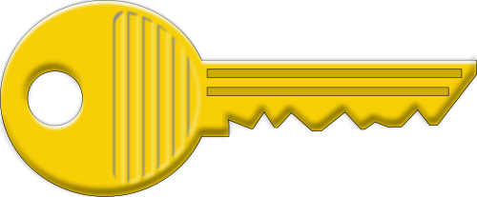
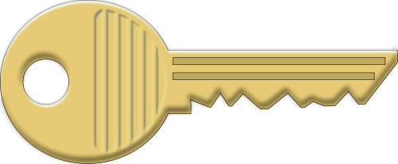
Our Goal
 | Device
Entropy Authority | Strong randomness | Weak randomness
Strong randomness
Weak randomness / Malicious
Reveals device’s secrets to EA only

