Slide 1
FlashPatch: Spreading Software Updates over Flash Drives in Under-connected Regions
Henry Corrigan-Gibbs Stanford | Jay Chen NYU Abu Dhabi
5th ACM DEV – San Jose, California
5 December 2014

Slide 2
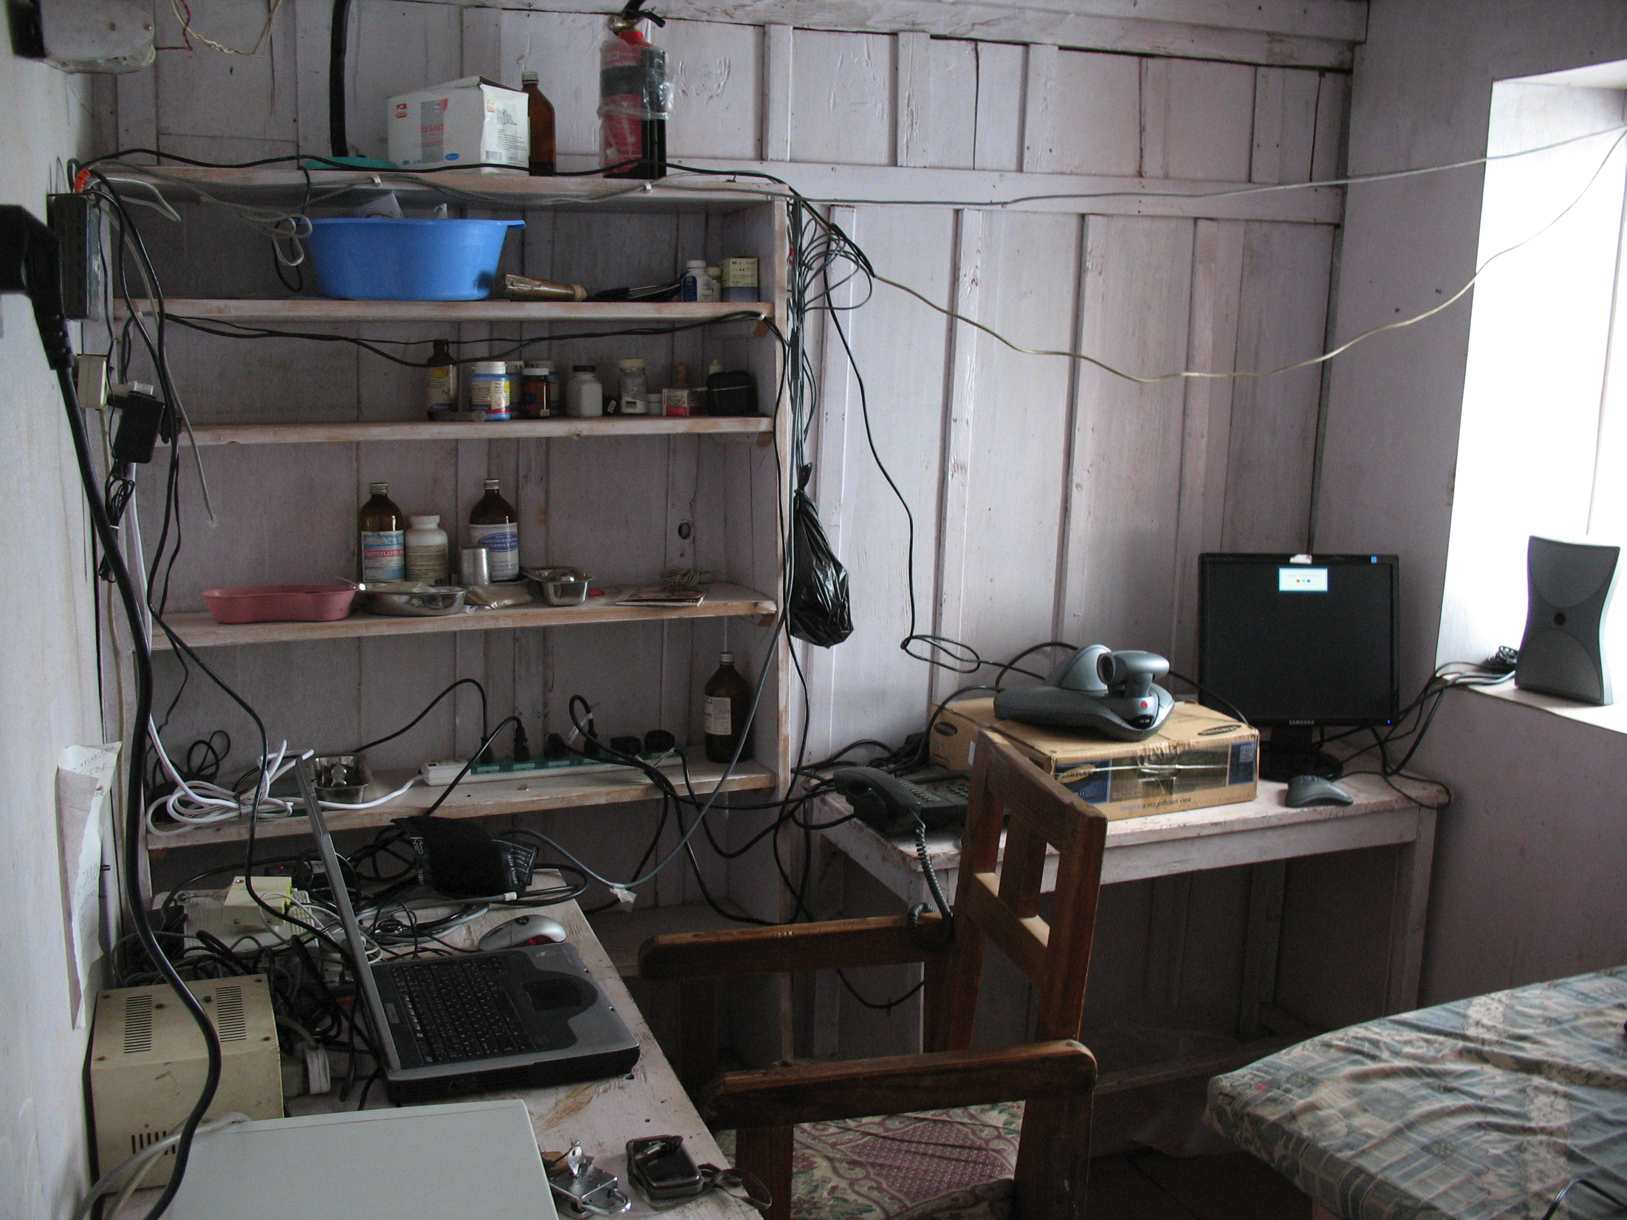
Expensive, low-bandwidth connection…
…good enough for email

Slide 3
Wait a minute…
1,197.3 MB !?!?!

Slide 4
Let’s do the math
Offline computers are never able to download updates.
Example: 100 MB software update
Cost
100 MB download: USD 5.64 (MTN Nigeria)
Daily GDP per capita: USD 8.23 (World Bank)
Time
On EDGE, get 120 Kb/s max throughput
Two hours to download

Slide 5
Paradox of Updates
If you DO update
Expensive
Time-consuming
Unclear benefits
If you DO NOT update
Vulnerable to flash-borne malware
Software bugs

Slide 6
Is there a better way to spread software updates?

Slide 7
Goal
Build a system for distributing software updates that is:
Realistic: no new hardware
Easy to use: no training
Effective: faster/cheaper than status quo

Slide 8
Outline
Motivation
System design
Evaluation
Conclusions

Slide 9
Outline
Motivation
System design
Evaluation
Conclusions

Slide 10
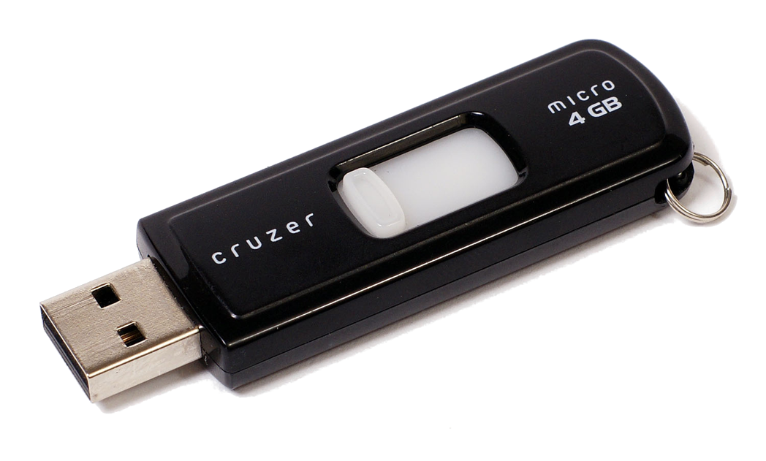
The Idea
Use a vector for virus transmission…
…as a vector for update propagation.

Slide 11
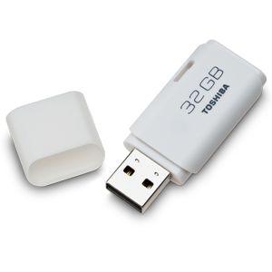
Flash Drives
…are ubiquitous
…are high-
bandwidth
… circulate quickly

Slide 12
FlashPatch
Copy updates to/from flash drives as they go by
Updates “piggyback” on the pre-existing flow of flash drives
NO CHANGE in user behavior required!!!

Slide 13
FlashPatch is a daemon that runs on all clients
2
2
2
2
1

Slide 14
2
2
3
2
1

Slide 15
3
2
3
3
1

Slide 16
3
2
3
3
1

Slide 17
3
2
3
3
3
1

Slide 18
3
2
3
3
3
1

Slide 19
3
3
3
3
3
1

Slide 20
3
3
3
3
3
1

Slide 21
3
3
3
3
3
3

Slide 22
G:\Videos\MJ.mov
…
G:\FlashPatch\data.db
G:\FlashPatch\README.txt
3
3
3
3
3
3

Slide 23
3
3
3
3
2
3

Slide 24
3
3
3
3
2
3

Slide 25
3
3
3
3
3
3

Slide 26
How it works
version: 15
data: [virus defs]
sig: 0x182fbc91d…
Symantec
server
Computer running Symantec AV

Slide 27
Properties
Consistency
Single vendor → No conflicting
updates
Security
Digital signatures → No “impostor” updates

Slide 28
3
3
3
3
“4”
3

Slide 29
3
3
3
3
X
“4”
“4”
3

Slide 30
Review: Goals
✓
Build a system for distributing software updates that:
Requires no new hardware
Runs on JWXPBs (Junky Windows XP Boxes)
Requires no training
No user intervention after install
Is more effective than status quo
✓
?

Slide 31
Outline
Motivation
System design
Evaluation
Conclusions

Slide 32
Research Questions
How quickly do flash drives move?
How prevalent are viruses? Which ones?
Is FlashPatch effective?

Slide 33
Implementation: Virus scanner
Based on open-source ClamAV
3,400 lines of C#
Spreads DB updates via FlashPatch
Scans all inserted flash drives for viruses
Sends back “anonymized” log files

Slide 34
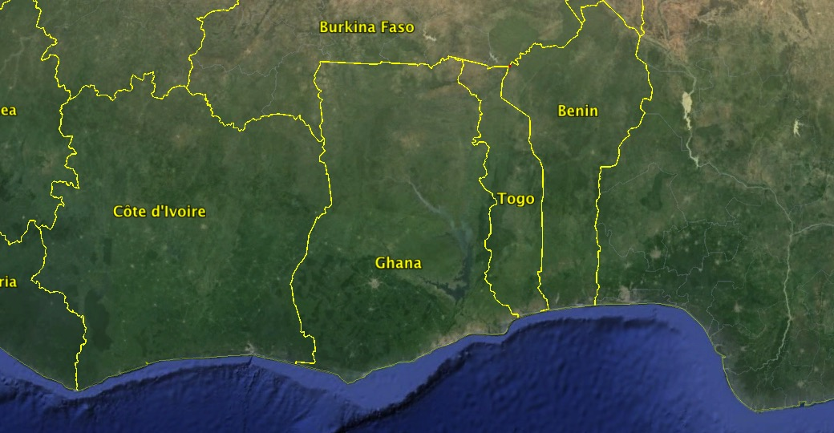

Slide 35
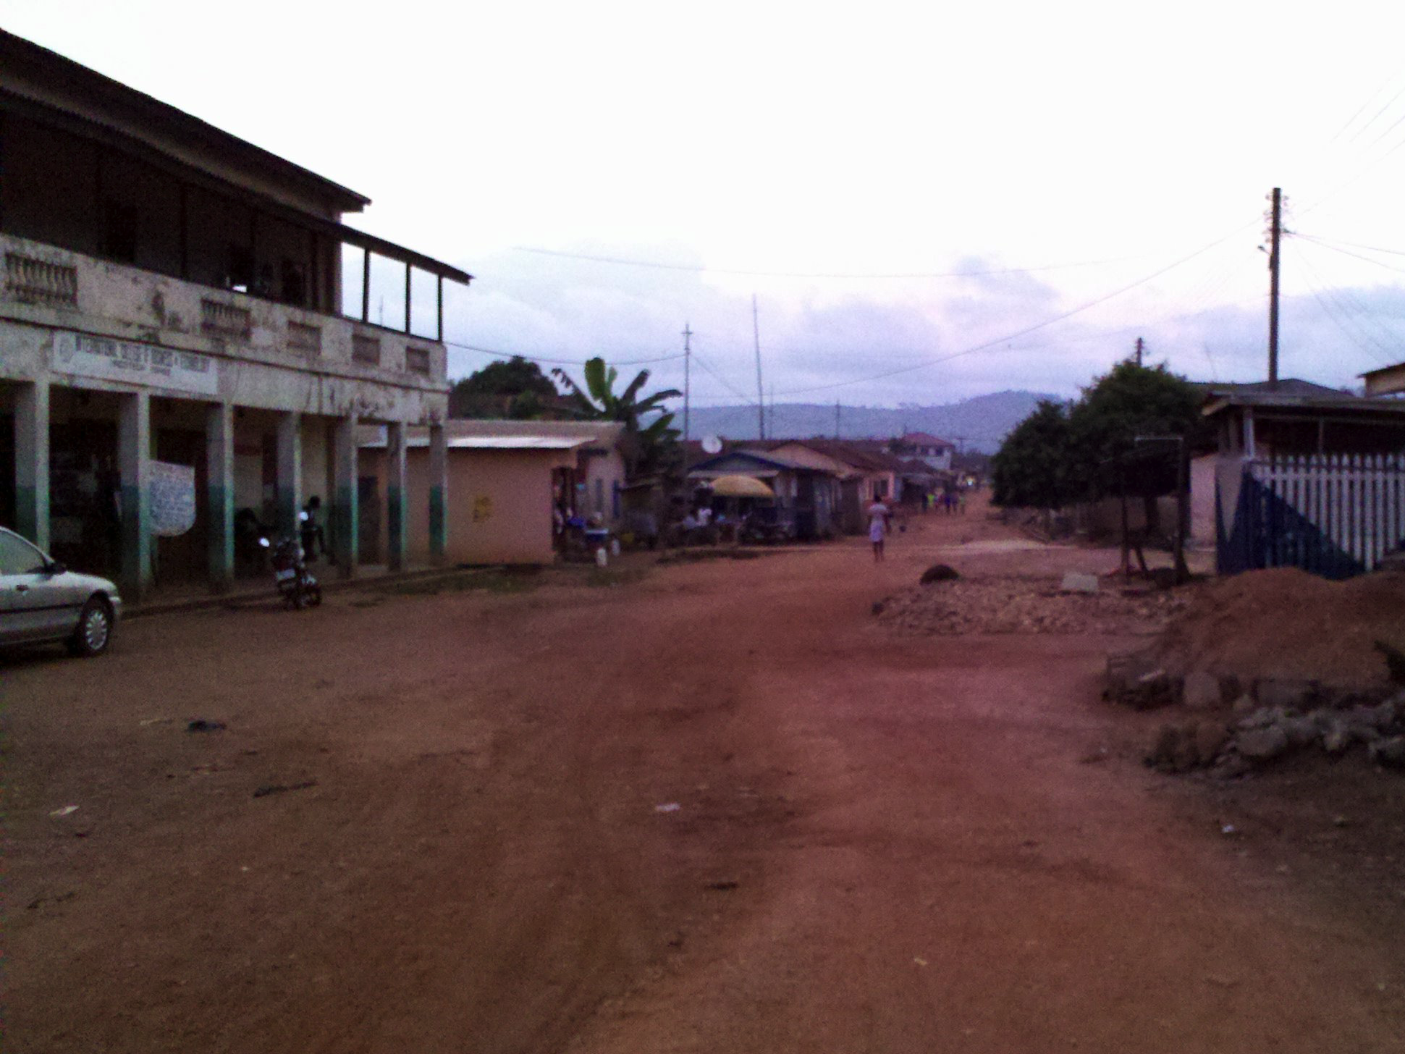
Hohoe
Population: 50,000 people
Handful of Internet cafés
Mostly EDGE with some 3G

Slide 36
Ethical Considerations
Informed consent
Resource use (flash space)
Limited distribution (we install the daemon)
Opt out
Privacy (MACs, IPs, file names)

Slide 37
Deployment
Deployed at:
6 Internet cafes
1 secondary school
1 graphic design shop
63 machines total
Between July 2013 and March 2014

Slide 38
Q1: How quickly do flash drives move?
Half of the machines saw 10+ drives
14 machines saw no flash drives

Slide 39
Q1: How quickly do flash drives move?
Large connected component
Disconnected machines

Slide 40
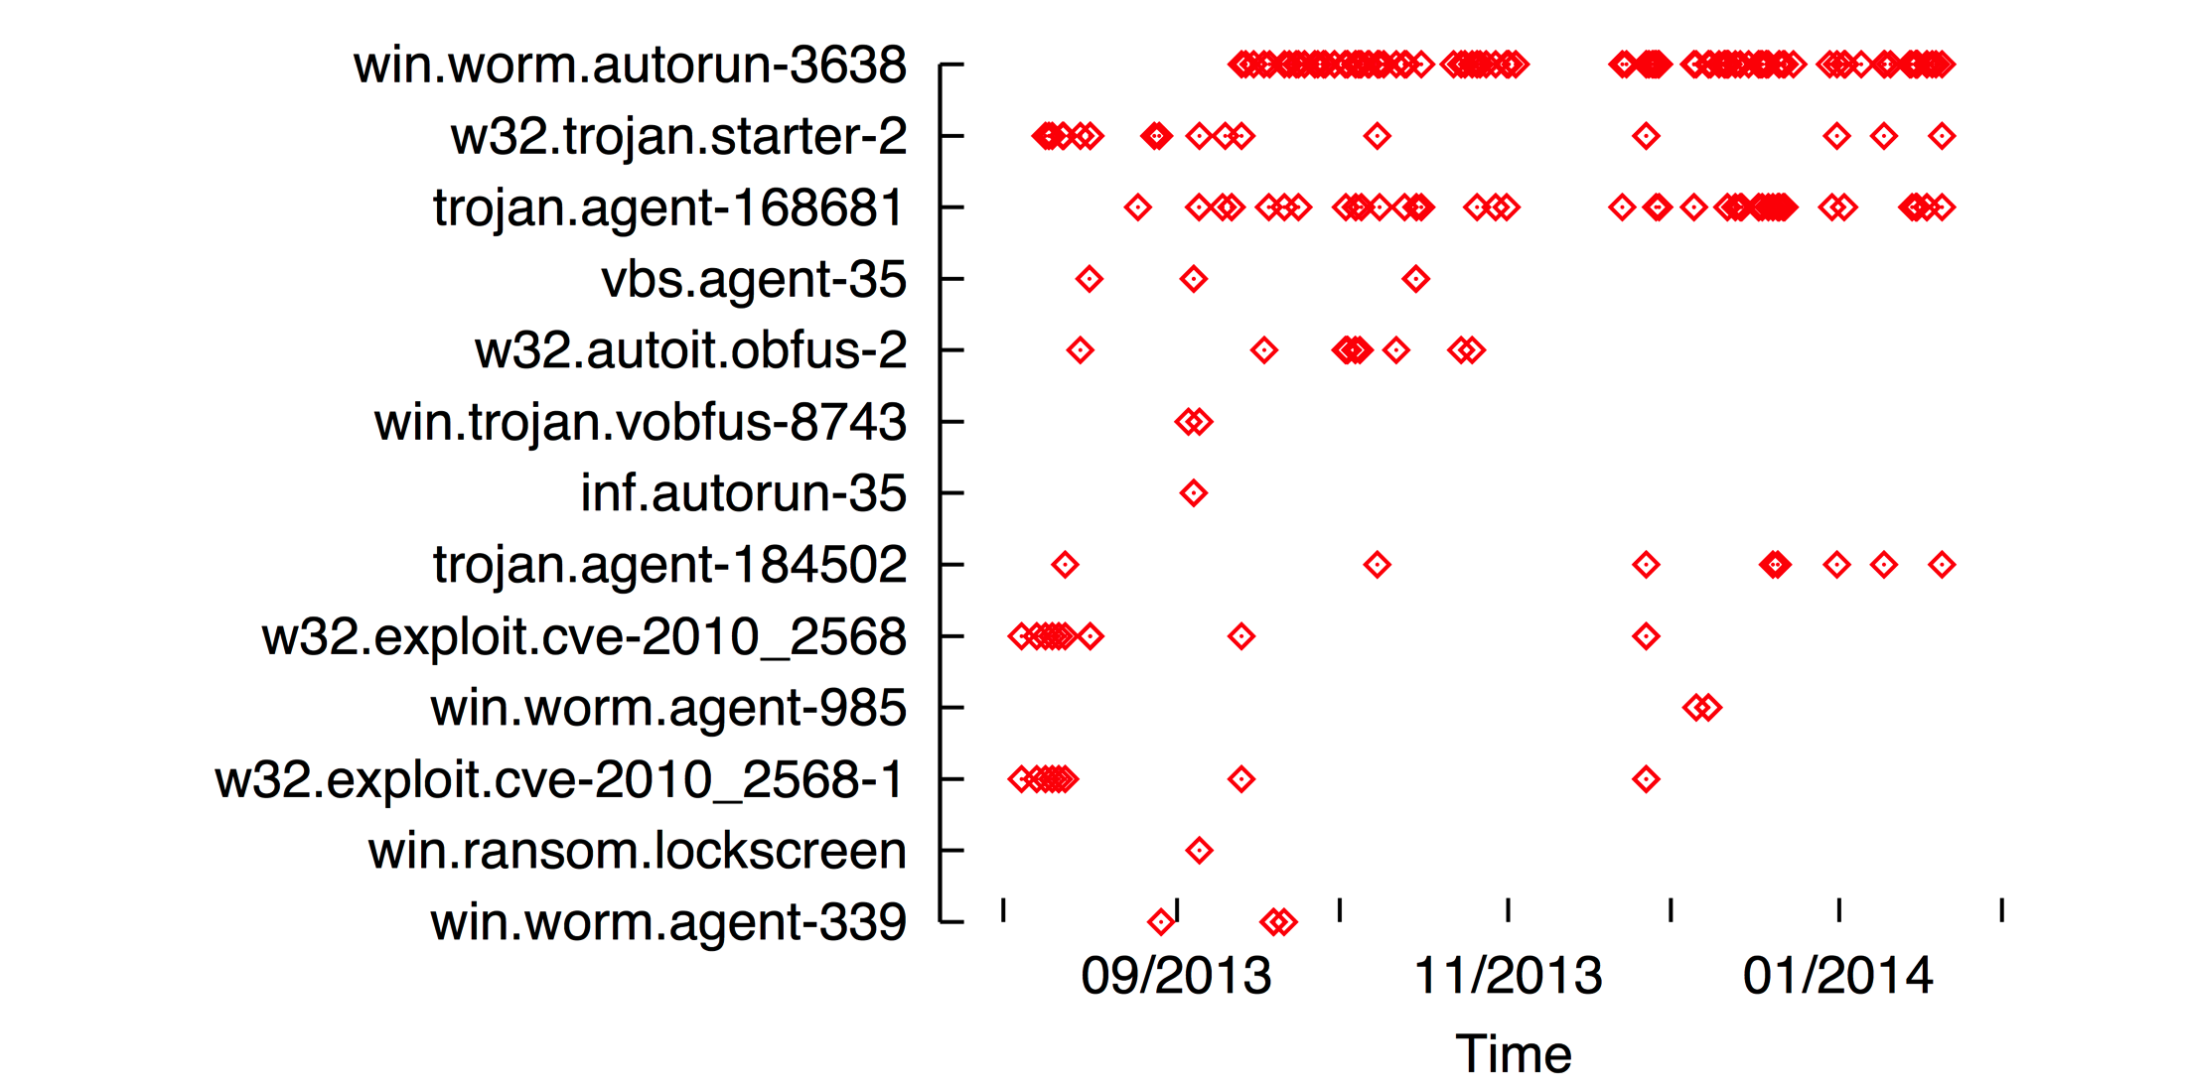
Q2: How prevalent are viruses?

Slide 41
Q2: How prevalent are viruses?
Scanned 1,242 flash drives
233 had at least one infected file (19%)
10% of drives had 6+ infected files
48 distinct virus types
Max: 130 sightings
Min: 1 sighting
… and ClamAV doesn’t catch everything…

Slide 42
Q2: How prevalent are viruses?
Many YOUNG viruses

Slide 43
Q3: Is FlashPatch effective?
FlashPatch protects ~30% of offline machines
Notes:
Explain why only 30%

Slide 44
Q3: Is FlashPatch effective?

Slide 45
Outline
Motivation
System design
Evaluation
Conclusions

Slide 46
Final Thoughts
FlashPatch: a system for spreading software updates in under-connected regions
— No new hardware
— No training
What’s next
Could FlashPatch be built into a “real” AV?
Are there other opportunities for HW-free ICTD?

