Slide 1
Cryptography in the Open Public-Key Crypto and the NSA
Henry Corrigan-Gibbs Stanford University
Silicon Valley Ethereum Meetup – 29.03.2015
My research is supported in part by an NDSEG Fellowship.

Slide 2
Part I. Technical History
(3000 BC – 1976)
Part II. Political History
(1976 – now)

Slide 3
A Brief History of Cryptography
“Dark Ages”
–3000
1976

Slide 4
“Dark Ages”
Motivating problem: protect military and diplomatic communications in transit
Few computing tools
Few mathematical tools

Slide 5
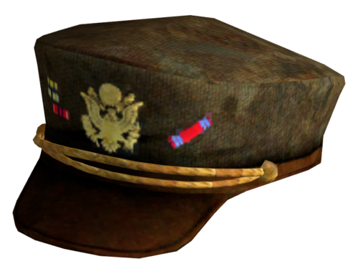

Slide 7
Attack at dawn

Slide 8
?!?
Attack at dawn!
Jklnf qkfiic slvnqi fqZ.

Slide 9
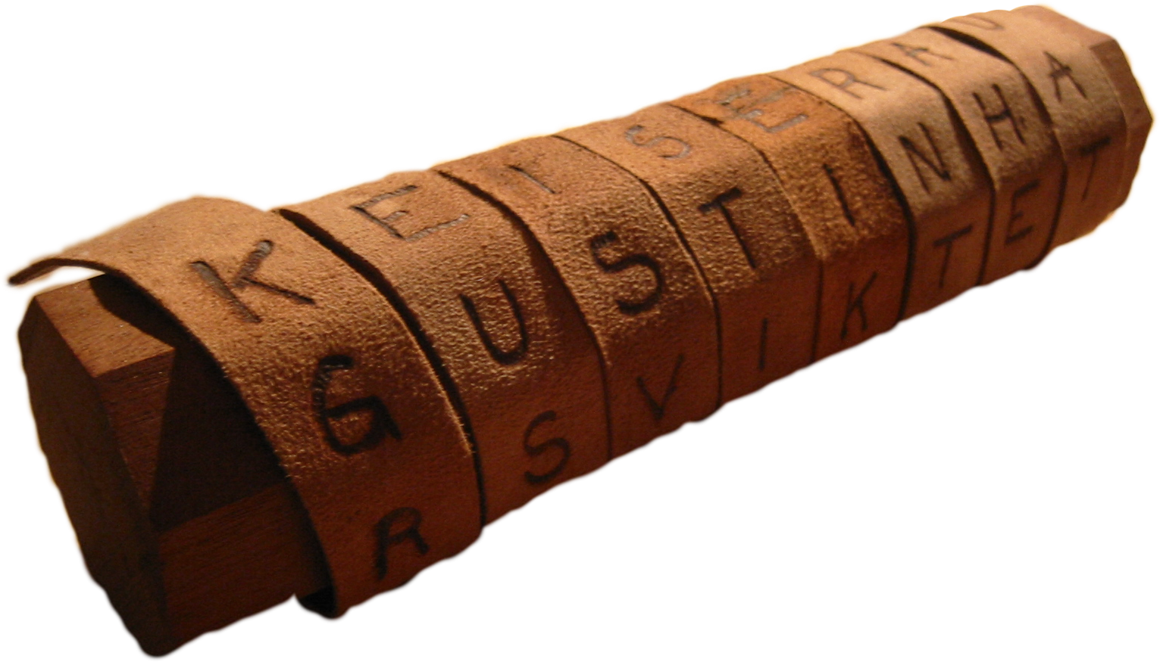
Spartan “Skytale” 400 BCE
See Kahn’s Codebreakers
http://en.wikipedia.org/wiki/Scytale#/media/File:Skytale.png

Slide 10
Spartan “Skytale” 400 BCE
X J K Q W F M V D P Q P
A T T A C K A T D A W N
W E T Y N C F H K Q E V
X C B G F Q D N M K H F
Y U P K O L V B C W E D

Slide 11
Spartan “Skytale” 400 BCE
X J K Q W F M V D P Q P
A T T A C K A T D A W N
W E T Y N C F H K Q E V
X C B G F Q D N M K H F
Y U P K O L V B C W E D
XAWXYJTECUKTTBPQAYGKWCNFOFKCQL

Slide 12
Spartan “Skytale” 400 BCE
X J K Q W F M V D P Q P
A T T A C K A T D A W N
W E T Y N C F H K Q E V
X C B G F Q D N M K H F
Y U P K O L V B C W E D
Diameter of the stick is the secret key

Slide 13
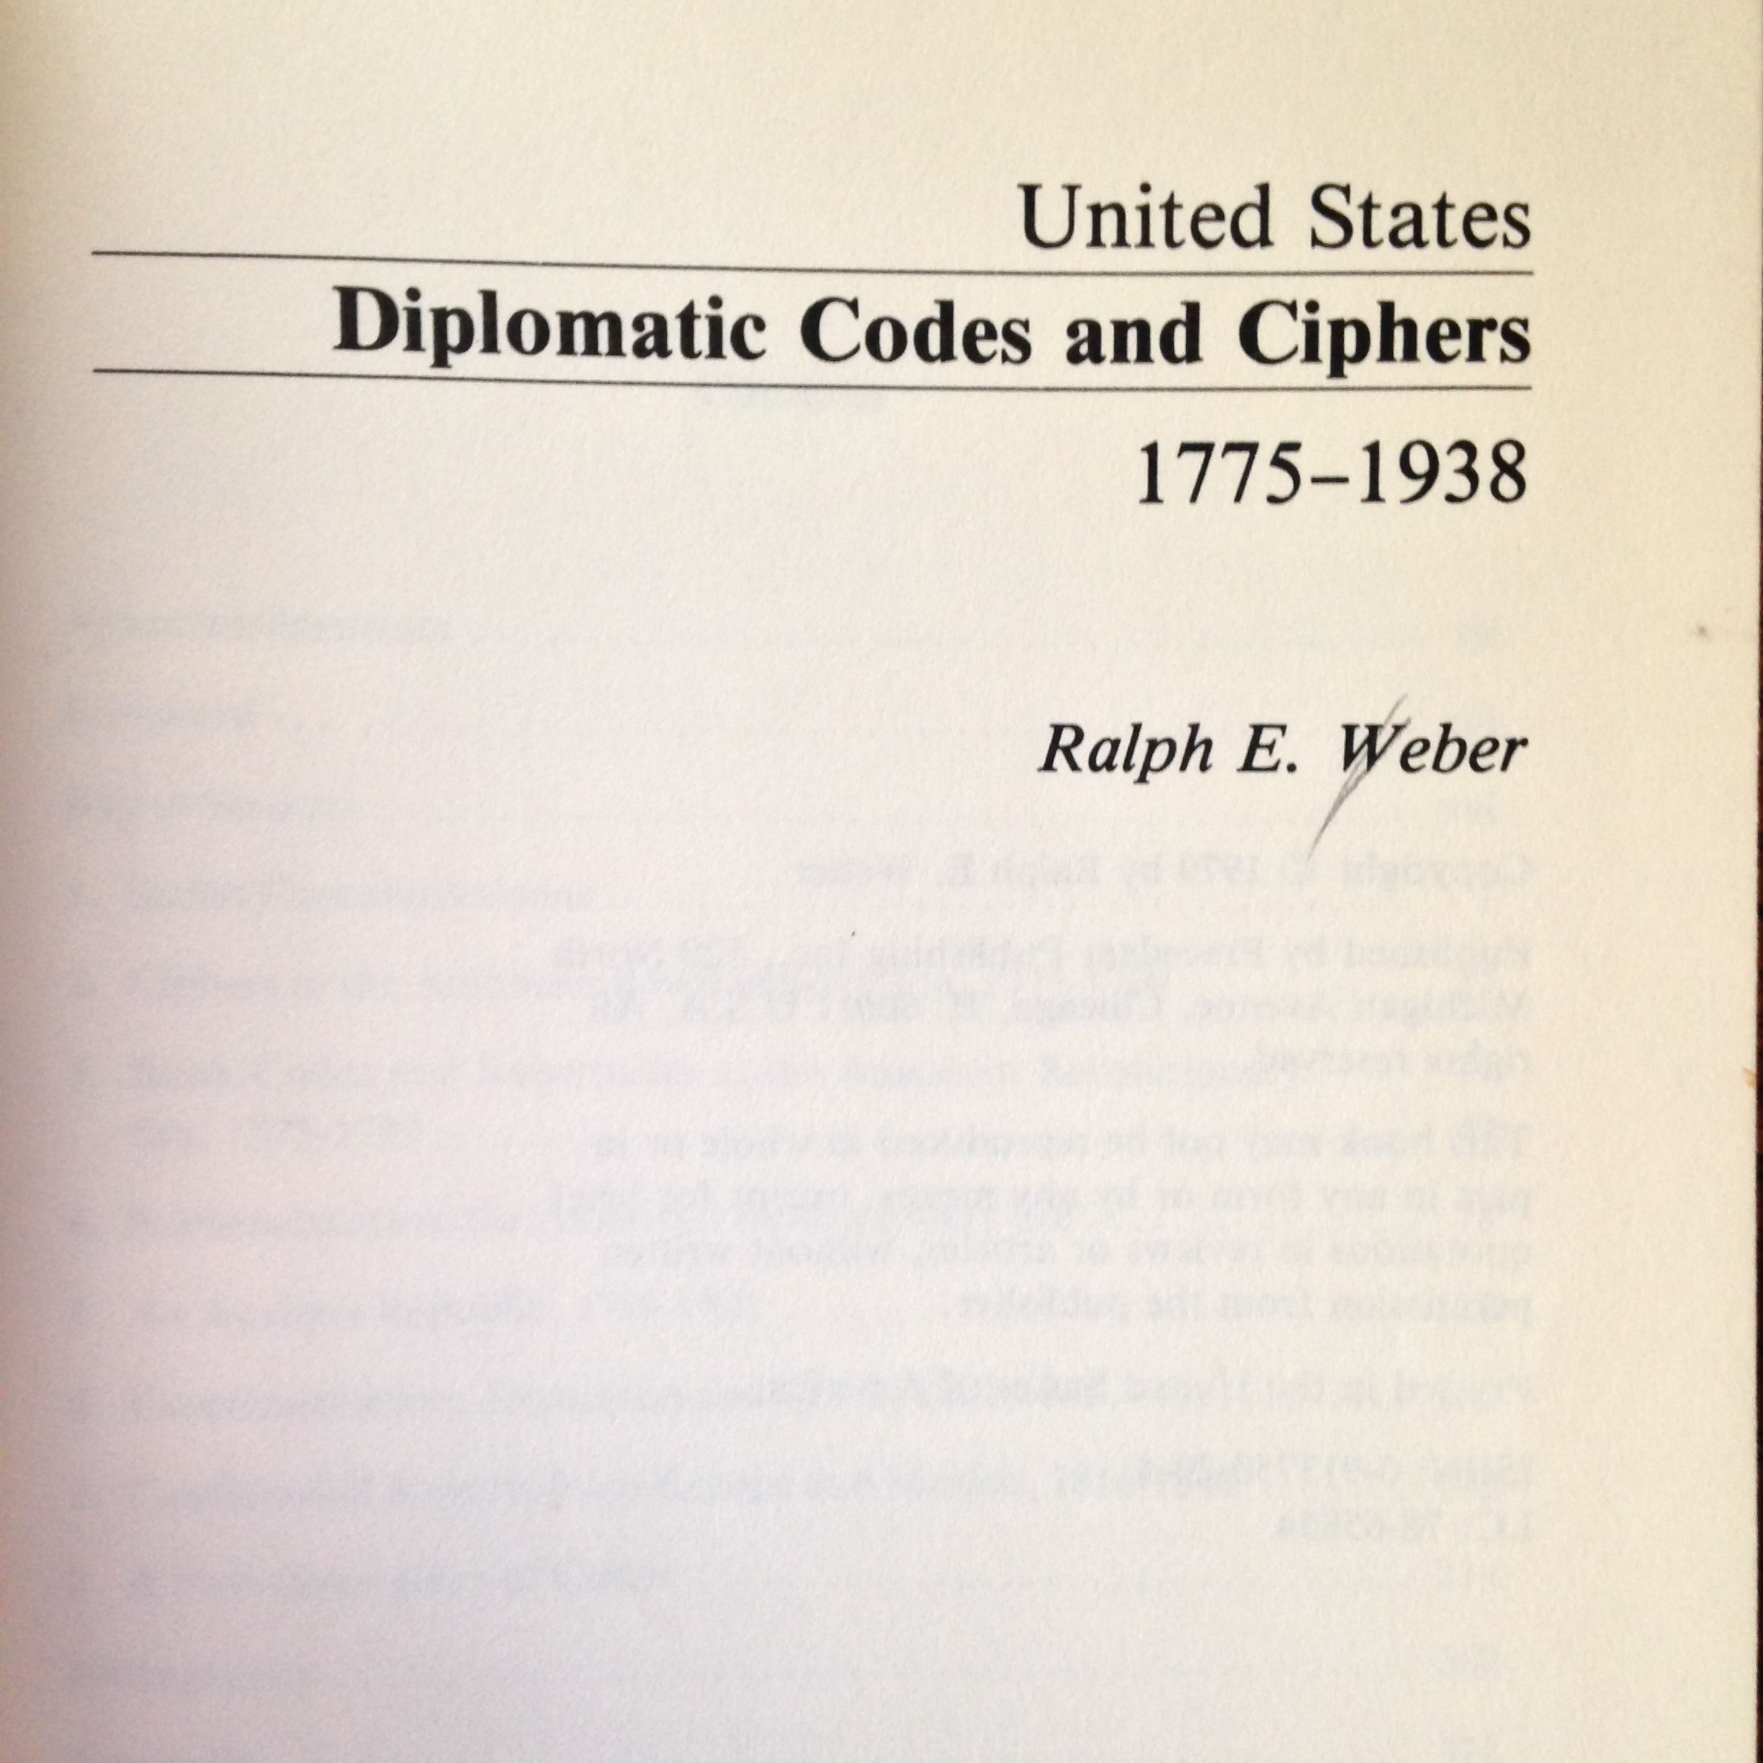

Slide 14
19th Century U.S. Diplomatic Codes
“Codebook” is secret key

Slide 15
“Dark Ages”
Two problems:
Security
Key distribution

Slide 16
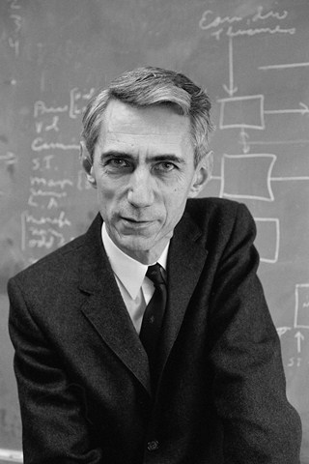
Claude Shannon (1949)
What does an ideal cipher look like?

Slide 17
Perfect Secrecy: One-Time Pad
Good news: The “one-time pad” protects against infinitely powerful adversaries
Bad news: If you want to encrypt N bits of data, you need a N-bit secret key
Must change key with every message!
Don’t try this at home!

Slide 18
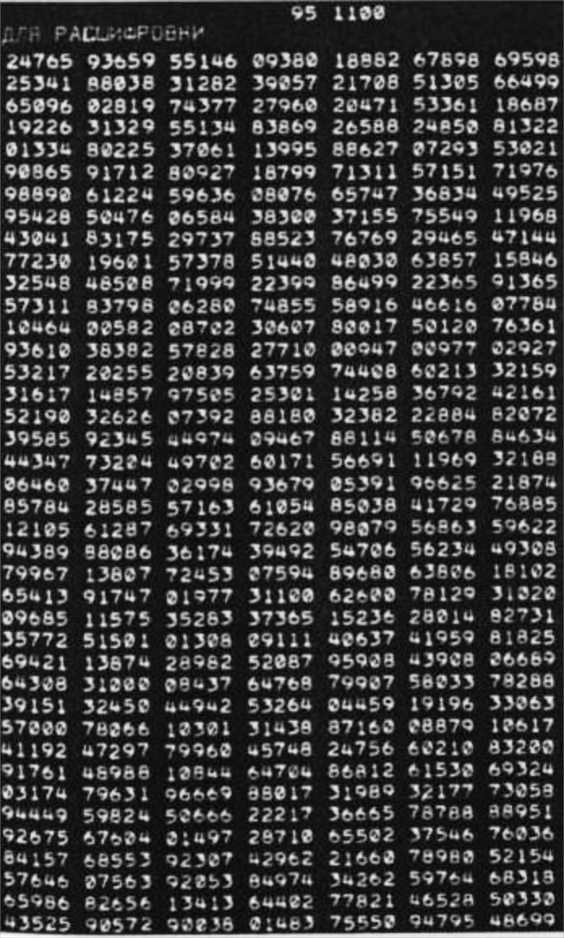
One-time pad widely used
US-USSR “Hot line”
Soviet diplomatic traffic
[…]

Slide 19
What happens
… if you run out of keying material?
… if you re-use keys?
… if your “random” keys are not so random?

Slide 20
See: Venona project

Slide 26
Where do you get the shared keys???

Slide 27
The One-Time Pad
Recall the two problems of crypto pre-1976:
Security
Key distribution

Slide 28
The One-Time Pad
Recall the two problems of crypto pre-1976:
Security [just use one-time pad]
Key distribution

Slide 29
The One-Time Pad
Recall the two problems of crypto pre-1976:
Security [just use one-time pad]
Key distribution

Slide 30
A Brief History of Cryptography
What happened here?
–3000
1976

Slide 31
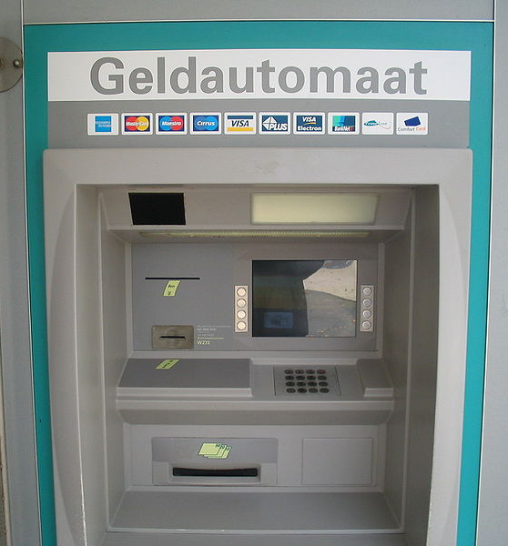
Digital Revolution
Pre-1970s:
Military applications drove interest in crypto
Post-1970s
Business applications for crypto emerged
http://en.wikipedia.org/wiki/Automated_teller_machine#/media/File:Geldautomaat.jpg

Slide 32
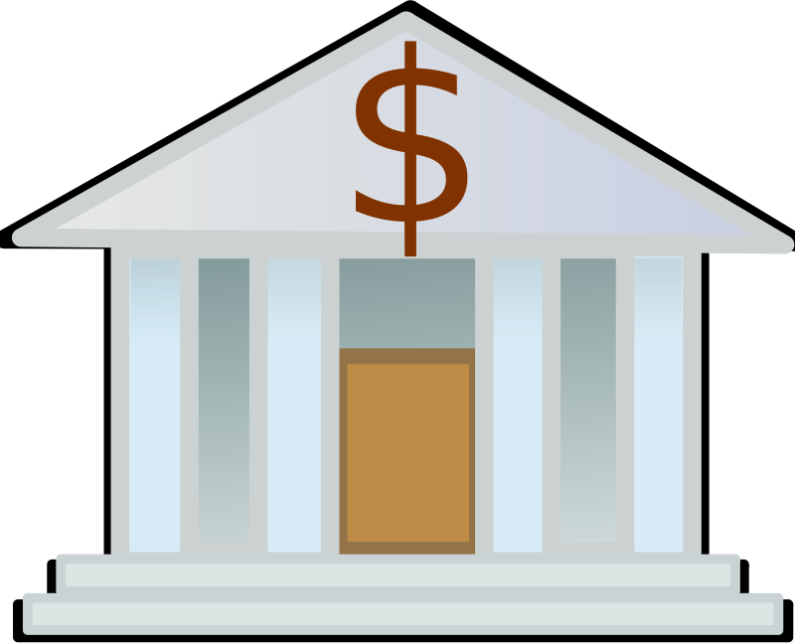
Why does business change the picture?

Slide 35
Key distribution in a decentralized network is not easy

Slide 36
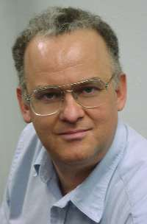
Ralph Merkle
Undergrad at UC Berkeley in 1970s
Q: Can two parties agree on a shared secret without private communication?
[e.g., over the Internet]

Slide 37
Merkle’s Beautiful Idea
Alice and Bob do ≈N work to agree on a secret
Eavesdropper must do ≈N² work to learn the secret

Slide 38
Alice picks N different numbers in {1,…,N²} , publishes their hashes
H(x₁)
H(x₂)
H(x₃)
H(x₄)
…
H(x_{N})
Barak, Boaz, and Mohammad Mahmoody-Ghidary. "Merkle puzzles are optimal—an o (n²)-query attack on any key exchange from a random oracle." CRYPTO 2009

Slide 39
H(x₁)
H(x₂)
H(x₃)
H(x₄)
…
H(x_{N})
H(y₁)
H(y₂)
H(y₃)
H(y₄)
…
H(y_{N})

Slide 40
Alice and Bob can use x₂ = y₄
as a shared key
H(x₁)
H(x₂)
H(x₃)
H(x₄)
…
H(x_{N})
H(y₁)
H(y₂)
H(y₃)
H(y₄)
…
H(y_{N})

Slide 41
H(x₁)
H(x₂)
H(x₃)
H(x₄)
…
H(x_{N})
H(y₁)
H(y₂)
H(y₃)
H(y₄)
…
H(y_{N})

Slide 42
H(x₁)
H(x₂)
H(x₃)
H(x₄)
…
H(x_{n})
H(y₁)
H(y₂)
H(y₃)
H(y₄)
…
H(y_{n})
Eavesdropper must make ≈N² guesses to recover x₂ or y₄

Slide 43
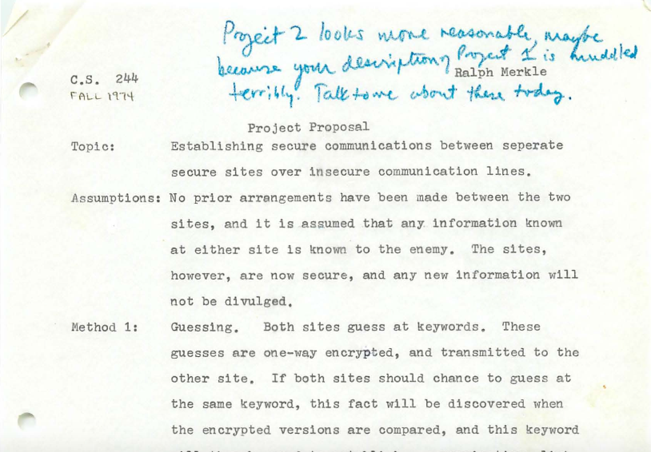
http://www.merkle.com/1974/FirstCS244projectProposal.pdf

Slide 44
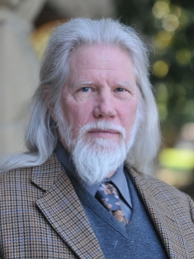
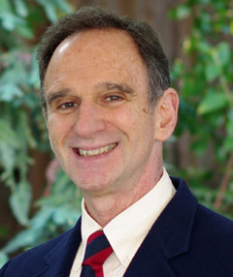
Diffie and Hellman

Slide 45
Diffie and Hellman’s Innovation
Alice and Bob do ≈k³ work to agree on a secret
Eavesdropper must do ≈2^{f(k)} work to learn the secret
Exponentially harder

Slide 46
Alice’s secret is the exponent “a”
gª mod p
g and p are (carefully picked) public N-bit integers

Slide 47
Bob’s secret is the exponent “b”
gª mod p
g^{b} mod p

Slide 48
Alice and Bob can use g^{ab} (mod p)
as a shared key
gª mod p
g^{b} mod p

Slide 49
Best known algorithm for recovering “a” from gª runs in time ≈e^{(O((log p)^{1/3}))}
~
gª mod p
g^{b} mod p

Slide 50
gª
g^{f}
g^{d}
g^{e}
g^{b}
g^{h}
g^{l}
g^{c}
g^{k}
g^{m}

Slide 51
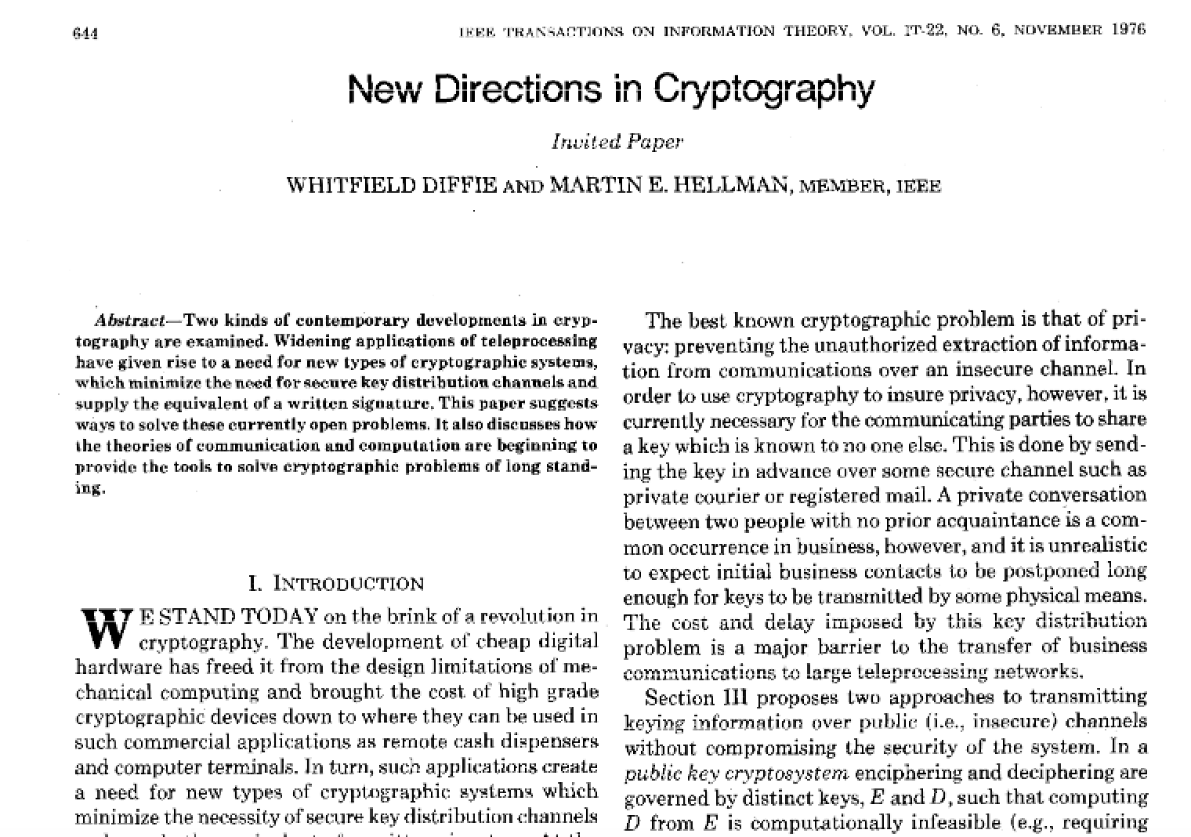

Slide 52
A Brief History of Cryptography
Golden Age?
–3000
1976

Slide 54
Part I. Technical History
(3000 BC – 1976)
Part II. Political History
(1976 – now)

Slide 55
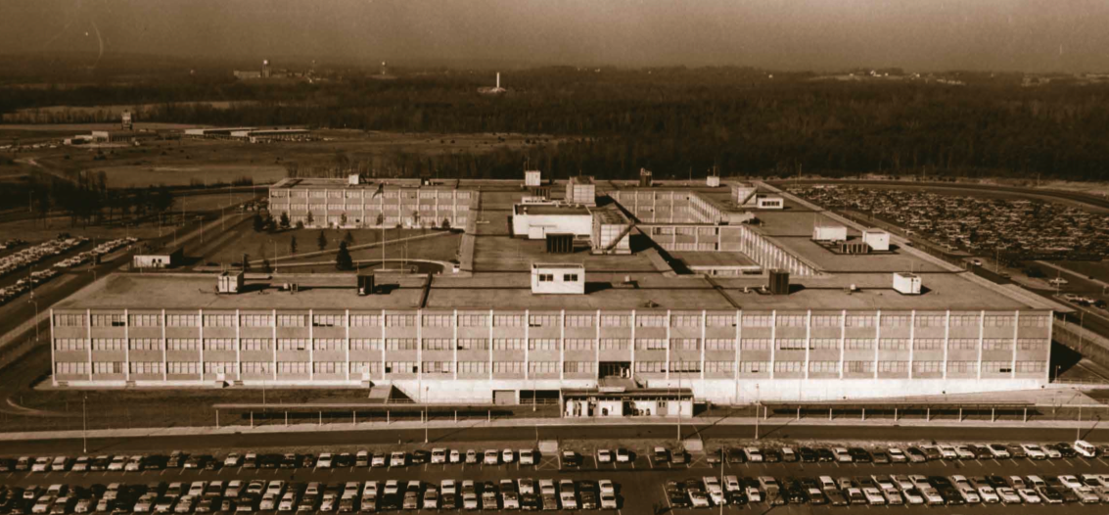
Meanwhile at Fort Meade…

Slide 56
“NSA regarded the technique as classified; now it was out in the open.”

Slide 57
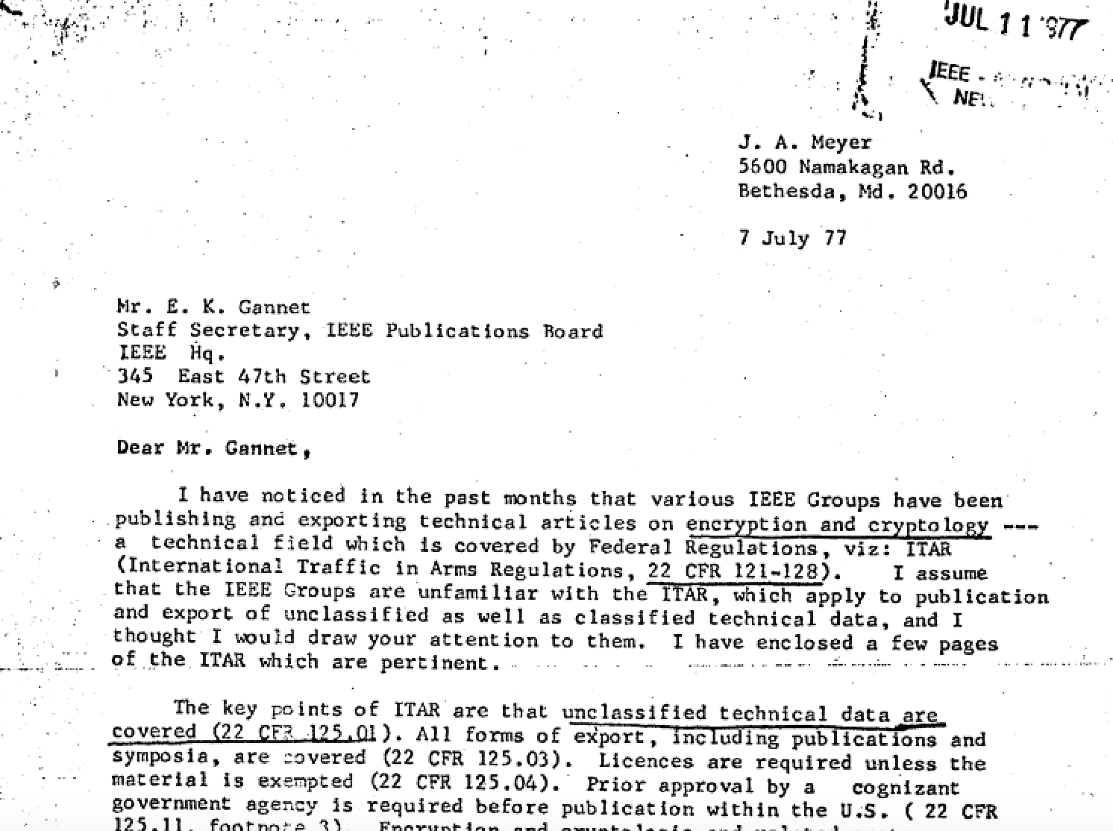
https://stacks.stanford.edu/file/druid:wg115cn5068/1977%200707%20Meyer%20letter.pdf

Slide 58
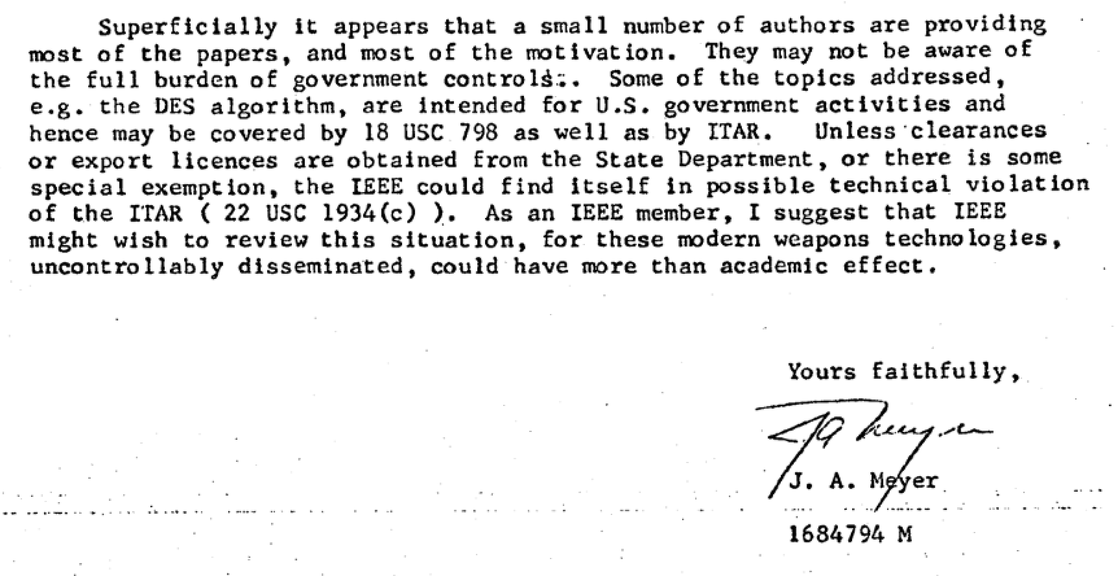
Later, Science confirmed that Meyer was an NSA employee

Slide 59
Meyer’s letter raised an important question…
Could the Federal government prevent academics from publishing on crypto?

Slide 60
“Of course not! First amendment!”
See: Atomic Energy Act of 1954

Slide 61
Four Legal Arguments
1. Atomic Energy Act of 1954
– No mention of crypto
2. Invention Secrecy Act of 1951
– Not patented
3. National Security Information (EOs)
– Doesn’t appear to cover public work
4. ITAR (“Int’l Traffic in Arms Regulations”)
– Not clear whether it applies to speech
http://fas.org/sgp/othergov/invention/stats.html
Notes:
Invention secrecy act
----- Meeting Notes (3/27/15 10:17) -----
- Add stuff about patents
- Source code export?

Slide 62
Hellman’s Arguments
There is a commercial need for crypto
– Lack of crypto IS a nat sec threat
Any country can easily build crypto tools – No point in prohibiting export
3. US is not at war
– Arguments from WWII don’t apply
https://stacks.stanford.edu/file/druid:wg115cn5068/1977%201003%20MH2Schwartz.pdf

Slide 63
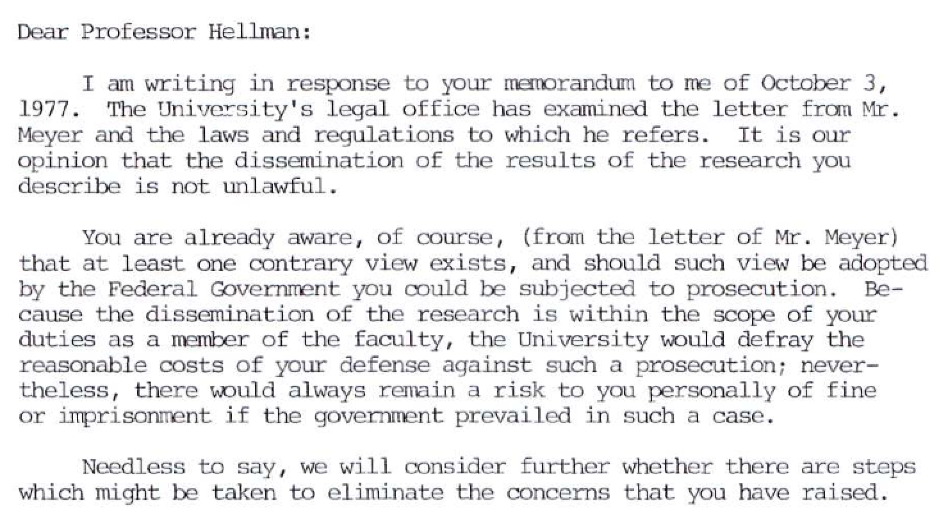
https://stacks.stanford.edu/file/druid:wg115cn5068/1977%201007%20Schwartz2MH.pdf

Slide 64
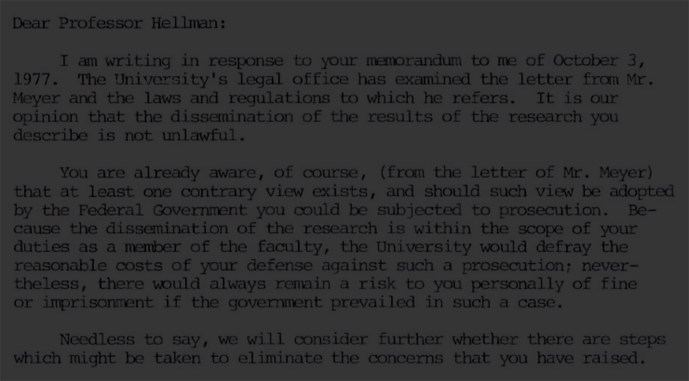
https://stacks.stanford.edu/file/druid:wg115cn5068/1977%201007%20Schwartz2MH.pdf

Slide 66
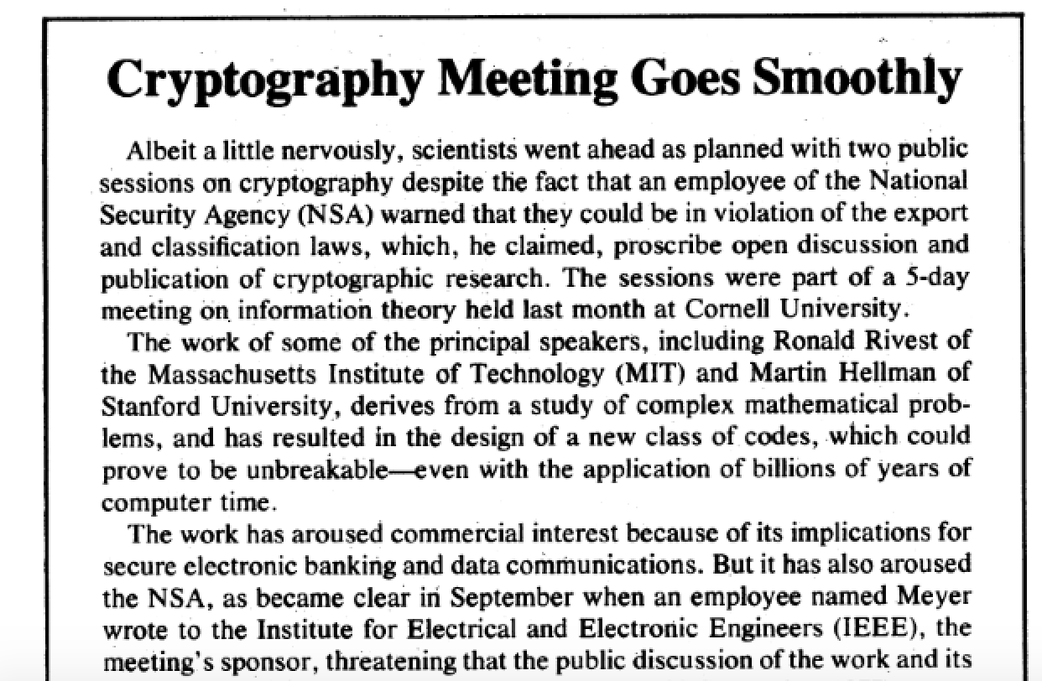
More details in my Stanford Mag piece
Cryptography Meeting Goes Smoothly by Deborah Shapley
Science 4 November 1977: 476.

Slide 67
?

Slide 68
What is the lesson here?
Crypto: How the Code Rebels Beat the Government—Saving Privacy in the Digital Age
By Steven Levy
(Published 2001)

Slide 69
What is the lesson here?
…or…
NSA leadership realized it could not win the public debate
Shifted to more subtle methods of influence (out of public eye)
[Funding, standards, purchasing power, …]

Slide 70
How Crypto Gets to Market
Funding
Research
Publication
Standardization
Implementation
Adoption

Slide 71
The Good News?
Rather than being careful to make sure that were[n’t] going to damage [our collection capabilities] . . . I would have been interested in how quickly they would have been able to make [cryptosystems] available in a form that would protect proprietary information as well as government information.
Admiral Bobby Ray Inman (ret.)
Former DIRNSA

Slide 72
Want more?
“The Codebreakers” – David Kahn
“The Puzzle Palace” – James Bamford
“Crypto” – Steven Levy
Martin Hellman Papers at Stanford
Dan Boneh’s Courses
– CS 155/255/355 at Stanford
– Coursera “Crypto I” (and II)

Slide 74
Questions?
Henry Corrigan-Gibbs
henrycg@stanford.edu / www.henrycg.com

Slide 77
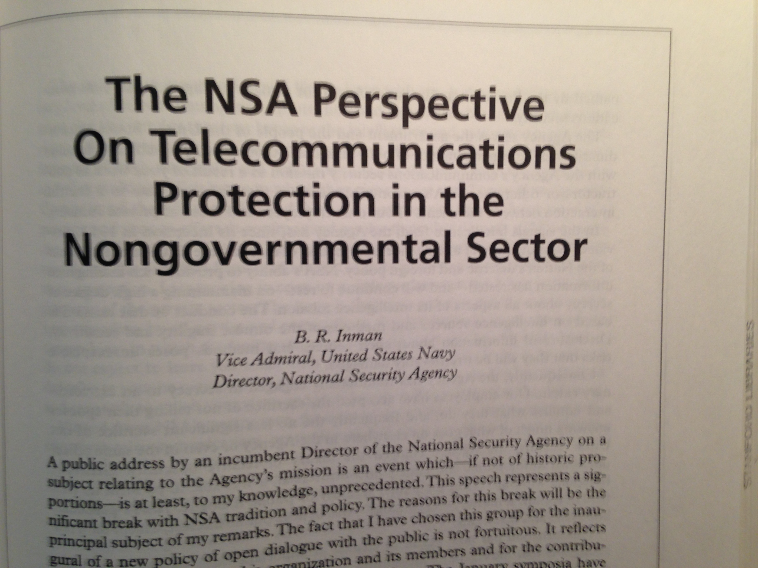

Slide 79
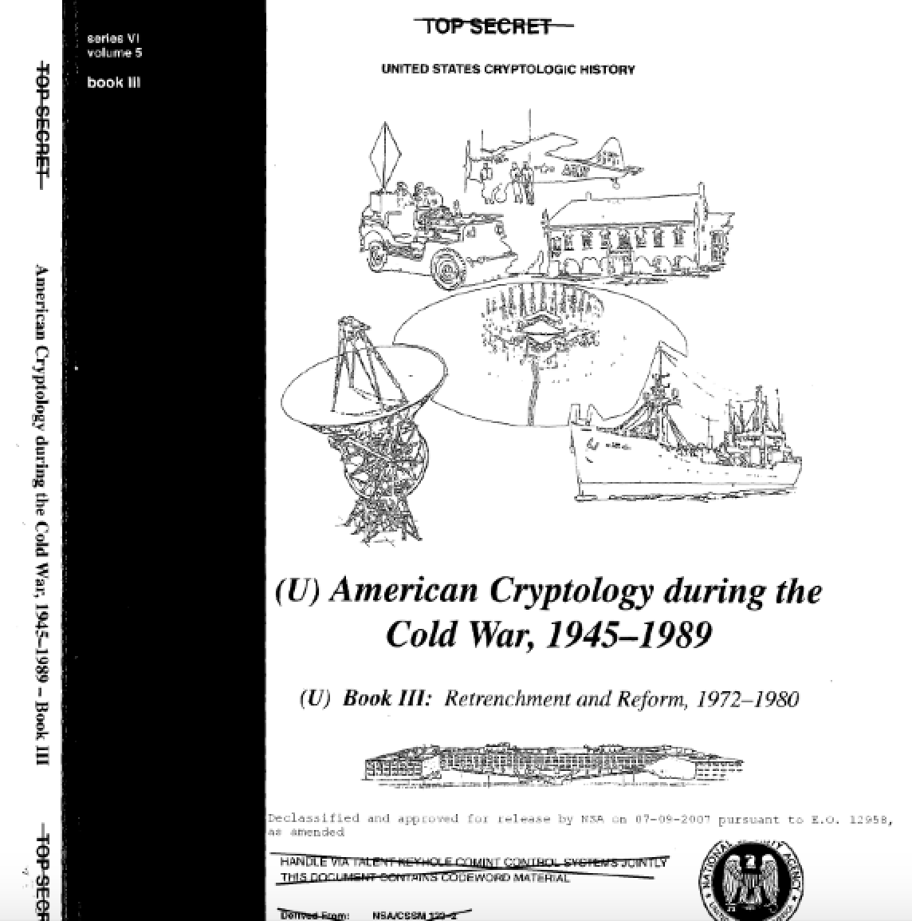
https://www.nsa.gov/public_info/_files/cryptologic_histories/cold_war_iii.pdf

Slide 80
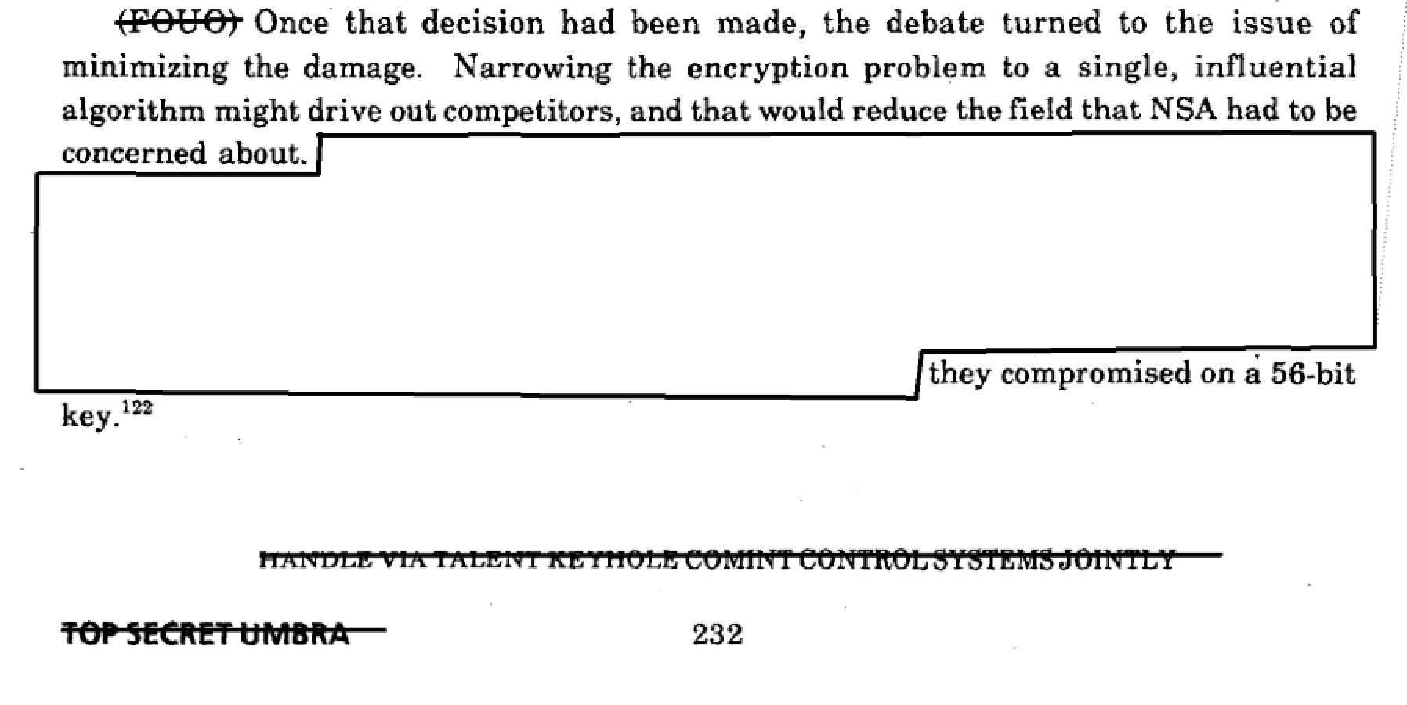
https://www.nsa.gov/public_info/_files/cryptologic_histories/cold_war_iii.pdf

Slide 81
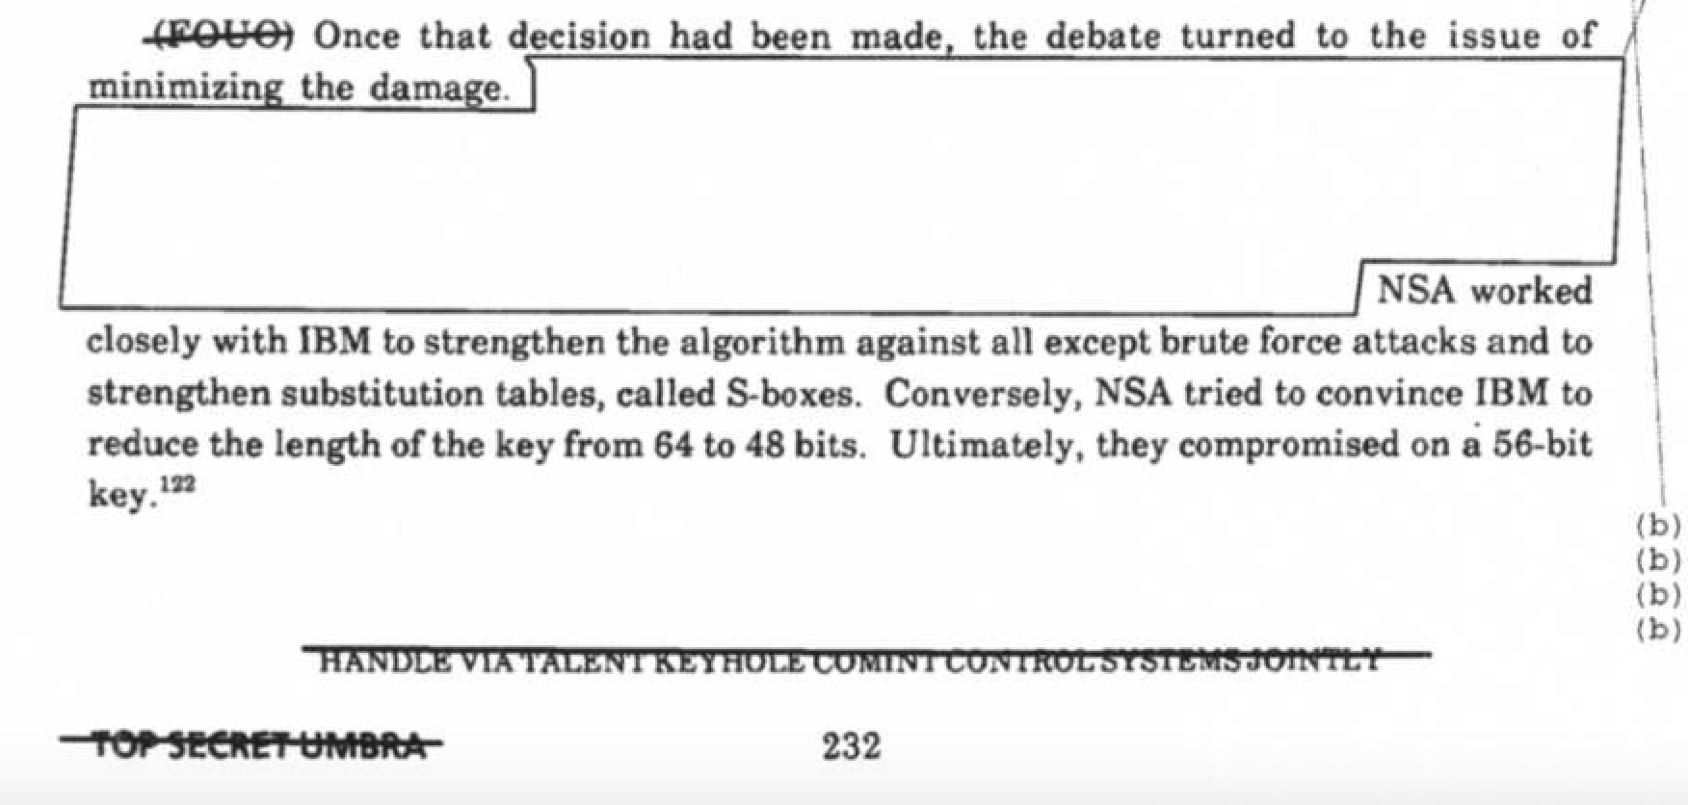
https://stacks.stanford.edu/file/druid:wg115cn5068/nsa-meyer.pdf

Slide 83
