Slide 1
Recommendations for Randomness in the Operating System
Henry Corrigan-Gibbs and Suman Jana Stanford University HotOS XV – 20 May 2015

Slide 3
GE Ethernet card
Apple iOS Sandbox
Android OpenSSL
Firefox DNS resolver

Slide 4
In the past two years!
[Everspaugh et al., Oakland’14]
[Garfinkel+Rosenblum, HotOS’05]
[Goldberg+Wagner, Dobbs‘96]
[Gutterman+Malkhi, CT-RSA’05]
[Gutterman et al., Oakland’06]
[Heninger et al., USENIX Sec’12]
[Lazar et al., APSys’14]
[Lenstra et al., 2012]
[Ristenpart+Yilek, NDSS’12]
[Yilek et al., IMC’09]

Slide 5
Why so many bugs?
Bad news: OS is a big part of the problem.
Randomness subsystems have:
Buggy design
Error-prone APIs
Misleading documentation
Good news: The OS can be part of the solution!
See paper

Slide 6
What is entropy?
Why do we need it?
Cryptographic secrets
ASLR
DNS source ports
Password salts
Etc.
Password has k bits of [guessing] entropy w.r.t. an adversary A
It takes A around 2^{k} guesses to guess your password
⇔

Slide 7
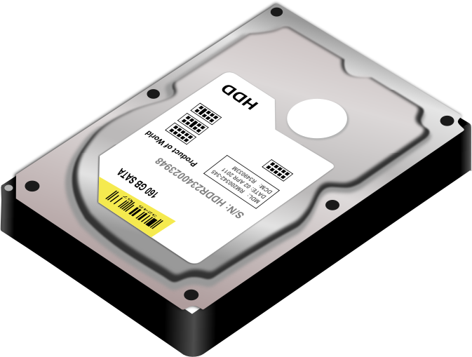
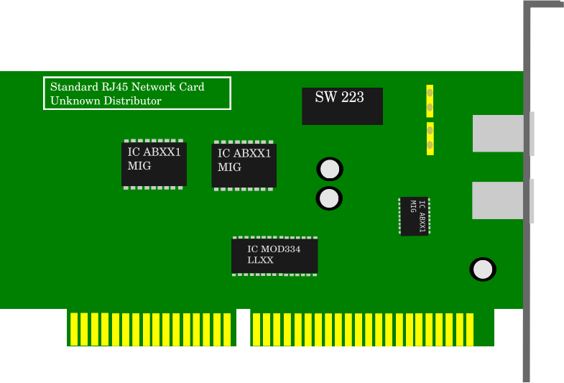
Randomness pool
01001101000100
Application reads /dev/random

Slide 8
Once the OS has accumulated enough entropy, it will never “run out” of entropy
256+ bits of randomness
seed
PRG
011010100101110010101111011000011010111

Slide 9
Great! But what should the OS do before it has 256 bits in the pool?
After first boot… .

Slide 10
State of the Art:
Entropy Estimation

Slide 11
State of the Art
0111
“0111”
27 bits
Ye Olde
Entropy
Estimator
“2.3 bits”

Slide 12
State of the Art
1000
“1000”
29.3 bits
Ye Olde
Entropy
Estimator
“0.8 bits”

Slide 13
State of the Art
30.1 bits
Ye Olde
Entropy
Estimator

Slide 14
State of the Art
Block /dev/random until pool has 256+ bits
X
30.1 bits
Ye Olde
Entropy
Estimator

Slide 15
Entropy is a function of
adversary’s knowledge
Estimate could be: 256 bits
Reality could be: 0 bits
Ye Olde
Entropy
Estimator
[Barak-Halevi CCS’05]
[Dodis et al. CCS’13]
[Kelsey et al., SAC‘00]

Slide 16
State of the Art
Entropy estimation
Long-blocking API
Trusted vs untrusted inputs
Entropy DoS attacks
/dev/random vs.
/dev/urandom
Slow accumulation
User-space randomness pools
Chaos!!!

Slide 17
One Consequence: User-space Pools
Reading many bytes from /dev/random can drive down entropy estimate and starve other processes
Kernel Space
User Space
P1
P1 and P2 get same “random” values!
[CVE-2013-1445, CVE-2013-3599, CVE-2014-0016, CVE-2014-0017]
P2

Slide 18
Our Proposal

Slide 19
Our Proposal
Option 1: Strong Assumptions
Assume low-order bit of “RDRAND” has one bit of entropy
Easy! Just gather 256 samples, use them to seed a PRG
What happens if your assumption is wrong?

Slide 21
Our Proposal
Option 2: “Best-effort” entropy accumulation
Never estimate
Never block
Any process can write into OS pool
Per-process pools
[See paper for details]
→ Honest process’ pools will eventually accumulate entropy
[Barak-Halevi CCS’05] [Dodis et al. CCS’13] [Kelsey et al., SAC‘00]

Slide 22
Conclusions
Popular OSes make using randomness more difficult than it needs to be
Entropy estimation is at the heart of the problem
Our Proposal
“Best effort” randomness
Never estimate, never block

