Slide 1
Riposte: An Anonymous Messaging System Handling Millions of Users
Henry Corrigan-Gibbs, Dan Boneh, and David Mazières Stanford University
IEEE Security and Privacy
18 May 2015

Slide 2





With encryption, we
can hide the data…
?!?
…but does that
hide enough?
pk
(pk, sk)
0VUIC9zZW5zaXRpdmU

Slide 3

Time | From | To | Size
10:12 | Alice | Bob | 2543 B
10:27 | Carol | Alice | 567 B
10:32 | Alice | Bob | 450 B
10:35 | Bob | Alice | 9382 B
…
[cf. Ed Felten’s testimony before the House
Judiciary Committee, 2 Oct 2013]

Slide 4
Time | From | To | Size
10:12 | Alice | taxfraud@stanford.edu | 2543 B
10:27 | Carol | Alice | 567 B
10:32 | Alice | Bob | 450 B
10:35 | Bob | Alice | 9382 B
Hiding the data is necessary, but not sufficient
…
[cf. Ed Felten’s testimony before the House
Judiciary Committee, 2 Oct 2013]

Slide 5


Goal
The “Anonymity Set”

Slide 6

Goal

Slide 7
Goal

Slide 8
Goal
DBs do not learn who wrote which message
0
To: taxfraud@stanford.edu
0
+
Protest will be held tomo…
See my cat photos at w…
0

Slide 9
Building block for systems related to “hiding the metadata”
→ Anonymous Twitter
→ Anonymous surveys
→ Private messaging, etc.

Slide 10
Low-latency anonymity systems (e.g., Tor)
… do not protect against a global adversary
Mix-nets
… require expensive ZKPs to protect against
active attacks
Riposte is an anonymous messaging system that:
protects against a near-global active adversary
handles millions of users in an
“anonymous Twitter” system

Slide 11
Outline
Motivation
A “Straw man” scheme
Technical challenges
Evaluation

Slide 12
“Straw man”
Scheme
[Chaum ‘88]
S_{X}
S_{Y}
0
0
0
0
0
0
0
0
0
0
Non-colluding servers

Slide 13
S_{X}
S_{Y}
0
0
0
0
0
0
0
0
0
0
“Straw man”
Scheme

Slide 14
S_{X}
S_{Y}
0
0
0
0
0
0
0
0
0
0
Write msg m_{A} into DB row 3
“Straw man”
Scheme

Slide 15
S_{X}
S_{Y}
0
0
0
0
0
0
0
0
0
0
0
0
“Straw man”
Scheme
m_{A}
0
0

Slide 16
S_{X}
S_{Y}
0
0
0
0
0
0
0
0
0
0
0
r₁
0
r₂
“Straw man”
Scheme
m_{A}
r₃
0
r₄
0
r₅

Slide 17
S_{X}
S_{Y}
0
0
0
0
0
0
0
0
0
0
0
r₁
-r₁
0
r₂
-r₂
-
=
“Straw man”
Scheme
m_{A}
r₃
m_{A} -r₃
0
r₄
-r₄
0
r₅
-r₅

Slide 18
S_{X}
S_{Y}
0
0
0
0
0
0
0
0
0
0
r₁
-r₁
r₂
-r₂
“Straw man”
Scheme
r₃
m_{A} -r₃
r₄
-r₄
r₅
-r₅

Slide 19
S_{X}
S_{Y}
0
0
r₁
-r₁
0
0
r₂
-r₂
0
0
r₃
m_{A} -r₃
0
0
r₄
-r₄
0
0
r₅
-r₅
“Straw man”
Scheme

Slide 20
S_{X}
S_{Y}
r₁
-r₁
r₂
-r₂
r₃
-r₃+m_{A}
r₄
-r₄
r₅
-r₅
“Straw man”
Scheme

Slide 21
S_{X}
S_{Y}
r₁
-r₁
r₂
-r₂
r₃
-r₃+m_{A}
r₄
-r₄
r₅
-r₅
0
0
“Straw man”
Scheme
0
0
m_{B}

Slide 22
S_{X}
S_{Y}
r₁
-r₁
r₂
-r₂
r₃
-r₃+m_{A}
r₄
-r₄
r₅
-r₅
0
s₁
-s₁
0
s₂
-s₂
-
=
“Straw man”
Scheme
0
s₃
-s₃
0
s₄
-s₄
m_{B}
s₅
m_{B} -s₅

Slide 23
S_{X}
S_{Y}
r₁
-r₁
r₂
-r₂
r₃
-r₃+m_{A}
r₄
-r₄
r₅
-r₅
s₁
-s₁
s₂
-s₂
“Straw man”
Scheme
s₃
-s₃
s₄
-s₄
s₅
m_{B} -s₅

Slide 24
S_{X}
S_{Y}
r₁
-r₁
s₁
-s₁
r₂
-r₂
s₂
-s₂
r₃
-r₃+m_{A}
s₃
-s₃
r₄
-r₄
s₄
-s₄
r₅
-r₅
s₅
m_{B} -s₅
“Straw man”
Scheme

Slide 25
S_{X}
S_{Y}
r₁ + s₁
-r₁ - s₁
r₂ + s₂
-r₂ - s₂
r₃ + s₃
-r₃ - s₃ + m_{A}
r₄ + s₄
-r₄ - s₄
r₅ + s₅
-r₅ - s₅ - m_{B}
“Straw man”
Scheme

Slide 26
S_{X}
S_{Y}
r₁ + s₁
-r₁ - s₁
r₂ + s₂
-r₂ - s₂
r₃ + s₃
-r₃ - s₃ + m_{A}
r₄ + s₄
-r₄ - s₄
r₅ + s₅
-r₅ - s₅ - m_{B}
“Straw man”
Scheme

Slide 27
S_{X}
S_{Y}
r₁ + s₁
-r₁ - s₁
r₂ + s₂
-r₂ - s₂
r₃ + s₃
-r₃ - s₃ + m_{A}
r₄ + s₄
-r₄ - s₄
r₅ + s₅
-r₅ - s₅ - m_{B}
“Straw man”
Scheme

Slide 28
S_{X}
S_{Y}
r₁ + s₁
-r₁ - s₁
r₂ + s₂
-r₂ - s₂
r₃ + s₃
-r₃ - s₃ + m_{A}
r₄ + s₄
-r₄ - s₄
r₅ + s₅
-r₅ - s₅ - m_{B}
“Straw man”
Scheme

Slide 29
S_{X}
S_{Y}
r₁ + s₁
-r₁ - s₁
0
r₂ + s₂
-r₂ - s₂
0
+
=
r₃ + s₃
-r₃ - s₃ + m_{A}
m_{A}
r₄ + s₄
-r₄ - s₄
0
r₅ + s₅
-r₅ - s₅ - m_{B}
m_{B}
At the end of the day, servers combine DBs to reveal plaintext
“Straw man”
Scheme

Slide 30
First-Attempt Scheme: Properties
“Perfect” anonymity as long as servers don’t collude
Can use k servers to protect against k-1 collusions
Practical efficiency: almost no “heavy” computation involved
Unlike a mix-net, storage cost is constant in the anonymity set size

Slide 31
Outline
Motivation
A “Straw man” scheme
Technical challenges
Evaluation

Slide 32
Outline
Motivation
A “Straw man” scheme
Technical challenges
  Collisions
  Malicious clients
  O(L) communication cost
Evaluation

Slide 33
Outline
Motivation
A “Straw man” scheme
Technical challenges
  Collisions
  Malicious clients
  O(L) communication cost
Evaluation
in the paper

Slide 34
Challenge: Bandwidth Efficiency
In “straw man” design, client sends DB-sized vector to each server
Idea: use a cryptographic trick to compress the vectors
→ Based on PIR protocols
s₁
s₂
s₃
s₄
s₅
[Ostrovsky and Shoup 1997]

Slide 35
Distributed Point Function
x₁
+
x₂
…
…
…
+
x_{n}
=
0
0
m
0
0
0
[Gilboa and Ishai 2014]

Slide 36
Distributed Point Function
x₁
+
x₂
…
…
…
+
x_{n}
=
Privacy: A subset of keys leaks nothing
about message or l
0
0
m
0
0
0
[Gilboa and Ishai 2014]

Slide 37

S_{X}
S_{Y}
0
0
0
0
0
0
0
0
0
0
DPFs Reduce Bandwidth Cost

Slide 38
S_{X}
S_{Y}
0
r₁
-r₁
0
0
r₂
-r₂
0
0
r₃
m_{A} -r₃
0
0
r₄
-r₄
0
0
r₅
-r₅
0
DPFs Reduce Bandwidth Cost

Slide 39
Alice sends
L^{1/2} bits (instead of L)
Two-server version just uses AES (no public-key crypto)
With fancier crypto, privacy holds even if all but one server is malicious
[Chor and Gilboa 1997]
[Gilboa and Ishai 2014]

Slide 40
Outline
Motivation
Definitions and a “Straw man” scheme
Technical challenges
Evaluation

Slide 41
Bottom-Line Result
Implemented the protocol in Go
For a DB with 65,000 Tweet-length rows, can process 30 writes/second
Can process 1,000,000 writes in 8 hours on a single server
Completely parallelizable workload

Slide 42
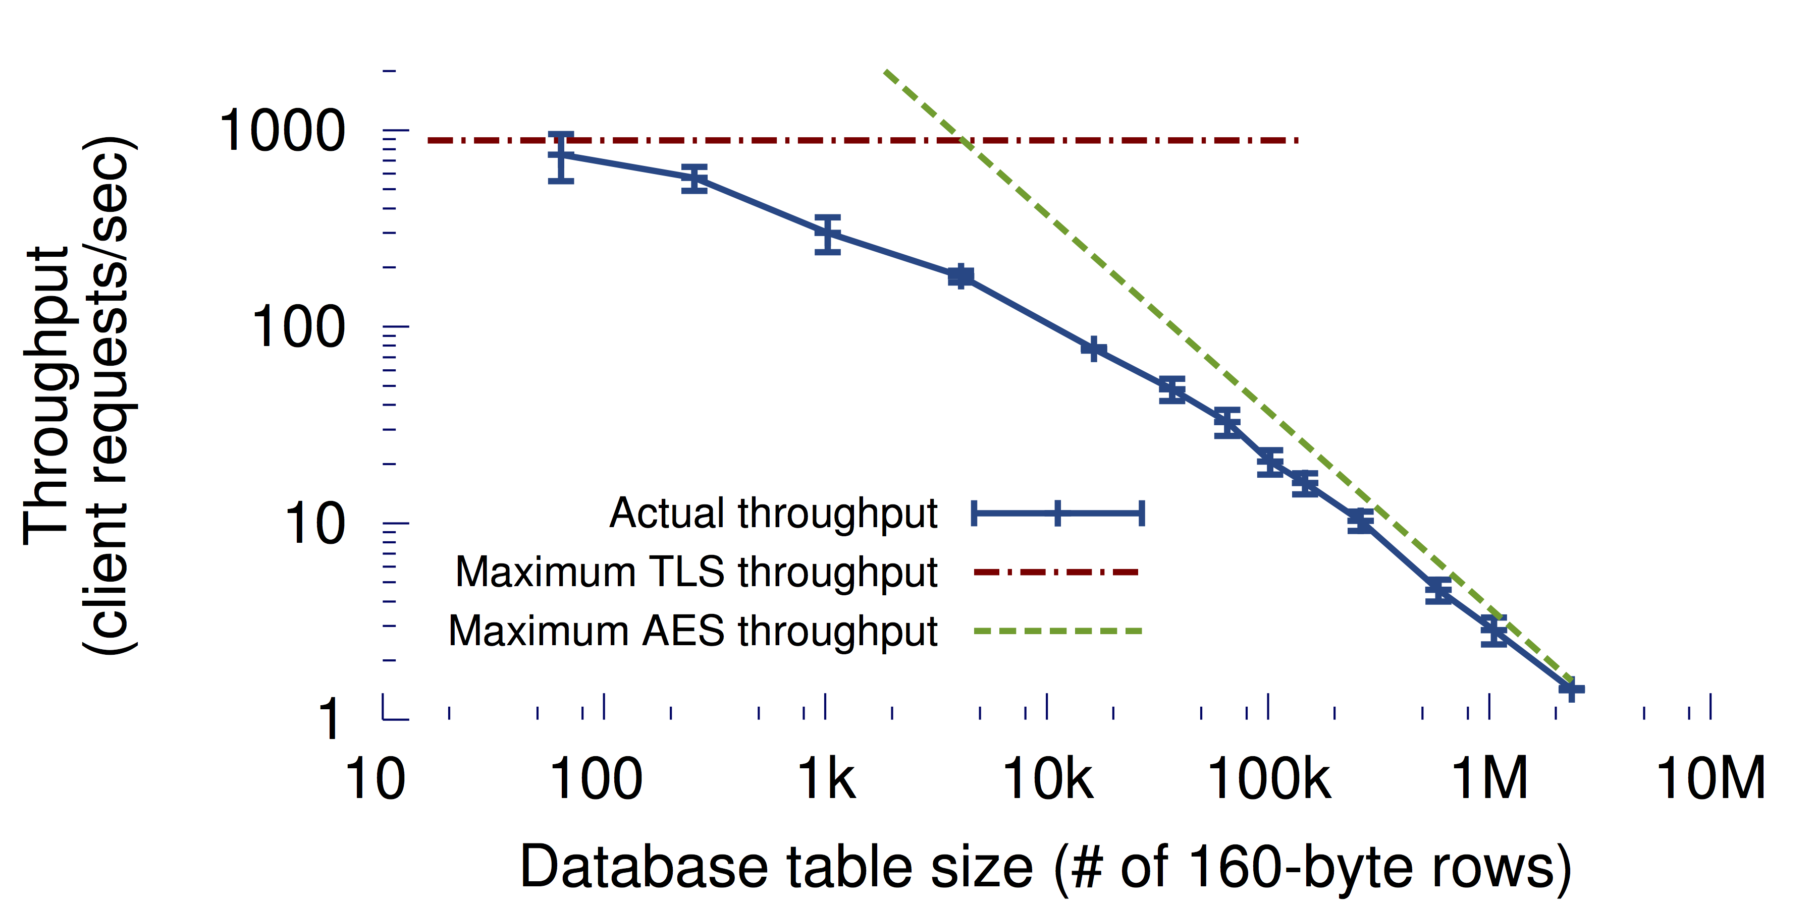
Throughput
(anonymous Twitter)
At large table sizes, AES cost dominates

Slide 43
Time | From | To | Size
10:12 | Alice | taxfraud@stanford.edu | 2543 B
10:15 | Bob | Alice | 567 B
10:17 | Carol | Bob | 450 B
10:22 | Dave | Alice | 9382 B

Slide 44
Time | From | To | Size
10:12 | Alice | Riposte Server | 207 KB
10:15 | Bob | Riposte Server | 207 KB
10:17 | Carol | Riposte Server | 207 KB
10:22 | Dave | Riposte Server | 207 KB
?!?

Slide 45
Conclusion
In many contexts, “hiding the metadata” is as important as hiding the data
Combination of crypto tools with systems design ➔ 1,000,000-user anonymity sets
Next step: Better performance at scale

