Slide 1

Lightweight Techniques for Private Heavy Hitters
Dan Boneh Stanford | Elette Boyle IDC Herzliya | Henry Corrigan-Gibbs MIT CSAIL | Niv Gilboa Ben-Gurion University | Yuval Ishai Technion
IEEE Security & Privacy 2021

Slide 2
Mozilla wants to know… which URLs most often crash the browser?
stanford.edu/images/logo.png
nytimes.com/index.html
google.com/search?q=prostate+cancer
…
nytimes.com/index.html

Slide 3

Today: Non-private data collection
stanford.edu/images/logo.png
nytimes.com/index.html
google.com/search?q=prostate+cancer
…
…
nytimes.com/index.html

Slide 4

We show: Mozilla can learn the most-often reported URLs, without learning which client reported which URL
stanford.edu/images/logo.png
The URLs that caused ≥1000 crashes are:
nytimes.com/2020/03/27/dogs.html
about.twitter.com/logo.png
…
nytimes.com/index.html
google.com/search?q=prostate+cancer
…
…
nytimes.com/index.html

Slide 5

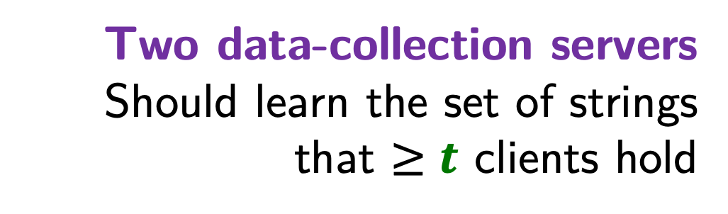
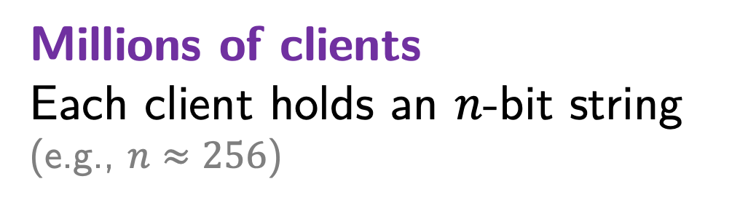
Private heavy-hitters problem
In setting of local differential privacy: [Bassily, Smith 2015] [Qin, Yan, Yu, Khalil, Xiao, Ren 2016]
[Bassily, Nissim, Stemmer, Guha 2017] [Bun, Nelson, Stemmer 2019] …
Millions of clients
Each client holds an $n$-bit string
(e.g., $n≈256$)
Privacy* against one malicious server, colluding with malicious clients
…
Two data-collection servers
Should learn the set of strings
that $≥t$ clients hold

Slide 6
Private heavy-hitters problem
In setting of local differential privacy: [Bassily, Smith 2015] [Qin, Yan, Yu, Khalil, Xiao, Ren 2016]
[Bassily, Nissim, Stemmer, Guha 2017] [Bun, Nelson, Stemmer 2019] …
Correctness against malicious clients.
Privacy against one malicious server.
Millions of clients
Each client holds an $n$-bit string
(e.g., $n≈256$)
…
Two data-collection servers
Should learn the set of strings
that $≥t$ clients hold

Slide 7
Private heavy-hitters problem
In setting of local differential privacy: [Bassily, Smith 2015] [Qin, Yan, Yu, Khalil, Xiao, Ren 2016]
[Bassily, Nissim, Stemmer, Guha 2017] [Bun, Nelson, Stemmer 2019] …
Minimal communication and computation costs
Millions of clients
Each client holds an $n$-bit string
(e.g., $n≈256$)
Support 100s of submissions per second
(Using 100-1000x less bandwidth
than general-purpose MPC)
100s of submissions per second
…
Two data-collection servers
Should learn the set of strings
that $≥t$ clients hold

Slide 8
Applications
Which URLs crash Firefox most often?
Which phone apps consume the most battery life?
Which passwords are most popular?
Which programs consume the most CPU?
Where do users of my app spent their time?
…

Slide 9
This talk
The private heavy-hitters problem
New tools
  Incremental distributed point functions
  Malicious-secure sketching
Evaluation

Slide 10
This talk
The private heavy-hitters problem
New tools
  Incremental distributed point functions
  Malicious-secure sketching
Evaluation

Slide 11


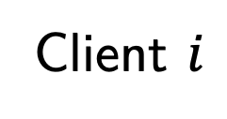
Private heavy hitters: A warm-up scheme
1. Client $i$ with string $s_{i}$ prepares a binary tree,
with 1s on the path to the $s_{i}$-th leaf of the tree.
1
1
0
0
1
0
0
0
0
0
1
0
0
0
0
Client $i$
String $s_{i}$ =
011

Slide 12
Private heavy hitters: A warm-up scheme
2. Each client secret-shares the labels on the tree’s nodes
and sends one share to each of the servers.
3
2
7
1
0
1
6
8
1
0
1
8
2
4
7
5
2
9
0
1
0
0
=
+
0
0
0
1
0
0
0
0
-2
-1
-7
0
0
-6
-8
Client $i$
-1
-8
-2
-3
-7
-5
-2
-9

Slide 13

Private heavy hitters: A warm-up scheme
2. Each client secret-shares the node labels
and sends one share to each of the servers.
$→$ Single message from client to servers
Client $i$

Slide 14
Private heavy hitters: A warm-up scheme
2. Each client secret-shares the node labels
and sends one share to each of the servers.
$→$ Single message from client to servers
…

Slide 15
Private heavy hitters: A warm-up scheme
3. Servers sum up shares from each client to get “aggregate” shares.
9
2
7
3
1
6
8
1
8
2
4
7
5
2
9
-3
…
0
-3
-3
1
-2
-8
-1
-8
-1
-3
-7
-1
-2
-9

Slide 16
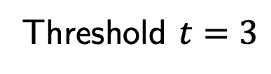
Private heavy hitters: A warm-up scheme
4. Servers publish shares to perform BFS search for heavy hitters.
9
Threshold $t=3$
2
7
3
1
6
8
6
1
8
2
4
7
5
2
9
-3
…
0
-3
-3
1
-2
-8
-1
-8
-1
-3
-7
-1
-2
-9

Slide 17
Private heavy hitters: A warm-up scheme
4. Servers use BFS with pruning to find all heavy hitters.
9
Threshold $t=3$
2
7
3
1
6
8
6
1
8
2
4
7
5
2
9
2
4
-3
…
0
-3
-3
1
-2
-8
-1
-8
-1
-3
-7
-1
-2
-9

Slide 18
Private heavy hitters: A warm-up scheme
4. Servers use BFS with pruning to find all heavy hitters.
9
Threshold $t=3$
2
7
3
1
6
8
6
1
8
2
4
7
5
2
9
2
4
4
0
-3
…
0
-3
-3
1
-2
-8
-1
-8
-1
-3
-7
-1
-2
-9

Slide 19
Private heavy hitters: A warm-up scheme
4. Servers use BFS with pruning to find all heavy hitters.
9
Threshold $t=3$
2
7
3
1
6
8
6
1
8
2
4
7
5
2
9
2
4
4
0
0
4
-3
…
0
-3
-3
1
-2
-8
Heavy hitter:
(string is path to heavy leaf)
101
-1
-8
-1
-3
-7
-1
-2
-9

Slide 20
Warm-up scheme: Properties
Correctness
Servers find exactly the set of heavy hitters (no error).
Privacy
If one server is honest, servers learn only the set of heavy “prefixes”
Are we done?

Slide 21
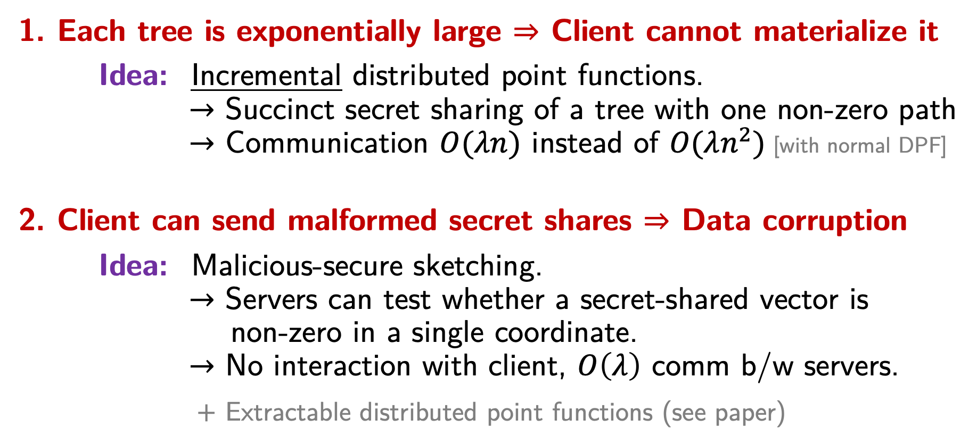
Technical challenges
e.g., when strings are
URLs, locations, passwords
1. Each tree is exponentially large $⇒$ Client cannot materialize it
Idea: Incremental distributed point functions.
$→$ Succinct secret sharing of a tree with one non-zero path
$→$ Communication $O(λn)$ instead of $O(λn^{2})$ [with normal DPF]
2. Client can send malformed secret shares $⇒$ Data corruption
Idea: Malicious-secure sketching.
$→$ Servers can test whether a secret-shared vector is
non-zero in a single coordinate.
$→$ No interaction with client, $O\left(λ\right)$ comm b/w servers.
$+$ Extractable distributed point functions (see paper)

Slide 22



Contribution 1:
Incremental distributed point functions (DPFs)
Each client secret-shares the labels on a tree with one non-zero path and sends one share to each server. Communication ${≈2}^{n}$ ☹
3
2
7
1
0
1
6
8
1
0
1
8
2
4
7
5
2
9
0
1
0
0
=
+
0
0
0
1
0
0
0
0
-2
-1
-7
0
0
-6
-8
Client
String $i$ =
011
$∈{\left\{0,1\right\}}^{n}$
-1
-8
-2
-3
-7
-5
-2
-9

Slide 23



Contribution 1:
Incremental distributed point functions (DPFs)
With incremental DPFs, client only sends each server a short key
For a tree of depth $n$,
and security parameter $λ≈128$,
the keys have size $O(λn)$. ☺
Using standard DPFs would
give keys of size $O(λn^{2})$.
$$KeyGen$$
Client $i$
String $i$ =
011
$∈{\left\{0,1\right\}}^{n}$

Slide 24

Contribution 1:
Incremental distributed point functions (DPFs)
The servers expand the key into shares of a tree, one node at a time
Evaluating the keys on a
path takes $O(n)$ AES ops.
Standard DPFs would
require $O(n^{2}$) AES ops.
9
2
7
3
1
6
8
1
8
2
4
7
5
2
9
-3
0
-3
-3
1
-2
-8
Client $i$
-1
-8
-1
-3
-7
-1
-2
-9

Slide 25
Contribution 1:
Incremental distributed point functions (DPFs)
Construction
Our incremental DPF builds on the DPF of BGI16
Just requires symmetric-key operations (PRG/AES)
The BGI16 DPF already uses a tree structure internally
  Our construction just exposes this structure explicitly

Slide 26

Technical challenges
1. Each tree is exponentially large $⇒$ Client cannot materialize it
Idea: Incremental distributed point functions.
$→$ Succinct secret sharing of a tree with one non-zero path
$→$ Communication $O(λn)$ instead of $O(λn^{2})$ [with normal DPF]
2. Client can send malformed secret shares $⇒$ Data corruption
Idea: Malicious-secure sketching.
$→$ Servers can test whether a secret-shared vector is
non-zero in a single coordinate.
$→$ No interaction with client, $O\left(λ\right)$ comm b/w servers.
$+$ Extractable distributed point functions (see paper)

Slide 27
Contribution 2:
Malicious-secure sketching
Client can send shares of garbage/random values
Servers cannot detect this!
3
2
7
1
0
1
6
8
1
0
1
8
2
4
7
5
2
9
0
1
0
0
=
+
0
0
0
1
0
0
0
0
-2
-1
-7
0
0
-6
-8
Client $i$
String $i$ =
011
-1
-8
-2
-3
-7
-5
-2
-9

Slide 28

Contribution 2:
Malicious-secure sketching
Client can send shares of garbage/random values
Servers cannot detect this!
3
2
7
3
6
1
7
8
1
1
1
6
2
4
7
5
2
9
5
1
9
5
=
+
1
8
9
1
6
2
6
4
0
-1
-6
-1
0
2
-3
Evil client $i$
0
2
7
-3
-1
1
4
-5

Slide 29
Contribution 2:
Malicious-secure sketching
Honest clients send shares of a tree
that has a single “1” at each level
(Each client can only vote for one string)
3
2
7
1
0
1
6
8
1
0
1
8
2
4
7
5
2
9
0
1
0
0
=
+
0
0
0
1
0
0
0
0
-2
-1
-7
0
0
-6
-8
-1
-8
-2
-3
-7
-5
-2
-9

Slide 30
Contribution 2:
Malicious-secure sketching
Honest clients send shares of a tree
that has a single “1” at each level
(Each client can only vote for one string)
Idea: The servers run a protocol
on each client’s key at each layer
to check that this invariant holds.
Protocol checks that servers
hold a secret sharing of a vector
of Hamming weight one.
3
2
7
0
1
6
8
1
8
2
4
7
5
2
9
+
-2
-1
-7
0
0
-6
-8
-1
-8
-2
-3
-7
-5
-2
-9

Slide 31
Contribution 2:
Malicious-secure sketching
Prior work allows testing whether shared vector has Hamming weight 1
– with security against semi-honest servers [BGI16]
– when servers can interact with the client [BBCGI19,ECZB19]
– with additional non-colluding servers [CBM15,APY20]
Our technique has none of these limitations.
Idea:
Convert semi-honest-secure scheme [BGI16] into malicious-secure one.
To do so, we use “algebraic manipulation detection” codes [CDFP08]

Slide 32
Technical challenges
1. Each tree is exponentially large $⇒$ Client cannot materialize it
Idea: Incremental distributed point functions.
$→$ Succinct secret sharing of a tree with one non-zero path
$→$ Communication $O(λn)$ instead of $O(λn^{2})$ [with normal DPF]
2. Client can send malformed secret shares $⇒$ Data corruption
Idea: Malicious-secure sketching.
$→$ Servers can test whether a secret-shared vector is
non-zero in a single coordinate.
$→$ No interaction with client, $O\left(λ\right)$ comm b/w servers.
$+$ Extractable distributed point functions (see paper)

Slide 33
This talk
The private heavy-hitters problem
New tools
  Incremental distributed point functions
  Malicious-secure sketching
Evaluation

Slide 34
This talk
The private heavy-hitters problem
New tools
  Incremental distributed point functions
  Malicious-secure sketching
Evaluation

Slide 35

Implementation
Roughly 3,500 lines of Rust
  Our open-source implementation:
  github.com/henrycg/heavyhitters
  Google’s C++ implementation of incremental DPF:
  github.com/google/distributed_point_functions
Experimental setup
Servers on opposite sides of U.S.
  Amazon EC2 us-east-1 (VA) and us-west-1 (CA)
Simulated clients in us-east-1
Each server is one c4.8xlarge (36 vCPU, 60 GiB RAM)

Slide 36
Incremental DPFs save computation
Succinct sketches
[MDC15]
Standard DPF
Incremental DPF
(this work)

Slide 37
Incremental DPFs save communication
Standard DPF
Incremental DPF
(this work)

Slide 38
Total cost is manageable for latency-tolerant applications
Searching for top-900 heavy hitters, 256-bit strings
(Strings sampled from Zipf distribution with parameter 1.03 and support 10k. Two c4-8xlarge communicating over WAN.)
Clients | Computation | Bandwidth
100k | 13.8 mins | 06.5 GB
200k | 27.2 mins | 13.1 GB
400k | 53.8 mins | 26.2 GB
Completely parallelizable

Slide 39
Lightweight Techniques for Private Heavy Hitters
With 400,000 clients, server-side computation
takes less than one hour over WAN.
Privacy against malicious server, correctness against malicious clients
→ MPC-style privacy guarantee (not local differential privacy)
New techniques
  More powerful distributed point functions: incremental & extractable (see paper)
  Tools for malicious security in systems using secret sharing
  Application to other private data-collection problems (see paper)
Paper: https://eprint.iacr.org/2021/017
Code: https://github.com/henrycg/heavyhitters

