Slide 1
Zero-Knowledge Proofs on Secret-Shared Data via Fully Linear PCPs
Dan Boneh | Elette Boyle | Henry Corrigan-Gibbs | Niv Gilboa | Yuval Ishai
Stanford | IDC Herzliya | Stanford | Ben-Gurion University | Technion

Slide 2
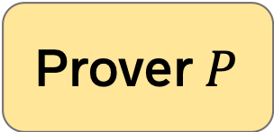
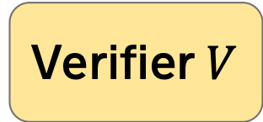
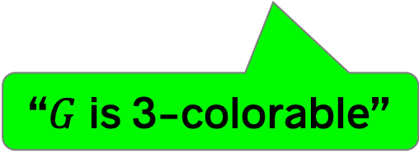

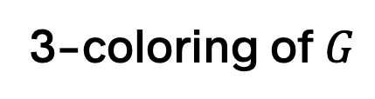

Review
Zero-knowledge proofs
[GMR89]
Prover $P$
Verifier $V$
3-coloring of $G$
$$G$$
“$G$ is 3-colorable”
Complete. Honest $P$ convinces honest $V$.
Sound. Dishonest $P^{∗}$ rarely fools honest $V$.
ZK. Dishonest $V^{∗}$ learns only that $G∈3COL$.
→ $V_{ }^{∗}$ learns nothing else about $G$

Slide 3

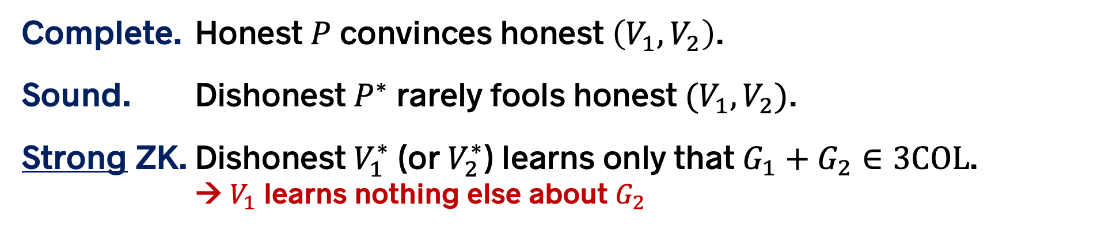

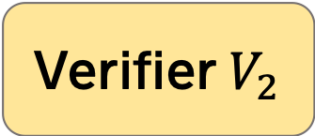

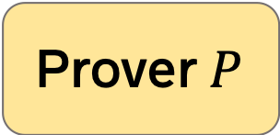
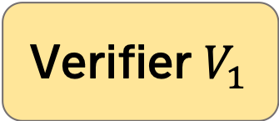
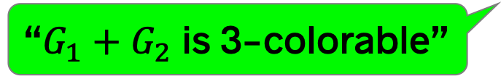
This paper
Zero-knowledge proofs on distributed data
Verifier $V_{1}$
Prover $P$
$$G_{1}$$
Verifier $V_{2}$
3-coloring
of $G_{1}+G_{2}$
“$G_{1}+G_{2}$ is 3-colorable”
$$G_{2}$$
Complete. Honest $P$ convinces honest $\left(V_{1},V_{2}\right)$.
Sound. Dishonest $P^{∗}$ rarely fools honest $(V_{1},V_{2})$.
Strong ZK. Dishonest $V_{1}^{∗}$ (or $V_{2}^{∗}$) learns only that $G_{1}+G_{2}∈3COL$.
→ $V_{1}$ learns nothing else about $G_{2}$

Slide 4
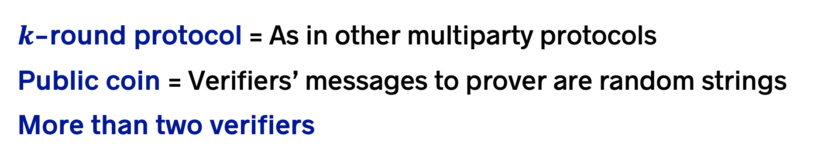
This paper
Zero-knowledge proofs on distributed data
Verifier $V_{1}$
Prover $P$
$$G_{1}$$
Verifier $V_{2}$
3-coloring
of $G_{1}+G_{2}$
“$G_{1}+G_{2}$ is 3-colorable”
$$G_{2}$$
$k$-round protocol = As in other multiparty protocols
Public coin = Verifiers’ messages to prover are random strings
More than two verifiers

Slide 5

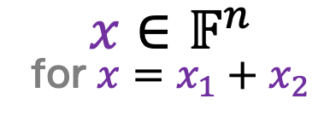


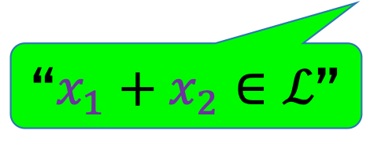
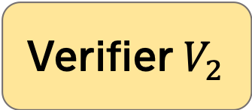
Special case
Zero-knowledge proofs on secret-shared data
Language $ℒ⊆𝔽^{n}$, for finite field $𝔽$.
Verifier $V_{1}$
$$x_{1}∈𝔽^{n}$$
Prover
$$x∈𝔽^{n}$$
for $x=x_{1}+x_{2}$
Verifier $V_{2}$
$$x_{2}∈𝔽^{n}$$
“$x_{1}+x_{2}∈ℒ$”

Slide 6

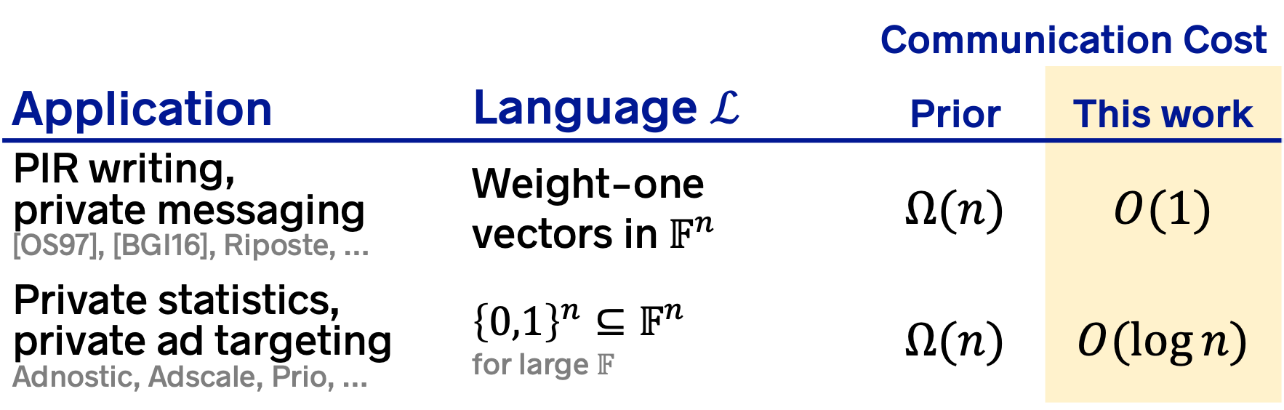
ZK proofs on distributed data
Applications and prior implicit constructions
 |  | Communication Cost
Application | Language $ℒ$ | Prior | This work
PIR writing, private messaging [OS97], [BGI16], Riposte, … | Weight-one vectors in $𝔽^{n}$ | $$Ω(n)$$ | $$O(1)$$
Private statistics, private ad targeting Adnostic, Adscale, Prio, … | $${\left\{0,1\right\}}^{n}⊆𝔽^{n}$$ for large $𝔽$ | $$Ω(n)$$ | $$O(\log{n})$$
Used in the Firefox
browser
Also: New application to malicious-secure MPC.

Slide 7




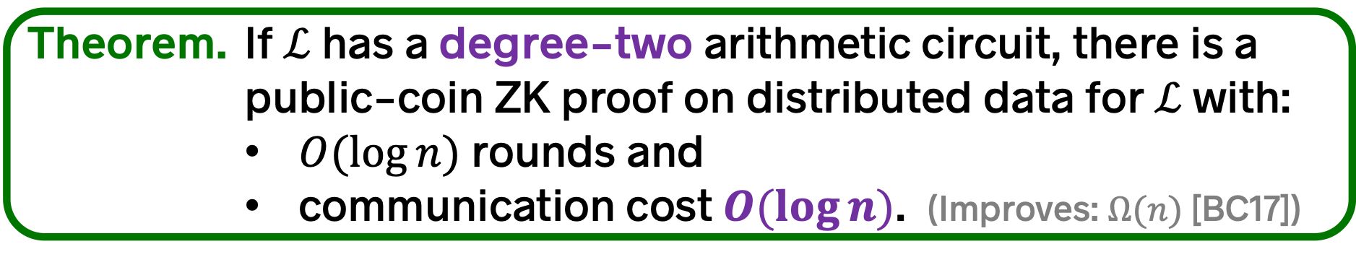
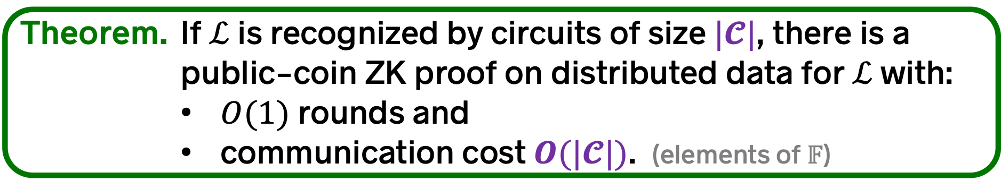
Selected results: New ZK proofs
Let $𝔽$ be a finite field. Let $ℒ⊆𝔽^{n}$ be a language. ($n≪𝔽$)
Theorem. If $ℒ$ is recognized by circuits of size $|𝓒|$, there is a
public-coin ZK proof on distributed data for $ℒ$ with:
        $O(1)$ rounds and
        communication cost $O(|𝓒|)$. (elements of $𝔽$)
Our proofs apply to a much larger class of “structured” languages (see paper)
Circuits with degree $O(1)$ or repetition or …
Theorem. If $ℒ$ has a degree-two arithmetic circuit, there is a
public-coin ZK proof on distributed data for $ℒ$ with:
        $O(\log{n})$ rounds and
        communication cost $O(\log{n})$. (Improves: $Ω(n)$ [BC17])
Generalizes special-purpose schemes. [CB17]
Non-trivial extension to setting in which prover and some verifiers collude.
$$k$$
$$n^{O\left(1/k\right)}$$

Slide 8
This talk
ZK proofs on distributed data
Fully linear PCPs
Application: Three-party computation

Slide 9
This talk
ZK proofs on distributed data
Fully linear PCPs
Application: Three-party computation

Slide 10
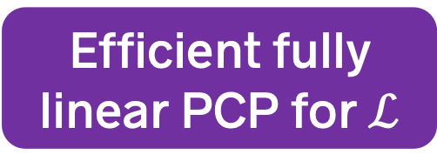
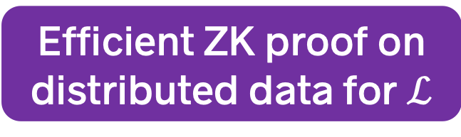
Constructing ZK proofs on distributed data
Step 1. Define “fully linear PCPs”
  A strengthening of linear PCPs [IKO07]
  We then show:
Step 2. Construct new fully linear PCPs
Efficient fully linear PCP for $ℒ$
implies
Efficient ZK proof on distributed data for $ℒ$

Slide 11
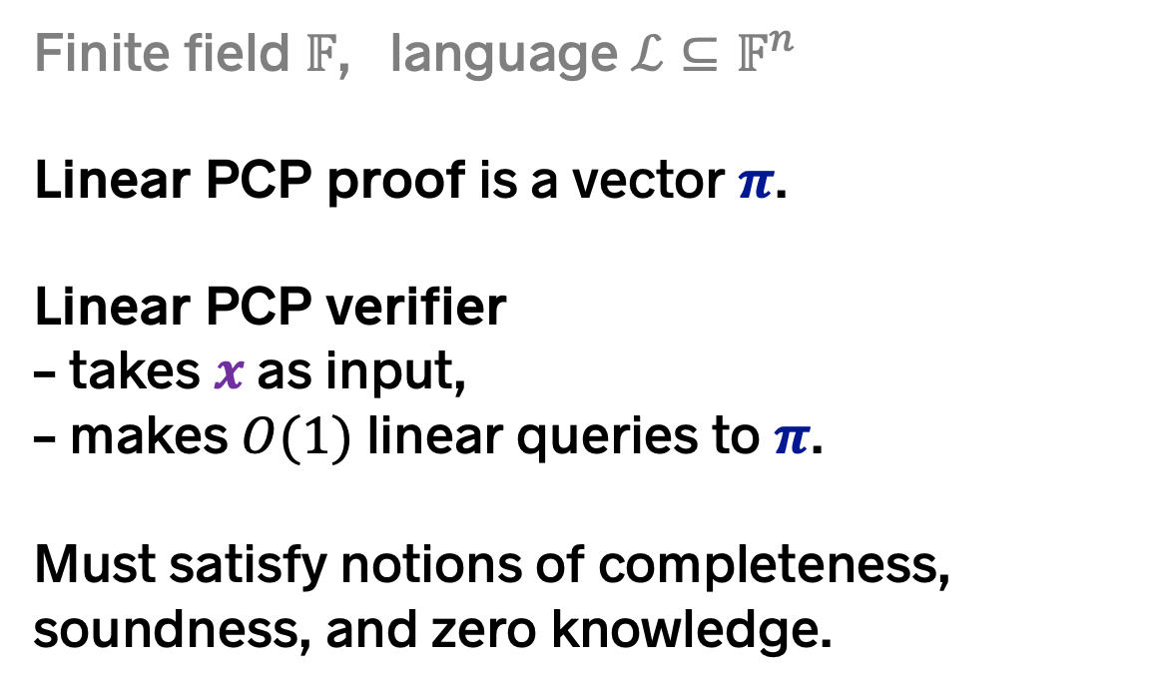
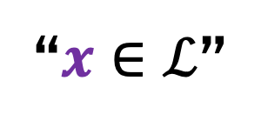
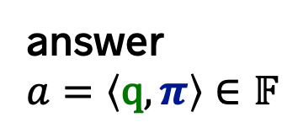
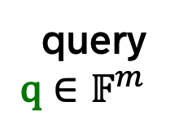


Linear probabilistically checkable proofs (PCPs) [IKO07]
Finite field $𝔽$, language $ℒ⊆𝔽^{n}$
Linear PCP proof is a vector $π$.
Linear PCP verifier
– takes $x$ as input,
– makes $O(1)$ linear queries to $π$.
Must satisfy notions of completeness, soundness, and zero knowledge.
$$π∈𝔽^{m}$$
query
$$\text{q}∈𝔽^{m}$$
answer
$$a=\left\langle \text{q},π\right\rangle ∈𝔽$$
LPCP Verifier
$$x∈𝔽^{n}$$
“$x∈ℒ$”

Slide 12

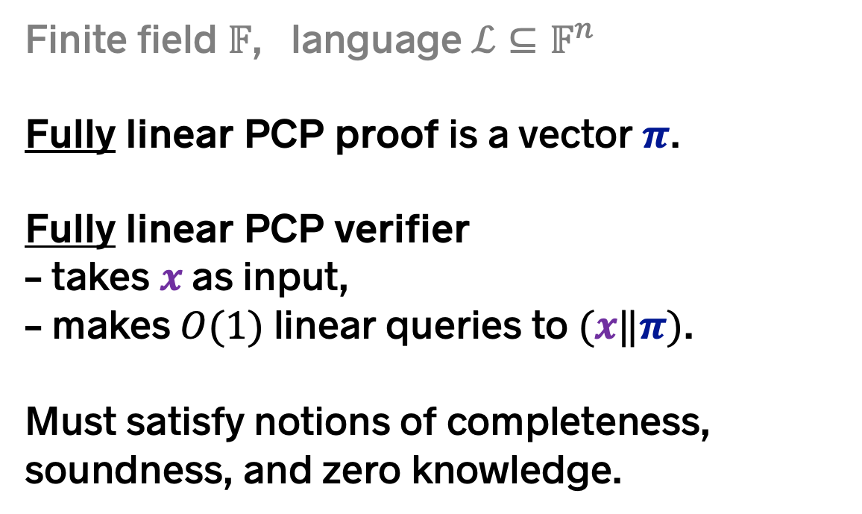

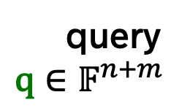

Fully linear probabilistically checkable proofs (PCPs)
[This work]
Finite field $𝔽$, language $ℒ⊆𝔽^{n}$
Fully linear PCP proof is a vector $π$.
Fully linear PCP verifier
– takes $x$ as input,
– makes $O(1)$ linear queries to $(x‖π)$.
Must satisfy notions of completeness, soundness, and zero knowledge.
$$x∈𝔽^{n}$$
$$π∈𝔽^{m}$$
query
$$\text{q}∈𝔽^{n+m}$$
answer
$$a=\left\langle \text{q},x‖π\right\rangle ∈𝔽$$
FLPCP Verifier
“$x∈ℒ$”

Slide 13



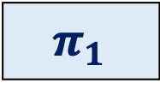



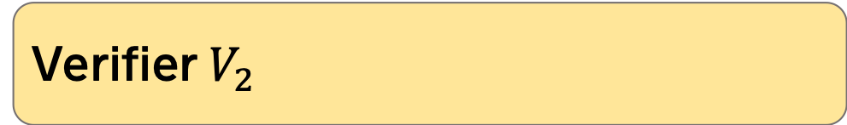
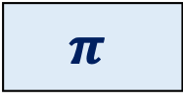

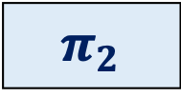
If language $ℒ$ has an efficient fully linear PCP, it has an efficient ZK proof on distributed data.
1. Generate FLPCP proof and split it using secret sharing.
Verifier $V_{1}$
$x_{1}$ $∈𝔽^{n/2}$
Prover
$${ π}_{1}$$
$$+$$
$$\left(x_{1}‖x_{2}\right)∈ℒ$$
$${ π}_{2}$$
$$=$$
Verifier $V_{2}$
$x_{2}$ $∈𝔽^{n/2}$
$${ π}_{ }$$

Slide 14
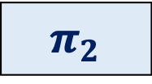
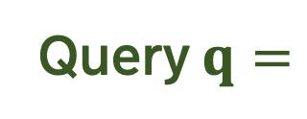


If language $ℒ$ has an efficient fully linear PCP, it has an efficient ZK proof on distributed data.
2. Sample query vectors using common randomness.
Verifier $V_{1}$
$x_{1}$ $∈𝔽^{n/2}$
$${ π}_{1}$$
Query $q=$
$5 \left| 1 \right| 2 | 7 | 4$ $| 9$
Verifier $V_{2}$
$x_{2}$ $∈𝔽^{n/2}$
$${ π}_{2}$$

Slide 15
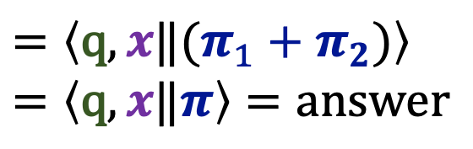

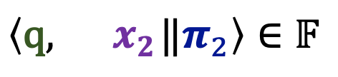
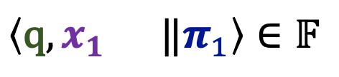
If language $ℒ$ has an efficient fully linear PCP, it has an efficient ZK proof on distributed data.
3. Publish shares of query answers and reconstruct.
Verifier $V_{1}$
$x_{1}$ $∈𝔽^{n/2}$
$${ π}_{1}$$
$$\left\langle \text{q},x_{1} ‖π_{1}\right\rangle ∈𝔽$$
$$=\left\langle \text{q}, {x‖(π}_{1}+π_{2})\right\rangle$$
$$=\left\langle \text{q},x‖π\right\rangle =answer$$
$$+$$
$$\left\langle \text{q},{ x}_{2}‖π_{2}\right\rangle ∈𝔽$$
Verifier $V_{2}$
$x_{2}$ $∈𝔽^{n/2}$
$${ π}_{2}$$

Slide 16
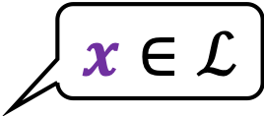
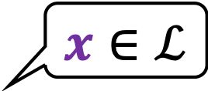
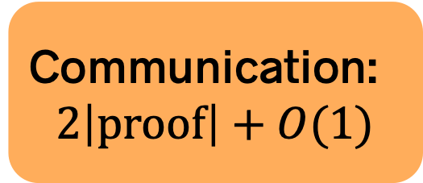
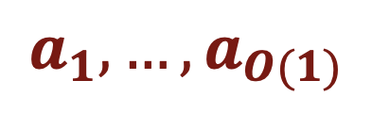
If language $ℒ$ has an efficient fully linear PCP, it has an efficient ZK proof on distributed data.
4. Recover $O\left(1\right)$ query answers, run FLPCP verifier.
Verifier $V_{1}$
$$x∈ℒ$$
$x_{1}$ $∈𝔽^{n/2}$
$${ π}_{1}$$
Communication:
$$2\left|proof\right|+O(1)$$
$$a_{1}, …, a_{O(1)}$$
Verifier $V_{2}$
$$x∈ℒ$$
$x_{2}$ $∈𝔽^{n/2}$
$${ π}_{2}$$

Slide 17
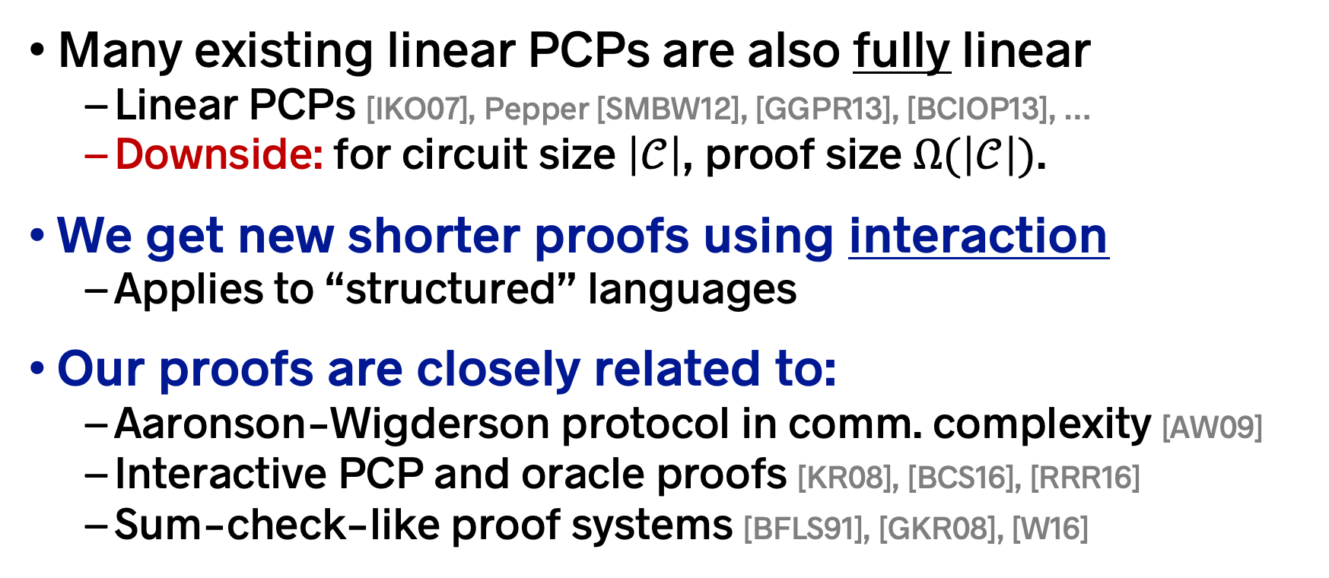
Fully linear PCPs: Constructions
Many existing linear PCPs are also fully linear
  Linear PCPs [IKO07], Pepper [SMBW12], [GGPR13], [BCIOP13], …
  Downside: for circuit size $\left|𝒞\right|$, proof size $Ω(\left|𝒞\right|)$.
We get new shorter proofs using interaction
  Applies to “structured” languages
Our proofs are closely related to:
  Aaronson-Wigderson protocol in comm. complexity [AW09]
  Interactive PCP and oracle proofs [KR08], [BCS16], [RRR16]
  Sum-check-like proof systems [BFLS91], [GKR08], [W16]

Slide 18

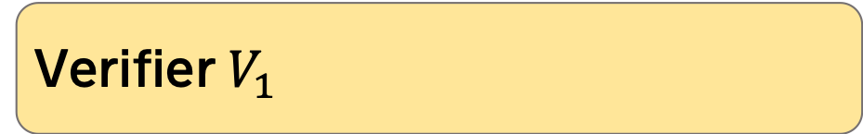


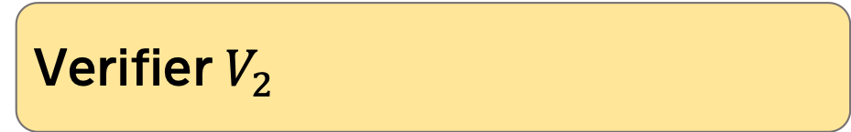

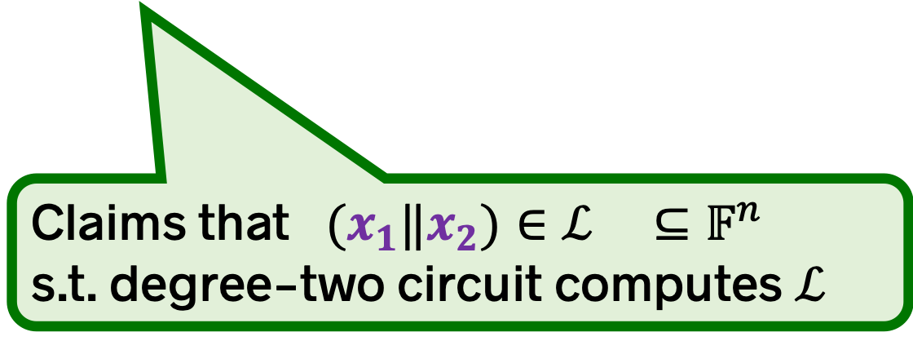
Short proofs for degree-two circuits
Verifier $V_{1}$
$x_{1}$ $∈𝔽^{n/2}$
$${ π}_{1}$$
Prover
$${ π}_{2}$$
Verifier $V_{2}$
$x_{2}$ $∈𝔽^{n/2}$
Claims that $(x_{1}‖x_{2})∈ℒ ⊆𝔽^{n}$
s.t. degree-two circuit computes $ℒ$

Slide 19


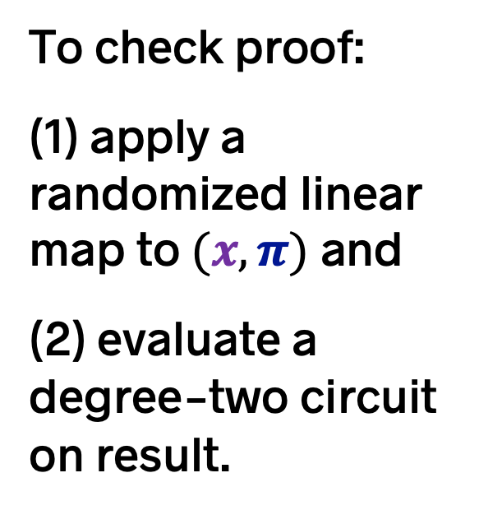
Short proofs for degree-two circuits
Verifier $V_{1}$
$x_{1}$ $∈𝔽^{n/2}$
$${ π}_{1}$$
To check proof:
(1) apply a randomized linear map to $(x,π)$ and
(2) evaluate a degree-two circuit on result.
Prover
Verifier $V_{2}$
$x_{2}$ $∈𝔽^{n/2}$
$${ π}_{2}$$

Slide 20


Short proofs for degree-two circuits
Verifier $V_{1}$
$x_{1}$ $∈𝔽^{n/2}$
$${ π}_{1}$$
Linear map
Prover
$x_{1}′$ $∈𝔽^{n/4}$
Apply locally
Verifier $V_{2}$
$x_{2}$ $∈𝔽^{n/2}$
$${ π}_{2}$$
Linear map
$x_{2}′$ $∈𝔽^{n/4}$

Slide 21
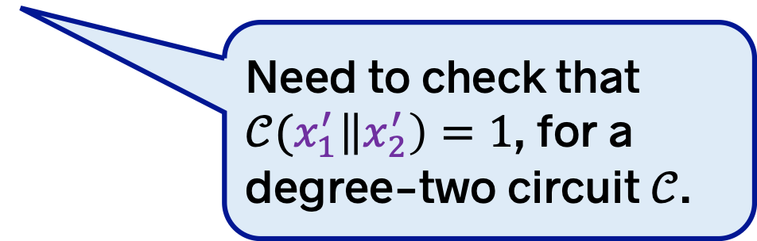


Short proofs for degree-two circuits
Verifier $V_{1}$
$x_{1}′$ $∈𝔽^{n/4}$
Need to check that $𝒞(x_{1}^{′}\left\|x_{2}^{′}\right)=1$, for a degree-two circuit $𝒞$.
Prover
Verifier $V_{2}$
$x_{2}′$ $∈𝔽^{n/4}$
Send coins to prover.
Invoke proof system recursively.

Slide 22
This talk
ZK proofs on distributed data
Fully linear PCPs
Application: Three-party computation

Slide 23
This talk
ZK proofs on distributed data
Fully linear PCPs
Application: Three-party computation

Slide 24
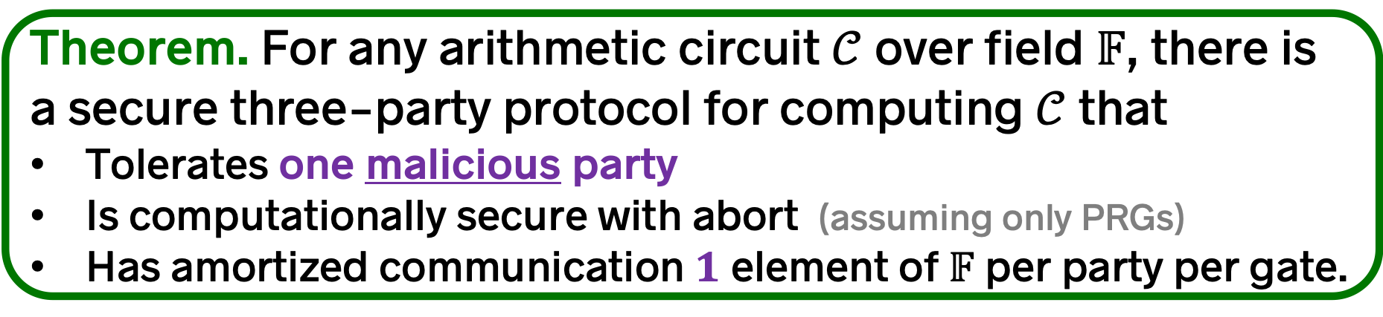
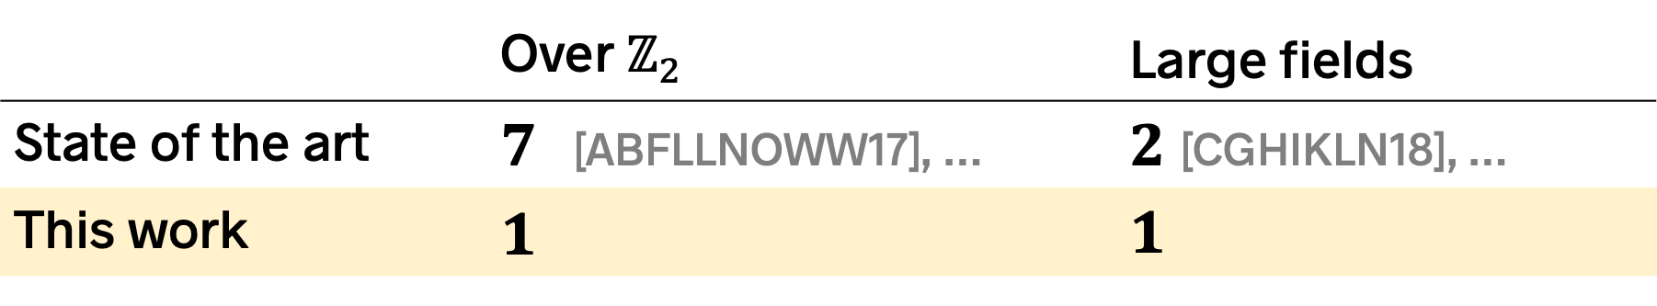
Our results: Application to MPC
Theorem. For any arithmetic circuit $𝒞$ over field $𝔽$, there is a secure three-party protocol for computing $𝒞$ that
Tolerates one malicious party
Is computationally secure with abort (assuming only PRGs)
Has amortized communication $1$ element of $𝔽$ per party per gate.
 | Over $ℤ_{2}$ | 0Large fields
State of the art | $7$ [ABFLLNOWW17], … | 0$2$ [CGHIKLN18], …
This work | $$1$$ | 0$1$
Matches cost of
best 3PC with
semi-honest security [AFLNO16]

Slide 25


We use a semi-honest MPC protocol $Φ$ that has two extra properties…
Protocol reveals nothing until the last message.
– Holds even if some parties are malicious.
– Malicious behavior at last message can only cause abort.
Checkable by a degree-two relation.
Each of player $i$’s messages is a degree-two function of:
    player $i$’s input and
    the messages that player $i$ has received so far.
Can instantiate with existing protocols: [AFLNO16], [KKW18], …

Slide 26

Overview of 3PC our protocol
1. Run semi-honest MPC protocol $Φ$
Player 2
Player 1
Players halt before publishing the last protocol message
Player 3

Slide 27


Overview of 3PC our protocol
2. Prove that messages complied with $Φ$
Player 2
Player 1
This is a ZK proof on distributed data:
Messages that player 1 sent are split across players 2 and 3
The language is recognized by a degree-two circuit
“The messages I sent you both observed the protocol $Φ$”
Player 3

Slide 28

Overview of 3PC our protocol
2. Prove that messages complied with $Φ$
Player 2
“The messages I sent you both observed the protocol $Φ$”
Player 1
Player 3

Slide 29

Overview of 3PC our protocol
2. Prove that messages complied with $Φ$
Player 2
Player 1
Possible with our new ZK proofs on distributed data for degree-two relations
Communication:
$O(log\left|𝒞\right|)$ per player
Player 3

Slide 30
Overview of 3PC our protocol
3. Reveal last message to recover output
Player 1
Dealer
Player 2

Slide 31

Summary of our three-party protocol
Communication cost per player (field elements)
Messages from $Φ$ $\left|𝒞\right|+o(|𝒞|)$
Proofs $O(\log{|𝒞|)}$
TOTAL $\left|𝒞\right|+o(\left|𝒞\right|)$
…per gate: $1 + o(1)$
Generalizations: [See paper]
– to $O(1)$-parties with honest majority
– to arbitrary rings $ℤ_{2^{k}}$

Slide 32

Comparison to GMW compiler [GMW87]
Like GMW, our compiler converts:
Semi-honest $Φ$ $→$ Malicious-secure $Φ$
Differences:
GMW uses “message-by-message” ZK proofs.
We use one big (but sublinear-size) proof at the end.
GMW requires assumptions/commitments.
Our compiler is information theoretically secure.
GMW requires that all players see all messages (broadcast channel).
With distributed ZK, can use point-to-point channels.

Slide 33
Summary: ZK proofs on distributed data
One prover, multiple verifiers, each with different input
  Protocol hides verifiers’ inputs from each other
Proofs are information theoretic and lightweight
New key tool: Fully linear proof systems
  Can unify with sum-check-based proofs? [GKR08], [CTY11], [T16], …
Applications: MPC, privacy-preserving systems, …
  Also to other models of distributed proof? [KOS18], [NPY18], …
Dan Boneh, Elette Boyle, Henry Corrigan-Gibbs, Niv Gilboa, Yuval Ishai
https://eprint.iacr.org/2019/188

