Slide 1



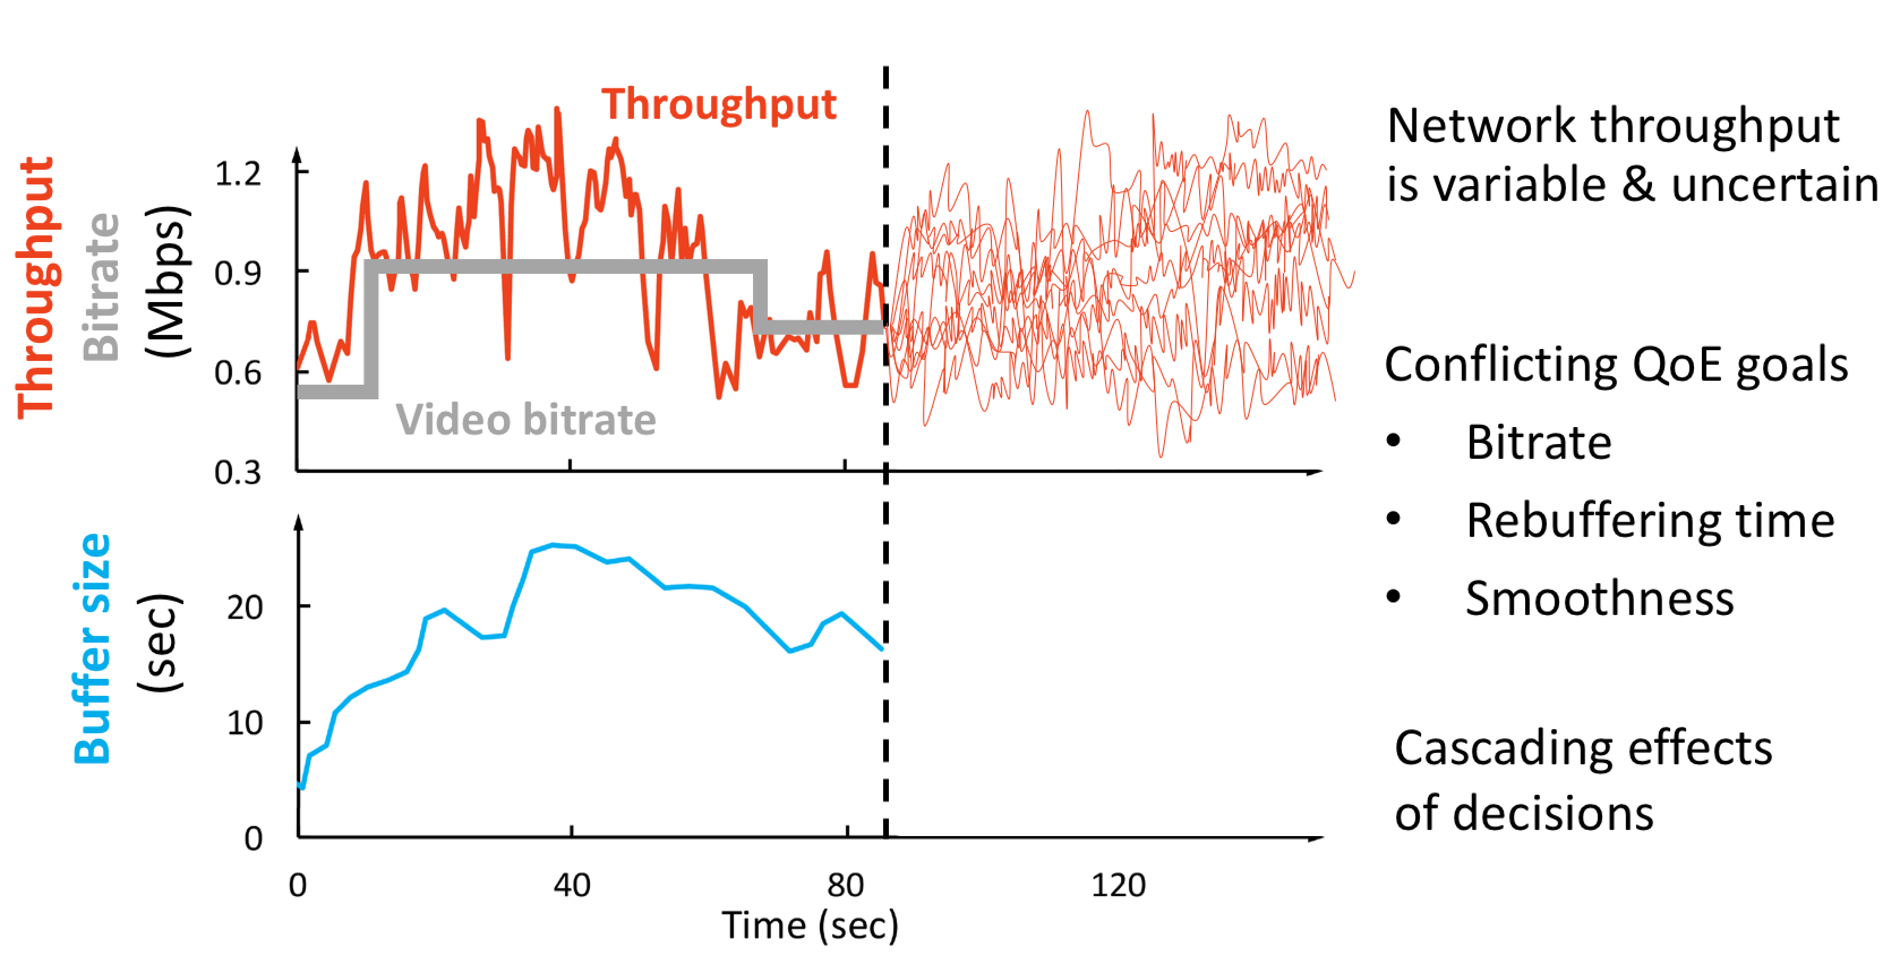
Real-world Video Adaptation with Reinforcement Learning
Hongzi Mao¹², Shannon Chen², Drew Dimmery², Shaun Singh², Drew Blaisdell², Yuandong Tian², Mohammad Alizadeh¹, Eytan Bakshy²
MIT Computer Science and Artificial Intelligence Laboratory¹ Facebook²
Background
RL setup for video bitrate adaptation
Video bitrate adaptation (720P, HD, 4K, etc.)
Adapt the bitrates based on network and video conditions
Goal: maximize video quality, minimize stalls
Policy Network Architecture
Variance Reduction
For each bitrate, the input feature is fed to a copy of the same policy network. We then apply a softmax layer for all the outputs from the policy network to compute the probability distribution of actions. This architecture can generalize to videos with arbitrary bitrate encodings
Input-driven MDP, where an exogenous, stochastic process significantly affects the system dynamics
When the input process is independent with the action, we can use an “input-dependent” baseline to reduce variance
Operationally, repeat the same network and watch time trace to compute baseline during training in simulator
Reward Shaping with Bayesian Optimization
Policy Translation
Translate the learned policy into linear policy
Trade-off performance for interpretability
Directly train RL on linear policy doesn’t work well
Experiment
On slow networks, where the bitrate adaptation task is harder, ABRL improves video quality by 5.9%, with 2.4% fewer stalls
In a week-long world-wide deployment on Facebook’s web based video platform with 30 million video sessions, ABRL improves the video quality by 1.6%, reduces the stall by 0.4%

