Slide 1



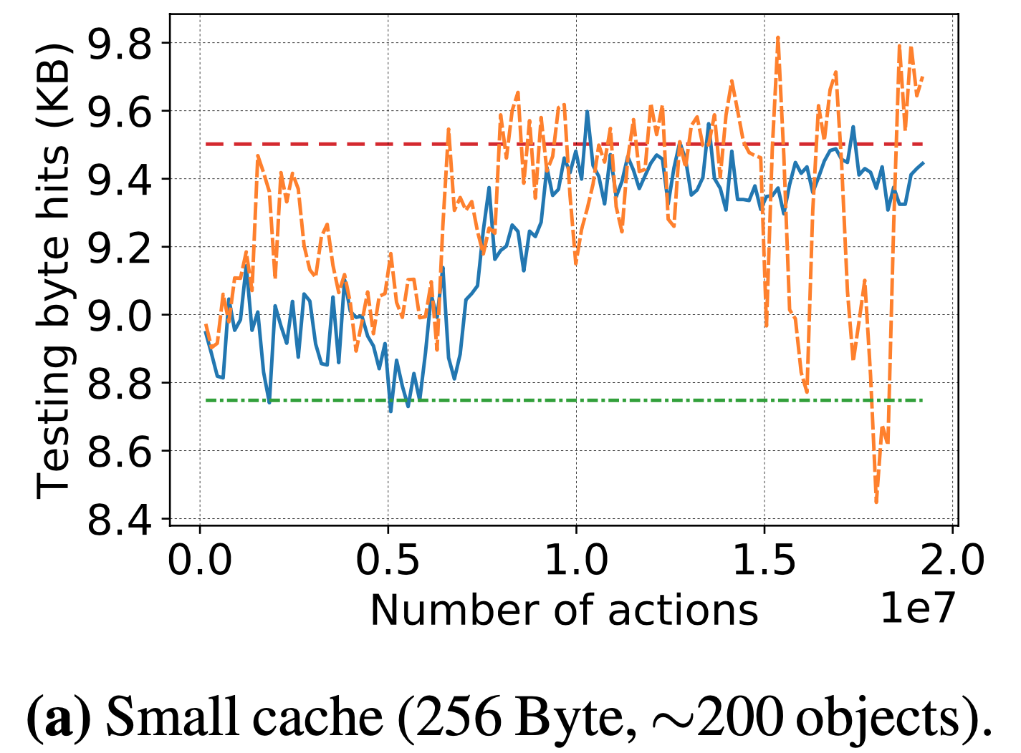
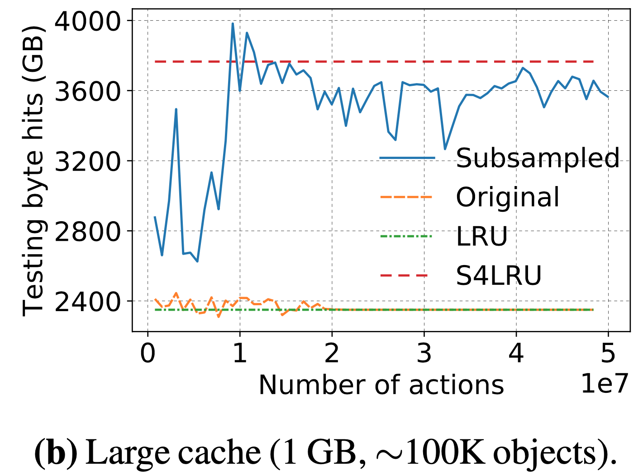
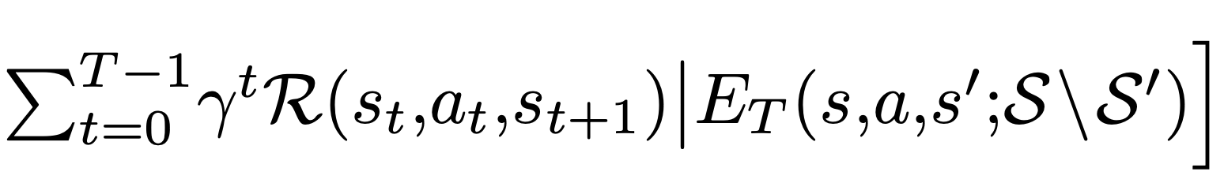
Learning Caching Policies with Subsampling
Haonan Wang, Hao He, Mohammad Alizadeh, Hongzi Mao
MIT Computer Science and Artificial Intelligence Laboratory
Motivation
Challenges
Why learning approach for caching policies?
Large caches significantly delay the reward feedback
  Typical CDN caches are hundreds of GBs (hosts many millions of objects)
  Reward feedback are 100× longer than normal RL applications (e.g., AlphaGo only deals with MDPs of < 400 steps)
Handcrafting optimal policy can be tedious
Object size distribution/arrival pattern changes
Optimize for different objectives (e.g., minimize overwrites for SSD based caches)
Problem setup
RL with subsampling
Cache admission setting (LRU for eviction)
State: size of incoming object, steps since last object visit, object total visit count, remaining cache size
Action: admit/drop
Reward: total byte hits since last action
Step: proceed until next cache miss
Subsample trace by hashing on object ID
Reduce the cache size proportionally
→ The caching statistics remains unchanged
Train RL on reduced caching problem (with small cache and subsampled trace)
Generalize the policy to larger problem (normalize remaining cache size to [0, 1]
Experiment
Theoretical Analysis
State transition:
Reward function:
As a reference, directly training RL on small cache (both subsampled and original) reaches state-of-the-art performance
For large caches, only subsampled RL can successfully train

