Slide 1


Park: An Open Platform for Learning-
Augmented Systems
Hongzi Mao
October 29, 2019
Park: An Open Platform for Learning-Augmented Computer Systems. H. Mao, P. Negi, A. Narayan, H. Wang, J. Yang, H. Wang, R. Marcus, R. Addanki, M. Khani, S. He, V. Nathan, F. Cangialosi, S. Venkatakrishnan, W. Weng, S. Han, T. Kraska, M. Alizadeh. Neural Information Processing Systems (NeurIPS), 2019.
Notes:
I’m gonna present “Park: an open platform for learning-augmented systems”. This talk is based on a paper to appear at NeurIPS this year. So this work is about building a benchmarking dataset for applying machine learning especially reinforcement learning to computer systems. It’s a collaboration joined by 15 other folks at MIT.

Slide 2
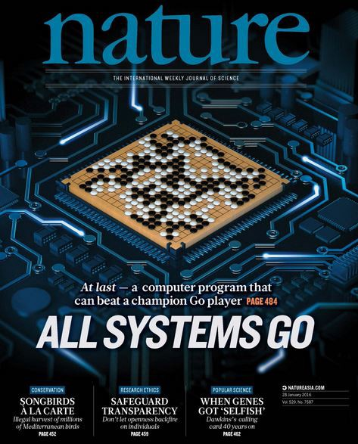
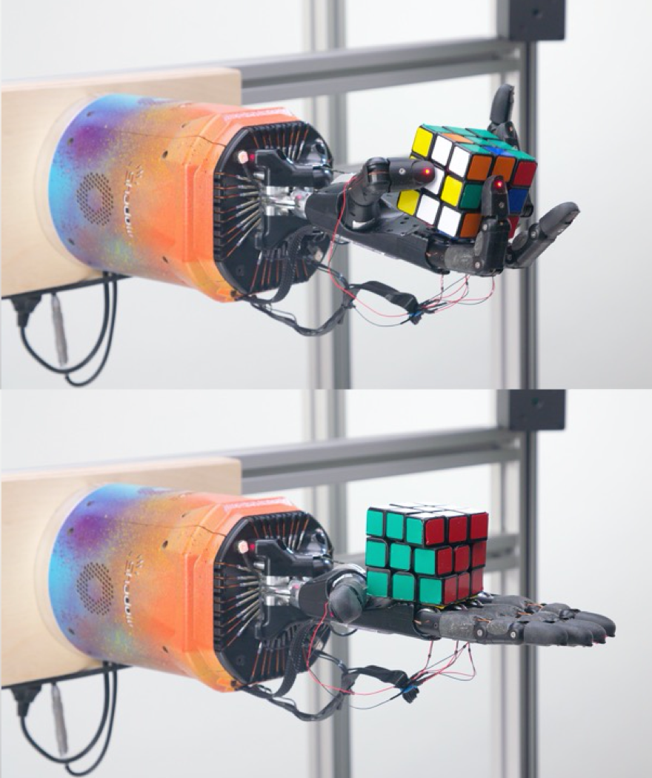
Reinforcement Learning in Controlled Settings
Game of Go
Starcraft
Robotic manipulation
Notes:
So we probably all heard many impressive and successful stories of deep reinforcement learning these few years. For example, RL algorithms developed by Deepmind has defeated human champions in board games like go or real time strategy games like Starcraft. Also, just very recently, OpenAI has trained a robotic arm to manipulate and solve a rubik’s cube.
But despite all the success, I think it’s reasonable to say RL so far has been largely limited to controlled settings. For settings like well simulated games or in-lab robotics. Compared to those settings, we rarely see RL being applied and deployed to some real world control systems.

Slide 3
Computer Systems: Natural Arena for RL
Full of sequential decision-making processes
Hard to model, currently rely on human-engineered heuristics
Abundant amount of data in software systems
Direct real benefit
Notes:
So this work aims to help apply RL to real-world computer systems. This is a relatively unexplored area for modern reinforcement learning, certainly not as popular as applying RL to robotics.
Now just at a high level, why do we think applying RL to computer systems is a sensible direction to explore. You have seen some research work in this session, but there is a broader conceptual motivation for this direction.
-
First of all, many control problems in computer systems have a natural flavor of sequential decision-making process. They can fit into the markov decision process framework suitable for RL. For example, for congestion control, packets arrive in a stream, each packet provides a piece of observation data for the network, and the receiver can decide how the next packet should be sent. This naturally is a sequential decision process. And many systems naturally have this kind of sequential model
-
Also, real world systems are hard to model accurately. Most state-of-the-art system controllers rely on human-engineered heuristics, which develop over simplified models. This potentially leaves significant room for improvement. Also, these heuristics sometimes are pretty complex, for example, a commercial database query optimizer can have many hundreds of parameters, tuning those heuristics for different workloads and systems are tedious. A general purpose learning solution that can adapt to different environments is a more scalable solution.
-
Now, unlike physical systems like you have to assemble and maintain robots, most software systems are already running with commodity hardware and collecting data is relatively cheap. The cost of experiment is cheaper and experiment most of the time can be faster. Compared to physical systems, this largely mitigate the high sample complexity problem of reinforcement learning.
-
Lastly, the benefit can directly translate into performance improvement or cost saving if we learn a better controller.

Slide 4
RL in Computer Systems
A surge of research work:
Datacenters: job scheduling (SIGCOMM 19), device placement (ICLR 18)
Networking: congestion control (ICML 19), video adaptation (SIGCOMM 17)
Databases: query optimization (VLDB 19), index structure (SIGMOD 18)
Ongoing industrial push:
Smart Choices (ICML 19)
Facebook Horizon (ICML 19)
Notes:
So because of all these benefits, we have witnessed some of the early work on applying RL to systems. There are both academic and industrial push on this direction. Just on this session today, you have seen Ryan presented a work on query optimization and Ravi talked about his work on tensorflow device placement. But despite the conceptual attraction and some ongoing research work, the area isn’t as popular as many other machine learning branches yet.

Slide 5
Common Platform for Benchmarking is Missing
Bridge RL community to focus on algorithmic development
Allow easy deployment of RL controllers in real systems
Compare different RL algorithms in common ground
Notes:
We want to facilitate machine learning research in computer systems. One major obstacle we believe, is a lack of common benchmark for comparing different solutions and a lack of easy-to-use platform to develop new RL algorithms in computer systems.
So if you think about it, the spring of machine learning in computer visions and other areas like health care, they thrived on large scale, well-labeled dataset.
Unlike those datasets of fixed data, RL for systems require interaction between a learning-based controller and a dynamical systems that provides feedback based on how a controller takes actions. It’s really a source of live data. You really need to run a real system or a realistic simulators to interact with the learning aglrotihms.
We know machine learning people want to avoid the overhead of building a complex computer system, and system people want to just test and really use robust ML models in a real system.

Slide 6
Park: An Open Platform
12 system environments for networking, databases, distributed systems, …
Contains real system and simulation
Interact with the system with a standard API
Notes:
To make the research easier in this direction, we build an open platform.
This platform uses a single API to connect between an RL controller and the underlying computer systems.
To develop new RL algorithms, the researchers just need to implement an agent object in python. The interface will invoke the agent whenever the system requests a control action. Through this interface, the system provides observation data for the agent. The agent is stateful, it can save the experience data for training as it is replying the system for what action to take.
The interface communicates with the underlying system with remote procedure calls. So the underlying systems live in a different process and can be written in different languages.
[.]
Along with this platform, we open sourced 12 system environments. So we hacked real systems to expose control to the RL agent through this RPC. These systems span different areas in networking and distributed systems, things like congestion control, database query optimization, caching, load balancing and so on. There are also both simulators and real systems in the dataset.
In terms of its functionality, this platform is somewhat similar to OpenAI gym but for computer system environments.

Slide 7
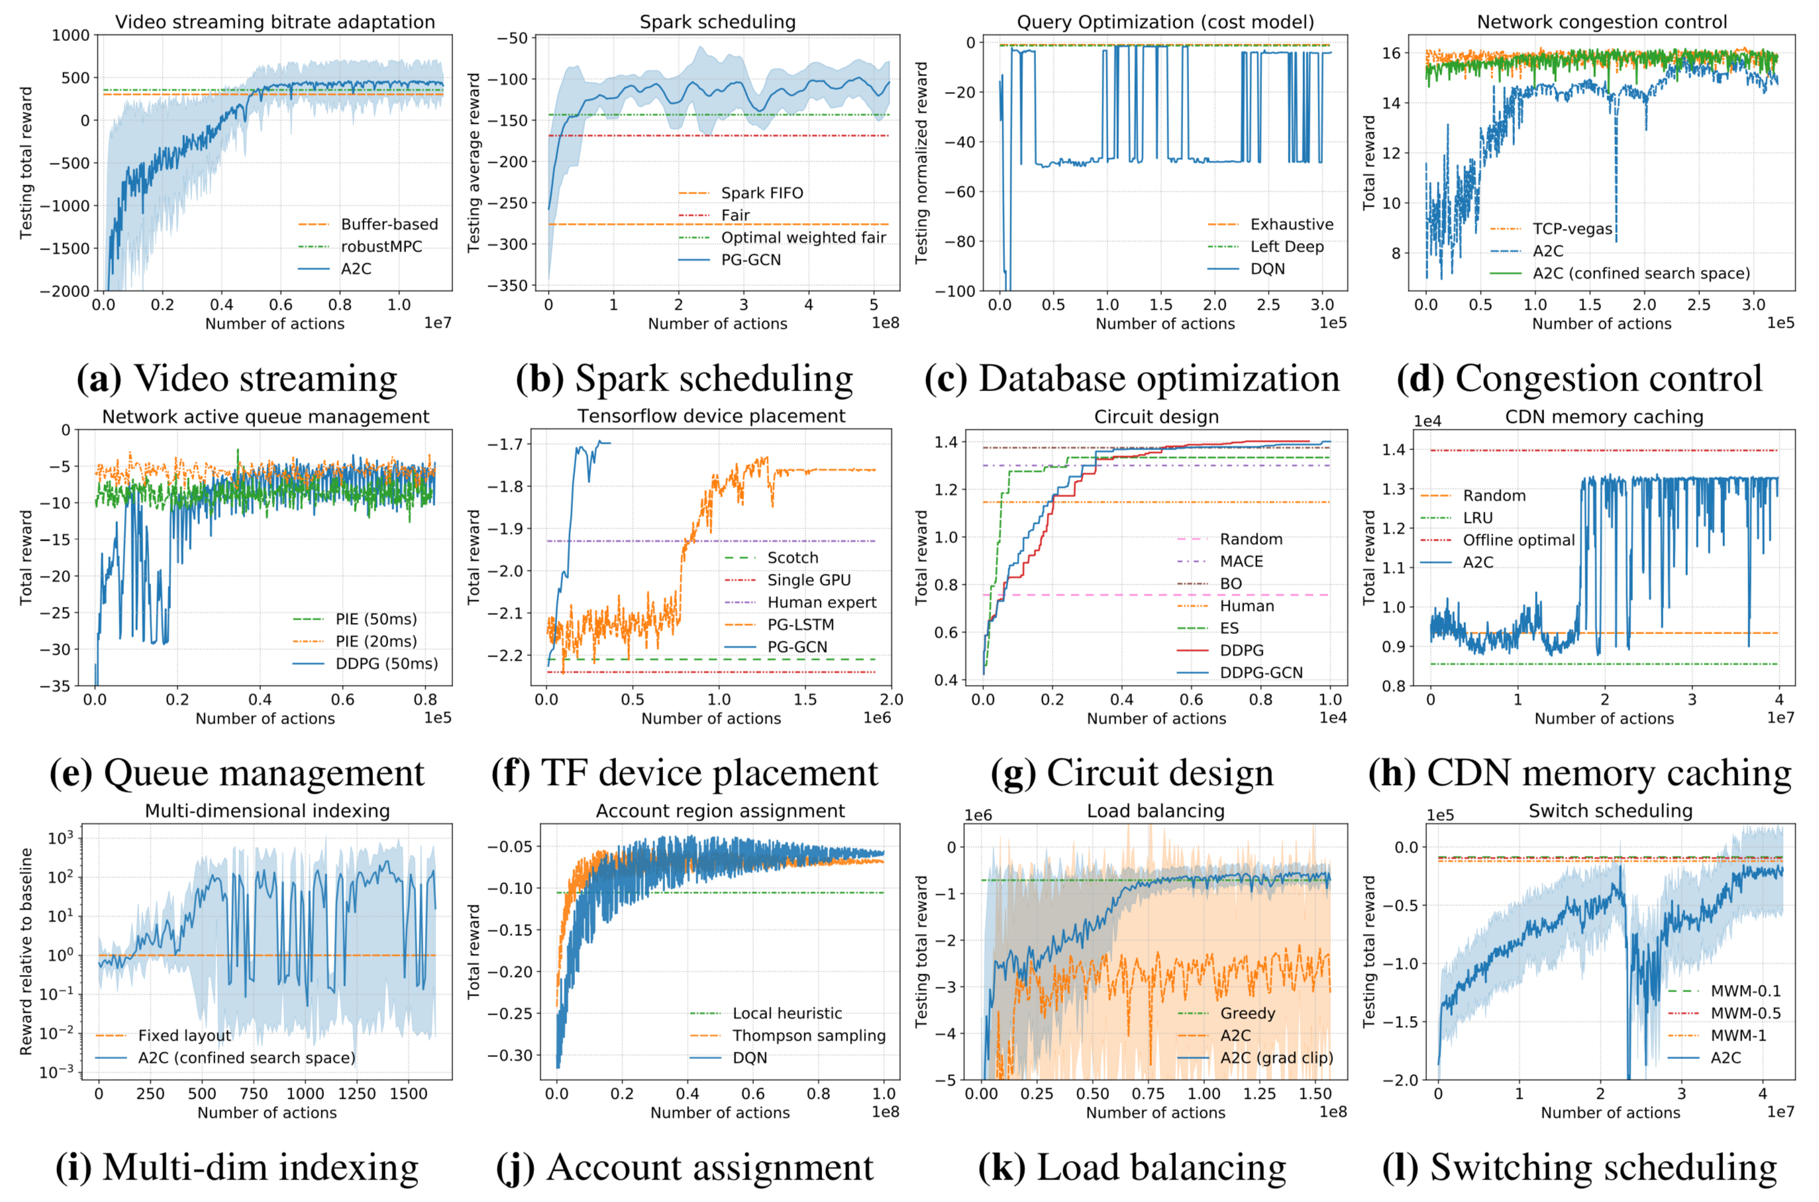
Existing RL Algorithms on Park
Notes:
And for each environment, we run some standard reinforcement learning algorithms. This set of plots are the learning curves of each environment. This is like a sanity check of our code. For each environment, over time the learning algorithm will improve the performance
By no means that those problems are all solved by existing RL methods. For many systems, the learning algorithms actually underperforms existing heuritics. And sometimes, we actually have to largely reduce the problem size to make reinforcement learning algorithms even feasible to run. There are many challenges for the system problems.

Slide 8
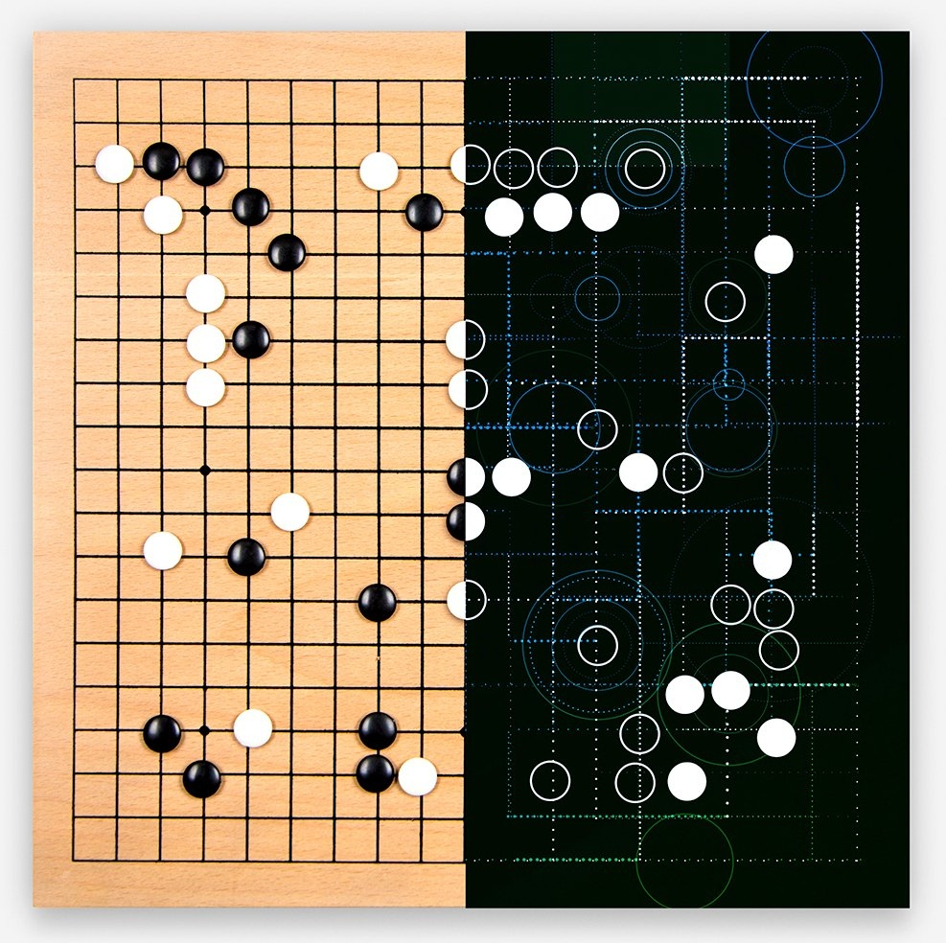
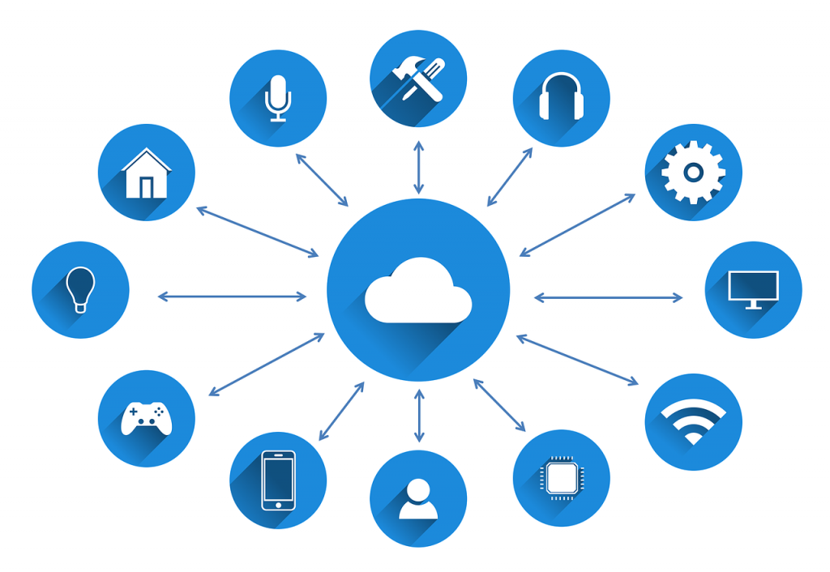
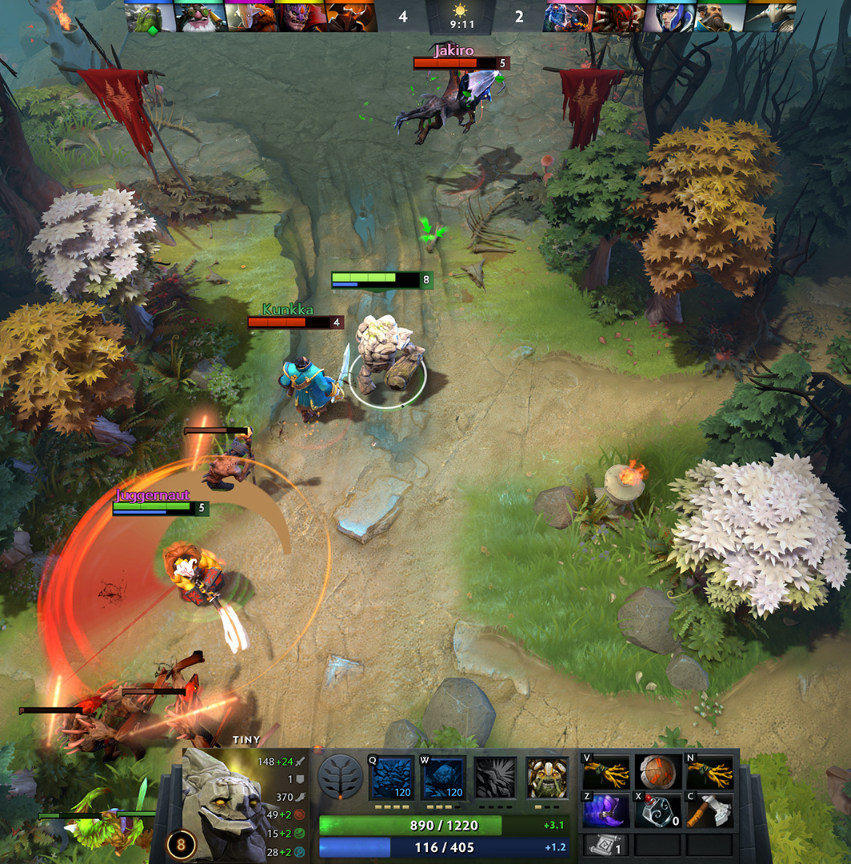
Challenges
Extremely long delay in reward feedback
CDN cache: each reward delays
> millions of steps
Game of Go: <400 steps
Dota 2: 80,000 steps
Learning Caching Policies with Subsampling. H. Wang, H. He, M. Alizadeh, H. Mao. NeurIPS Machine Learning for Systems Workshop, 2019.
Notes:
[Why is it hard - platform makes it easy to play with the environment. Zoom in the results more. More "applications" of this platform.]
Let me just give a few examples that we can foresee.
First is a problem about delayed reward for an action. It’s known that reinforcement learning is increasingly difficult if the reward delay is long, because by the time the reward feedback arrives, the RL agent would have taken many actions. It is hard to assign credit to an action if the reward is delayed for many steps.
Now, for applications that we successfully applied state of the art reinforcement learning techniques, like game of Go, each game will last for at most less than 400 steps, because the entire board is 19 by 19. For larger problems, like playing dota, the game lasts for about 80 thousand steps.
But system problems, the reward delay sometimes can be very long. Caching is an example. For CDN caches, which stores popular objects for a CDN network, the cache size can easily be hundreds of Gigabytes. This means the cache can store over many millions of objects. Now on average, each object will be hit again in the cache after some millions of other object request. If we use object hit as the reward, each reward signal will be delayed for millions of steps on average. This delay is orders of magnitude longer than any of the current RL applications
So dealing with delayed reward in general can be very tricky. For this CDN caching problem in this Park platform, we have a preliminary solution of using subsampling. Because of the time I can’t go into details but there is a workshop paper to appear also at NeurIPS this year.

Slide 9
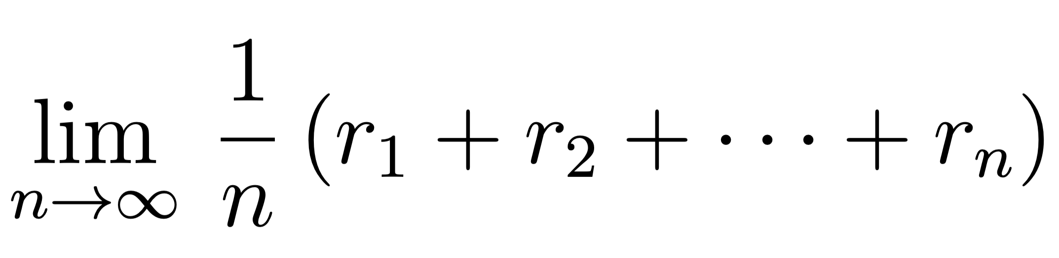
Challenges
Infinite horizon
γ^{n}
γ²
r_{t}
r_{t+1}
r_{t+2}
…
r_{t+n}
γ
r_{t}
r_{t+1}
r_{t+2}
…
r_{t+n}
Discounted reward formulation
Average reward formulation
Notes:
Another example, is infinite horizon problem. Unlike RL for games, sometimes there isn’t really an end of episode for system problems. Many systems like scheduling or load balancing, the controller is designed to sit at the system forever. It doesn’t really have an end.
For those problem, we might need to think carefully for how we aggregate the reward signal through the steps.
You know, currently people focus mostly on the discounted reward formulation, which basically counts the reward in the far future as less important than the reward in the near future. But this might not be the right formulation for long running systems. A scheduler might send some job to finish in the future and some other jobs to finish sonner, but the job completes in the future might be equally important as the job completes now.
So if we think about it, actually in the beginning of RL formulation, there are two branches of the framework. One is this discounted framework that’s being used a lot. The other one is an average reward formulation. We might want to explore more on the other branch for these system problems.

Slide 10
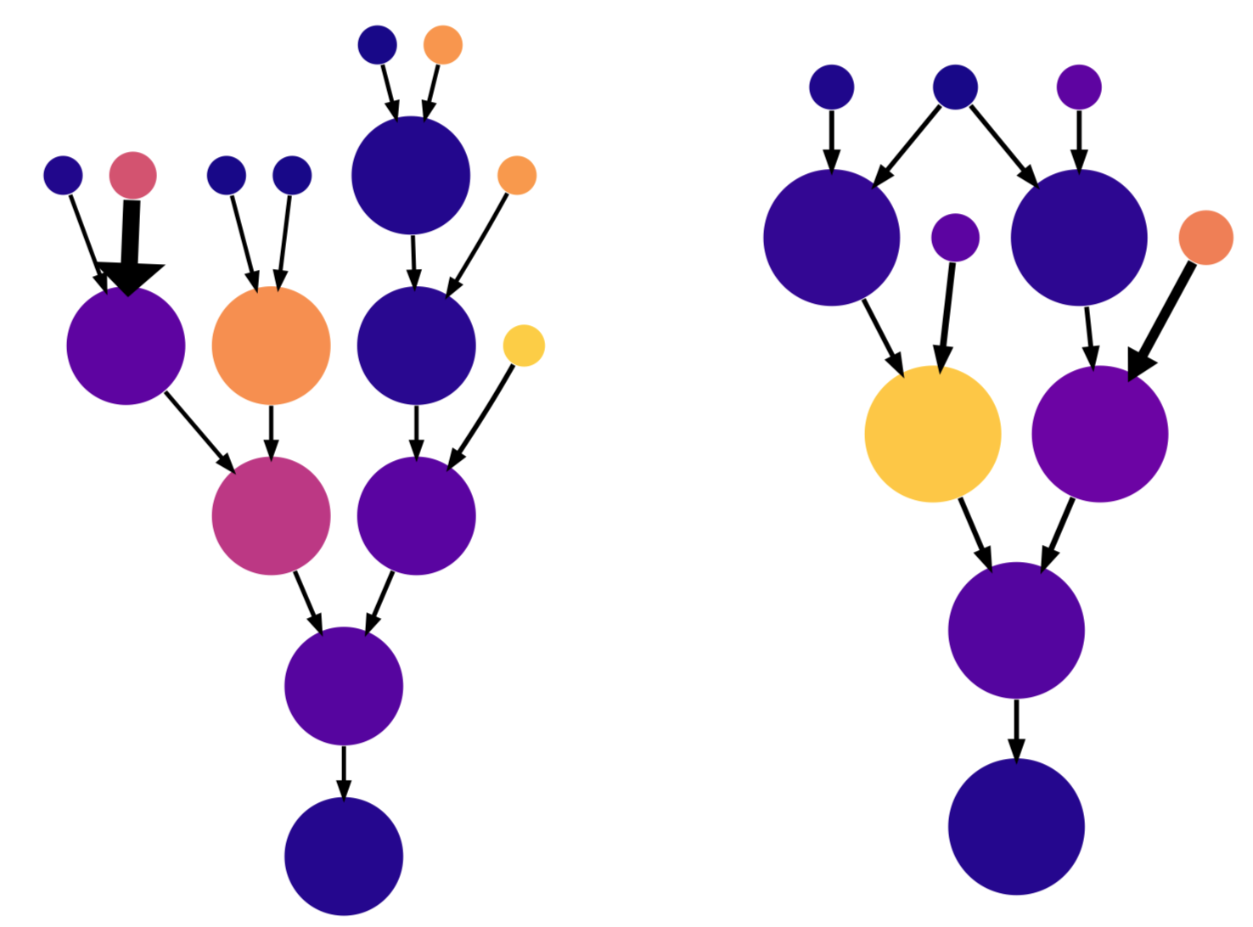
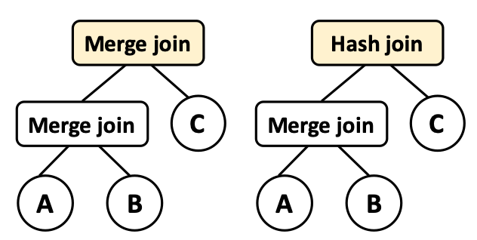
Challenges
Representation of states and actions
Spark job scheduling
Database query optimization
Tensorflow device placement
Learning Scheduling Algorithms for Data Processing Clusters. H. Mao, M. Schwarzkopf, S. Venkatakrishnan, Z. Meng, M. Alizadeh. SIGCOMM, 2019.
Neo: A Learned Query Optimizer. R. Marcus, P. Negi, H. Mao, C. Zhang, M. Alizadeh, T. Kraska, O. Papaemmanouil, N. Tatbul. VLDB, 2019.
Placeto: Efficient Progressive Device Placement Optimization. R. Addanki, S. Venkatakrishnan, S. Gupta, H. Mao, M. Alizadeh. NeurIPS, 2019.
Notes:
For many system problems, encoding the state observation efficiently is the key to learn strong and generalizable RL controllers.
For example, many of the problems have this graph encoding of information. For job scheduling, many computation jobs are represented as directed acyclic graphs, where each node is a computation stage and the edge is data dependency. Similar structure shows up in database query optimization and tensorflow device placement.
For those problems, we use variants of graph neural network to process those graph state inputs. And we show, especially this device placement problem, that graph neural network naturally encodes the state information, because it aligns with the problem structure and can empirically generalize much better than other ways of naïve state encoding like traversing through all nodes without naturally capturing the topology information
Figuring out an efficient way of state representation for different systems can be an interesting challenge.

Slide 11
Challenges
Representation of states and actions
IN
OUT
Switch scheduling
Notes:
Finding an efficient representation for the action space sometimes can also be challenging.
For example, in Park, we have a switch scheduling problem. It is about output a matching between input port and output port so that the packet throughput is maximized over a period of time. The possible mapping is exponentially large as we grow the number of input and output ports.
For naïve encoding, if we just ask the agent to directly output the mapping, the action space will be exponentially large because it has to contain every single possible mapping. Btw, in our benchmarking experiment for existing RL, we have to reduce the problem to a toy problem of 3 by 3 switch so that the action space is manageable. For practical switch can easily have over one hundred ports. Efficiently encoding the action space is a challenging task.

Slide 12
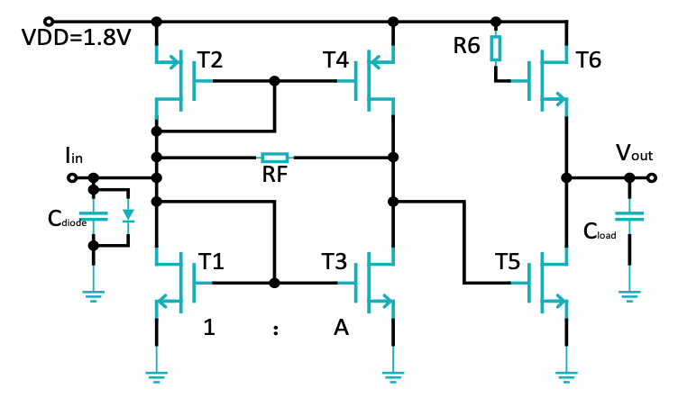
Challenges
Needle-in-a-haystack problem
Sender
Receiver
Circuit design
Network congestion control
Learning to Design Circuits. H. Wang, J. Yang, H.-S. Lee, S. Han. NIPS Machine Learning for Systems Workshop, 2018.
Notes:
Lastly, I want to highlight this needle-in-a-haystack problem. For some systems, most of the state space doesn’t provide a gradient or difference in the reward signal for exploration. This means the outcome for reward is indifferent in most of the state space. This type of feedback is not meaningful to do gradient descent based training.
Circuit design can be an example. If the RL agent output a circuit that is invalid, which can happen quite frequently in general if the circuit is large, there is no electric current running the circuit. In these cases, the reward you receive will be equally bad. In that case, the RL agent doesn’t have a gradient in the reward feedback to update its circuit generation policy.
Network congestion control can also be an example, although this is a very different system applications. So the agent might send the network packets faster than network capacity, so the packets keeps being dropped at the queue. Now, the agent has to keep the sending rate small, for multiple, consecutive steps, in order to drain the queue. Only after the queue is drained or significantly reduced, I receive a difference in the reward for the improvement of packet delay. Before this happens, in between these conservative actions, once the agent chooses to be aggressive, which happens easily for random exploration, the queue builds up again and the agent receive indifferent low rewards. Learns to keep action consistent for multiple steps can be difficult for random exploration if the feedback does not provide a meaningful signal.
So efficient learning for these problems require us to design smarter exploration process. One possible solution is to try relying on some prior knowledge for systems to guide the agent for exploration.

Slide 13
Summary
Park builds an open platform that uses a single API to connect to 12 computer system environments
Many systems expose unique challenges that need new RL algorithms
Park repo: https://github.com/park-project/park
Notes:
So as a quick summary, through park we build an open platform that uses a single API to connect to 12 representative computer system problems that you can develop RL or other machine learning algorithms to optimize.
Many of these systems contain unique challenges that may require new learning algorithms.
More information and open sourced code can be found in this website.
Thank you.

