Slide 1



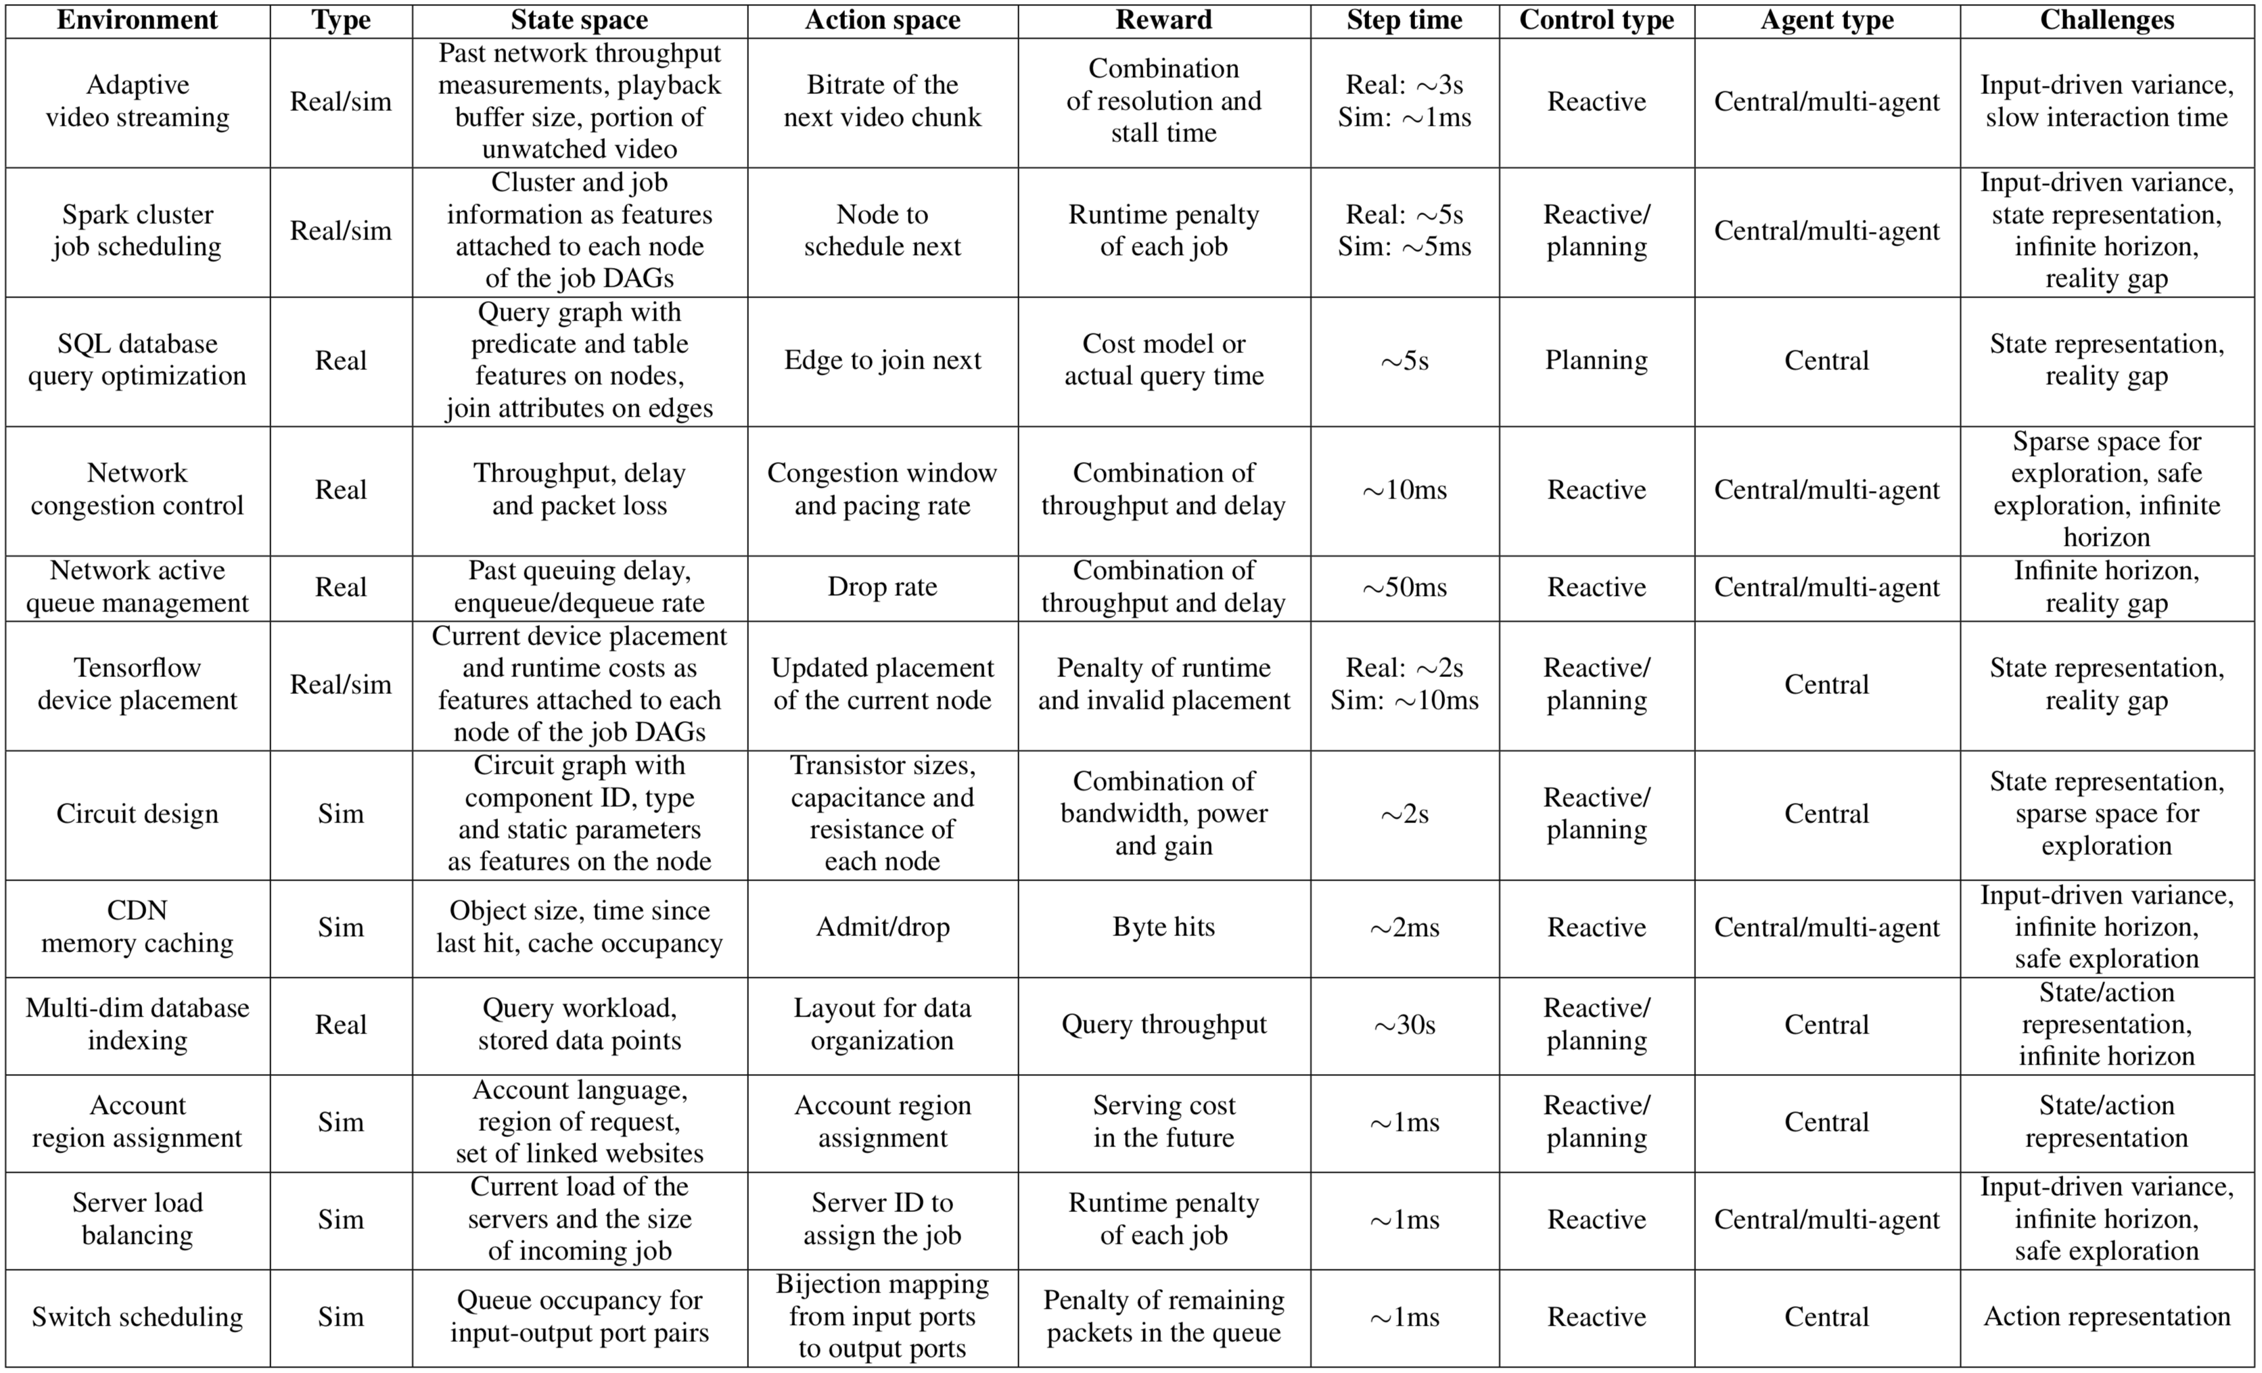
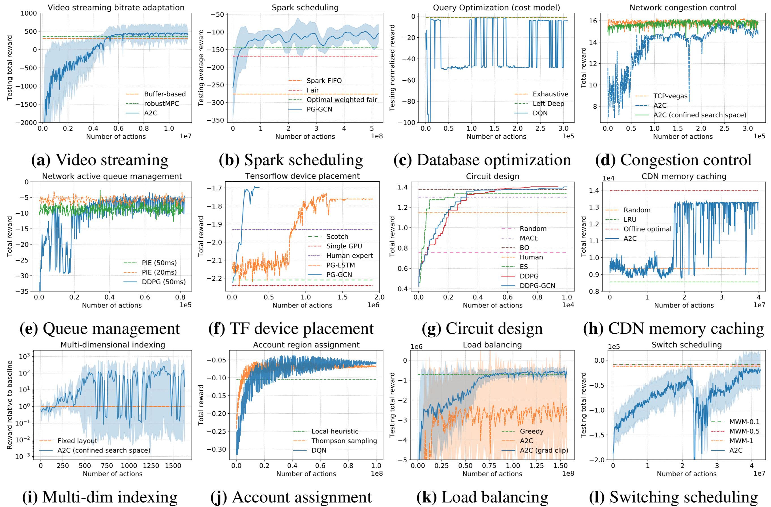
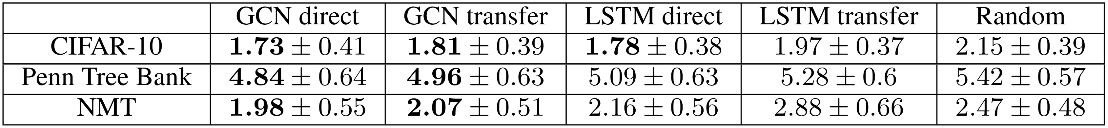
Park: An Open Platform for Learning-Augmented Computer Systems
Hongzi Mao, Parimarjan Negi, Akshay Narayan, Hanrui Wang, Jiacheng Yang, Haonan Wang, Ryan Marcus, Ravichandra Addanki, Mehrdad Khani, Songtao He, Vikram Nathan, Frank Cangialosi, Shaileshh Bojja Venkatakrishnan, Wei-Hung Weng, Song Han, Tim Kraska, Mohammad Alizadeh
MIT Computer Science and Artificial Intelligence Laboratory
Motivation
Sequential Decision Making Problems in Computer Systems
Computer systems are full of MDPs
Software systems are cheap to generate data
Small improvements translate to huge gains
Unique challenges that require new RL methods
Human-engineered schemes are often sub-optimal
Park
Wide range of problems in computer systems
  operating systems, networking, distributed systems, databases, hardware designs, …
Different problem settings
  Fast reactive control loop vs. long-term planning
  Centralized control vs. multi-agent distributed control
Challenges
Benchmark Experiments
State-action space
  The needle-in-the-haystack problem
  Representation of state-action space
Decision process
  Infinite horizon problem
  Stochasticity in MDP
  causing huge variance
Reality gap

