Slide 1
CSR: Core Surprise Removal in Commodity Operating Systems
Noam Shalev Technion
Eran Harpaz Technion
Hagar Porat Technion
Idit Keidar Technion
Yaron Weinsberg IBM Research
April 6, 2016 ASPLOS 2016 Atlanta, Georgia.

Slide 2
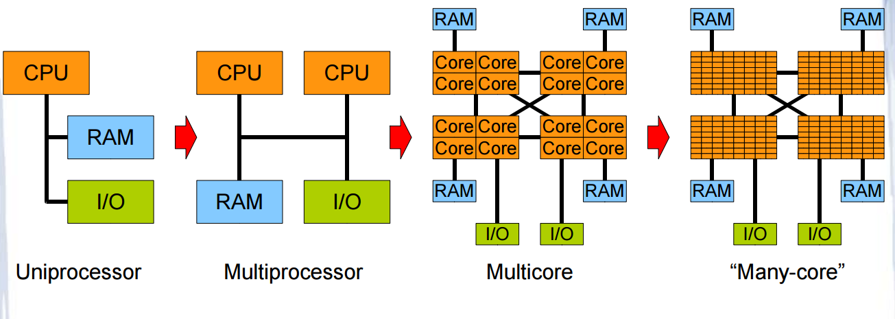
Motivation
Technology scaling
Many-core architecture is here
Machines with a thousand cores are subject to research [TERAFLUX, 2014]

Slide 3
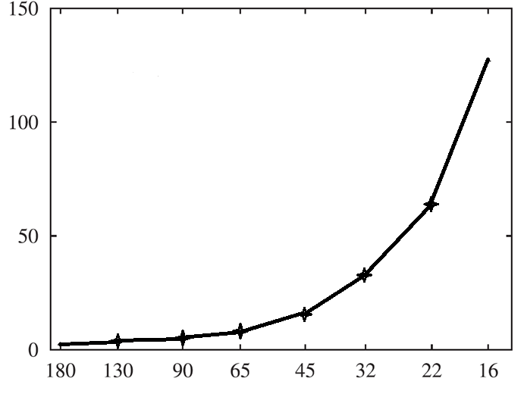
Motivation
Technology scaling
Nano scale phenomena
Hardware reliability decreases [Radetzki et al., 2013]
Faults more likely
Relative Failure Rate
Technology Node (nm)

Slide 4
Motivation
Core failures can no longer be ruled out [Srinivasan et al. 2004]
More
Cores
Less
Reliability

Slide 5
Motivation
What happens today?

Slide 6
Contributions
A strategy for overcoming Core Surprise Removal (CSR)
Objective – keep the system alive following a core fault
Easily integrate into existing operating systems

Slide 7
Contributions
A strategy for overcoming Core Surprise Removal (CSR)
Objective – keep the system alive following a core fault
Easily integrate into existing operating systems
Implementation in the Linux kernel.
Use Hardware Transactional Memory to cope with failures in critical kernel code
Provide a proof of concept on a real system.
CSR

Slide 8
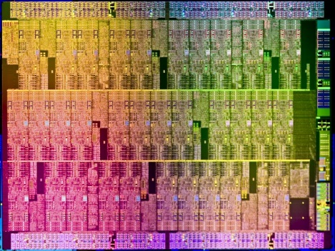
Fault Model (1/2)
Chip Multi-Processor System
Reliable shared memory
Fault-prone cores
Reliable Failure Detection Unit (FDU) [Weis et al. ,2012]
Halts execution of the faulty core
Flush L1 upon failure detection
Reports to OS.

Slide 9
Fault Model (2/2)
Fail-Stop Model
Faulty core stops executing from some point onward
Registers and buffers are unavailable
L1 Cache data is flushed upon failure [Giorgi et al., 2014].
Core
Core
Core
Core
Core
Core
Core
Core
L1
L1
L1
L1
L1
L1
L1
L1
L2 Cache
L2 Cache
L2 Cache
L2 Cache
L3 Cache
Reliable Shared Memory

Slide 10
CSR – Recovery Strategy
Flag as faulty
Treat it as offline, and never Hot-plug it again
Reset interrupt affinities
Handle lost interrupts, migrate IPI queue
Migrate tasklets, work-queues
Update kernel services
RCU subsystem, performance events, etc.
Terminate the running process
Free its resources
Migrate processes.
CSR
OS dependent

Slide 11
CSR – Recovery Strategy
Flag as faulty
Reset interrupt affinities
Migrate tasklets, work-queues
Update kernel services
Terminate the running process
Migrate processes.
What about cascading failures?

Slide 12
CSR – Recovery Strategy
Mark Faulty
Reset Interrupts
Migrate Tasklets
Migrate Workqueues
Update Services
Close Task
Migrate Processes

Slide 13
CSR – Recovery Strategy
Mark Faulty
Reset Interrupts
Migrate Tasklets
Migrate Workqueues
Update Services
Close Task
Migrate Processes

Slide 14
CSR – Recovery Strategy
Tasklet Queue
Recovery Workqueue
Mark Faulty
Close Task
Reset Interrupts
Migrate Workqueues
Migrate Tasklets
Update Services
Queue Work
Migrate Processes

Slide 15
CSR – Recovery Strategy
FDU Triggered
Recovery Ops
Tasklet Queue
Recovery Workqueue
Queue Tasklets
Mark Faulty
Close Task
Verify Visibility
Reset Interrupts
Migrate Workqueues
Ack
Inform FDU
Migrate Tasklets
Update Services
Resume
Queue Work
Migrate Processes

Slide 16
Cascading Failures Support
Use tasklets and work-queues to execute the recovery process
In a cascading failure case:
FDU chooses a new core
The third tasklet migrates the remaining operations.
Tasklets Queue
Recovery Workqueue
Queue Tasklets
Mark as faulty
Close Task
Verify Visibility
Reset Interrupts
Migrate Workqueues
Inform FDU
Migrate Tasklets
Migrate Tasklets
Update Kernel Services
Execute Tasklets
Queue Work
Migrate Tasks
Executing core
Executing core
Any Core

Slide 17
CSR – Interim Summary
Designed to integrate into commodity operating systems
No overhead when the system is correct
Tolerates cascading failures
Scalable
Recovery guarantees?
17

Slide 18
Evaluation – Take 1
But… How?

Slide 19
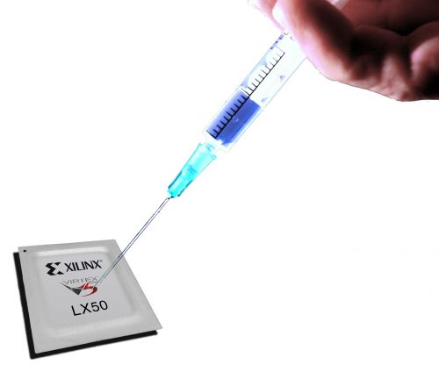
Virtualized Environment
Modified QEMU
Crashes a random core at random time
Distinguish between idle, user and kernel mode
Run different workloads
Postmark, Metis and SPEC CPU2006 benchmarks
Recovery validation
By creating a file and flushing it to the disk using sync

Slide 20
Results
Idle mode success rate: 100% ☺
User mode success rate: 100% ☺
Meaning that the system is protected ALL the time, except for….
Kernel mode
Well… It’s complicated.

Slide 21
Critical Kernel Sections
Fault during critical kernel section execution
Deadlock
Cannot kill kernel space
Reclaim lock by keeping ownership?
No – inconsistent data.
Core#0
Core#1
Core#2
Core#3

Slide 22
Results – Kernel Mode Fault Injections

Slide 23
Results – Kernel Mode Fault Injections
System crashes always happen due to a held lock

Slide 24
Critical Kernel Sections - Solution
Solution: Use Hardware Transactional Memory to execute kernel critical sections
TxLinux [Rossbach et al. SOSP 07’]
For reliability purposes
Does not use locks
Prevent deadlocks
Execute atomically
Prevent inconsistent data

Slide 25
Contributions
A strategy for overcoming Core Surprise Removal (CSR)
Objective – keep the system alive following a core fault
Easily integrate into existing operating systems
Implementation in the Linux kernel
Use Hardware Transactional Memory to cope with failures in critical kernel code
Provide a proof of concept on a real system.
HTM
CSR

Slide 26
Integrating Intel TSX® with Linux
Replace scheduler locks with lock elision code
TSX is a best effort HTM
Transactions are not guaranteed to commit
Retry
Not all instructions can commit transactionally
Resort to regular locking
Too large sections
Split
Energy Saving | Performance Gain | Commit Rate | Workload
4% | - | 100% | Idle
1% | 0% | 99.9% | 16-threads
3% | 3% | 99.9% | 32-threads
2% | 4% | 99.8% | 64-threads

Slide 27
Evaluation – Take 2
But again… How?

Slide 28
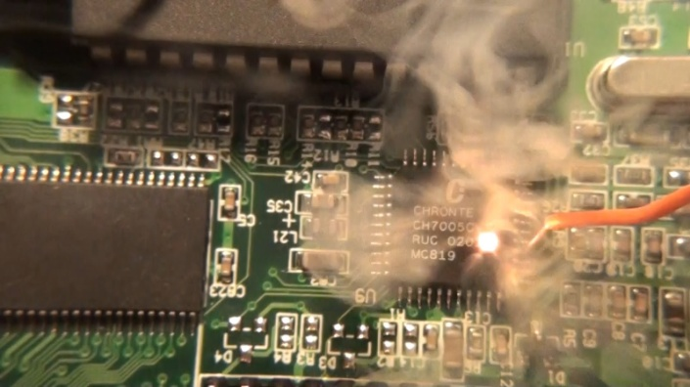
Fault Injection on a Real System
Crash simulation on a real system
Executed in kernel mode
interrupts_disable(); //unresponsive
If (fault_injection()==smp_processor_id())
while(TRUE); //”stops” executing

Slide 29
Evaluation – Recovery Timeline (Real System)
Tasks migrated to core #0
Load is balanced
Failure is detected
Core #13 has no tasks
64-core server, only 0-15 are presented.
10 tasks are affined to each core.

Slide 30
Evaluation – Cloud Setting
Real Time: 7:58
Real Time: 8:00
Crash!
Crash!
Crash!
Crash!
Initial correct state cloud setting
After a crash, original kernel

Slide 31
Evaluation – Cloud Setting
Real Time: 7:58
Real Time: 8:00
Alive
Alive
Alive
Crash!
Initial correct state cloud setting
After a crash, CSR on host

Slide 33
Thank You! Questions?

