Slide 1
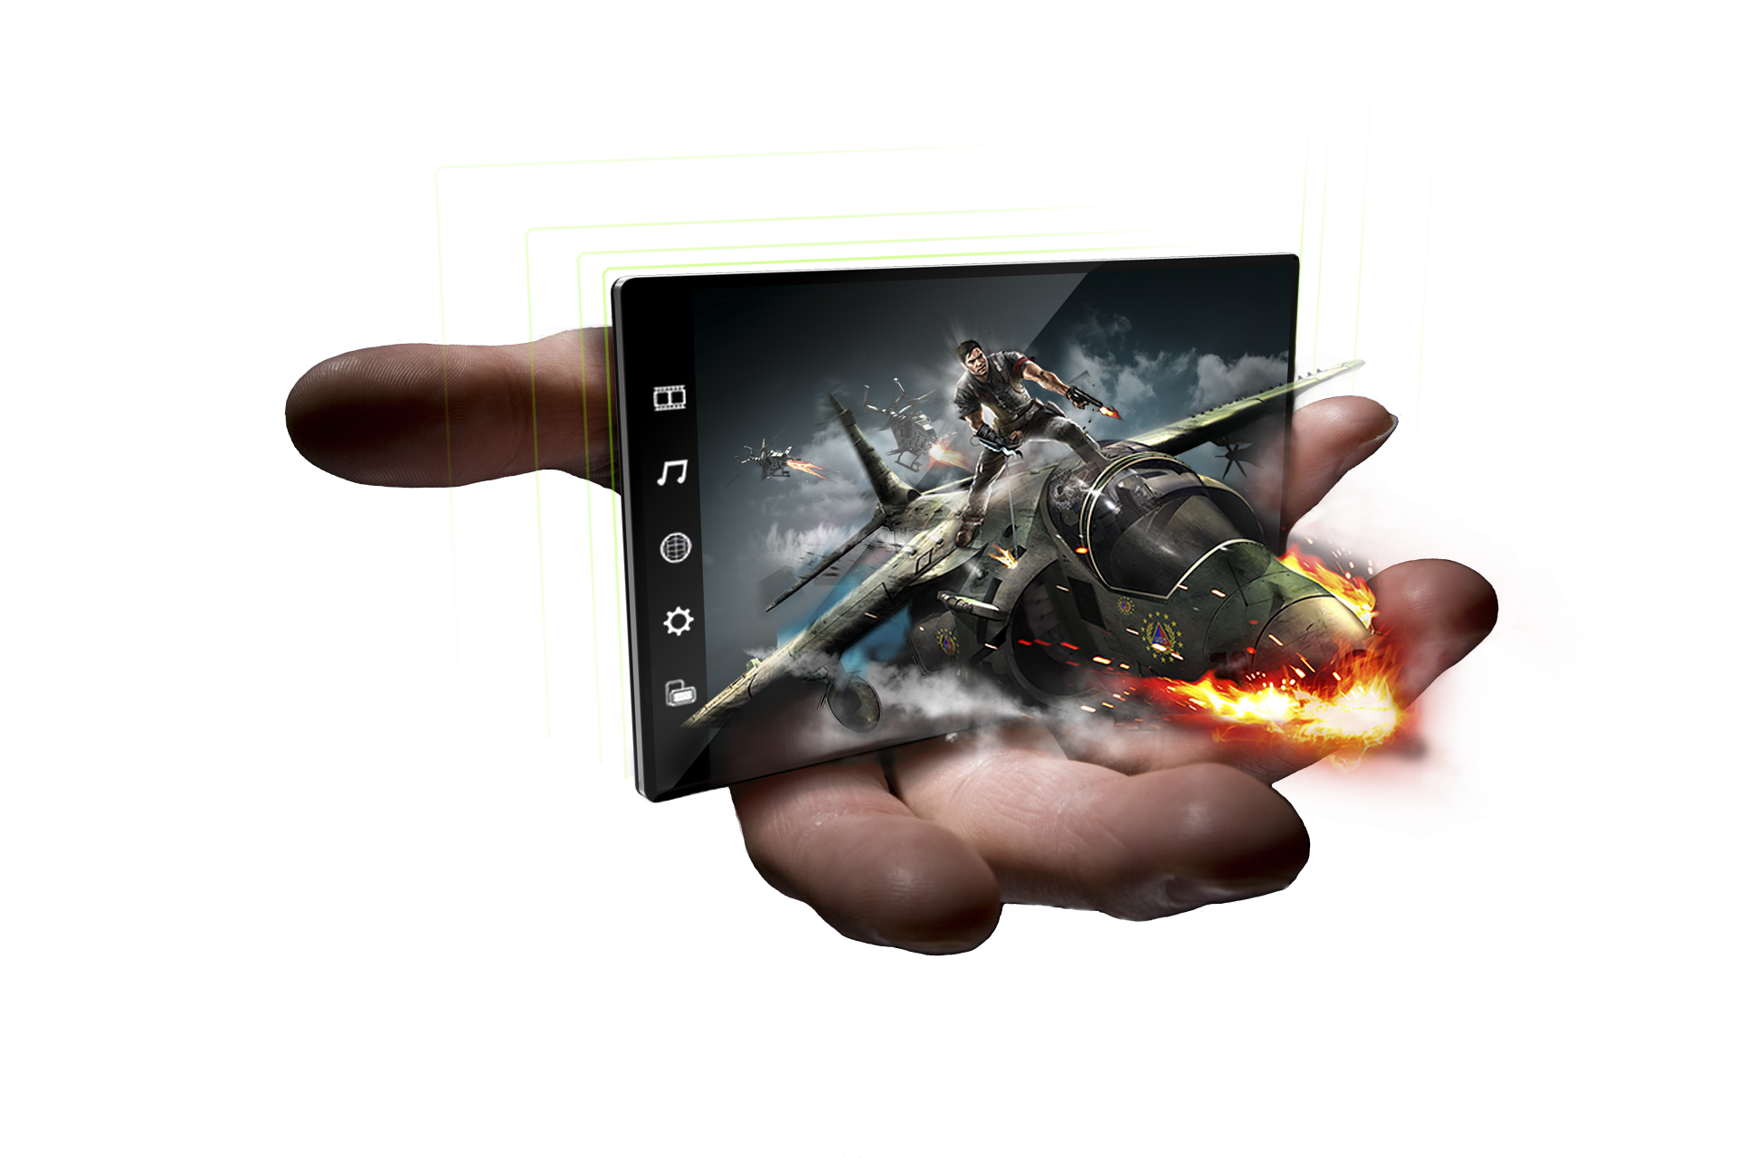
3D Graphics and Cameras
Kari Pulli
Senior Director
NVIDIA Research

Slide 2
Overview
OpenGL ES 1.x
  now getting out-dated
OpenGL ES 2.0
  Java
  C/C++
WebGL
  HTML + JavaScript
OpenCV
  C++ / Java
All examples on this session on Android

Slide 3
OpenGL
The most widely adopted graphics standard
  most OS’s, thousands of applications
Map the graphics process into a pipeline
  matched traditional graphics HW well
A foundation for many higher level APIs
  Open Inventor; VRML / X3D; Java3D; game engines

Slide 4
OpenGL ES 1.x Fixed Function pipe
API
Triangles/Lines/Points
Primitive
Processing
Vertices
Transform
and
Lighting
Primitive
Assembly
Rasterizer
Vertex
Buffer
Objects
Texture
Environment
Color
Sum
Fog
Alpha
Test
Depth
Stencil
Color
Buffer
Blend
Dither
Frame Buffer
Notes:
This shows the existing ES 1.1 pipeline. The boxes coloured orange represent the functions that will be replaced by shaders in ES 2.0. The transform and lighting block is replaced by the vertex shader. The texture environment, colour sum, fog and alpha test are all replaced by the fragment shader.

Slide 5
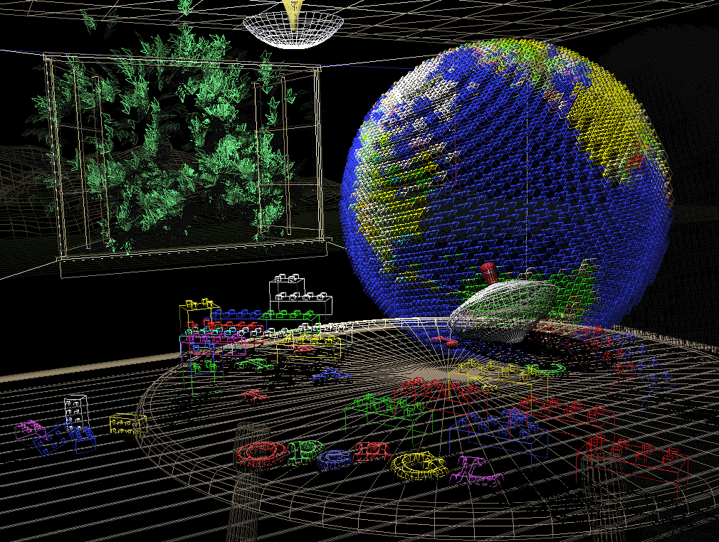
Project vertices to camera…

Slide 6
OpenGL ES 1.x Fixed Function pipe
API
Triangles/Lines/Points
Primitive
Processing
Vertices
Transform
and
Lighting
Primitive
Assembly
Rasterizer
Vertex
Buffer
Objects
Texture
Environment
Color
Sum
Fog
Alpha
Test
Depth
Stencil
Color
Buffer
Blend
Dither
Frame Buffer
Notes:
That used the vertices that were transformed and given colors but not lit, assembled to lines, rasterized to pixels connecting the end points, and displayed.
It exercised mostly part of the top line.

Slide 7
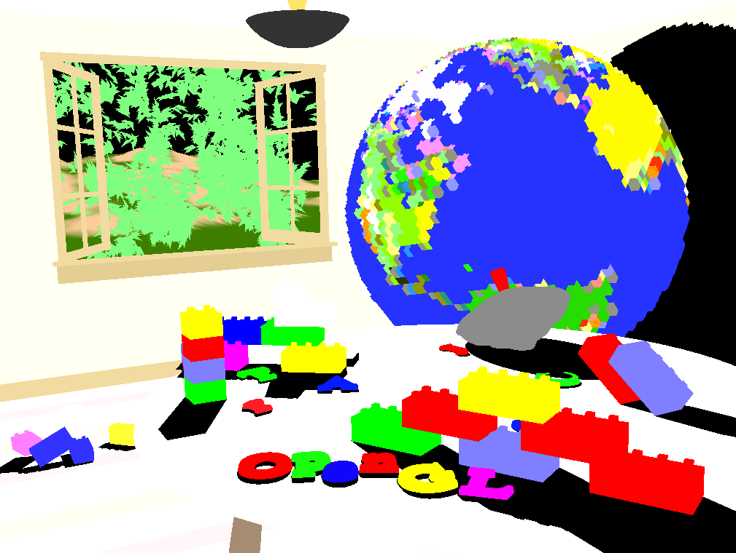
… connect them to triangles …

Slide 8
OpenGL ES 1.x Fixed Function pipe
API
Triangles/Lines/Points
Primitive
Processing
Vertices
Transform
and
Lighting
Primitive
Assembly
Rasterizer
Vertex
Buffer
Objects
Texture
Environment
Color
Sum
Fog
Alpha
Test
Depth
Stencil
Color
Buffer
Blend
Dither
Frame Buffer
Notes:
Now vertices are connected to opaque triangles, more pixels are generated by the rasterizer to fill the triangles, and a depth test in the bottom row is applied to throw away pixels that are behind some object closer to the camera.

Slide 9
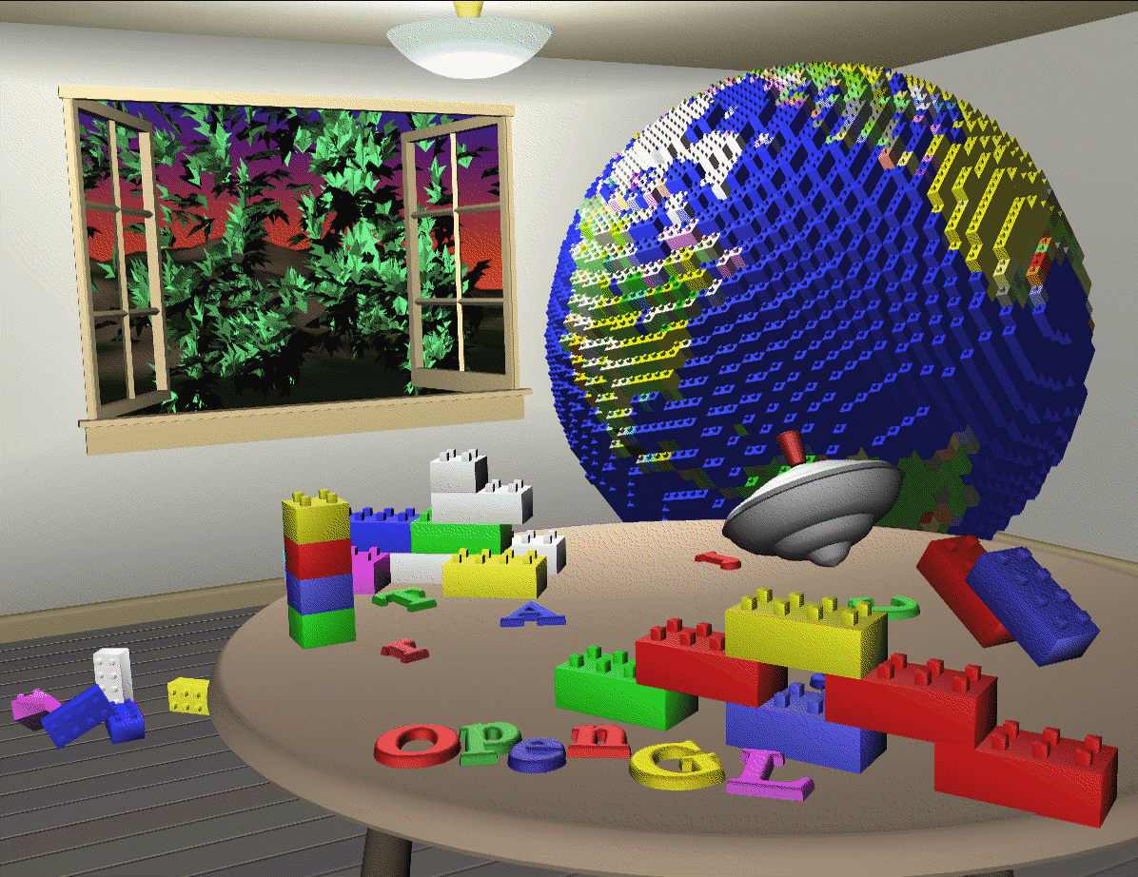
… shade them based on lights …

Slide 10
OpenGL ES 1.x Fixed Function pipe
API
Triangles/Lines/Points
Primitive
Processing
Vertices
Transform
and
Lighting
Primitive
Assembly
Rasterizer
Vertex
Buffer
Objects
Texture
Environment
Color
Sum
Fog
Alpha
Test
Depth
Stencil
Color
Buffer
Blend
Dither
Frame Buffer
Notes:
Now lighting is applied, that is still in the first orange box.

Slide 11
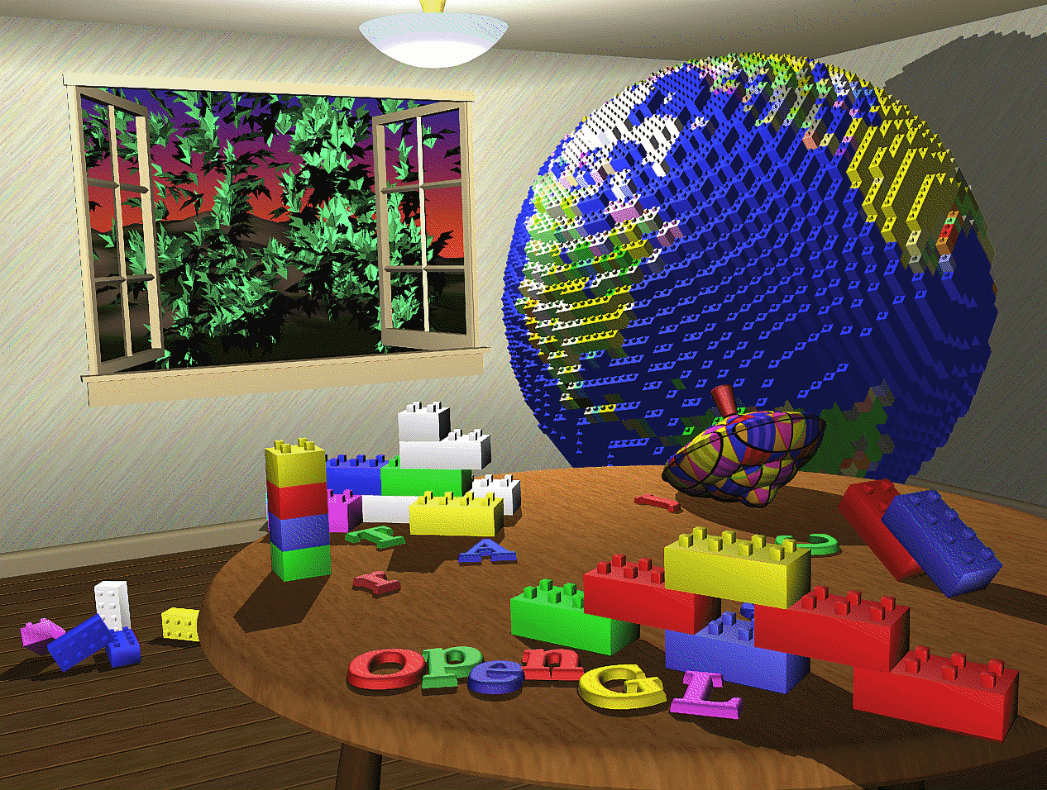
… add texture maps, shadows, …

Slide 12
OpenGL ES 1.x Fixed Function pipe
API
Triangles/Lines/Points
Primitive
Processing
Vertices
Transform
and
Lighting
Primitive
Assembly
Rasterizer
Vertex
Buffer
Objects
Texture
Environment
Color
Sum
Fog
Alpha
Test
Depth
Stencil
Color
Buffer
Blend
Dither
Frame Buffer
Notes:
Texture maps modify the colors for the pixels filling in the triangles, this is in the middle row. Stencil buffers are often used to create shadows (last row).

Slide 13



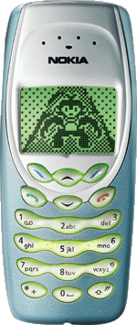
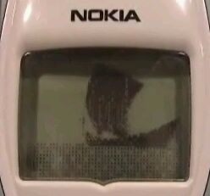
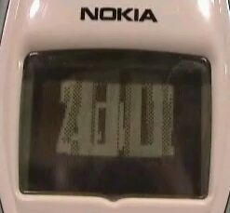
What is OpenGL ES?
OpenGL was just too big for Embedded Systems with limited resources
  memory footprint, floating point HW
Create a more compact API
  mostly a subset of OpenGL
  that can still do almost all OpenGL can
  the work was done at Khronos
Nokia prototyped such a subset in 2002

Slide 14
OpenGL ES 1.0
Simplify OpenGL 1.3
  remove old complex functionality
    glBegin – glEnd (OUT); vertex arrays (IN)
  keep almost all the functionality
    lights, projections, 2D textures, …
Shipped in 2004 (mostly SW engines)
static const GLbyte verts[4 * 3] =
{ -1, 1, 1, 1, 1, 1,
1, -1, 1, -1, -1, 1 };
static const GLubyte colors[4 * 3] =
{ 255, 0, 0, 255, 0, 0,
0,255, 0, 0,255, 0 };
glVertexPointer( 3,GL_BYTE,0, verts );
glColorPointerf( 3,GL_UNSIGNED_BYTE,
0, colors );
glDrawArrays( GL_TRIANGLE_STRIP,
0, 4 );
glBegin(GL_POLYGON);
glColor3f (1, 0, 0);
glVertex3f(-.5, .5, .5);
glVertex3f( .5, .5, .5);
glColor3f (0, 1, 0);
glVertex3f( .5,-.5, .5);
glVertex3f(-.5,-.5, .5);
glEnd();

Slide 15
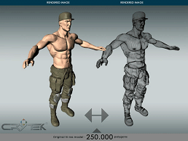
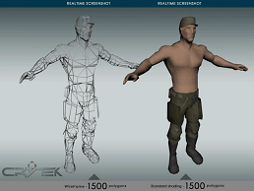
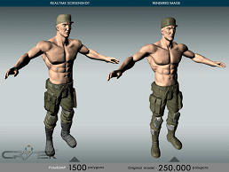
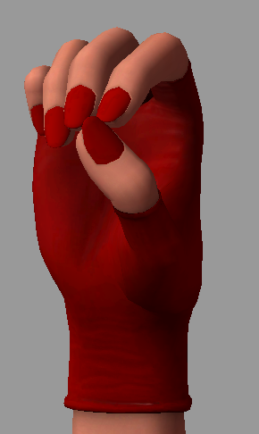
OpenGL ES 1.1
Add features such as bump maps
and skinning (deformable animation)
Shipped in 2005
  begin of HW accelerated mobile 3D graphics
  Symbian, iOS, Android, Meego, …

Slide 16
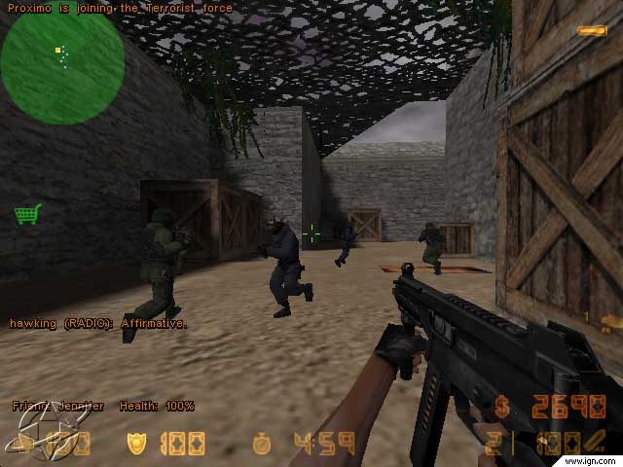
Fixed-function graphics in games

Slide 17
OpenGL ES 2.0 Programmable pipe (introduced in 2007)
API
Triangles/Lines/Points
Primitive
Processing
Vertices
Vertex
Shader
Primitive
Assembly
Rasterizer
Vertex
Buffer
Objects
Fragment
Shader
Depth
Stencil
Color
Buffer
Blend
Dither
Frame Buffer
Notes:
This shows how the vertex and fragment shaders fit into the ES 2.0 pipeline.

Slide 18
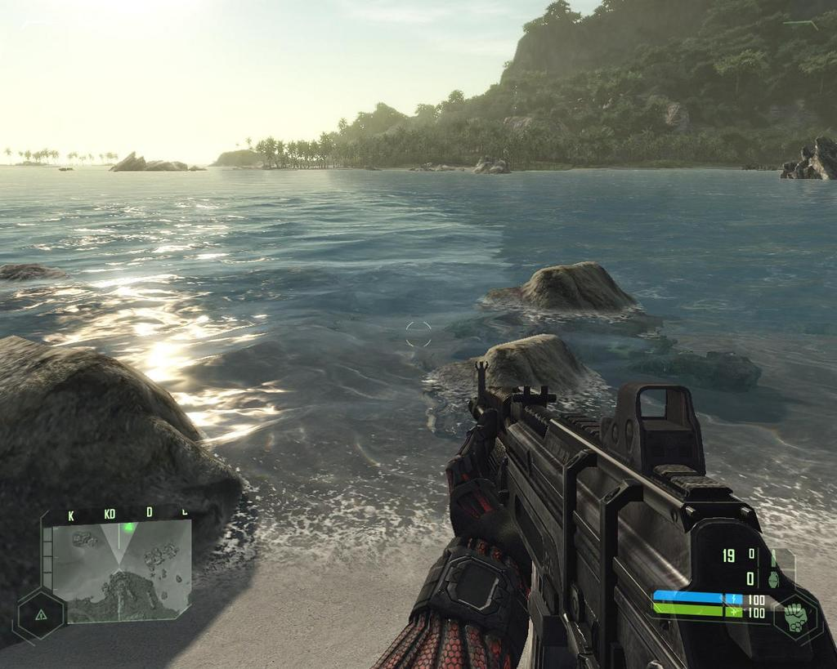
Shaders in games

Slide 19
The difference?
Fixed-function graphics
  simple illumination models
    evaluate at vertices, interpolate in between
  smooth animations difficult inside GPU
Shaders
  vertex shader
    smooth deformations and morphing
    arbitrary illumination models
  fragment shader
    per-pixel illumination effects
    arbitrary illumination models

Slide 20
ES 2.0 is a very bare-bones API
Setup
Input of per-object constants (uniforms)
Input of per-vertex data (attributes)
  no special property types (normals, texture coordinates, …)
  it’s up to the shaders to interpret what the numbers mean
And the shaders of course
  sources as strings, compiled and linked on the fly
  connect C/C++ program variables with shader variables
Some fixed-function stuff (blending, depth tests, …)

Slide 21
Programmer’s model
Per-vertex data for this object
Attributes
(8 * vec4)
Constants for this object
Vertex Uniforms
(128 * vec4)
Vertex
Shader
Primitive
Assembly
& Rasterize
Varyings
(8 * vec4)
Fragment Uniforms
(16 * vec4)
Fragment
Shader
Textures
Per-Sample
Operations
Notes:
The input to the pipeline is a set of attributes. Each vertex can have up to 8 attributes and each attribute can be up to a 4-vector in size. Attributes are not shared between vertices. Note that for each draw call (e.g. a triangle list or a triangle strip), all the vertices must have the same number and type of attributes.
The vertex shader is run once for each vertex. The inputs to the vertex shader are the vertex attributes and the vertex uniforms. Attributes are used to specify values that vary relatively frequently such as position that usually varies per vertex. Uniforms are used to specify values that vary less frequently such as transforms and light positions.
For each vertex processed, as set of value is output from the vertex shader to the rasterizer. The number and types of values output does not need to be the same as the number and types input.
Up until this point, the values are per-vertex. The rasterizer inputs each triangle with its associated vertex values and generates a set of fragments, one for each pixel of the triangle. The vertex input values are interpolated across the triangle (taking into account the perspective) and the per-fragment values that are output are known as ‘varyings’
The fragment shader operates in a similar manner to the vertex shader. The shader runs once for each fragment input. It reads the incoming varyings and the fragment uniforms and outputs a colour value.
This is the end of the programmable operations. After the fragment shader, the rest of the pipeline is fixed function. The per-sample operations are depth-stencil, colour blend and dither. Depending on the implementation, these may be performed at per-pixel resolution or may (in the case of multi-sampling) be performed at a higher resolution.

Slide 22
Android SDK
The main Android SDK is Java
  the language is very similar to Sun’s original Java
    UI libraries are different from Java SE
    a different VM (called Dalvik)
http://developer.android.com/
  one-stop-shop for Android tools and documentation
The easiest way to install all the needed tools is
  http://developer.nvidia.com/mobile/tegra-android-development-pack
  JDK, SDK, NDK, Eclipse, …

Slide 23
Many Android versions (1 June 2011)
Android Version | Market Share
Honeycomb (3.0, 3.1) | 0.6%
Gingerbread (2.3) | 9.2%
Froyo (2.2) | 64.6%
Eclair (2.0, 2.1) | 21.2%
Donut (1.6) | 2.5%
Cupcake (1.5) | 1.9%
^ "Platform Versions". Android Developers. http://developer.android.com/resources/dashboard/platform-versions.html. "based on the number of Android devices that have accessed Android Market within a 14-day period ending on the data collection date noted below"
Notes:
Let’s look at some Android OS version market share numbers released at the beginning of June. This most recent public chart gives the basic idea of the breakdown of Android versions across all Android devices. If you support Éclair and newer, you will cover about 96% of the active devices. If you make Froyo your minspec, you’ll still net about three-quarters and rising. If you choose to make Gingerbread or Honeycomb your minspec, you’ll be WAITING at least a while for your total addressable market to expand. So why would you select a newer OS version as a minspec? The main answer is required features: let’s discuss them in more detail.

Slide 24
Quickly evolving platform (5 July 2011)
Android Version | Market Share
Honeycomb (3.0, 3.1) | 0.9%
Gingerbread (2.3) | 18.6%
Froyo (2.2) | 59.4%
Eclair (2.0, 2.1) | 17.5%
Donut (1.6) | 2.2%
Cupcake (1.5) | 1.4%
^ "Platform Versions". Android Developers. http://developer.android.com/resources/dashboard/platform-versions.html. "based on the number of Android devices that have accessed Android Market within a 14-day period ending on the data collection date noted below"
Notes:
It’s interesting to see how the market share is changing in one month.

Slide 25
Quickly evolving platform (15 Sep 2012)
Android Version | Market Share
Jelly Bean (4.1) | 1.2%
Ice Cream Sandwich (4.0) | 20.9%
Honeycomb (3.0, 3.1) | 2.1%
Gingerbread (2.3) | 57.5%
Froyo (2.2) | 14%
Eclair (2.0, 2.1) | 3.7%
Donut (1.6) | 0.4%
Cupcake (1.5) | 0.2%
^ "Platform Versions". Android Developers. http://developer.android.com/resources/dashboard/platform-versions.html. "based on the number of Android devices that have accessed Android Market within a 14-day period ending on the data collection date noted below"

Slide 26
Hello OpenGL ES 2.0 on Android SDK
The following OpenGL ES tutorial is available at
  http://developer.android.com/training/graphics/opengl/index.html

Slide 27
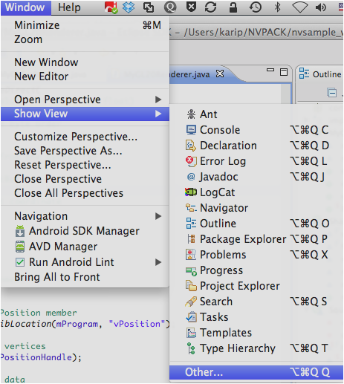
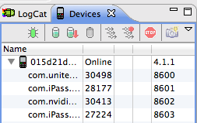
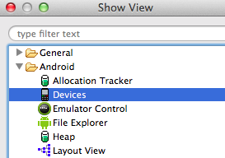
Make sure device is connected
Attach with USB cable
Eclipse show device

Slide 28
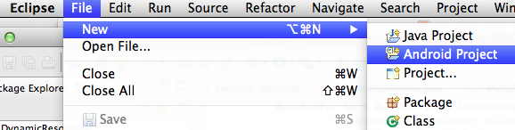
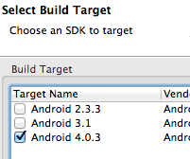
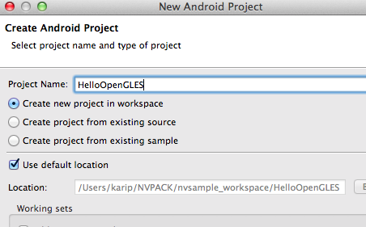
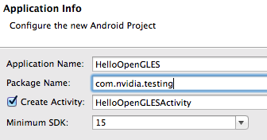
Create an Android project

Slide 29
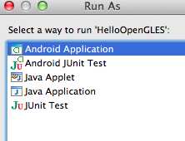
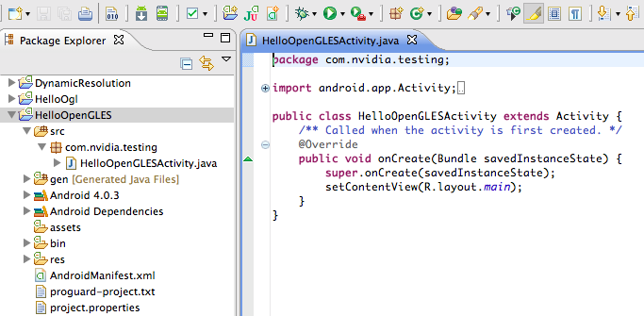
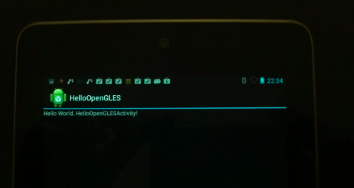
Try it out

Slide 30
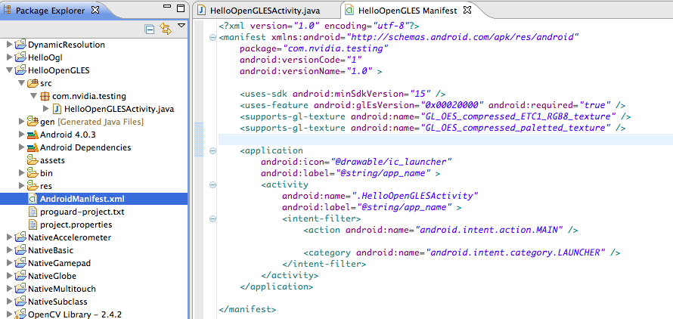
Modify manifest for OpenGL ES 2.0

Slide 31
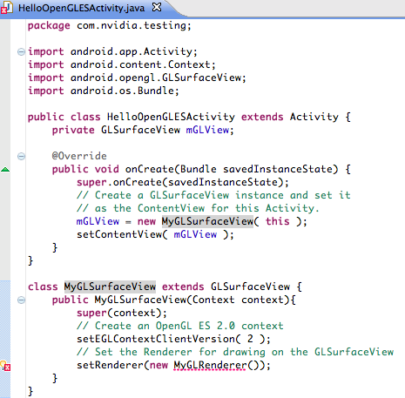
Add a GLSurfaceView
A new header
Create a GLSurfaceView
and set it
as the main content view
Create a renderer for
your surface view
(in another *.java file)

Slide 32
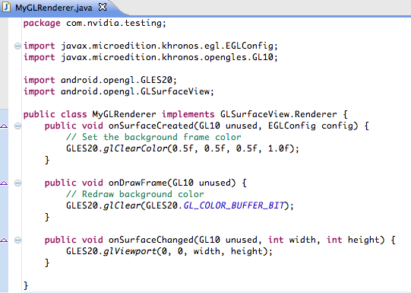
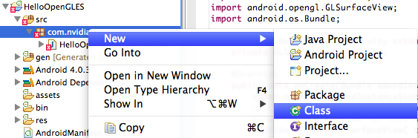
Add renderer
Called once, to
set things up
Called for each
redraw event
Called whenever surface changes
(e.g., rotate device from portrait to landscape)

Slide 33
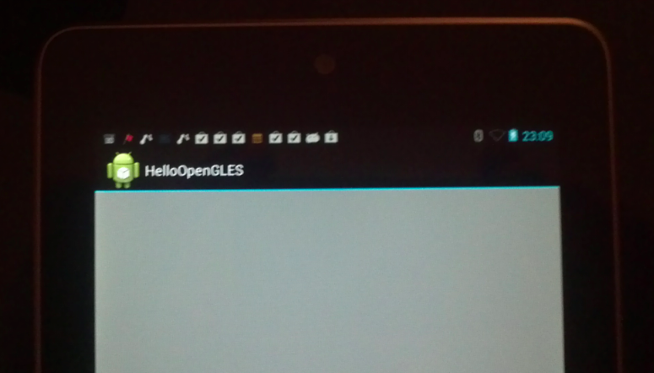
Run the app

Slide 34
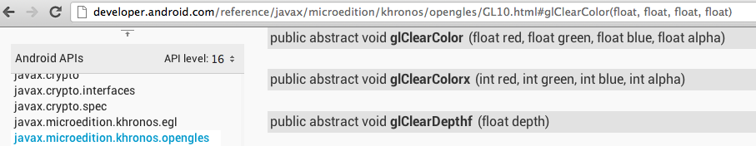
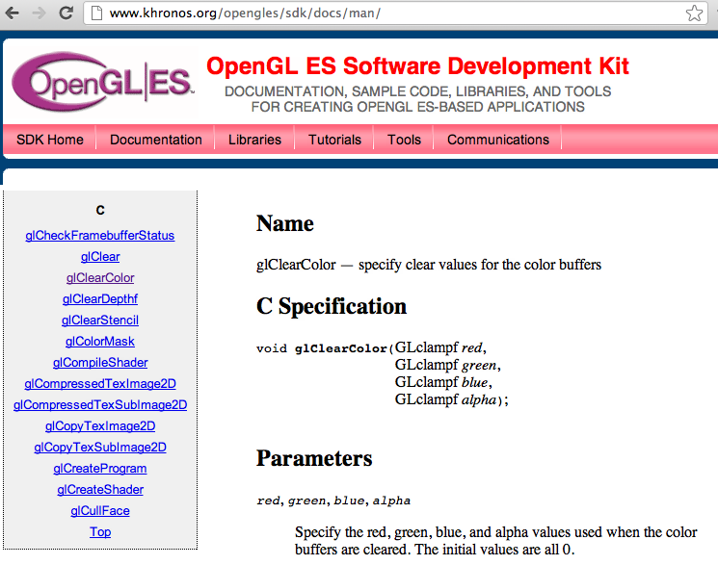
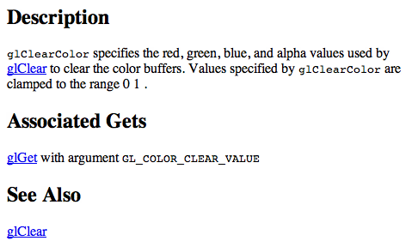
Finding out OpenGL ES function details
Android documentation doesn’t give details
Khronos sdk
docs do

Slide 35
Adding shapes and shaders
To draw any objects we need:
Create the program
  vertex shader
  fragment shader
  compile and link
Set up data
  vertex coordinates
  colors
Run the program with the data
Attributes
(8 * vec4)
Vertex Uniforms
(128 * vec4)
Vertex
Shader
Primitive
Assembly
& Rasterize
Varyings
(8 * vec4)
Fragment Uniforms
(16 * vec4)
Fragment
Shader
Textures
Per-Sample
Operations

Slide 36
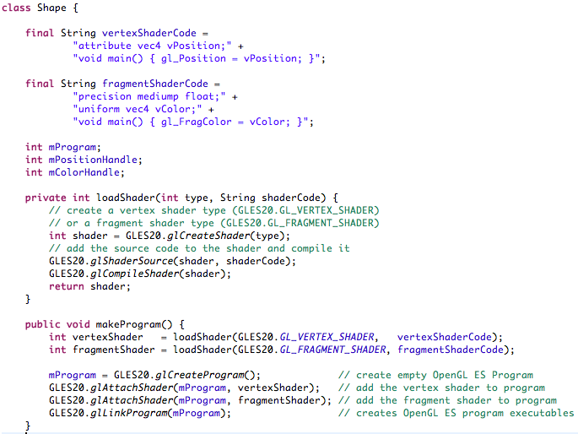
Program: create a helper class
Simple default
shaders
Utility for
compiling
a shader
Make a full
program

Slide 37
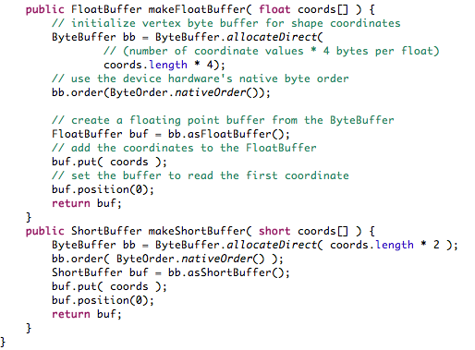
Rest of Shape: utilities for buffers

Slide 38
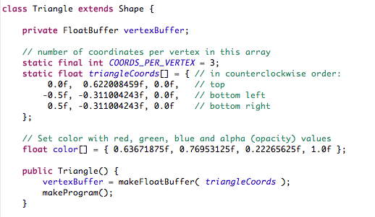
Triangle class: setup data & compile

Slide 39
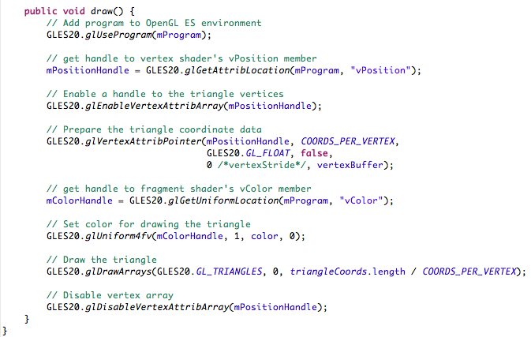
… and draw
Connect the
vertex locations
Connect the
colors
Draw, and clean up

Slide 40
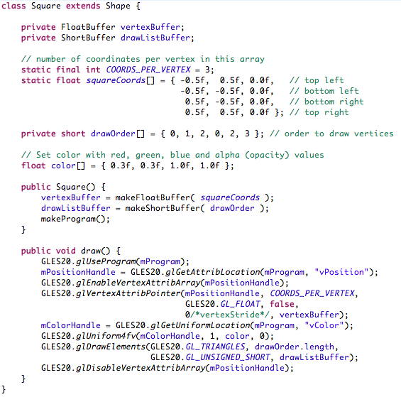
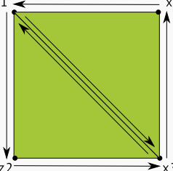
Another
Shape for a
Square
0 3
1 2
Use indices
to make two
triangles
Different drawing call

Slide 41
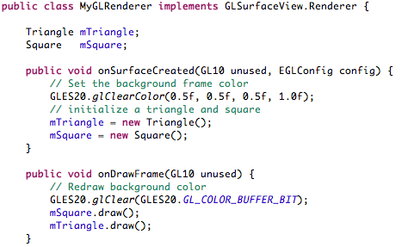
Modify the renderer

Slide 42
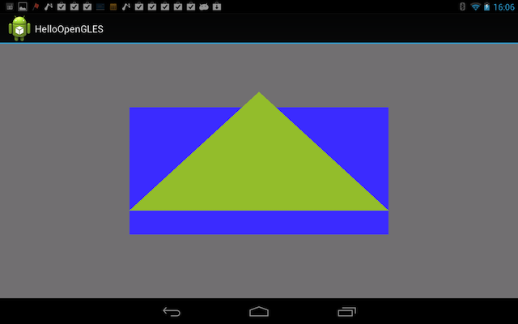

Slide 43
The Vertex Shader can do:
Modify any of the attributes of a vertex
Examples (old stuff, ES 1.1 could do):
  Transformation of position and normals
    using model-view and projection matrices
  Texture coordinate generation and transformation
  Per-vertex lighting
Examples (new stuff):
  Arbitrary vertex morphing and skinning
  Advanced lighting
    per-vertex more complex lighting models
    calculation of values used later for per-pixel lighting
  Other per vertex data (density for physics, …)
Notes:
In general, any operation that takes in a vertex and outputs a modified form of that vertex, one at a time, can be performed by the vertex shader.

Slide 44
The Vertex Shader cannot do:
Anything that
  requires information from more than one vertex
  for example
    any triangle operations (e.g. clipping, culling)
    tessellation of meshes to denser meshes
  accesses color buffer
That is: “One comes in, one goes out”
Notes:
The vertex shader does not have access to neighbouring vertices or any per-pixel or per-fragment values.

Slide 45
The Fragment Shader can do:
Calculate new colors per pixel
  texture blending
  fog
Dependent textures
Pixel discard
  alpha testing
Bump and environment mapping
Render to multiple render targets (MTR) at once
  think of running the vertex part only once, but for the same geometry, producing different intermediate results to different textures at once
Notes:
In general any operation that takes in a fragment and generates a colour can be performed by the fragment shader.

Slide 46
The Fragment Shader cannot do:
Read from any buffer
  including the previous color
Write to any buffer
  except provide the new color
  which is blended by the later stages of fixed-funtion pipe
Why the limitations?
Now the implementation can
  rasterize different elements in parallel
  hide the latency of frame buffer access for blending
Notes:
Certain operations are not possible due to the difficulties they cause with implementations. For example, programmable blending operations require a read before or during shader execution and this can incur a high silicon and/or performance cost. Depth and stencil operations may be done at higher that pixel resolution if multi-sampling is used and so requires a 3rd type of shader. Programming these functions is generally less useful although it is possible it may be introduced in a later version of the specification.

Slide 47
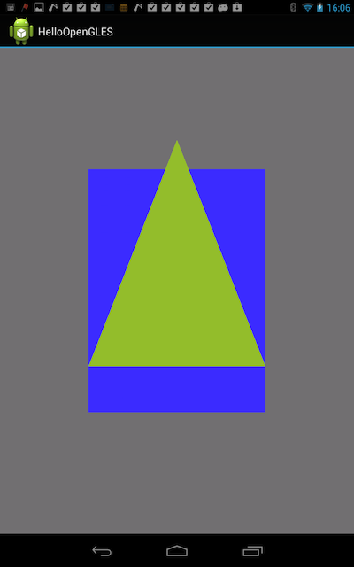
Coordinates are relative to the screen!
Default goes from -1 to 1 in both x and y

Slide 48
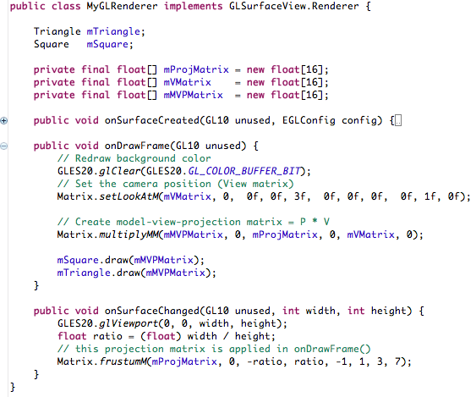
Matrices

Slide 49
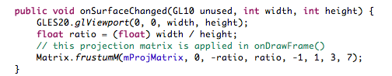
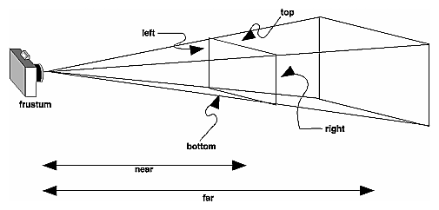
Frustum matrix for projection

Slide 50
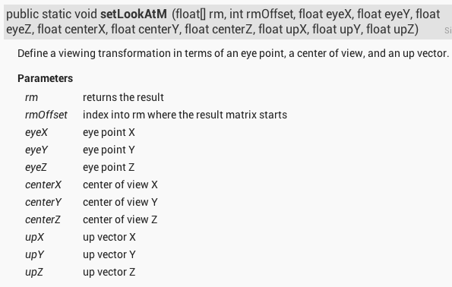
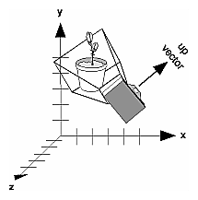
View matrix for placing camera
Z
Up
y
x
Tgt
Eye
z
Y
xyz – camera coords
XYZ – world coords
X

Slide 51
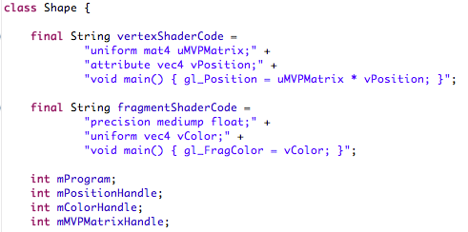
Add matrix to the shader

Slide 52
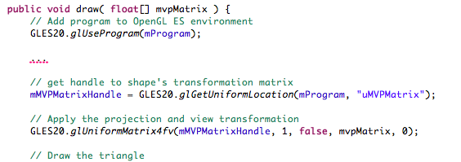
Add matrix to the shader and draw()

Slide 53
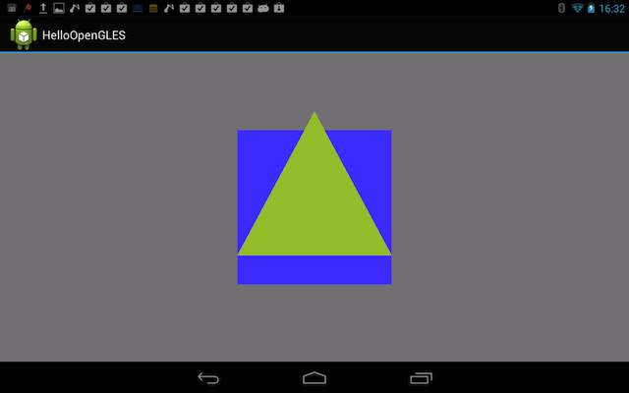

Slide 54
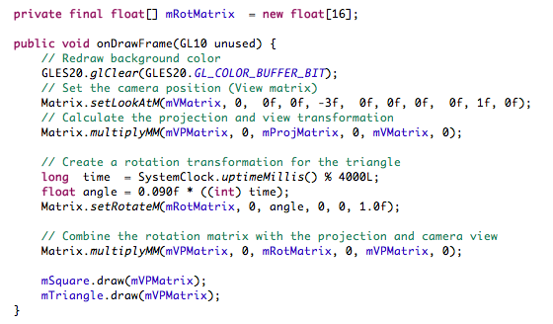
Adding motion

Slide 55


Slide 56
Add user interaction events
Modify GLSurfaceView to process touch events
Modify Renderer to accept calculated angle

Slide 57


Slide 58


Slide 59


Slide 60
Android and Native Code
Native code adds some complexity
  but unlocks peak performance (games, image processing)
  makes porting existing (C/C++) code easier
  reduces portability
A set of cross-compiler toolchains
  gcc for ARM
  hosted on Windows, Linux, or Mac
JNI, the Java/Native Interface
  connecting native code to Java
Gingerbread (Android 2.3) introduced NativeActivity
  avoids the need for any Java code
Notes:
The first issues that most games face is the questions of Java versus C code. The question of Java versus native code has several facets on Android which we’ll detail in this talk, but for now, an overview. The question is oversimplified: all Android apps are Java at the top level, although in the latest versions of Android, you the developer may not have to write any of that Java code.
Java-level APIs give access to all Android platform features
Native (C/C++)-level APIs give access to many important game platform features, but not all of them
Java-only apps can be simpler to code and manage
But Native apps unlock both peak system/app performance and allow for reuse of existing console and PC engine source code
The choice is per-game, but for high-end, differentiated content, we mainly see Native-based games and engines
Native C++ code is handled via the Native Development Kit and generally called from a Java-based app class. We’ll be spending a good bit of quality time with the NDK, so let me introduce it.
Put simply, the NDK is a set of cross-compiler toolchains that build your C and C++ code for Android devices, along with a set of headers and libs for the APIs that Android allows native code to call directly. These APIs are known as “stable” APIs, not in the sense of being stable at runtime, but in the sense that the APIs themselves won’t require changes moving forward, and thus an app built on them can be forward-compatible with new Android versions. Finally, the NDK includes as a part of its stable APIs the Java-to-Native code bindings known as JNI, or the Java Native Interface. All of this serves to generate shared library code that can interop with the Java level app.

Slide 61


Slide 62
OpenGL ES 2.0 on Android NDK
Tegra SDK provides tools for C / C++ apps
The following example comes from
  http://developer.nvidia.com/tegra-android-development-pack

Slide 63



Slide 65


Slide 66


Slide 67





Slide 68


Slide 69

No Java at all

Slide 70



WebGL: OpenGL ES 2.0 in JavaScript
The only truly cross-platform way to create applications is to use web technologies
WebGL provides OpenGL ES 2.0 in a browser
  Supported by many desktop browsers
    Chrome, Firefox, Safari, Opera
  Coming to also on smartphones
    Firefox on Android runs WebGL

Slide 71


WebGL tutorial: http://learningwebgl.com
<html> <head>
<title>Learning WebGL &mdash; lesson 1</title>
<meta http-equiv="content-type" content="text/html; charset=ISO-8859-1">
</head>
<body onload="webGLStart();">
<canvas id="lesson01-canvas" style="border: none;" width="500" height="500">
</canvas>
</body> </html>
… // shaders, mini matrix library
<script type="text/javascript">
… // more functions
function webGLStart() {
var canvas = document.getElementById("lesson01-canvas");
initGL(canvas);
initShaders();
initBuffers();
gl.clearColor(0.0, 0.0, 0.0, 1.0);
gl.enable(gl.DEPTH_TEST);
drawScene();
}
</script>
Notes:
First, the HTML code creates a canvas and as the page loads, it calls javascript function webGLStart()
The HTML script node contains that function, which gets a handle to the canvas so it can draw on it, and it calls a few functions defined in the same script node, calls some gl calls, and calls another function that does the rendering.
GLES code in yellow

Slide 72
Initialize gl context
var gl;
function initGL(canvas) {
try {
gl = canvas.getContext("experimental-webgl");
gl.w = canvas.width;
gl.h = canvas.height;
} catch (e) {
}
if (!gl) {
alert("Could not initialise WebGL, sorry :-(");
}
}
Notes:
The init function sets up the webgl context from the canvas, and stores there also the size of the canvas

Slide 73
Shaders: vertex
, fragment
<script id="shader-vs" type="x-shader/x-vertex">
attribute vec3 aVertexPosition;
uniform mat4 uMVMatrix;
uniform mat4 uPMatrix;
void main(void) {
gl_Position = uPMatrix * uMVMatrix * vec4(aVertexPosition, 1.0);
}
</script>
<script id="shader-fs" type="x-shader/x-fragment">
#ifdef GL_ES
precision highp float;
#endif
void main(void) {
gl_FragColor = vec4(1.0, 1.0, 1.0, 1.0);
}
</script>
Notes:
There are two script nodes that store the vertex and fragment shaders.

Slide 74
Compile a shader
function getShader(gl, id) {
var shaderScript = document.getElementById(id);
if (!shaderScript) { return null; }
var shader;
if (shaderScript.type == "x-shader/x-fragment") {
shader = gl.createShader(gl.FRAGMENT_SHADER);
} else if (shaderScript.type == "x-shader/x-vertex") {
shader = gl.createShader(gl.VERTEX_SHADER);
} else { return null; }
var range = document.createRange();
range.selectNodeContents(shaderScript);
gl.shaderSource(shader, range.toString());
range.detach();
gl.compileShader(shader);
if (!gl.getShaderParameter(shader, gl.COMPILE_STATUS)) {
alert(gl.getShaderInfoLog(shader));
return null;
}
return shader;
}
Notes:
a getShader() function gets a shader code string, creates a shader, compiles it, and checks whether the compilation was successful.

Slide 75
Compile and link GL program; get attribute & uniform locations
var prg; // shader program
function initShaders() {
prg = gl.createProgram();
gl.attachShader(prg, getShader(gl, "shader-vs"));
gl.attachShader(prg, getShader(gl, "shader-fs"));
gl.linkProgram(prg);
if (!gl.getProgramParameter(prg, gl.LINK_STATUS)) {
alert("Could not initialise shaders");
}
gl.useProgram(prg);
prg.vtxPos = gl.getAttribLocation(prg, "aVertexPosition");
gl.enableVertexAttribArray(prg.vtxPos);
prg.pMatrixUniform = gl.getUniformLocation(prg, "uPMatrix");
prg.mvMatrixUniform = gl.getUniformLocation(prg, "uMVMatrix");
}
Notes:
initShaders() calls that getShader() method twice, once for each shader, links, sets up the program, and stores handles to the attributes and uniforms in the shader.

Slide 76
Initialize vertex position buffers
var tri; // triangleVertexPositionBuffer
var sqr; // squareVertexPositionBuffer
function initBuffers() {
tri = gl.createBuffer();
gl.bindBuffer(gl.ARRAY_BUFFER, tri);
var vertices = [ 0.0, 1.0, 0.0,
-1.0, -1.0, 0.0,
1.0, -1.0, 0.0 ];
gl.bufferData(gl.ARRAY_BUFFER, new Float32Array(vertices), gl.STATIC_DRAW);
tri.itemSize = 3; tri.numItems = 3;
sqr = gl.createBuffer();
gl.bindBuffer(gl.ARRAY_BUFFER, sqr);
vertices = [ 1.0, 1.0, -1.0,
-1.0, 1.0, -1.0,
1.0, -1.0, -1.0,
-1.0, -1.0, -1.0 ];
gl.bufferData(gl.ARRAY_BUFFER, new Float32Array(vertices), gl.STATIC_DRAW);
sqr.itemSize = 3; sqr.numItems = 4;
}
Notes:
initBuffers() creates two buffers and fills them with the vertex data for a triangle and a square.

Slide 77
Include a simple matrix utility library
OpenGL ES 2.0 does not include any matrix utilities
  idea is that matrix math happens on CPU
  OpenGL ES 2.0 concentrates on things running on GPU
  it’s easy to write such utility libraries
Include such a library from a file in the same folder
<script type="text/javascript"
src="glMatrix-0.9.5.min.js">
</script>
Notes:
we also include a small matrix utility library which is in a separate file (it could be inlined too)

Slide 78
Finally, draw the scene
function drawScene() {
gl.viewport(0, 0, gl.w, gl.h);
gl.clear(gl.COLOR_BUFFER_BIT | gl.DEPTH_BUFFER_BIT);
var pMatrix = mat4.create();
mat4.perspective(45, gl.w / gl.h, 0.1, 100.0, pMatrix);
gl.uniformMatrix4fv(prg.pMatrixUniform, false, pMatrix);
var mvMatrix = mat4.create(); mat4.identity(mvMatrix);
mat4.translate(mvMatrix, [-1.5, 0.0, -7.0]);
gl.uniformMatrix4fv(prg.mvMatrixUniform, false, mvMatrix);
gl.bindBuffer(gl.ARRAY_BUFFER, tri);
gl.vertexAttribPointer(prg.vtxPos, tri.itemSize, gl.FLOAT, false, 0, 0);
gl.drawArrays(gl.TRIANGLES, 0, tri.numItems);
mat4.translate(mvMatrix, [3.0, 0.0, 0.0]);
gl.uniformMatrix4fv(prg.mvMatrixUniform, false, mvMatrix);
gl.bindBuffer(gl.ARRAY_BUFFER, sqr);
gl.vertexAttribPointer(prg.vtxPos, sqr.itemSize, gl.FLOAT, false, 0, 0);
gl.drawArrays(gl.TRIANGLE_STRIP, 0, sqr.numItems);
}
Notes:
blue lines call to that matrix utility, the rest are normal gl calls.

Slide 80
Camera: the “I” of visual I/O
Graphics is one half of the visual I/O
  the output
Camera provides the input
  capture textures
  affect the application

Slide 81





OpenCV
Thousands of Developers, Cross Platform API
Open standard for Computer Vision
Over a decade old,
professionally developed
  Over 3 Million Downloads!
  > 500 Algorithms
Common API for Server, Workstation, Desktop and now Mobile Platforms!

Slide 82



Computer Vision = Smart Photography
Get the right shot, automatically
Face Detection
Scene Classification
Stabilization
Notes:
Talk about the soon-to-be ubiquitous nature of computer vision. Why discuss this stuff at an automotive conference – The auto industry will be able to leverage this technology, just like it’s leveraging graphics technology.

Slide 83




Computer Vision = New Applications
Augmented Reality
Gesture interfaces
Augmented Reality Ghost Hunter (Argh)
Wordlens
Google Goggles

Slide 84












OpenCV functionality overview
General Image Processing
Segmentation
Machine Learning, Detection
Image Pyramids
Transforms
Fitting
Camera Calibration
Features
Depth Maps
Optical Flow
Inpainting
Tracking

Slide 85






OpenCV for Android
Optimized for ARM, Tegra, & Android
Install from
  http://opencv.itseez.com/doc/tutorials/introduction/android_binary_package/android_binary_package.html
  TADP 2.0 includes OpenCV

Slide 86

Tutorial: Android Camera
Part of the Android OpenCV distribution
Get camera image
Display it

Slide 87

Tutorial: Add OpenCV
The second part of the tutorial adds OpenCV functionality
  real-time Canny edge detector from the input image

Slide 88

OpenCV supports Java and Native

