Slide 1
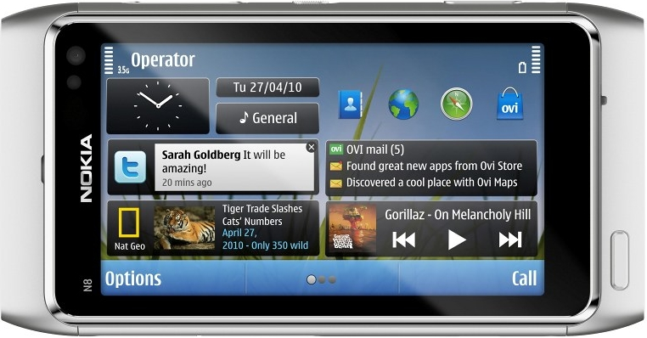
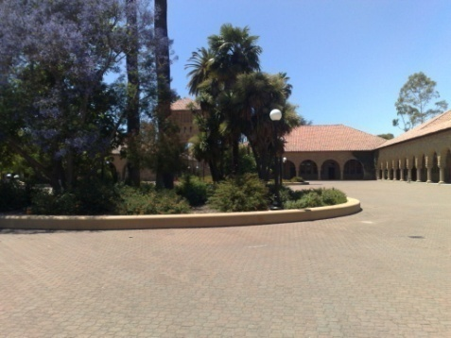



















Color Matching of Image Sequences with Combined Gamma and Linear Corrections
Yingen Xiong and Kari Pulli
Download our panorama software :
http://store.ovi.com/content/51491

Slide 2
Outline
Introduction
  What is the problem? Why do we need color correction?
  Related work
Color correction with color matching
  Problem expression
  Color matching by gamma correction
  Color mean matching by gamma correction
  Combination of gamma and linear corrections
Applications and results
Conclusions

Slide 3






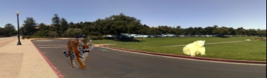

Introduction: Mobile Panorama System
Image capturing
Color correction
Object editing
camera
Image registration
Image labeling
Image warping
Panorama viewing
or
Image blending
Download our panorama software: http://store.ovi.com/content/51491

Slide 4
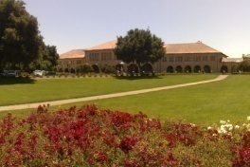
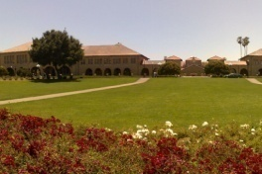
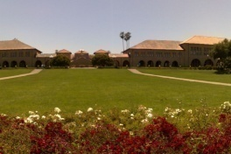
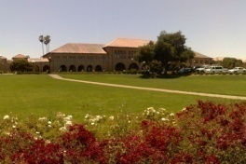
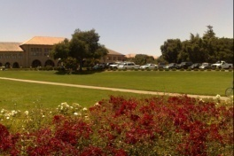
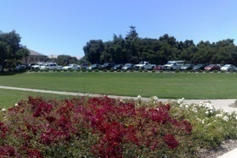
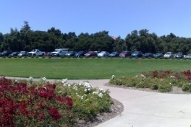
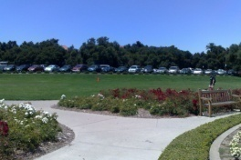
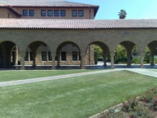
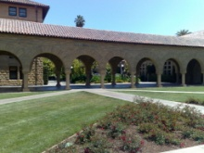
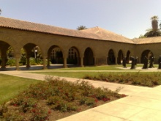
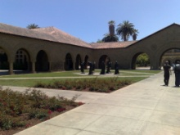
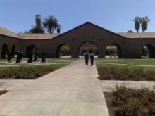
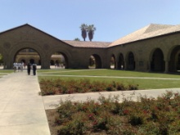
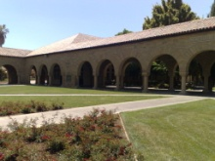
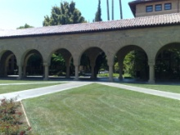
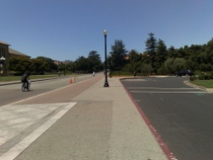
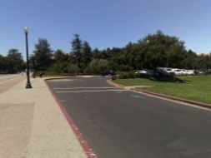
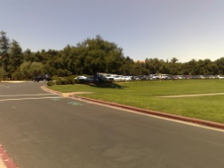
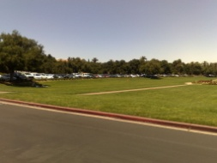
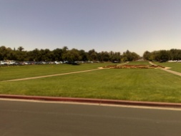
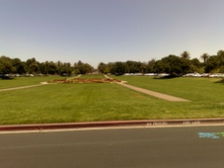
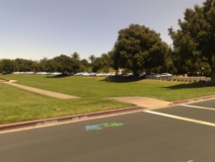
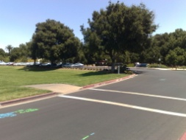



















What is the Problem?
Image parameters (focus, exposure, WB) change for each image
Changes in illumination lead to different exposure levels
  The same objects in different frames may have different apparent colors

Slide 5
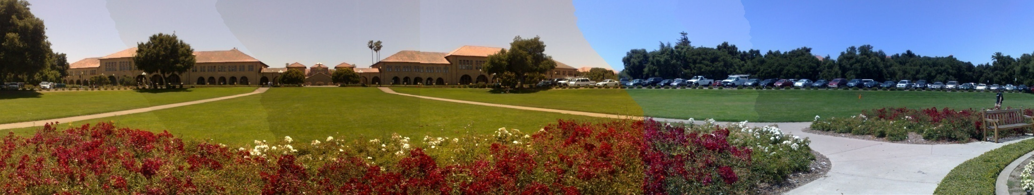
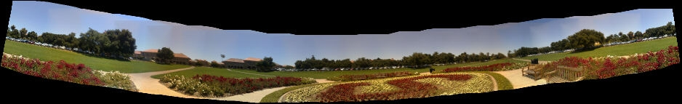
Panorama Stitching without Color Correction
Stitching artifacts ; visible seams; bad color transitions

Slide 6
















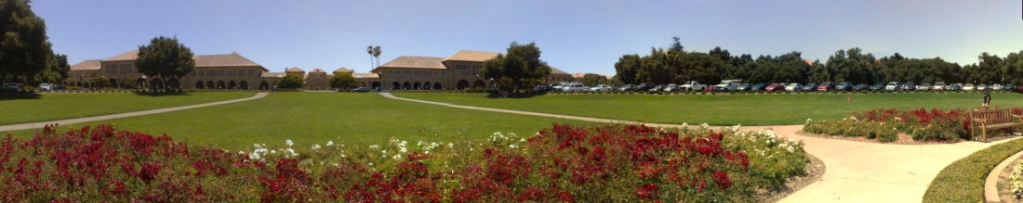
Color Correction to Reduce Color Differences
Perform color correction before panorama stitching

Slide 7
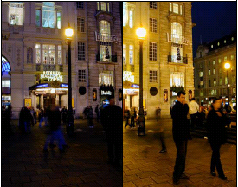
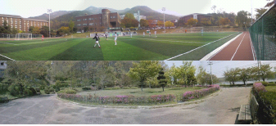

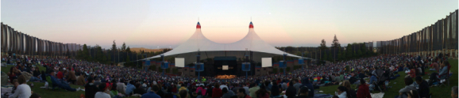
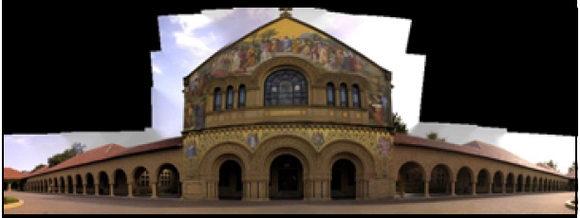
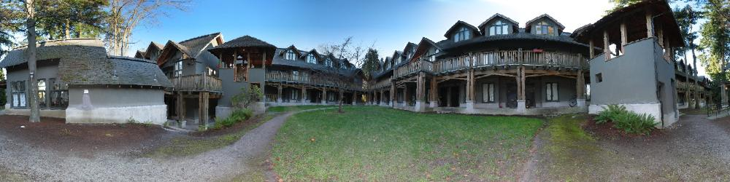

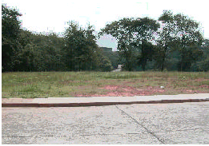
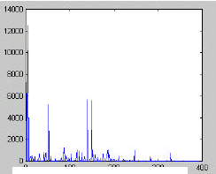
Related Work
Linear-model-based color correction
  Color correction
  Luminance correction
Polynomial mapping and others
Tian et al. 2002
Ha et al. 2007
Xiong and Pulli 2009
  sRGB color space
  YCbCr color space
  Linearized RGB color space
Meunier and Borgmann 2000
Brown and Lowe 2007
  Linearized RGB color space
  sRGB color space
Pham and Pringle 1995
Zhang et al. 2001
  Polynomial mapping
  Histogram mapping

Slide 8

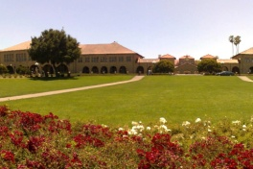
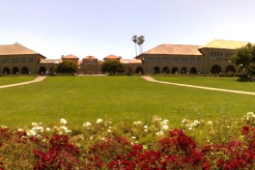
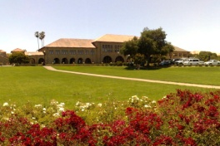
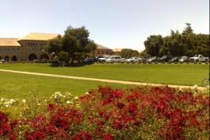
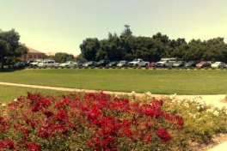
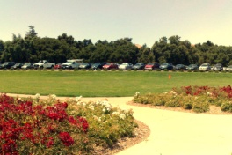
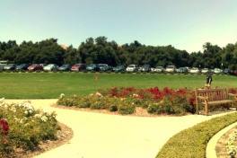
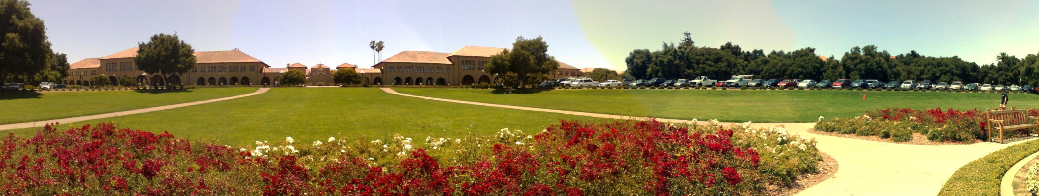
Color Correction using Linear Model
Original source images with different colors
Simple, fast, color saturation, low quality

Slide 9
Efficient Color Correction is Needed
Avoid saturation problems
Reduce color differences

Slide 10
Color Matching with Gamma Correction

Slide 11
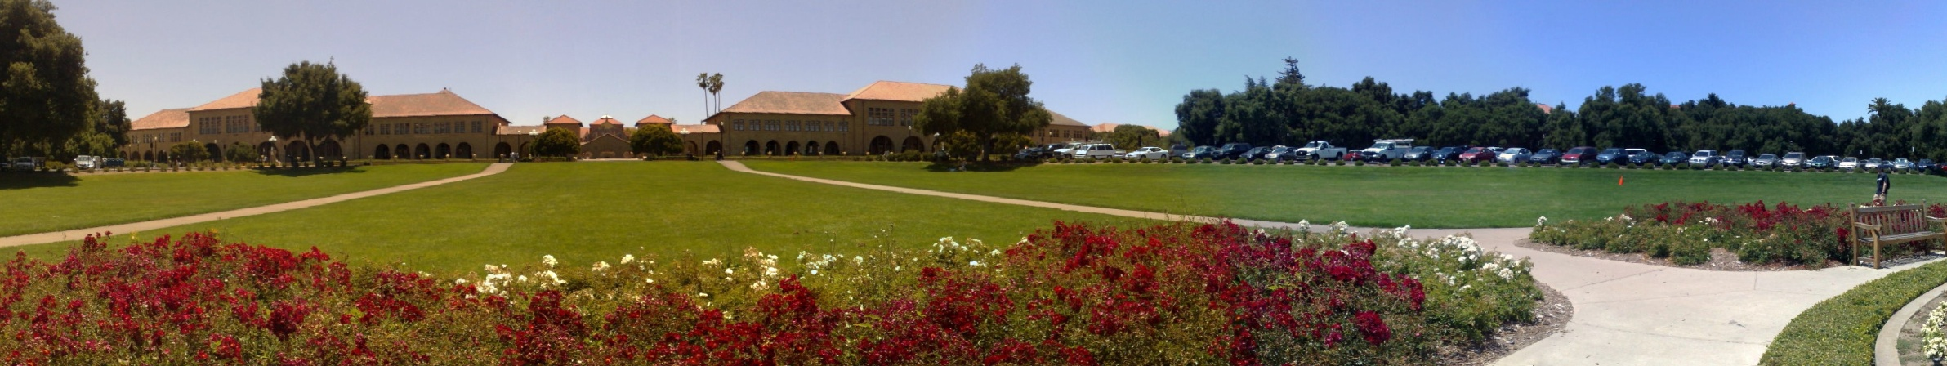
Color Matching with Gamma Correction

Slide 12
Color Mean Matching with Gamma Correction

Slide 13
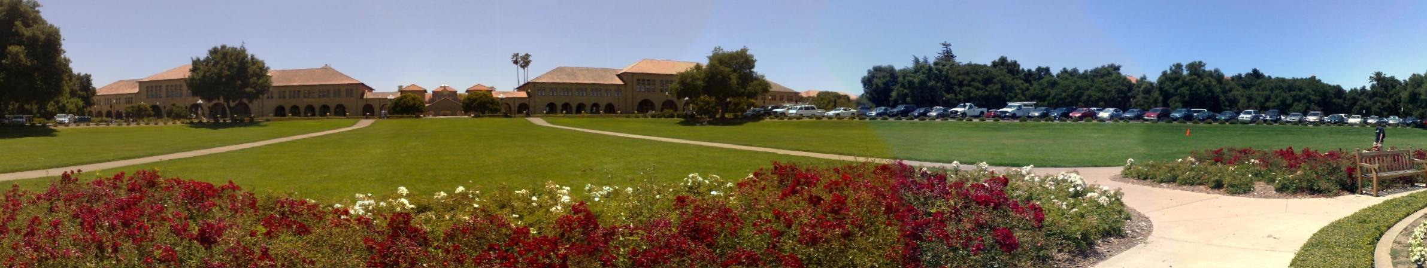
Color Mean Matching with Gamma Correction

Slide 14
Combination of Gamma and Linear Correction

Slide 15

Combination of Gamma and Linear Correction

Slide 16
Comparison of the Results

Slide 17
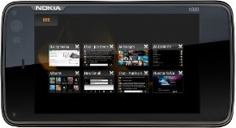
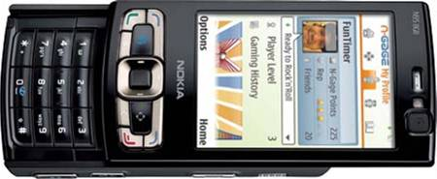
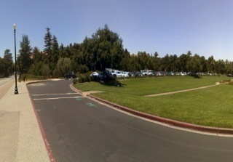
Applications and Result Analysis
Application environment
  Implemented in a
  mobile panorama imaging system
  Runs on several mobile devices
    Nokia N900, N8, N95, …
Nokia N900
ARM Cortex A8 600 MHz processor
256MB RAM
768MB virtual memory
3.5 inch touch display
Nokia N95 8G
ARM 11 332 MHz processor
128MB RAM
Nokia N8

Slide 18
Computation Time
Computational time for color correction:
    5 images: 0.37, 1.08, 1.86 seconds
    10 images: 0.97, 1.56, 4.12 seconds
Resolution | Time for 5 Images (sec.) |  |  |  | Time for 10 Images (sec.)
 | A | B | C | D | A | B | C | D
1280x960 | 0.37 | 3.30 | 2.48 | 6.15 | 0.97 | 6.96 | 5.44 | 13.37
2048x1536 | 1.08 | 6.72 | 4.70 | 12.50 | 1.56 | 14.44 | 10.46 | 26.46
2576x1936 | 1.86 | 15.98 | 12.25 | 30.09 | 4.12 | 35.63 | 29.34 | 69.09
    A: color correction, B image labeling, C: image blending, D: image stitching

Slide 19








Color and Color Mean matching

Slide 20










Gamma Correction in Different Color Spaces

Slide 21



















Different Color Correction
  Local linear correction in sRGB
  Local linear correction in YCbCr
  Global linear correction in sRGB
  Color matching with gamma correction
  Color matching with gamma mean correction

Slide 22
















Different Color Correction
  Local linear correction in sRGB
  Local linear correction in YCbCr
  Global linear correction in sRGB
  Color matching with gamma correction
  Color matching with gamma mean correction

Slide 23







Image Sequences with Random Order

Slide 24


















































More Examples

Slide 25
Conclusions
Color correction with color matching
  Gamma correction for luminance
  Linear correction for chrominance
Implementation
  Runs on mobile phones, high quality
    download from http://store.ovi.com to your N8 / N900
Advantages
  No color saturation problems during color correction
  Good color transitions for the whole image sequence
  Efficient (fast) execution

Slide 26
Thank You

Slide 27


Questions?
Download our mobile panorama software at http://store.ovi.com/content/51491

