Slide 1
A Survey of Image Retargeting Techniques
Daniel Vaquero¹, Matthew Turk¹,
Kari Pulli², Marius Tico², Natasha Gelfand²
¹University of California, Santa Barbara
²Nokia Research Center, Palo Alto

Slide 2
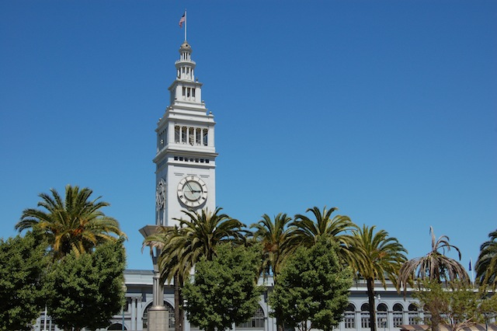
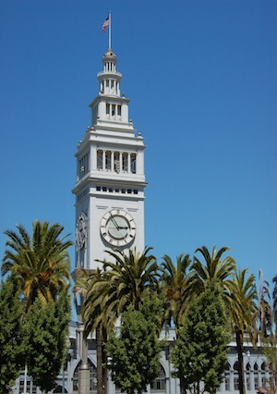
What is our paper about?
Literature Review of Image Retargeting Operators
Resize an image of size m x n to m’ x n’, while
Preserving important content
Preserving important structure
Generating a result free of visual artifacts
n
n’
m’
m
Notes:
Goals for this presentation: introduce the image retargeting problem, present our classification of methods, and give an overview of representative techniques

Slide 3
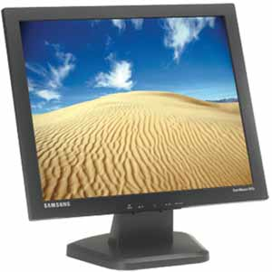
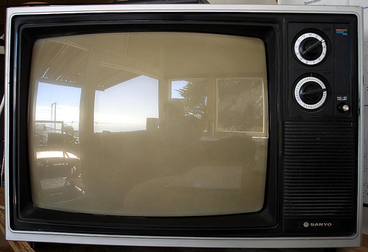
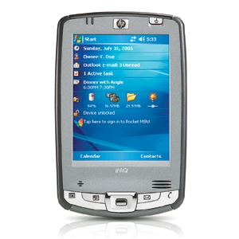
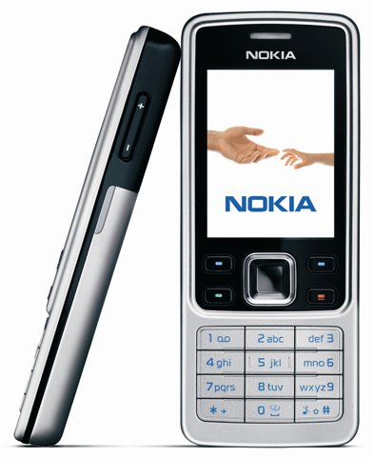
Applications
Display on Different Devices
Differences in
Size
and
Aspect Ratio

Slide 4
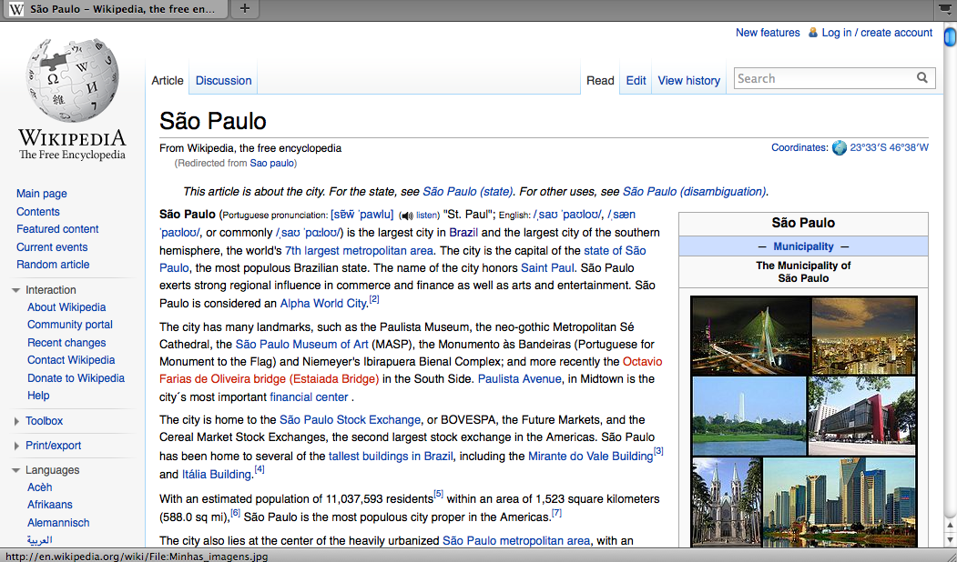
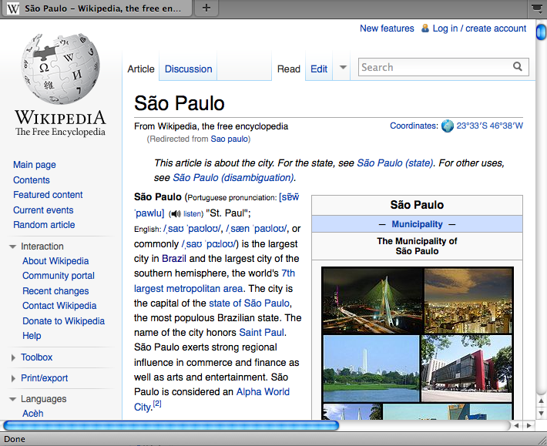
Applications
Dynamic Document Layout
Notes:
Text adapts to change in size, but it would be nice if images do it as well

Slide 5
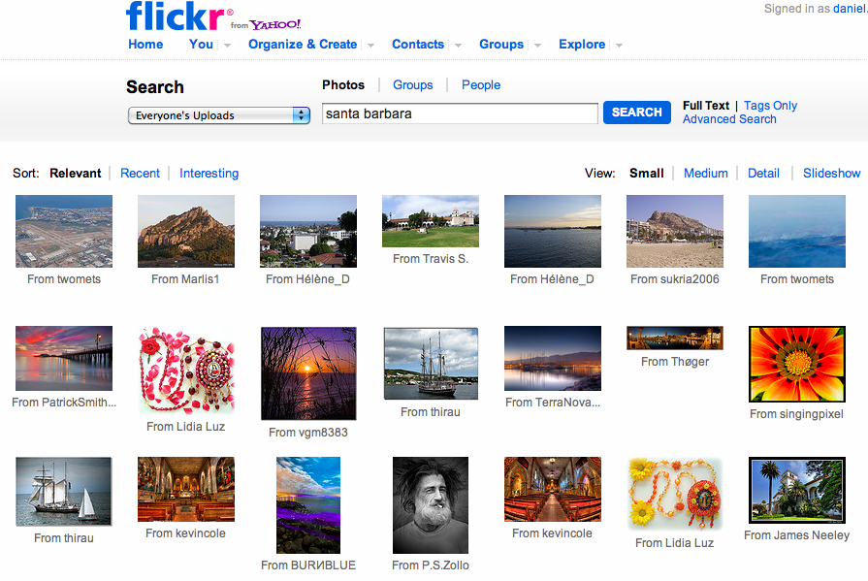
Applications
Thumbnails for Image Browsing

Slide 6
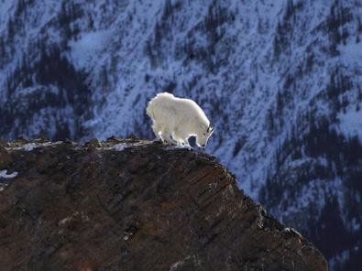
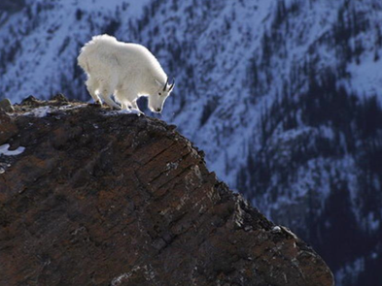
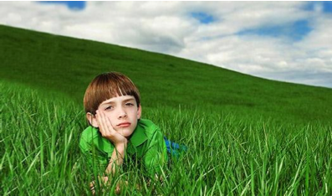
Applications
Improving Photo Composition
[Liu et al., Eurographics 2010]

Slide 7
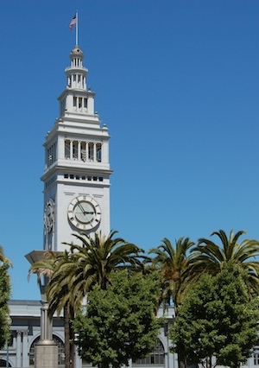
Content-Aware Image Retargeting
Preserve important
content while keeping an aesthetically
pleasing image
input
cropping
scaling
content-aware
Notes:
Cropping and scaling often do not give satisfactory results, content-aware methods try to preserve important content while keeping an aesthetically pleasing image

Slide 8
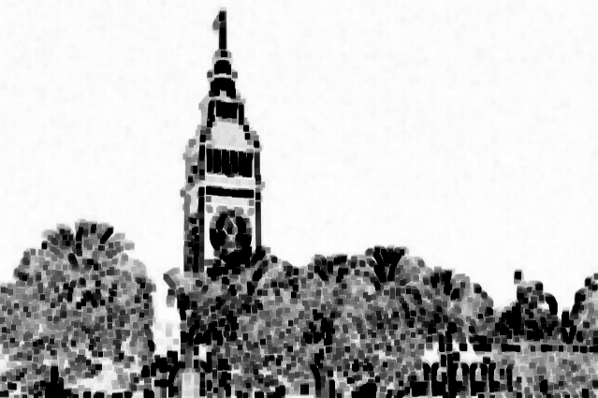
Content-Aware Retargeting Flow
Compute importance map
Retargeting operation
Image
Output image
Target image size
User interaction (optional)
Constraints (optional user interaction)
Notes:
The majority of content-aware retargeting techniques follows a similar flow.

Slide 9
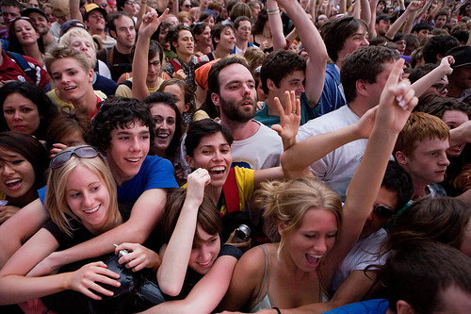
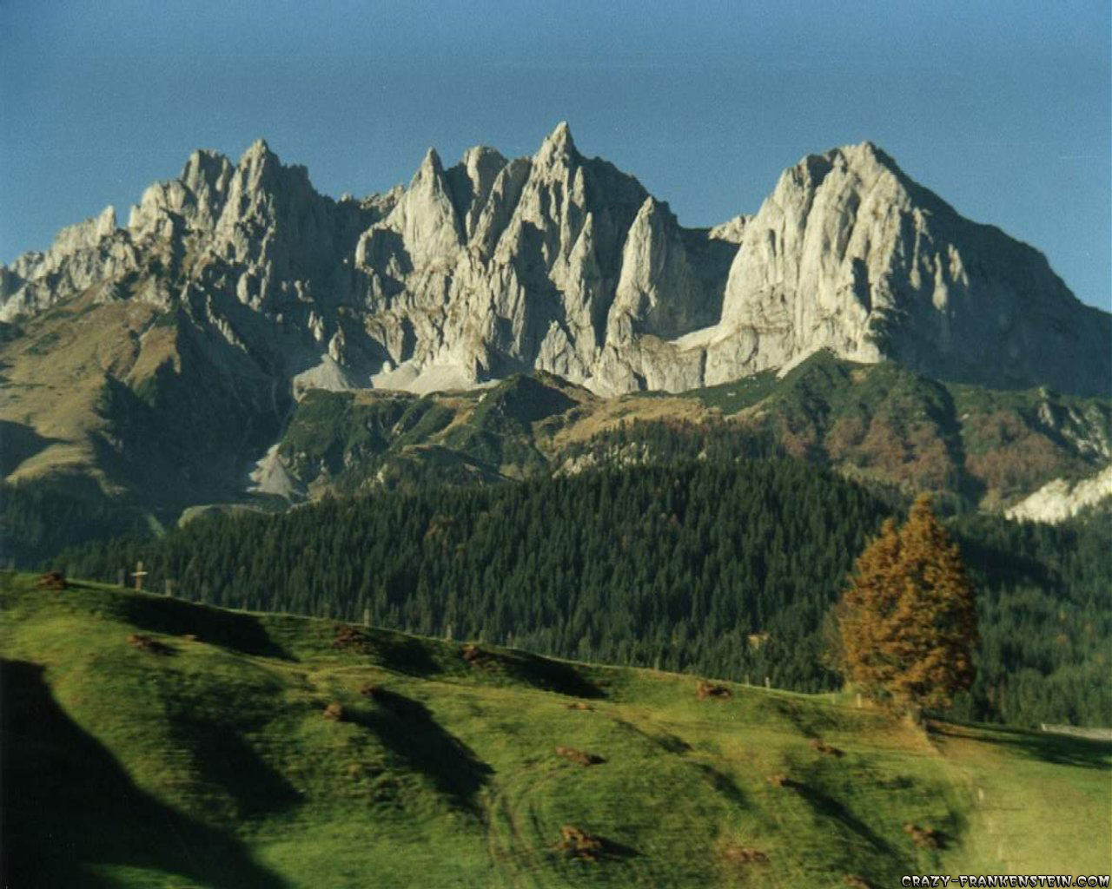
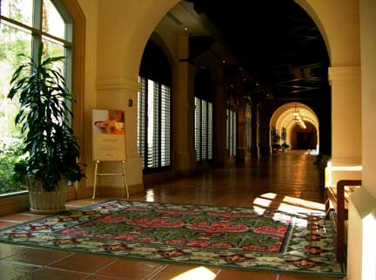
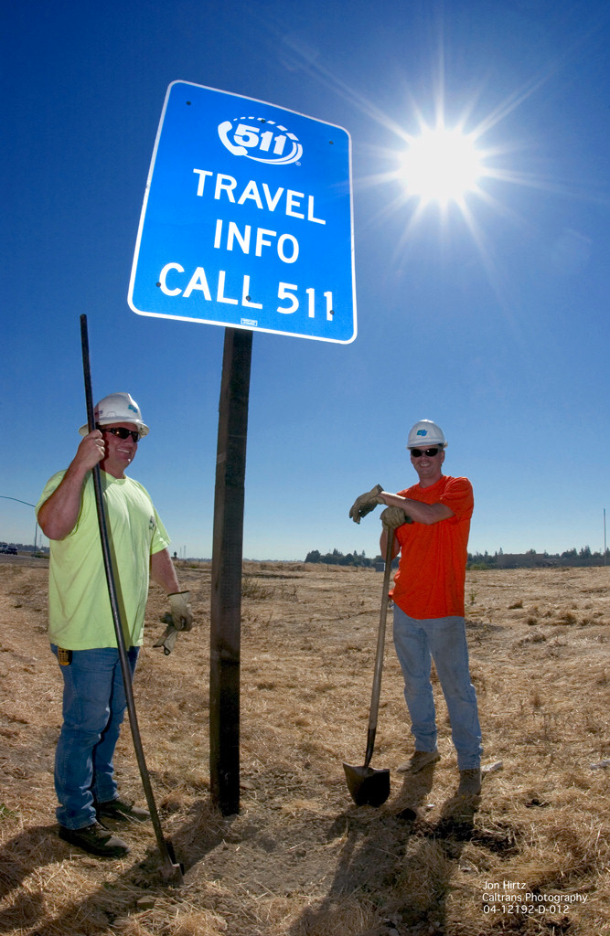
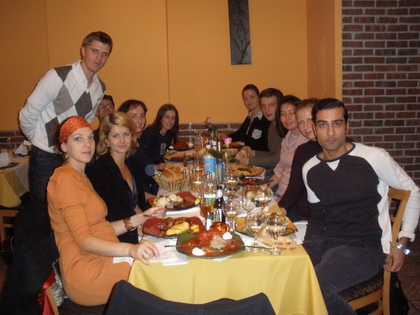
Challenges
How to determine what is important?
Variability of natural scenes
Computational complexity
Some applications require real-time retargeting, but content-aware methods often involve solving complex optimization problems
Notes:
Variability of natural scenes: landscapes, crowded scenes, faces, text, indoors, outdoors

Slide 10
Content-Aware Retargeting Flow
Compute importance map
Retargeting operation
Image
Output image
Target image size
User interaction (optional)
Constraints (optional user interaction)

Slide 11
Content-Aware Retargeting Flow
Compute importance map
Retargeting operation
Image
Output image
Target image size
User interaction (optional)
Constraints (optional user interaction)
Notes:
Duplicate the slide

Slide 12
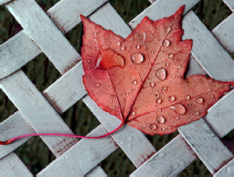
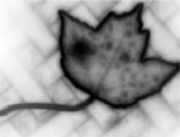
Importance Map Estimation
Assign a value in [0,1] to every pixel
Bottom-up methods
Low-level features (intensities, color, edge orientation)
Top-down methods
Semantic information (faces, text, structures, symmetries, etc.)
Semi-automatic methods (user interaction)
[Goferman et al., CVPR 2010]
Notes:
Bottom-up methods mimic how the human visual system directs attention
Top-down use semantic information
Techniques also may combine both
Subjective problem, user interaction is unavoidable

Slide 13
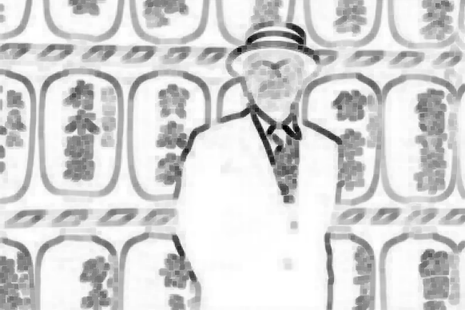
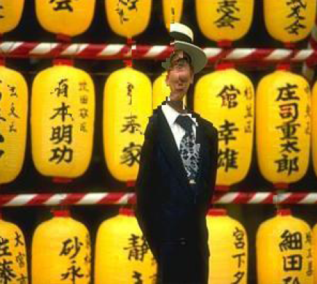
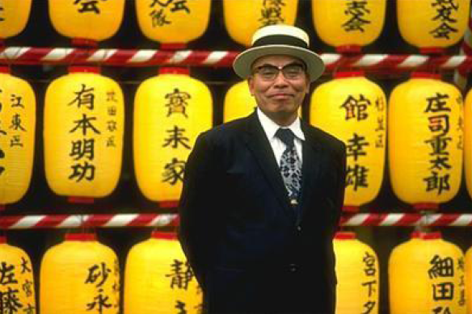
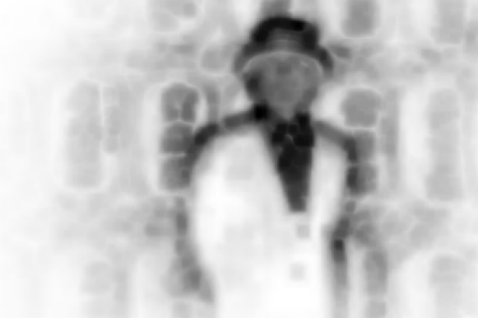
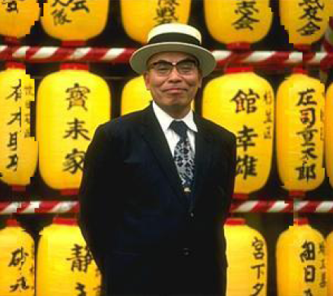
Importance Map
[Goferman et al., CVPR 2010]
gradient norm
result
input
context-aware saliency
result
Notes:
The importance map has direct influence over the retargeting result

Slide 14
Content-Aware Retargeting Flow
Compute importance map
Retargeting operation
Image
Output image
Target image size
User interaction (optional)
Constraints (optional user interaction)

Slide 15
Content-Aware Retargeting Flow
Compute importance map
Retargeting operation
Image
Output image
Target image size
User interaction (optional)
Constraints (optional user interaction)

Slide 16
Content-Aware Retargeting Operators
Our contribution: classification of methods
Automatic Cropping
Scaling Variants
Rapid Serial Visual Presentation (RSVP)
Segmentation-Based
Seam Carving
Warping-Based
Patch-Based
Multi-Operator
Notes:
One of our contributions is to come up with a classification of retargeting methods. We’ll give an overview of representative techniques in each class, please refer to the paper for a complete review.

Slide 17
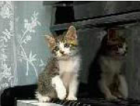
Automatic Cropping
[Suh et al., UIST 2003]
Select the cropping window that maximizes a quality measure
input
saliency map
result
result
input
face detection

Slide 18
Automatic Cropping
Other representative quality measures:
Aesthetic value [Nishiyama et al., ACM Multimedia 2009]
Gaze-based interaction [Santella et al., CHI 2006]
Automatic cropping:
Does not introduce artifacts
Does not distort the original image
Cannot retain all relevant content if important areas are scattered
Can only eliminate unimportant content at the periphery

Slide 19
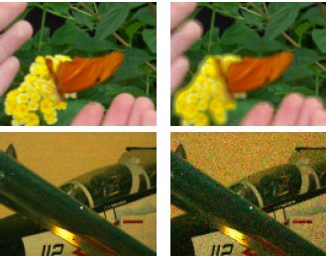
Scaling Variants
[Samadani et al., ICIP 2007]
Scaling:
Generates blockiness and aliasing
Key objects may become less visible or unrecognizable
Scaling variants try to
preserve details:
E.g., blurry and noisy thumbnails
standard
scaling
preserving
blur and noise

Slide 20
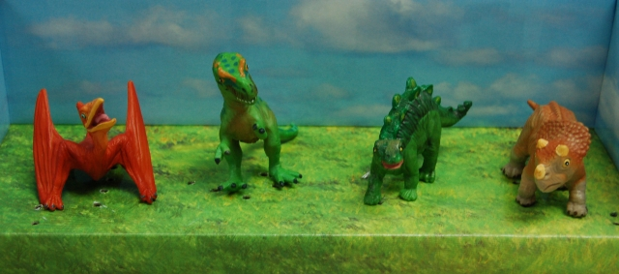
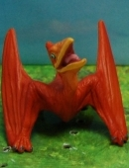
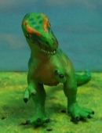
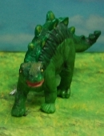
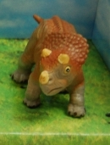
Rapid Serial Visual Presentation (RSVP)
[Liu et al., ACM Multimedia 2003]
Trade space for time
Generate an optimal path of pan and zoom operations
input

Slide 21
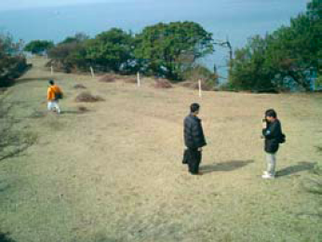
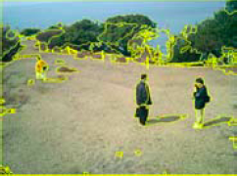
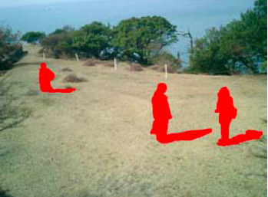
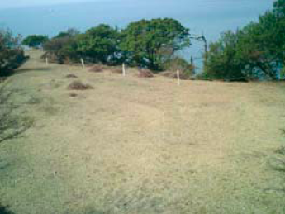
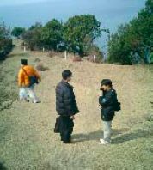
Segmentation-Based
[Setlur et al., MUM 2005]
input
segmentation
saliency map
object cut-out
inpainting
scaling
paste objects
Notes:
Depends on accurate segmentation and inpainting

Slide 22
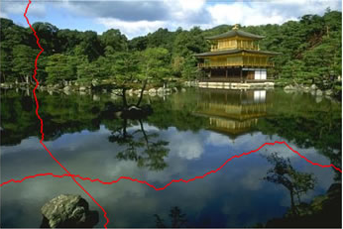
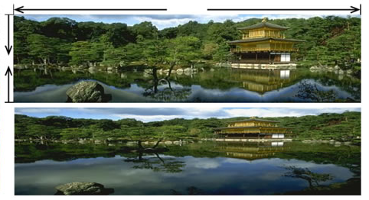
Seam Carving
[Avidan & Shamir, SIGGRAPH 2007]
Seam
8-connected path of pixels
1 pixel per row (column)
input
seam carving
scaling

Slide 23
Seam Carving
Produces impressive results when there are enough low-importance seams to be removed
Creates distortion and artifacts when seams cut through important areas
Extensions:
Forward energy criterion, graph cut formulation, extension to video [Rubinstein et al., SIGGRAPH 2008]
Importance diffusion [Cho et al., ICIP 2009]

Slide 24
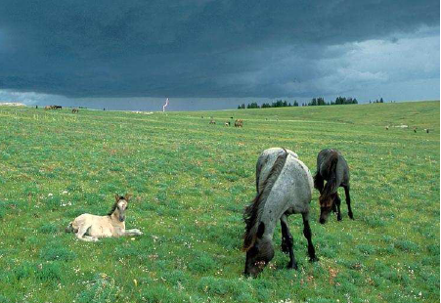
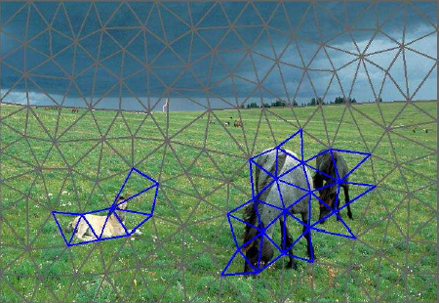
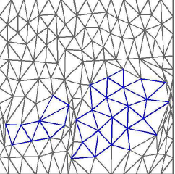
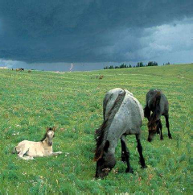
Warping-Based Methods
[Guo et al., IEEE Trans. MM 2009]
input
mesh + saliency
The local distortion of important regions is constrained to be as small as possible, while other regions can distort more
distorted
mesh
result

Slide 25
Warping-Based Methods
Do not create discontinuity artifacts
Can generate smearing artifacts
Can change the relative proportions of objects
Representative techniques:
Fisheye-view warping
[Liu & Gleicher, UIST 2005]
Constrained sparse linear
system of equations
[Wolf et al., ICCV 2007]
Mesh-based
[Wang et al., SIGGRAPH ASIA 2008]

Slide 26
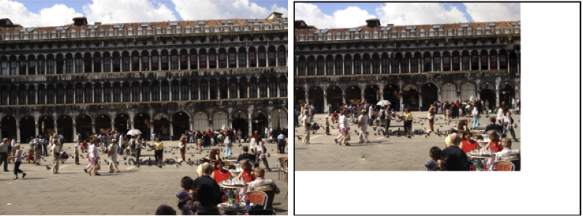
Patch-Based Methods
Retarget images through rearrangement of image patches, minimizing an input/output distance
Techniques:
Bidirectional similarity [Simakov et al., CVPR 2008]
Patch transform [Cho et al., CVPR 2008]
PatchMatch [Barnes et al., SIGGRAPH 2009]
Shift-map [Pritch et al., ICCV 2009]
[Cho et al., CVPR 2008]
input
output

Slide 27
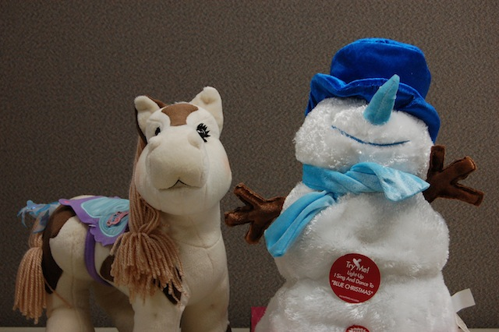
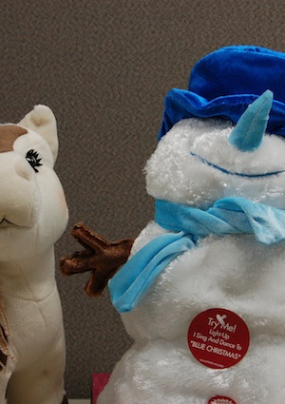
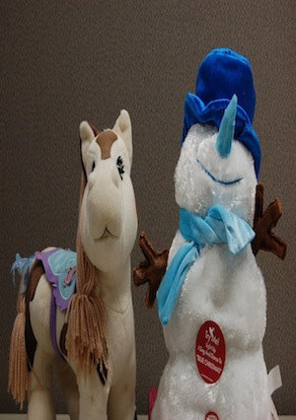
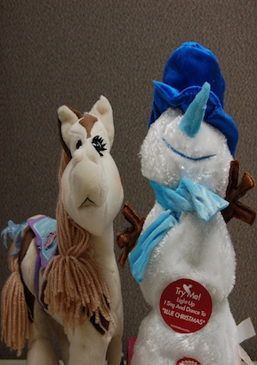
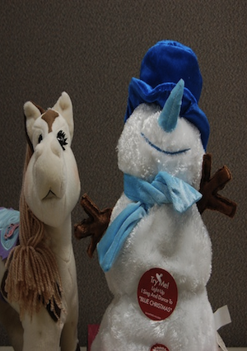
Multi-Operator Methods
[Rubinstein et al., SIGGRAPH 2009]
Find a sequence of operators
that minimizes a distance
measure between the input
and the output
input
cropping
scaling
seam carving
multi-operator

Slide 28
Discussion and Future Directions
Classification of image retargeting operators
Operators have advantages and disadvantages
Current trend: combination of operators
Evaluation is qualitative,…
There is a need for a standard dataset
…often subjective,…
Perceptual measures would be relevant
Interactive techniques are appropriate in some applications
…and depends on the application at hand
Domain-specific retargeting

Slide 29
Thank you!
Daniel Vaquero
www.cs.ucsb.edu/~daniel
ilab.cs.ucsb.edu

Slide 30
Straightforward Resizing Operators

