Slide 1
An Energy Efficient Time-sharing Pyramid Pipeline for
Multi-resolution Computer Vision
Qiuling Zhu, Navjot Garg, Yun-Ta Tsai, Kari Pulli
Notes:
Hello everyone. Thanks for coming to the talk. In this brief 12 mins, I would like to introduce you a novel pyramid architecture that aims for low energy, and area cost sensitive devices.

Slide 2

Notes:
Now we cannot possibly imagine a phone without a camera, can we?
But engineering such a tiny pinhole camera on a phone requires solving lots of engineering challenges.
Making it smaller means less light is coming in, which means the signal is more vulnerable to noise.
Lens has to be simple due to the packaging size, which means more distortion and aberration.
Optical zoom Is too luxury to have. Hence super-resolution is required.
We cannot defy the law of physics. But we can use math to help us reconstruct the signal in an optimal way, which requires a lot of computation.

Slide 3
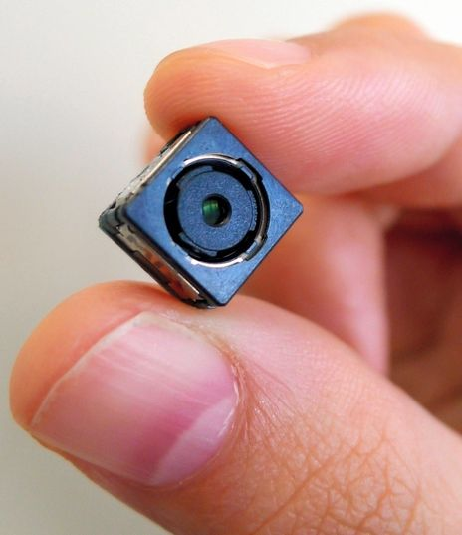

Image Processing Pipeline
Exposure / Focus Adjustment
Bad Pixel Correction
Black Level
Denoise
Demosaic
Lens Correction
Metering
Image Enhancing
Tone Mapping
Notes:
How much computation you say?
I am giving a very simple pipeline here from camera sensor to display.
The pipeline can change if we change the camera sensor.
Each time we change a camera, the whole process has to be recalibrated, which is very time consuming.
Some of the process is done by fixed function hardware which is very old fashion and could not keep up with the pace of the mobile world.
Move the whole process to the general processor is also very power hungry, and too much memory bandwidth is required.
Imagine that you have a 13MPix camera and want to be able to process it very very fast, and also very low power.
But we also do not want to design an ASIC that is not flexible. It has to work on every single camera system, no matter how different they are.

Slide 4
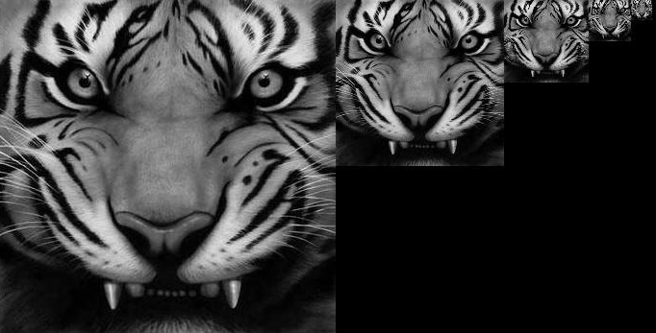
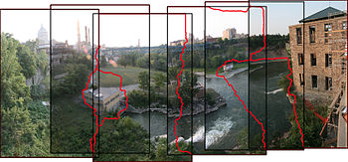
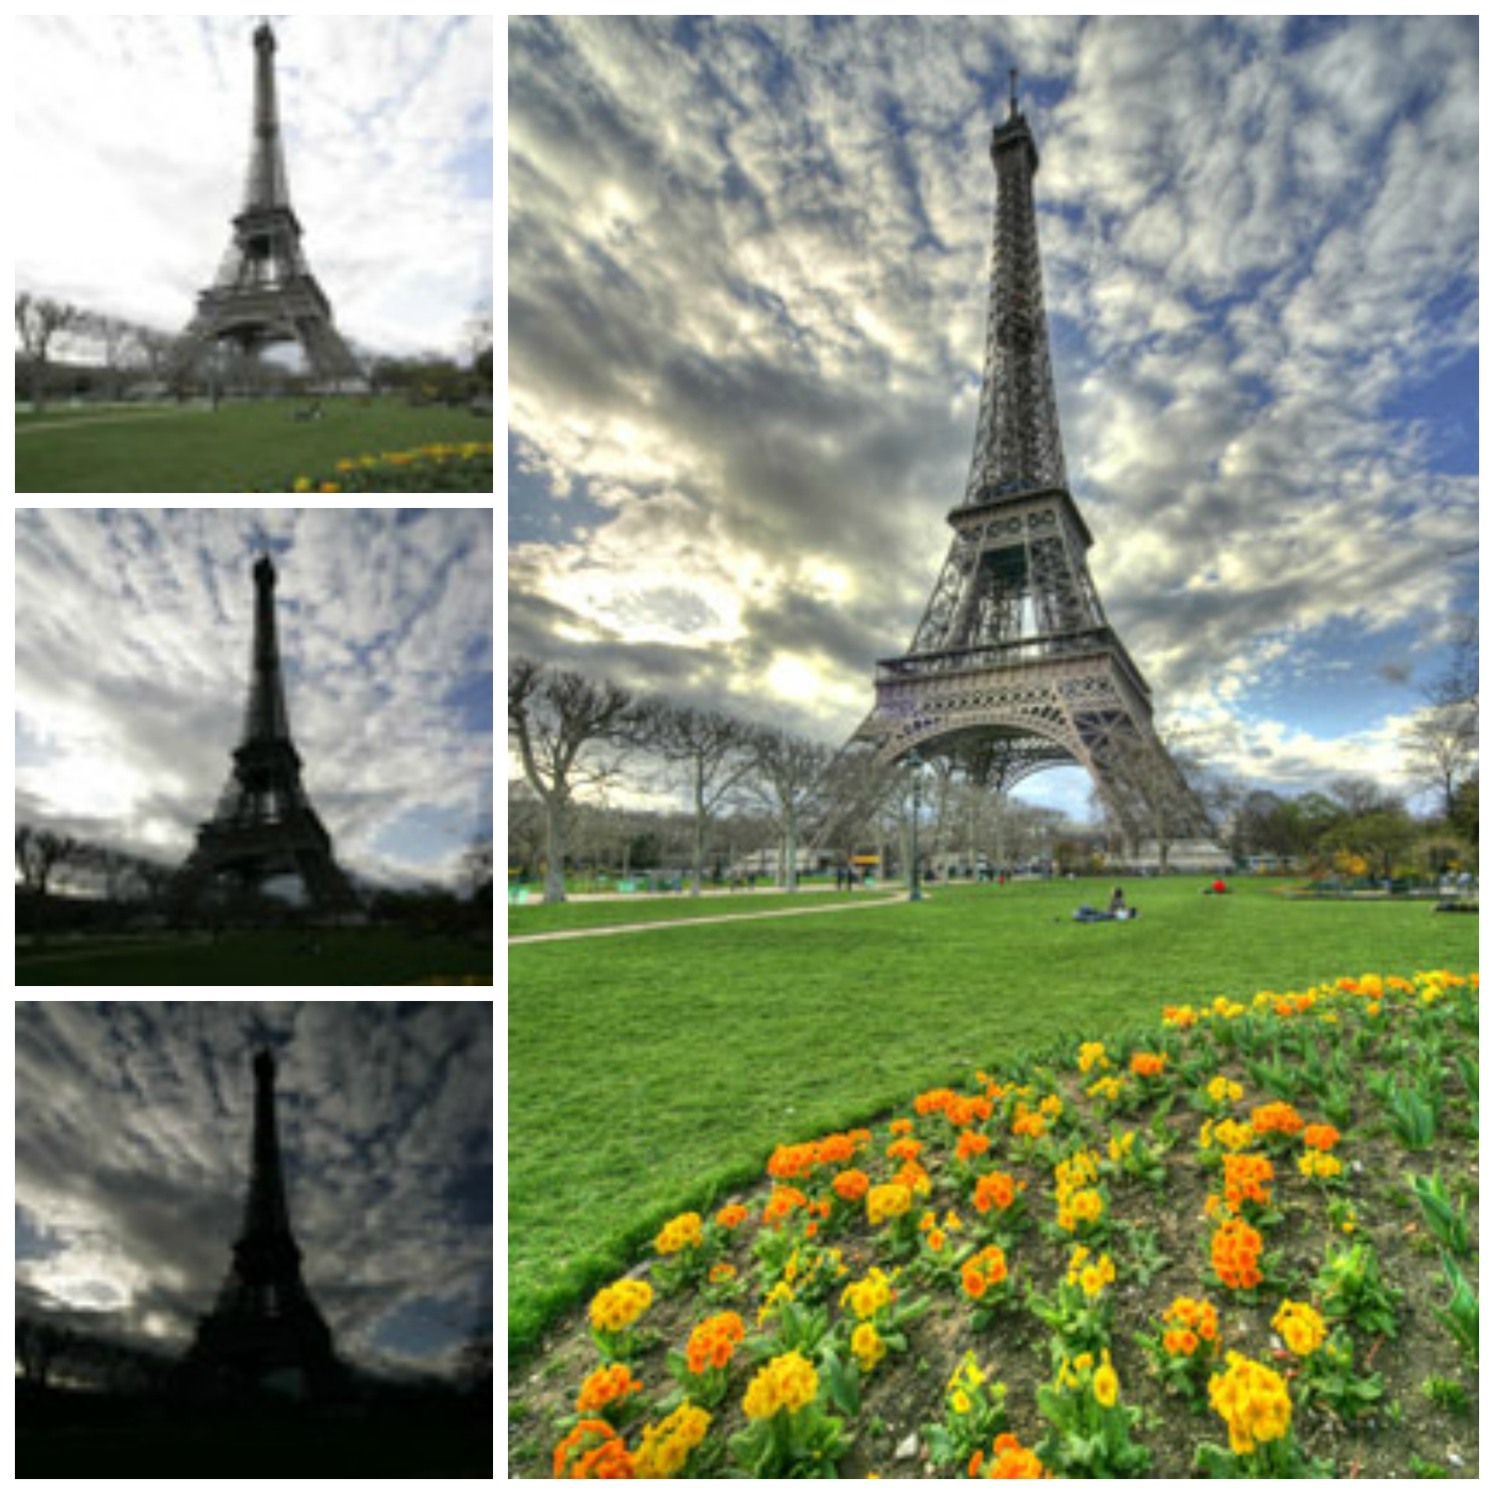
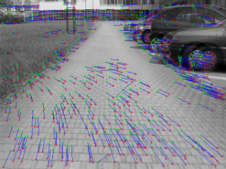

Motivation: Multi-resolution Processing
Notes:
Fortunately, all the image processing pipelines have something in common: multi-resolution processing.
Multi-resolution processing is ubiquitous everywhere in digital image processing.
<click>
From panorama stitching,
<click>
HDR imaging,
<click>
detail enhancement and sharpening,
<click>
as well as optical flow and object tracking, just to name a few.
As camera resolution increases, such intensive computation and memory bandwidth requirement quickly become the main bottleneck on an embedded device. The wide variety of applications present huge opportunities for hardware design.

Slide 5
Background: Linear Pipeline and Segment Pipeline
PYR-1
PYR-2
PYR-3
PYR-n
Input G₀
Line Buffer
Line Buffer
Line Buffer
Line Buffer
G₁
G₂
G₃
G₄
Input G₀
PYR
G_{k+1}
Output
G_{k}
Line Buffer
DRAM
Notes:
There are two common approaches that have been used in the past. Linear Pipeline and Segment Pipeline.

Slide 6

Linear Pipeline
PYR-1
PYR-2
PYR-3
PYR-n
Input G₀
Line Buffer
Line Buffer
Line Buffer
Line Buffer
G₁
G₂
G₃
G_{n}
+ Less demand of off-chip memory bandwidth
- Inefficient use of the PE resources
- Area and power overhead
Notes:
Linear Pipeline duplicates separate processing elements (PEs) for each pyramid level. All processing elements (PEs) work together for all pyramid levels in parallel.
Such design is incredibly simple.
<click>
There is no global memory traffic at all. All the intermediate data streams through the line buffer without the need of storing back to the DRAM, which conserves memory bandwidth.
<click>
Yet, it is very inefficient. Successive processing elements work at ¼ reduced clock rates, making less efficient use of the computational resources. The duplication of the logic also consumes more area and power than necessary.

Slide 7
Segment Pipeline
Input G₀
PYR
G_{k+1}
Output
G_{k}
Line Buffer
DRAM
+ Small area cost
- Requires very high memory bandwidth
Notes:
Unlike the Linear Pipeline, the Segment Pipeline only has one processing element (PE).
<click>
Such design is extremely area cost effective.
<click>
However, it can only process one pyramid level at a time. The intermediate data will have to store back to the global memory which results high memory bandwidth.

Slide 8
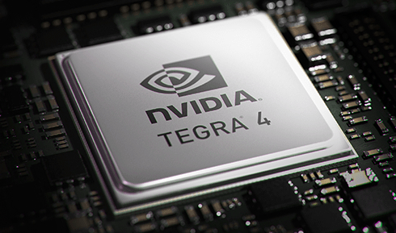
Design Principles
Low Power
  Minimize DRAM traffic
Small Area
  Logic reuse
High Throughput
  Data parallelism
Flexibility
  Configurable filter banks
Notes:
When we start to design our own pipeline, we set a few goals that try to improve the shortcoming of previous approaches:
<click>
Low power via minimizing the DRAM traffic.
<click>
High throughput through data parallelism.
<click>
Small area from logic reuse.
<click>
Flexibility with configurable filter banks.
Now we will discuss how we achieve each one of them in further detail.

Slide 9



Time-sharing Pipeline: Exploit Spatial Locality
Timing Mux
G₂
G₁
PE
G₀
Notes:
Unlike previous approaches, we fully exploit the spatial locality of a pyramid.
<click>
In a typical pyramid, each pixel only needs 4 pixels from the previous level.
We can interleave the operation of each level with a timing mux.
<click>
Once we have accumulated enough of pixels, we can immediately switch to next level without waiting for the whole image being processed.
Not only we can reuse the logic, the processing element (PE) is also always busy.

Slide 10
PYR-2
PYR-2
PYR-3
PYR-3
PYR-n
PYR-1
PYR-n
PYR-1
Input G₀
Input G₀
Line Buffer
Line Buffer
Line Buffer
Line Buffer
Line Buffer
Line Buffer
Line Buffer
Line Buffer
G₁
G₁
G₄
G₃
G₄
G₂
G₃
G₂
Notes:
Comparing with the linear pipeline,
<click>
we leave only one processing element (PE) and line buffers.
The cost of the processing logics is tremendously reduced without increasing the penalty of global memory traffic.

Slide 11
Input G₀
Input G₀
PYR
PYR
Output
G_{k+1}
Output
G_{k+1}
G_{k}
G_{k}
Line Buffer
DRAM
Line Buffer_{k}
Line Buffer_{k+1}
Line Buffer_{n}
Notes:
Comparing with the Segment Pipeline,
<click>
our intermediate data never goes out to the global memory, and only process part of the image before executing the next pyramid level.

Slide 12
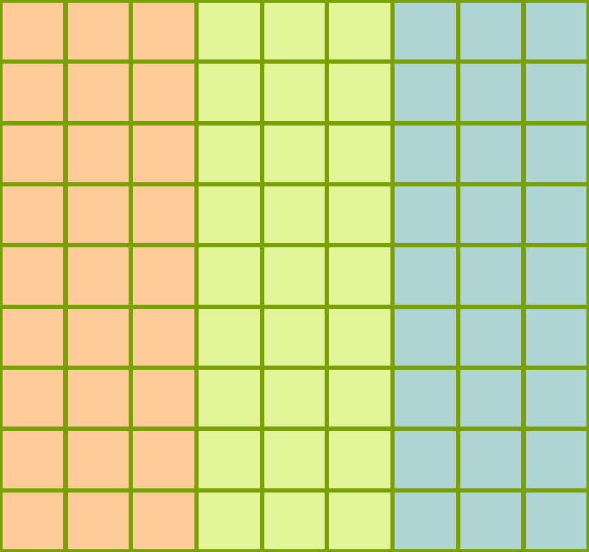
Data Parallelism
Slice 0
Slice 1
Slice 2
Notes:
If we understand how to exploit spatial locality, we can push the concept even further by adapting data parallelism.
<click>
For example, we can divide the image into slices. Each time-sharing pipeline can operate on each slice independently. This increases throughput and scalability.
Because we reduced the area cost and memory bandwidth, we could put a lot of them.
We can optimize the parallel degree with given power and area budget. For detail analysis, please refer to our paper.

Slide 13

Notes:
Time-sharing pipeline sounds great. However, it is only useful if it can be adapted into the real world applications.
We selected two of the most common pyramids to demonstrate our architecture: Laplacian and Hierarchical Lucas-Kanade.

Slide 14





Laplacian Pyramid
Notes:
Laplacian Pyramid is one of the most important pyramids. It has been widely used in many image processing applications.
To construct the pyramid,
<click>
we first convolve the image with Gaussian kernel then down sample it. The down-sampled result will be up-sampled back to the original resolution then subtract with the previous image.
The difference of the two images is the approximation of the Laplacian which records certain frequency data.
<click>
Repeating this process will construct the pyramid.
Why is this particular pyramid useful?
It is because different frequency band of the image signal is stored in different level of the pyramid.
We can manipulate certain frequency bands without polluting others.

Slide 15
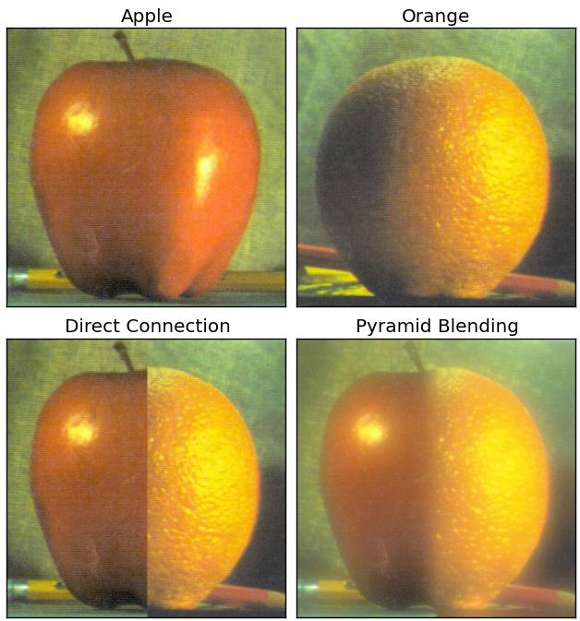
Notes:
Imagine that you have apple and orange, cutting them in half and stitching together will show sharp seam.
<click>
However, if we blend each frequency band separately, the sharp seam will be replaced by the smooth transition.
There are many applications in image processing and computer vision relying on this approach such as panorama stitching and high dynamic range photography.

Slide 16
Timing Mux
Timing Mux
Timing Mux
G4
Timing Mux
G4
G4
G4
Timing Mux
Timing Mux
Timing Mux
Timing Mux
Timing Mux
Timing Mux
Timing Mux
Timing Mux
G3
G3
G3
G3
G2
G2
G2
Conv2
G2
Conv2
Conv2
Conv2
Conv2
Conv2
Conv2
Conv2
G1
G1
G1
G1
G0
G0
G0
G0
DRAM
DRAM
DRAM
DRAM
Notes:
I am going to show you how we adapt time-sharing pipeline to the Laplacian Pyramid.
The pipeline operates in 3 stages:
<click>
the first stage resembles a gaussian pyramid;
<click>
the second stage performs up-sampling;
<click>
the third stage computes the difference of gaussian.
Other convolution pyramids can also be easily adapted into a similar form.
However, what if the pyramid pipeline is not convolution based?

Slide 17
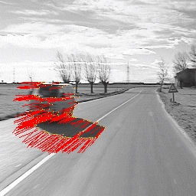
Hierarchical Lucas-Kanade
Notes:
Window search is another the most common form of pyramids on computer vision applications.
For example, optical flow, object recognition, face detection, etc. In our study, we use Lucas-Kanade as an example.

Slide 18
Q
Q
t
t + 1
Notes:
Here I am going to briefly explain how Lucas-Kanade algorithm works without going into too much detail.
Imagine that you have two frames in temporal order at time t and t + 1.
We want to find out the motion of a block Q between the frames.
Assuming the lighting condition did not change dramatically, then we can assume the intensity of Q in these two frames are constant.

Slide 19
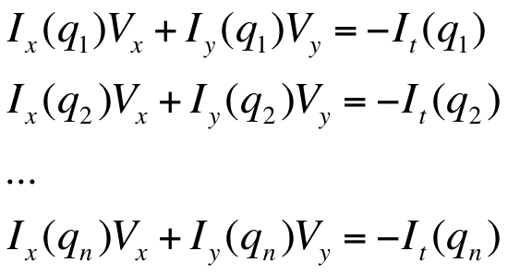
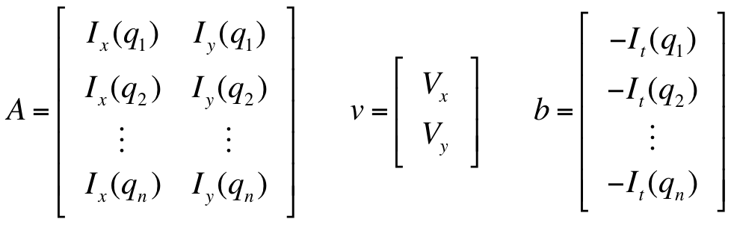
Notes:
Thus, our goal is to find a motion vector (Vx, Vy) that maintain intensity consistency constrain.
<click>
We could also write the formula into matrices, and solve this equation under least square principles. We first guess the initial motion vector, and gradually descent to the right solution.

Slide 20


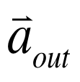
A₃
~A₃
B₃
warp
refine
A₂
~A₂
B₂
A₁
warp
~A₁
refine
B₁
A₀
~A₀
B₀
warp
refine
warp
refine
Notes:
To adapt hierarchical approach, we first construct two gaussian pyramids for both frames.
<click>
One we have gaussian pyramids, we start to search the motion from coarse to fine fashion.
Warp operator allows us to query the value of a pixel with given estimated motion vector; the refine operator tries to refine the solution based on the least square principle I just explained.
The result propagates to the finest level.

Slide 21
Timing Mux
Timing Mux
Timing Mux
Timing Mux
MV4
MV4
MV3
MV3
MV2
MV2
MV1
MV1
MV0
MV4
MV0
MV4
MV3
MV3
MV2
MV2
MV1
MV1
MV0
MV0
G4-A
G4-A
G4-B
G4-A
G4-B
G4-A
G4-B
Timing Mux
G4-B
Timing Mux
Timing Mux
Timing Mux
Timing Mux
Timing Mux
Timing Mux
Timing Mux
Timing Mux
Timing Mux
Timing Mux
Timing Mux
Timing Mux
Timing Mux
Timing Mux
Timing Mux
ME
ME
ME
ME
G3-A
G3-A
G3-B
G3-A
G3-B
G3-A
G3-B
G3-B
warp
warp
warp
warp
Conv2
Conv2
Conv2
Conv2
Conv2
Conv2
Conv2
G2-A
Conv2
G2-A
G2-A
G2-A
G2-B
G2-B
G2-B
G2-B
G1-A
G1-A
G1-A
G1-A
G1-B
G1-B
G1-B
G1-B
Warp-Cache
Warp-Cache
Warp-Cache
Warp-Cache
G0-A
G0-A
G0-A
G0-A
G0-B
G0-B
G0-B
G0-B
DRAM
DRAM
DRAM
DRAM
Notes:
To represent the algorithm in the form of time-sharing architecture, we break it up into 3 stages:
<click>
Gaussian pyramid construction from fine to coarse, which is not much different from the Laplacian Pyramid,
<click>
motion estimation from coarse to fine,
<click>
and motion vector propagation.

Slide 22
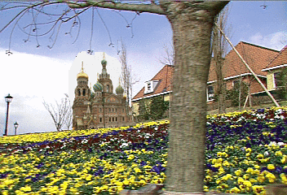
Simulation Result
Optical flow (velocity) on a benchmark image with a left-to-right movement
Notes:
We implemented a functional simulator for Lucas-Kanade optical flow, and here is the simulation result.

Slide 23
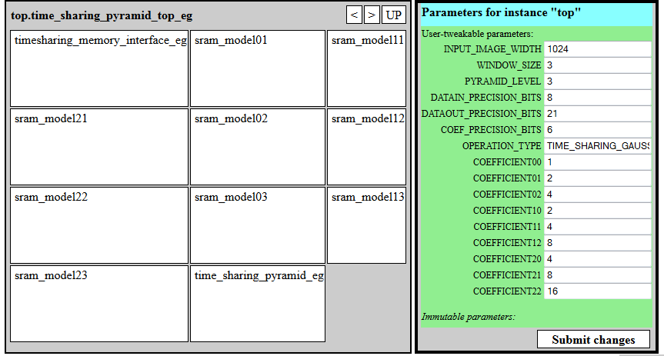
Hardware Synthesis in 32nm CMOS
SRAM line buffer
Sliding window shift registers
DIN
M
U
X
M
U
X
TIMGING SHARING
CONTROL
Level-1
DRAM_EN
PE
Conv2
M
U
X
M
U
X
M
U
X
Level-2
M
U
X
DOUT
M
U
X
Level-3
Block diagram of a convolution-based time-sharing pyramid engine
(e.g., 3-level Gaussian pyramid engine with a 3x3 convolution window)
Hardware chip generator GUI
Notes:
To evaluate actual HW performance, we synthesized the pipeline using Genesis 2 chip generator based on 32nm technology.
Here is how the uArch of the time-sharing pipeline looks like. We have timing-sharing control logic to determine which level of the pyramid that the processing element can access.
In between the control logic, we have line buffer and shift registers for each level.
From the uArch, we can clearly see that time-sharing pipeline has overhead of the control logic, line buffers and shift registers. The cost is proportional to the number of levels.
One purpose of our evaluation is trying to figure out whether such overhead would out weight the benefit.

Slide 24
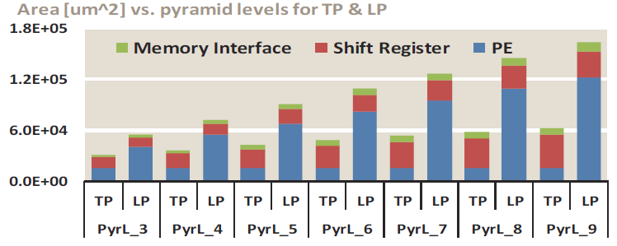
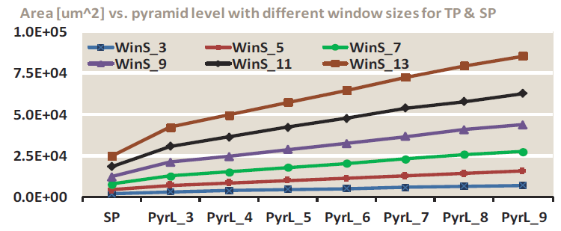
Area Evaluation
Design points are running at 500 MHz on 32nm CMOS
Time-Sharing Pipeline (TP ) vs. Linear Pipeline (LP)
Save area costs from PE reused
The overhead of shift Registers and control logic are negligible
Time-Sharing Pipeline (TP ) vs. Segment Pipeline (SP)
TP consumes more area as the number of pyramid levels grows
TP is competitive when window size is relative small
Notes:
We ran the simulation on 32nm process for each architecture design.
Comparing with the linear pipeline (LP), time-sharing pipeline (TP) clearly has advantages in both power and area consumption. Time-sharing pipeline (TP) costs 40% less in both area and power.
The gap widen as the pyramid level increased, which indicates time-sharing pipeline (TP) scales much better than the linear pipeline (LP).
Breaking down the cost, time-sharing pipeline has constant cost on the processing element (PE). The costs of shift registers dominates as the levels of pyramid increased.
<click>
Comparing with the segment pipeline (SP), time-sharing pipeline (TP) is more expensive with large support region, but competitive when the window size is relative small (3x3 and 5x5).

Slide 25
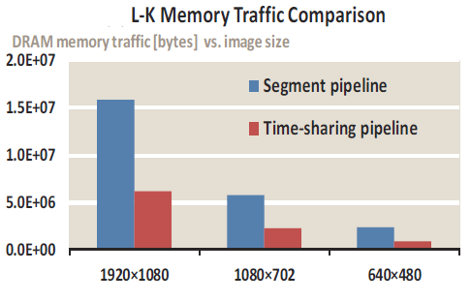
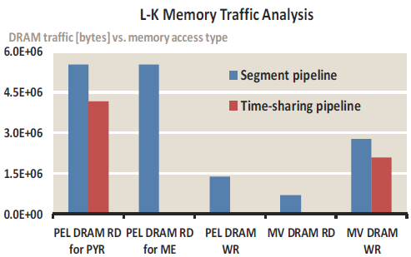
Memory Bandwidth Evaluation
DRAM traffic is an order of magnitude less than SP ➔ Energy saving
TP has no intermediate data traffic to DRAM
Notes:
On the other hand, the time-sharing pipeline has very little global memory traffic comparing to the segment pipeline. We performed Lucas-Kanade optical flow on two designs, the difference is huge. The gap widen when the resolution increased. Such saving also leads to further energy saving.

Slide 26
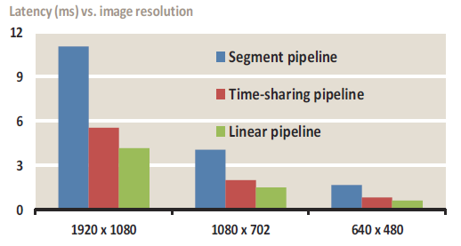
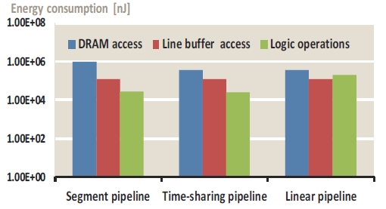
Overall Performance & Energy Evaluation
TP is almost 2x faster than SP
TP is only slightly slower than LP,
while eliminating all the logic costs
Energy consumption is dominated by DRAM accesses
vs. SP: 10x saving on DRAM access (log scale),
similar on chip memory access and logic processing cost
vs. LP: Similar DRAM access cost,
but less energy cost on the on-chip logic processing
Notes:
Overall, the time-sharing pipeline is about 2x faster than the segment pipeline which greatly benefits many latency sensitive applications such as object tracking.
The linear pipeline is the fastest overall but it consumes more area and power.
In terms of energy, DRAM access dominates the power.
Comparing with the segment pipeline (SP), we have 10x saving on DRAM traffic.
Comparing with the linear pipeline (LP), we have similar costs on DRAM access, but cheaper costs on logic operation.

Slide 27
Summary
A novel architecture that keeps the best of the both worlds:
  Low DRAM traffic
  Competitive area cost
Application demonstration:
  Laplacian Pyramid
  Hierarchical Lucas-Kanade optical flow
Performance analysis
Next: heterogeneous imaging pipeline across multi-core system
Questions?
Notes:
In conclusion,
<click>
we presented an architecture that tries to keep the best of both linear and segment pipeline, and weed out their shortcoming.
<click>
We also demonstrate how our architecture can be adapted by different applications.
<click>
Finally, we presented performance analysis on 32nm technology.

