Slide 1
Robust Interactive Image Segmentation with Automatic Boundary Refinement
Dingding Liu* Yingen Xiong† Linda Shapiro* Kari Pulli†
† Nokia Research Center, Palo Alto, CA 94304, USA
*Department of Electrical Engineering,
University of Washington, WA 98095, USA

Slide 2
Contents
Introduction
Motivation
Related work
Summary of Method
Details of Approach
Merge pre-segmented regions
Detect suspicious low-contrast object boundary regions
Refine suspicious boundary regions
Experiments and Results
Conclusions and Future Work

Slide 3
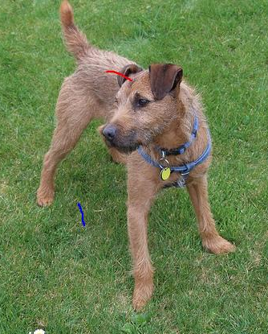
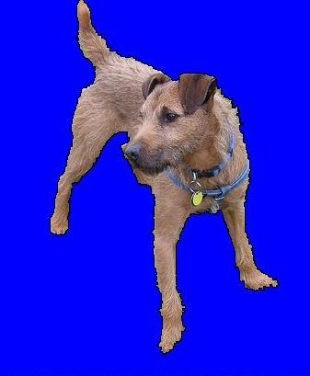
Introduction
Research aim Make interactive segmentation more robust and less sensitive to user input

Slide 4
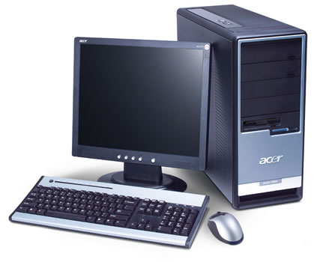
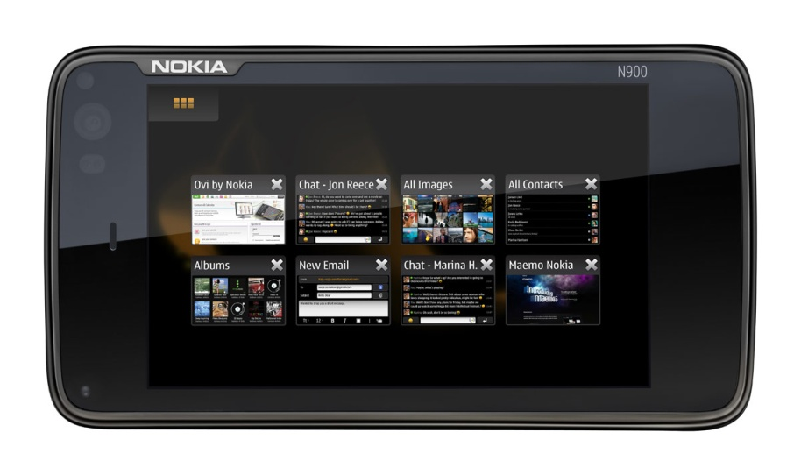
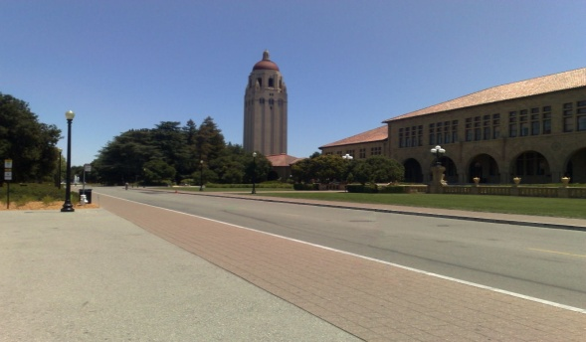
Introduction
Motivation: Image editing on mobile devices
Convenience – Anytime, anywhere
Challenges – Limited computational resources Smaller screens and imprecise input

Slide 5
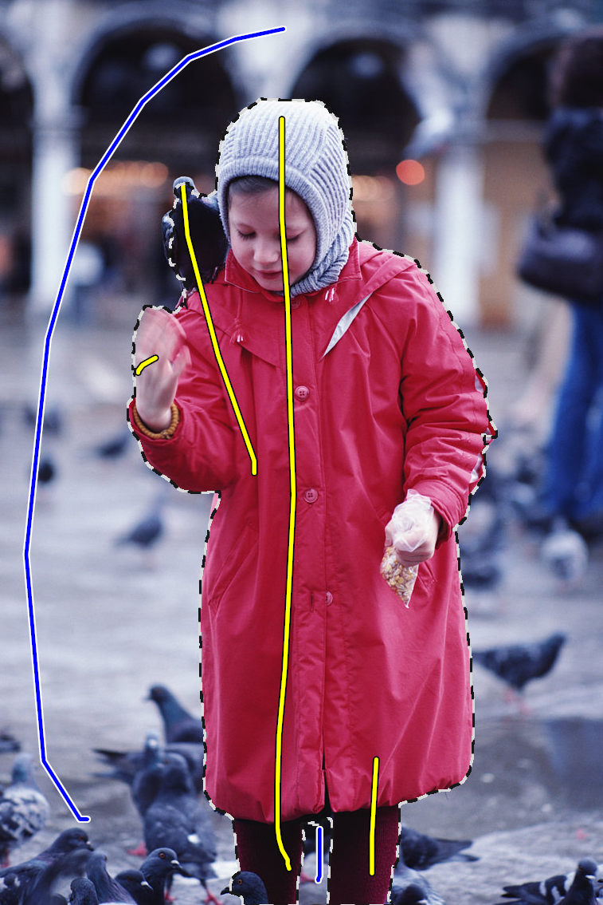
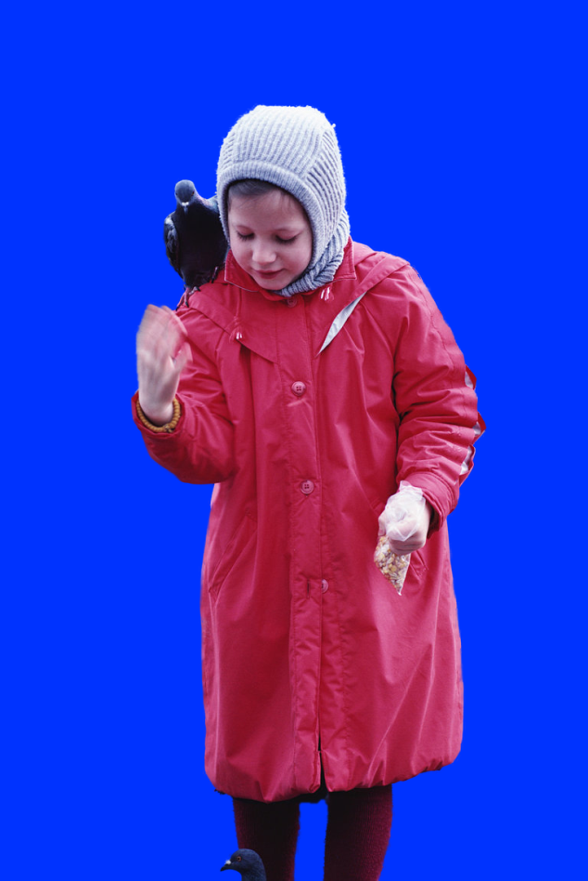
Related Work - Interactive Image Segmentation
Lazy Snapping ( Li et al., ACM Transactions on Graphics 2004)

Slide 6
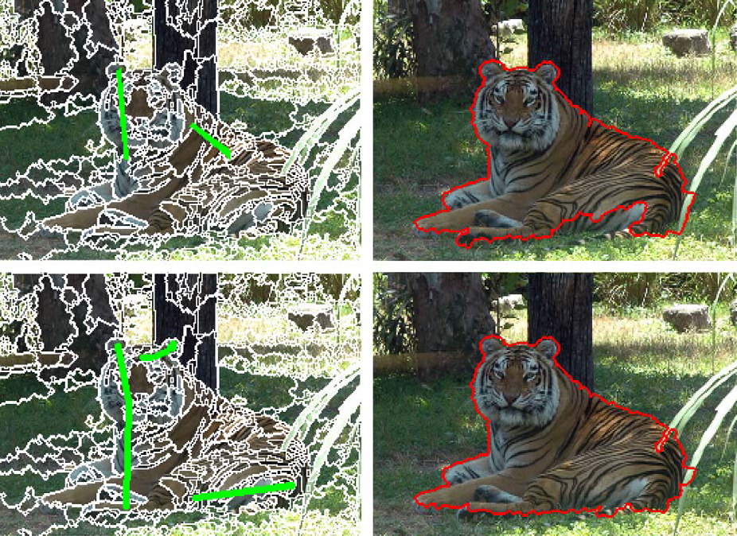
Related Work - Interactive Image Segmentation
Interactive Image Segmentation by Maximal Similarity Based Region (Ning et al., Pattern Recognition 2010)

Slide 7
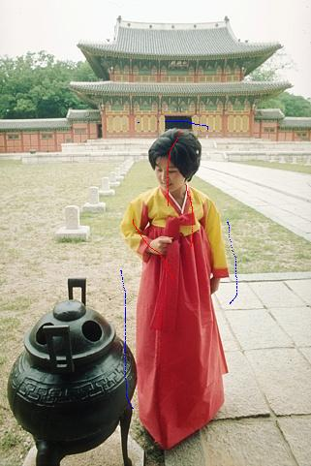
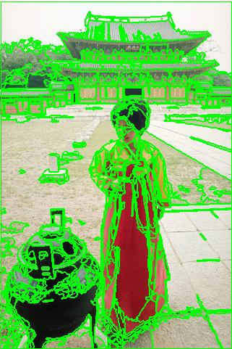
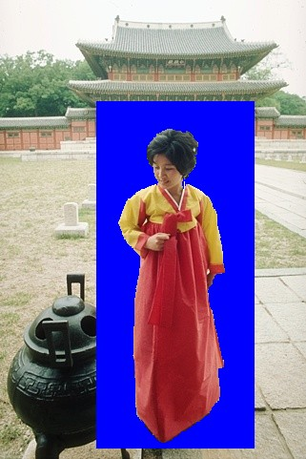
Summary of Method
Merge pre-segmented regions according to user inputs
Detect suspicious low-contrast object boundary regions
Relabel those regions

Slide 8
Contents
Introduction
Motivation
Related work
Summary of Method
Details of Approach
Merge pre-segmented regions
Detect suspicious low-contrast object boundary regions
Refine suspicious boundary regions
Experiments and Results
Conclusions and Future Work

Slide 9
Algorithm: Merge Pre-segmented Regions
Merge regions according to Maximal Similarity-Based Region Merging (MSRM) rule:
Merge R and Q if R is Q’s most similar neighboring region
Marked Background Region
Marked Foreground Region | Unlabeled Region1 (Q) | Unlabeled Region2
 | Unlabeled Region3 (R) | Unlabeled Region4
Marked Background Region
Marked Foreground Region | Q+R = Merge of ( Unlabeled Region1 (R) &Unlabeled Region3 (Q) ) | Unlabeled Region2
 |  | Unlabeled Region4

Slide 10
Algorithm: Detect Low-Contrast Object Boundary Regions
Largest minimum mean color difference
Larger minimum mean color difference
Median minimum mean color difference
Smaller minimum mean color difference
Smallest minimum mean color difference
Put all the boundary regions’ minimal mean color differences with their neighboring regions dbd into a vector Dbd
Set the median of Dbd as threshold
Suspicious low-contrast object boundary regions
Select the regions whose dbd< threshold

Slide 11
Algorithm: Refine Suspicious Boundary Regions
Re-evaluate each suspicious region by relabeling the pixels in side
Marked Regions
Local Info
Texture Similarity
Color Similarity
Count the number of foreground and background pixels inside each region to decide whether it should be foreground or background
P1 | P2 | P3
P4 | P0 | P5
P6 | P7 | P8
Suspicious regions
Global information: Color and texture similarity with marked regions
Local information: Pixels similarity with its neighbors
Notes:
Each pixel in the selected low-contrast boundary regions is classified to be foreground or background according to its local and global information
Count the number of foreground and background pixels inside each region to decide whether it should be
foreground or background

Slide 12
Algorithm: Refine Suspicious Boundary Regions
Relabel pixels in the low-contrast boundary regions
A binary labeling problem
Minimize energy terms
Data term measuring color and texture similarity
Pairwise term measuring gradient along object boundary
Notes:
E1 encodes the color similarity of a pixel to the marked foreground
or background, taking into account the color standard deviation
(std) within the regions, which can be regarded as the simplest
texture information. They are also used to weight the color difference
and std difference.
E2 is the energy due to the gradient along the
object boundary. It also acts like a smoothing term, enforcing that
similar neighboring pixels have the same label.

Slide 13
Algorithm: Refine Suspicious Boundary Regions
Color similarity and standard deviation of regions
Notes:
For each pixel i, suppose C(i) is its color, F
n is the mean color
of marked foreground regions, B
m is the mean color of marked background
regions, and (i) is the std of the region which it belongs to.
F
n is the foreground region std, and B
m is the background region
std. The following distances are computed:

Slide 14
Algorithm: Refine Suspicious Boundary Regions
for
Notes:
For each pixel i, suppose C(i) is its color, F
n is the mean color
of marked foreground regions, B
m is the mean color of marked background
regions, and (i) is the std of the region which it belongs to.
F
n is the foreground region std, and B
m is the background region
std. The following distances are computed:

Slide 15
Algorithm: Refine Suspicious Boundary Regions
Minimize the energy function by the max-flow library
Notes:
For each pixel i, suppose C(i) is its color, F
n is the mean color
of marked foreground regions, B
m is the mean color of marked background
regions, and (i) is the std of the region which it belongs to.
F
n is the foreground region std, and B
m is the background region
std. The following distances are computed:

Slide 16
Experiments and Results

Slide 17
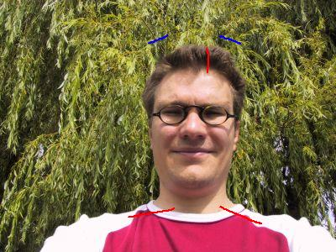
Experiments and Results

Slide 18
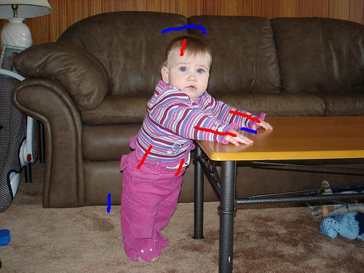
Experiments and Results

Slide 19
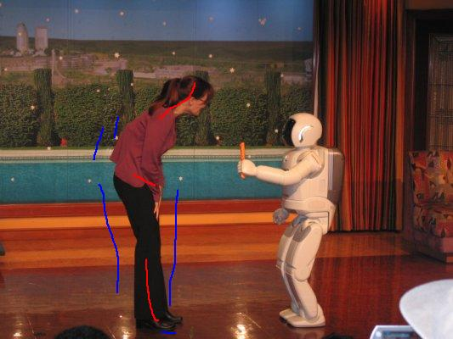
Experiments and Results

Slide 20
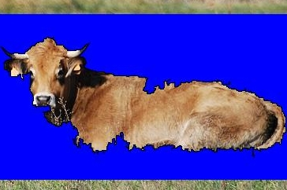
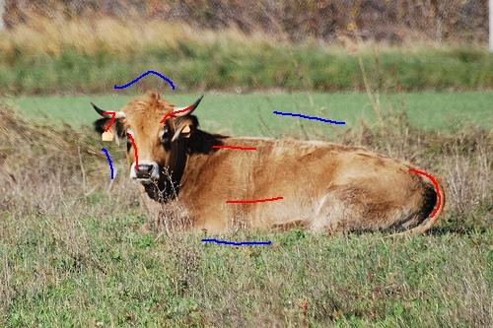
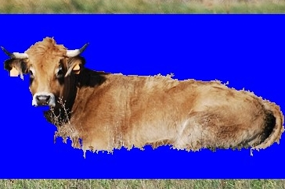
Experiments and Results

Slide 21
Experiments and Results
Comparison of correctly labeled pixel percentages

Slide 22
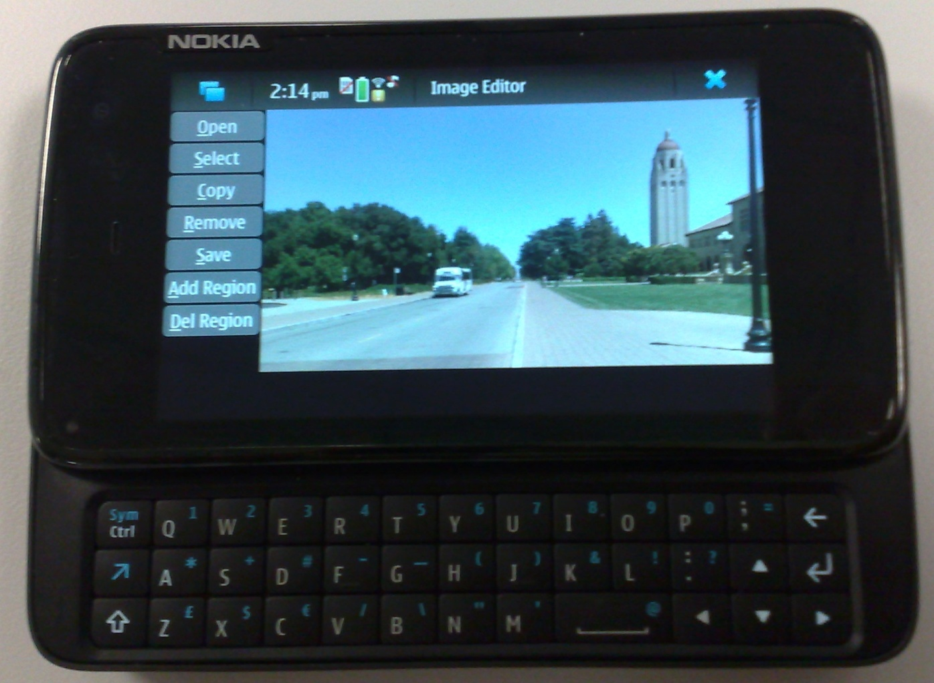
Experiments and Results
Implementation on the mobile phone
Hardware
Nokia N900 phones
An ARM Cortex-A8 600 MHz processor
256 MB RAM, 768 MB virtual memory
3.5 inch touch-sensitive widescreen display

Slide 23
Conclusions and Future Work
We have proposed a robust interactive segmentation algorithm with automatic boundary refinement procedure
Less user input
More robust to user input
It can save the user efforts in making the boundary better
Future work
Improve the speed
Combine with other image editing operations
Notes:
Interactive image segmentation is a challenging problem, and even
more challenging on mobile phones as memory and processing
power is more limited, and accurate marking is more difficult than
on desktop. We have presented an effective robust interactive image
segmentation algorithm with a novel automatic boundary refinement
procedure that requires less user input and is robust to the quantity
and locations of strokes. Both local and global information is
considered in the boundary refinement process. The most obvious
advantage of our approach is that it can save the user efforts in
making the boundary better. Compared to zooming in and manually
adding extra strokes or markers to correct the erroneous boundary
segments, it is more convenient and more friendly when applied on
mobile phones. The algorithm has been implemented on a Nokia
N900 phone with an ARM Cortex-A8 600 MHz processor, 256 MB
RAM, and a 3.5 inch touch-sensitive widescreen display. We plan to
further improve the speed of the proposed algorithm and combine it
with other image editing operations, to facilitate more elaborate, yet
easy image editing.

Slide 24
Thank you!

