Slide 1

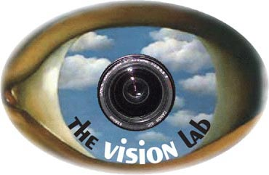

Recognizing Human-Object Interaction Activities
Action Classification
Action Retrieval
Bangpeng Yao, Aditya Khosla and Li Fei-Fei
Computer Science Department, Stanford University
{bangpeng,aditya86,feifeili}@cs.stanford.edu

Slide 2
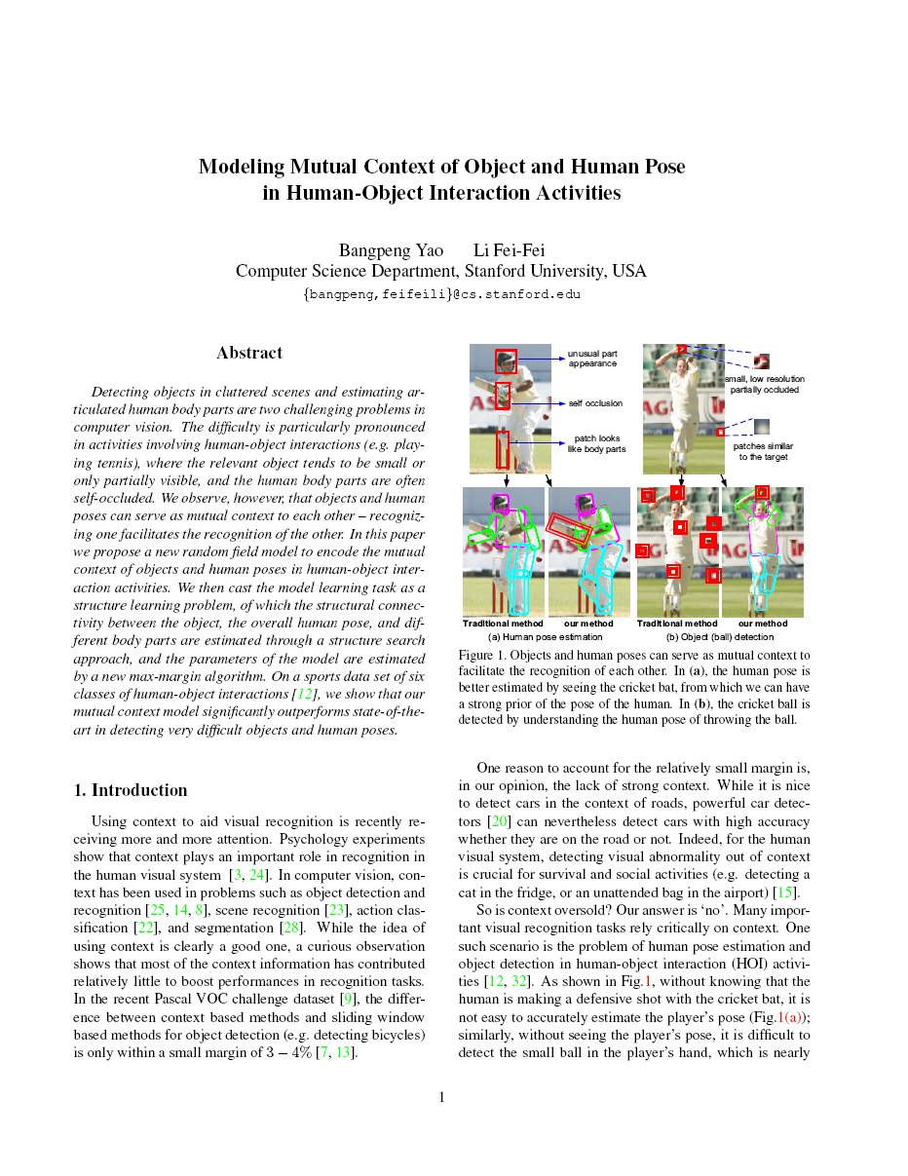
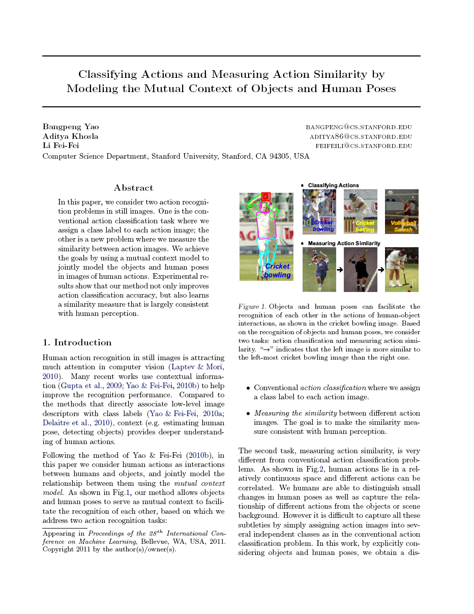
B. Yao and L. Fei-Fei. “Modeling Mutual Context of Object and Human Pose in Human-Object Interaction Activities.” CVPR 2010.
B. Yao, A. Khosla, and L. Fei-Fei. “Classifying Actions and Measuring Action Similarity by Modeling the Mutual Context of Objects and Human Poses.” ICML 2011.
Notes:
This talk is based on our CVPR and ICML work.

Slide 3
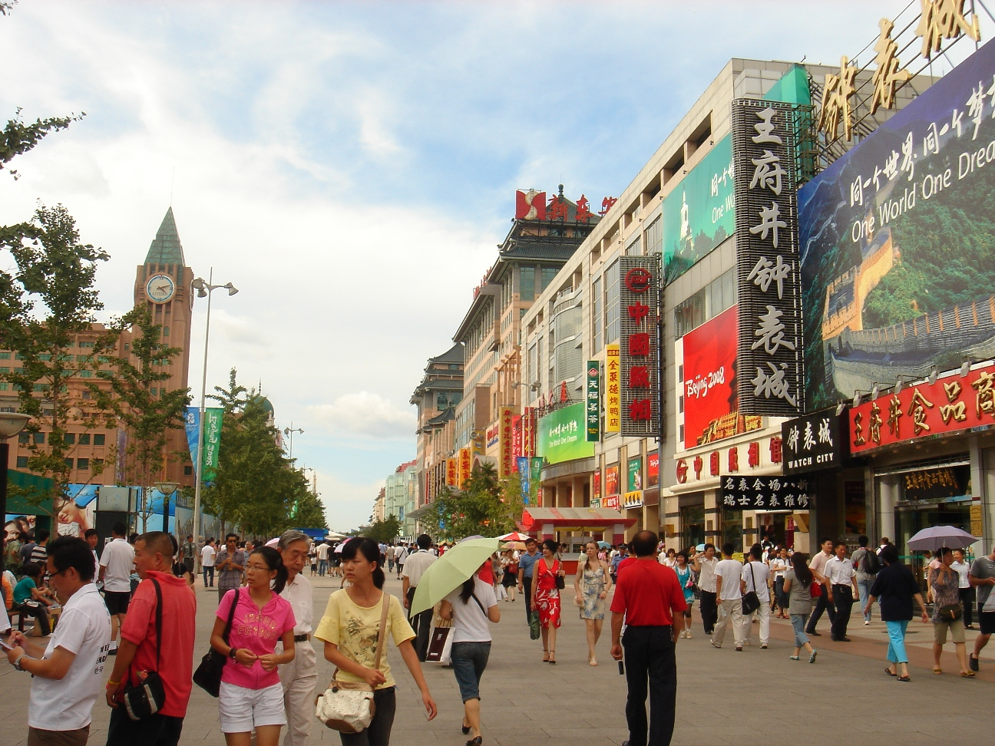
Visual Recognition
Notes:
Visual recognition involves a number of tasks. Given this image,

Slide 4
Visual Recognition
Outdoor, street scene
Notes:
We can recognize the overall scene,

Slide 5
Visual Recognition
Sky
Buildings
Humans
Road
Notes:
Or segment and classify different objects, such as …

Slide 6
Visual Recognition
Focus on Humans
Notes:
In this work, we focus on recognizing humans.

Slide 7
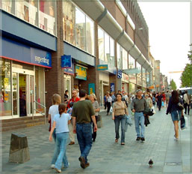
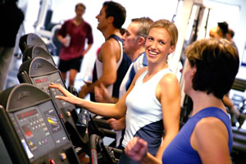
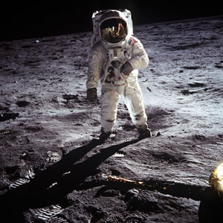
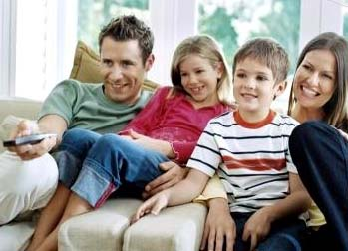
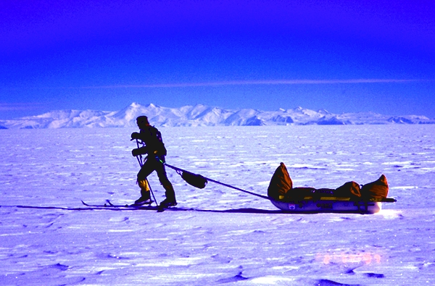
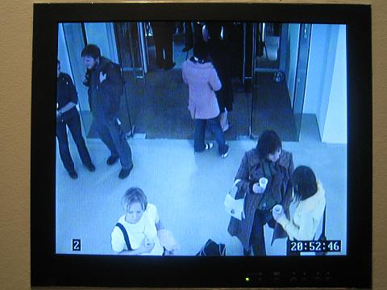
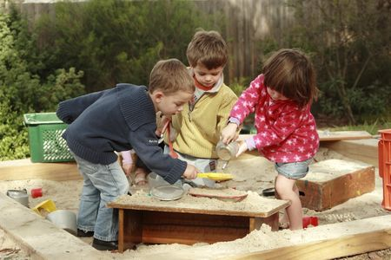
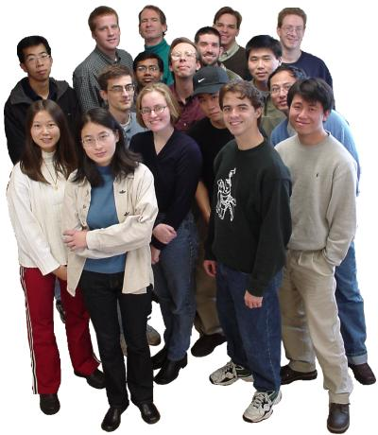
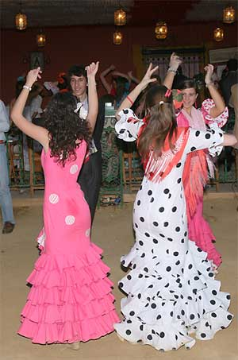
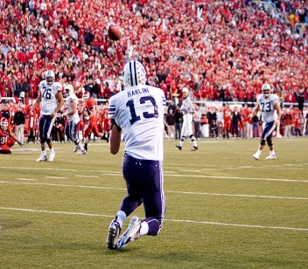

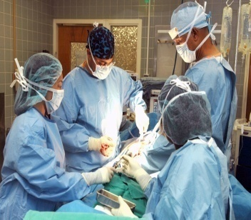
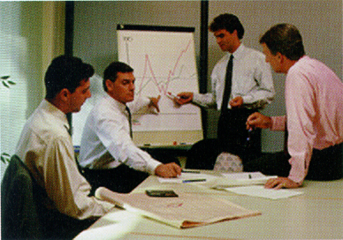
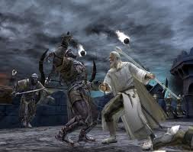

Why humans are important?
Human images are everywhere:
Notes:
Humans are everywhere …

Slide 8
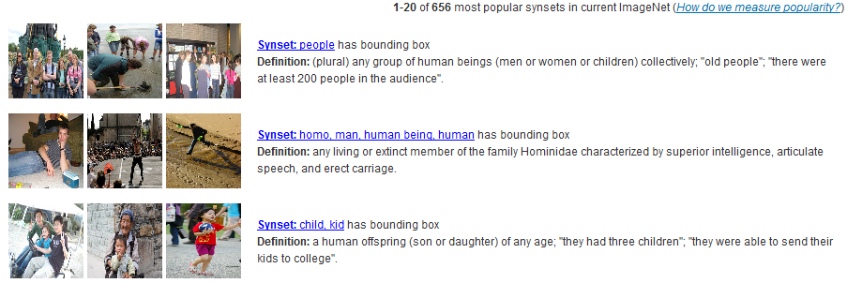
Why humans are important?
Top 3 most popular synsets in ImageNet:
http://www.image-net.org/
Deng et al, 2009
Notes:
The 3 most popular synsets of ImageNet are all related to humans.

Slide 9
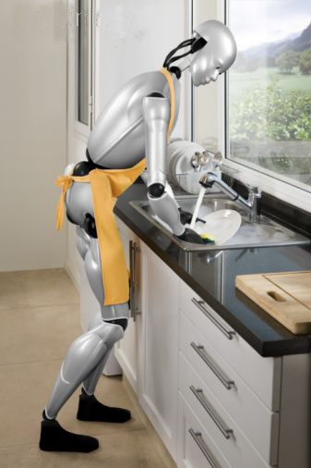
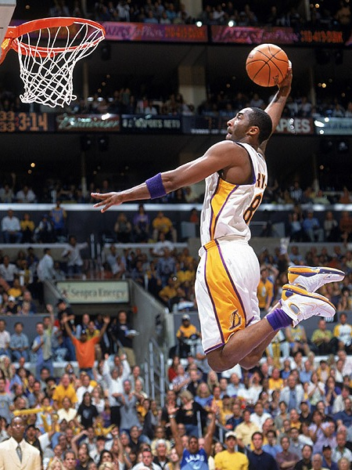
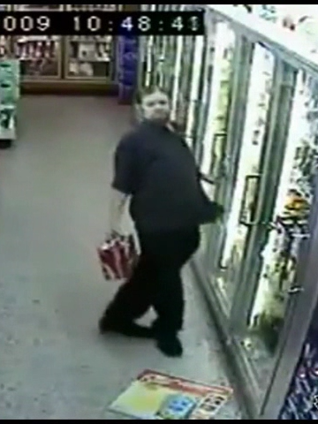
Human Action Recognition
Robots interact with objects
Automatic sports commentary
Security – Drunk people detection
Notes:
More specifically, we would like to recognize human actions. This problem has a wide range of applications …

Slide 10
Human Action Recognition
Human-Object Interaction
B. Yao and L. Fei-Fei. Modeling Mutual Context of Object and Human Pose in Human-Object Interaction Activities. IEEE Computer Vision and Pattern Recognition (CVPR). 2010.
B. Yao, A. Khosla, and L. Fei-Fei. Classifying Actions and Measuring Action Similarity by Modeling the Mutual Context of Objects and Human Poses. International Conference on Machine Learning (ICML). 2011.
Robots interact with objects
Automatic sports commentary
Security – Drunk people detection
Notes:
Following our work in CVPR’10 and ICML’11, we treat humans actions as interactions between humans and objects so as to have deeper understandings of different actions.

Slide 11
Outline
Mutual context model for Action Recognition
  Motivation
  Model representation
  Model learning
Recognition I: Action Classification, Object Detection, and Pose Estimation
Recognition II: Action Retrieval by Matching Action Similarity
Conclusion

Slide 12
Outline
Mutual context model for Action Recognition
  Motivation
  Model representation
  Model learning
Recognition I: Action Classification, Object Detection, and Pose Estimation
Recognition II: Action Retrieval by Matching Action Similarity
Conclusion

Slide 13
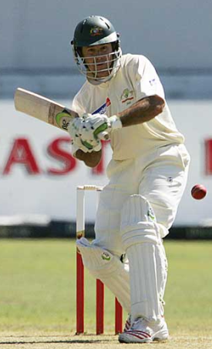
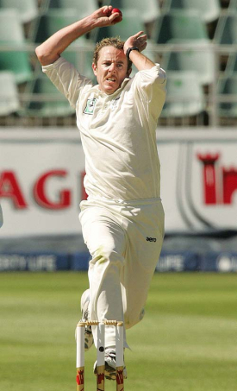
Human pose estimation & Object detection
Human pose estimation is challenging.
Difficult part appearance
Self-occlusion
Image region looks like a body part
Felzenszwalb & Huttenlocher, 2005
Ren et al, 2005
Ramanan, 2006
Ferrari et al, 2008
Yang & Mori, 2008
Andriluka et al, 2009
Eichner & Ferrari, 2009

Slide 14
Human pose estimation & Object detection
Human pose estimation is challenging.
Felzenszwalb & Huttenlocher, 2005
Ren et al, 2005
Ramanan, 2006
Ferrari et al, 2008
Yang & Mori, 2008
Andriluka et al, 2009
Eichner & Ferrari, 2009

Slide 15
Human pose estimation & Object detection
Facilitate
Given the object is detected.

Slide 16
Human pose estimation & Object detection
Object detection is challenging
Small, low-resolution, partially occluded
Image region similar to detection target
Viola & Jones, 2001
Lampert et al, 2008
Divvala et al, 2009
Vedaldi et al, 2009

Slide 17
Human pose estimation & Object detection
Object detection is challenging
Viola & Jones, 2001
Lampert et al, 2008
Divvala et al, 2009
Vedaldi et al, 2009

Slide 18
Human pose estimation & Object detection
Facilitate
Given the pose is estimated.

Slide 19

Human pose estimation & Object detection
Mutual Context

Slide 20
Outline
Mutual context model for Action Recognition
  Motivation
  Model representation
  Model learning
Recognition I: Action Classification, Object Detection, and Pose Estimation
Recognition II: Action Retrieval by Matching Action Similarity
Conclusion

Slide 21
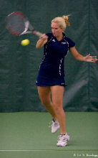
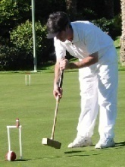
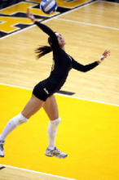
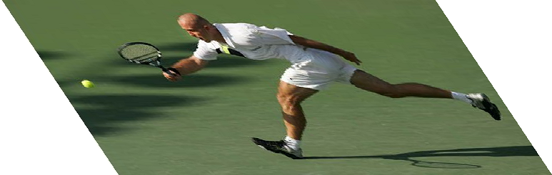
Mutual Context Model Representation
Activity
A
Activity classes:
Tennis forehand
Croquet shot
Volleyball smash
I
I
Image evidence
[Yao et al, 2011]
Notes:
In our model, the activity class is represented by “A”, for example tennis forehand, …

Slide 22
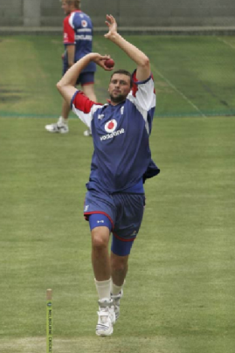
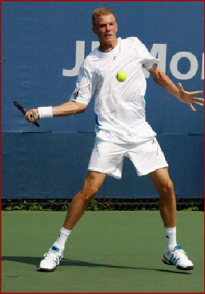
Mutual Context Model Representation
Human pose as layout of body parts.
Activity
A
Human pose
H
Body parts
P₁
P₂
P_{L}
I
[Yao et al, 2011]
Notes:
Each human pose H is treated as layouts of different body parts.

Slide 23

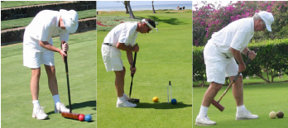
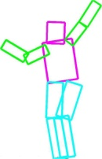
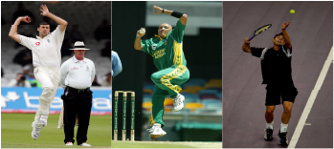

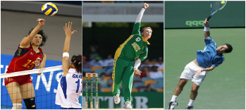
Mutual Context Model Representation
Human pose as layout of body parts.
Activity
A
Atomic poses – pose dictionary.
Human pose
H
Body parts
P₁
P₂
P_{L}
Volleyball smashing
Cricket bowling
Tennis forehand
I
[Yao et al, 2011]
Notes:
We further discretize the human poses by constructing a “human pose dictionary”, which consists of a set of atomic poses. The humans encoded by the same atomic pose have similar body part layouts. In our next discussions we will see that this discretization makes our model learning and inference much easier.

Slide 24
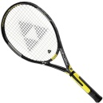
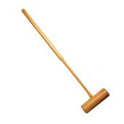
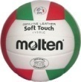
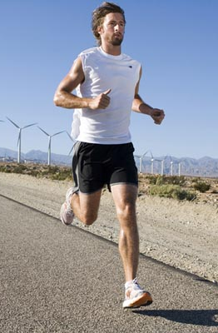
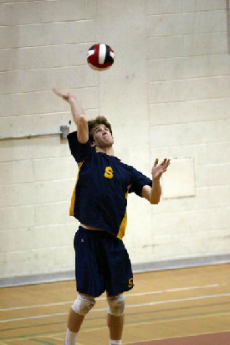

Mutual Context Model Representation
Activity
List of objects:
A
Human pose
Objects
H
Human interact with any number of objects:
O^{M}
O¹
Body parts
P₁
P₂
P_{L}
I
[Yao et al, 2011]
Notes:
The objects involved in human-object interactions, for example …, are represented by O. The number of objects in a particular image is represented by M. Note that M can be different in different images, for example …

Slide 25

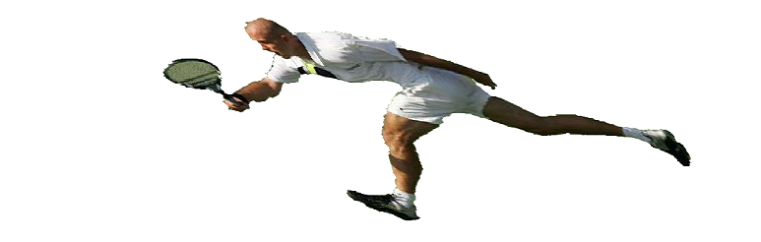
Mutual Context Model Representation
Activity
A
Human pose
Objects
H
O^{M}
O¹
Body parts
P₁
P₂
P_{L}
I
[Yao et al, 2011]
Notes:
Finally, all the objects, human body parts, and activity classes are conditioned on the image appearance, where the objects and human poses are modeled by extracting features from specific image regions, while the activity class considers the overall image as a whole.

Slide 26
Mutual Context Model Representation
Conditional Random Field:
Activity
A
Human pose
Objects
H
O^{M}
O¹
Body parts
P₁
P₂
P_{L}
I
[Yao et al, 2011]
Notes:
Our model is a conditional random field. Now let’s go through the potential functions of our model.

Slide 27
Mutual Context Model Representation
Conditional Random Field:
Activity
A
Human pose
Objects
H
Compatibility between actions, objects, and human poses:
O^{M}
O¹
Body parts
P₁
P₂
P_{L}
I
[Yao et al, 2011]
Notes:
The compatibility between actions, objects, and human poses are parameterized by simply counting the co-occurrence statistics among the three concepts. \zeta_{I,j,k} represents the strength of the interaction between atomic pose h_i, object o_j, and action class a_k.

Slide 28
Mutual Context Model Representation
Conditional Random Field:
Activity
A
Human pose
Objects
H
Modeling actions:
O^{M}
O¹
Body parts
P₁
P₂
P_{L}
N_{a}-dimensional output of an action classifier
I
[Yao et al, 2011]
Notes:
The human action is modeled by a discriminative classifier, whose output is denoted by s(I). \eta_k is the weight of the classifier output for the k-th action.

Slide 29
Mutual Context Model Representation
Conditional Random Field:
Activity
A
Human pose
Objects
H
Modeling objects:
O^{M}
O¹
Body parts
P₁
P₂
P_{L}
Object detection scores
Spatial relationship between two object windows
I
[Yao et al, 2011]
Notes:
As for the objects, we consider both independent object detection scores as well as spatial relationship between different object detection windows. In this equation, \gamma_j is the weight template for object class o_j. \gamma_{j,j\prime} is the weights for the geometric relationships between o_j and o_j\prime.

Slide 30
Mutual Context Model Representation
Conditional Random Field:
Activity
A
Human pose
Objects
H
Modeling human poses:
O^{M}
O¹
Body parts
P₁
P₂
P_{L}
Location of the l-th body part with the prior of atomic pose h_{i}
Detection score of the l-th body part
I
[Yao et al, 2011]
Notes:
The human poses are parameterized by considering the visual appearance and location of different body parts. We model the appearance and body parts in each atomic pose separately. In this equation, f indicates the detection score of the corresponding body part, which encodes the appearance information. We also estimate the distribution of each body part with respect to the prior of each atomic pose represented by h_i. \alpha_{I,l} and \beta_{I,l} are the feature weights for the location and appearance information of the l-th body part in atomic pose I respectively.

Slide 31
Mutual Context Model Representation
Conditional Random Field:
Activity
A
Human pose
Objects
H
Modeling human poses:
O^{M}
O¹
Body parts
P₁
P₂
P_{L}
Spatial relationship between the l-th body part and the m-th object window
I
[Yao et al, 2011]
Notes:
We also model the spatial relationship between the objects and different body parts. \lambda is the corresponding feature weight.

Slide 32
Outline
Mutual context model for Action Recognition
  Motivation
  Model representation
  Model learning
Recognition I: Action Classification, Object Detection, and Pose Estimation
Recognition II: Action Retrieval by Matching Action Similarity
Conclusion

Slide 33
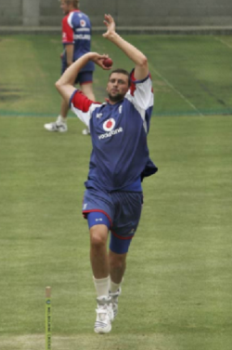

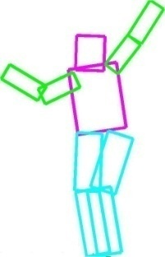
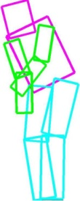
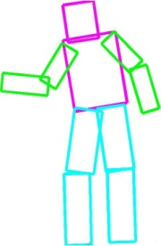
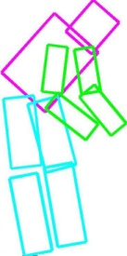
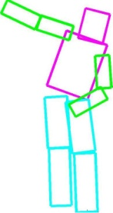
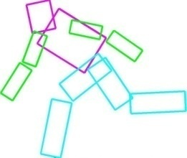
Mutual Context Model Learning
Obtaining atomic poses
Activity
A
Human pose
Annotating
Objects
H
O^{M}
O¹
Body parts
P₁
P₂
P_{L}
Clustering
I
[Yao et al, 2011]

Slide 34

Mutual Context Model Learning
Obtaining atomic poses
Potentials
  Object & body part detection
Activity
A
Human pose
Objects
H
O^{M}
O¹
Body parts
Deformable part model [Felzenszwalb et al, 2008]
P₁
P₂
P_{L}
One detector for each object or body part
I
[Yao et al, 2011]

Slide 35
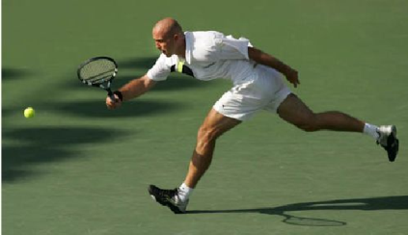

Mutual Context Model Learning
Obtaining atomic poses
Potentials
  Object & body part detection
  Action classification
Activity
A
Human pose
Objects
H
O^{M}
O¹
Body parts
Spatial pyramid model [Lazebnik et al, 2005]
P₁
P₂
P_{L}
I
[Yao et al, 2011]

Slide 36
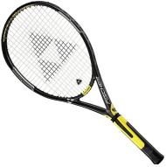
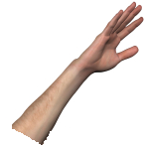
Mutual Context Model Learning
Obtaining atomic poses
Potentials
  Object & body part detection
  Action classification
  Spatial relationships
Activity
A
Human pose
Objects
H
O^{M}
O¹
Body parts
Bin function [Desai et al, 2009]
P₁
P₂
P_{L}
I
[Yao et al, 2011]

Slide 37
Mutual Context Model Learning
Obtaining atomic poses
Potentials
  Object & body part detection
  Action classification
  Spatial relationships
Model parameter estimation
Activity
A
Human pose
Objects
H
O^{M}
O¹
Body parts
P₁
P₂
P_{L}
Standard Conditional random field: Belief Propagation
[Pearl, 1988]
I
[Yao et al, 2011]

Slide 38
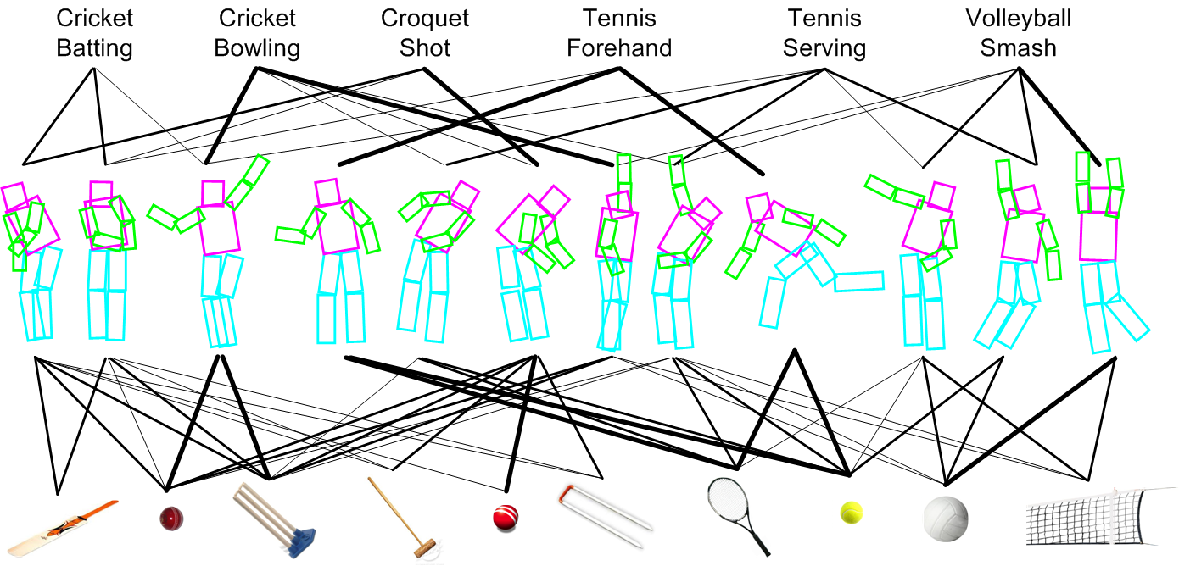
Model Learning Result
Activity classes:
Atomic poses:
Objects:

Slide 39





Model Learning Result
Activity classes:
Atomic poses:
Objects:

Slide 40

Model Learning Result
Activity classes:
Atomic poses:
Objects:

Slide 41
Outline
Mutual context model for Action Recognition
  Motivation
  Model representation
  Model learning
Recognition I: Action Classification, Object Detection, and Pose Estimation
Recognition II: Action Retrieval by Matching Action Similarity
Conclusion

Slide 42

Model Inference for Pose Estimation, Object Detection, and Action Classification
Initialization
Iteratively optimize :
  Updating the layout of human body parts
  Updating the object detections
  Updating the action and atomic pose labels
Action a₁
Action a₂
Action a₃
Action a_{Na}
Notes:
Then, we use the following iterative procedure to update those detection and classification results, until an optimum value of our model function can be reached.

Slide 43



Model Inference for Pose Estimation, Object Detection, and Action Classification
Initialization
Iteratively optimize :
  Updating the layout of human body parts
Re-estimate human pose
Action a₁
Action a₂
Action a₃
Action a_{Na}
Mixture model
0.51
0.06
0.04
[Felzenszwalb et al, 2005]
[Sapp et al, 2010]
Notes:
Given the current inference results, we update the human pose estimation result in the following way. We obtain the marginal distribution of the human pose labels with respect to different atomic poses. Then by using the prior distribution of body parts in each atomic pose, we obtain an updated prior distribution of different body parts for this particular image. We use this updated prior to achieve better pose estimation by using pictorial structure approach.

Slide 44
Model Inference for Pose Estimation, Object Detection, and Action Classification
Initialization
Iteratively optimize :
  Updating the layout of human body parts
  Updating the object detections
Start from no objects in the image;
Evaluate the contribution of increasing for each detection window separately.
Action a₁
Action a₂
Action a₃
Action a_{Na}
Notes:
The object detection results are updated by evaluating the contribution of each object window to the overall model function. The objects are added to the current object set if they can contribute to optimizing the model function, otherwise the object will be deleted.

Slide 45
Model Inference for Pose Estimation, Object Detection, and Action Classification
Initialization
Iteratively optimize :
  Updating the layout of human body parts
  Updating the object detections
  Updating the action and atomic pose labels
Action a₁
Action a₂
Action a₃
Action a_{Na}
Enumerating all possible A and H values to maximize .

Slide 46





Action Classification Experiment
Sport data set: 6 classes, 180 training (supervised with object and body part locations) & 120 testing images
Cricket batting
Cricket bowling
Croquet shot
Tennis forehand
Tennis serve
Volleyball smash
[Gupta et al, 2009]

Slide 47
Action Classification Results
Yao & Fei-Fei, (2010)
Yao et al, (2011)
Notes:
Our ICML results outperforms others by 4%, and achieves the best result in 3 out of 6 classes. Note that in our 2010 work, we did not use the overall image information.

Slide 48
Object Detection and Pose Estimation
Sport data set: 6 classes, 180 training (supervised with object and body part locations) & 120 testing images
Cricket batting
Cricket bowling
Croquet shot
Tennis forehand
Tennis serve
Volleyball smash
[Gupta et al, 2009]

Slide 49
Object Detection Results
Method | Felzensz-walb et al. (2010) | Desai et al. (2009) | Yao et al. (2011)
cricket bat | .17 | .18 | .20
cricket ball | .24 | .27 | .32
cricket stump | .77 | .78 | .77
croquet mallet | .29 | .32 | .34
croquet ball | .50 | .52 | .58
croquet hoop | .15 | .17 | .22
tennis racket | .33 | .31 | .37
tennis ball | .42 | .46 | .49
volleyball | .64 | .65 | .67
volleyball net | .04 | .06 | .09
overall | .36 | .37 | .41

Slide 50


Object Detection Results
Method | Felzensz-walb et al. (2010) | Desai et al. (2009) | Yao et al. (2011)
cricket bat | .17 | .18 | .20
cricket ball | .24 | .27 | .32
cricket stump | .77 | .78 | .77
croquet mallet | .29 | .32 | .34
croquet ball | .50 | .52 | .58
croquet hoop | .15 | .17 | .22
tennis racket | .33 | .31 | .37
tennis ball | .42 | .46 | .49
volleyball | .64 | .65 | .67
volleyball net | .04 | .06 | .09
overall | .36 | .37 | .41

Slide 51


Object Detection Results
Method | Felzensz-walb et al. (2010) | Desai et al. (2009) | Yao et al. (2011)
cricket bat | .17 | .18 | .20
cricket ball | .24 | .27 | .32
cricket stump | .77 | .78 | .77
croquet mallet | .29 | .32 | .34
croquet ball | .50 | .52 | .58
croquet hoop | .15 | .17 | .22
tennis racket | .33 | .31 | .37
tennis ball | .42 | .46 | .49
volleyball | .64 | .65 | .67
volleyball net | .04 | .06 | .09
overall | .36 | .37 | .41

Slide 52
Human Pose Estimation Results
Method | Yao & Fei-Fei (2010) | Andrilu-ka et al. (2009) | Yao et al. (2011)
head | .58 | .71 | .76
torso | .66 | .69 | .77
left/right upper arms | .44 | .44 | .52
 | .40 | .40 | .45
left/right lower arms | .27 | .35 | .39
 | .29 | .36 | .37
left/right upper legs | .43 | .58 | .63
 | .39 | .63 | .61
left/right lower legs | .44 | .59 | .60
 | .34 | .71 | .77
overall | .42 | .55 | .59

Slide 53


Human Pose Estimation Results
Method | Yao & Fei-Fei (2010) | Andrilu-ka et al. (2009) | Yao et al. (2011)
head | .58 | .71 | .76
torso | .66 | .69 | .77
left/right upper arms | .44 | .44 | .52
 | .40 | .40 | .45
left/right lower arms | .27 | .35 | .39
 | .29 | .36 | .37
left/right upper legs | .43 | .58 | .63
 | .39 | .63 | .61
left/right lower legs | .44 | .59 | .60
 | .34 | .71 | .77
overall | .42 | .55 | .59

Slide 54
Outline
Mutual context model for Action Recognition
  Motivation
  Model representation
  Model learning
Recognition I: Action Classification, Object Detection, and Pose Estimation
Recognition II: Action Retrieval by Matching Action Similarity
Conclusion

Slide 55








Action Recognition as Classification
Playing Bassoon
Playing Guitar
Playing Erhu
Cricket batting
Tennis Forehand
Volleyball Smashing
Yao & Fei-Fei (2010)
Gupta et al (2009)
Ikizler-Cinbis et al, 2009
Desai et al, 2010
Yang et al, 2010
Delaitre et al, 2011
Maji et al, 2011
Running
Reading
PASCAL VOC (2010)

Slide 56





Is Classification the End?
stand
run
Actions in a continuous space

Slide 57




Is Classification the End?
Same action,
Different meanings

Slide 58

Is Classification the End?
More than one action at the same time
Calling
Shopping

Slide 59










Retrieval Instead of Classification
Retrieval as Similarity Ranking
>
>
>
>
>
>
>
>

Slide 60











Retrieval as Similarity Ranking
Ref.
Decreasing of similarity value

Slide 61
Retrieval as Similarity Ranking
Ref.
Decreasing of similarity value

Slide 62
Retrieval as Similarity Ranking
Challenges:
  How to obtain the ground-truth?
  How to perform automatic retrieval?
  How to evaluate a retrieval system?
Ref.
Decreasing of similarity value

Slide 63





Action Retrieval: Obtaining Ground Truth
Human annotation experiment:
  Eight human subjects, the same set of 252 trials.
One trial:
Comparison images
Reference image

Slide 64




Action Retrieval: Obtaining Ground Truth
Human annotation experiment:
  Eight human subjects, the same set of 252 trials.
One trial:
Comparison images
Reference image
Reference image

Slide 65





Action Retrieval: Obtaining Ground Truth
Human annotation experiment:
  Eight human subjects, the same set of 252 trials.
One trial:
Comparison images
Reference image
?
?
?

Slide 66






Action Retrieval: Obtaining Ground Truth
Human annotation experiment:
  Eight human subjects, the same set of 252 trials.
One trial:
Comparison images
Reference image
?
?
?

Slide 67
Action Retrieval: Obtaining Ground Truth
Human annotation experiment:
  Eight human subjects, the same set of 252 trials.

Slide 68






Action Retrieval: Obtaining Ground Truth
From pairwise annotation to overall similarity:
Pairwise
Similarity
Human annotation
vector
Sim( , )
-1 0 1 0 0
0 1 0 0 -1
Ref.
Notes:
Based on the pairwise human annotations of image similarities, we convert them to the overall similarity between each image and the reference image. The vector of similarities are denoted by s, where each component represents the similarity between one image and the reference image.

Slide 69
Action Retrieval: Obtaining Ground Truth
From pairwise annotation to overall similarity:
Pairwise
Similarity
Human annotation
vector
Sim( , )
-1 0 1 0 0
0 1 0 0 -1
Ref.
Notes:
Consider all the annotations, we have this optimization problem.

Slide 70














Action Retrieval: Obtaining Ground Truth
From pairwise annotation to overall similarity:
0.260
0.227
0.145
0.135
0.112
0.085
0.075
0.041
0.012
0.006
Ref.
0.002
0.000
0.000
0.000
0.000

Slide 71









Action Retrieval: Our Approach
Action class
>
Human pose
>
Object
>
Notes:
Both action class, human pose, and object can be used to measure the similarity of different objects in different situations.

Slide 72

Action Retrieval: Our Approach
Action class
Distance between two images I and I’:
>
Human pose
>
Total variance:
Object
>
Chi-square statistics:
Notes:
We use larger weights to action classes and human poses because the action classification and pose estimation results are more reliable than object detection.

Slide 73





Action Retrieval: Evaluation Metric
Ranking from an algorithm:
Ranking by ground-truth similarity:
Ref.
Accuracy
: ground-truth similarity
Number of Neighborhoods

Slide 74
Action Retrieval: Result
MC: Mutual Context

Slide 75
Action Retrieval: Result
MC: Mutual Context
SPM: spatial pyramid matching (Lazebnik et al, 2005)
Use the confidence scores of SPM output to evaluate the action similarity.

Slide 76
Action Retrieval: Result

Slide 77


Action Retrieval: Result

Slide 78
Action Retrieval: Result

Slide 79
Outline
Mutual context model for Action Recognition
  Motivation
  Model representation
  Model learning
Recognition I: Action Classification, Object Detection, and Pose Estimation
Recognition II: Action Retrieval by Matching Action Similarity
Conclusion

Slide 80



Conclusion
Human action as human-object interaction:
Action classification:
Croquet shot
Tennis forehand
Cricket bowling
Matching action similarity:
>
>

Slide 81



Acknowledgment
Stanford Vision Lab reviewers:
  Jia Deng
  Jia Li

