Slide 1
Spark
In-Memory Cluster Computing for
Iterative and Interactive Applications
Matei Zaharia, Mosharaf Chowdhury, Tathagata Das, Ankur Dave, Justin Ma, Murphy McCauley, Michael Franklin, Scott Shenker, Ion Stoica
UC BERKELEY

Slide 2
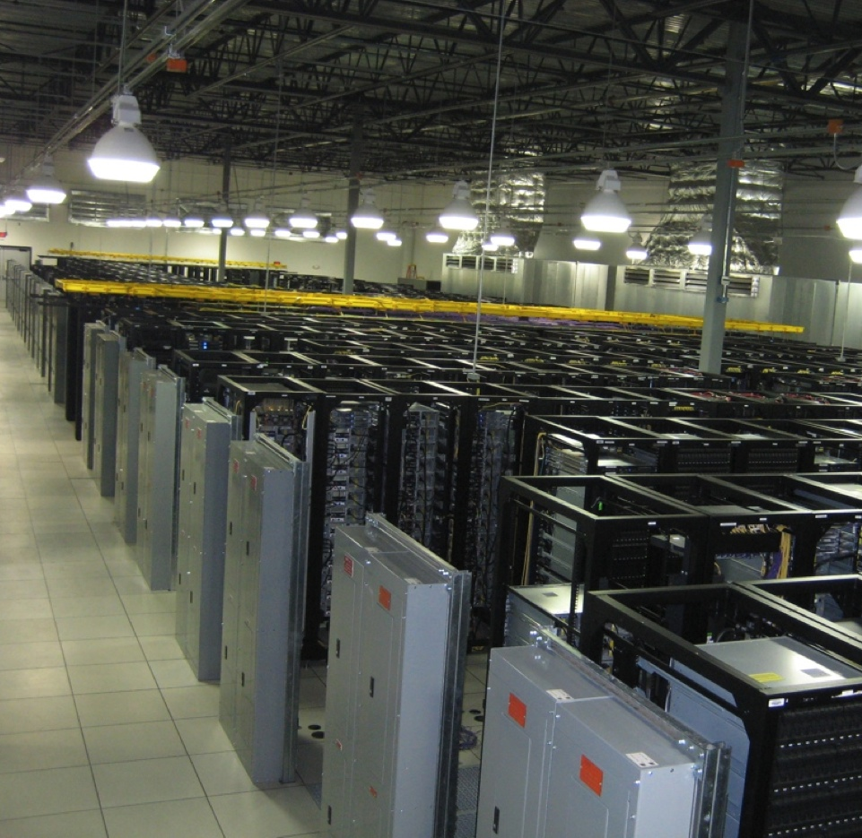
Environment
Notes:
Point out that Scala is a modern PL etc
Mention DryadLINQ (but we go beyond it with RDDs)
Point out that interactive use and iterative use go hand in hand because both require small tasks and dataset reuse

Slide 3
Motivation
Most current cluster programming models are based on acyclic data flow from stable storage to stable storage
Map
Reduce
Input
Map
Output
Reduce
Map
Notes:
Acyclic

Slide 4
Motivation
Most current cluster programming models are based on acyclic data flow from stable storage to stable storage
Map
Reduce
Benefits of data flow: runtime can decide where to run tasks and can automatically recover from failures
Input
Map
Output
Reduce
Map
Notes:
Also applies to Dryad, SQL, etc
Benefits: easy to do fault tolerance and

Slide 5
Motivation
Acyclic data flow is inefficient for applications that repeatedly reuse a working set of data:
Iterative algorithms (machine learning, graphs)
Interactive data mining tools (R, Excel, Python)
With current frameworks, apps reload data from stable storage on each query
Notes:
Point out that both types of apps are actually quite common / desirable in data analytics

Slide 6
Example: Iterative Apps
iteration 1
result 1
iteration 2
result 2
iteration 3
result 3
Input
. . .
iter. 1
iter. 2
. . .
Input
Notes:
Each iteration is, for example, a MapReduce job

Slide 7
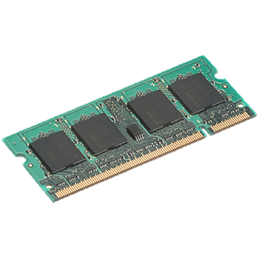
Goal: Keep Working Set in RAM
iteration 1
one-time processing
iteration 2
iteration 3
Input
Distributed memory
. . .
iter. 1
iter. 2
. . .
Input

Slide 8
Challenge
How to design a distributed memory abstraction that is both fault-tolerant and efficient?

Slide 9
Challenge
Existing distributed storage abstractions have interfaces based on fine-grained updates
Reads and writes to cells in a table
E.g. databases, key-value stores, distributed memory
Require replicating data or logs across nodes for fault tolerance ➔ expensive!

Slide 10
Solution: Resilient Distributed Datasets (RDDs)
Provide an interface based on coarse-grained transformations (map, group-by, join, …)
Efficient fault recovery using lineage
Log one operation to apply to many elements
Recompute lost partitions on failure
No cost if nothing fails

Slide 11
RDD Recovery
iteration 1
one-time processing
iteration 2
iteration 3
Input
Distributed memory
. . .
iter. 1
iter. 2
. . .
Input

Slide 12
Generality of RDDs
Despite coarse-grained interface, RDDs can express surprisingly many parallel algorithms
These naturally apply the same operation to many items
Capture many current programming models
Data flow models: MapReduce, Dryad, SQL, …
Specialized models for iterative apps: BSP (Pregel), iterative MapReduce, bulk incremental
Also support new apps that these models don’t
Notes:
Key idea: add “variables” to the “functions” in functional programming

Slide 13
Outline
Programming interface
Applications
Implementation
Demo

Slide 14
Spark Programming Interface
Language-integrated API in Scala
Provides:
Resilient distributed datasets (RDDs)
Partitioned collections with controllable caching
Operations on RDDs
Transformations (define RDDs), actions (compute results)
Restricted shared variables (broadcast, accumulators)
Notes:
You write a single program → similar to DryadLINQ
Distributed data sets with parallel operations on them are pretty standard; the new thing is that they can be reused across ops
Variables in the driver program can be used in parallel ops; accumulators useful for sending information back, cached vars are an optimization
Mention cached vars useful for some workloads that won’t be shown here
Mention it’s all designed to be easy to distribute in a fault-tolerant fashion

Slide 15
Example: Log Mining
Load error messages from a log into memory, then interactively search for various patterns
Base RDD
Cache 1
lines = spark.textFile(“hdfs://...”)
errors = lines.filter(_.startsWith(“ERROR”))
messages = errors.map(_.split(‘\t’)(2))
cachedMsgs = messages.cache()
Transformed RDD
Worker
results
tasks
Block 1
Driver
Action
cachedMsgs.filter(_.contains(“foo”)).count
cachedMsgs.filter(_.contains(“bar”)).count
Cache 2
Worker
. . .
Cache 3
Result: full-text search of Wikipedia in <1 sec (vs 20 sec for on-disk data)
Worker
Block 2
Result: scaled to 1 TB data in 5-7 sec (vs 170 sec for on-disk data)
Block 3
Notes:
Key idea: add “variables” to the “functions” in functional programming

Slide 16
Fault Tolerance
RDDs track lineage information that can be used to efficiently reconstruct lost partitions
Ex:
messages = textFile(...).filter(_.startsWith(“ERROR”))
.map(_.split(‘\t’)(2))
HDFS File
Filtered RDD
Mapped RDD
filter (func = _.contains(...))
map (func = _.split(...))

Slide 17
Example: Logistic Regression
Goal: find best line separating two sets of points
random initial line
+
+
+
+
+
+
–
+
+
–
–
–
+
+
–
–
–
–
–
–
target
Notes:
Note that dataset is reused on each gradient computation

Slide 18
Example: Logistic Regression
val data = spark.textFile(...).map(readPoint).cache()
var w = Vector.random(D)
for (i <- 1 to ITERATIONS) {
val gradient = data.map(p =>
(1 / (1 + exp(-p.y*(w dot p.x))) - 1) * p.y * p.x
).reduce(_ + _)
w -= gradient
}
println("Final w: " + w)
Notes:
Key idea: add “variables” to the “functions” in functional programming

Slide 19
Logistic Regression Performance
127 s / iteration
first iteration 174 s
further iterations 6 s
Notes:
This is for a 29 GB dataset on 20 EC2 m1.xlarge machines (4 cores each)

Slide 20
Example: Collaborative Filtering
Goal: predict users’ movie ratings based on past ratings of other movies
1 ? ? 4 5 ? 3
? ? 3 5 ? ? 3
5 ? 5 ? ? ? 1
4 ? ? ? ? 2 ?
R =
Users
Movies

Slide 21
Model and Algorithm
Model R as product of user and movie feature matrices A and B of size U×K and M×K
R
A
B^{T}
=
Alternating Least Squares (ALS)
Start with random A & B
Optimize user vectors (A) based on movies
Optimize movie vectors (B) based on users
Repeat until converged

Slide 22
Serial ALS
var R = readRatingsMatrix(...)
var A = // array of U random vectors
var B = // array of M random vectors
for (i <- 1 to ITERATIONS) {
A = (0 until U).map(i => updateUser(i, B, R))
B = (0 until M).map(i => updateMovie(i, A, R))
}
Range objects

Slide 23
Naïve Spark ALS
var R = readRatingsMatrix(...)
var A = // array of U random vectors
var B = // array of M random vectors
for (i <- 1 to ITERATIONS) {
A = spark.parallelize(0 until U, numSlices)
.map(i => updateUser(i, B, R))
.collect()
B = spark.parallelize(0 until M, numSlices)
.map(i => updateMovie(i, A, R))
.collect()
}
Problem: R re-sent to all nodes in each iteration

Slide 24
Efficient Spark ALS
Solution: mark R as broadcast variable
var R = spark.broadcast(readRatingsMatrix(...))
var A = // array of U random vectors
var B = // array of M random vectors
for (i <- 1 to ITERATIONS) {
A = spark.parallelize(0 until U, numSlices)
.map(i => updateUser(i, B, R.value))
.collect()
B = spark.parallelize(0 until M, numSlices)
.map(i => updateMovie(i, A, R.value))
.collect()
}
Result: 3× performance improvement

Slide 25
Scaling Up Broadcast
Initial version (HDFS)
Cornet broadcast

Slide 26
Cornet Performance
1GB data to 100 receivers
[Chowdhury et al, SIGCOMM 2011]

Slide 27
Spark Applications
EM alg. for traffic prediction (Mobile Millennium)
Twitter spam classification (Monarch)
In-memory OLAP & anomaly detection (Conviva)
Time series analysis
Network simulation
…

Slide 28
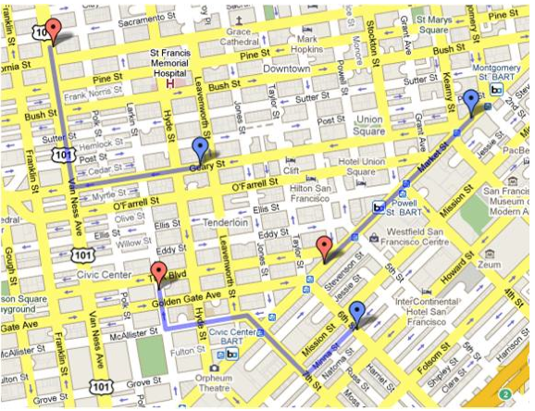
Mobile Millennium Project
Estimate city traffic using GPS observations from probe vehicles (e.g. SF taxis)

Slide 29
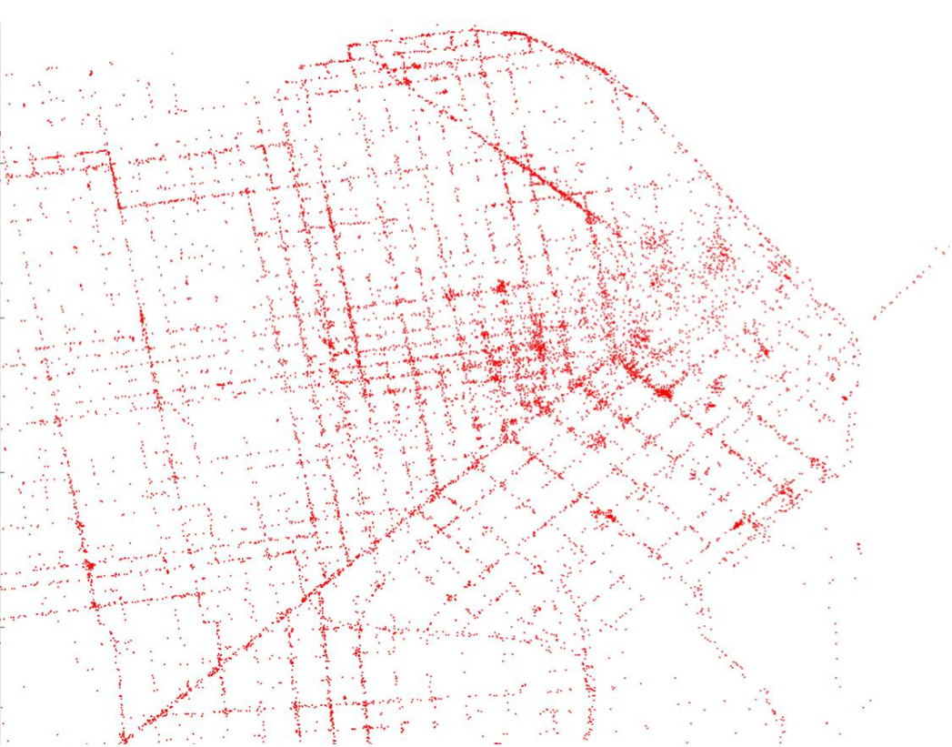
Sample Data
Credit: Tim Hunter, with support of the Mobile Millennium team; P.I. Alex Bayen; traffic.berkeley.edu
Notes:
One day’s worth of SF taxi measurements

Slide 30
Challenge
Data is noisy and sparse (1 sample/minute)
Must infer path taken by each vehicle in addition to travel time distribution on each link

Slide 31
Challenge
Data is noisy and sparse (1 sample/minute)
Must infer path taken by each vehicle in addition to travel time distribution on each link

Slide 32
Solution
EM algorithm to estimate paths and travel time distributions simultaneously
observations
flatMap
weighted path samples
groupByKey
link parameters
broadcast

Slide 33
Results
[Hunter et al, SOCC 2011]
3× speedup from caching, 4.5x from broadcast

Slide 34
Cluster Programming Models
RDDs can express many proposed data-parallel programming models
MapReduce, DryadLINQ
Bulk incremental processing
Pregel graph processing
Iterative MapReduce (e.g. Haloop)
SQL
Allow apps to efficiently intermix these models
Notes:
Say it’s because these all do data-parallel operations

Slide 35
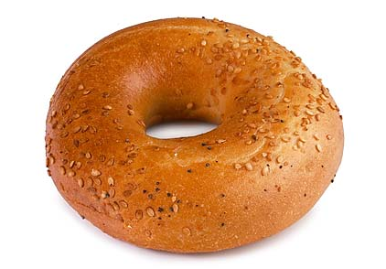
Models We Have Built
Pregel on Spark (Bagel)
200 lines of code
Haloop on Spark
200 lines of code
Hive on Spark (Shark)
3000 lines of code
Compatible with Apache Hive
ML operators in Scala
Notes:
Say it’s because these all do data-parallel operations

Slide 36
Implementation
Spark runs on the Mesos cluster manager [NSDI 11], letting it share resources with Hadoop & other apps
Can read from any Hadoop input source (HDFS, S3, …)
Spark
Hadoop
MPI
…
Mesos
Node
Node
Node
Node
No changes to Scala language & compiler
Notes:
Mention it’s designed to be fault-tolerant

Slide 37
Outline
Programming interface
Applications
Implementation
Demo

Slide 38
Conclusion
Spark’s RDDs offer a simple and efficient programming model for a broad range of apps
Solid foundation for higher-level abstractions
Join our open source community:
www.spark-project.org

Slide 39
Related Work
DryadLINQ, FlumeJava
Similar “distributed collection” API, but cannot reuse datasets efficiently across queries
GraphLab, Piccolo, BigTable, RAMCloud
Fine-grained writes requiring replication or checkpoints
Iterative MapReduce (e.g. Twister, HaLoop)
Implicit data sharing for a fixed computation pattern
Relational databases
Lineage/provenance, logical logging, materialized views
Caching systems (e.g. Nectar)
Store data in files, no explicit control over what is cached

Slide 40
Spark Operations
Transformations (define a new RDD) | map filter sample groupByKey reduceByKey sortByKey | flatMap union join cogroup cross mapValues
Actions (return a result to driver program) | collect reduce count save lookupKey

Slide 41
Job Scheduler
Dryad-like task DAG
Reuses previously computed data
Partitioning-aware to avoid shuffles
Automatic pipelining
A:
B:
G:
Stage 1
groupBy
C:
D:
F:
map
E:
join
Stage 2
union
Stage 3
= previously computed partition
Notes:
NOT a modified version of Hadoop

Slide 42
Fault Recovery Results
Notes:
These are for K-means

Slide 43
Behavior with Not Enough RAM

