Slide 1
Secure Hierarchy-Aware Cache Replacement Policy (SHARP):
Defending Against Cache-Based Side Channel Attacks
Mengjia Yan, Bhargava Gopireddy, Thomas Shull, Josep Torrellas
University of Illinois at Urbana-Champaign
http://iacoma.cs.uiuc.edu
ISCA 2017
Notes:
.

Slide 2




Shared Resources in Cloud
Shared hardware resources can leak information
Cache side-channel attacks: attacker observes a victim’s cache behavior
  Can bypass software security policies
  Leave no trace
VM Isolation
Victim
Attacker
VM
VM
Core
L1
Core
L1
Core
L1
Core
L1
Shared LLC
Notes:
In a typical cloud server, multiple users are co-located on the same chip.
From a VM perspective, they are isolated from each other.
However, the shared hardware such as LLC can still leak information. In a cache side-channel attack,
Attacker/spy observe’s …. to obtain sensitive information.

Slide 3




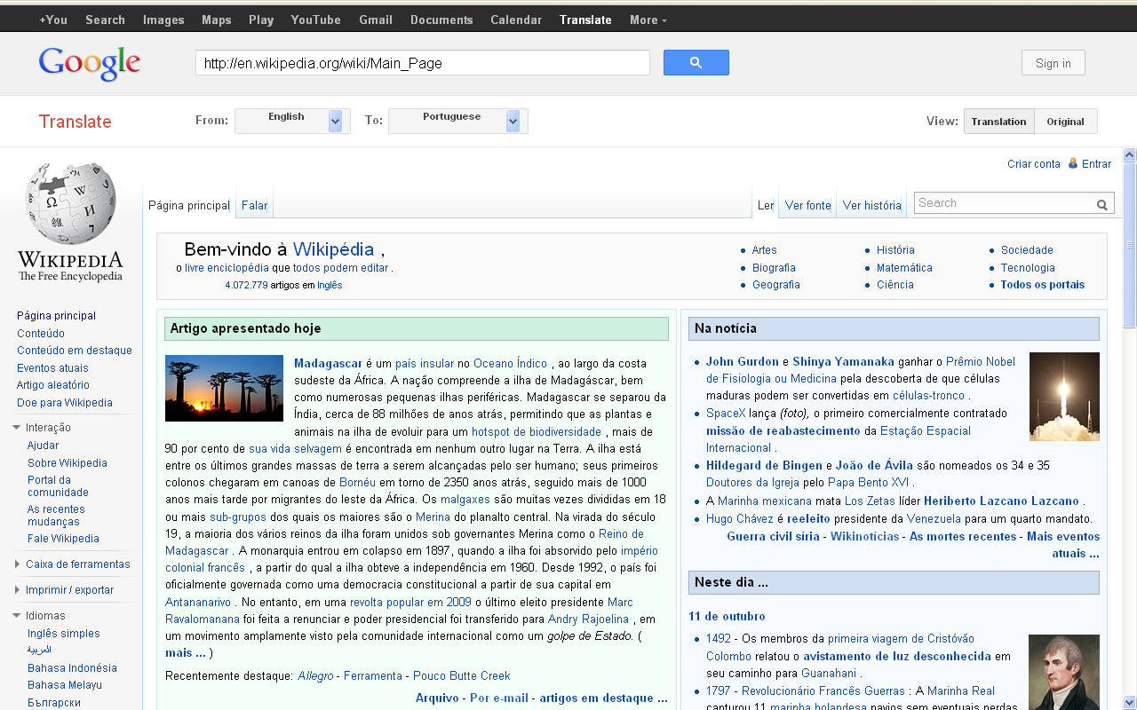
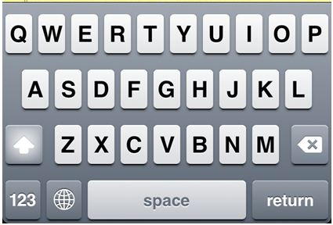
Cache Side-Channel Attacks are Increasing
Public cloud
Cryptography
Personal devices
Everyday applications
CCS’09
CCS’14
CCS’15
Usenix’16
RSA and AES
secret keys
Notes:
Every day applications such as web browser, pdf reader

Slide 4
Sample Cache Side-Channel Attack:
RSA Encryption Key
for i = n−1 down to 0 do
r = sqr(r)
…..
if e_{i} == 1 then
r = mul(r,b)
….
end
end
Probe addresses:
Monitored by the spy to obtain information
Notes:
Lets look at a sample cache side channel attack that targets RSA encryption key.
The code snippet shown here is at the core of the algorithm.
The “for” loop in this code, iterates over the n bits of the encryption key.
Each iteration corresponds to a bit, and it performs a sqr operation. If the bit is 1, it also performs a multiply operation
Therefore, the number of times the sqr operation is executed is the number of bits in the key
And the number of times mul operation is executed is the numbers of bits that are “1”.
The entry points of these functions are called probe addresses.
They can be monitored by the spy to figure out the bits of the encryption key.
Square and multiply based exponentiation
Identify the probe address in offline phase.
Of “mul” and “sqr” operations
If the attacker can figure out the exponent, it can leak the key.

Slide 5
Attack Illustration
Victim L1 Cache
Spy L1 Cache
Cache Set
Shared L2 Cache
(Inclusive)
Notes:
To illustrate how an attacker can monitor the access pattern, let’s consider two cores running victim and spy programs.
Each core has a private cache, and they share the L2 cache which is inclusive
Each row represent a cache set and each box represents a cache line.

Slide 6
Attack Illustration
Victim L1 Cache
Spy L1 Cache
Probe address
Shared L2 Cache
(Inclusive)
Notes:
Currently, victim has accessed the probe address and it is present in it’s private cache and L2.

Slide 7
Attack Illustration
Victim L1 Cache
Spy L1 Cache
Probe address
Evict
Spy’s line
Inclusion Victim
Spy Access
Hit
Access
Time
Evict
Wait
Analyze
Conflict
Shared L2 Cache
(Inclusive)
Notes:
The spy first prepares for the attack by filling in the cache set containing the probe address with its own lines.
After this, the spy begins the attack by accessing a new line. This causes a conflict in L2.
As L2 is inclusive, the line is evicted from L1 as well. Such evicted line is called as an inclusion victim.
The spy then waits for a specific period of time during which the victim might access the probe address again.
After the wait period, during the analysis phase, spy tries to access the same probe address.
As the victim has accessed the line during the wait phase, the spy’s access results in a hit.

Slide 8
Attack Illustration – Cont’d
Victim L1 Cache
Spy L1 Cache
Probe address
Spy’s line
Spy Access
Miss
No Access
Time
Evict
Wait
Analyze
Memory
Access
Shared L2 Cache
(Inclusive)
Notes:
If the victim did not access the line during the wait phase, then the spy’s access will miss in cache and needs to be fetched from memory.
By measuring the time taken to service the request, the spy can deduce whether the line was a hit or a miss in the cache.
Based on this information, the spy can figure out whether a particular function was accessed during the wait period.
The attacker repeats the process again to obtain more information.

Slide 9
Cache Side-Channel Attack Classification
Access
No Access
Time
Evict
Wait
Wait
Evict
Analyze
Evict
Analyze
Evict
Victim L1 Cache
Spy L1 Cache
Eviction Strategies
Conflict-based
Flush-based
Evict
X
Evict
Inclusion Victim
clflush addrX
X
Conflict
Shared L2 Cache
Notes:
The cache side channel attacks are classified into two types based on the eviction strategy employed by the attacker.
First type is a conflict-based attack. The example I have shown falls into this category.
These work by creating a conflict in the shared cache that induces an inclusion victim in private cache.
The second type is a Flush-based attack.
In this type of attack, a special instruction such as “clflush”, is used by the spy to evict an address from all levels of cache hierarchy.

Slide 10
Contributions
Insight: Conflict-based attacks rely on “Inclusion Victims”
Introduce SHARP:
  A shared cache replacement policy that defends against conflict-based attacks by preventing inclusion victims
  A slightly modified “clflush” instruction to prevent flush-based attacks
SHARP has desirable characteristics
  Prevents all known cache-based side channel attacks
  Minimal performance overhead
  No programmer intervention
  Minor hardware modifications

Slide 11
Contributions
Insight: Conflict-based attacks rely on “Inclusion Victims”
Introduce SHARP:
  A shared cache replacement policy that defends against conflict-based attacks by preventing inclusion victims
  A slightly modified “clflush” instruction to prevent flush-based attacks
Notes:
The main contributions of our work are the following.
First we make a key observation that – all conflict based attacks rely on inclusion victims.
We introduce SHARP -…..
Together they constitute SHARP design.

Slide 12
SHARP: Preventing Inclusion Victims
Step 1: Find a cache line in the set that is
not present in any private cache
Notes:
Let us see how SHARP prevents the inclusion victims.
During the victim selection phase of the cache replacement,
We first try to pick an entry that is not present in any private cache (in the replacement priority order).

Slide 13
SHARP: Preventing Inclusion Victims
Step 1: Find a cache line in the set that is
not present in any private cache
Victim L1 Cache
Spy L1 Cache
Probe address
Spy’s line
Inclusion victim from
other core is prevented
Line not in any
private cache
Shared L2 Cache
Notes:
If we go back to the example from earlier, the three cache lines shown in grid boxes are not present in any private cache.
So instead of picking the victim’s line, we select this other line and thereby prevent an inclusion victim.

Slide 14
SHARP: Prevention of MultiCore Attack
Step 1: Find a cache line in the set that is
not present in any private cache
Otherwise
Step 2: Find a cache line in the set that is present only in the requesting core’s private cache
Notes:
If we are not able to find any such entry, then we try to pick an entry that is present only in the requesting core’s private cache.

Slide 15
SHARP: Prevention - MultiCore Attack
Step 2: Find a cache line in the set that is present only in the requesting core’s private cache
Notes:
To illustrate this we consider a multicore attack on the victim.

Slide 16
SHARP: Prevention - MultiCore Attack
Step 2: Find a cache line in the set that is present only in the requesting core’s private cache
Victim
Spy 1
Spy 2
Evict
Inclusion victim from
other core is prevented
Shared L2 Cache
Conflict
Notes:
Here we have two spy threads running on two cores working together and filling up the cache set.
As we can see when the spy2 tries to bring in a new line, all the lines are present in private caches.
In this case, we pick a line that is only the requesting core’s private cache, causing a conflict with itself and evicting it’s own line

Slide 17
SHARP Summary
Step 1: Find a cache line in the set that is
not present in any private cache
Otherwise
Step 2: Find a cache line in the set that is present only in the requesting core’s private cache
Otherwise
Step 3: Randomly evict a line, increment alarm counter
SHARP needs to know whether a line is present in private cache
Use presence bits in directory (Core Valid Bits)
Query, with a message, the private caches for information
Notes:
If we are still not able to find a line, then we randomly evict a line and increment the alarm counter.
If the alarm counter exceeds a particular threshold, then we trigger an interrupt to alert the user.
These three steps form the core algorithm of SHARP replacement policy.
To execute the steps 1 and 2, SHARP needs to know whether a line is present in private cache or not.
For this, we either use presence bits in directory such as core valid bits
Or we query the private caches with a message.

Slide 18
Obtaining Private Cache Information: CVB
Using Core Valid Bits (CVB) only:
  Step 1: Pick a line without any CVB set
  Step 2: Pick a line with only the requester’s CVB set
  Step 3: Random replacement + increment alarm counter
✓ Readily available
✗ Conservative
  Silent evictions from private cache do not update CVB
Notes:
The easiest way to do this is by using the core valid bits only.
For this case,
In the first step of the algorithm, we pick a line without any CVB set which implies that no core has this line.
If no such entry is found, then we pick a line with only the requestor’s CVB set.
If not we perform random replacement and increment an alarm counter.
The main advantage of this scheme is that the information is readily available.
But it is very conservative as silent evictions ……

Slide 19
Obtaining Private Cache Information: CVB
Using Core Valid Bits (CVB) only:
  Step 1: Pick a line without any CVB set
  Else Step 2: Pick a line with only the requester’s CVB set
✓ Readily available
✗ Conservative
  Silent evictions from private cache do not update CVB
Notes:
The easiest way to do this is by using the core valid bits only.
For this case,
In the first step of the algorithm, we pick a line without any CVB set which implies that no core has this line.
If no such entry is found, then we pick a line with only the requestor’s CVB set.
If not we perform random replacement and increment an alarm counter.
The main advantage of this scheme is that the information is readily available.
But it is very conservative as silent evictions ……
Therefore CVB is stale.

Slide 20
Obtaining Private Cache Information: Hybrid
Using combination of CVB and queries to private caches
  Step 1: Pick a line without any CVB set
  Else Step 2: Send queries to refresh CVB until a replacement candidate is found (all CVB bits zero, or only requester’s CVB set)
✓ Accurate
✗ Significant network overhead to send messages
Notes:
The second method is by using a combination of CVB and queries to private caches.
The first step remains the same, in which we pick a line without any CVB set.
In the second step, however, we send queries to private caches and refresh the CVB.
We do this until a replacement candidate is found.
Finally if no candidate is found, we do random replacement and increment alarm counter.
This scheme is quite accurate but has a lot of network overhead.

Slide 21
Obtaining Private Cache Information: SHARP
Hybrid scheme with a limit on the query count
  Step 1: Pick a line without any CVB set
  Else Step 2: Send queries to refresh CVB for at most N lines.
  If candidate is not found, use current CVB for the rest
  (to pick a line present only in the requester’s cache)
✓ Accurate enough
✓ Low overhead
Notes:
That brings us to the scheme that is employed by SHARP.
We use the same hybrid scheme that I just discussed, but with a limit on the number of queries.
Therefore the first step remains the same as earlier. s
And in the second step, we send atmost N queries.
If a suitable replacement line is not found, then we use the conservative CVB for the rest of the ways, to pick a line.

Slide 22
Experimental Setup
MarssX86 cycle-level full system simulator
2 to 16 out of order cores
  Private DL1, IL1, L2 (32KB, 32KB, 256KB)
  Shared Inclusive L3 cache (2MB slice per core)
  Baseline replacement policy: pseudo LRU
Notes:
We evaluated our scheme using MarssX86 full system simulator.
We simulated several configurations that had atleast 2 cores and upto 16 cores.
We have a private IL1, DL1, L2 caches.
First, lets look at how SHARP’s defense works.

Slide 23
Security Evaluation: RSA Attack
Baseline LRU: Access pattern of sqr, mul is clear
Hit
for i = n−1 down to 0 do
r = sqr(r)
…..
if e_{i} == 1 then
r = mul(r,b)
….
end
end
Notes:
Let us go back to the example that we saw earlier.
Each blue dot in the picture corresponds to a hit, as observed by the attacker. The absence of a blue dot indicates a miss.
The bottom row corresponds to the hits of “sqr” function call and the top row corresponds to the hits of “mul” function call.
Recall that the loop iterates over each bit and performs sqr operation. If the bit is 1, then it also does a multiply operation.
Therefore whenever there is a blue dot in top row, immediately after a blue dot in the bottom row, it implies that the bit of the encryption key is 1.
This is highlighted using vertical shaded box.
When there is no follow-up dot in top row after one in bottom row, then the bit is 0. These are highlighted with shaded horizontal patterns.
As you can see, using a baseline replacement policy the access pattern is leaked very easily.
Say that, this example shows 3 such instances

Slide 24
Security Evaluation: RSA Attack
Baseline LRU: Access pattern of sqr, mul is clear
SHARP: No obvious access pattern of sqr, mul
Notes:
However, using SHARP, we prevent the eviction of the victim’s cache lines.
Hence, whenever spy tries to access the probe address, it results in a hit.
As a result the spy cannot obtain information about the execution patterns
And thus we prevent information leakage.

Slide 25
L3 Misses Per Kilo Instructions
Inability to evict shared data causes cache thrashing
“cvb” performs the worst
Notes:
To understand the impact of our replacement policy on benign workloads, we evaluated
SPEC and PARSEC benchmarks on 4 to 16 cores.
Due to lack of time, I will just present the results for a 4 core parsec benchmark.
We show for replacement policies here.
The first bar corresponds to the baseline. Second green bar – CVB, Hybrid and
The y-axis shows the L3 MPKI normalized to the baseline policy.
And the x-axis shows the parse benchmarks.
As you can see the “cvb” scheme performs the worst. The hybrid scheme and SHARP use queries and can perform much better.
But in some benchmarks such as ferret, the MPKI is high because of the inability to evict shared data. This causes cache thrashing increasing the MPKI.

Slide 26
Execution Time
Modest slowdown of 6% due to large working set
Average execution time increase ≈ 1%
Notes:
Now let’s take look at the execution time overheads. The benchmarks on x-axis and the bars remain the same.
On y-axis we show execution time normalized to Baseline replacement policy.
The impact on the execution time increase is quite low with an average of 1% increase in execution time. The largest slowdown seen is till a reasonable
6% for the canneal benchmark due to its large working set.

Slide 27
More in the Paper
Prevention of flush-based attacks
Detailed evaluation
  Mixes of SPEC workloads
  Scalability to 8,16 cores
  Threshold Alarm Analysis
Handling of related attacks, defenses
Insights into the scheme, corner cases
Notes:
In the paper we also discuss how SHARP prevents flush-based attacks.
A detailed …
We also discuss how SHARP handles related attacks and the corresponding defenses.
Finally, we also present more insights into our scheme and discuss the corner cases.

Slide 28
Conclusion
Insight: Conflict-based attacks rely on “Inclusion Victims”
Presented SHARP:
  Shared cache replacement policy that defends against conflict-based attacks by preventing inclusion victims
  Slightly modified “clflush” instruction to prevent flush-based attacks
Prevents all known cache-based side channel attacks
Minimal performance loss
No programmer intervention
Minor hardware modifications
Notes:
In conclusion,
We make a key insight …
Based on this observation, we …

Slide 29
Secure Hierarchy-Aware Cache Replacement Policy (SHARP): Defending Against Cache-Based Side Channel Attacks
Mengjia Yan, Bhargava Gopireddy, Thomas Shull, Josep Torrellas
University of Illinois at Urbana-Champaign
http://iacoma.cs.uiuc.edu
ISCA 2017
Notes:
.

Slide 30
Backup

Slide 31
Preventing Flush-Based Attacks
“clflush” instruction
  Invalidates an address from all levels of the cache hierarchy
  Can be used at all privilege levels on any address
Used to handle inconsistent memory states
  Memory-mapped IO
  Self modifying code
Attacker exploits “clflush” through page sharing of
  Shared library
  Page de-duplication
Write-able
Read-Only
SHARP: Allow “clflush” only if the thread has write access to the address
Copy-On-Write
Notes:
Contrast between the two.

Slide 32
Starvation
Threshold for alarms
Pathological cases
How does it apply to other replacement policies ?
  Performance will still be better ?

Slide 33
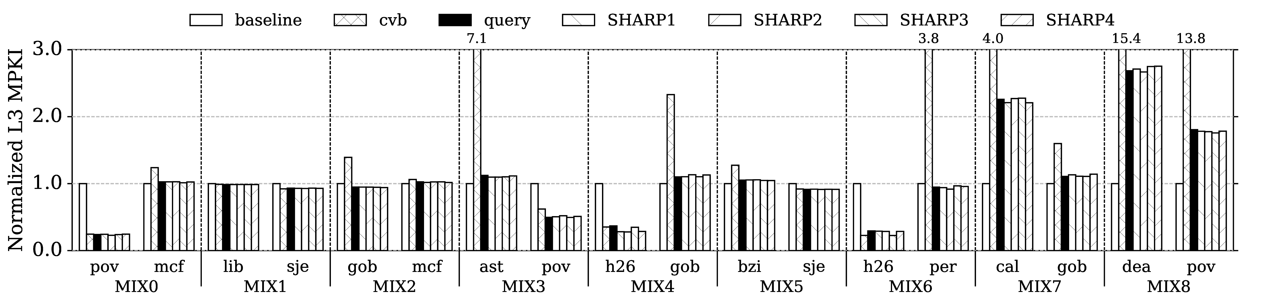
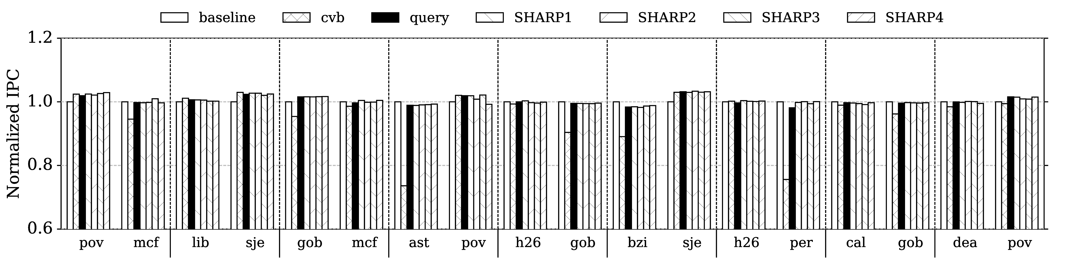
Performance Evaluation on SPEC Benchmarks

Slide 34
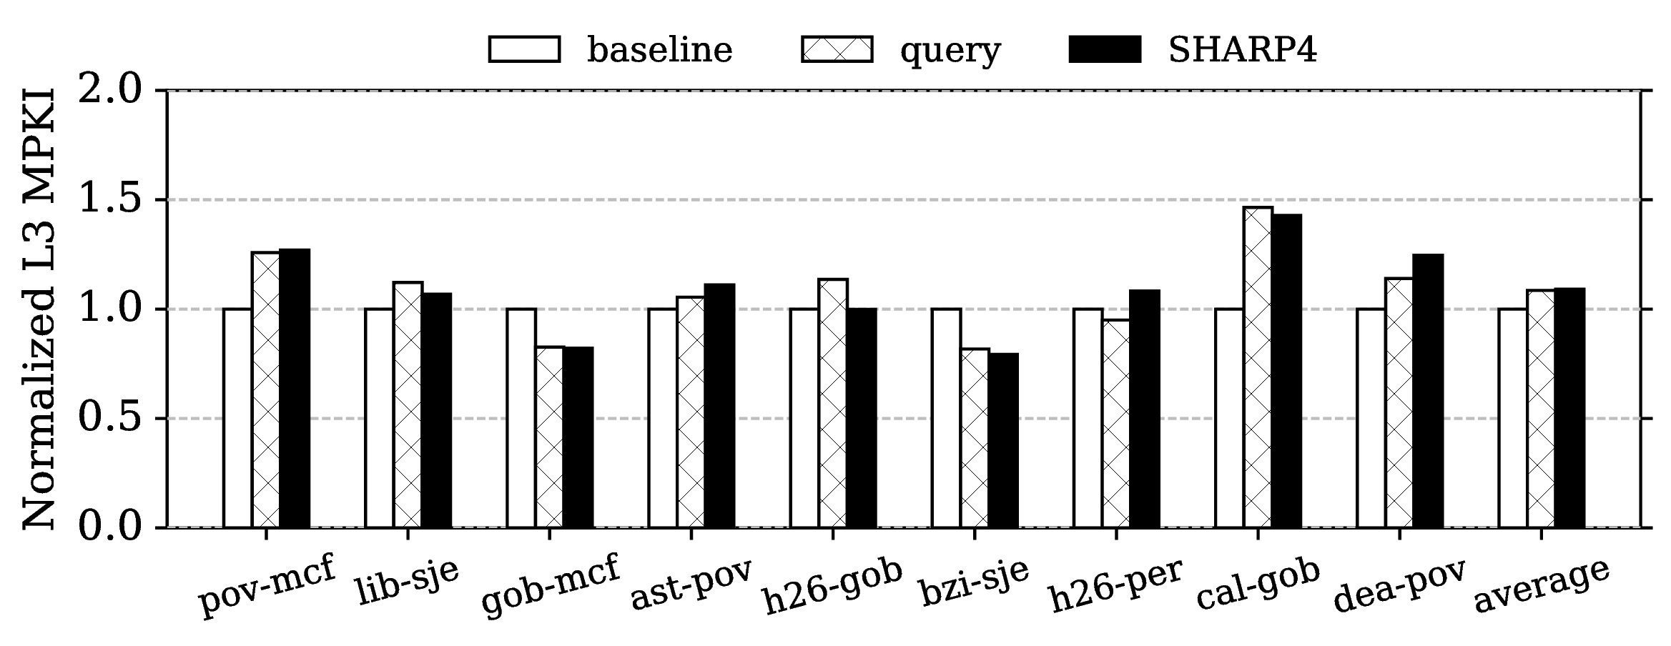
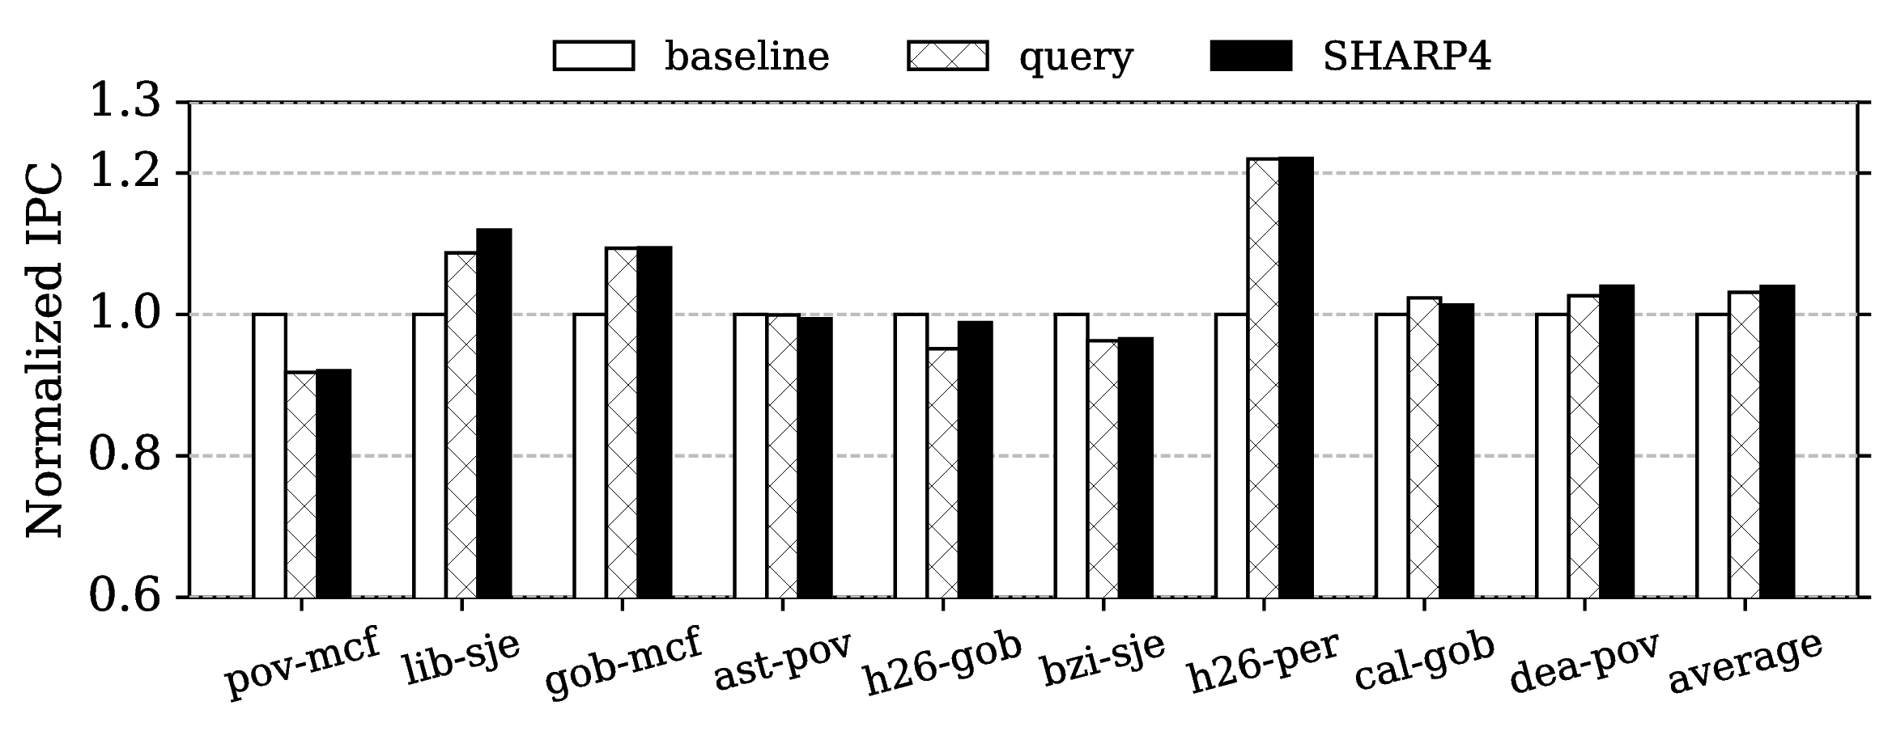
Performance Evaluation on Scalability
Mixes of SPEC applications on 8-core setup

Slide 35
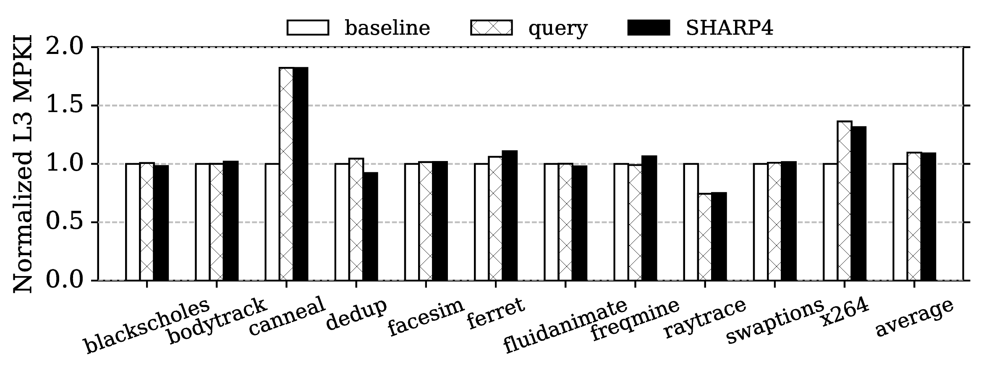
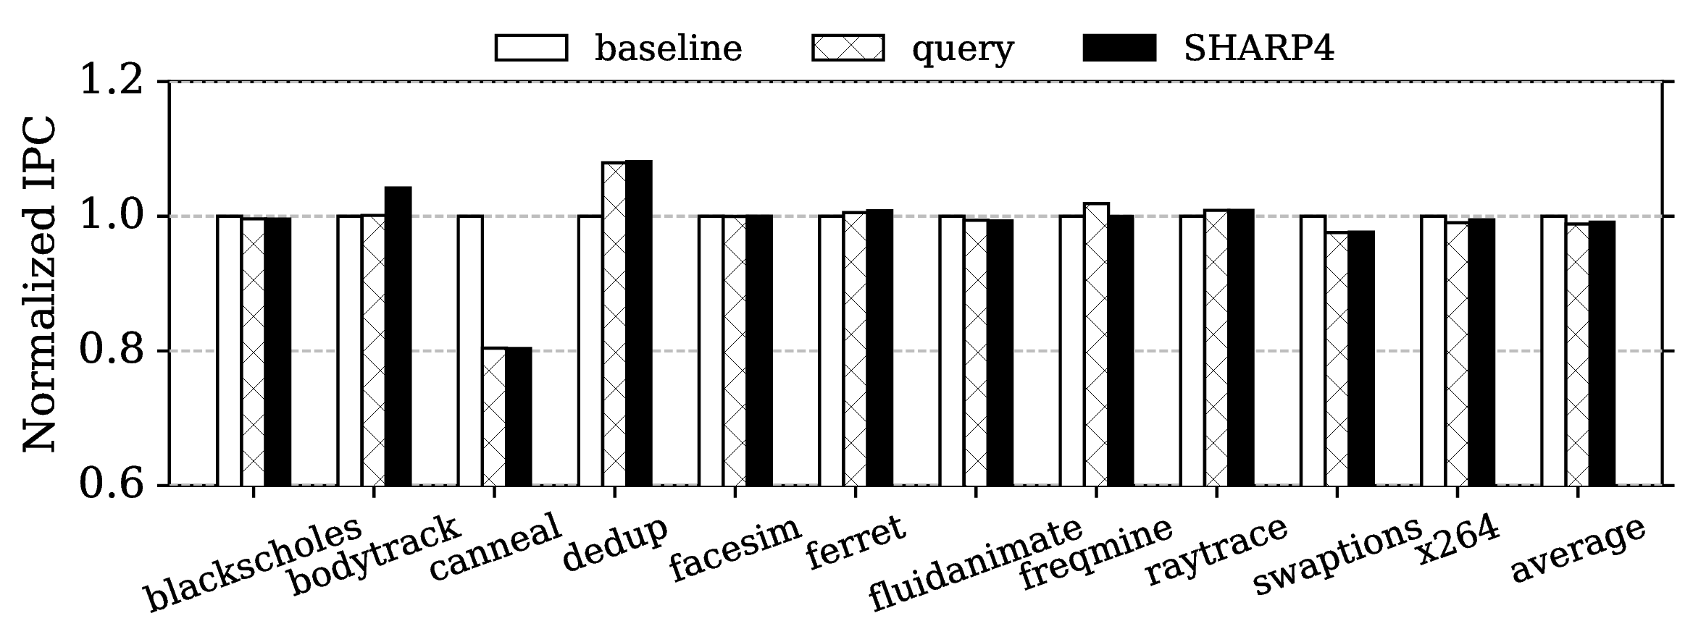
Performance Evaluation on Scalability
PARSEC applications on 16-core setup

Slide 36
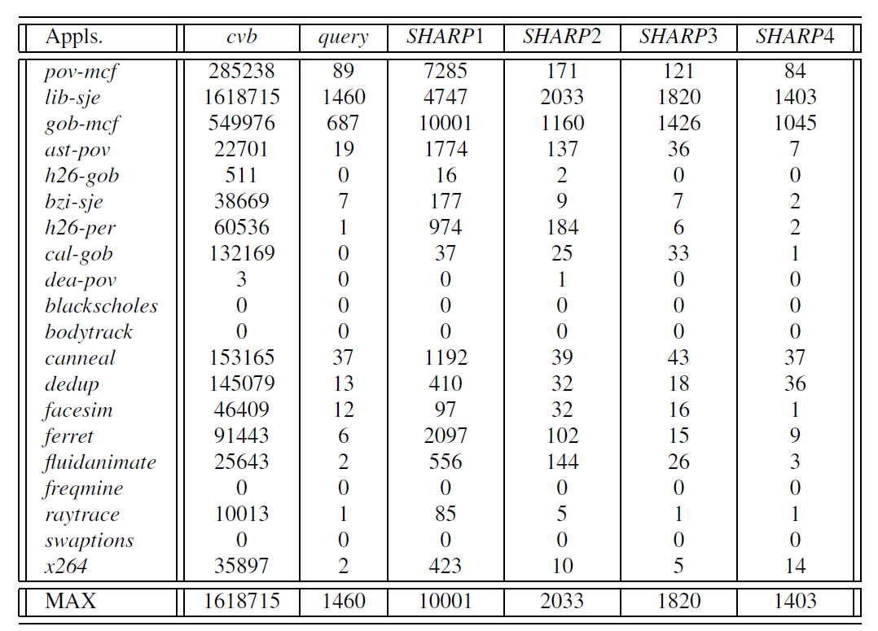
Alarm Anlysis
An attacker thread will increment its counter at least 100,000 times in 1 billion cycles
It is safe to use 2,000 as threshold in SHARP4
Alarms per 1 billion cycles in benign workloads

Slide 37
Compare to Related Works
Conflict-based attack
  Cache partition
  Software assisted cache locking
Flush-based attack
  Disable “clflush” in user space
High performance overhead
Require code modification
Difficult to precisely determine addresses to protect
Legacy issues

Slide 38
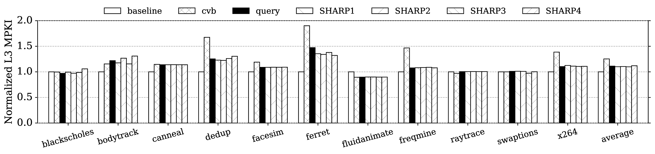
Performance Evaluation on PARSEC Benchmark
“cvb” performs the worst
Inability to evict shared data causes cache thrashing, thus higher MKPI
Reducing inclusion victims lowers MPKI
Average MPKI increase is low
Notes:
Benign program

Slide 39
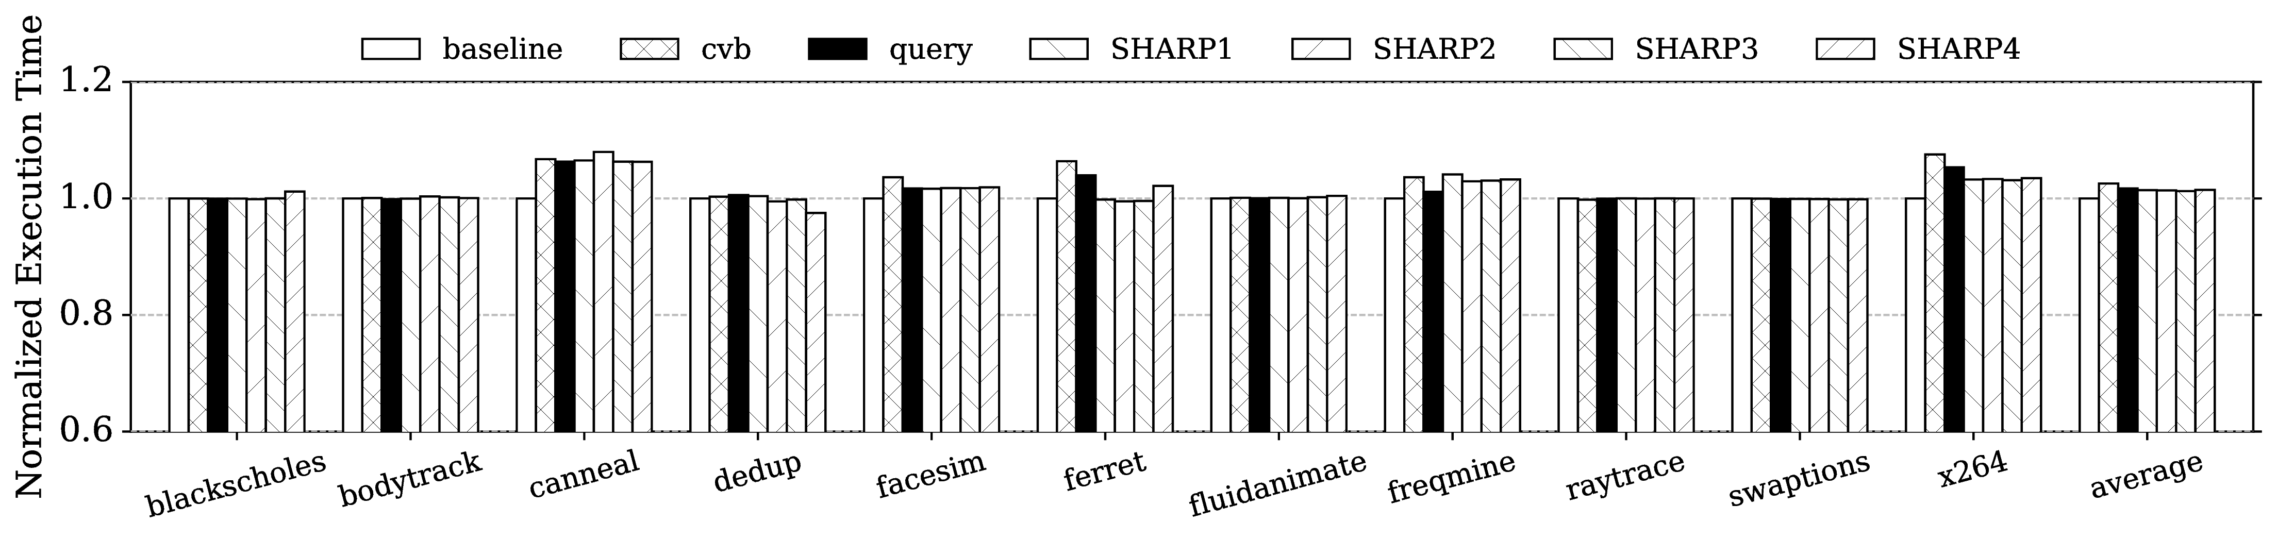
Performance Evaluation on PARSEC Benchmark
Modest slowdown of 6% due to large working set.
Average execution time increase ≈ 1%

Slide 40
Experiment Setup
MarssX86 cycle-level full system simulator
Parameters for the simulated system
Evaluated configurations
Parameter | Value
Multicore | 2-16 cores at 2.5GHz
Core | 4-issue, out-of-order, 128-entry ROB
Private L1 I-Cache/D-Cache | 32KB, 64B line, 4-way Access latency: 1 cycle
Private L2 Cache | 256KB, 64B line, 8-way, Access latency: 5 cycles after L1
Query from L3 to L2 | 3 cycles network latency each way
Shared L3 Cache | 2MB bank per core, 64B line, 16-way, Access latency: 10 cycles after L2
Coherence Protocol | MESI
DRAM | Access latency: 50ms after L3
Operating System | 64-bit version of Ubuntu 10.4
Config. | Line Replacement Policy in L3
baseline | Pseudo-LRU replacement.
cvb | Use CVBs in both step 1 and 2
query | CVBs in step1 & queries in step 2
SHARPX | CVBs in step 1. In step 2, limit the max number of queries to X, where X = 1, 2, 3 or 4.

Slide 41
Key Observation: Inclusion Victims
Cache 0 - Victim
Cache 1 - Spy
Evict
Inclusion Victim
Conflict
SHARP Main Idea: Prevent Inclusion Victims
Notes:
Add animation

Slide 42
SHARP: New Cache Replacement for Security
Prevents an attacker thread from creating “Inclusion Victims”
Cache 0 - Victim
Cache 1 - Spy
Prevents all known cache-based side channel attacks
Minimal performance loss
No programmer intervention
Conflict
Notes:
highlight arrows

Slide 43
Attacks on Inclusive Hierarchical Caches
Cache based side channel attacks rely on “Inclusion Victims”
Evict
Cache 0 - Victim
Cache 1 - Spy
Shared address
Spy’s line
Conflict
Notes:
highlight arrows

Slide 44
SHARP: New Cache Replacement for Security
Prevents an attacker thread from creating “Inclusion Victims”
Prevents cache-based side channel attacks
minimal performance penalty
Cache 0 - Victim
Cache 1 - Spy
Conflict
Notes:
highlight arrows

Slide 45
Sample Attack – RSA Encryption Key
Square and multiply based exponentiation
Input : base b, modulo m,
exponent e = (e_{n−1} ...e₀ )₂
Output: b^{e} mod m
r = 1
for i = n−1 down to 0 do
r = sqr(r)
r = mod(r,m)
if e_{i} == 1 then
r = mul(r,b)
r = mod(r,m)
end
end
return r
Probe addresses
used by spy
Notes:
Square and multiple based exponentiation
Identify the probe address in offline phase.
Of “mul” and “sqr” operations
If the attacker can figure out the exponent, it can leak the key.

Slide 46
Compare to Related Works
Conflict-based attack
  Cache partition
  Software assisted cache locking
Flush-based attack
  Disable “clflush” in user space
High performance overhead
Require code modification
Difficult to precisely determine addresses to protect
Legacy issues

Slide 47
Security Evaluation: Poppler
Using baseline LRU replacement policy
Using SHARP replacement policy
Notes:
A PDF rendering library

Slide 48
Impact on Benign Programs
Disadvantages:
  Limits the maximum cache usage by a program
Advantages:
  Helps improve the

Slide 49
SHARP: Replacement Policy – Victim Selection
Check the presence bits in directory (eg. Core Valid Bits)
If there exists a line that is not present in any
private cache: Select it
In the replacement priority order,
Send queries to private cache and refresh presence bits
Stop if the line is present in only requester’s private cache
Select the victim randomly and increment alarm counter
If the alarm counter is greater than threshold, generate an interrupt

Slide 50
SHARP: Replacement policy in stages

