Slide 1
SecDir: A Secure Directory to Defeat
Directory Side-Channel Attacks
Mengjia Yan*, Jen-Yang Wen, Christopher W. Fletcher, Josep Torrellas
University of Illinois at Urbana-Champaign
*University of Illinois at Urbana-Champaign/MIT
ISCA, June 2019

Slide 2
Motivation
Cache-based side-channel attacks are serious security threats
Directories are also vulnerable to side-channel attacks [Yan et al, S&P’19]
It is challenging to design secure directories inexpensively and scalably
Core
L1
Core
L1
Core
L1
Core
L1
L2
L2
L2
L2
Shared LLC
directory
Notes:
Dir similar to caches, vulnerable, In a moment I will explain it in more details
As we will see

Slide 3
Contribution: A Secure Directory (SecDir)
Key: Block directory interference between processes
Main idea: Take a portion of the storage used by conventional directory and re-assign it to per-core private directory (Victim Directory)
Core
L1
Core
L1
Core
L1
Core
L1
Core
L1
Core
L1
Core
L1
Core
L1
L2
L2
L2
L2
L2
L2
L2
L2
Shared LLC
Shared LLC
directory
directory
VD
Notes:
We call it secdir
Classical partition introduces low utilization and is not scalable.
On the other hand, our design is more scalable even than the baseline.

Slide 4
Outline
Background
The Problem
Threat Model
SecDir Design
Evaluation

Slide 5
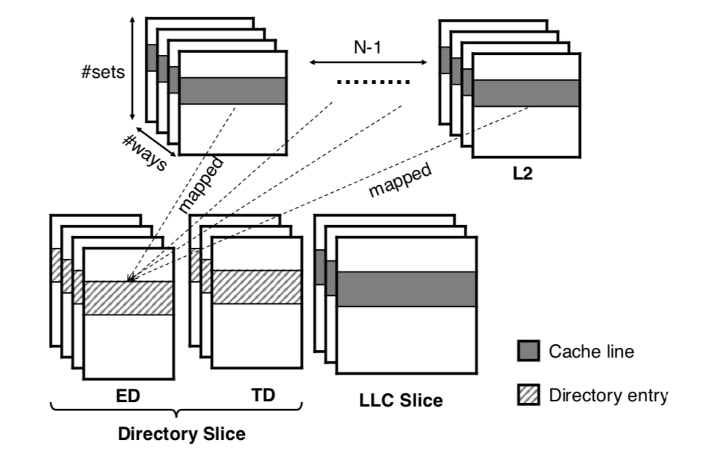
Directory Basics
Directory is used to keep presence information for cache lines
A directory entry contains “sharer information”, address tag, coherence state
  Sharer information: N presence bits, where N is # of cores in machine
Directory is partitioned into slices like LLC using a hash function
Notes:
one slice/bank of LLC, organized associatively
For example, the sharer information is organized ….

Slide 6
Directories in Non-inclusive Cache Hierarchies
[Yan et al, S&P’19]
Trend to have non-inclusive cache hierarchies
Added Extended Directory to hold state for lines that are in private caches (L2)
Slice of Intel Skylake-X/SP LLC and directory
Notes:
Now we need the structure to hold directory entries for lines only in L2
++ the ed contains again ……

Slide 7
Directories are Vulnerable to Side-Channel Attacks
[Yan et al, S&P’19]
Every single line in the cache hierarchy has a directory entry
Directory conflict → Evicts victim’s directory entry → Evicts victim’s cache line
Root cause: Limited per-slice directory associativity
victim
core 0
attacker
core 1
attacker
core 2
Private cache
 |  | ……
 |  | ……
 |  | …
 |  | …
 |  | …
 |  | …
 |  | …
 |  | …
 |  | ……
 |  | ……
 |  | ……
 |  | ……
 |  | ……
 |  | ……
 |  | ……
 |  | ……
 |  | ……
 |  | ……
 |  | ……
 |  | ……
 |  | …
 |  | ……
LLC
slice
extended
directory
(ED)
traditional
directory
(TD)
cache lines
Notes:
People used to believe …..
But, directories … read title
Solid boxes are cache lines; dashed boxes are directory entries
TODO:…….

Slide 8
Defense Goal & Threat Model
Goal: A secure directory to block directory interference between processes
 |  | Co-location
 |  | Same-core | Cross-core
Attack Strategy | Active |  | X
 | Passive
* Victim self-conflicts (e.g. in victim’s private structures) are not considered leakage
Notes:
One is the co-location, means how the attacker and the victim are co-located, which can be on the same core, or different cores.
What is active attackers? Actively attempts to create directory conflicts to evict victim’s cache lines
A passive attacker is the attacker only passively monitor the victim’s access patterns

Slide 9
Naïve Secure Directory Designs Are Not Scalable
Strategy I: Substantially increase associativity of each directory slice
  Unrealistic: Need too high associativity
(e.g. > 300 for a 22-core machine)
 |  | …
Notes:
For that, I will tell you two naïve ….

Slide 10
Naïve Secure Directory Designs Are Not Scalable
Strategy I: Substantially increase associativity of each directory slice
  Unrealistic: Need too high associativity (e.g. > 300 for a 22-core machine)
Strategy II: Way-partition the directory slice (at least 1 way per security domain)
  Unacceptable: Inflexible, low performance and limiting

Slide 11
Our proposal: SecDir
Main idea: Take part of the storage used by conventional directory and re-assign it to per-core private directories: Victim Directories (VD)
Slice of Intel
Skylake-X directory.
VD bank
Slice of SecDir.
Provide per-core isolation
Notes:
For example, we take two ways out of the 4 ways……

Slide 12
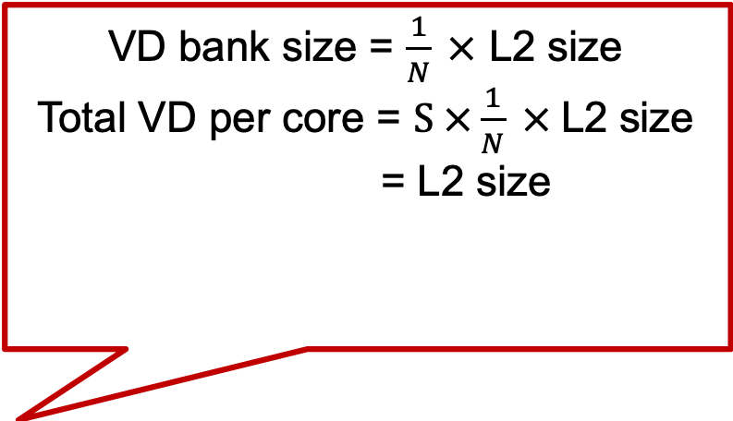
Our proposal: SecDir
N: number of cores
S: number of slices
Provides inexpensive and scalable isolation
Uses modest storage
VD bank size = $\frac{1}{N} ×$ L2 size
Total VD per core = $S ×\frac{1}{N} ×$L2 size
= L2 size
VD size for a core is constant irrespective to N
Notes:
More cores, more storage for sharer information, our design becomes more competitive.

Slide 13
SecDir Blocks Directory Interference
Consider each directory transition and its security implications
Notes:
Add animation, put a yellow box moving between …..
The animation shows the move of the directory entry for the line
Directroy entry v.s. cache line

Slide 14
SecDir Blocks Directory Interference
Consider each directory transition and its security implications
  ED←→ TD: Line location does not change; no leakage
Notes:
Add animation, put a yellow box moving between …..
The animation shows the move of the directory entry for the line
Directroy entry v.s. cache line

Slide 15
SecDir Blocks Directory Interference
Consider each directory transition and its security implications
  ED←→ TD: Line location does not change; no leakage
  ② TD → Memory: Line is in LLC but in no L2; It is because of L2 self-conflicts, not due to attacker
Notes:
Add animation, put a yellow box moving between …..
The animation shows the move of the directory entry for the line
Directroy entry v.s. cache line

Slide 16
SecDir Blocks Directory Interference
Consider each directory transition and its security implications
  ED←→ TD: Line location does not change; no leakage
  ② TD → Memory: Line is in LLC but in no L2; It is because of L2 self-conflicts, not due to attacker
  ③ TD → VD: Line location does not change. VD of every sharer receives a copy. no leakage
Notes:
Add animation, put a yellow box moving between …..
The animation shows the move of the directory entry for the line
Directroy entry v.s. cache line

Slide 17
SecDir Blocks Directory Interference
Consider each directory transition and its security implications
  ED←→ TD: Line location does not change; no leakage
  ② TD → Memory: Line is in LLC but in no L2; It is because of L2 self-conflicts, not due to attacker
  ③ TD → VD: Line location does not change. VD of every sharer receives a copy. no leakage
  ⑤ VD → Memory: L2 line is evicted; VD self-conflict, not due to attacker
SecDir prevents cache line evictions
due to attacker induced directory interference
Notes:
Add animation, put a yellow box moving between …..
The animation shows the move of the directory entry for the line
Directroy entry v.s. cache line

Slide 18
SecDir Optimizations
Provides high associativity in VD
  VD supports Cuckoo hashing to increase effective VD associativity
Delivers efficient directory lookup
  Uses a “Early-Miss” (EM) bit → skips many VD lookups

Slide 19
Experimental Setup and Benchmarks
Configurations: two 8-core designs
  Baseline: Use Skylake-X directory (ED associativity=12)
  SecDir: Take 4 ways from the ED to create the VD
    Remaining ED is as big as L2
    Augment VD in each slice with 28.5KB → per-core VD is as big as L2
Benchmarks:
  SPEC Mixes: Groups of programs running 8 threads, with different characteristics
  PARSEC: Individual parallel programs running with 8 threads
Notes:
We then augment VD in …..

Slide 20
Evaluation Results – PARSEC
ED/TD conflicts migrate entries to VD without evicting L2 lines → fewer L2 misses
B: baseline S: SecDir

Slide 21
Evaluation Results – PARSEC
Under benign conditions, the performance overhead is negligible
+ Fewer L2 misses
- VD accesses add 5-10 cycles
Summary: Secure and little performance impact

Slide 22
More in the paper & Discussion
More performance results for SPECMIX
Security discussion
  VD timing issues
Performance evaluation
  Effects of the two optimizations: cuckoo hashing and Early-Miss bits
  Storage and area overhead

Slide 23
Conclusion
Directories are vulnerable to side-channel attacks [Yan et al, S&P’19]
Naïve solutions are not effective
Contribution: SecDir
  Main idea: Take a portion of the storage used by conventional directory and re-assign it to per-core private directory (Victim Directory)
  Provides isolation inexpensively and scalably
  Uses moderate storage

Slide 24
Q&A

Slide 25
SecDir Blocks Directory Interference
Consider each directory transition and its security implications
  ED←→ TD: Line location does not change; no leakage
  ② TD → Memory: Line is in LLC but in no L2; L2 self-conflicts
  ③ TD → VD: Line location does not change. VD of every sharer receives a copy. no leakage
  ④ VD → TD: L2 wants to write back the cache line to LLC; L2 self-conflict
Notes:
Add animation, put a yellow box moving between …..
The animation shows the move of the directory entry for the line
Directroy entry v.s. cache line

Slide 26
Evaluation of SPECMIX
Under benign conditions, the performance overhead is negligible
+ ED/TD conflicts migrate entries to VD: do not evict L2 lines → fewer L2 misses
- VD accesses add 5-10 cycles
Summary: Secure and little performance impact

Slide 27
Evaluation of SPECMIX
SecDir has fewer L2 misses because fewer directory conflicts
No VD hits (since no shared data) → VD accesses add to a DRAM latency

Slide 28
Directories in Non-inclusive Cache Hierarchies
[Yan et al, S&P’19]
Trend to have non-inclusive cache hierarchies
  #cores ↑, LLC size ↑, latency ↑;
  Thus, we want LLC access ↓, L2 size ↑
  Too much duplication if inclusive
Added Extended Directory to hold state for lines in private caches (L2)
Slice of Intel Skylake-X/SP LLC and directory.

Slide 29
Naïve Secure Directory Designs
Strategy I: Substantially increase associativity of each directory slice
  Unrealistic: Need too high associativity
 |  | …
To hide one cache block from the victim, it requires
W_{ED} + W_{TD} > W_{L2} x (N-1) + W_{L3}
where W is associativity.
Notes:
Maybe cut this slides

Slide 30
Evaluation Results – PARSEC
Similar results except that VD sometime hits:
- P1 brings data and its dir is evicted into VD
- P2 accesses the data
Still: Few VD hits:
- Speed of VD does not matter much

Slide 31
Directories are Vulnerable to Attacks
[Yan et al, S&P’19]
Every single line in the cache hierarchy has a directory entry
Attacker can cause conflicts in the directory → evicting a victim directory entry
  This, in turn, evicts a victim cache line
victim
core 0
attacker
core 1
cache
line
directory
entry
Private L2
Target
address
 |  | ……
 |  | ……
 |  | …
 |  | …
cache lines
Attacker's
addresses
 |  | ……
 |  | ……
 |  | ……
 |  | ……
 |  | ……
 |  | ……
 |  | ……
 |  | ……
 |  | ……
 |  | ……
 |  | ……
 |  | ……
Shared
LLC
slice
extended
directory
(ED)
traditional
directory
(TD)
 |  | ……
 |  | ……

Slide 32
Victim Directory Lookup
First ED/TD: one associative lookup; returns sharer info
Then VD: lookups at multiple VD banks; returns one bit per core

Slide 33
VD Lookups Are Efficient: Not On Critical Paths
Transaction | VD Operation
② TD → Memory | ------
③ TD → VD | Insert the address into the VDs of all the sharers. No search, cheap
④ VD → TD | On L2 writeback: Search all VD banks to find the address and remove all the matches. Expensive, but no on critical paths
⑤ VD → DRAM | On VD self-conflict: Remove the conflicting address from the VD bank. No search, cheap
Read | Read VD banks in batches. Stop when we hit in one
Write | Search all banks and invalidate the relevant copies

Slide 34
Minimizing VD Self-Conflicts
Organize VD as Cuckoo Directory
Performance: Longer lookup/insert latency
Security:
  Reduce VD self-conflicts
  Obscures victim self-conflict patterns
1 | a | b
2 | c | d
3 | e | f
4 | g
h₁(x)
VD bank
x
h₂(x)

Slide 35
Example: VD Offers High Associativity
Example: insert x into an almost full VD
1 | a | b
2 | c | d
3 | e | f
4 | g
1 | a | b
2 | f | d
3 | e | x
4 | g | c
not changed
entry
h₁(x)
x
①
relocation
moved entry
h₂(x)
②
relocation
(a) Before inserting item x
(b) After item x inserted

Slide 36
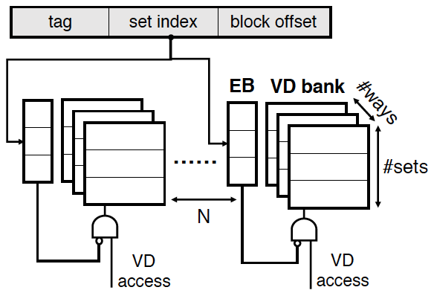
Early Detection of VD Misses
Under benign conditions: VD will be highly underutilized
Want to quickly detect when a VD access will miss → save E
  Add an Empty Bit (EB) per set and bank
  If all the entries in that set of that bank are Invalid → EB is set

Slide 37
SecDir Uses Low Area
  VD does not store “sharing information”
  More cores → More bits of sharing information “saved”
Baseline: Skylake-X directory (W_{ED}=12).
SecDir: Take some ED ways for VD. For example, keep W_{ED}=8 (such that ED can hold as many lines as L2).
Summary: by stealing 4 ways of ED, we quickly attain a per-core VD that has as many entries as L2 lines
Comparing the number of per-core VD entries machine-wide to the number of L2 lines. Values above 1 mean that the per-core VD has more entries than lines in L2.

Slide 38
Directories are Vulnerable to Attacks
[Yan S&P’19]
As the victim re-accesses the data → directory entry reloaded
Attacker can observe the directory changing
victim
core 0
attacker
core 1
Non-inclusive cache hierarchy
Private cache
 |  | ……
 |  | ……
 |  | …
 |  | …
cache
line
directory
entry
 |  | ……
target
address
 |  | ……
 |  | ……
 |  | ……
 |  | ……
 |  | ……
 |  | ……
 |  | ……
 |  | ……
 |  | ……
 |  | ……
 |  | ……
 |  | ……
 | ……
attacker's
addresses
LLC
slice
extended
directory
(ED)
traditional
directory
cache lines
Notes:
In a typical cloud server, multiple users are co-located on the same chip.
From a VM perspective, they are isolated from each other.
However, the shared hardware such as LLC can still leak information. In a cache side-channel attack,
Attacker/spy observe’s …. to obtain sensitive information.

Slide 39
Other Results in the Paper
In an attack, the VD does prevent victim misses
The Empty bit (EB) saves 60-80% of the VD accesses
Under worst attack (i.e., all victim directory entries in the VD), the Cukoo hashing eliminates many of the self-conflicts
Storage and area overhead of SecDir is small for 8 cores (for 44 cores, break even)

Slide 40
Directory Basics (Snoop filter, Core valid bits)
Directory entry contains “sharer information” for a cache line.
  E.g., 1 dirty bit + N presence bits, where N is # of cores in machine
Directory partitioned into slices like LLC using a hash function
As the number of cores increases, tendency toward non-inclusive caches. → Added Extended Directory to hold state for lines in pvt caches (L2)
Sharer Information | Address Tag | Coherence State | Data
#sets
#ways
Notes:
In a typical cloud server, multiple users are co-located on the same chip.
From a VM perspective, they are isolated from each other.
However, the shared hardware such as LLC can still leak information. In a cache side-channel attack,
Attacker/spy observe’s …. to obtain sensitive information.

Slide 41
Ideal Secure Directory
Set aside some dir area to support many isolated partitions inexpensibly and scalably.
Each partition should provide high associativity
  Victim suffers minimal self-conflicts
Directory needs little area and can provide fast lookups
Notes:
In a typical cloud server, multiple users are co-located on the same chip.
From a VM perspective, they are isolated from each other.
However, the shared hardware such as LLC can still leak information. In a cache side-channel attack,
Attacker/spy observe’s …. to obtain sensitive information.

Slide 42
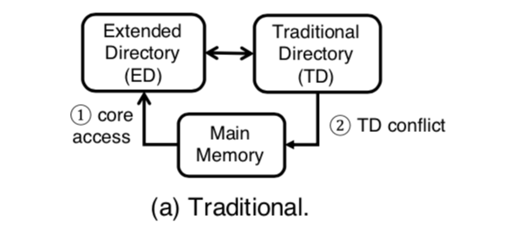
Current Directory Operation
Transaction | When
ED → TD | Conflict in ED; Eviction of data from L2
TD → ED | Write to a line shared by multiple L2

Slide 43
SecDir Operations Provide Isolation
Transaction | Explanation + Security
② TD → Memory | Line is in LLC but in no L2. No leakage
③ TD → VD | Line location does not change. To be safe, VD of every sharer receives a copy. No leakage
④ VD → TD | L2 self-conflict. Requires searching all VDs. Safe leak
⑤ VD -> DRAM | VD self-conflict. Cannot move to TD due deadlock. Safe leak

Slide 44
Contribution: A Secure Directory -- SecDir
Take part of the storage used by conventional dir and re-assign it to per-core private dirs: Victim Directory (VD)
Distributed VD for a core holds as many lines as in pvt L2
To provide high associativity, VD organized as Cuckoo directory
OK to be slower than main dir because it is a victim dir
Uses modest space because it does not keep sharer info (it is per-core)
Modeled a modified Intel Skylake dir → Secure + negligible perf impact
Notes:
In a typical cloud server, multiple users are co-located on the same chip.
From a VM perspective, they are isolated from each other.
However, the shared hardware such as LLC can still leak information. In a cache side-channel attack,
Attacker/spy observe’s …. to obtain sensitive information.

Slide 45
SecDir Properties
Provides inexpensive and scalable isolation
Provides high associativity
Uses low storage
Delivers efficient directory lookup

Slide 46
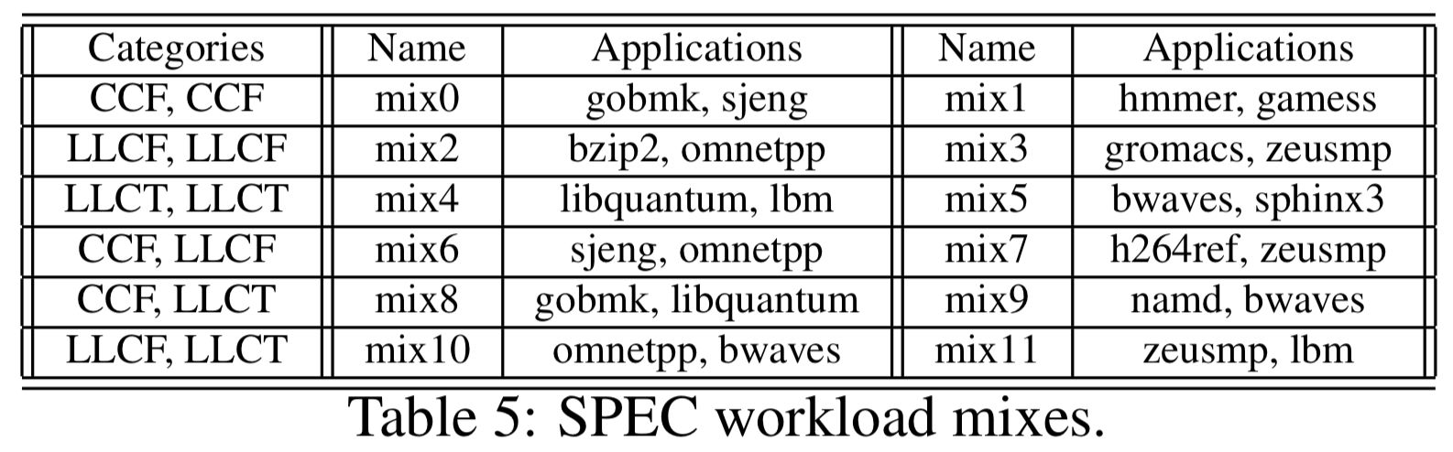
Benchmarks
SPEC Mixes
  Profile applications on baseline to classify them into
  CCF (core cache fit); LLCF (LLC fit); LLCT (LLC thrashing)
PARSEC

Slide 47
Directory Structure
Naïve organization of the “sharer information”:
  Each entry has: 1 dirty bit + N presence bits
  N: number of cores in the machine
Directory partitioned into slices using hash function
As the number of cores increases, tendency toward non-inclusive caches. → Added Extended Directory
Notes:
In a typical cloud server, multiple users are co-located on the same chip.
From a VM perspective, they are isolated from each other.
However, the shared hardware such as LLC can still leak information. In a cache side-channel attack,
Attacker/spy observe’s …. to obtain sensitive information.

Slide 48
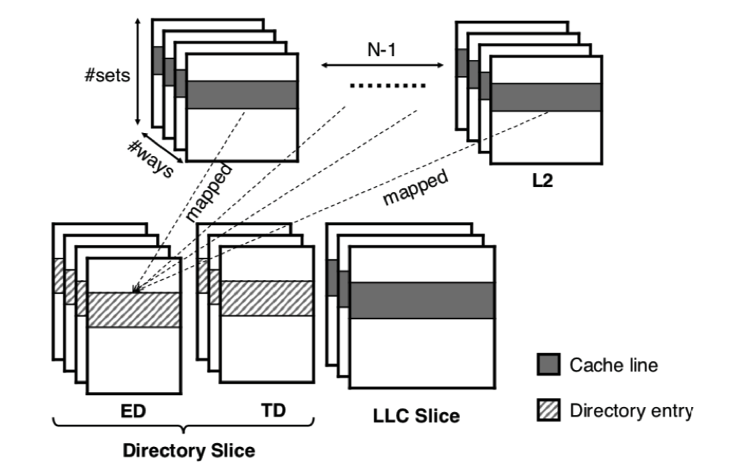
Directories for Non-Inclusive Caches
  Directories are easy targets
To hold a victim line, need a high per-slice associativity:
  W_{TD} + W_{ED} > W_{L2} x (N-1) + W_{L3}
Notes:
In a typical cloud server, multiple users are co-located on the same chip.
From a VM perspective, they are isolated from each other.
However, the shared hardware such as LLC can still leak information. In a cache side-channel attack,
Attacker/spy observe’s …. to obtain sensitive information.

Slide 49
Directories are Easy Targets
Victim reads line; data goes to L2 and dir info to ED
Attacker causes ED conflicts: dir info moves from ED to TD
Attacker causes TD conflicts: dir info evicted from TD; data evicted from L2
Notes:
In a typical cloud server, multiple users are co-located on the same chip.
From a VM perspective, they are isolated from each other.
However, the shared hardware such as LLC can still leak information. In a cache side-channel attack,
Attacker/spy observe’s …. to obtain sensitive information.

