Slide 1
Attack Directories, Not Caches: Side Channel Attacks in a Non-Inclusive World
Mengjia Yan, Read Sprabery, Bhargava Gopireddy, Christopher W. Fletcher, Roy Campbell, Josep Torrellas
University of Illinois at Urbana-Champaign
S&P’19 May 21
Notes:
Btw, I’m a computer architect.
According to my understanding, the cache design in the latest intel processor is very reasonable, but vulnerable to our directory-based side channel attacks.

Slide 2
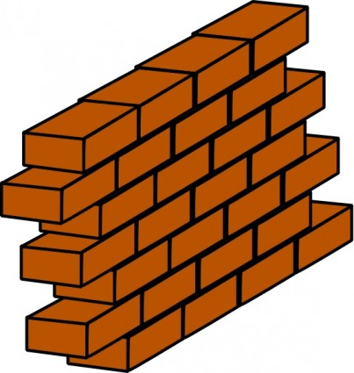
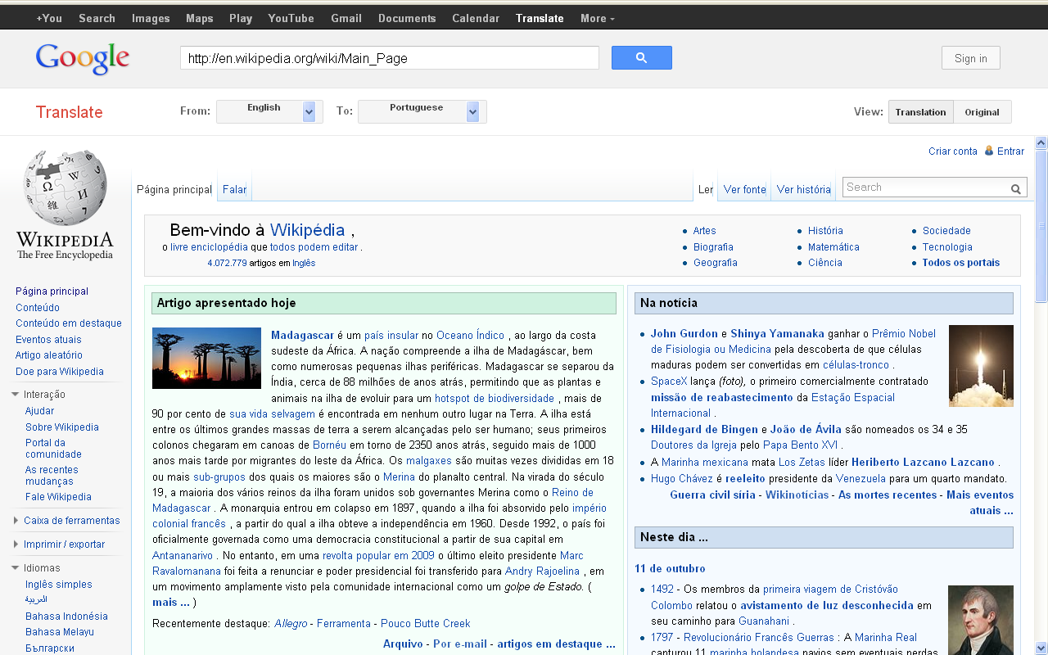
Cache Side Channel Attacks are Popular and Effective
Attack Platforms
Target Applications
VM Isolation
Victim
VM
Attacker
VM
Core
L1
Core
L1
Core
L1
Core
L1
Shared LLC
Notes:
For example, given a multi-core processor, we have virtual machines from different users, even though we have software isolation, information leakage can still happen due to the shared cache resources.

Slide 3
Why another cache side channel attack?
Notes:
So, since the attacks are already so successful, why we need another side channel attack?

Slide 4
Cache Side Channel Attacks on Inclusive Caches
Flush+Reload
Flush+Flush
Prime+Probe
Prime+Abort
Evict+Reload
Invalidate+Transfer
Flush+Prefetch
…….
Conflict-based attacks.
Only demonstrated on inclusive cache hierarchies.
Notes:
The reason is as follows.
Except those attacks that require the clflush instruction, the rest of them are called conflict-based attacks.
These attacks are stealthier, more difficult to defend against, since they leverage cache conflicts to evict victim’s line out of cache.
While, those attacks have only been demonstrated on inclusive cache hierarchies, which is fine.
Because 2 years ago, all intel processors use inclusive caches.

Slide 5
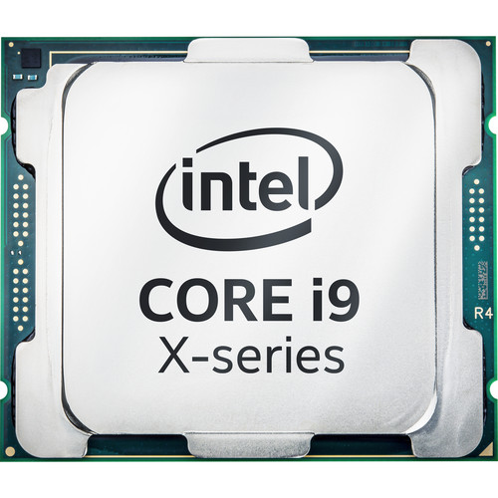
New Intel Processors Use Non-inclusive Caches
New Intel CPU Cache Architecture Boosts Protection Against Side-Channel Attacks
Skylake-X/SP
(released in 2017)
We challenge this assumption and prove that it is wrong
Notes:
Things changed in 2017.
What happened next is that people thinks cache attacks will fail on these processors.
You can still find articles online with a title such as ……
This is the time you need our new cache attack to prove this assumption is wrong.

Slide 6
Inclusive Caches v.s. Non-inclusive Caches
Inclusive: Private L2 lines are also present in LLC
Non-inclusive: Private L2 lines may or may not be present in LLC
private
L2
private
L2
shared
LLC
(inclusive)
shared
LLC
(non-inclusive)

Slide 7
Challenges of Conflict-based Attacks
Lack of Visibility into the Victim’s Private Cache
Target address
Attacker’s addresses
victim
cache 0
attacker
cache 1
victim
cache 0
attacker
cache 1
evict an
inclusion
victim
private
L2
Victim’s line does not exist in LLC
shared
LLC
insert to LLC.
cache conflict.
insert to LLC.
No conflict
No inclusion victim
Inclusion Victim
(a) inclusive cache
(b) non-inclusive cache
Notes:
Let me show you how the attacks work differently on these two different cache hierarchies.

Slide 8
The Inclusive Directory Structure in Skylake-X
Directory (snoop filter): tracks presence information for cache lines
TD holds directory entries for lines in LLC slice
ED holds directory entries for lines in L2 but not LLC
Directory is inclusive
1000 0000
cache lines
 |  | ……
 |  | ……
 |  | ……
 |  | ……
 |  | ……
 |  | ……
 |  | ……
 |  | ……
 |  | ……
 |  | ……
 |  | ……
 |  | ……
Shared
LLC
slice
extended
directory
(ED)
traditional
directory
(TD)
The new attack surface!

Slide 9
Prime+Probe Attacks on Skylake-X
The attacker causes conflicts in ED
→ evict victim’s line from L2 to LLC
Prime
victim
core 0
attacker
core 1
cache
line
directory
entry
Private L2
Target
address
 |  | ……
 |  | ……
 |  | …
 |  | …
cache lines
Attacker's
addresses
 |  | ……
 |  | ……
 |  | ……
 |  | ……
 |  | ……
 |  | ……
 |  | ……
 |  | ……
 |  | ……
 |  | ……
 |  | ……
 |  | ……
Shared
LLC
slice
inclusion victim
extended
directory
(ED)
traditional
directory
(TD)
 |  | ……
 |  | ……
Notes:
In a typical cloud server, multiple users are co-located on the same chip.
From a VM perspective, they are isolated from each other.
However, the shared hardware such as LLC can still leak information. In a cache side-channel attack,
Attacker/spy observe’s …. to obtain sensitive information.

Slide 10
Prime+Probe Attacks on Skylake-X
The victim re-accesses the line
→ Directory entry reloaded and attacker can observe
Probe
victim
core 0
attacker
core 1
cache
line
directory
entry
Private L2
 |  | ……
 |  | ……
 |  | …
 |  | …
 |  | ……
Target
address
cache lines
Attacker's
addresses
 |  | ……
 |  | ……
 |  | ……
 |  | ……
 |  | ……
 |  | ……
 |  | ……
 |  | ……
 |  | ……
 |  | ……
 |  | ……
 |  | ……
Shared
LLC
slice
 | ……
extended
directory
(ED)
traditional
directory
(TD)
Notes:
In a typical cloud server, multiple users are co-located on the same chip.
From a VM perspective, they are isolated from each other.
However, the shared hardware such as LLC can still leak information. In a cache side-channel attack,
Attacker/spy observe’s …. to obtain sensitive information.

Slide 11
Evaluation on RSA Encryption Algorithm
Square-and-Multiply Exponentiation (GnuPG 1.4.13)
for i = n-1 to 0 do r = sqr(r) mod n if e_{i} == 1 then r = mul(r, b) mod n end end

Slide 12
Evaluation Trace
Epoch ID
Access latencies measured in the probe operation in Prime+Probe.
A sequence of “01010111011001” can be deduced as part of the exponent.

Slide 13
More in the Paper
Eviction set construction algorithm
Steps of reverse engineering the directory structure
A multi-threaded high-bandwidth Evict+Reload attack
Attack results on AMD machines

Slide 14
Countermeasures
Increase directory associativity → unrealistic
Way-partition of the directory → not feasible
SecDir: A Secure Directory to Defeat Directory Side Channel Attacks [ISCA’19]
Mengjia Yan, Jen-Yang Wen, Christopher W. Fletcher, and Josep Torrellas
University of Illinois at Urbana-Champaign

Slide 15
Main Contributions
Reverse engineer
the directory structure
First two cache attacks on non-inclusive caches
Evaluate on RSA
Directory = The unified structure for conflict-based cache attacks
Notes:
Is it true?
We find it is not true at all
Just as vulnerable as before
I investigate the new hierarchy and find there is another structure → directory, make the processor as vulnerable as before

Slide 16
Thank You!

