Slide 1

ECCV 2018
Burst Image Deblurring
Using Permutation Invariant
Convolutional Neural Networks
Miika Aittala Frédo Durand
MIT CSAIL
Supported by
Toyota Research Institute
Notes:
Thanks for the introduction.

Slide 2
In many problems the input is an unstructured set of images with no meaningful ordering
This fits awkwardly with typical CNN’s with ”numbered” input slots
Notes:
So this paper is about burst deblurring, but the main idea is a CNN architecture that treats its inputs in an order-invariant manner.
This is very important for many problems where the input is a losely structured _set _ of observations.
Burst deblurring is an example of such a problem.

Slide 3
Burst deblurring? + results sneak peek
Ground truth
set of severely degraded images of the same target
Input
Result
using only 1st frame
combining frames
1 & 2
1, 2, 3
1, 2, 3, 4
etc.
Notes:
To make that more concrete, let’s see what it is about.
Our input is a set of photos suffering from camera shake and noise, but each depicting the same static target.
As you can see, all of these photos are pretty much destroyed, but each one in a different way, and so each one still contains partial information about different aspects of the underlying sharp image.
So the question is, can we computationally combine these observations to recover the latent sharp image.
To demonstrate the idea, I'll show you a sneak peek of what our method gets out of this burst.
So if we just feed a single photo to our network, this leftmost one here, there's not much to work with, and the result is so-and-so.
But, when we feed the two leftmost photos simultaneously, we get a result that is much sharper than either one of the inputs.
And as we keep adding images, further detail is resolved, though of course with diminishing returns.
Note that the images are also strongly denoised.
And this is the ground truth. So this one was a synthetically blurred dataset, but I'll show results with actual physically shaken photos later.

Slide 4
Key contributions
CNN that treats inputs as unordered set of arbitrary size
  Same network for all input sizes
  Exact same result regardless of input order
Synthetic training procedure
  On-the-fly blurs
  Complex noise patterns
  Gamma correction, HDR, etc.
Notes:
So how do we achieve this?
The main idea is a CNN architecture that is designed with two notable characteristics of this input data in mind.
First of all, the network can accept any number of inputs, whether it be three images, five, or fifteen -- in such a way that the more images you supply, the better result you are likely to get.
The second, somewhat more subtle, but I would argue _more important_ point is that the network is invariant to permutations of the input set -- that is, it returns _exactly_ the same result regardless of which order the images are supplied in.
So in effect, it treats the inputs as an unstructured bag of images.
I'll motivate this with some examples shortly.
Another contribution we make is a synthetic data generation pipeline for this problem. But let's first look at the architecture.

Slide 5
for the sake of motivation: RNN’s
… and their shortcomings
Notes:
To illustrate some of the problems that stem from sensitivity to input permutations, I'll first talk about recurrent CNN's applied to this problem.
That said, they have actually been successfully applied to this problem before, but I'll show that we can do better with a very different architecture.

Slide 6
…
Arbitrarily many times
Notes:
So the idea with RNNs is that you repeatedly feed frames to a recurrent unit, perhaps internally a U-Net or something, which accumulates info from previous frames it's seen and updates the estimate of the sharp image as it goes. I'm showing it unrolled here.
This way we can naturally keep feeding as many images as we like.
However, the process applied on each input frame is now heavily dependent on its position in the sequence.
Consequently, the network might have trouble "remembering" what it saw many iterations ago.
Or conversely, fail to update the initial estimate to the fullest as new evidence is presented.

Slide 7
Notes:
Combining subtle complementary cues that occur several frames apart might be very challenging.
Fundamentally, these troubles stem from the sensitivity to the input ordering.

Slide 8
Our approach
permutation invariance by pooling
See e.g.:
Zaheer, M., Kottur, S., Ravanbakhsh, S., Poczos, B., Salakhutdinov, R.R., Smola, A.J.
Deep sets
NIPS 2017
Notes:
With this motivation, I'll now discuss our approach, which is by construction indifferent to the input order.
The underlying ideas about pooling have previously been discussed for example by Zaheer and colleagues; we extend them here to the CNN context.

Slide 9
?
?
?
Notes:
So the most obvious source of asymmetry here are the recurrent connections that chain the units into a sequence. Let's first get rid of those.
But now we're just left with N copies of the same network, each of which receives one frame, but which don't talk to each other. So how to find a common consensus between their findings?

Slide 10
tied
weights
max-pooling
Notes:
Our solution is to use these copies of the network as intermediate "feature extractors" that examine each input image separately, using identical tied network weights.
The features from these per-input-image tracks are then collapsed together into a joint feature map using a symmetric pooling operation.
We use max-pooling. I'll describe that in a second.
Finally, these "consensus features" are processed into the unified estimate of the sharp image by a common CNN tail.
And the whole thing is trained end-to-end.

Slide 11
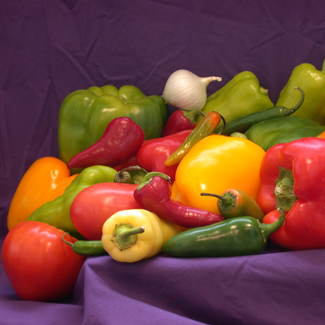
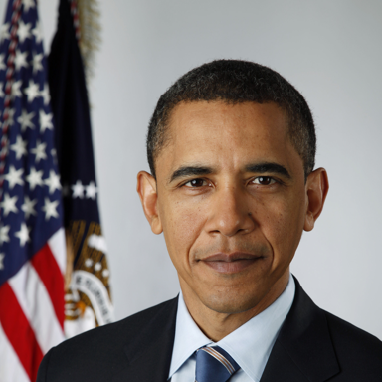
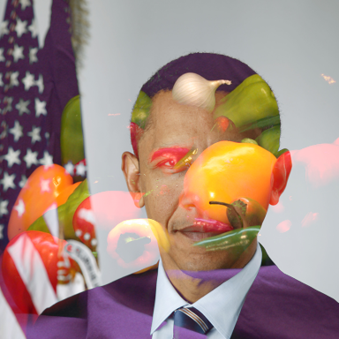
max ( , ) =
W * H * C
W * H * C
W * H * C
✓ Permutation invariant
✓ Any number of inputs
Intuition: “vote” over features that should go to output image
Notes:
So what is this max-pooling?
It simply means computing the maximum activation among the inputs at every pixel and feature channel.
So illustrated with these 3-channel feature maps, also known as RGB images, we get the result shown here.
So all the dimensions remain as they were, but the resulting map now includes contributions from both the inputs.
And of course we can throw more maps into the mix, and the order we do so in is irrelevant.
Note that those were the two desiderata we had -- which the network as a whole now inherits.
And why is this meaningful? The point is that via training, the network learns to produce whatever kind of features are meaningful with respect to the maximum operation.
One intuition is that they perform a sort of “vote” about what should go into the output.

Slide 12
tied
weights
max-pooling
Notes:
So as said, we can now vary the number of inputs we give

Slide 13
max-pooling
Notes:
… and the ordering is immaterial.
In practice we implement the feature extraction networks as U-Nets, which are the de facto solution for image translation problems these days.
The final decoding network is just a sequence of a couple of layers.
As it's not clear whether a few layers at the end are actually sufficient for reconstructing the image, in early experiments we found it useful to also include intermediate pooling layers within the feature extraction stage, with pooled features concatenated back to the local feature stacks. This establishes a sort of back-and-forth communication channel between them.
You can see the paper for the details on that.

Slide 14
max-pooling
Notes:
… and the ordering is immaterial.
In practice we implement the feature extraction networks as U-Nets, which are the de facto solution for image translation problems these days.
The final decoding network is just a sequence of a couple of layers.
As it's not clear whether a few layers at the end are actually sufficient for reconstructing the image, in early experiments we found it useful to also include intermediate pooling layers within the feature extraction stage, with pooled features concatenated back to the local feature stacks. This establishes a sort of back-and-forth communication channel between them.
You can see the paper for the details on that.

Slide 15
Data and training
Notes:
So that’s it for the architecture.
The network is trained in a supervised manner using synthetic data.

Slide 16
Synthetic training data
random Imagenet photo
synthetic burst with blur and noise generated on the fly in TensorFlow
Notes:
The data is from Imagenet images, which go through a variety of degradations, including blur _and_ noise.

Slide 17
Kernels & noise computed on the fly
”chunky” correlated noise via random convolutions etc.
random walks
Notes:
The blur kernels are computed as random walks, and applied as convolutions.
We simulate the characteristic “chunky” noise commonly seen in real-world imaging devices, via random convolutions and nonlinearities

Slide 18
overexposed regions filled in with random HDR content
Notes:
We also simulate some other effects, like streaky overexposed highlights and proper-ish gamma correction.

Slide 19
burst length (1 to 8) and difficulty randomized on per-minibatch/sample basis
Notes:
So for example from these four random Imagenet crops, the generated bursts might look like this.
We actually randomize the length and difficulty of the generated bursts.
This way the network learns to take advantage of a variety of cues that might be present in a given burst.
And these are the results we get from these validation set examples.

Slide 21
Results
Notes:
Ok, so how does it work? Let’s look at some real world results.

Slide 22
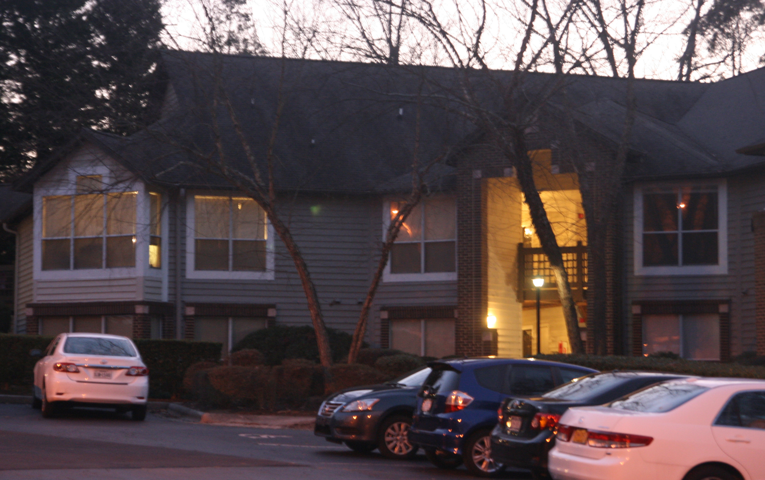
1. Typical input photo (one of 12)
2. Our result
3. Result of Wieschollek et al. (2017)
Wieschollek, P., Hirsch, M., Schölkopf, B., Lensch, H.
Learning blind motion deblurring.
ICCV 2017
Notes:
I’ll first show results on a moderately challenging standard dataset by Delbracio and colleagues. (CHECK)
Here’s a typical input photo from one of their bursts, consisting of 12 images.
And here is the result we recover.
In comparison to the state of the art neural burst deblurring algorithm of Wieschollek and colleagues from last year, which uses recurrent neural networks,
We find that our result consistently recovers more detail in the images, while suffering from fewer artifacts such as oversharpening effects.

Slide 23
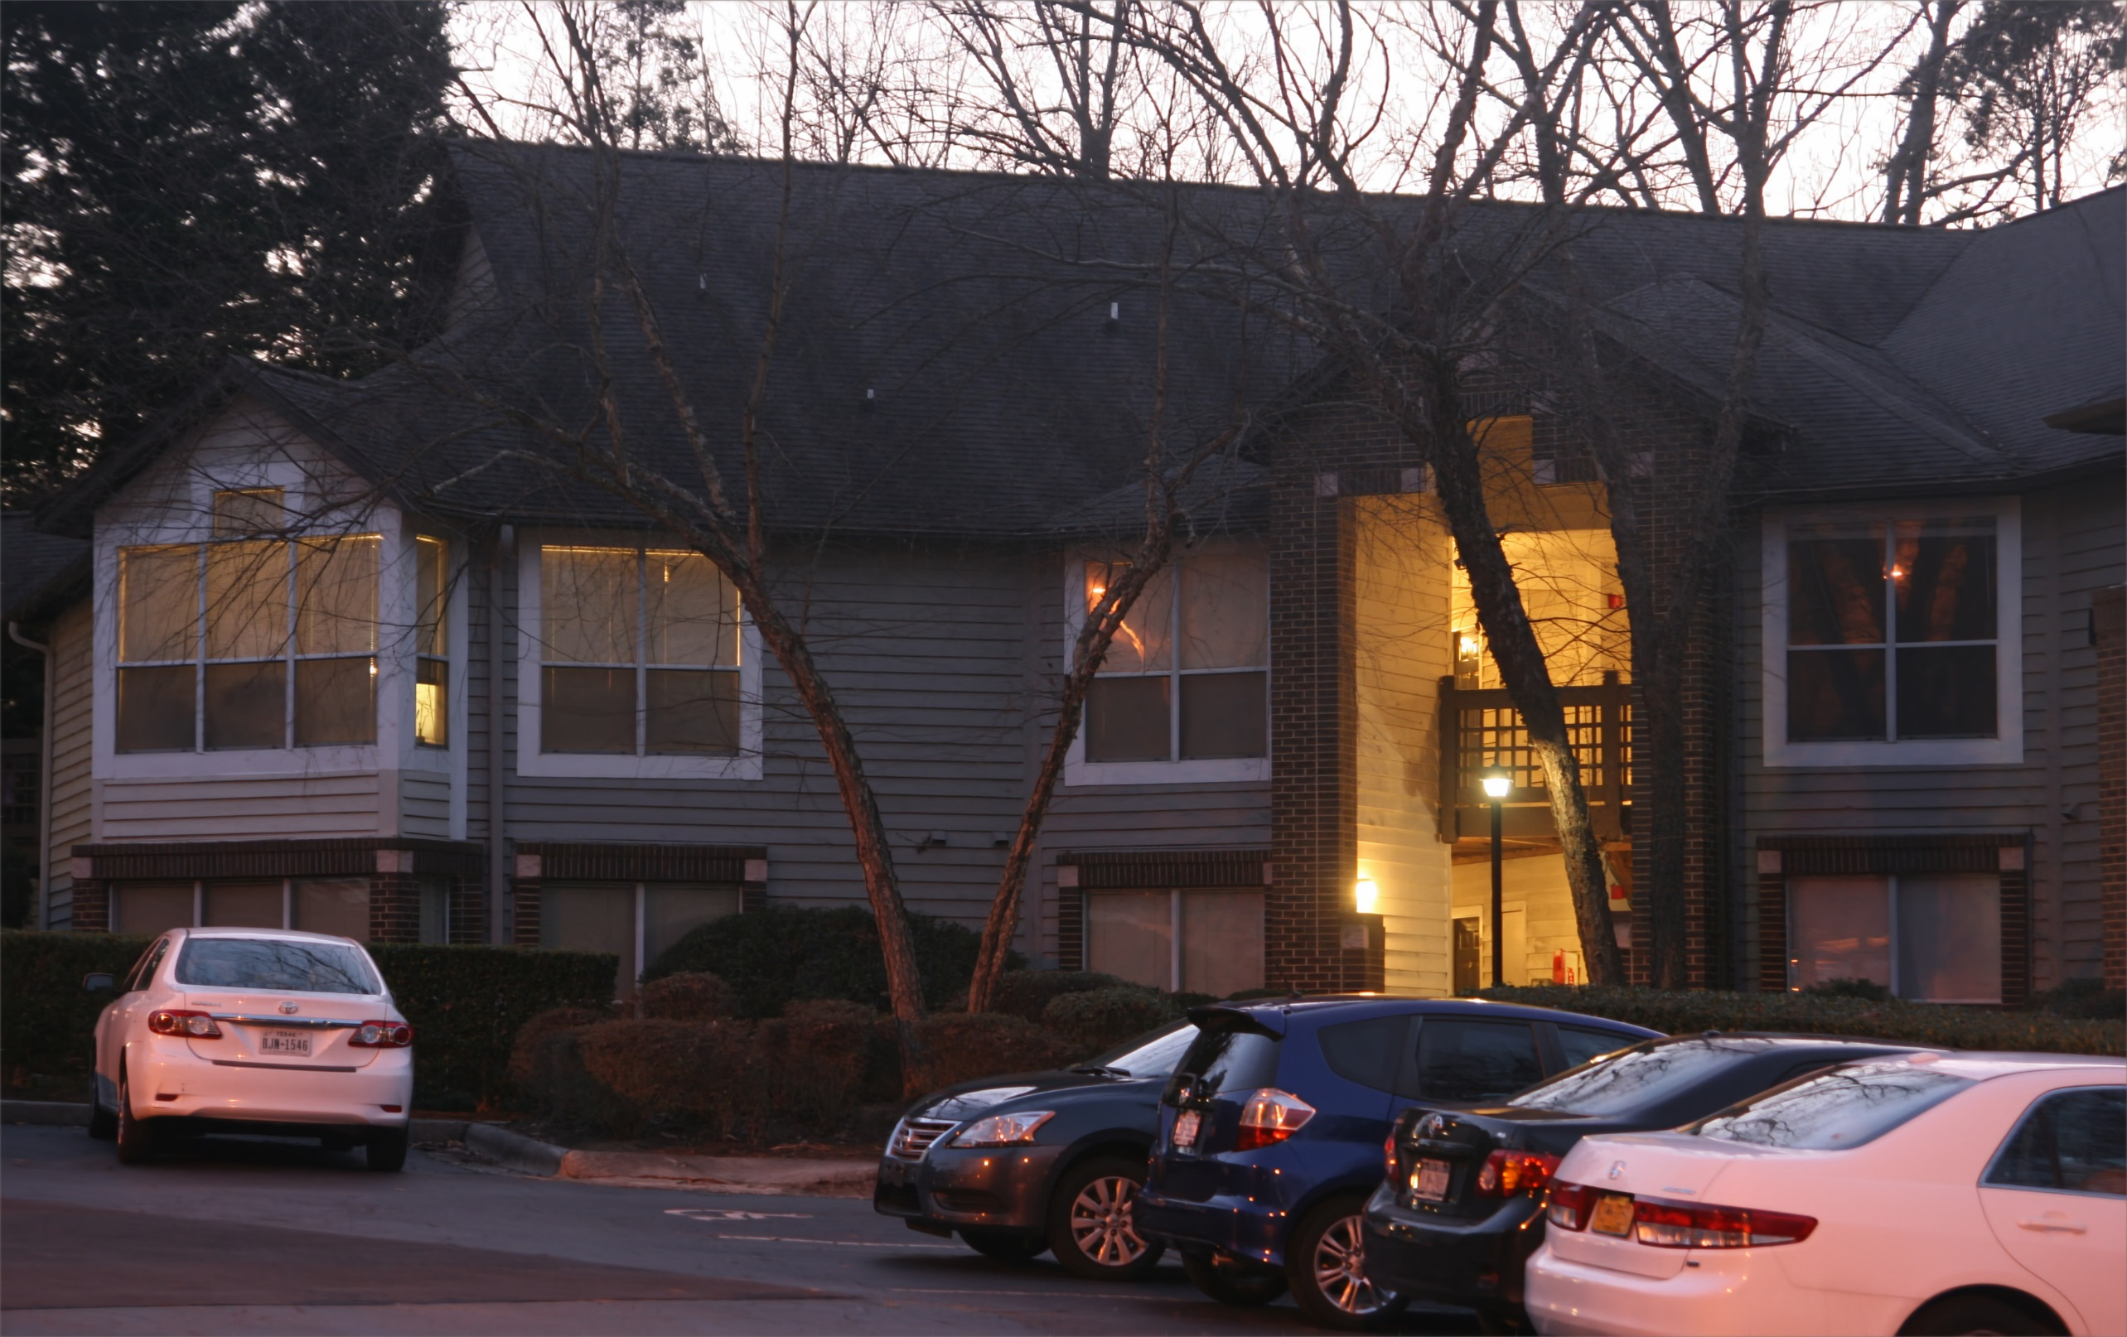
1. Typical input photo (one of 12)
2. Our result
3. Result of Wieschollek et al. (2017)
Wieschollek, P., Hirsch, M., Schölkopf, B., Lensch, H.
Learning blind motion deblurring.
ICCV 2017
Notes:
I’ll first show results on a moderately challenging standard dataset by Delbracio and colleagues. (CHECK)
Here’s a typical input photo from one of their bursts, consisting of 12 images.
And here is the result we recover.
In comparison to the state of the art neural burst deblurring algorithm of Wieschollek and colleagues from last year, which uses recurrent neural networks,
We find that our result consistently recovers more detail in the images, while suffering from fewer artifacts such as oversharpening effects.

Slide 24
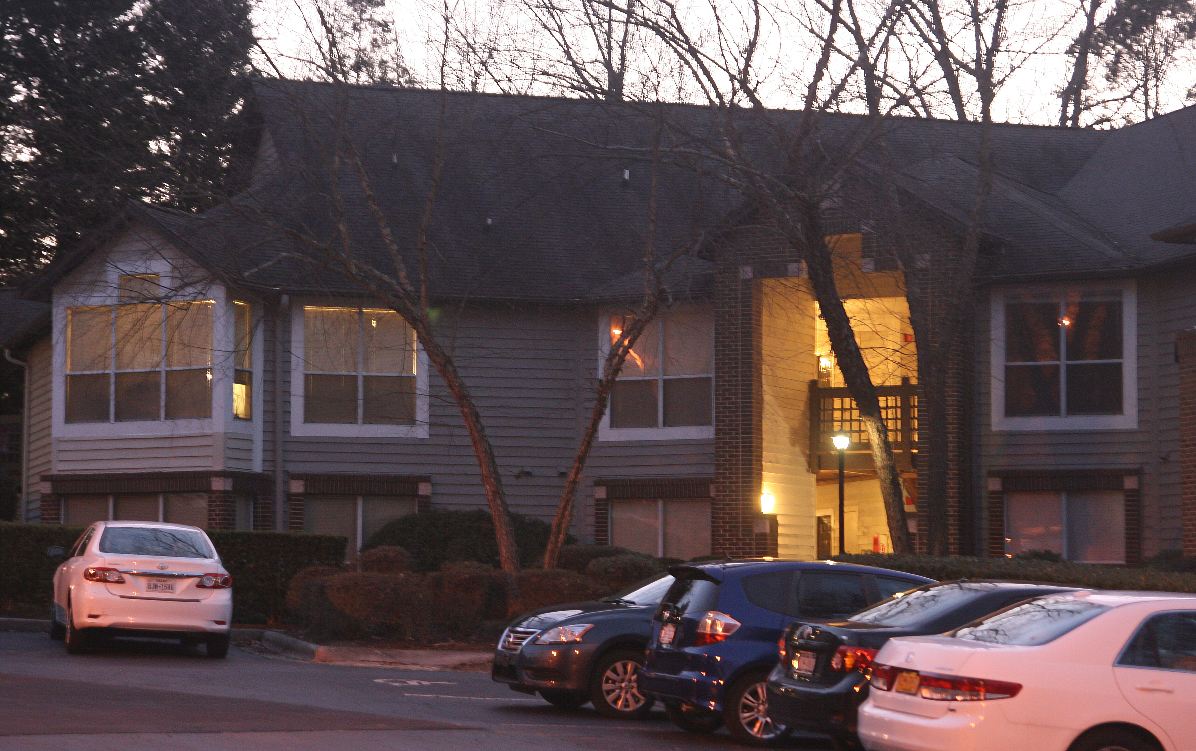
1. Typical input photo (one of 12)
2. Our result
3. Result of Wieschollek et al. (2017)
Wieschollek, P., Hirsch, M., Schölkopf, B., Lensch, H.
Learning blind motion deblurring.
ICCV 2017
Notes:
I’ll first show results on a moderately challenging standard dataset by Delbracio and colleagues. (CHECK)
Here’s a typical input photo from one of their bursts, consisting of 12 images.
And here is the result we recover.
In comparison to the state of the art neural burst deblurring algorithm of Wieschollek and colleagues from last year, which uses recurrent neural networks,
We find that our result consistently recovers more detail in the images, while suffering from fewer artifacts such as oversharpening effects.

Slide 25
1. Typical input photo (one of 12)
2. Our result
3. Result of Wieschollek et al. (2017)
Wieschollek, P., Hirsch, M., Schölkopf, B., Lensch, H.
Learning blind motion deblurring.
ICCV 2017
Notes:
And here is a zoomed-in version for the details. Notice in particular the license plate.

Slide 26
1. Typical input photo (one of 12)
2. Our result
3. Result of Wieschollek et al. (2017)
Wieschollek, P., Hirsch, M., Schölkopf, B., Lensch, H.
Learning blind motion deblurring.
ICCV 2017
Notes:
And here is a zoomed-in version for the details. Notice in particular the license plate.

Slide 27
1. Typical input photo (one of 12)
2. Our result
3. Result of Wieschollek et al. (2017)
Wieschollek, P., Hirsch, M., Schölkopf, B., Lensch, H.
Learning blind motion deblurring.
ICCV 2017
Notes:
And here is a zoomed-in version for the details. Notice in particular the license plate.

Slide 29
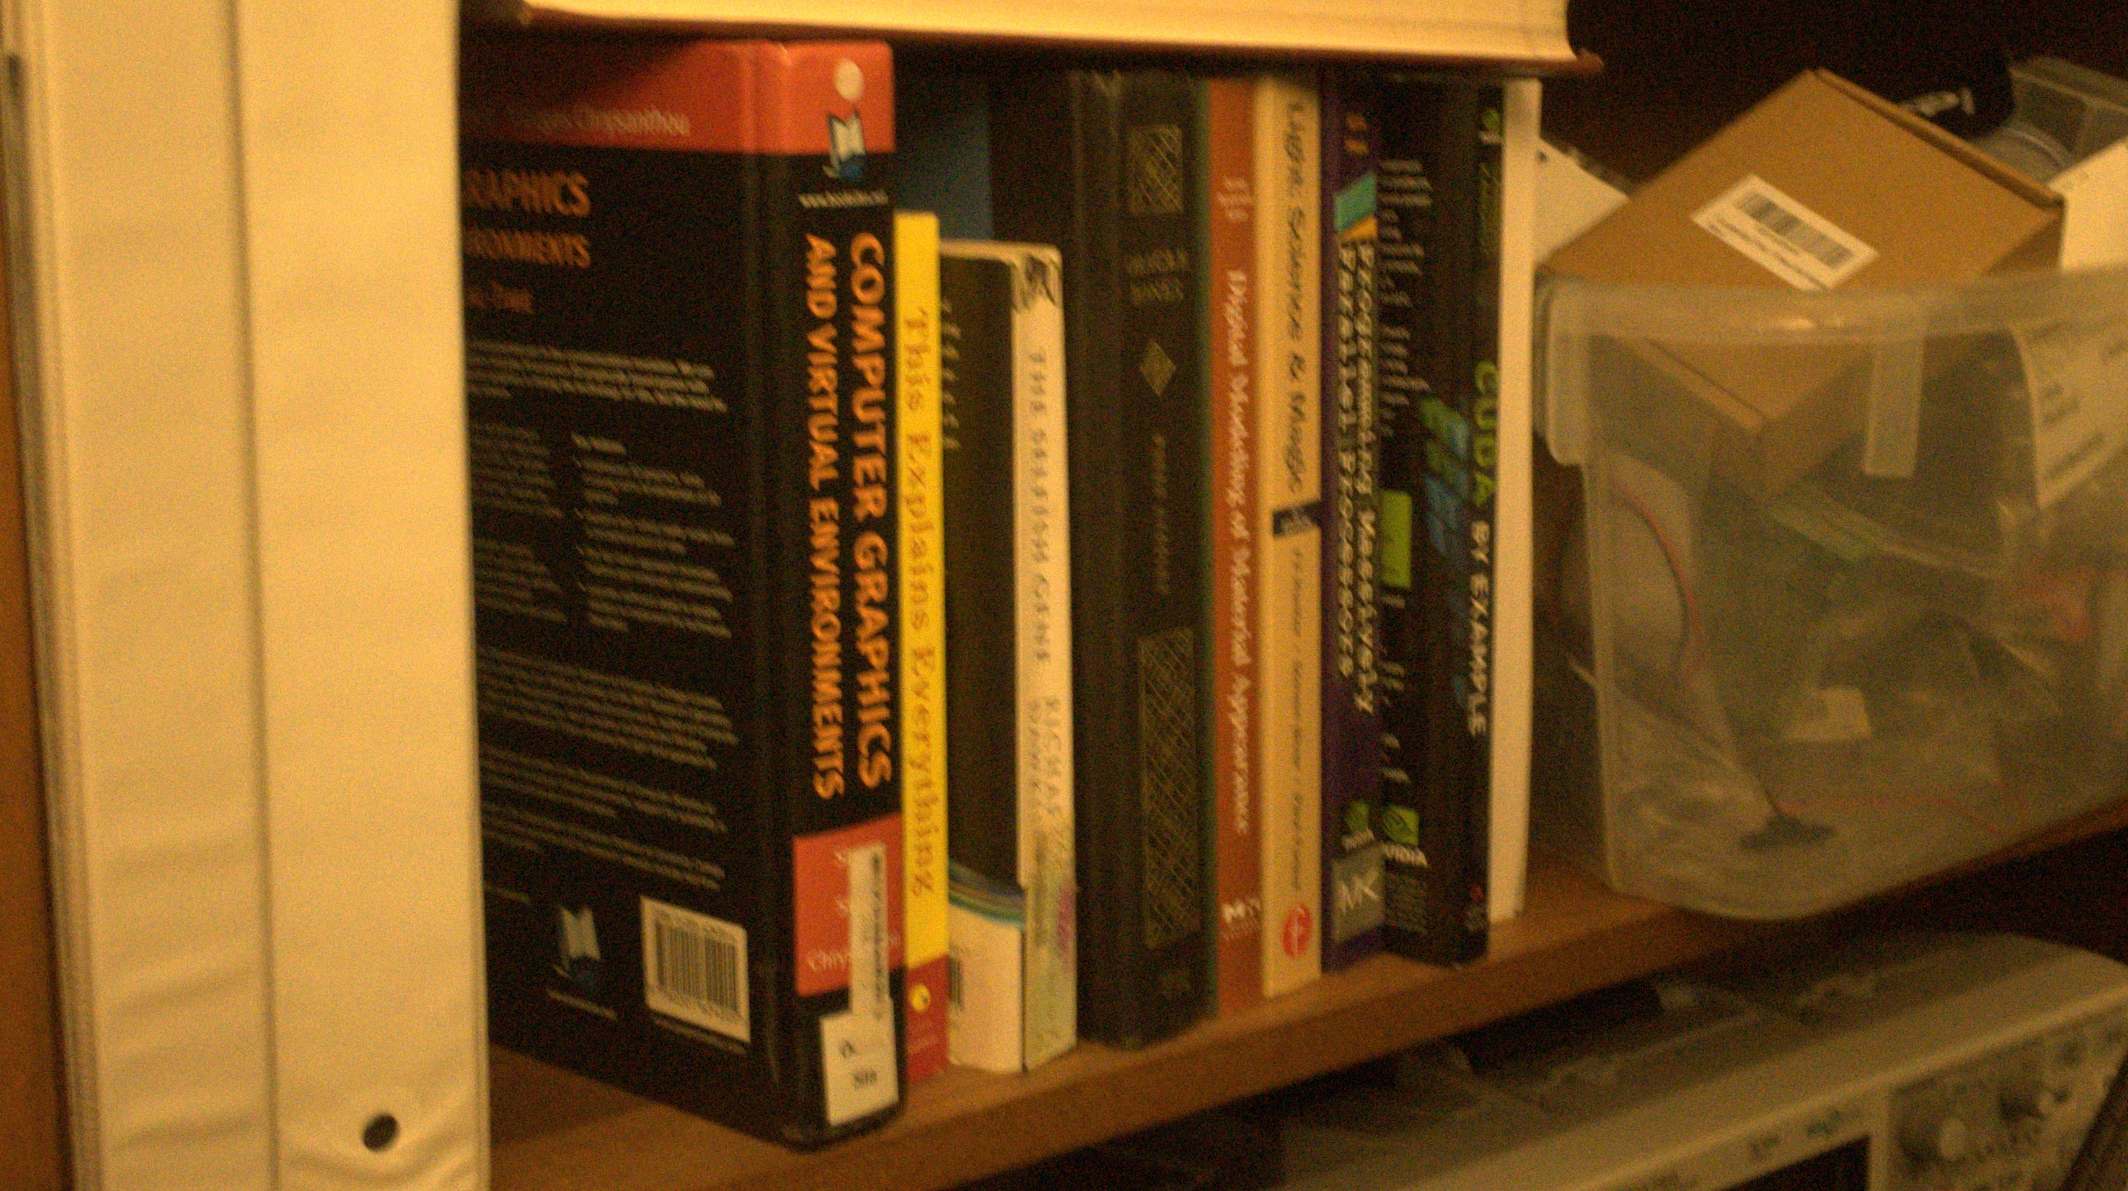
Input burst
from iPhone SE
(pre-aligned with homographies)
Notes:
As a more challenging example, this is a burst we took with an iPhone. I hope you can see that every one of these eight frames is extremely low quality, suffering from severe motion blur and noise.
In particular, no frame is “lucky”, meaning significantly sharper than the others.

Slide 30
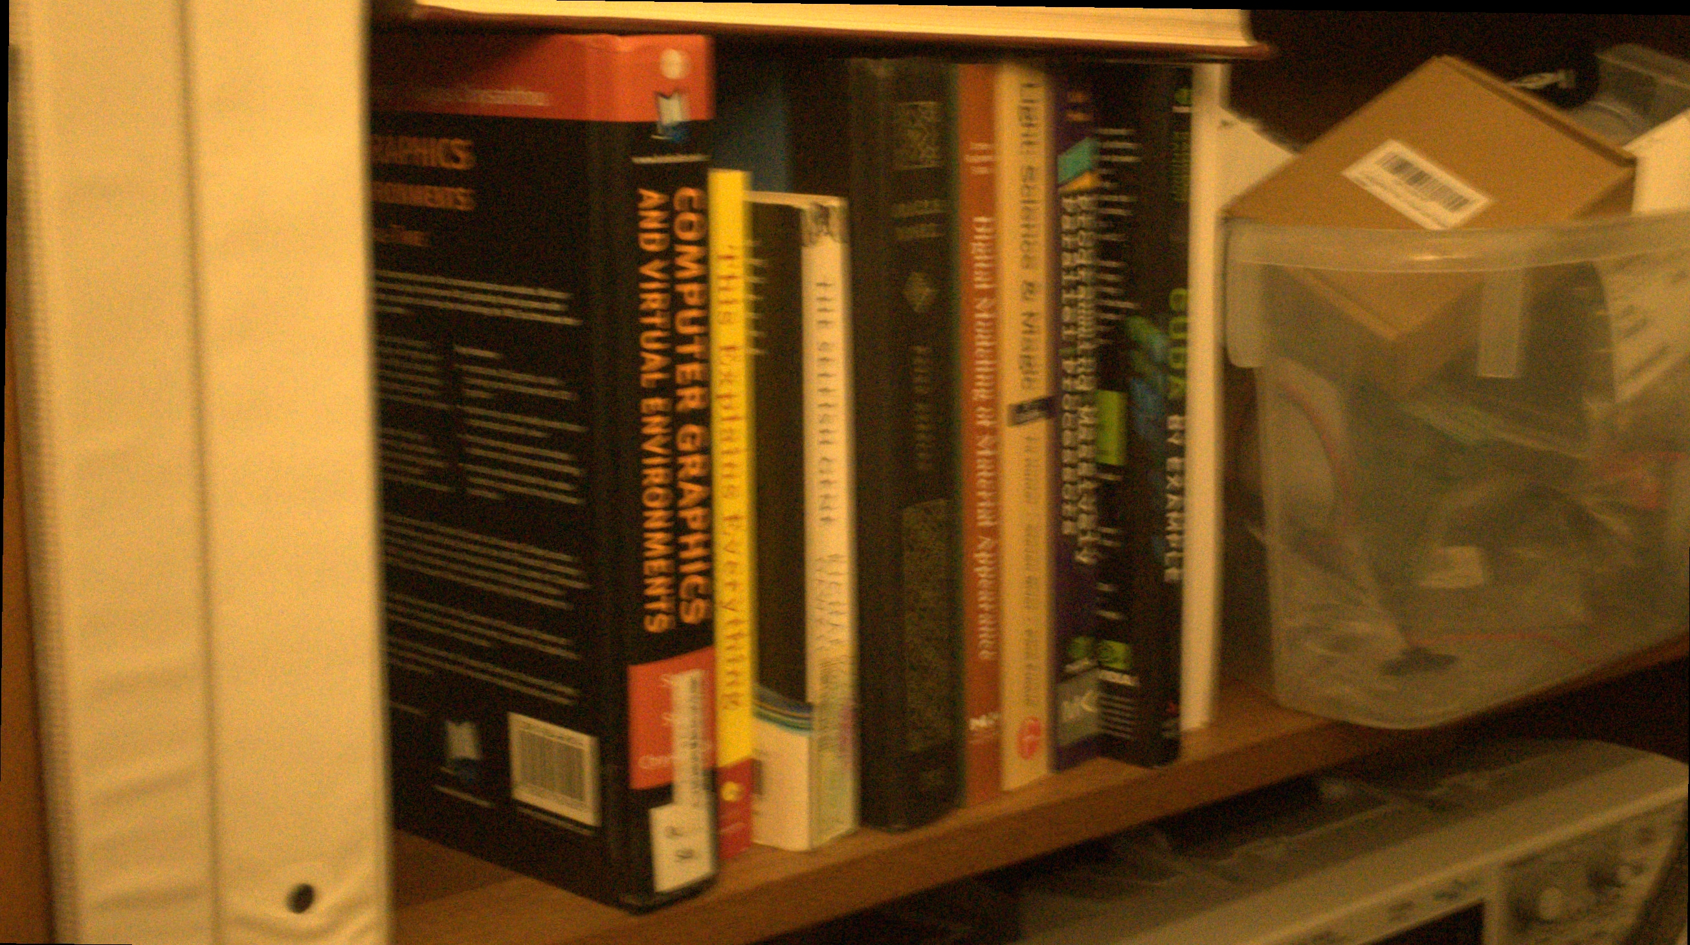
Input burst
from iPhone SE
Notes:
As a more challenging example, this is a burst we took with an iPhone. I hope you can see that every one of these eight frames is extremely low quality, suffering from severe motion blur and noise.
In particular, no frame is “lucky”, meaning significantly sharper than the others.

Slide 31
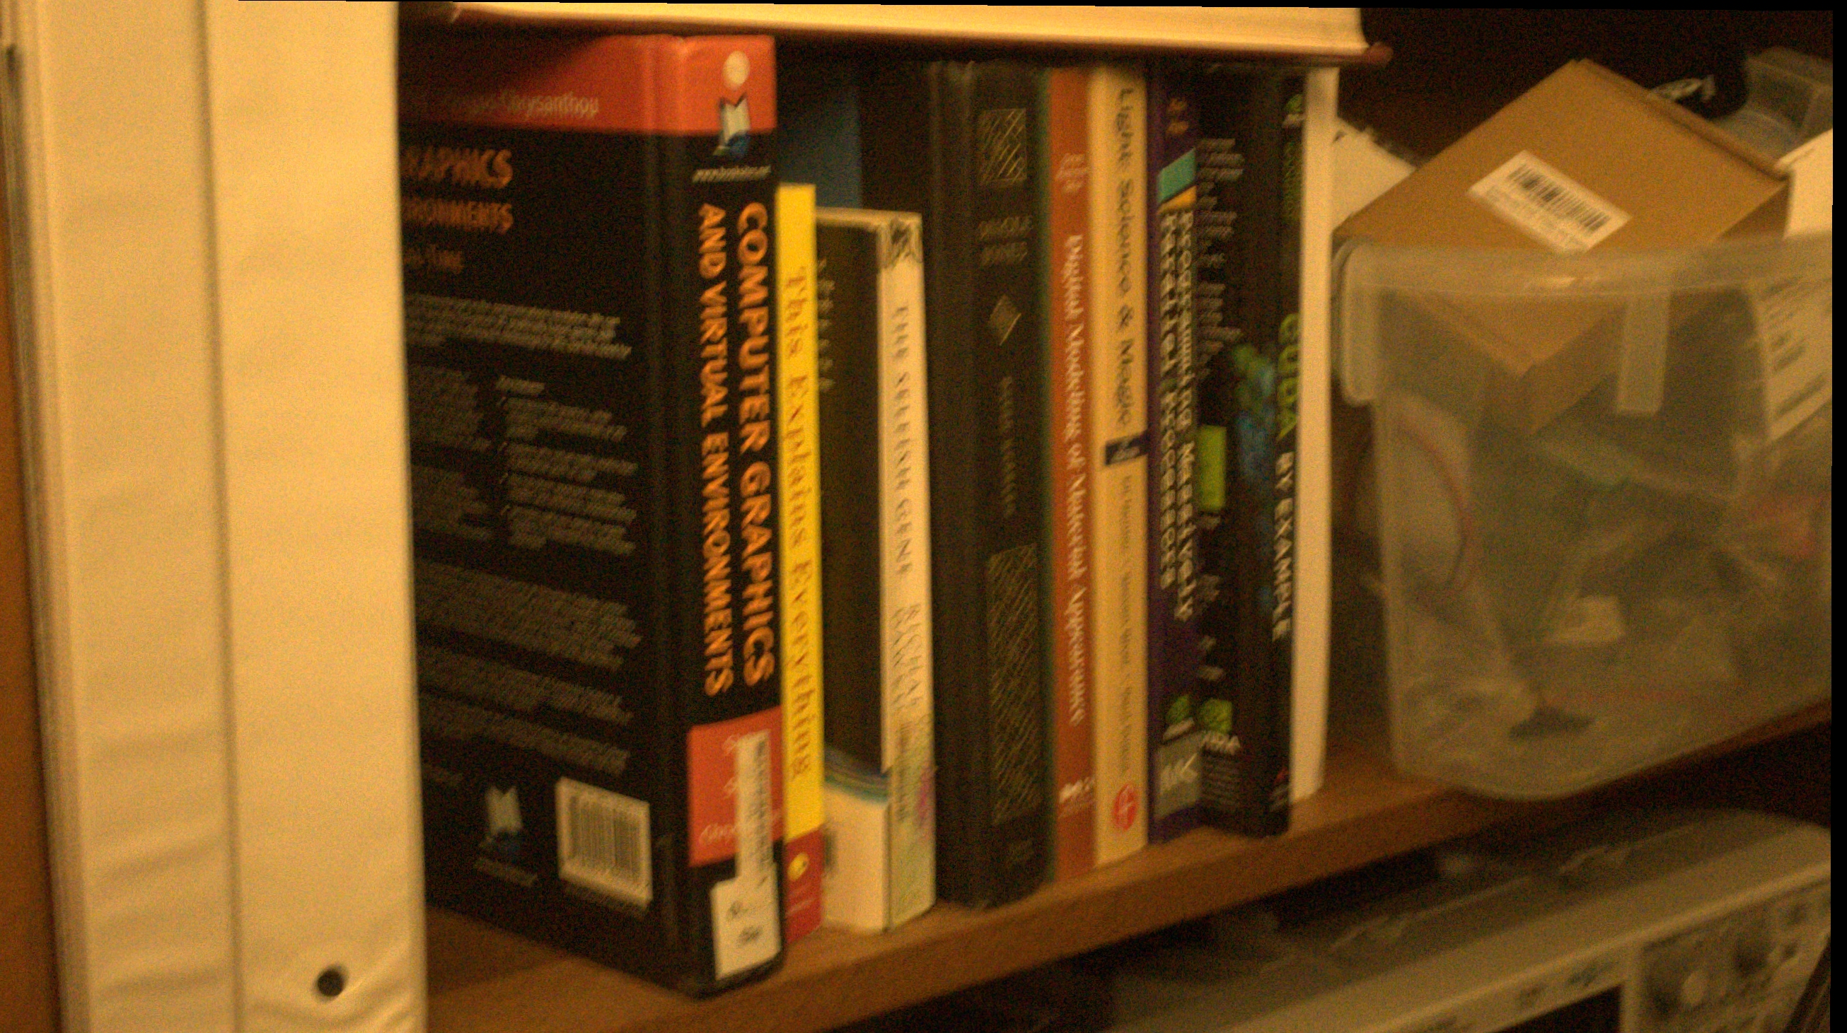
Input burst
from iPhone SE
Notes:
As a more challenging example, this is a burst we took with an iPhone. I hope you can see that every one of these eight frames is extremely low quality, suffering from severe motion blur and noise.
In particular, no frame is “lucky”, meaning significantly sharper than the others.

Slide 32

Input burst
from iPhone SE
Notes:
As a more challenging example, this is a burst we took with an iPhone. I hope you can see that every one of these eight frames is extremely low quality, suffering from severe motion blur and noise.
In particular, no frame is “lucky”, meaning significantly sharper than the others.

Slide 33
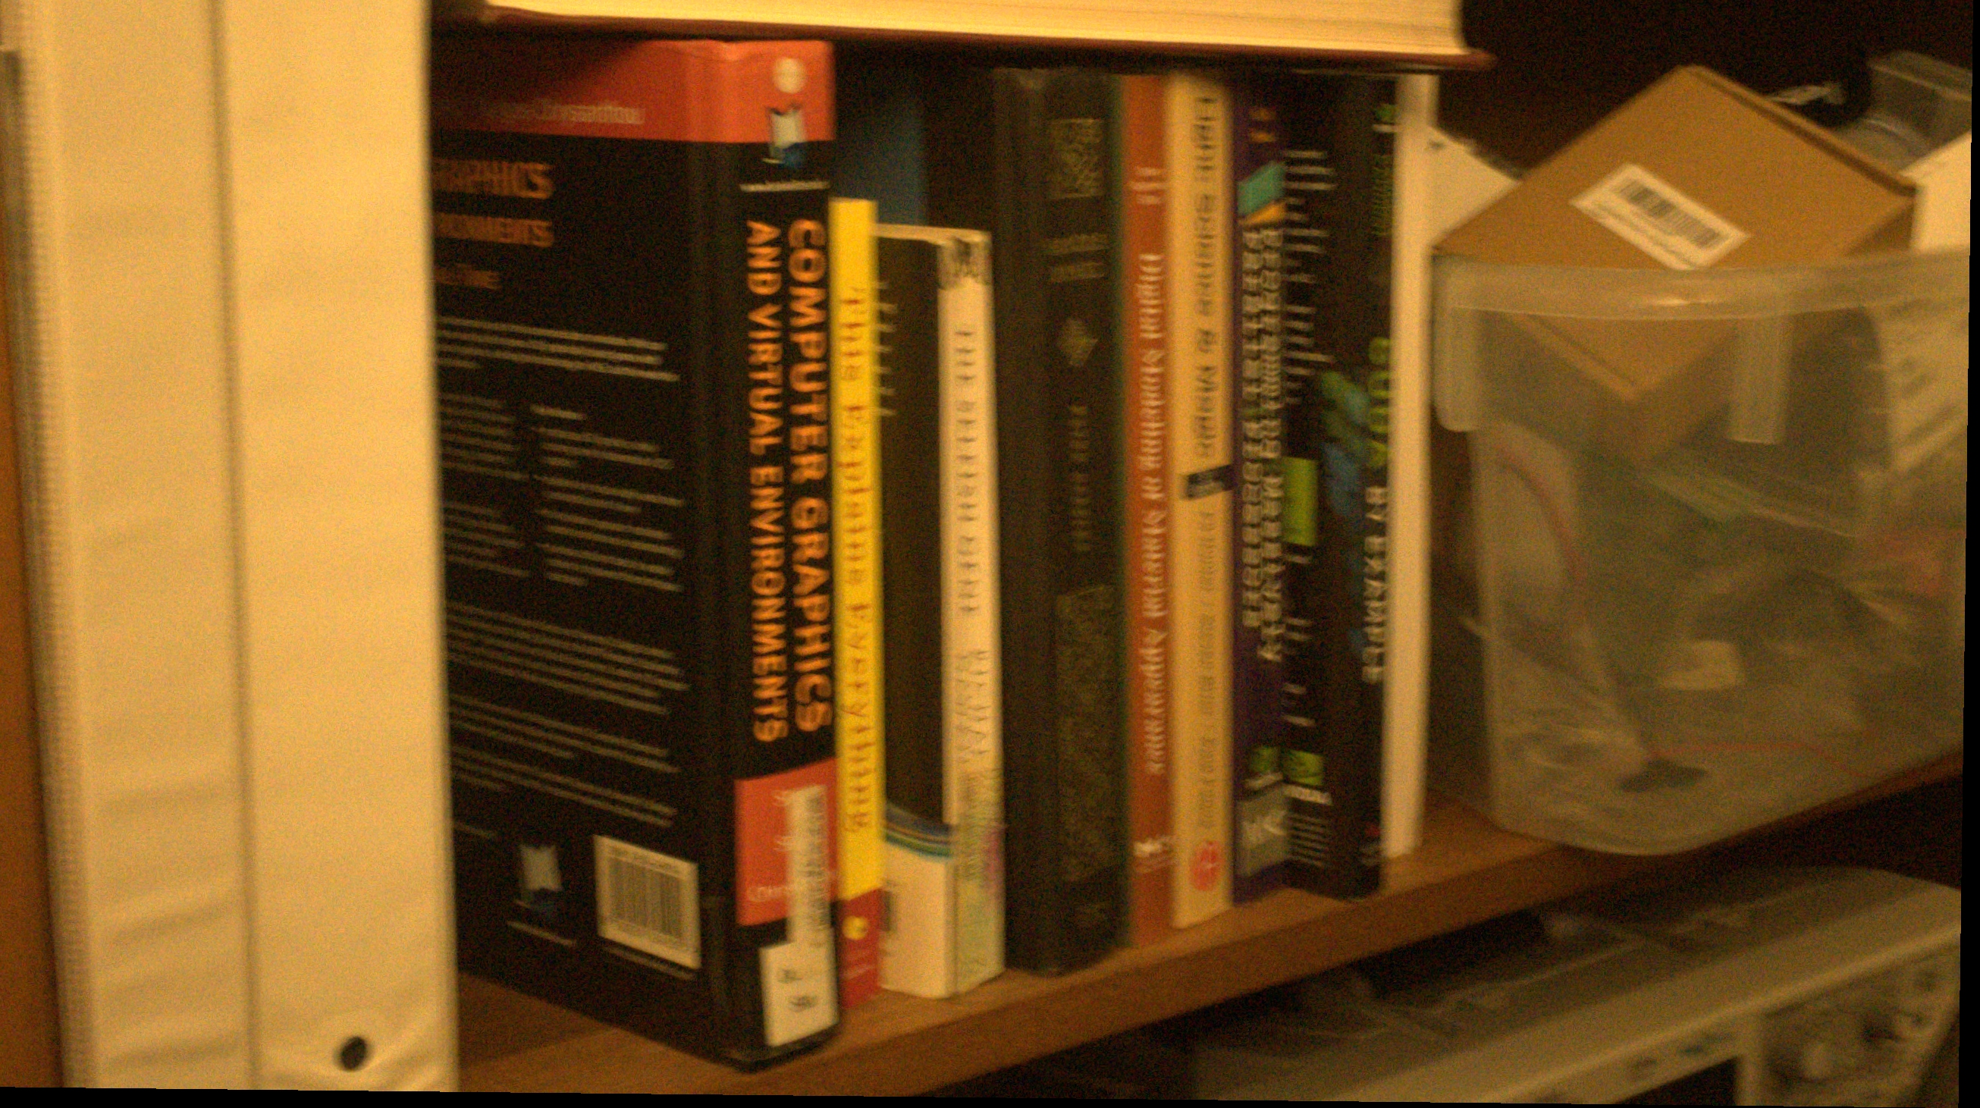
Input burst
from iPhone SE
Notes:
As a more challenging example, this is a burst we took with an iPhone. I hope you can see that every one of these eight frames is extremely low quality, suffering from severe motion blur and noise.
In particular, no frame is “lucky”, meaning significantly sharper than the others.

Slide 34

Input burst
from iPhone SE
Notes:
As a more challenging example, this is a burst we took with an iPhone. I hope you can see that every one of these eight frames is extremely low quality, suffering from severe motion blur and noise.
In particular, no frame is “lucky”, meaning significantly sharper than the others.

Slide 35
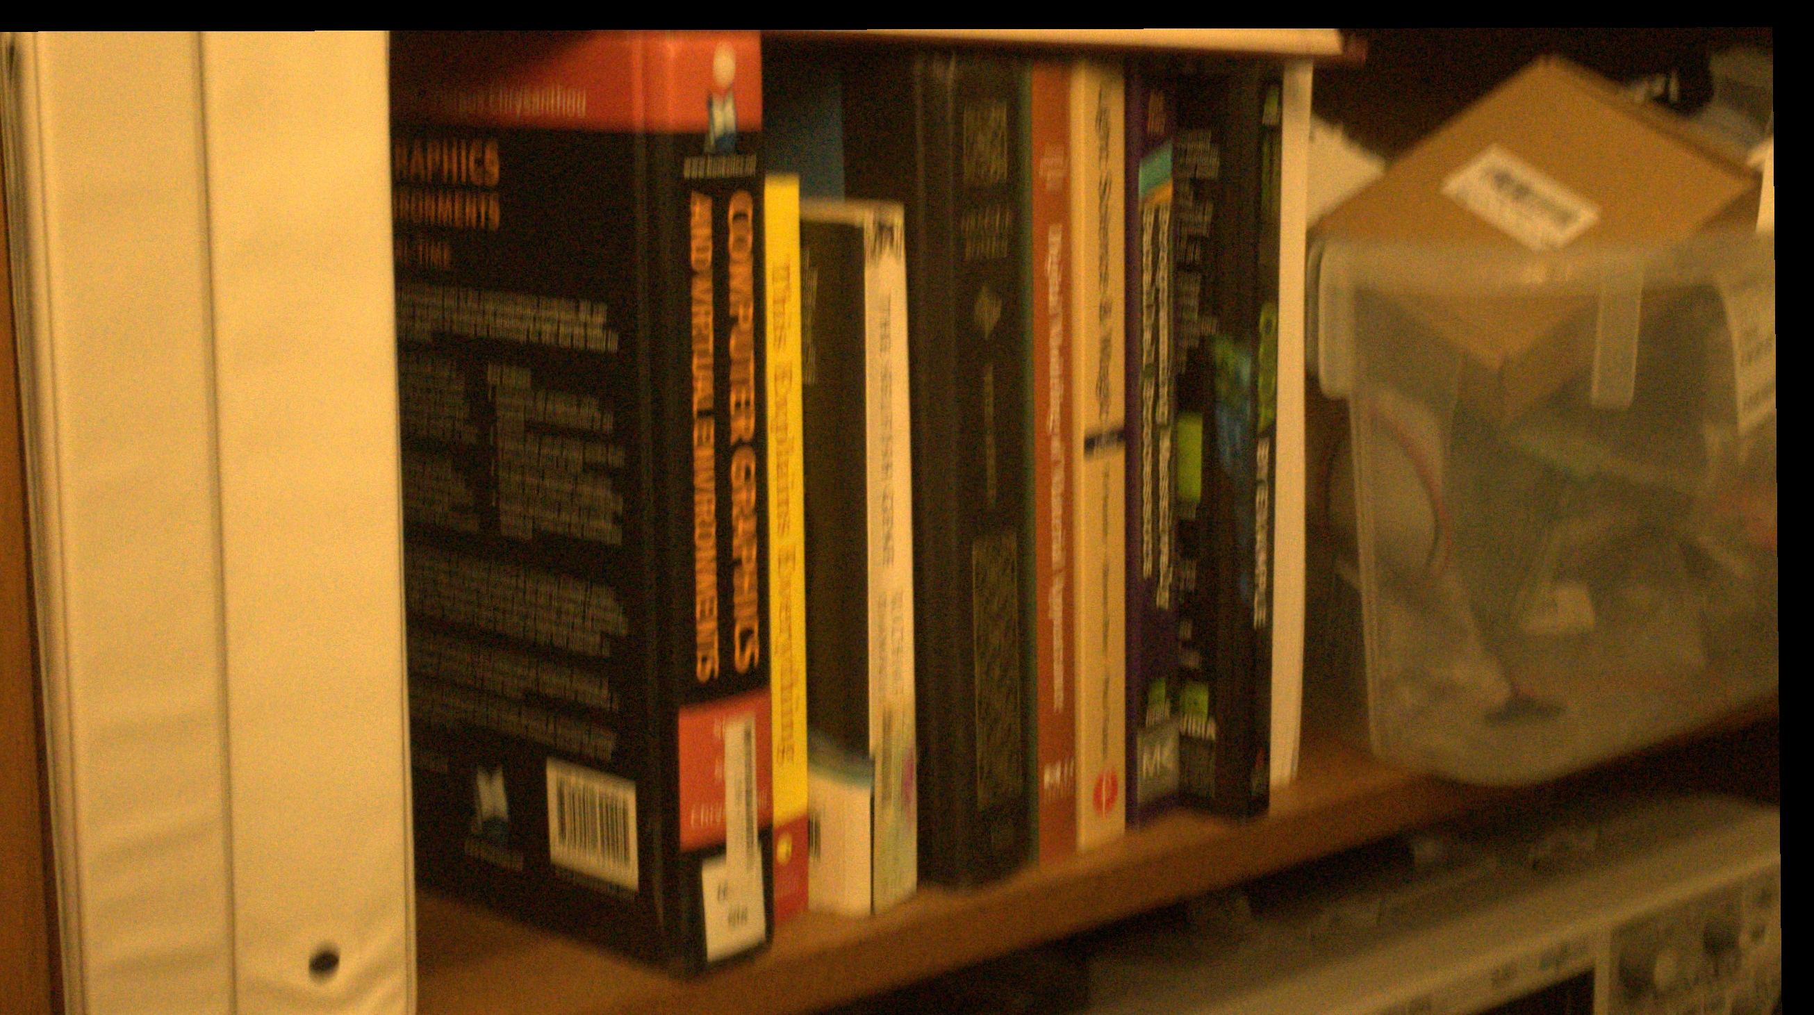
Input burst
from iPhone SE
Notes:
As a more challenging example, this is a burst we took with an iPhone. I hope you can see that every one of these eight frames is extremely low quality, suffering from severe motion blur and noise.
In particular, no frame is “lucky”, meaning significantly sharper than the others.

Slide 36
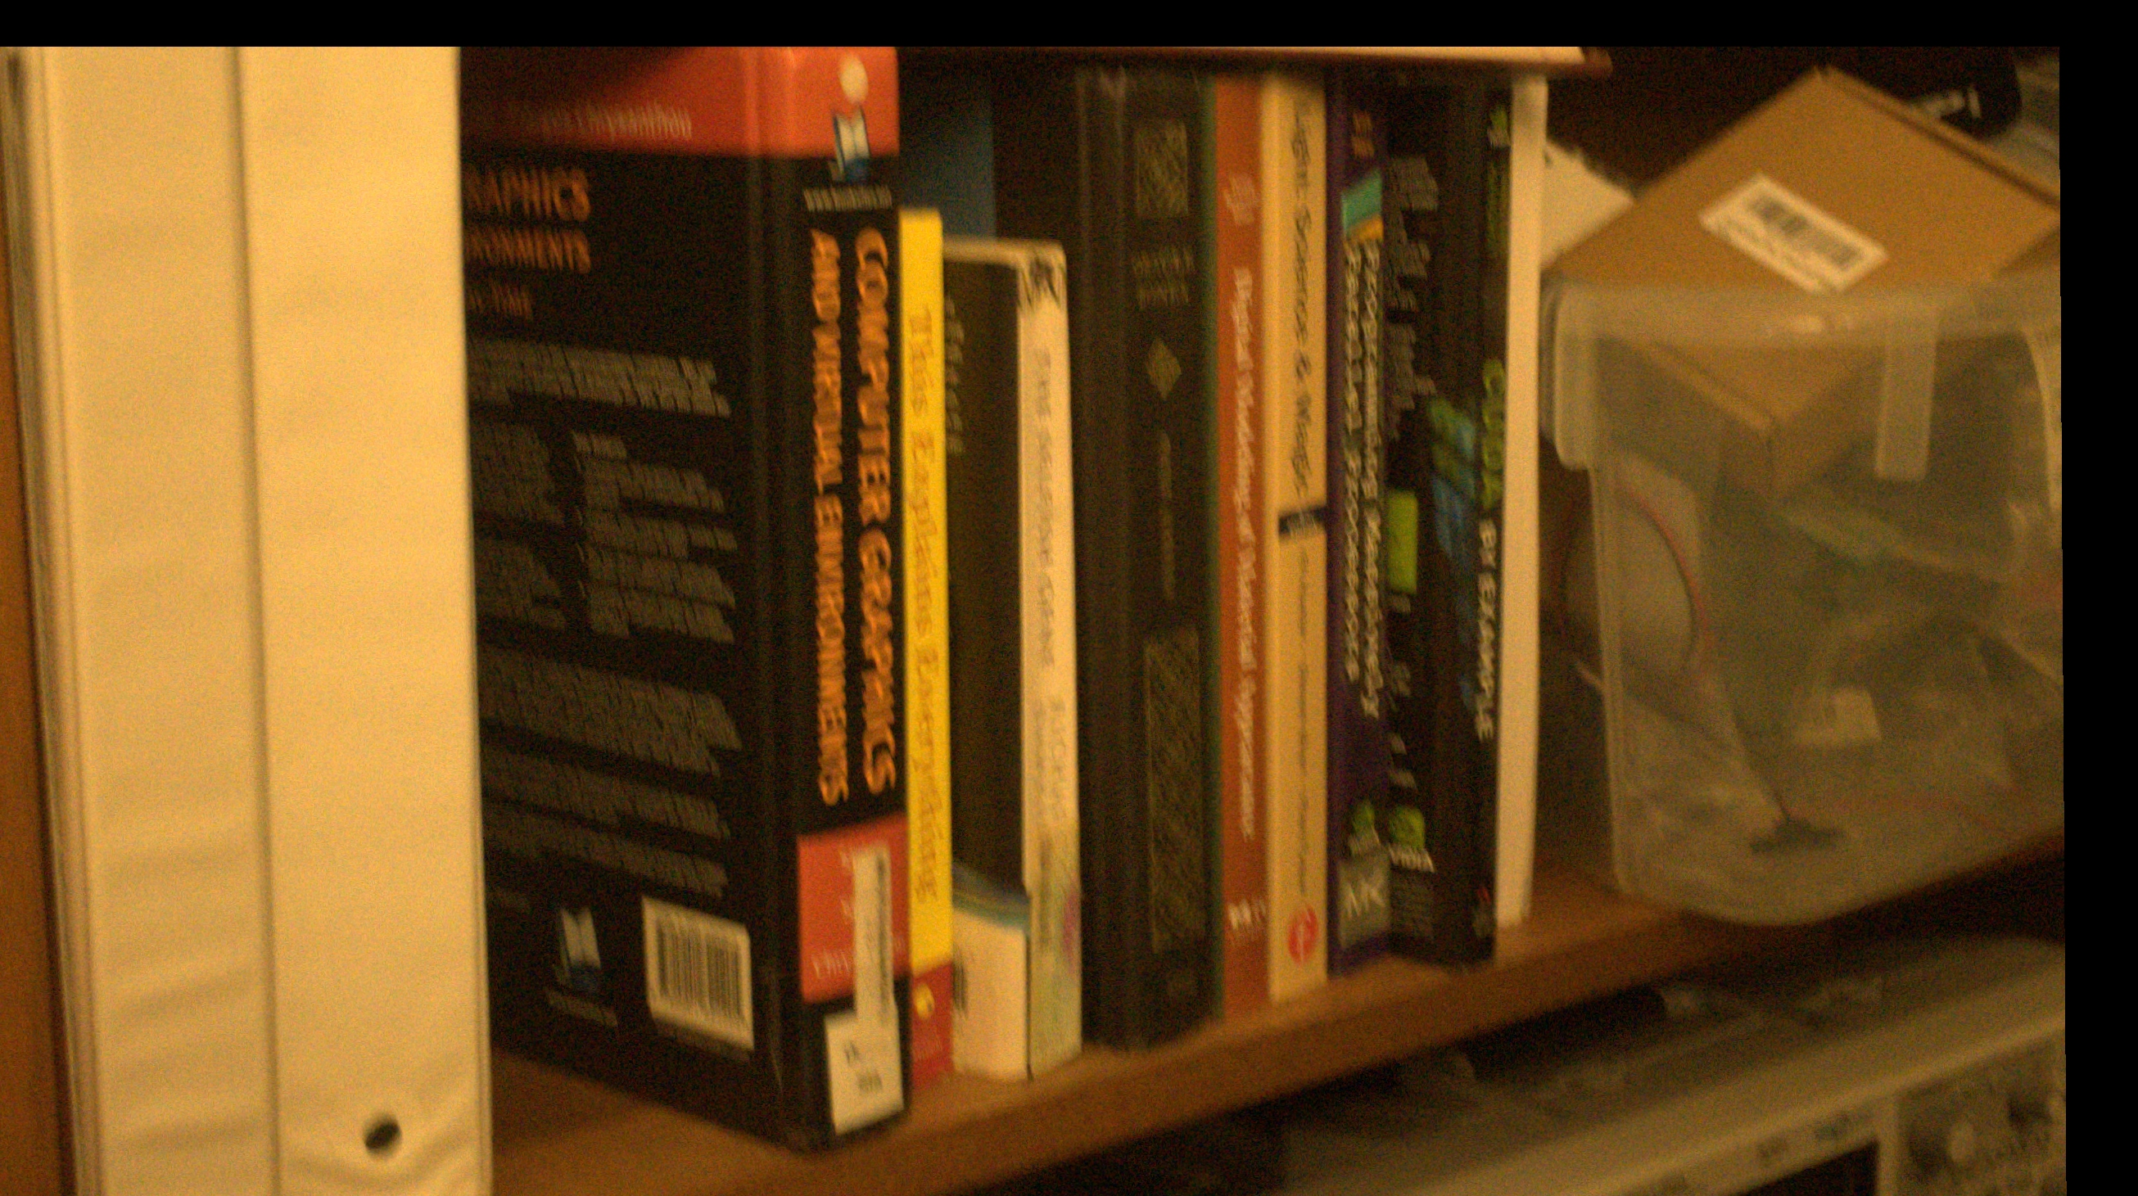
Input burst
from iPhone SE
Quiz: can you read the numbers?
Notes:
Let’s take a closer look at one region.
Down here we have a few numbers and stuff printed on the back of the book.
Here is a zoomed-in view of that region, from each eight images in the burst.
We can make a little user study here – can you read the numbers shown in these crops, in the highlighted region?
I’ll return to this shortly.

Slide 37
Result with increasing number of inputs in burst
Notes:
So in the following I’ll show the result we get from this burst.

Slide 38
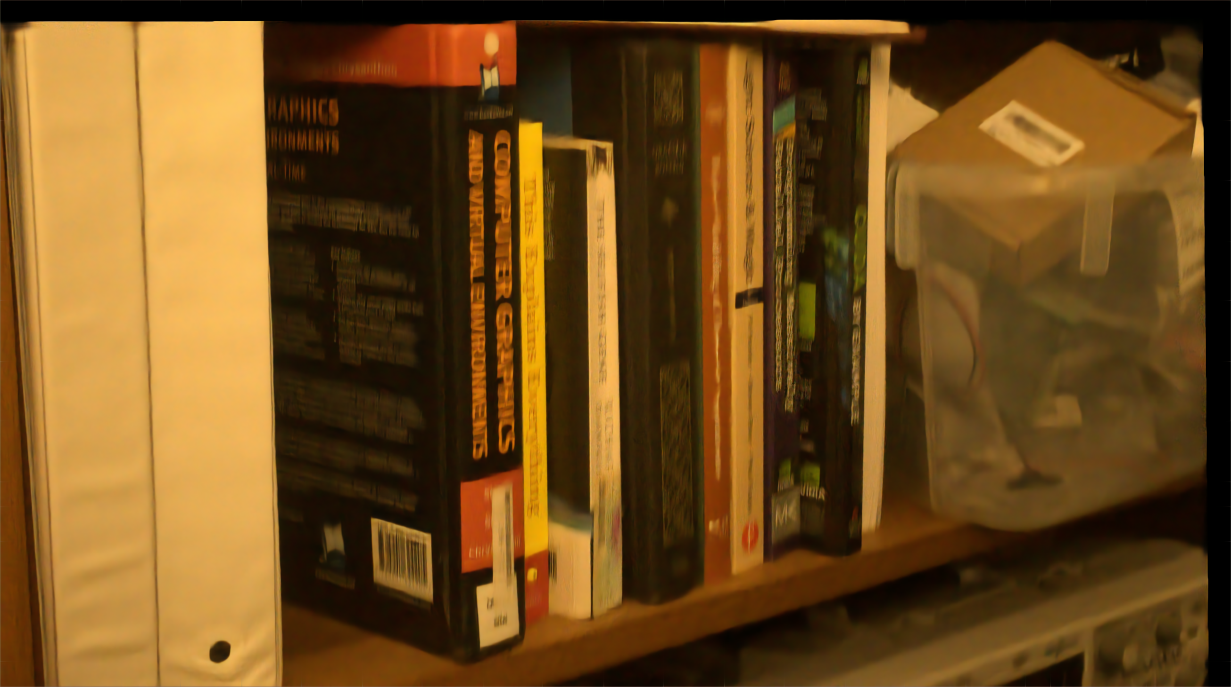
Result
using frame 1 only
Notes:
If we just feed the first frame, we get something like this.

Slide 39

Result
using frames 1 & 2
Notes:
Adding a second frame improves the sharpness somewhat. But see what happens as we add a third, … etc

Slide 40

Result
using frames 1-3

Slide 41

Result
using frames 1-4

Slide 42

Result
using frames 1-5

Slide 43
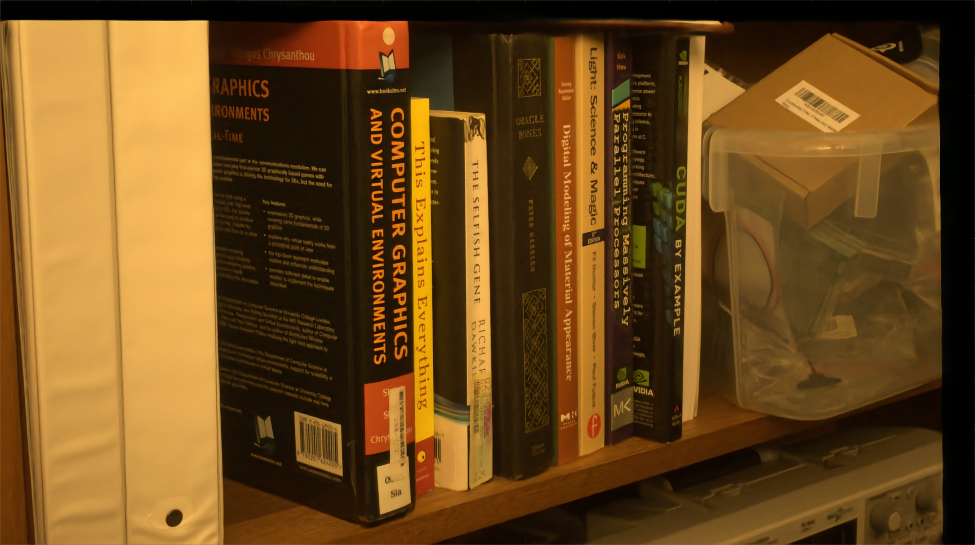
Result
using frames 1-6

Slide 44
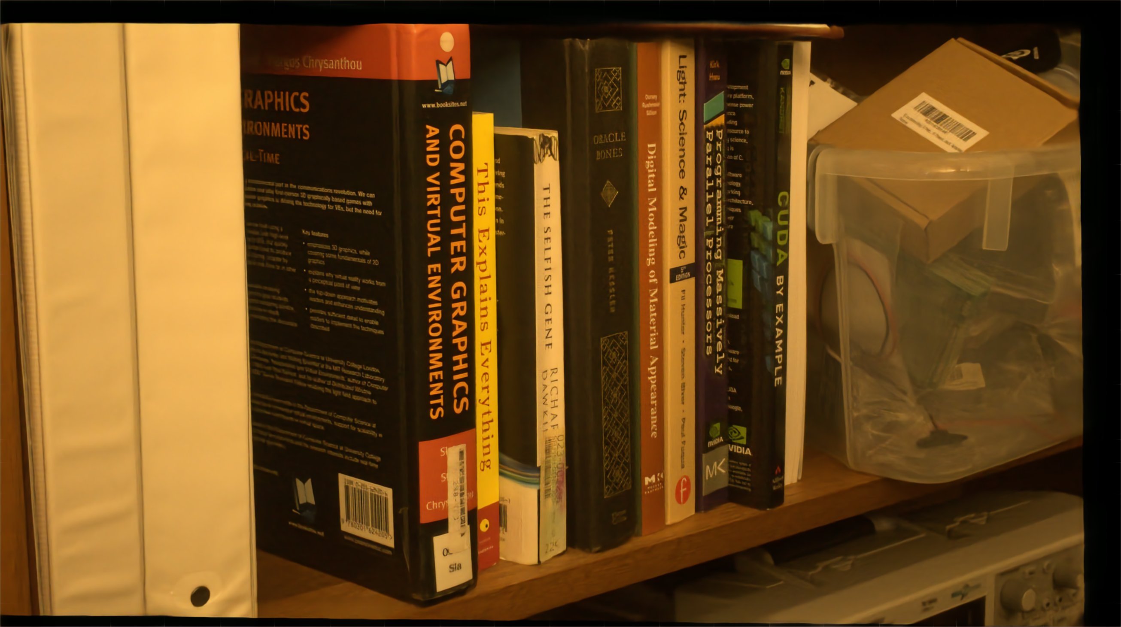
Result
using frames 1-7

Slide 45
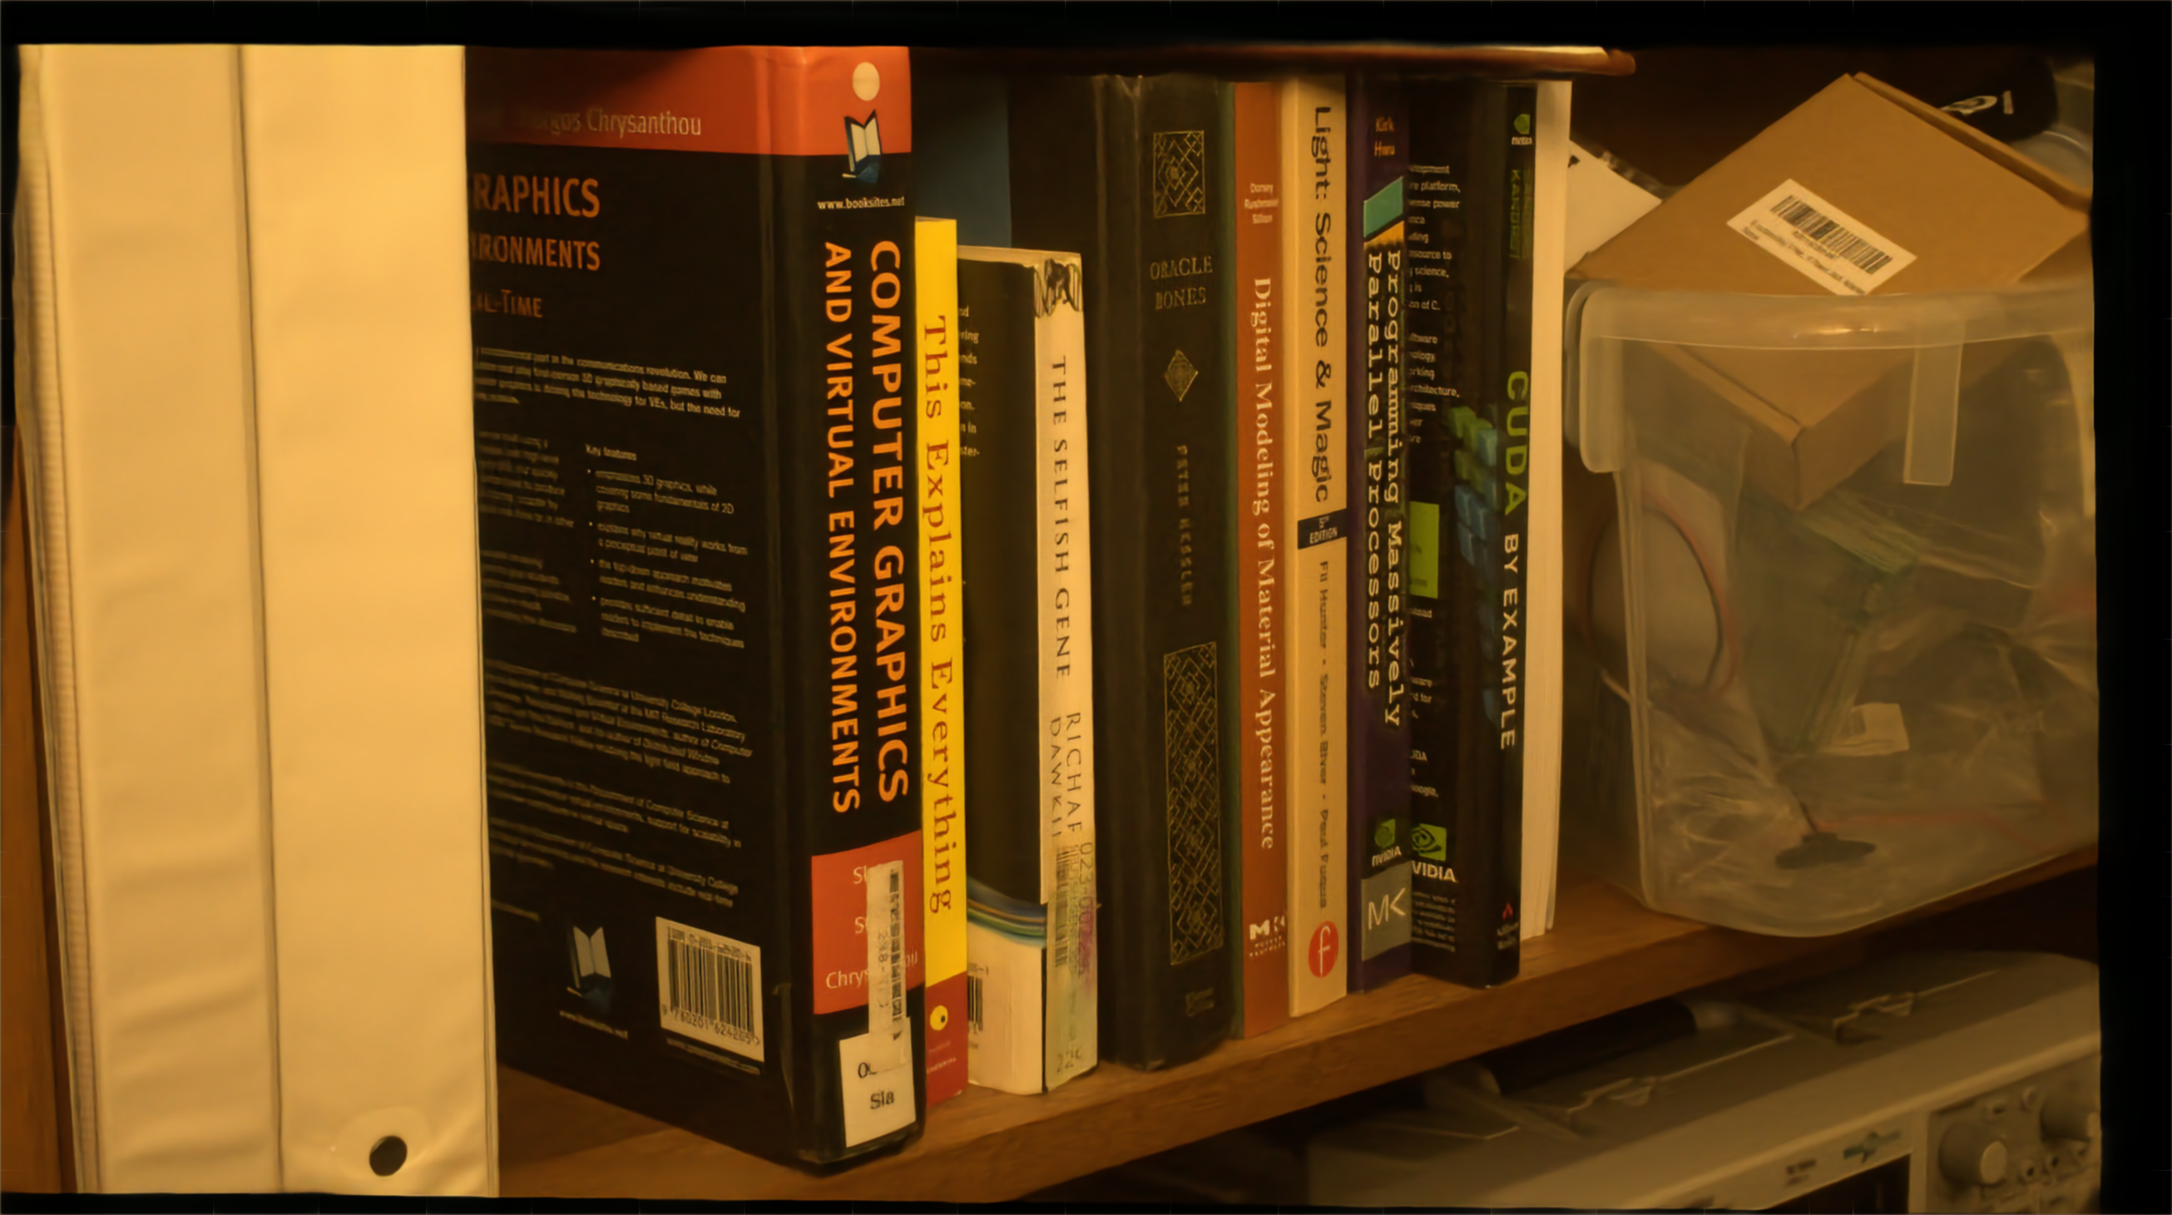
Result
using all frames
Notes:
So this is the result for the full burst.
I’ll zoom into the region we looked at before. Can you read the text this time?
For comparison, I’ll flip back and forth with a typical input frame in the burst.
I hope you agree that our method significantly improves the quality and legibility of the image.

Slide 46
Typical input photo
Notes:
So this is the result for the full burst.
I’ll zoom into the region we looked at before. Can you read the text this time?
For comparison, I’ll flip back and forth with a typical input frame in the burst.
I hope you agree that our method significantly improves the quality and legibility of the image.

Slide 47
Inputs
Result
number of photos in burst →
Notes:
Here you can see how that blown-up region behaved as a function of the number of input frames.
We also verified that those are the actual numbers on the physical specimen.

Slide 48
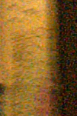
Input
Our result
Wieschollek et al. (2017)
Notes:
In this challenging dataset, the method of Wiescholleck and colleagues, as well as all other methods we tried, failed to reveal the numbers or significantly improve the image quality.

Slide 49
Numerical experiment:
Introducing a new frame to a burst is always likely to improve the result accuracy
Notes:
We also ran a numerical experiment where we studied the impact of the burst length on the reconstruction quality in our synthetic validation set.
So for example this first bar here denotes that adding a second frame to a one-frame burst is likely to result in significant improvement in the SSIM of the reconstruction, and this effect persists with further additions.

Slide 51
Limitations & practicalities
Assumption of static scene (camera motion only)
  However, in principle applicable to e.g. optical flow aligned data (see paper for experiment)
Runtime
  1.5 min for 8-frame 12-megapixel burst
  Plus roughly the same for pre-alignment
Notes:
The main practical limitation of the method is that it’s geared towards static scenes, where all motion is due to hand shake, but we do show some successful preliminary results with flow-aligned data in the paper.
The runtime at a couple of minutes is not quite cell-phone level yet, though at least the pre-alignment step could likely be significantly optimized.

Slide 52
Discussion
Sort of black-box analogue to e.g. ML/MAP estimation
  Accumulation of unstructured ”evidence”
  Wider applicability to tasks of similar character?
Considering blur and severe noise simultaneously with challenging training data is beneficial
Notes:
As a more general philosophical point, I’d like to point out the similarity of this scheme to classical inference approaches where evidence is accumulated via likelihood functions. There too a key property is exchangeability and arbitrary cardinality of the input data. Vanilla CNN’s don’t quite naturally fit into this paradigm, and I think our success here shows the potential of the pooling approaches to other problems of similar flavor.
While the architecture is the main thing behind our results, it does also benefit from the challenging and varied training data. In particular, it’s beneficial to consider noise and blur simultaneously, as you tend to get both in realistic low-light situations.

Slide 53
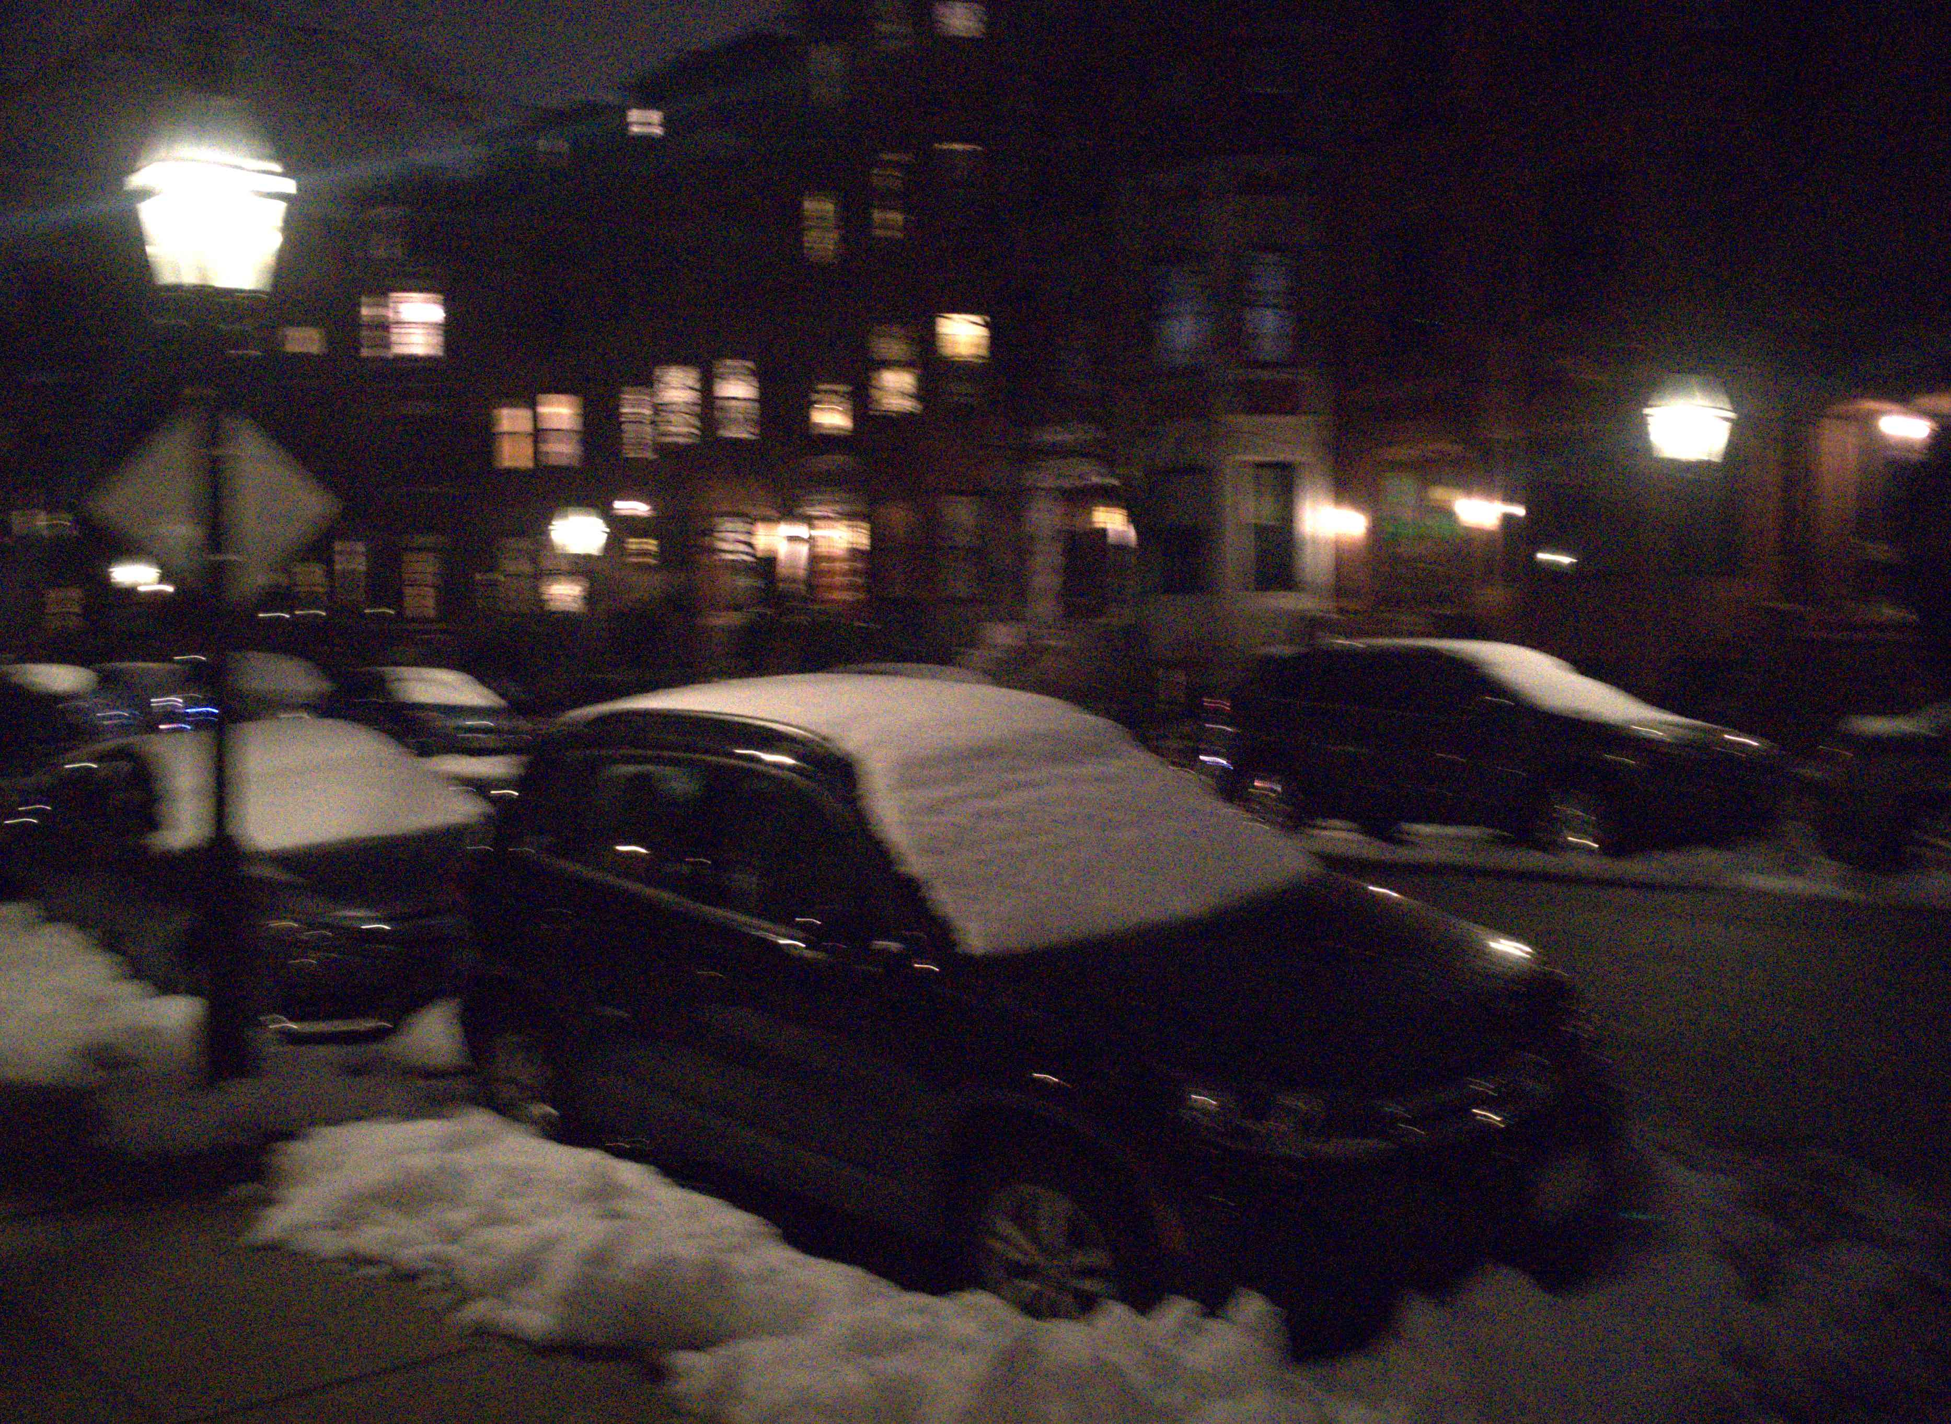
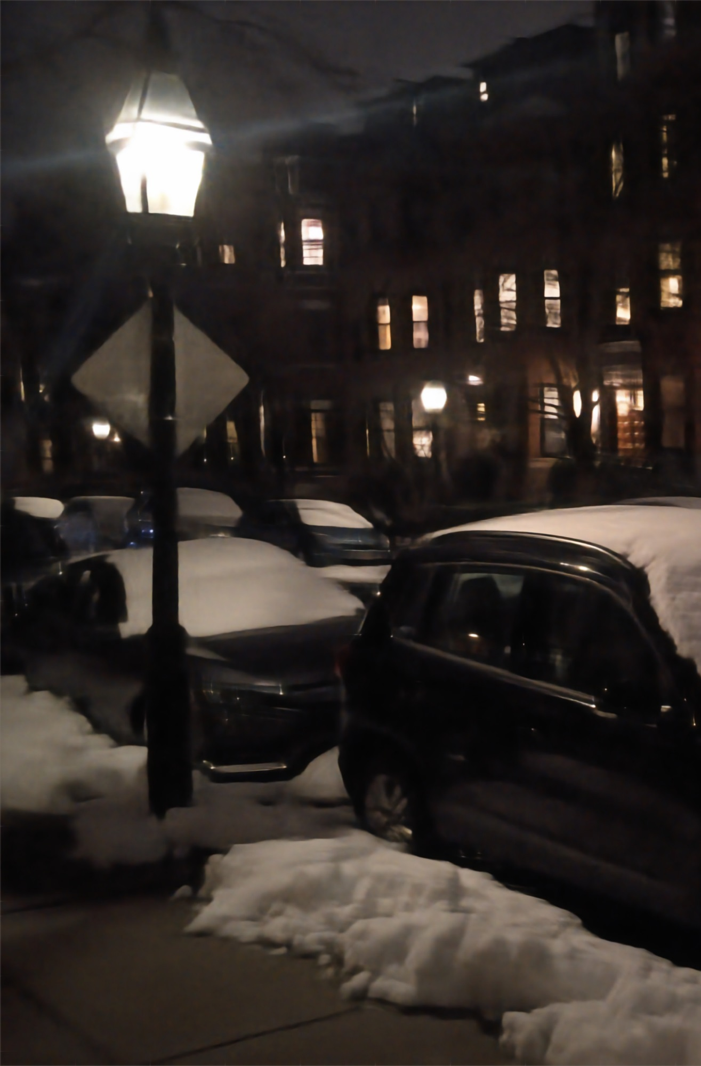
Thank you
code, pretrained model and datasets will be available soon
Poster P-2B-29
← our result
input frames →

Slide 54

Thank you
code, pretrained model and datasets will be available soon
Poster P-2B-29
← our result
input frames →

Slide 55
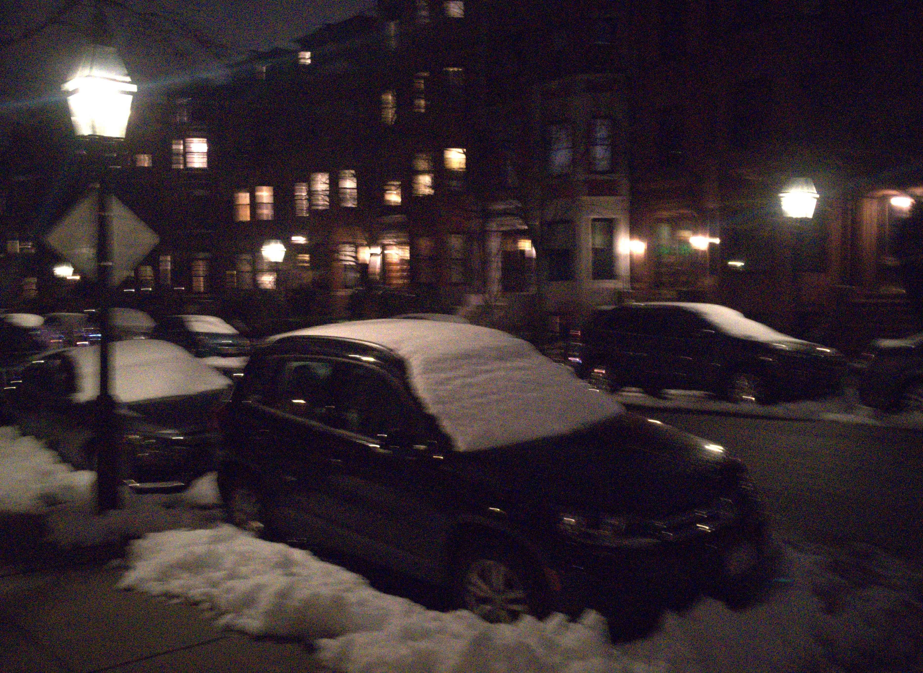
Thank you
code, pretrained model and datasets will be available soon
Poster P-2B-29
← our result
input frames →

Slide 56
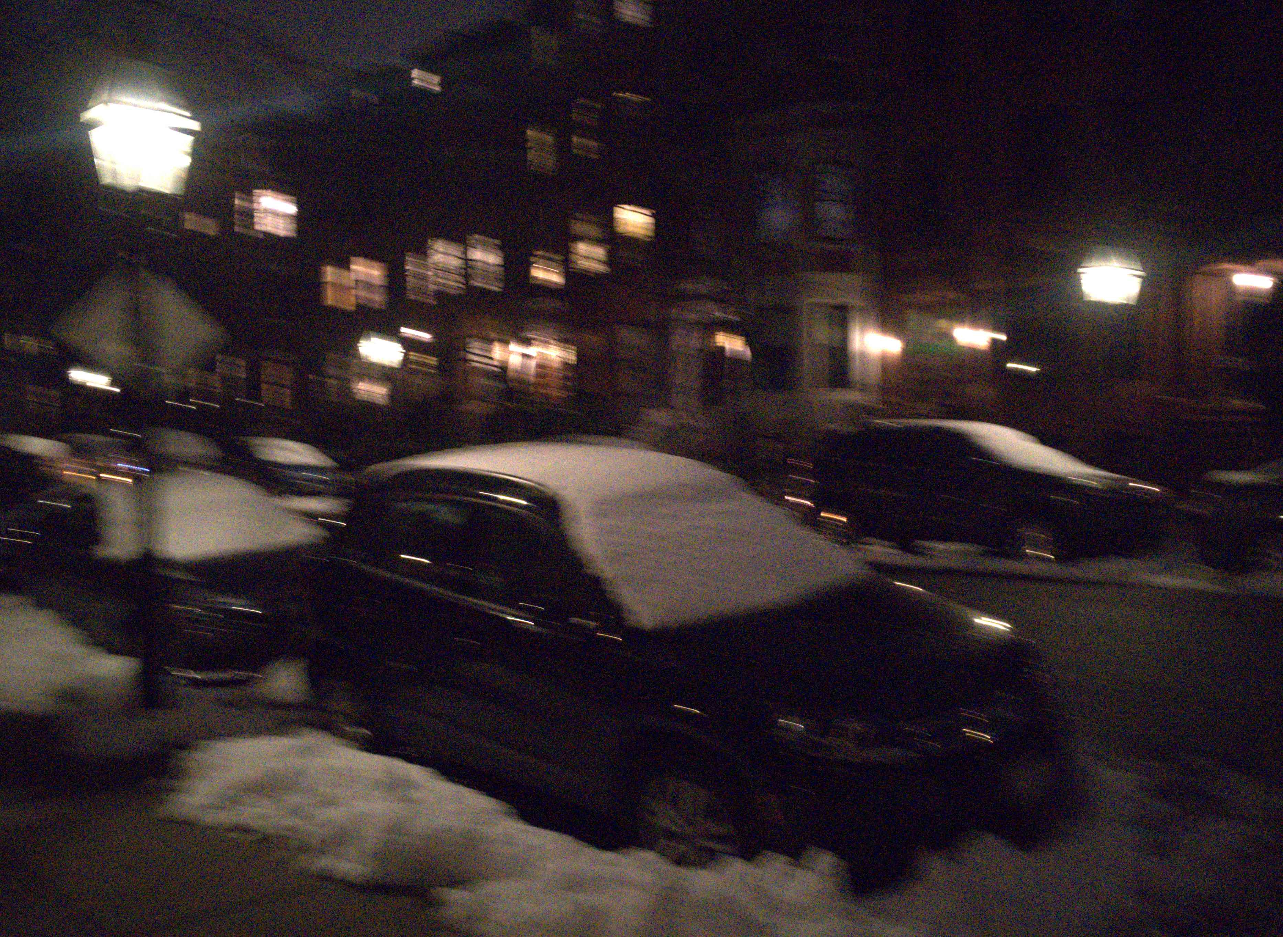
Thank you
code, pretrained model and datasets will be available soon
Poster P-2B-29
← our result
input frames →

Slide 57
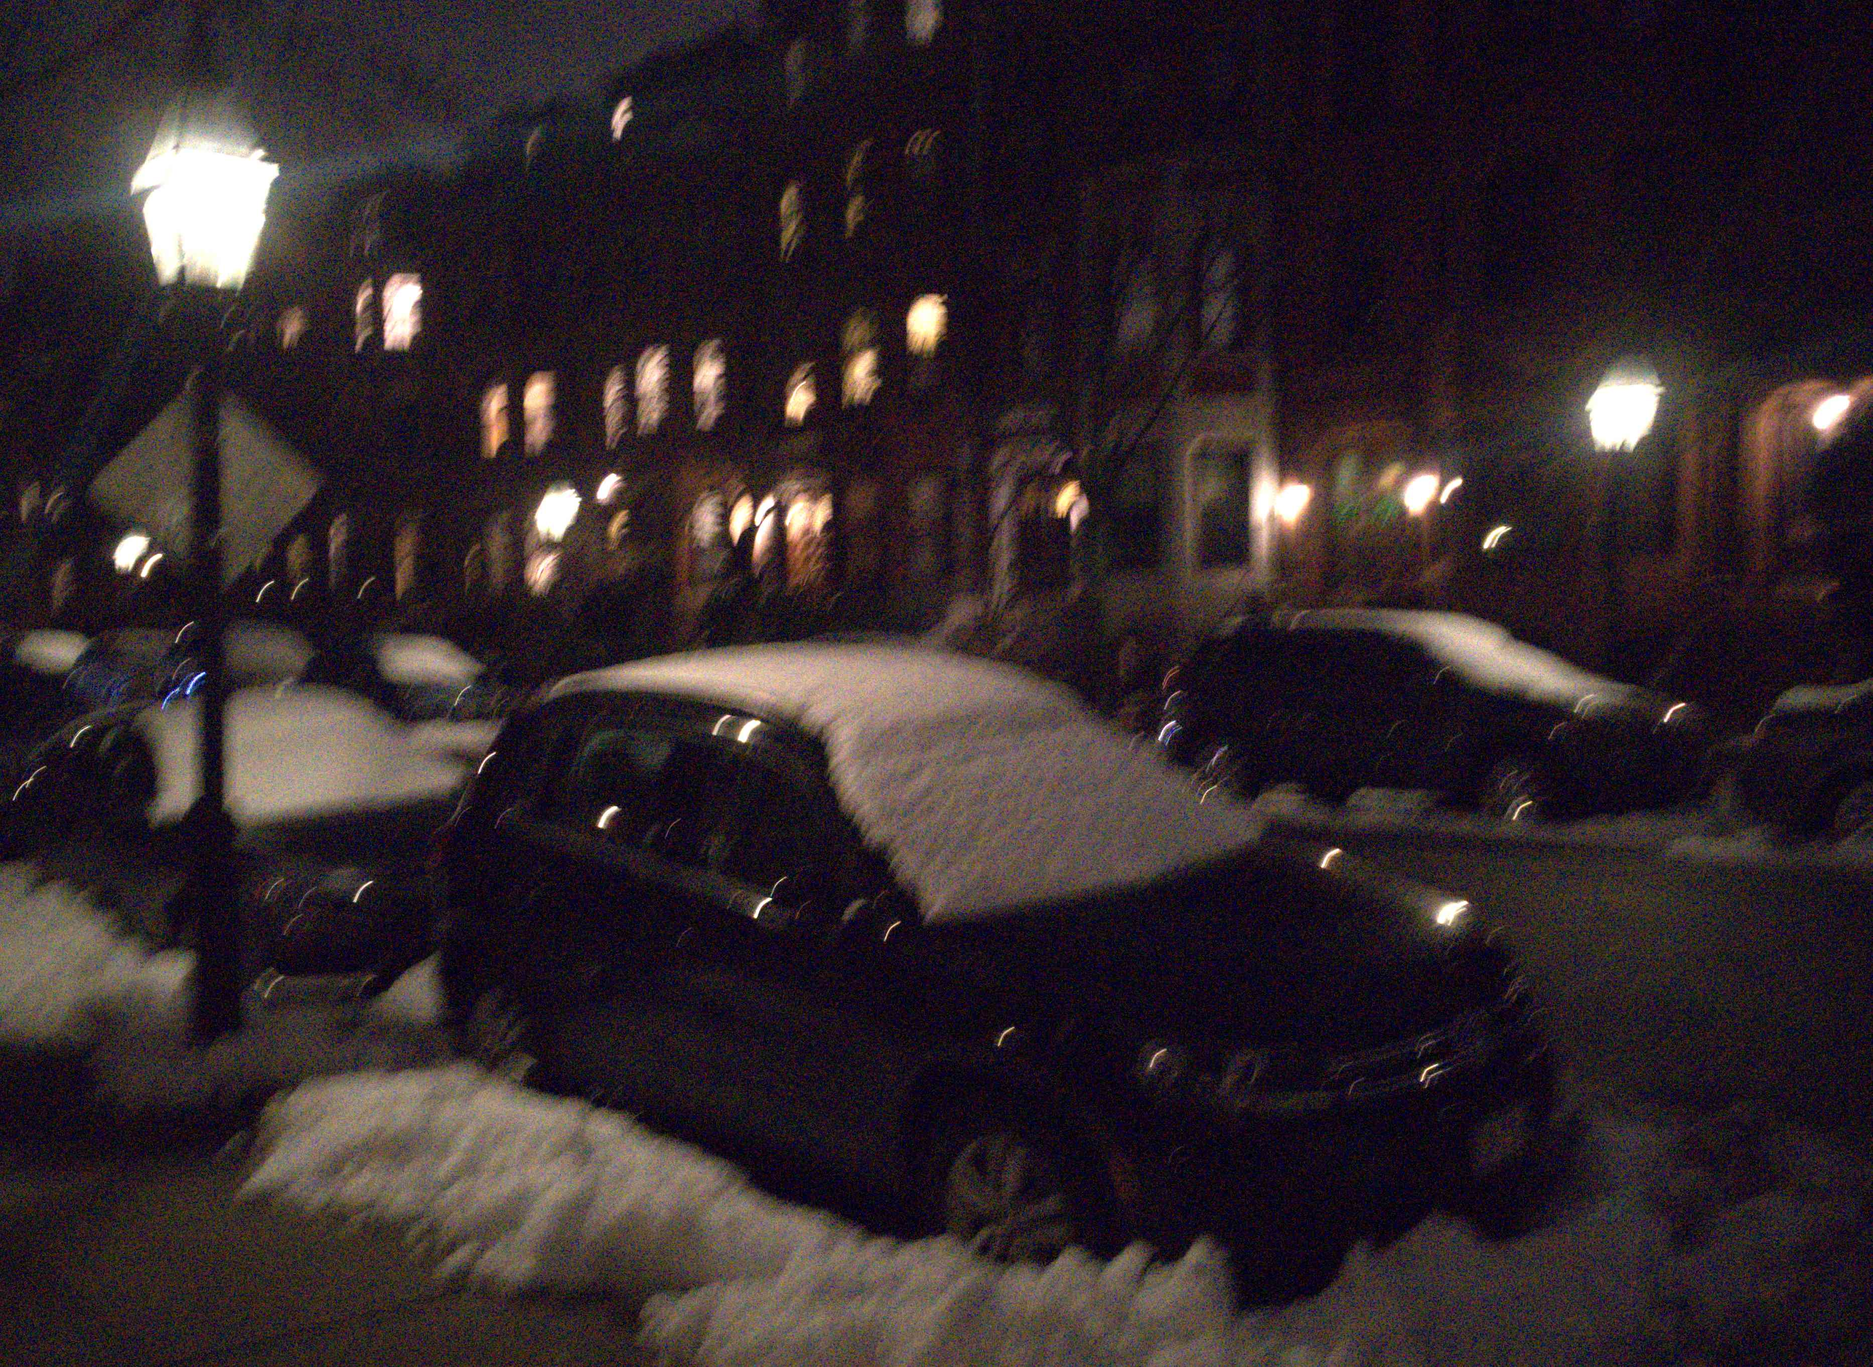
Thank you
code, pretrained model and datasets will be available soon
Poster P-2B-29
← our result
input frames →

Slide 58

Thank you
code, pretrained model and datasets will be available soon
Poster P-2B-29
← our result
input frames →

Slide 59

Thank you
code, pretrained model and datasets will be available soon
Poster P-2B-29
← our result
input frames →

Slide 60
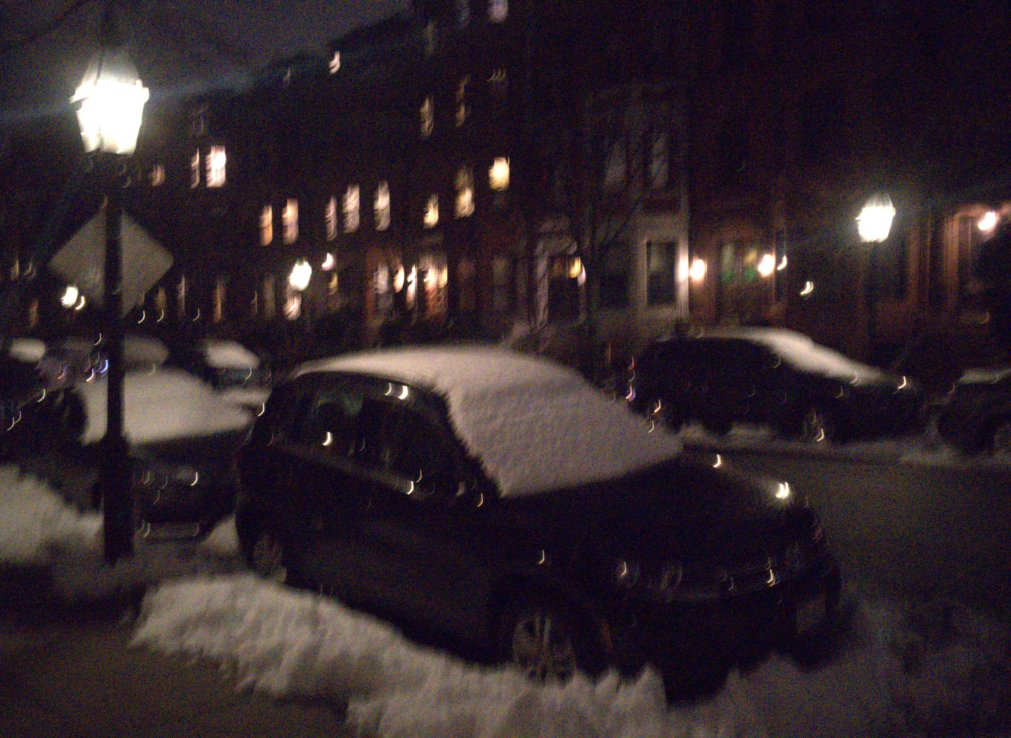
Thank you
code, pretrained model and datasets will be available soon
Poster P-2B-29
← our result
input frames →

Slide 61
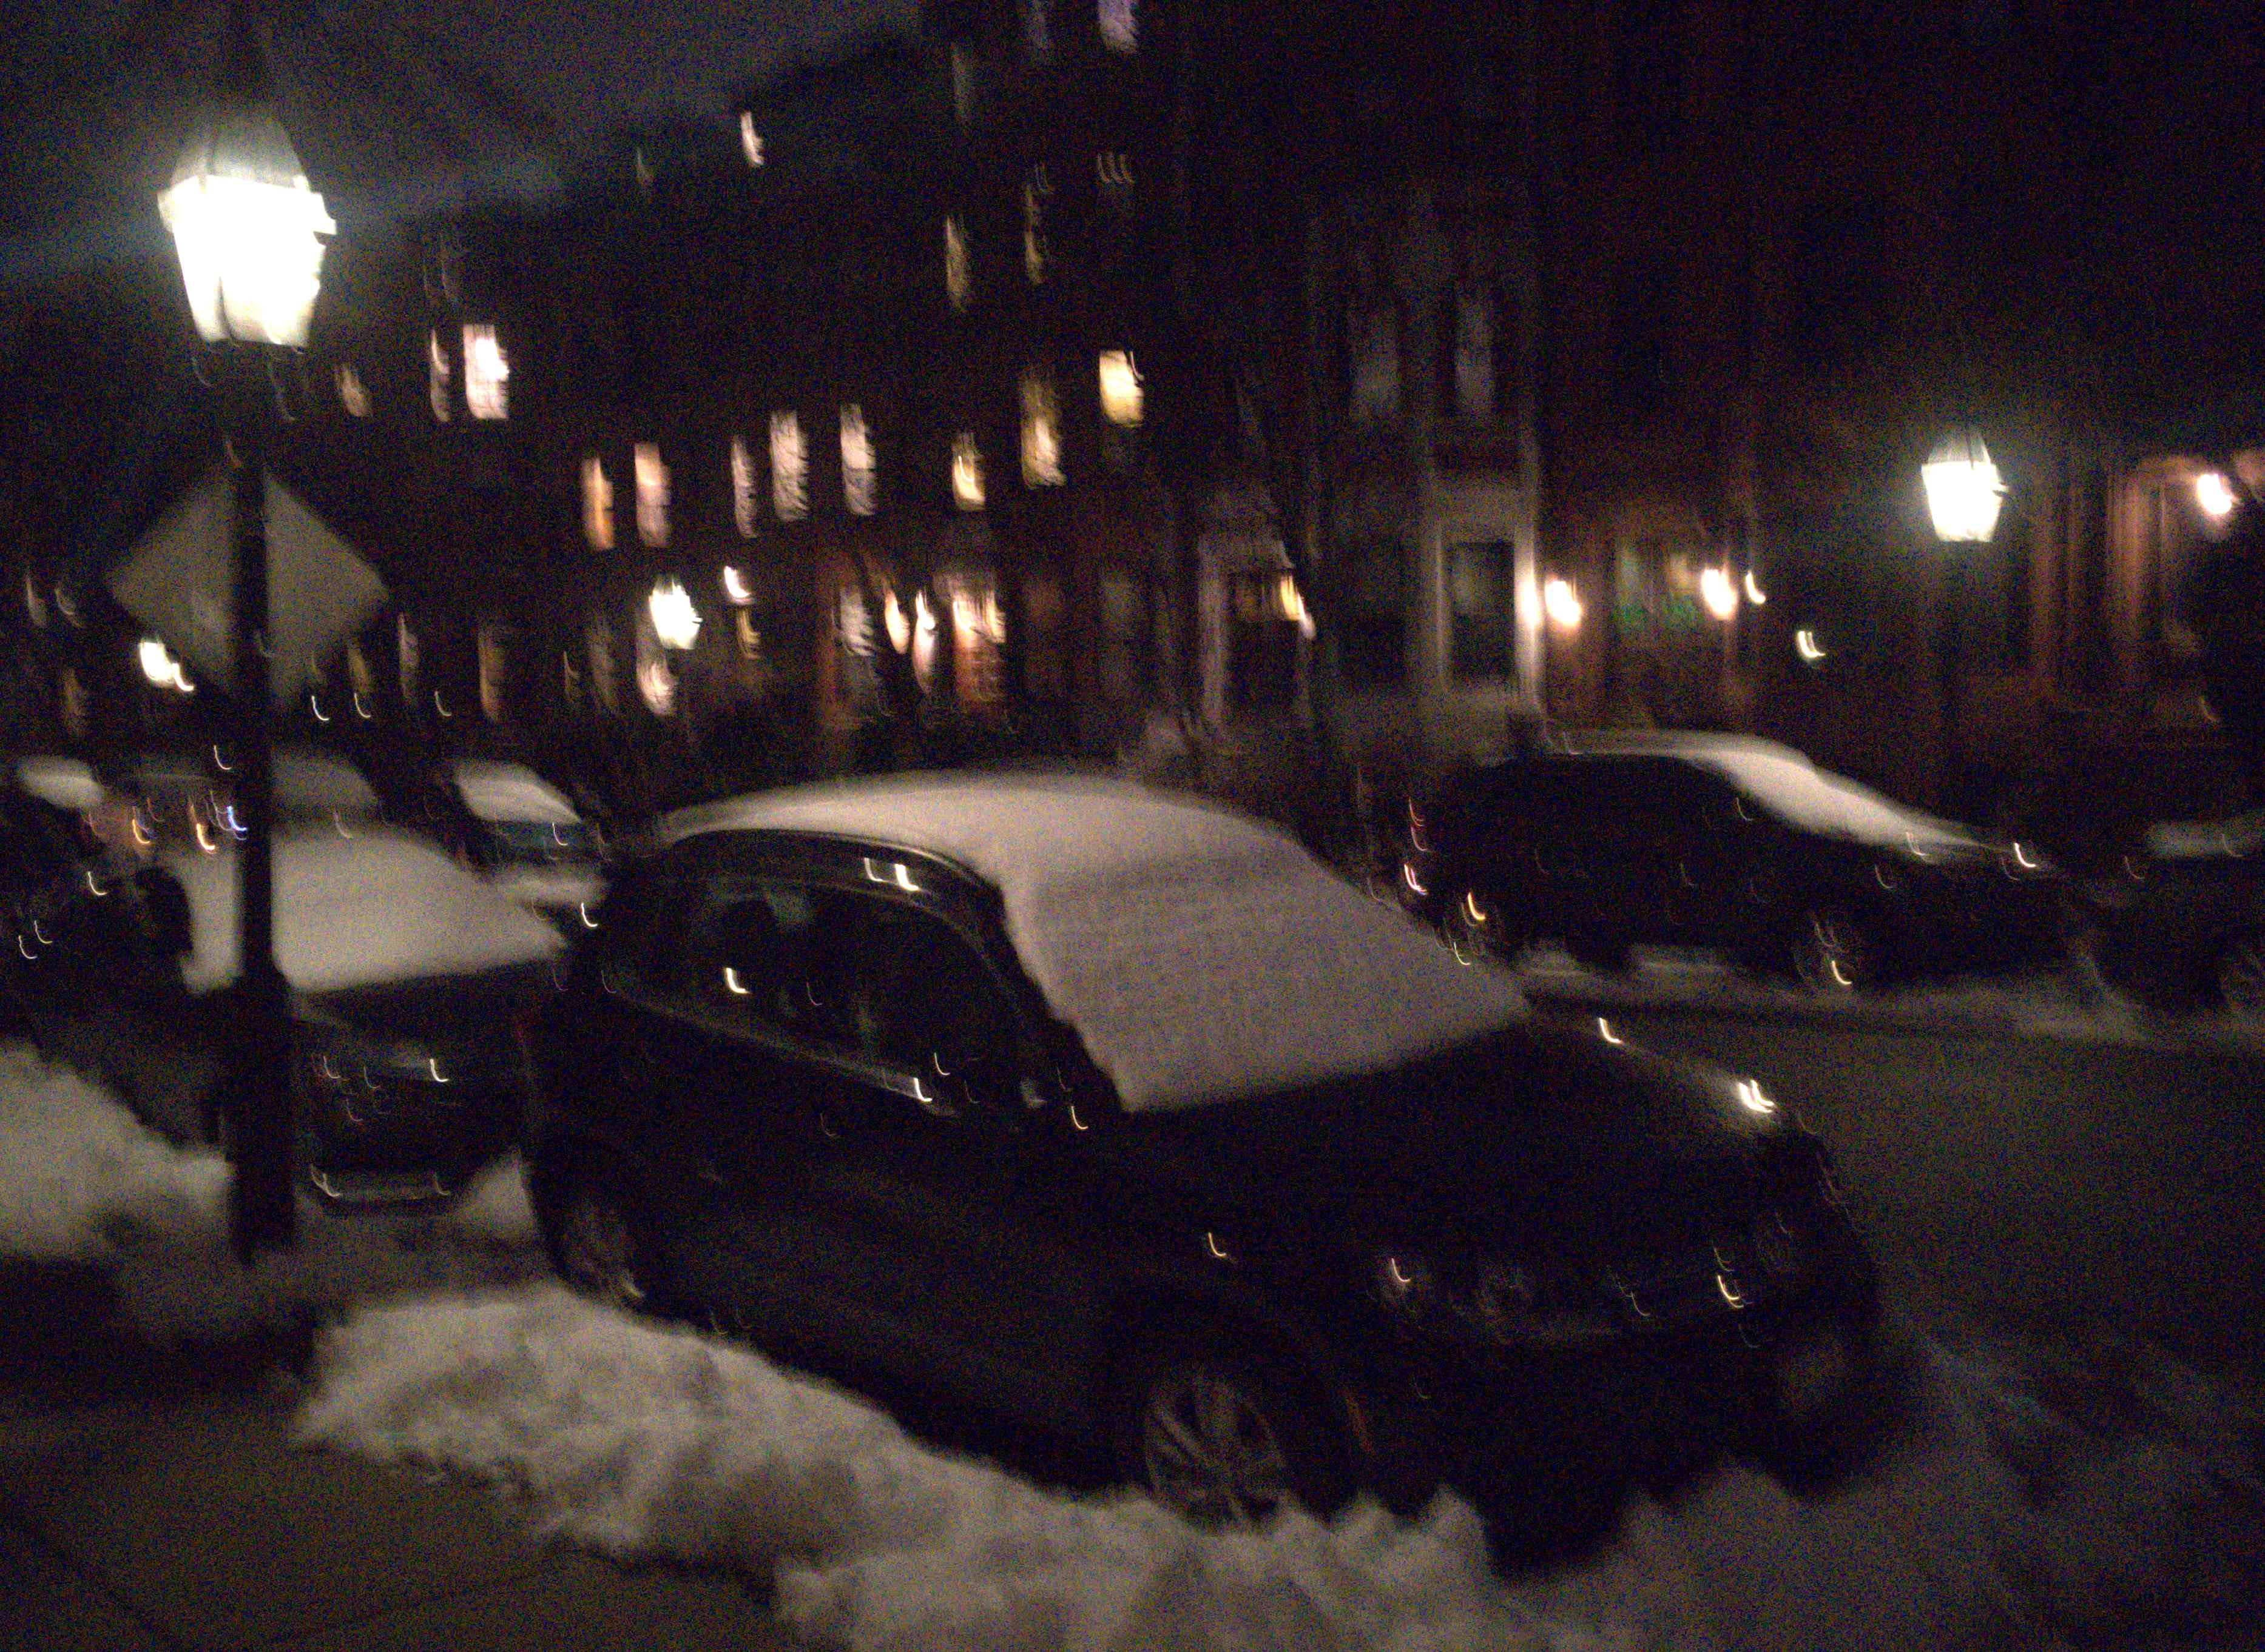
Thank you
code, pretrained model and datasets will be available soon
Poster P-2B-29
← our result
input frames →

Slide 62
Thank you
code, pretrained model and datasets will be available soon
Poster P-2B-29
← our result
input frames →

Slide 63
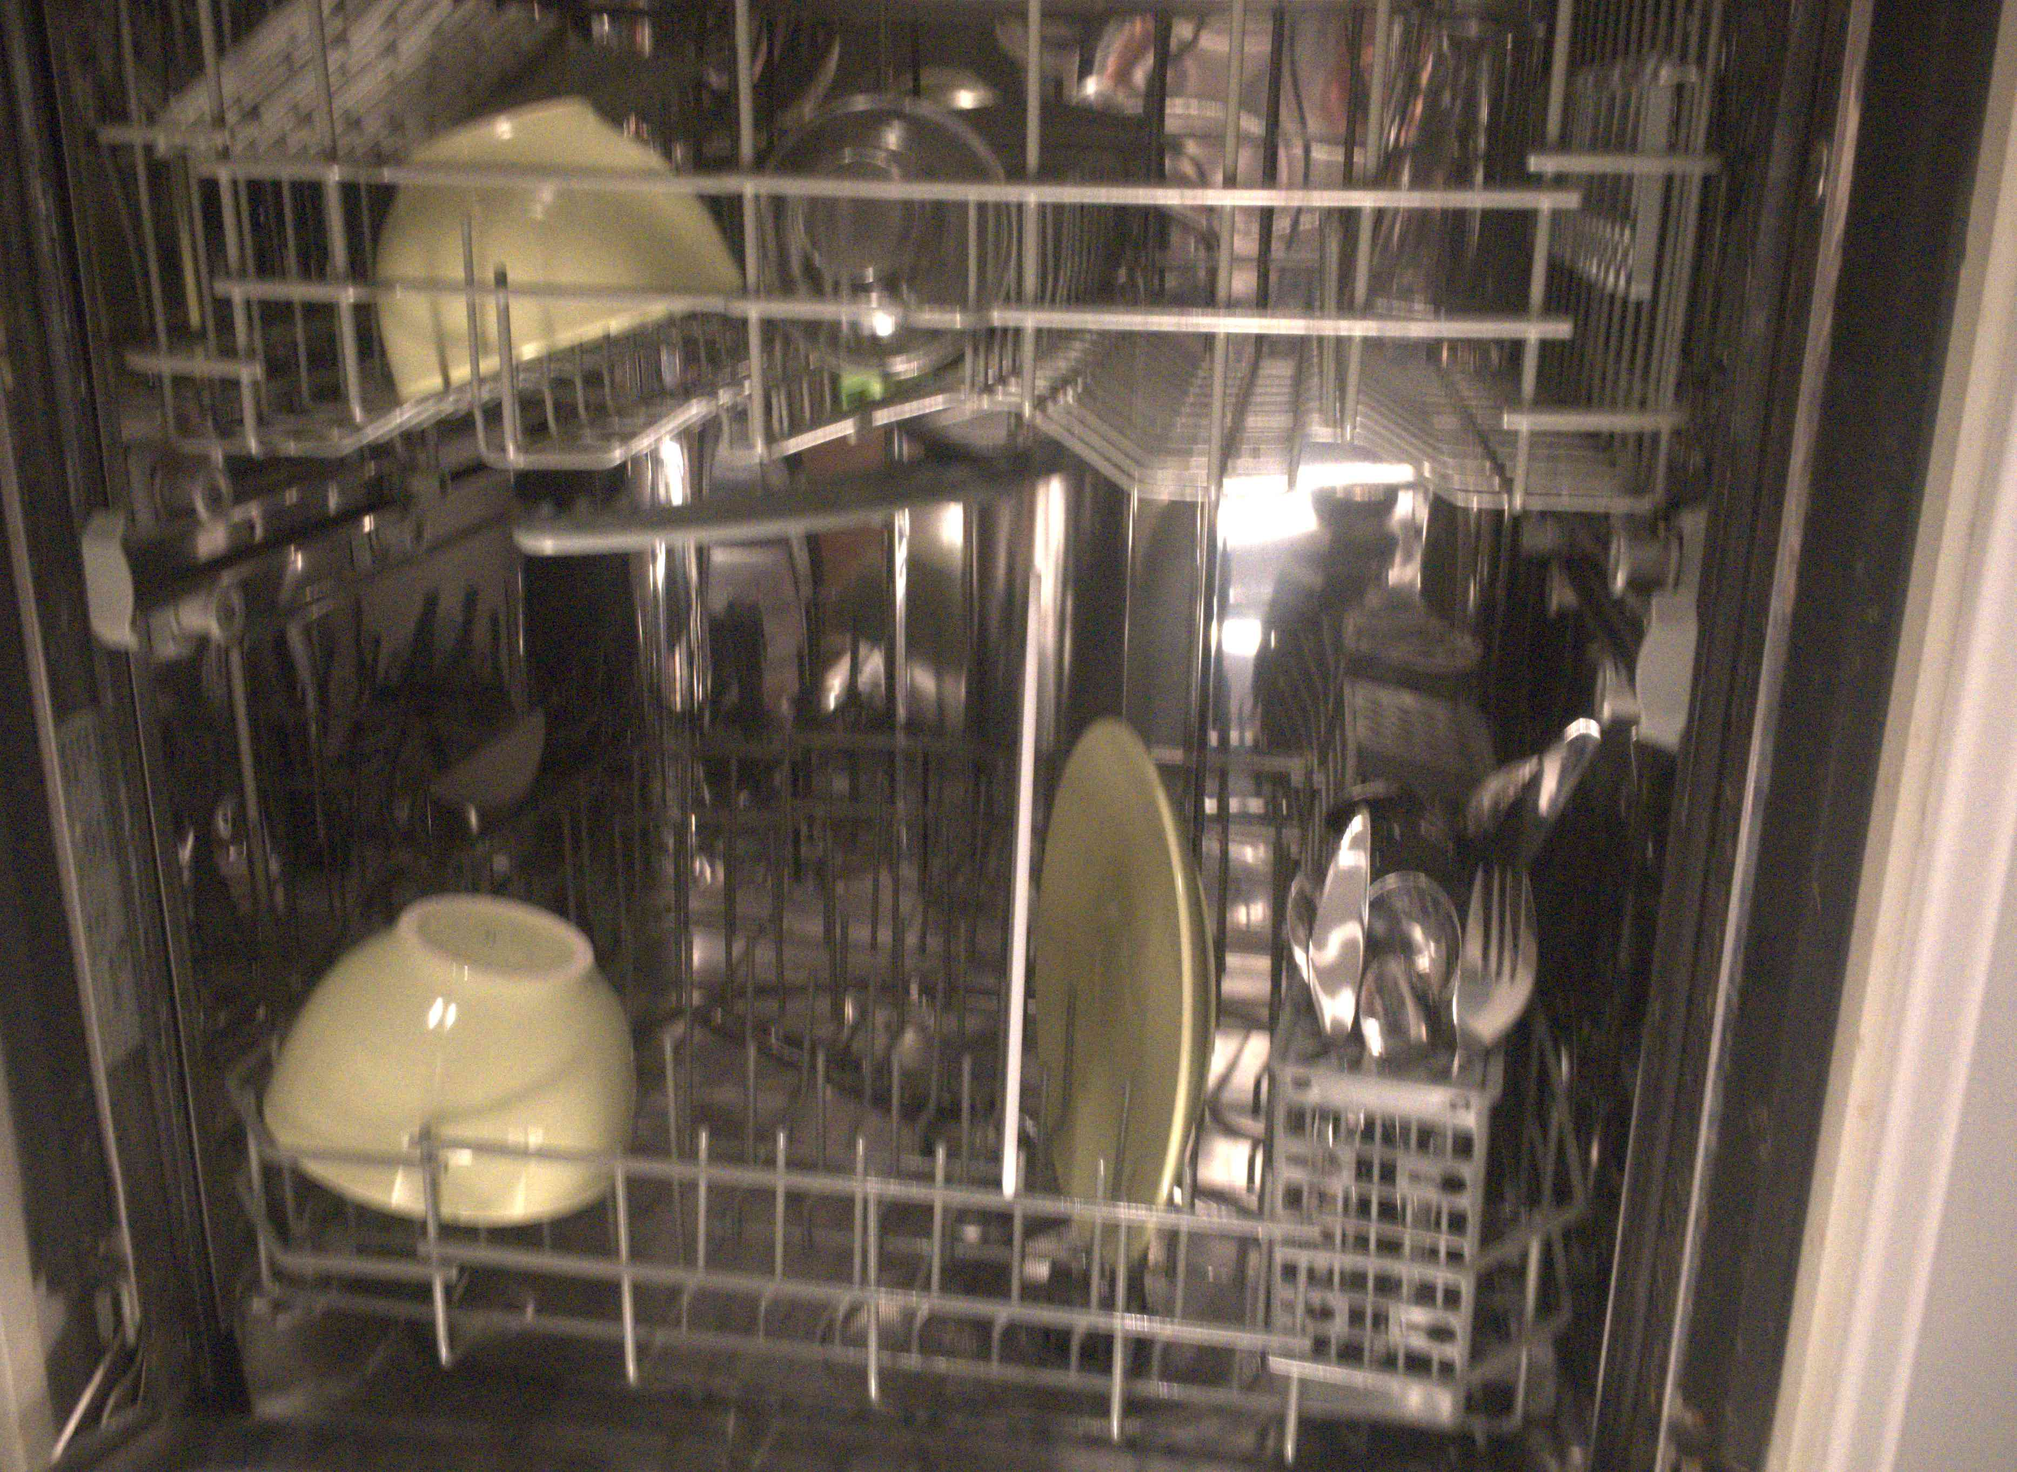

Thank you
code, pretrained model and datasets will be available soon
Poster P-2B-29
← our result
input frames →

Slide 64
Thank you
code, pretrained model and datasets will be available soon
Poster P-2B-29
← our result
input frames →

Slide 65
Thank you
code, pretrained model and datasets will be available soon
Poster P-2B-29
← our result
input frames →

Slide 66
Thank you
code, pretrained model and datasets will be available soon
Poster P-2B-29
← our result
input frames →

Slide 67
Thank you
code, pretrained model and datasets will be available soon
Poster P-2B-29
← our result
input frames →

Slide 68
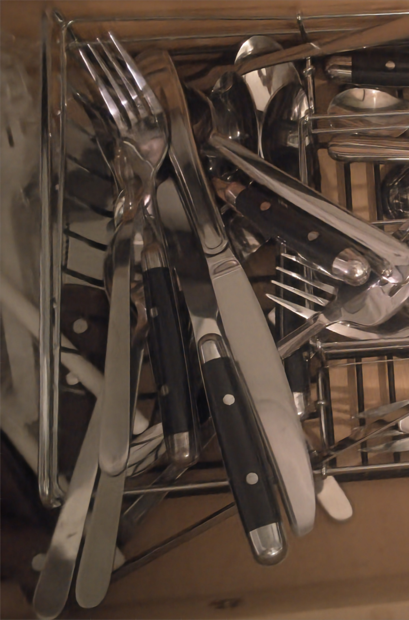
Thank you
code, pretrained model and datasets will be available soon
Poster P-2B-29
← our result
input frames →

Slide 69
Thank you
code, pretrained model and datasets will be available soon
Poster P-2B-29
← our result
input frames →

Slide 70
Thank you
code, pretrained model and datasets will be available soon
Poster P-2B-29
← our result
input frames →

Slide 71
Thank you
code, pretrained model and datasets will be available soon
Poster P-2B-29
← our result
input frames →

Slide 72
Thank you
code, pretrained model and datasets will be available soon
Poster P-2B-29
← our result
input frames →

Slide 73
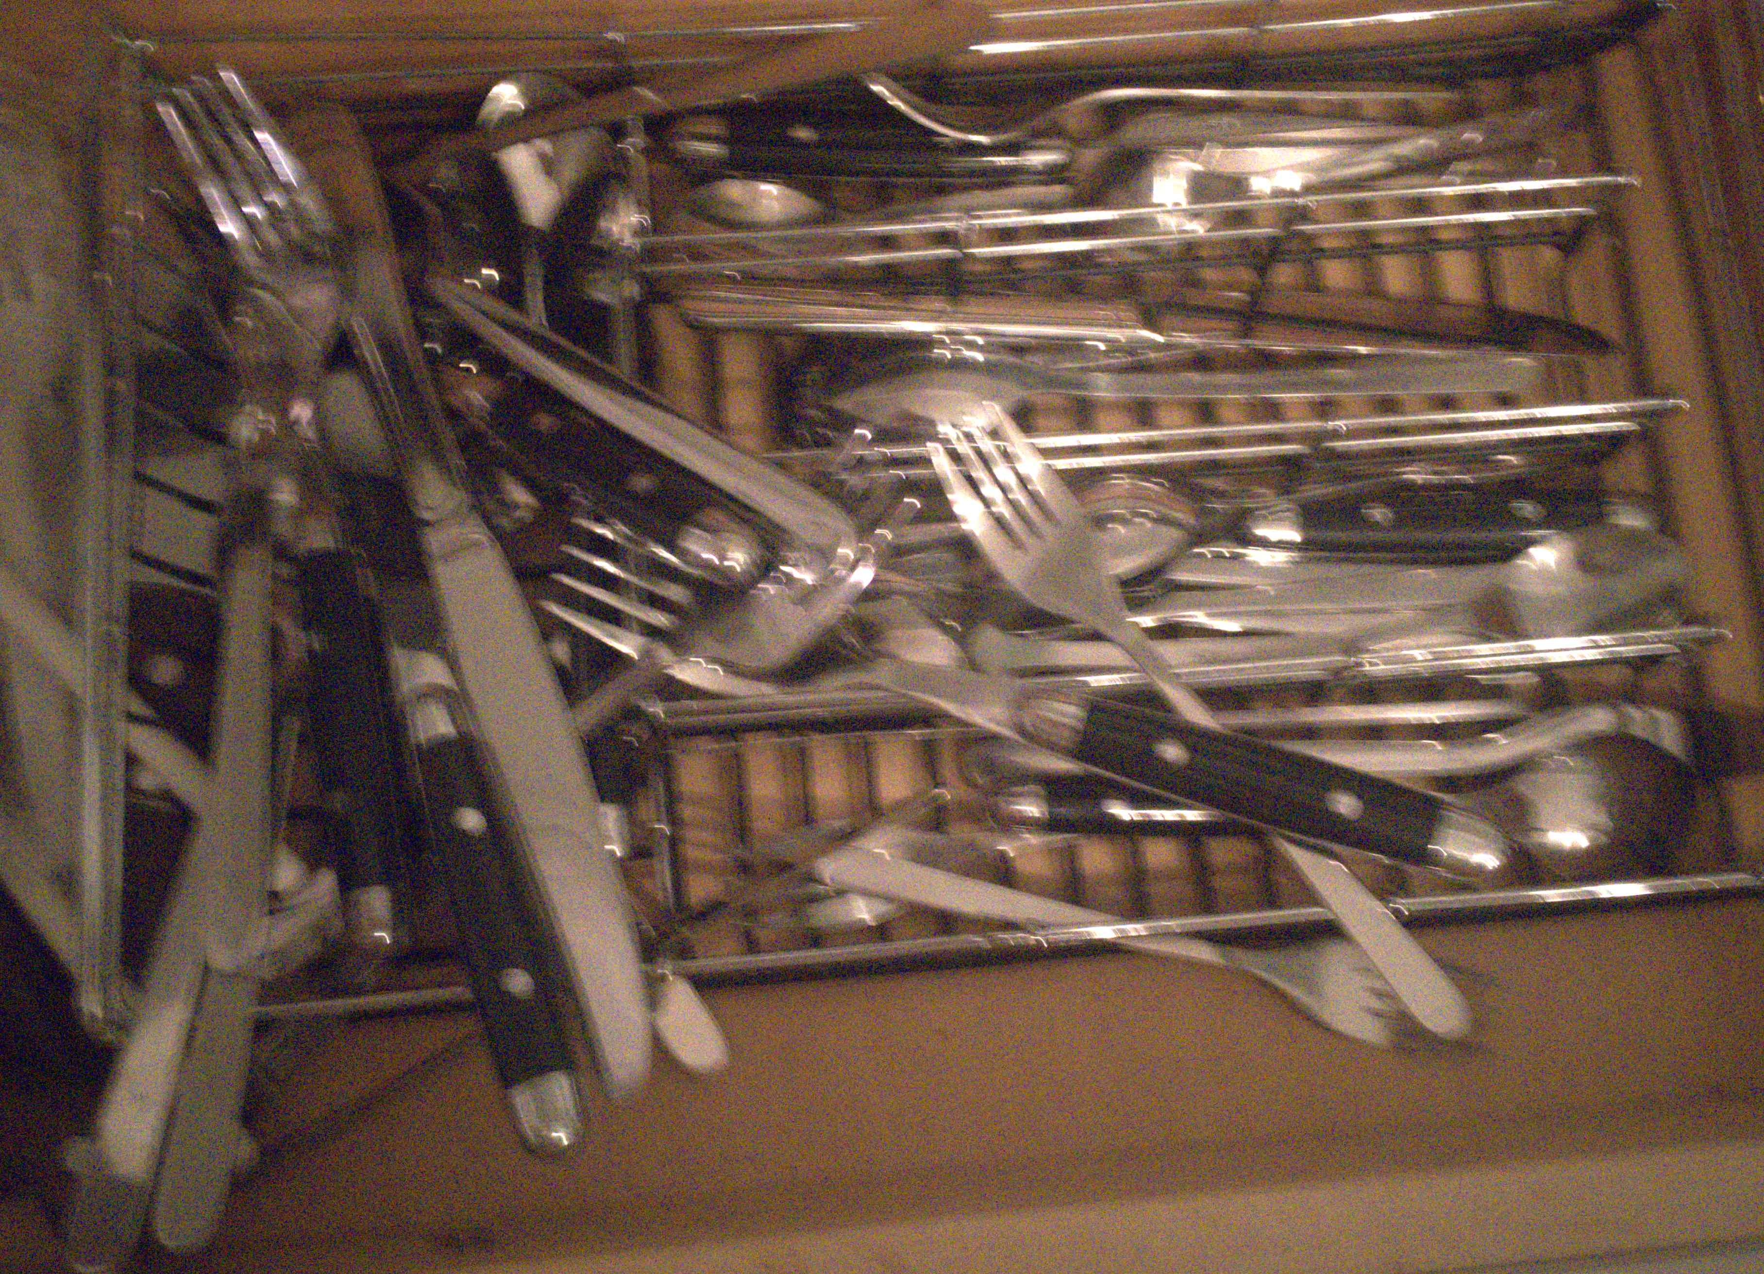
Thank you
code, pretrained model and datasets will be available soon
Poster P-2B-29
← our result
input frames →

Slide 74
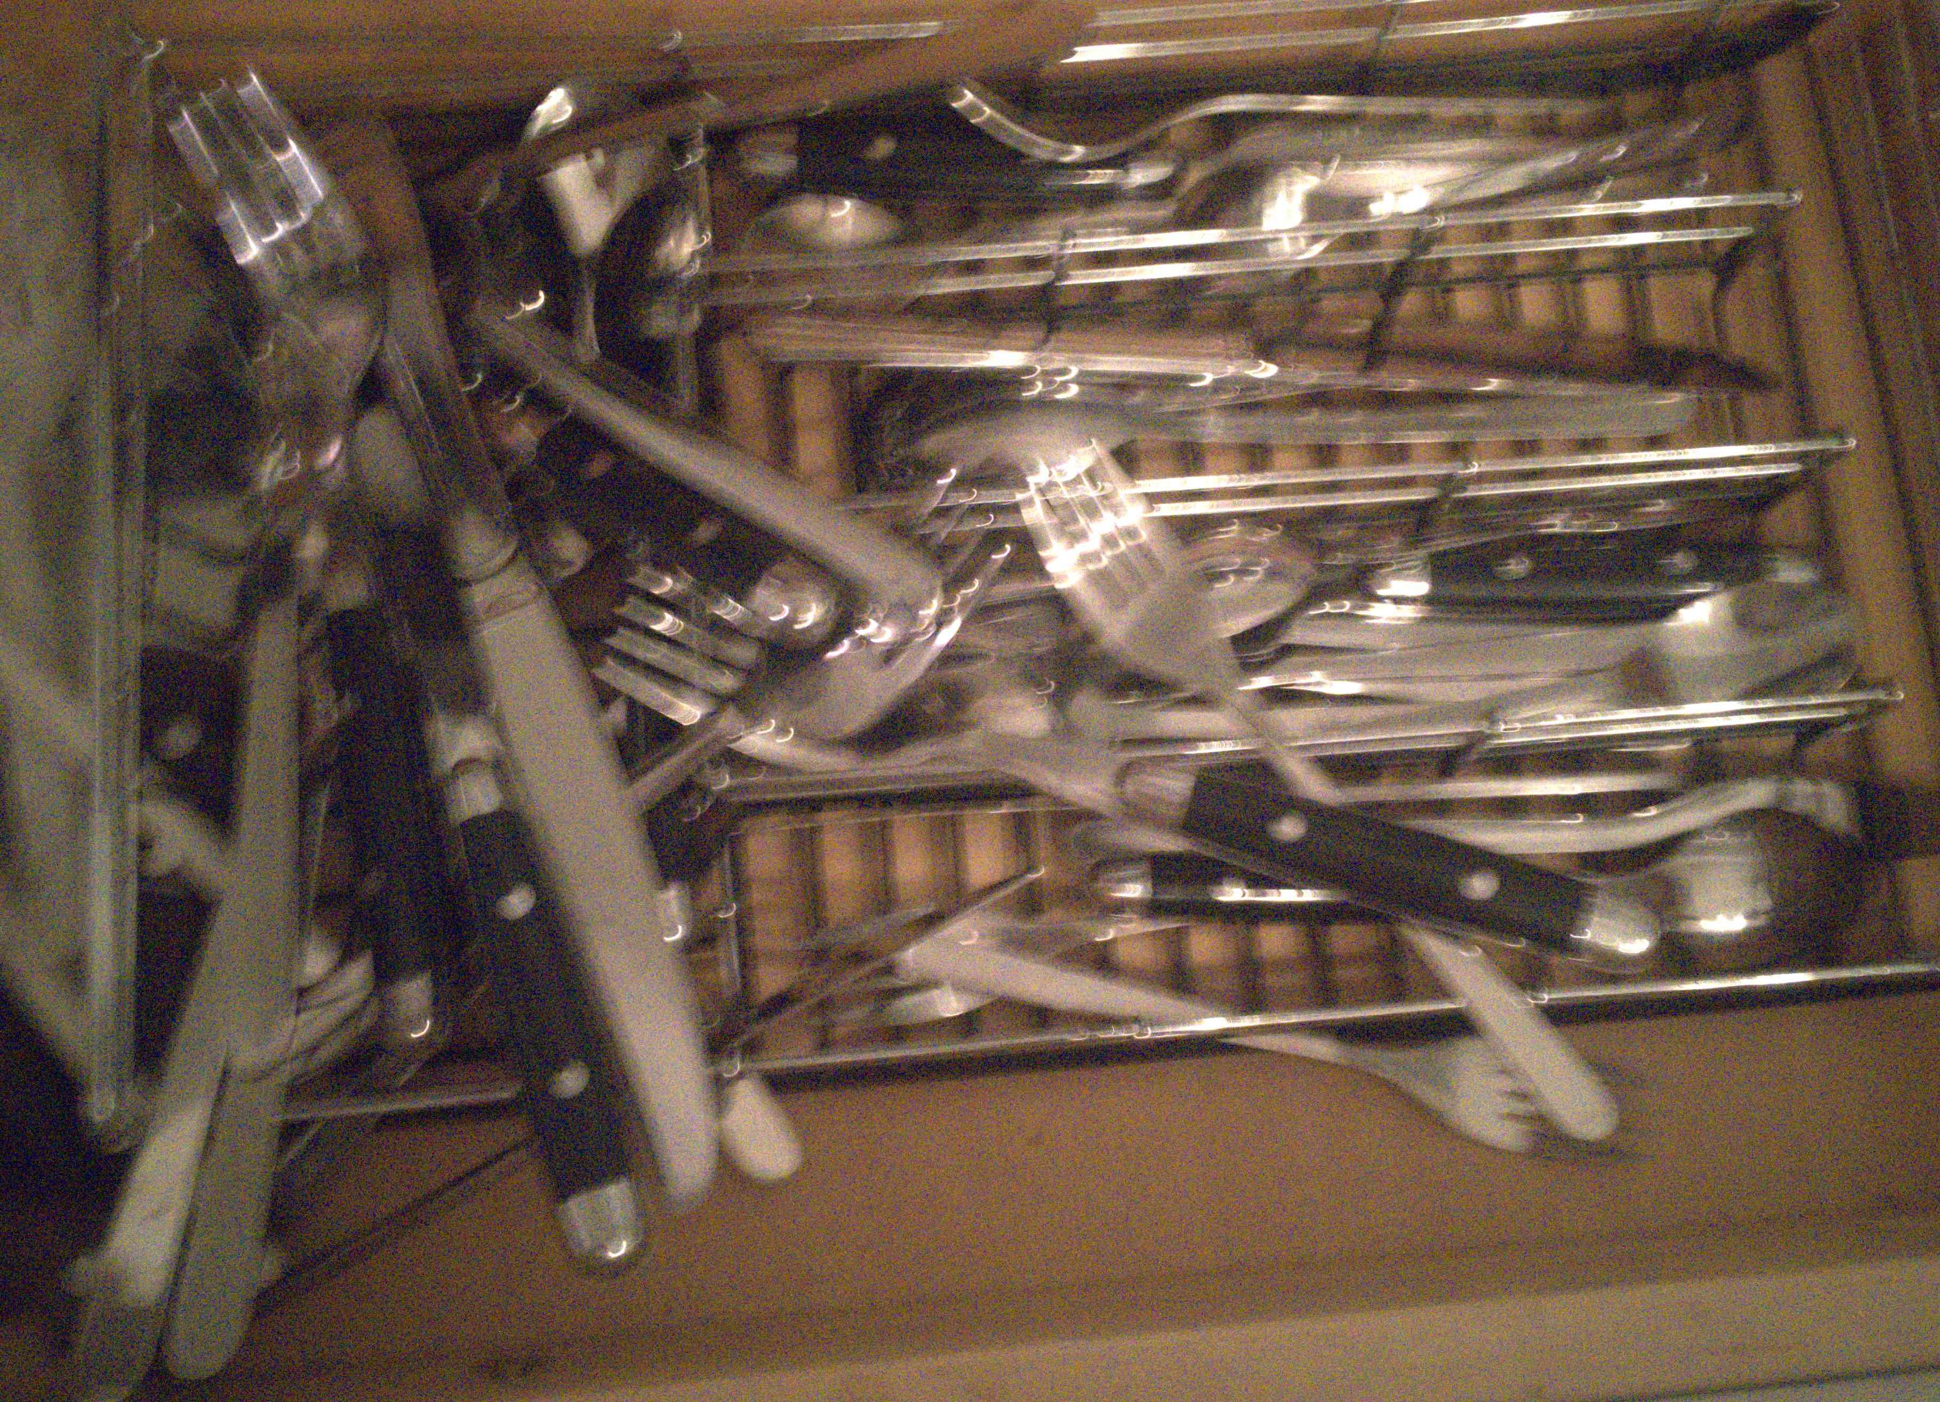
Thank you
code, pretrained model and datasets will be available soon
Poster P-2B-29
← our result
input frames →

Slide 75

Thank you
code, pretrained model and datasets will be available soon
← our result
input frames →

Slide 76
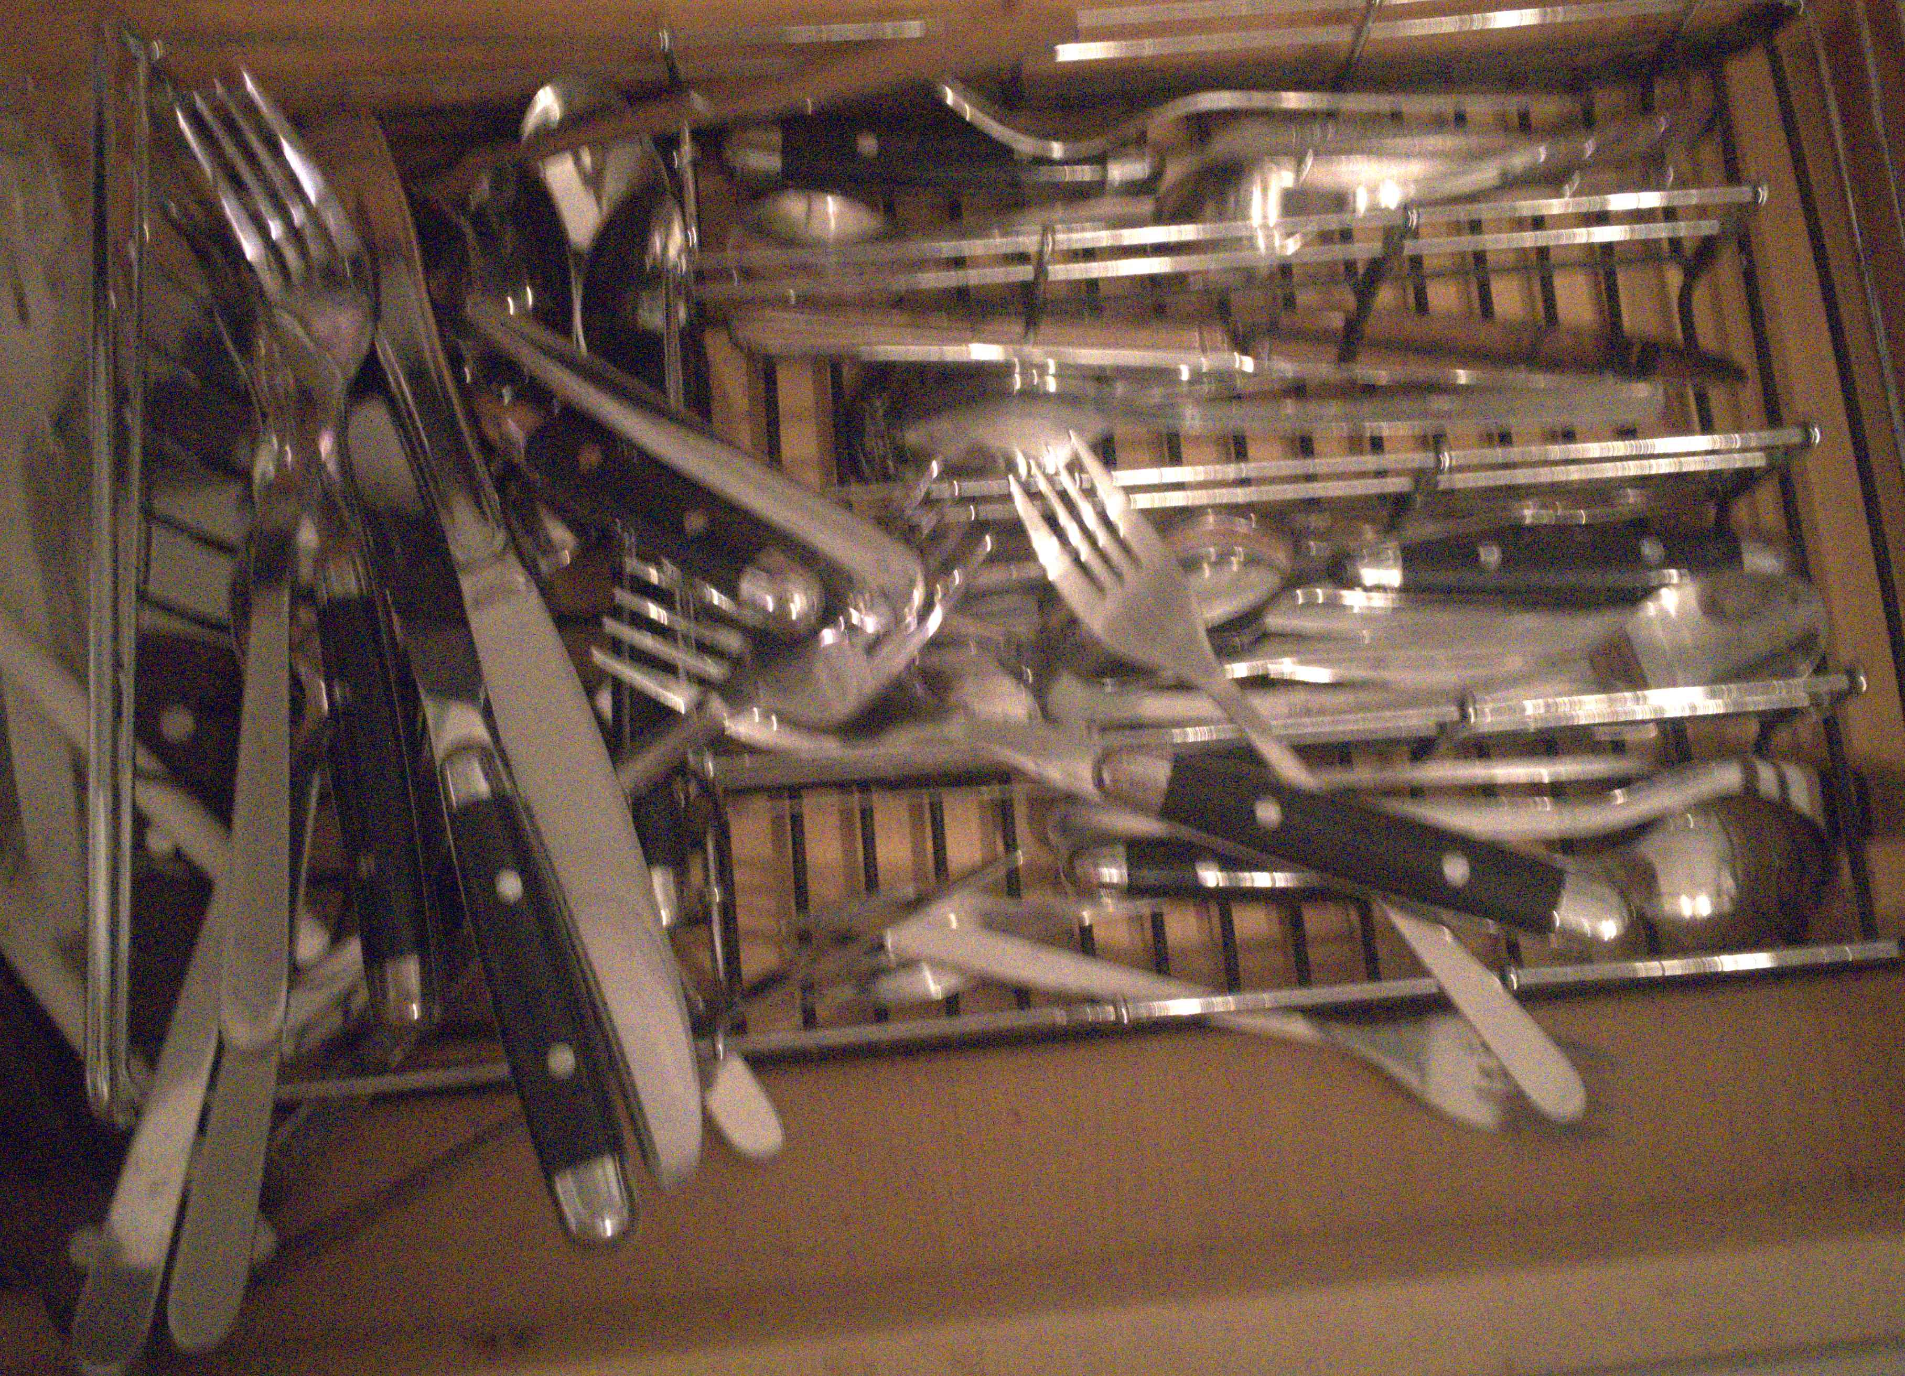
Thank you
code, pretrained model and datasets will be available soon
← our result
input frames →

Slide 77

Thank you
code, pretrained model and datasets will be available soon
Poster P-2B-29
← our result
input frames →

Slide 78
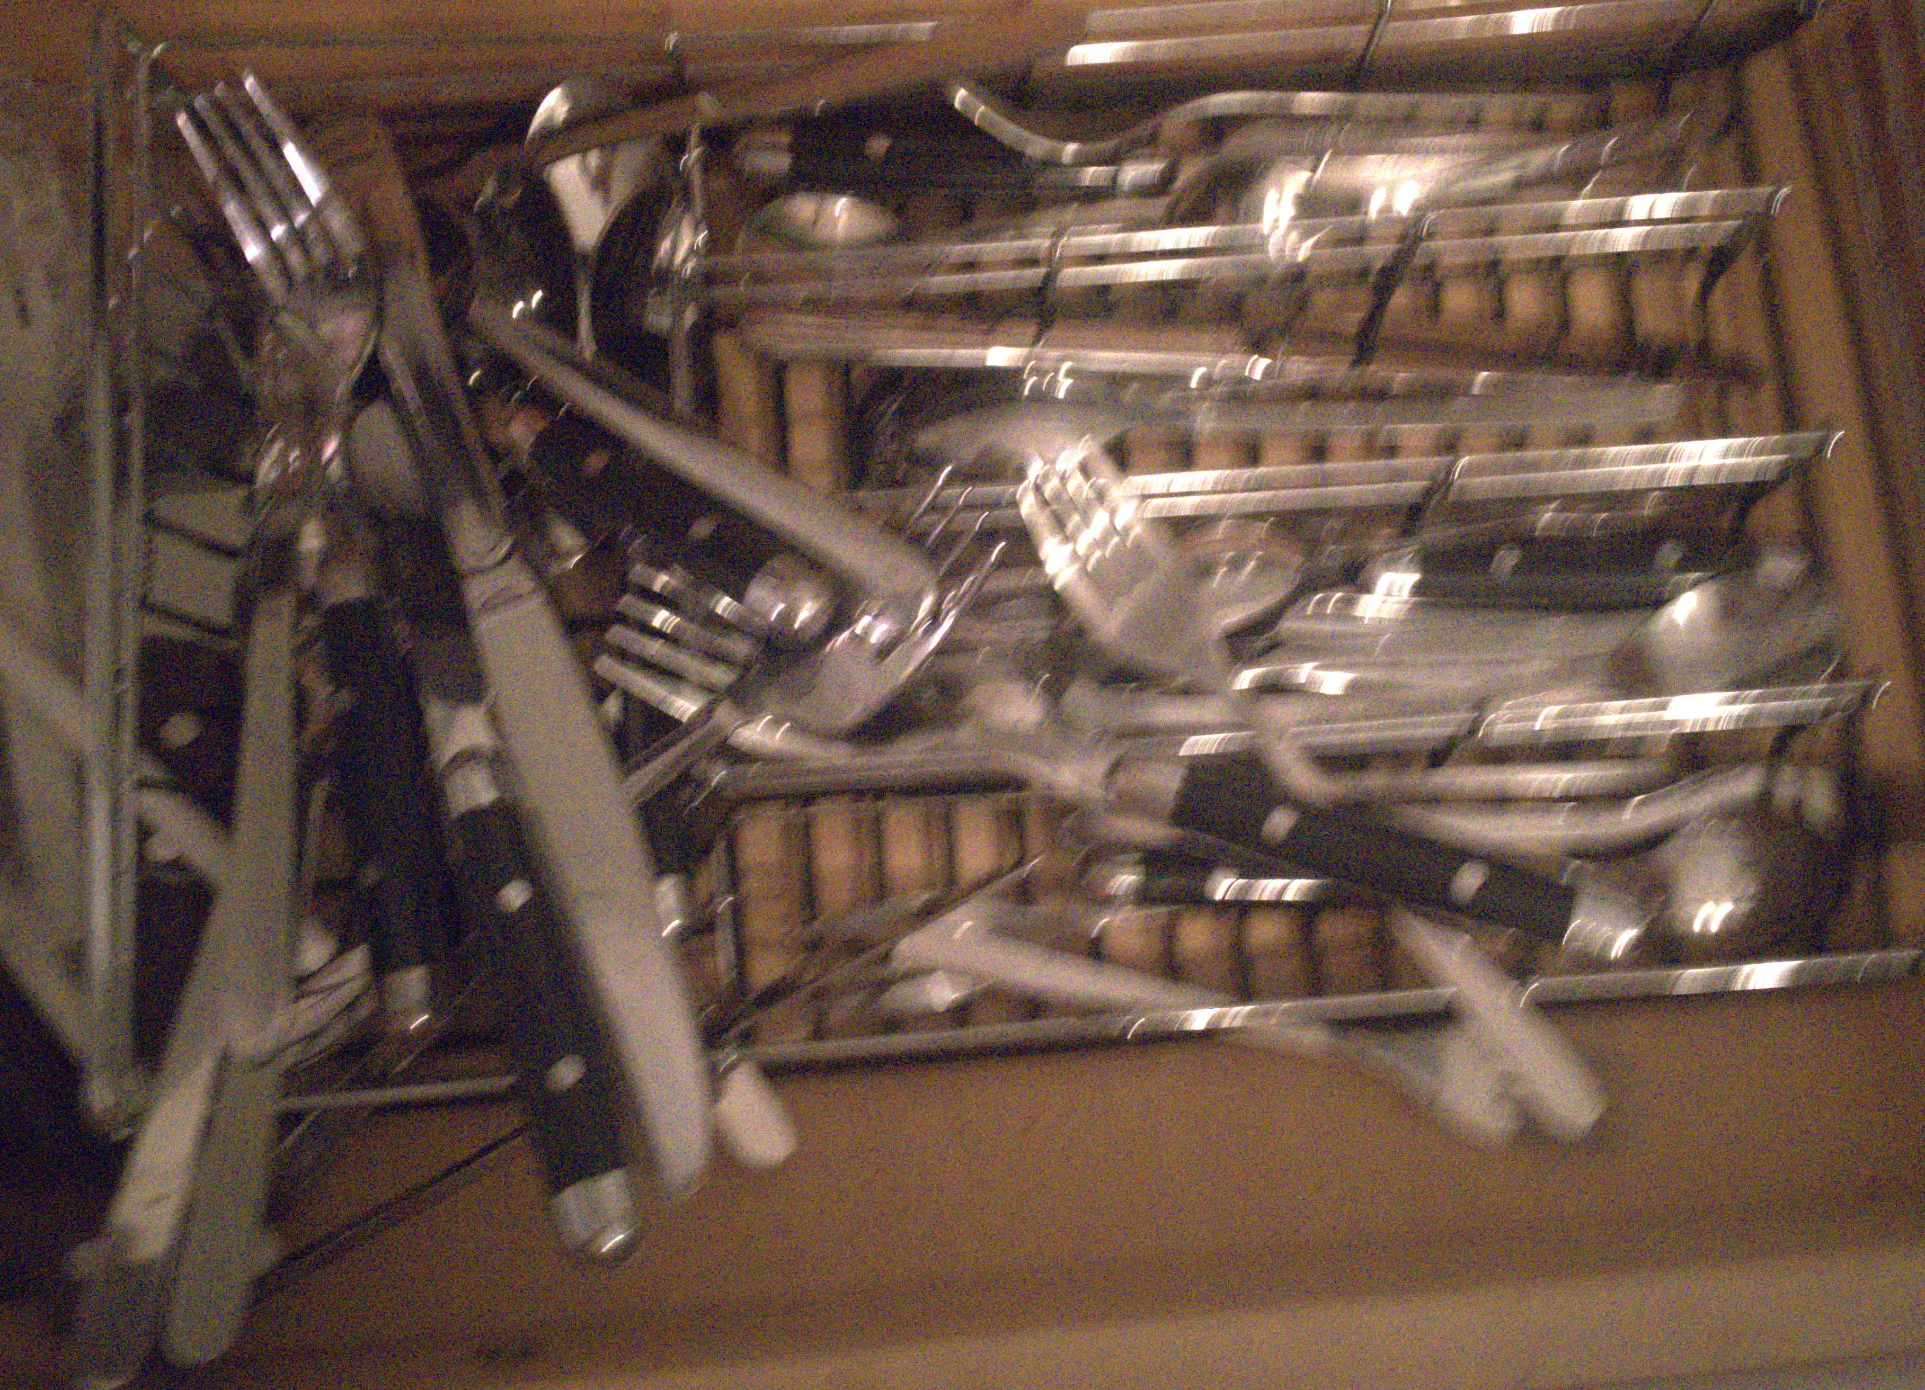
Thank you
code, pretrained model and datasets will be available soon
Poster P-2B-29
← our result
input frames →

Slide 79
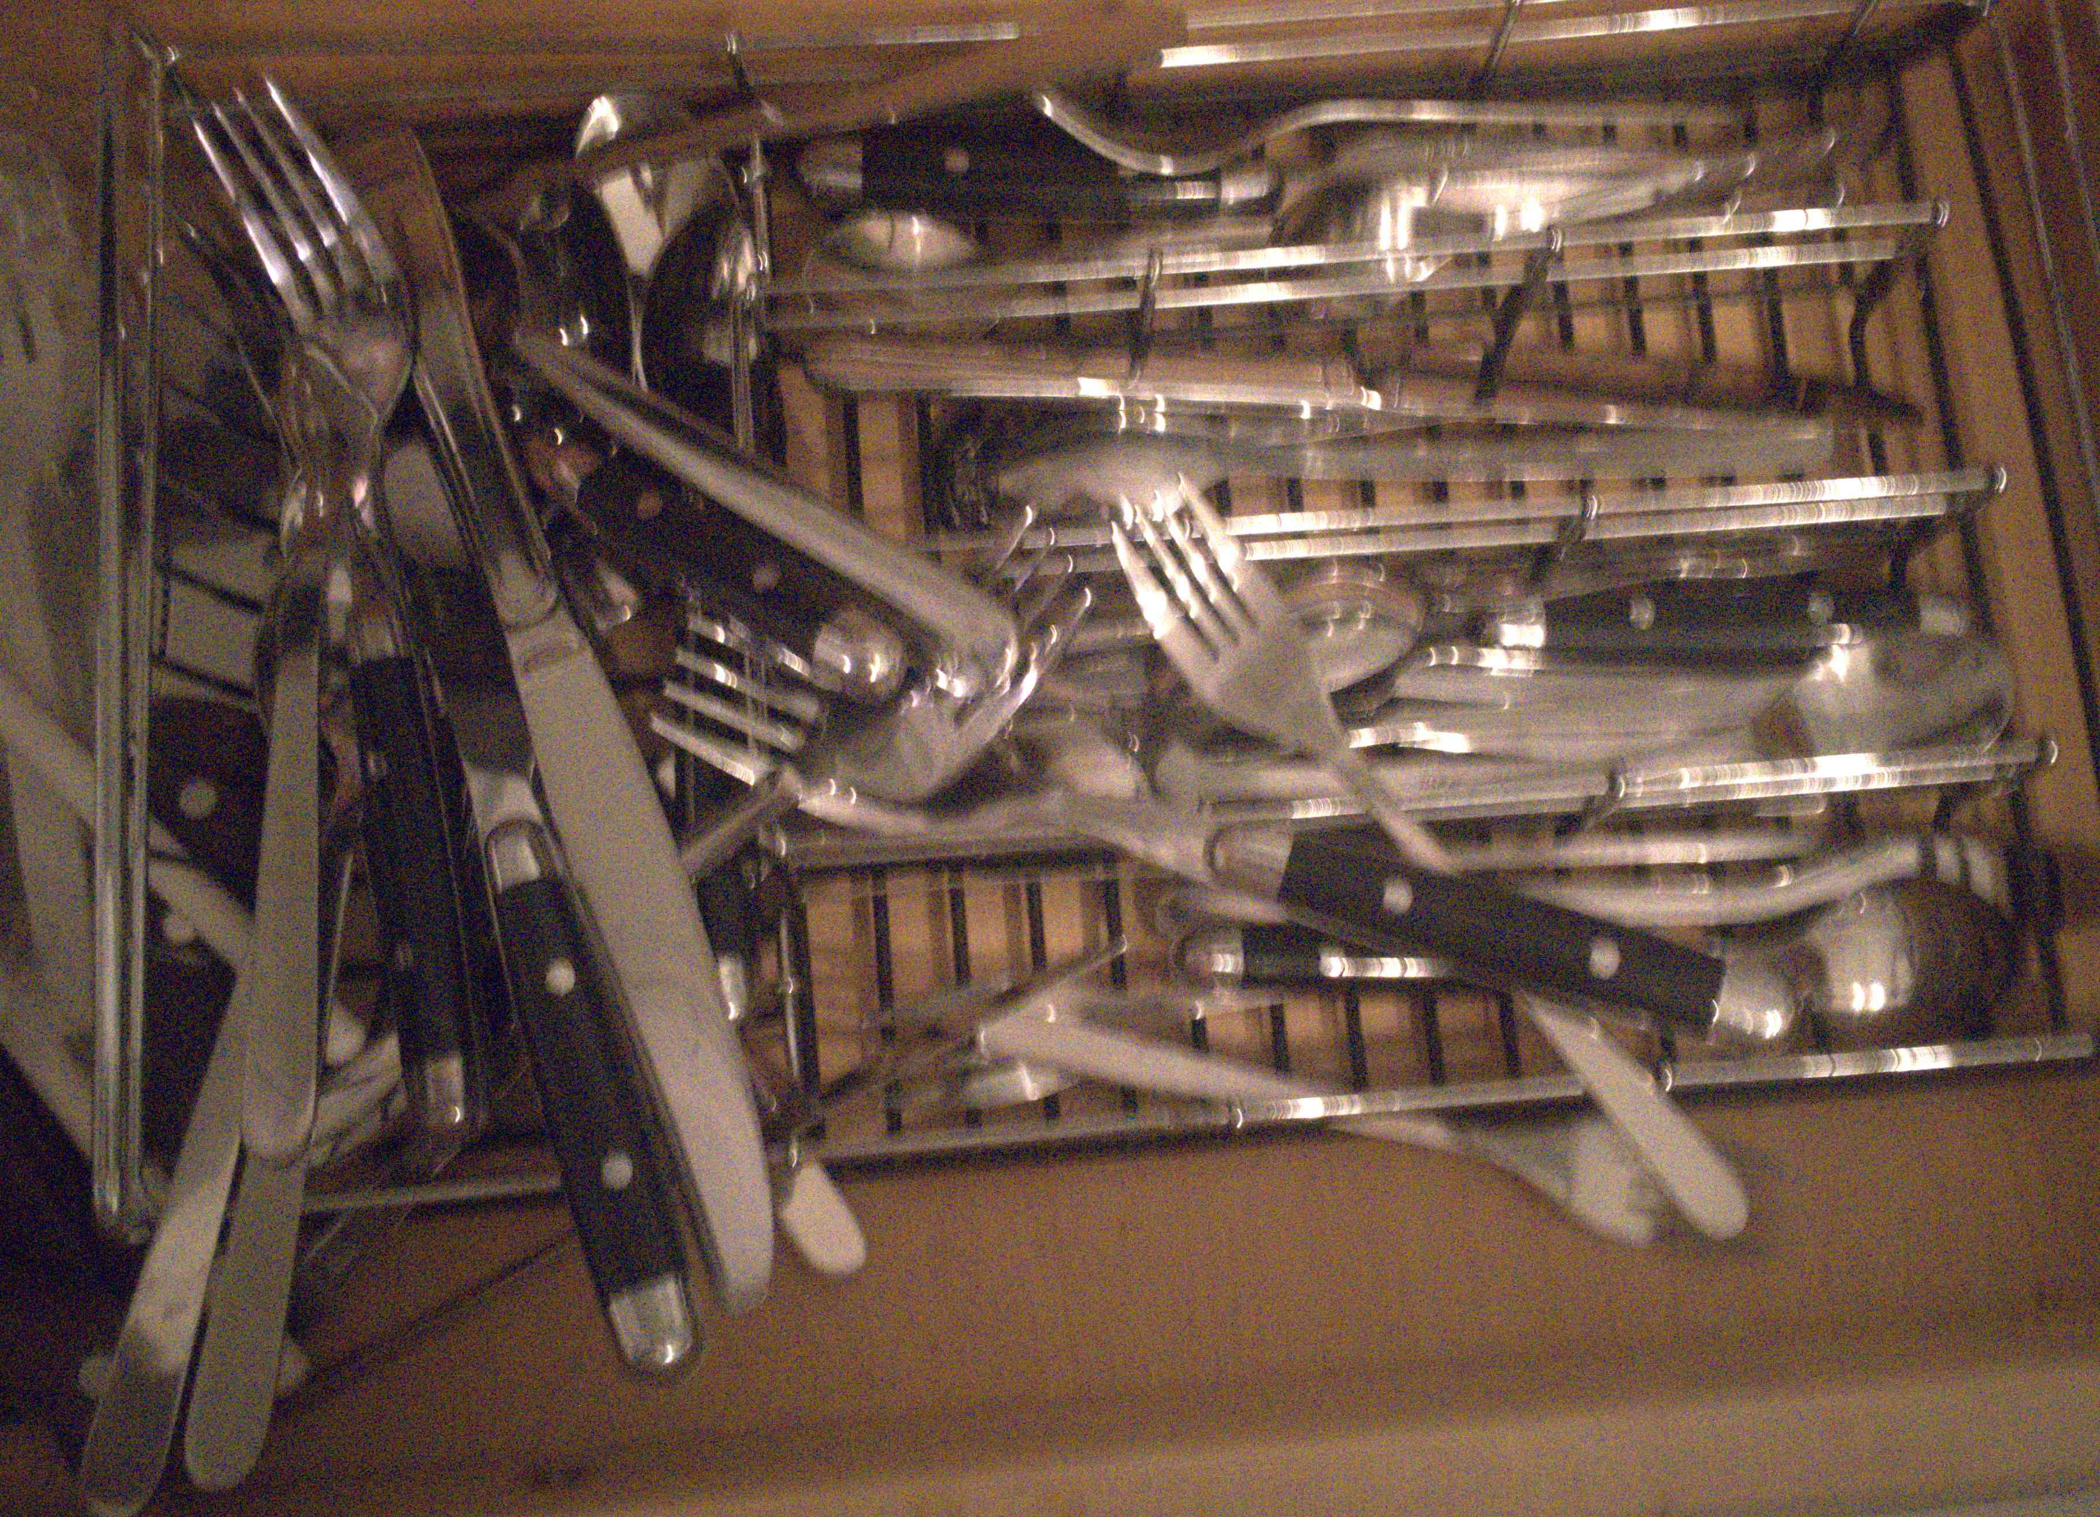
Thank you
code, pretrained model and datasets will be available soon
Poster P-2B-29
← our result
input frames →

Slide 80
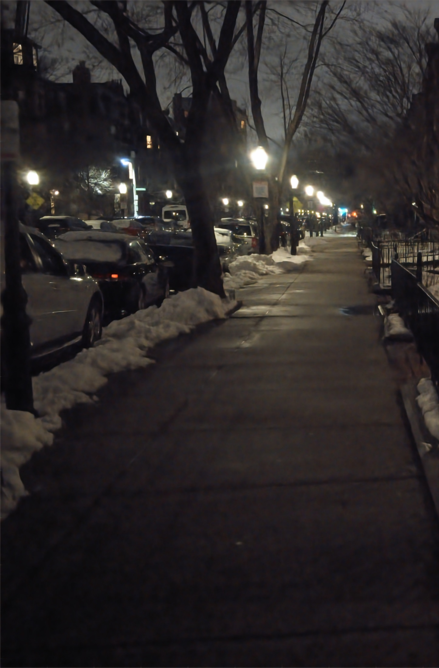
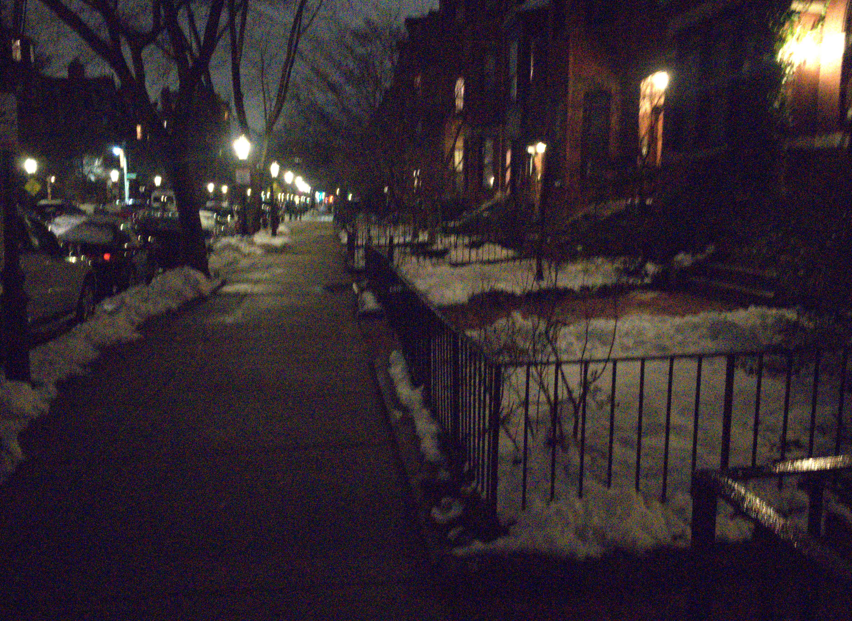
Thank you
code, pretrained model and datasets will be available soon
Poster P-2B-29
← our result
input frames →

Slide 81
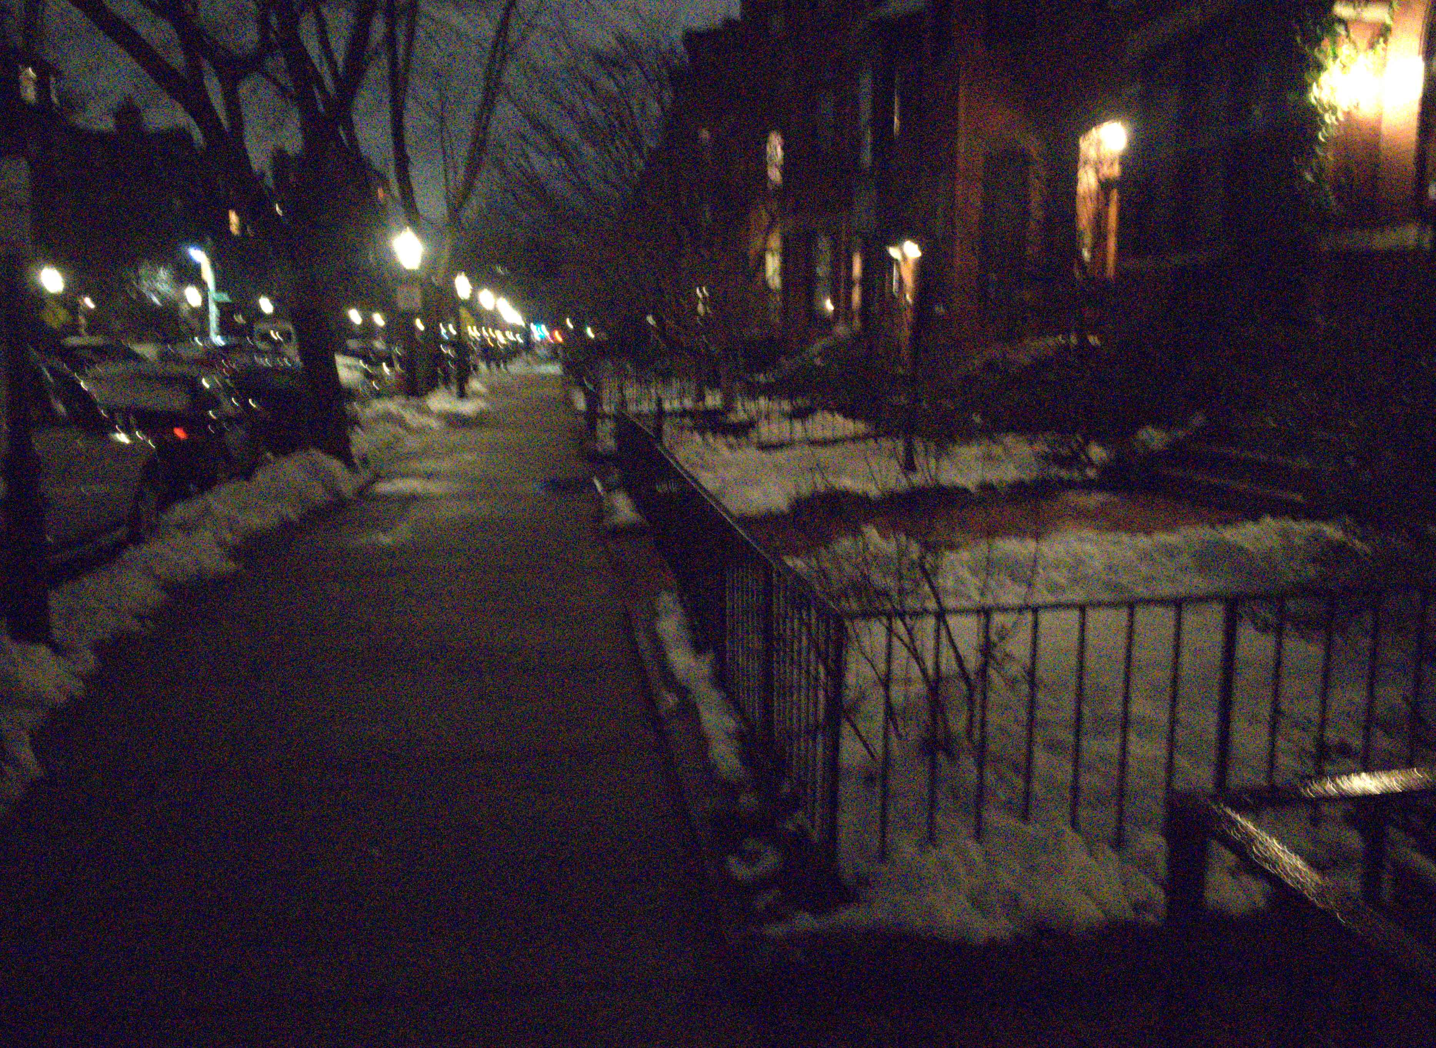
Thank you
code, pretrained model and datasets will be available soon
Poster P-2B-29
← our result
input frames →

Slide 82
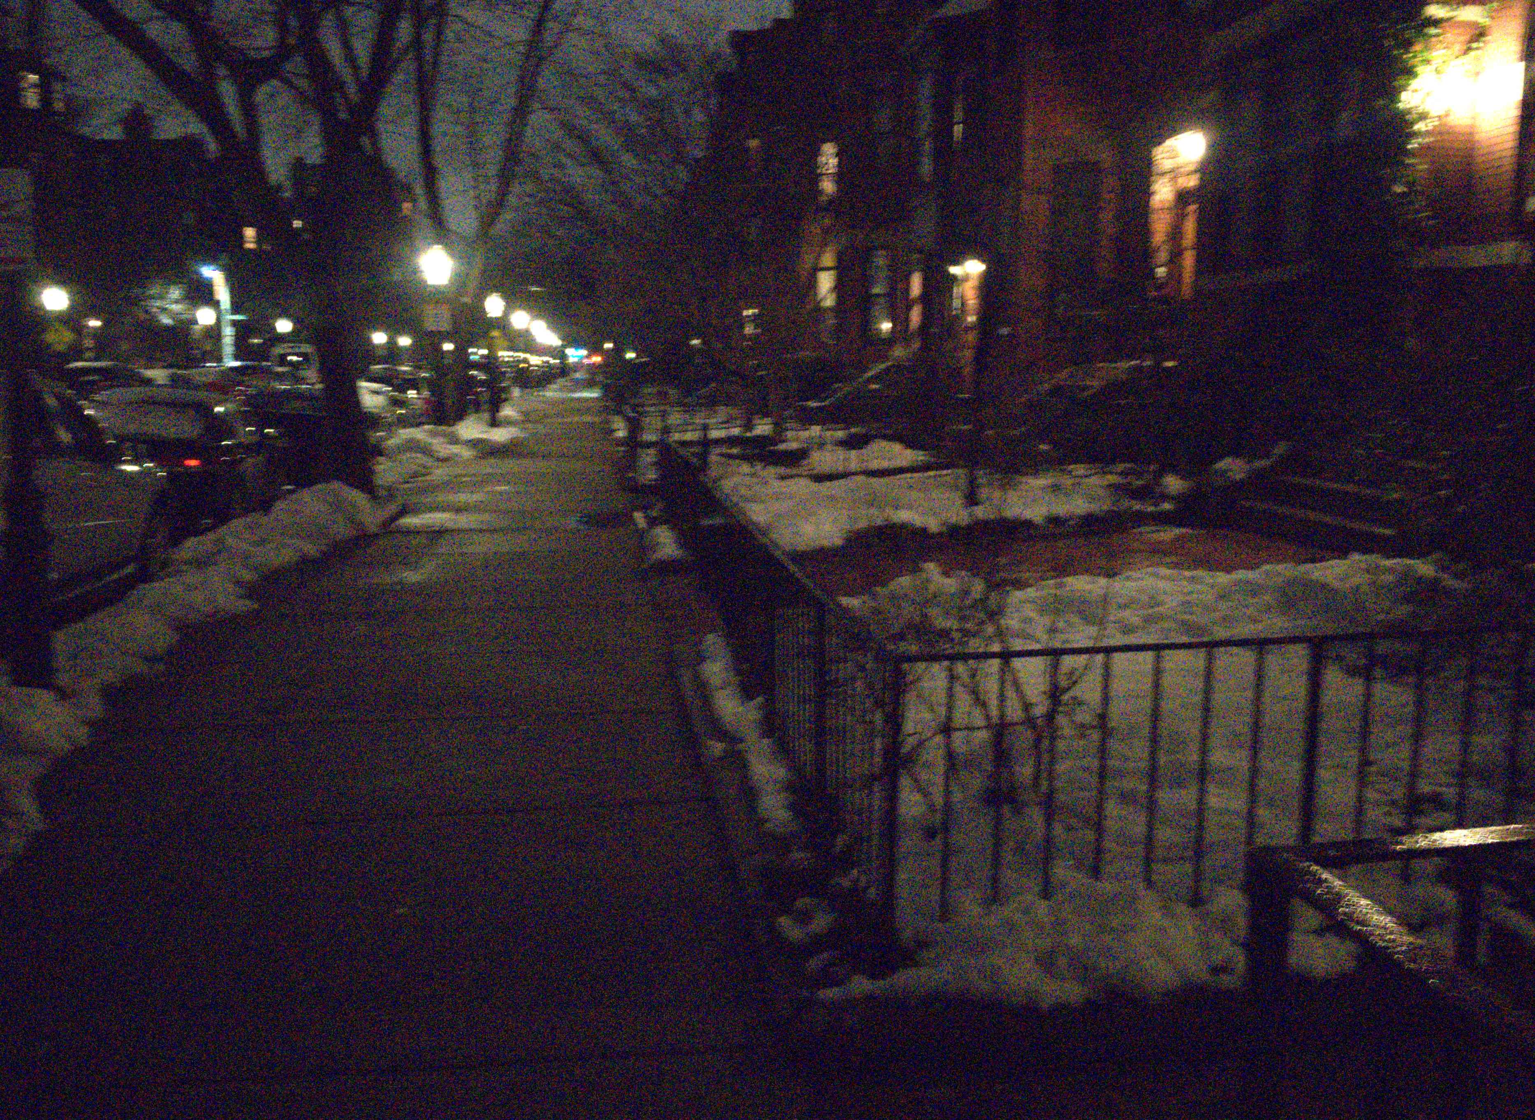
Thank you
code, pretrained model and datasets will be available soon
Poster P-2B-29
← our result
input frames →

Slide 83

Thank you
code, pretrained model and datasets will be available soon
Poster P-2B-29
← our result
input frames →

Slide 84
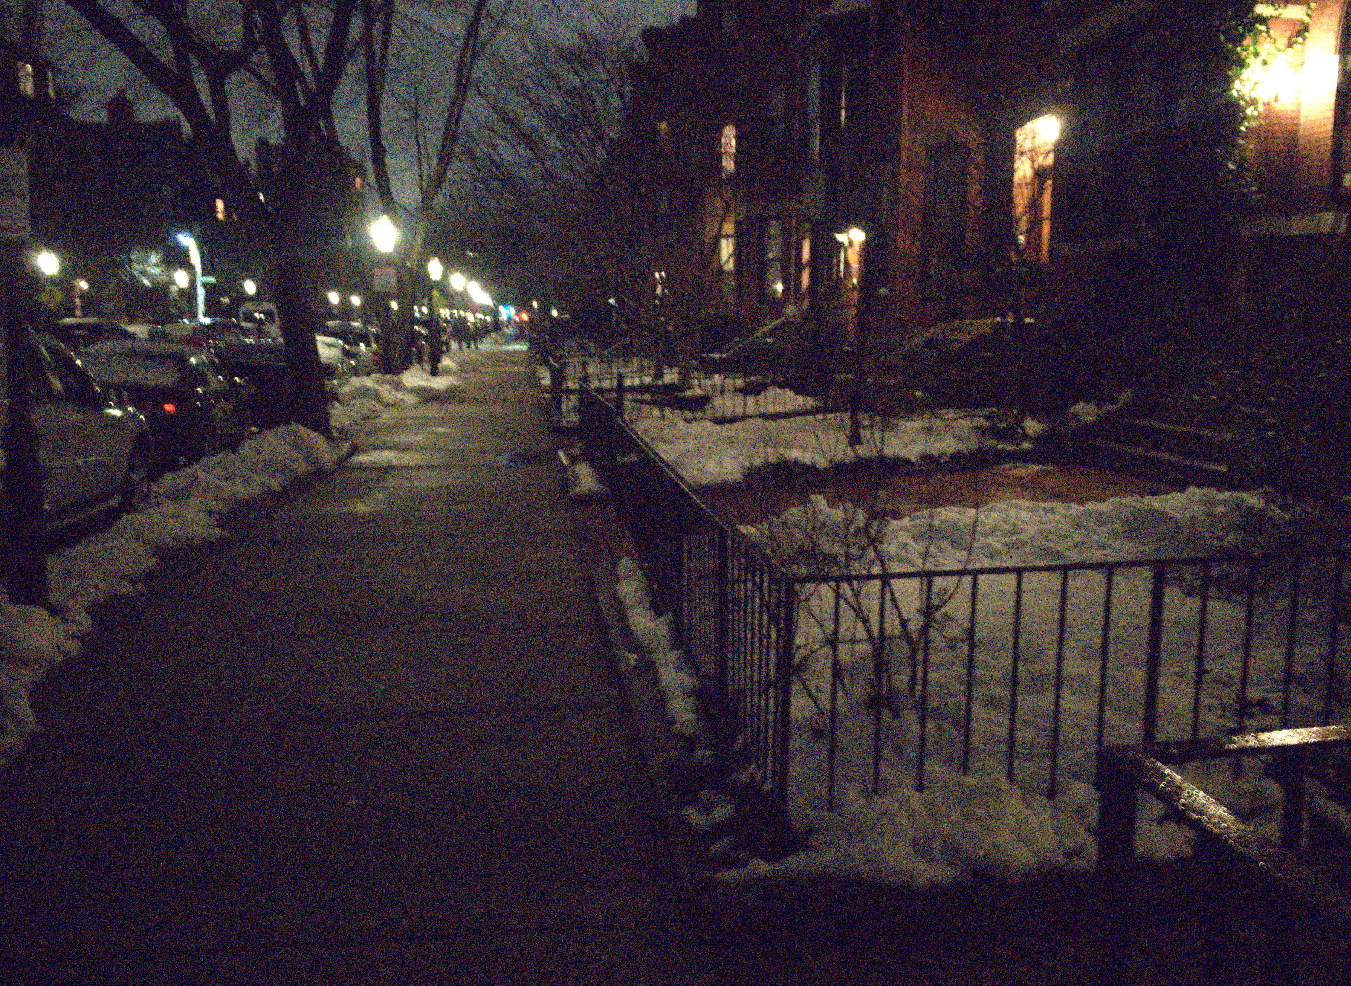
Thank you
code, pretrained model and datasets will be available soon
Poster P-2B-29
← our result
input frames →

Slide 85
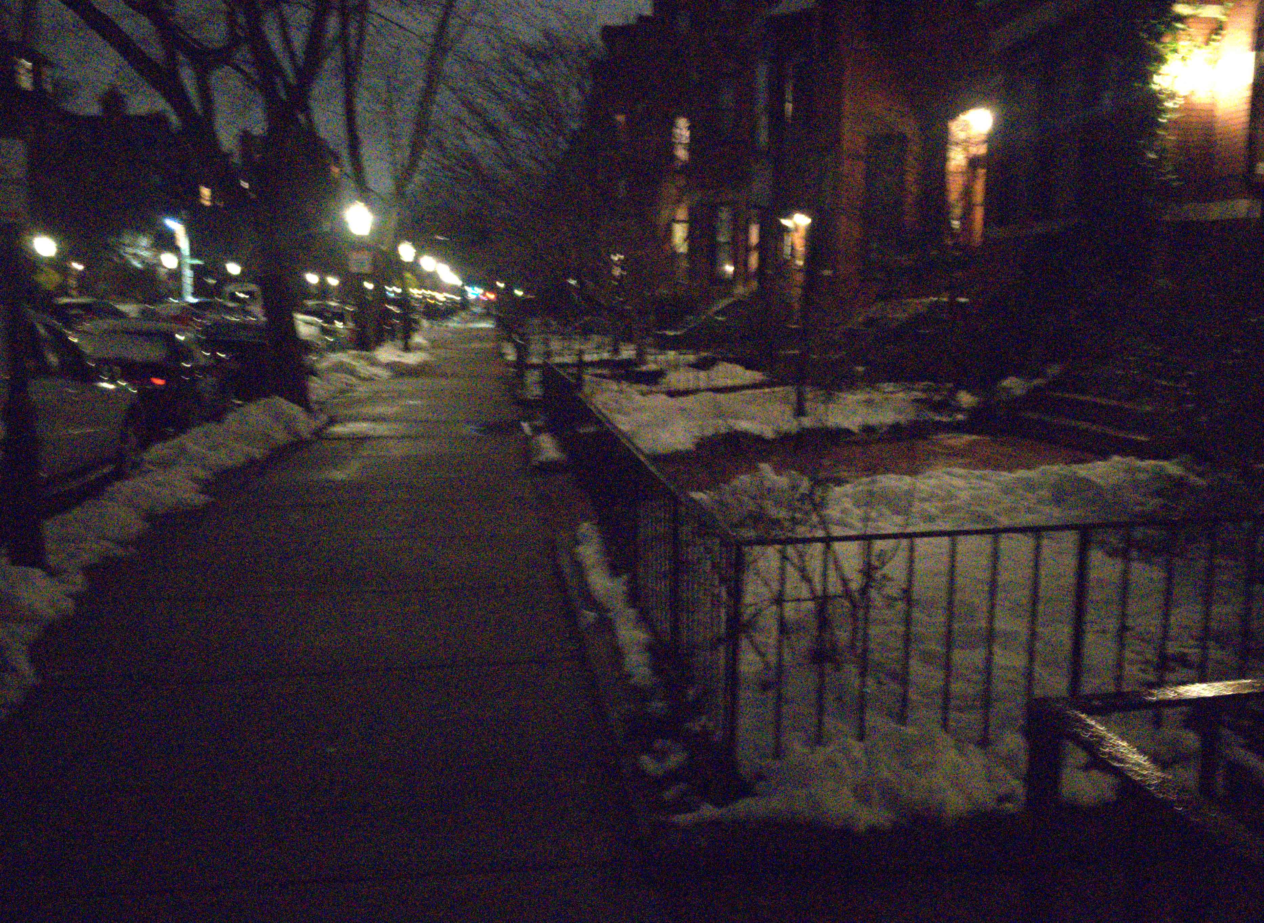
Thank you
code, pretrained model and datasets will be available soon
Poster P-2B-29
← our result
input frames →

Slide 86
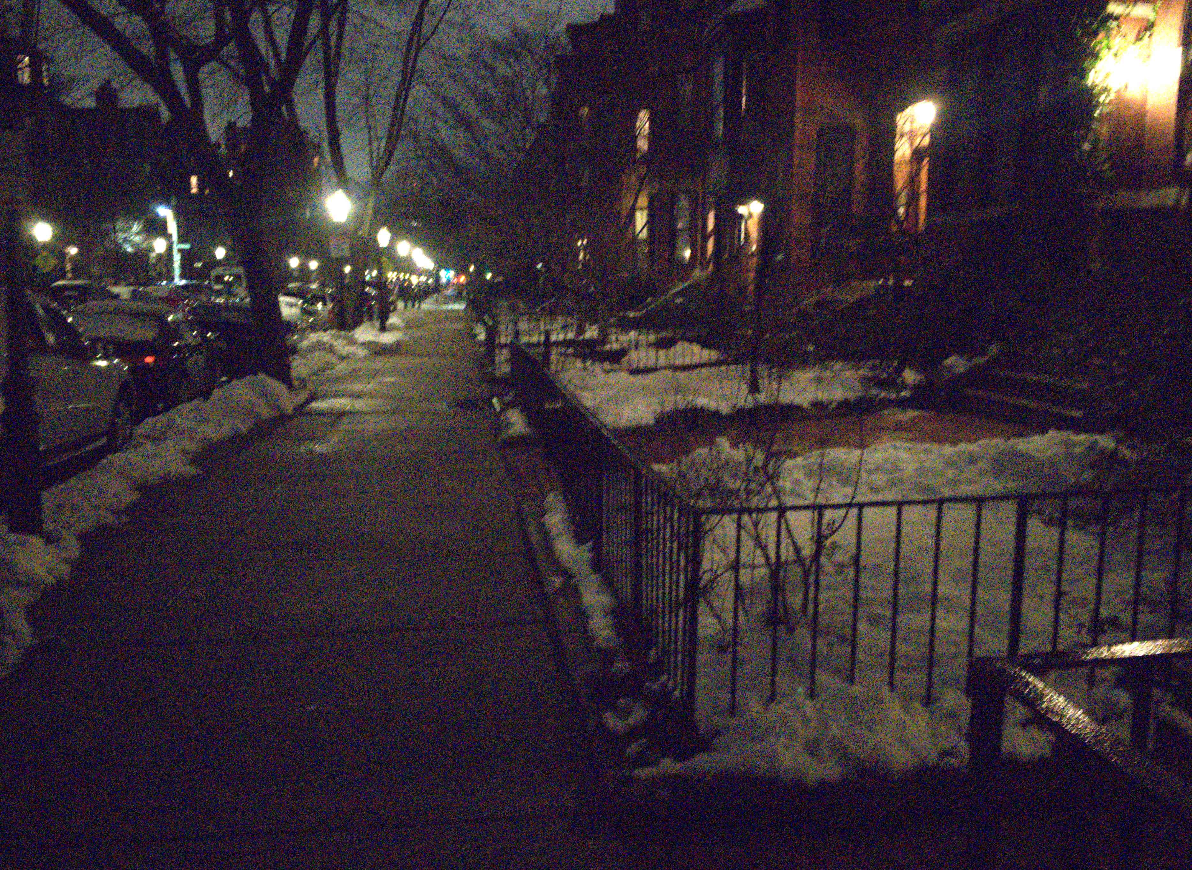
Thank you
code, pretrained model and datasets will be available soon
Poster P-2B-29
← our result
input frames →

Slide 87

Thank you
code, pretrained model and datasets will be available soon
Poster P-2B-29
← our result
input frames →

Slide 88
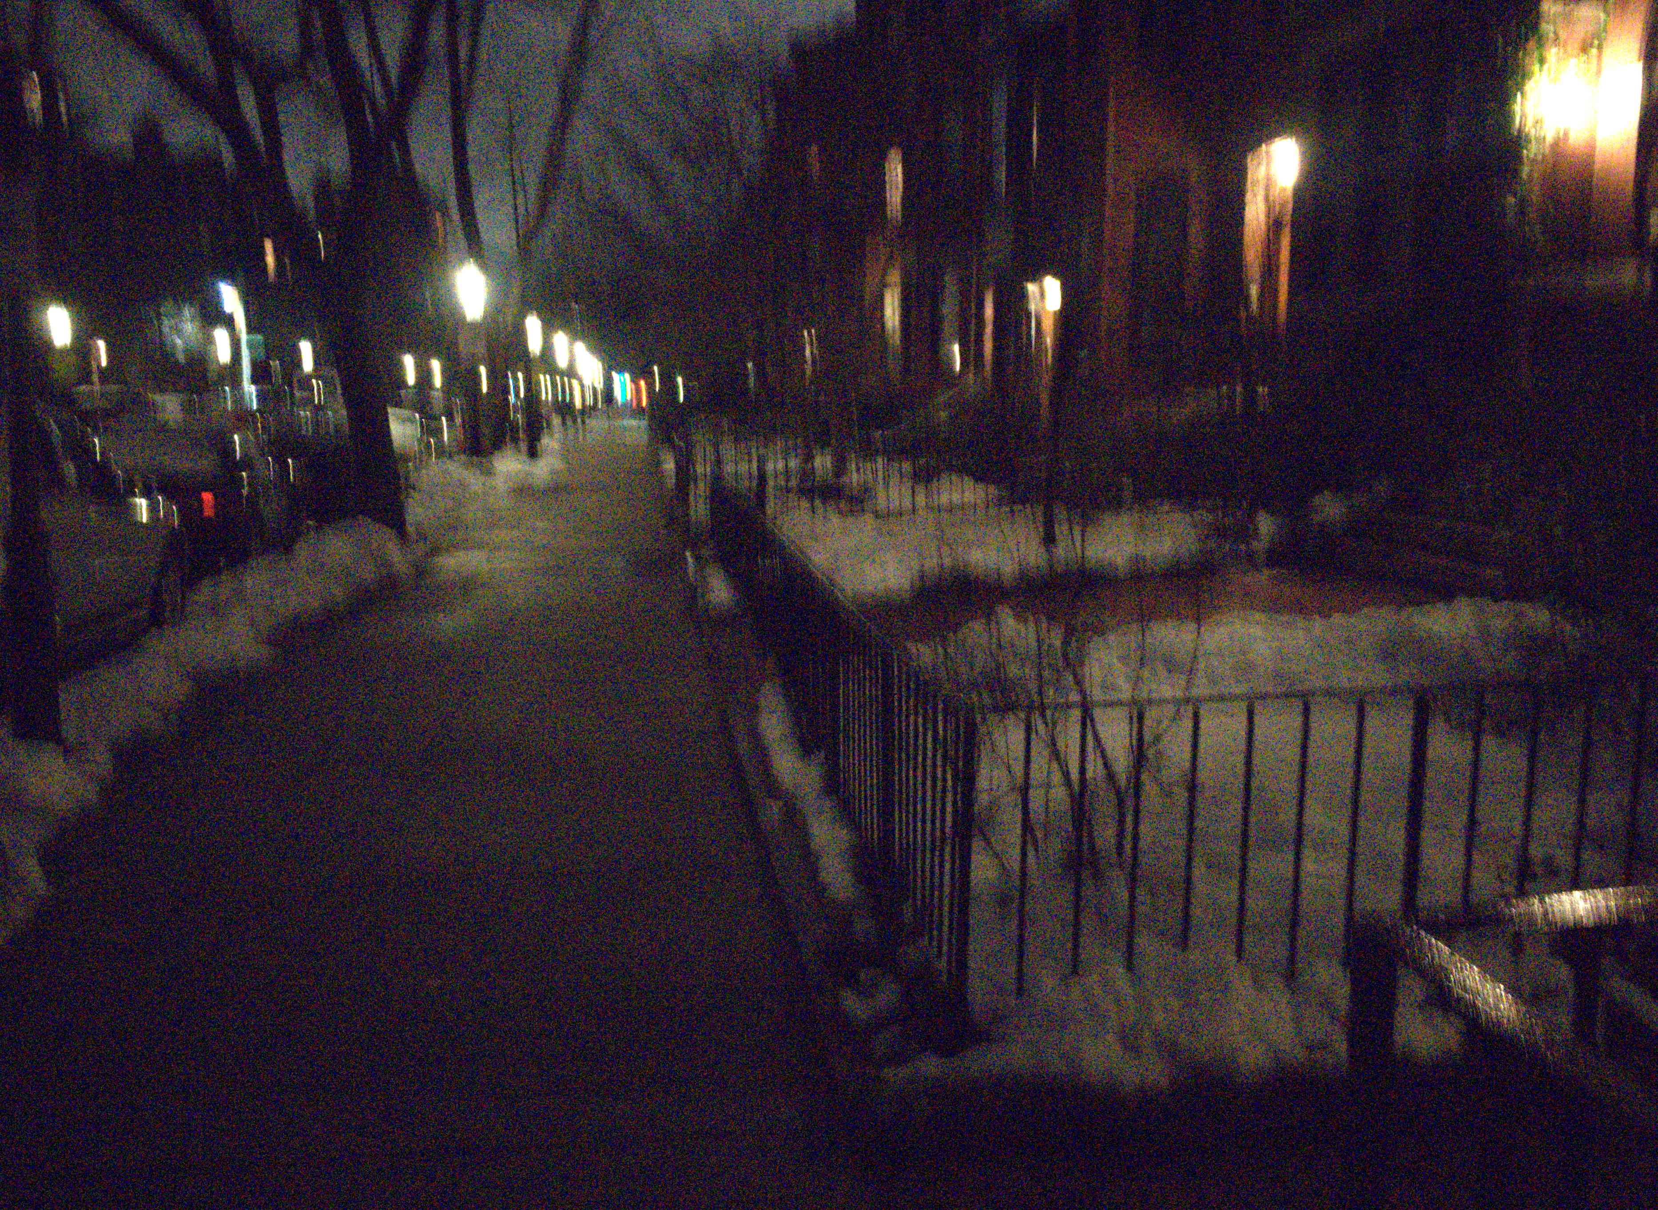
Thank you
code, pretrained model and datasets will be available soon
Poster P-2B-29
← our result
input frames →

Slide 89
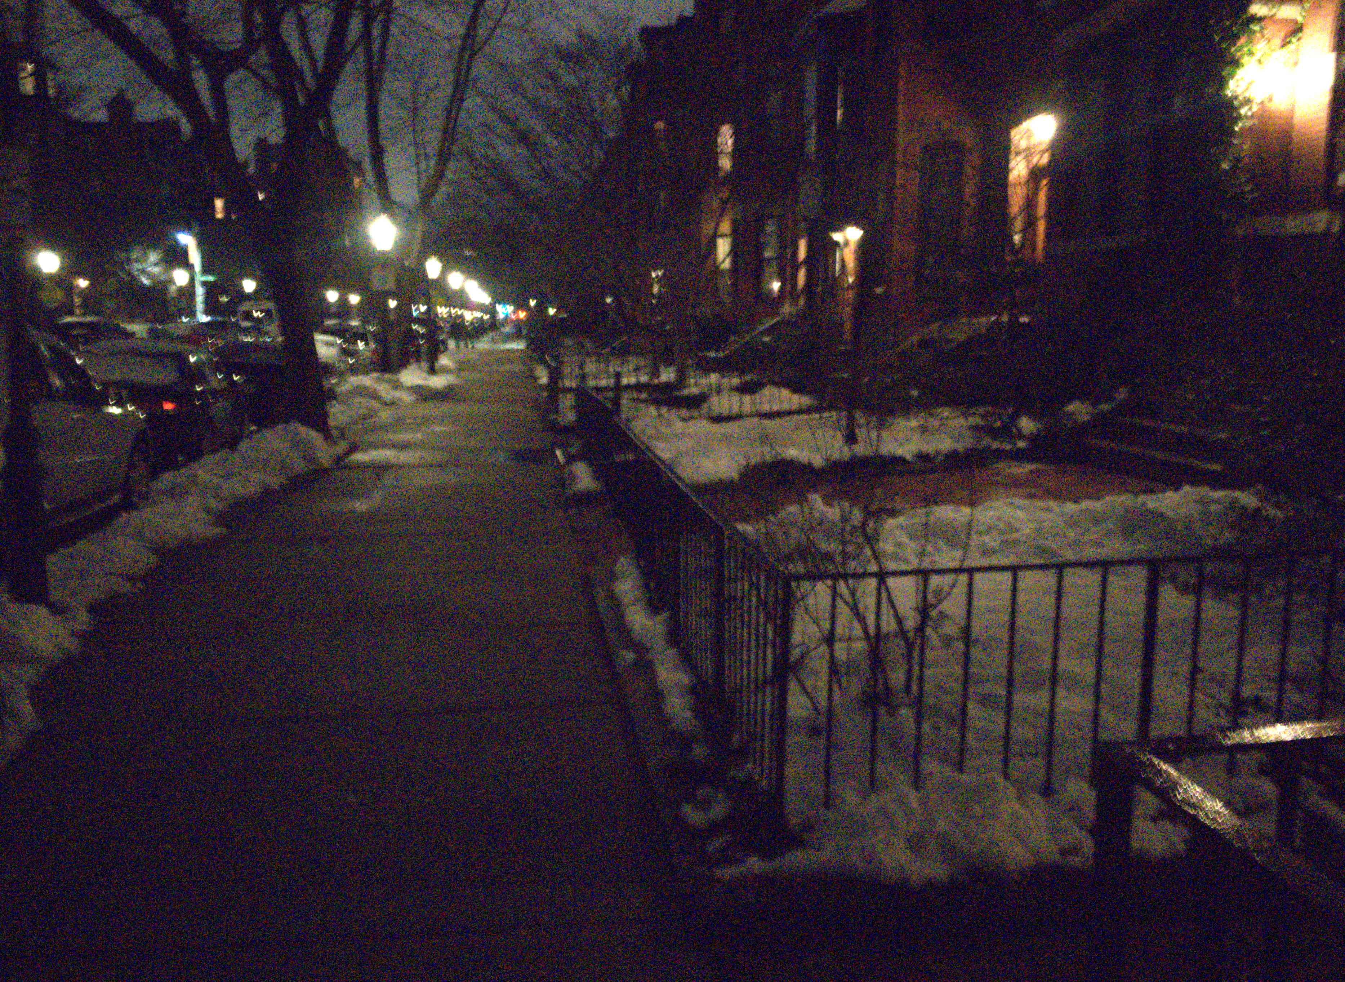
Thank you
code, pretrained model and datasets will be available soon
Poster P-2B-29
← our result
input frames →

Slide 90
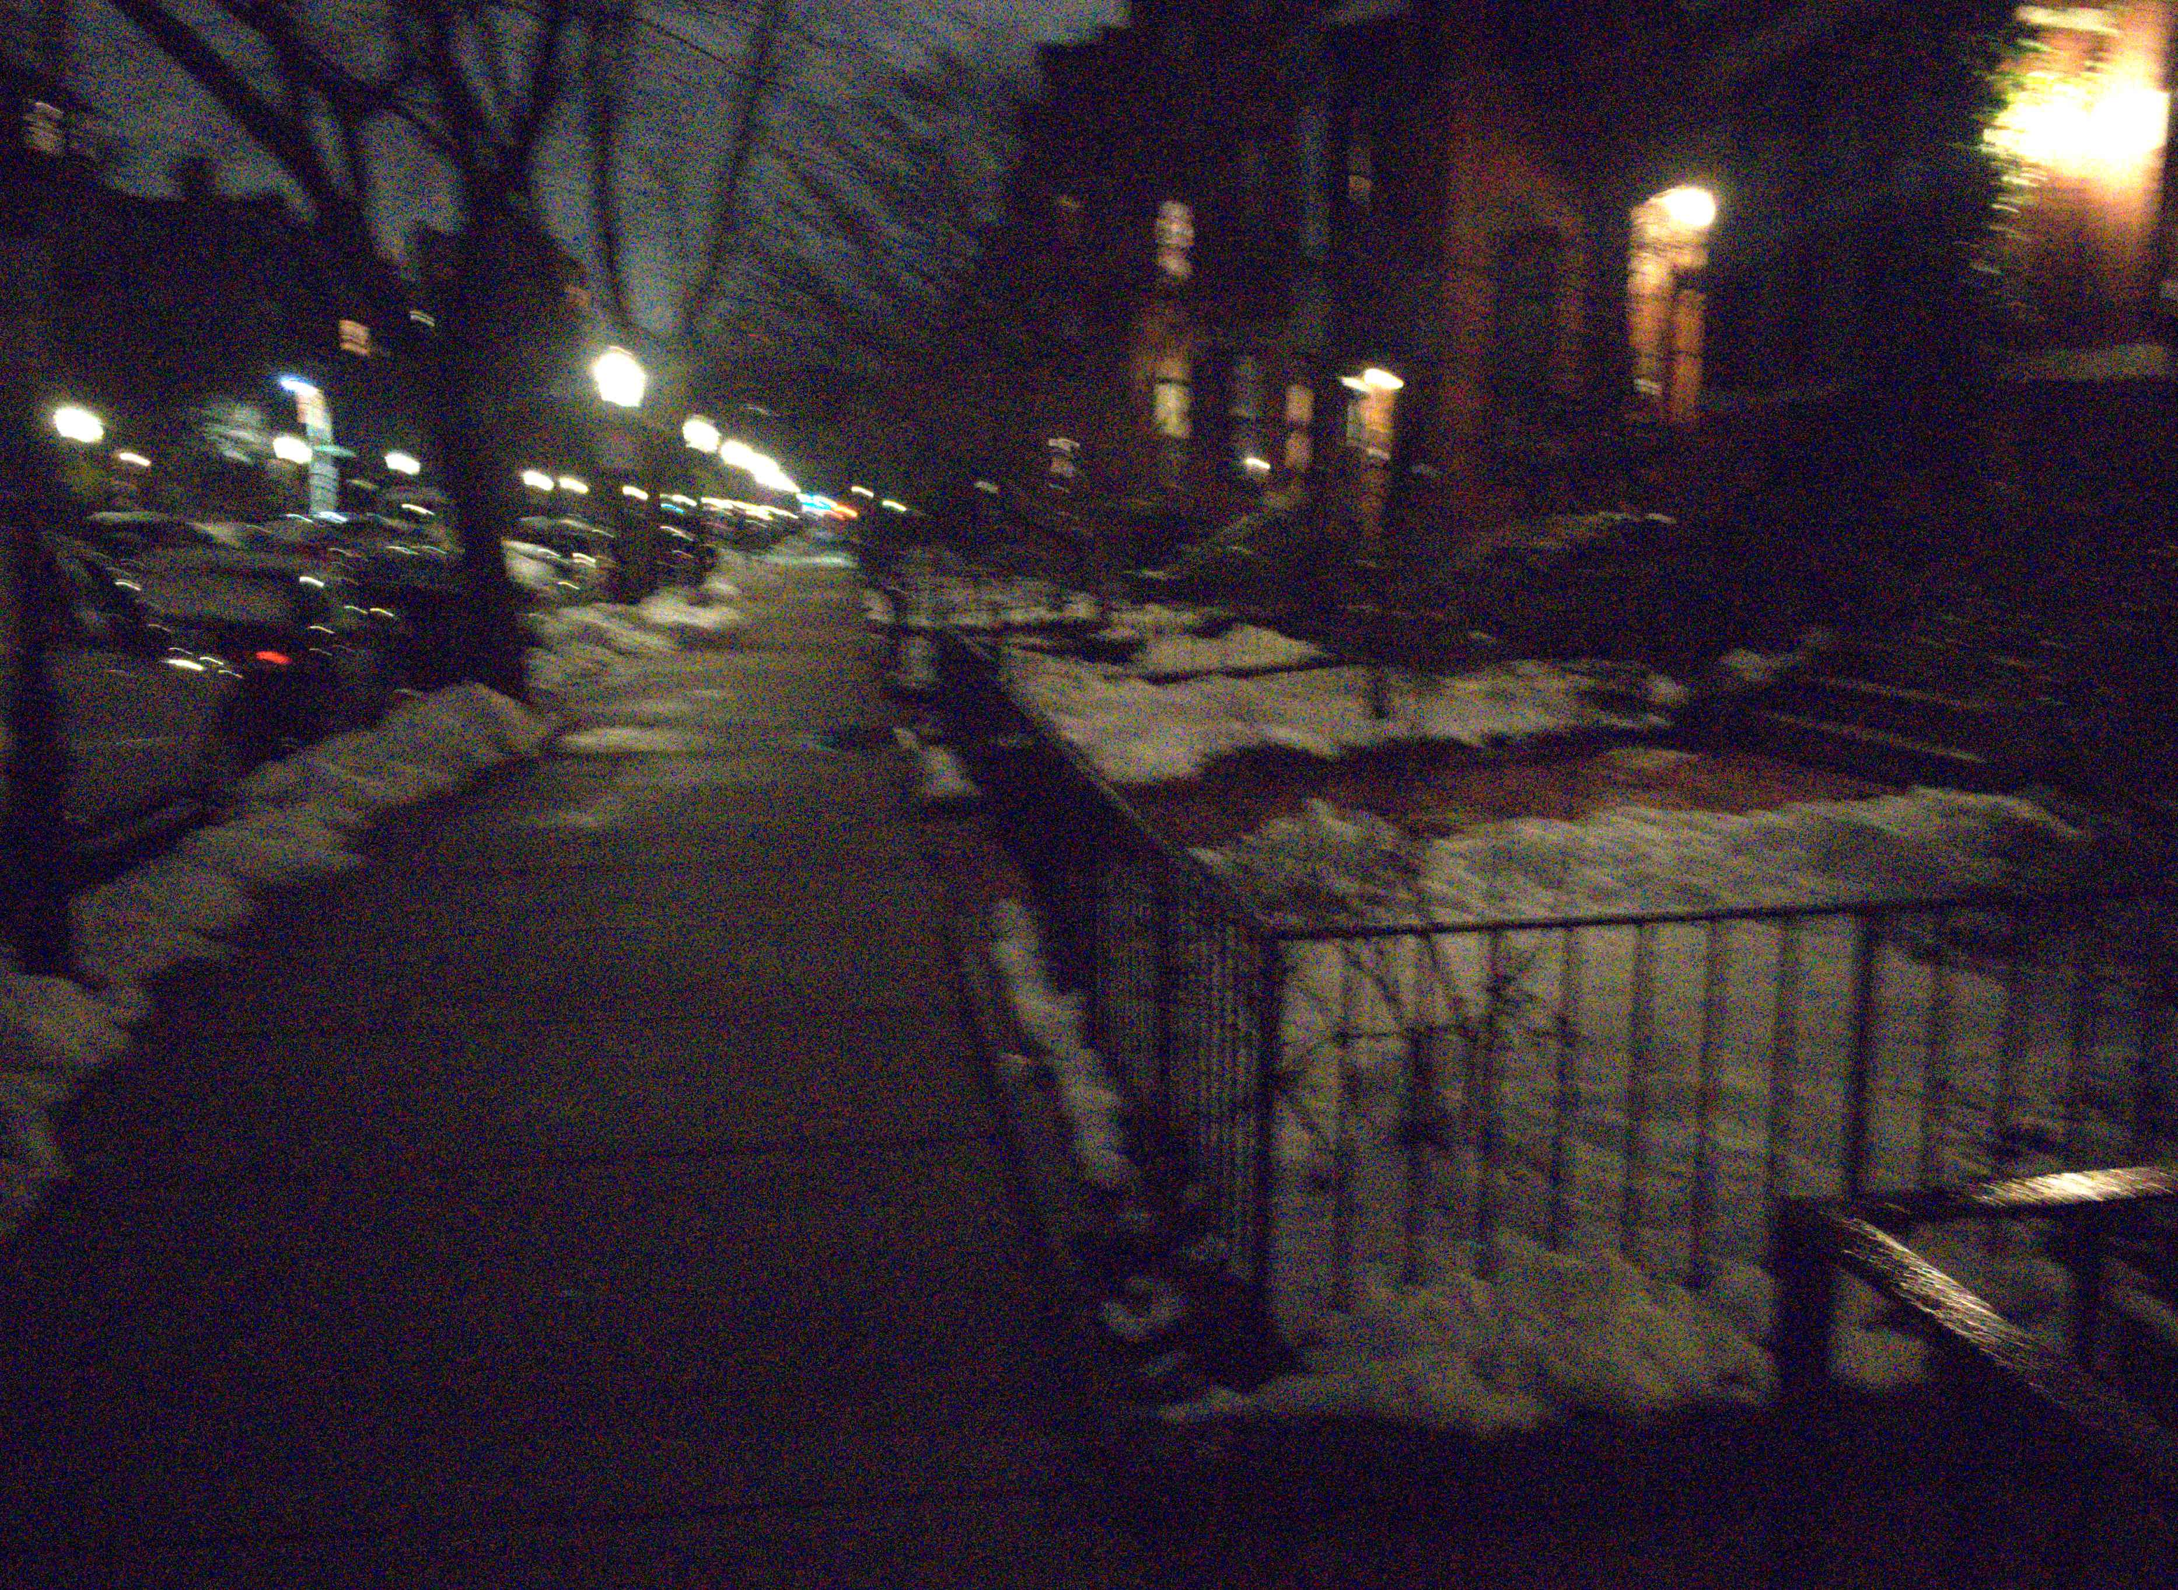
Thank you
code, pretrained model and datasets will be available soon
Poster P-2B-29
← our result
input frames →

Slide 91
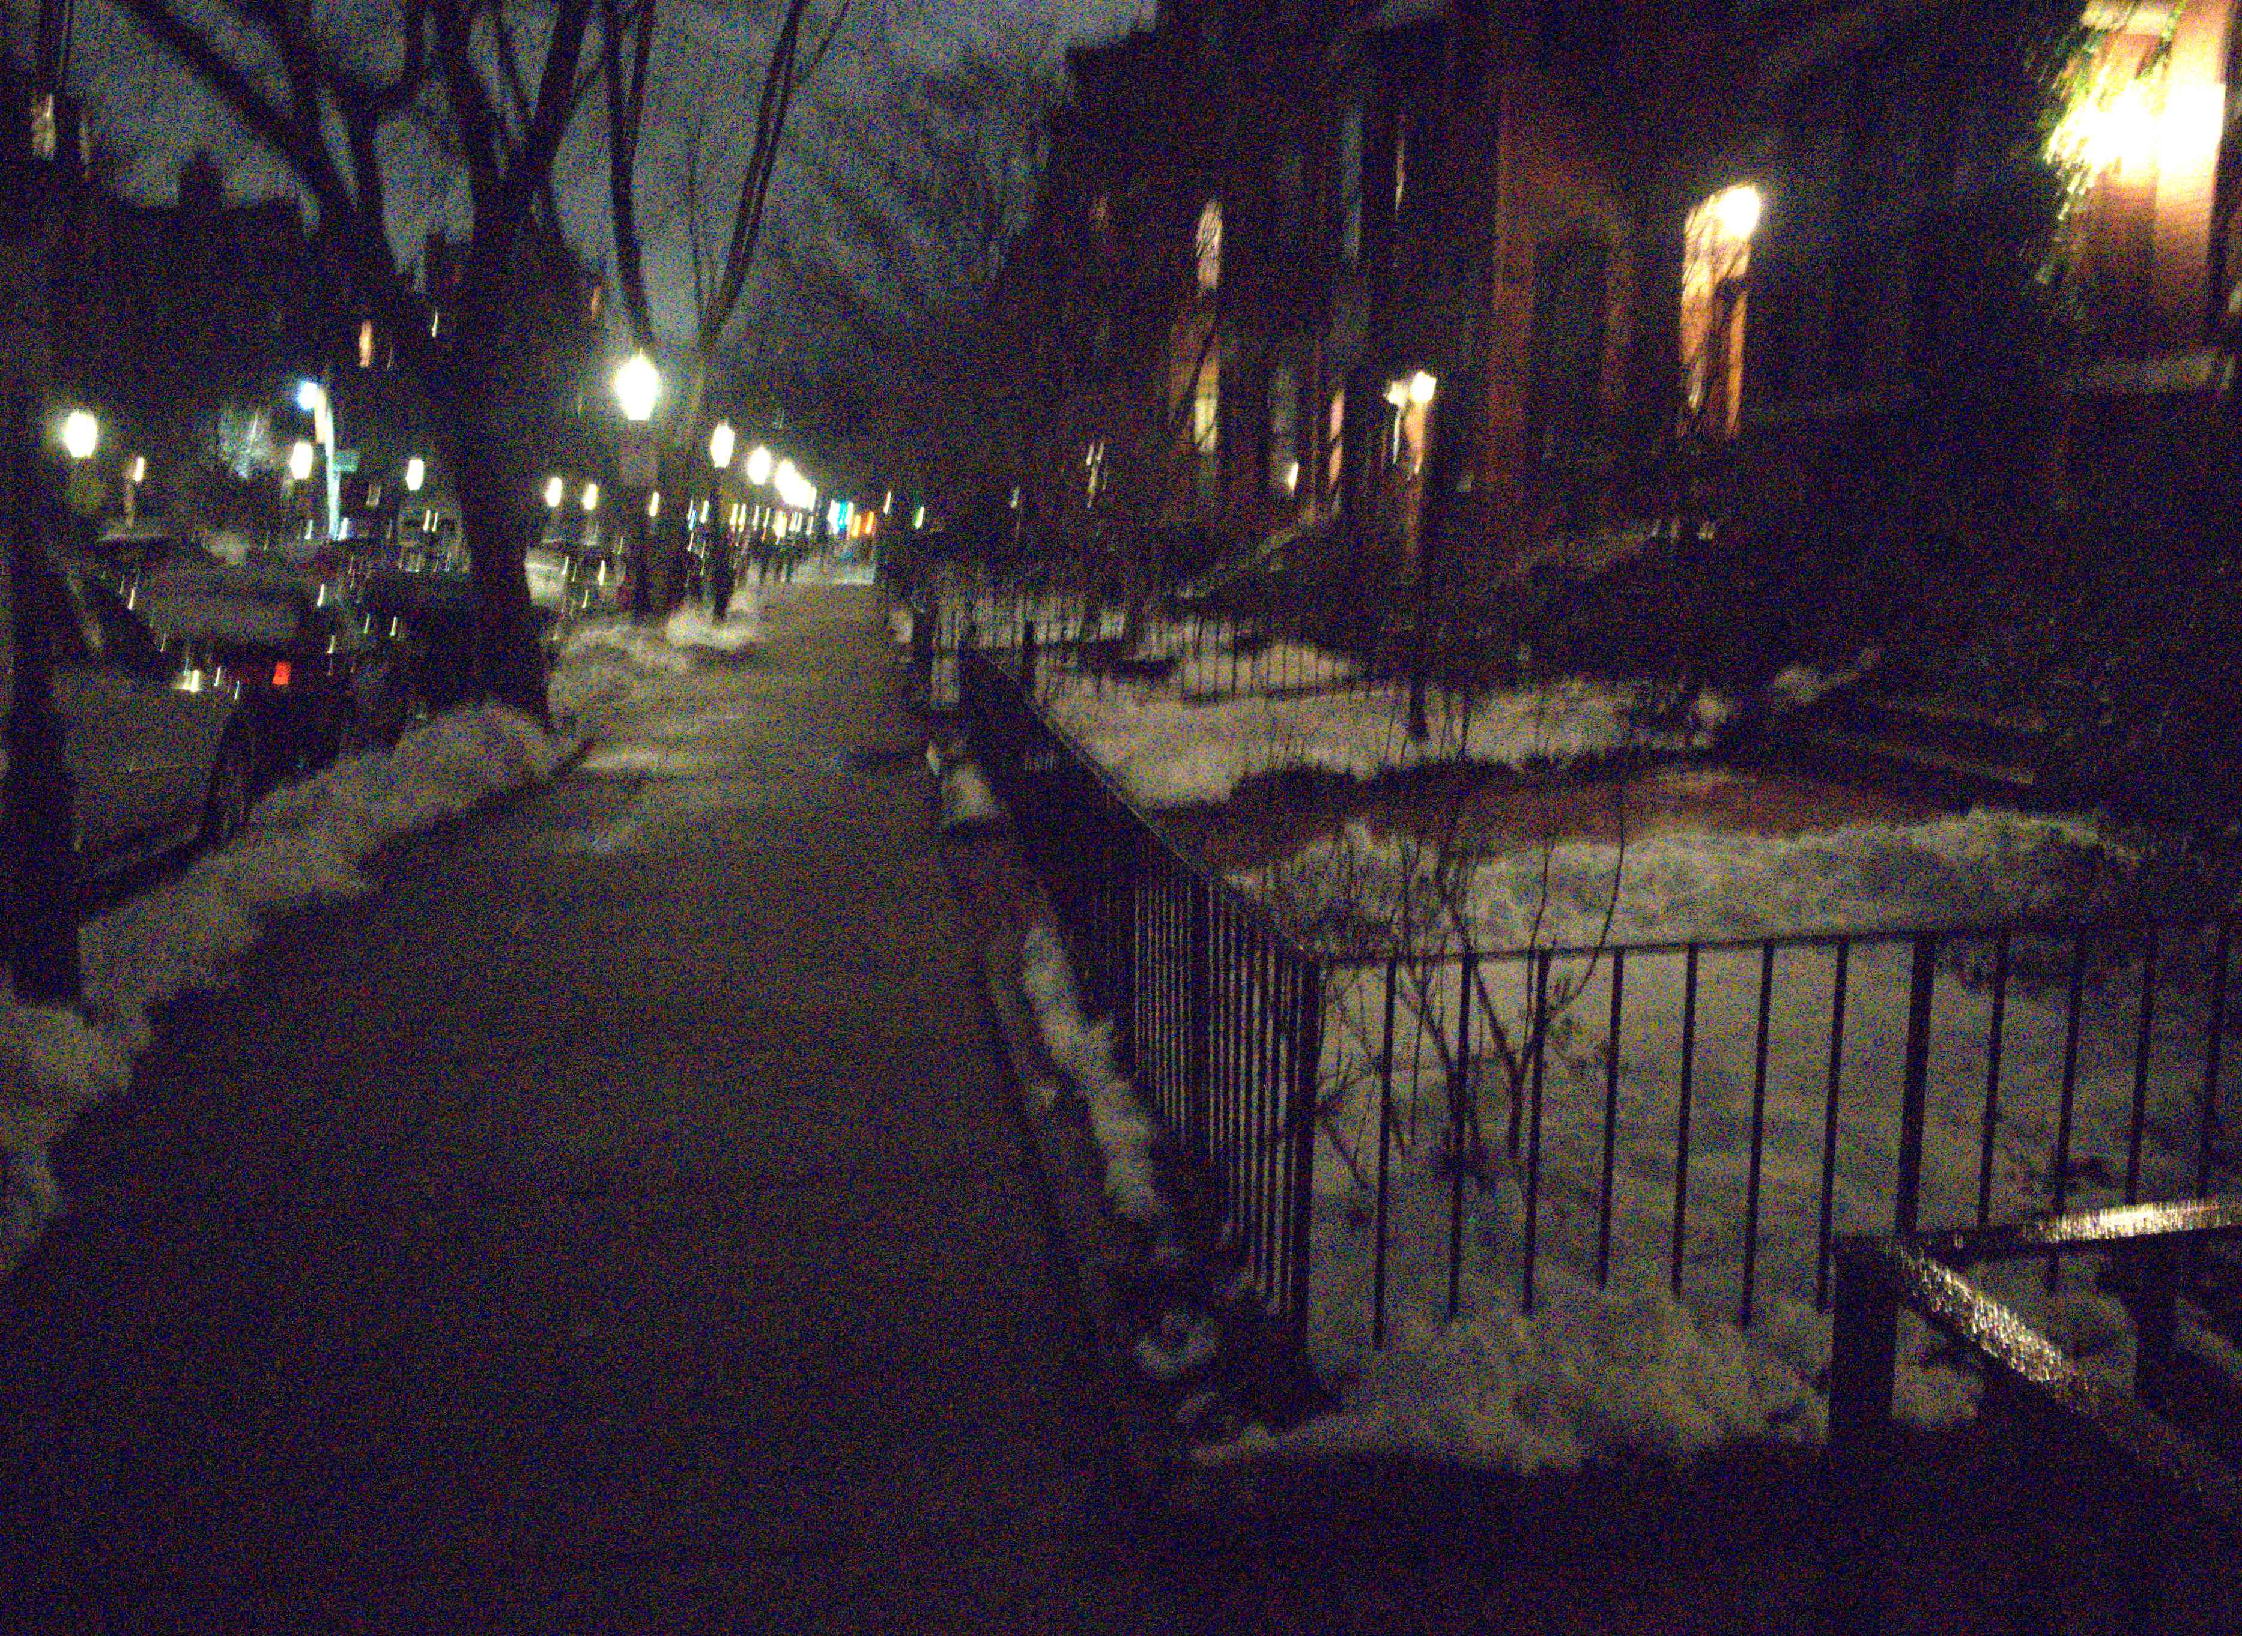
Thank you
code, pretrained model and datasets will be available soon
Poster P-2B-29
← our result
input frames →

Slide 92
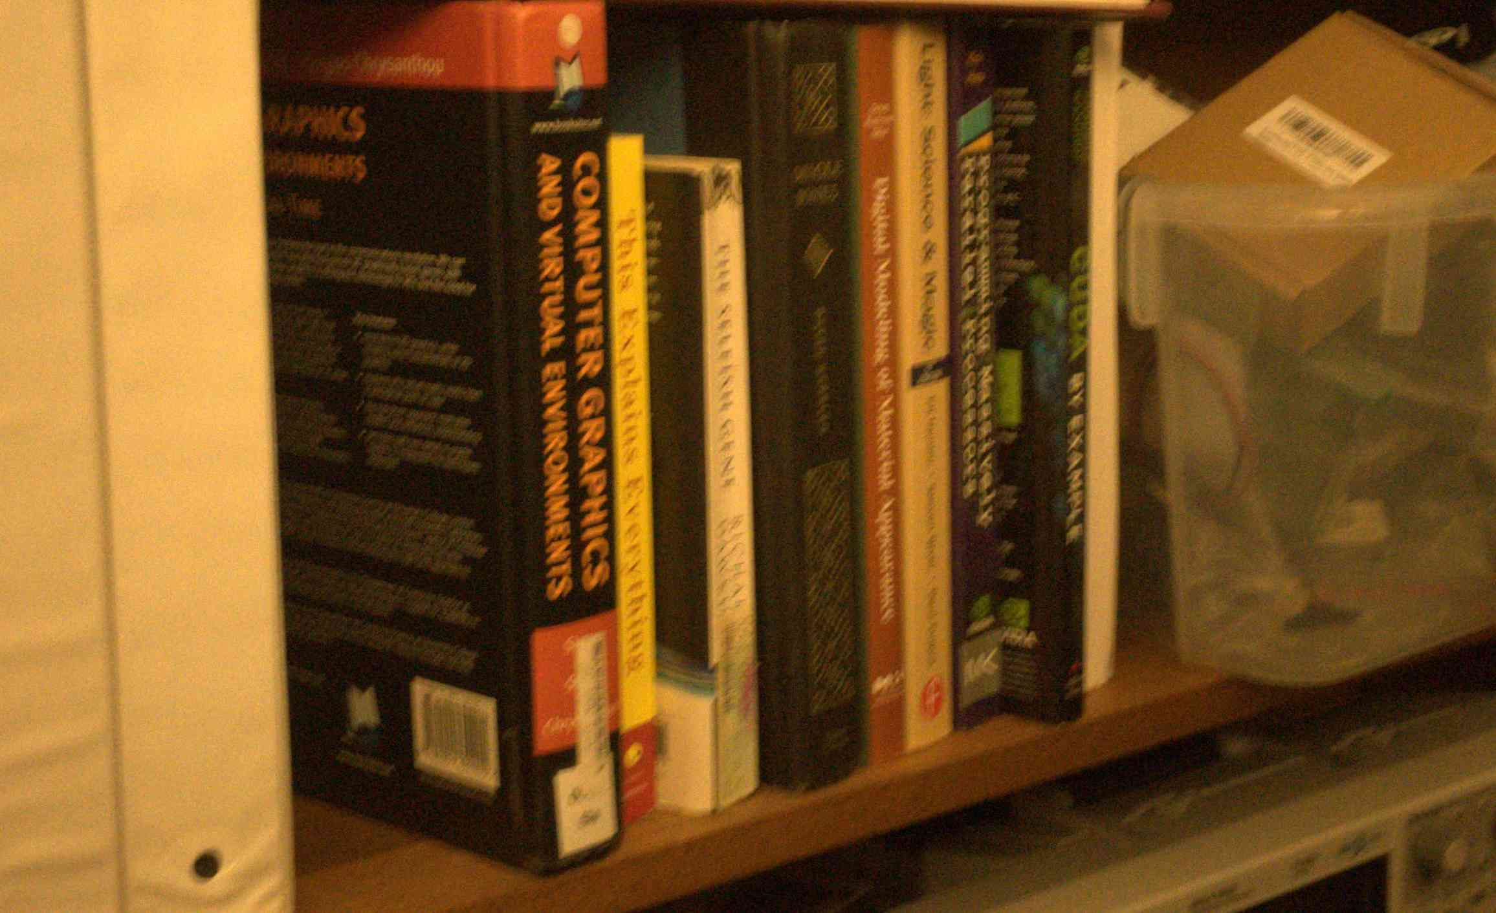
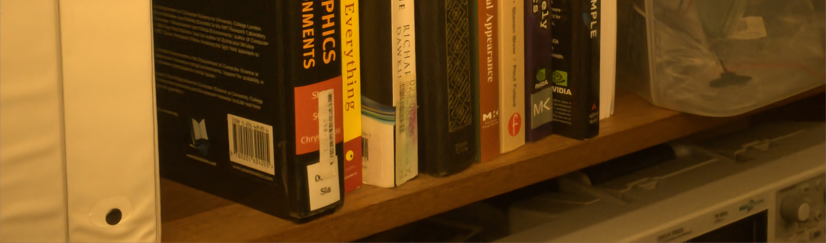
Thank you
code, pretrained model and datasets will be available soon
Poster P-2B-29

Slide 93
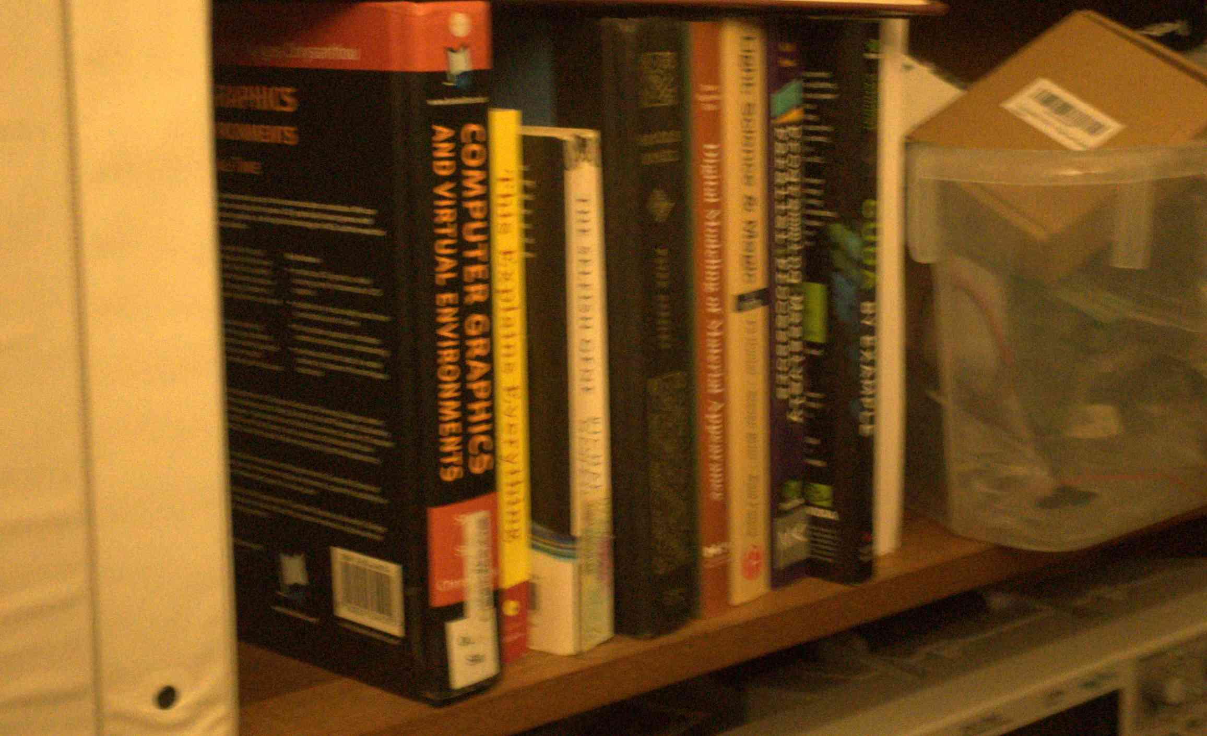
Thank you
code, pretrained model and datasets will be available soon
Poster P-2B-29

Slide 94
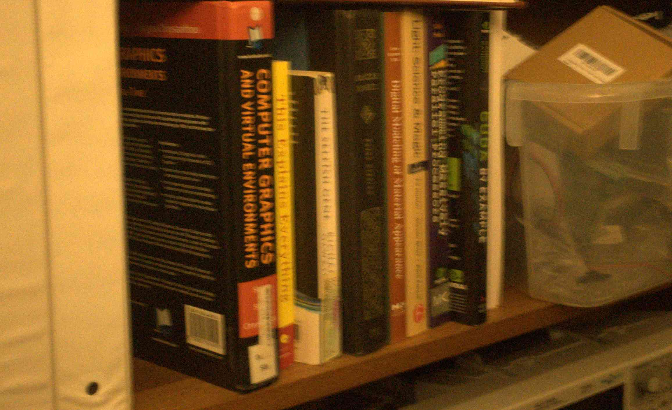
Thank you
code, pretrained model and datasets will be available soon
Poster P-2B-29

Slide 95

Thank you
code, pretrained model and datasets will be available soon
Poster P-2B-29

Slide 96

Thank you
code, pretrained model and datasets will be available soon
Poster P-2B-29

Slide 97

Thank you
code, pretrained model and datasets will be available soon
Poster P-2B-29

Slide 98

Thank you
code, pretrained model and datasets will be available soon
Poster P-2B-29

Slide 99

Thank you
code, pretrained model and datasets will be available soon
Poster P-2B-29

