Slide 1
EQ-Radio: Emotion Recognition using Wireless Signals
Mingmin Zhao, Fadel Adib, Dina Katabi
MIT

Slide 2


  Does my advisor like my research?
Graduate student
Advisor

Slide 3

  Does my advisor like my research?
How can we tell people’s emotions even if
they don’t show up on their faces?

Slide 4
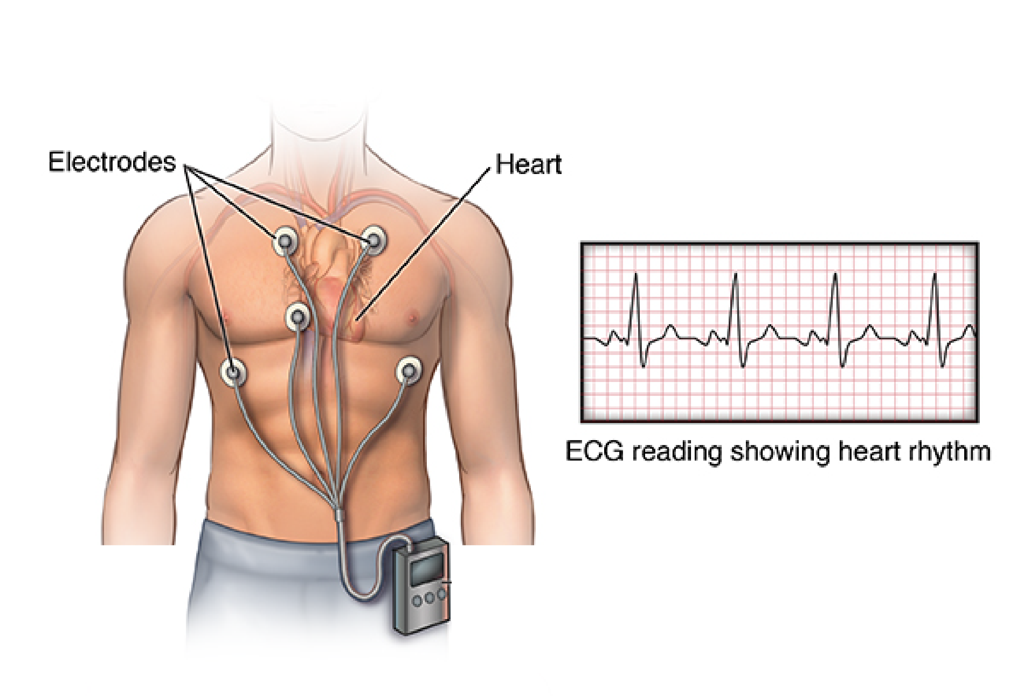
  Existing approaches measure vital signs
Use ECG to get very accurate heartbeats

Slide 5

  Existing approaches measure vital signs

Slide 6
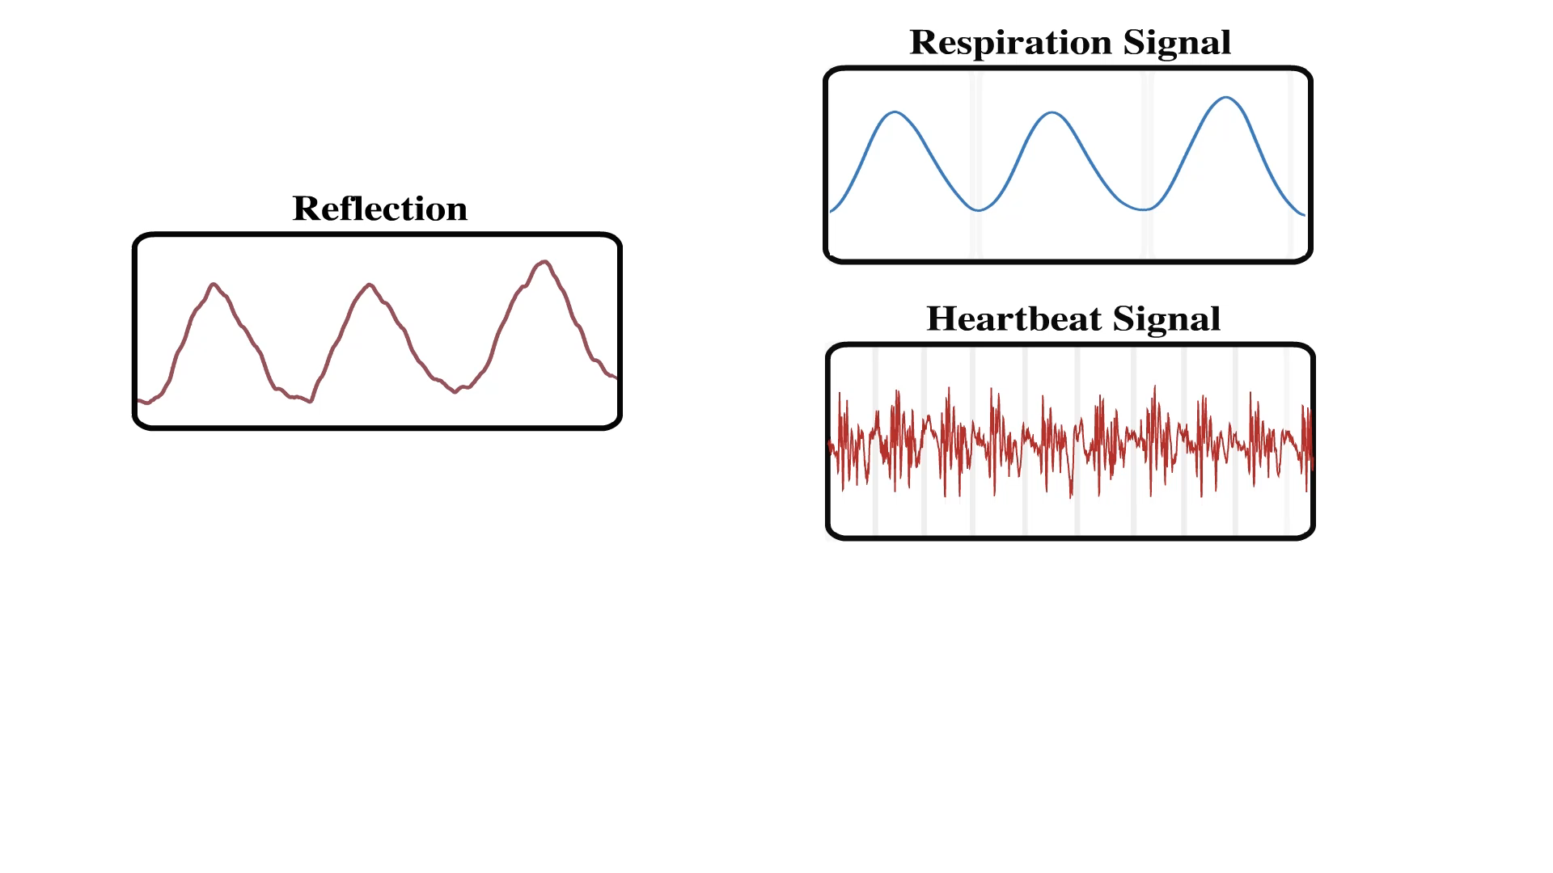

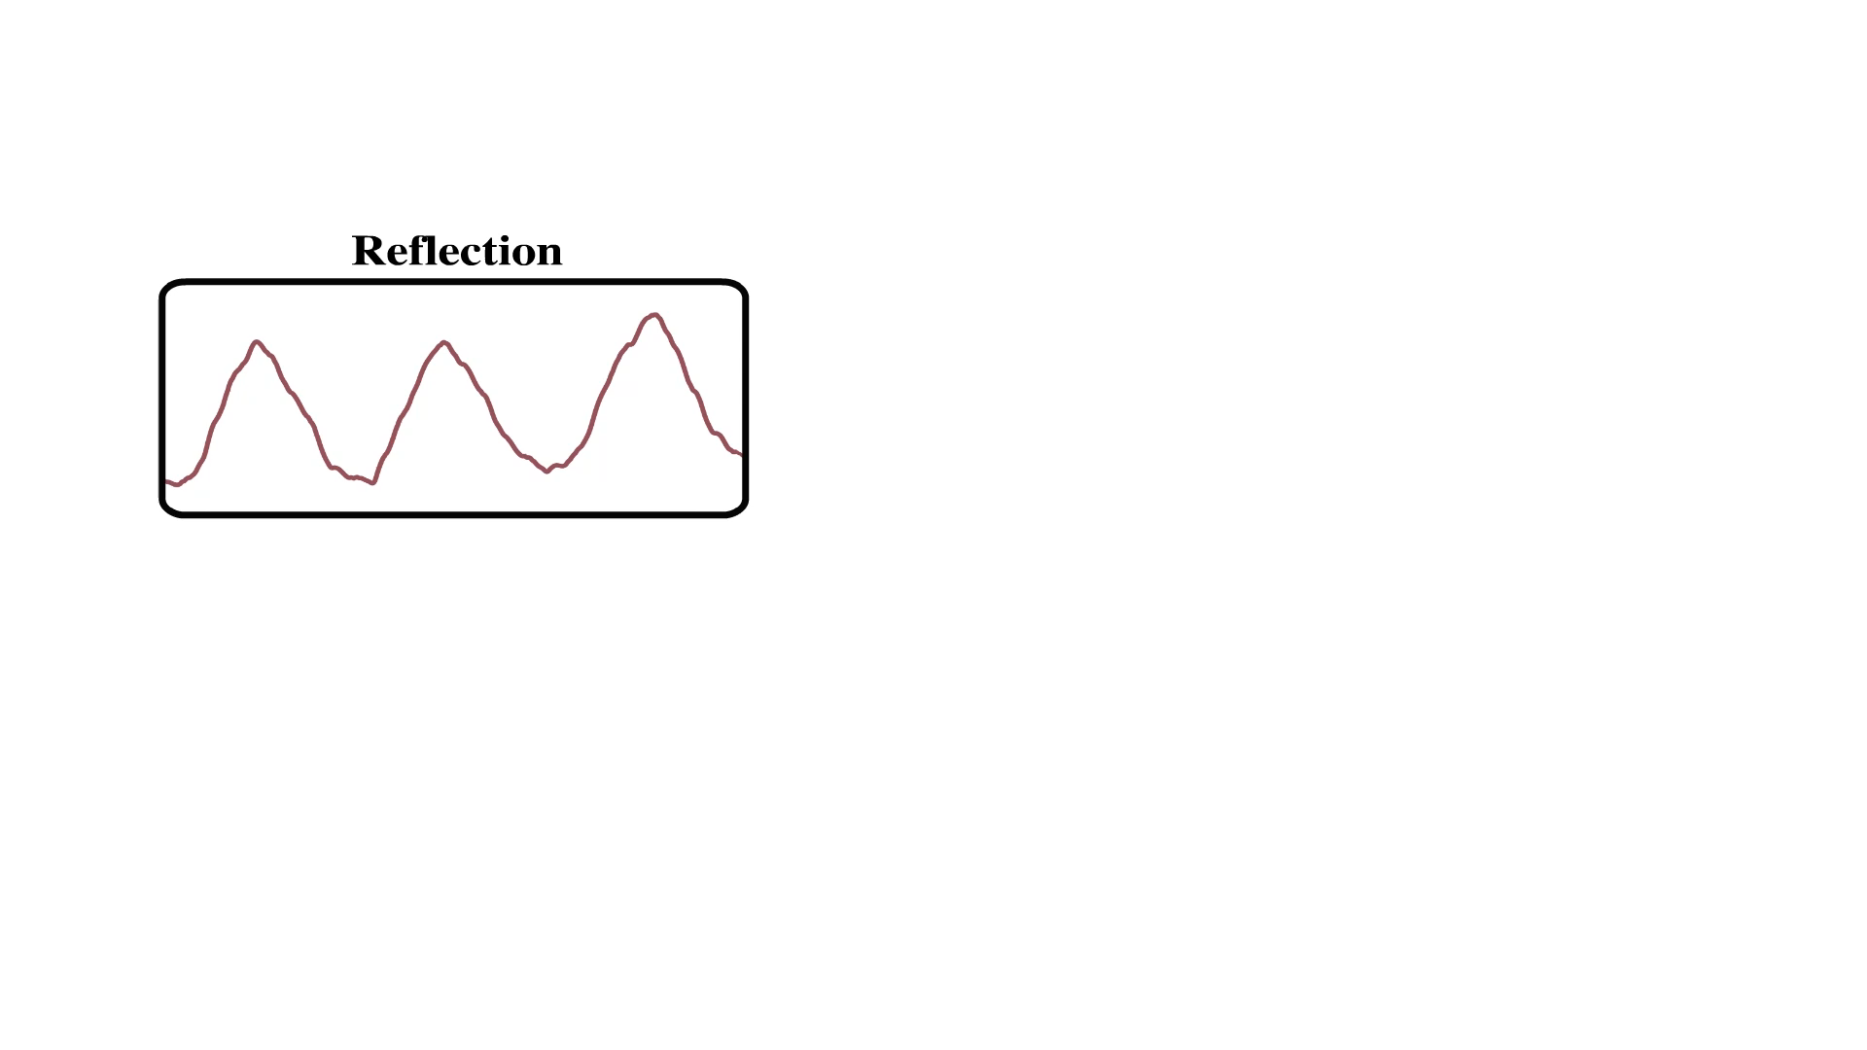
  EQ-Radio: Emotion recognition
  using wireless signals

Slide 7
  Key challenge: Inter-Beat Interval (IBI)
Emotion recognition needs accurate measurements of the length of every single heartbeat
We need to extract IBI with accuracy over 99%

Slide 8
  Contributions of EQ-Radio
First system that can recognize emotion using wireless signals
IBI extraction algorithm with accuracy of 99.6%
User study and empirical results showing that EQ-Radio is as accurate as ECG-based emotion recognition

Slide 9
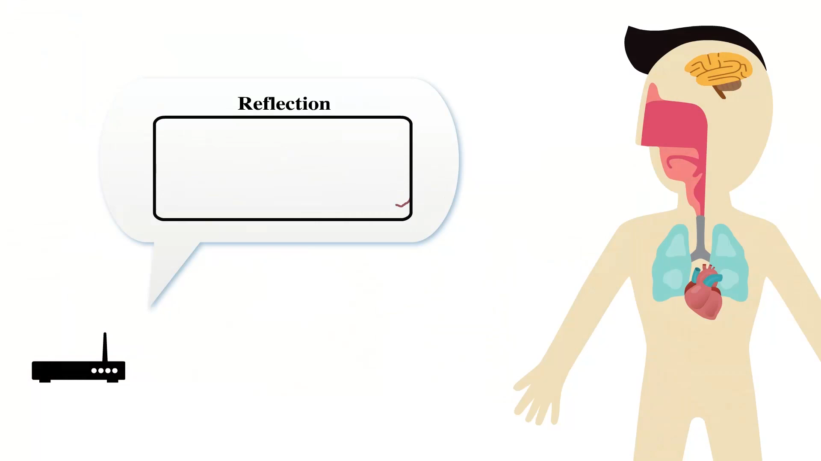
  Input signal
Wireless reflection of the human body

Slide 10
  Input signal
Heartbeats
Inhale
Exhale
Our signal:
ECG signal:
How do we extract accurate IBI?

Slide 11
  Step 1: Remove breathing signal
Breathing masks heartbeats
We use acceleration filter
  Heartbeat involves rapid contraction of muscle
  Breathing is slow and steady

Slide 12
  Heartbeat signal
Output of acceleration filter
ECG signal

Slide 13
  Heartbeat signal
Other typical examples:
How to segment the signal into individual heartbeats?

Slide 14
  Step 2: Heartbeat segmentation
Intuition: heartbeat repeats with certain shape (template)
If we can somehow discover the template, then we can segment into individual heartbeats

Slide 15
  Step 2: Heartbeat segmentation
Intuition: heartbeat repeats with certain shape (template)
Random template:
Segmentation Update
Template Update

Slide 16
  Step 2: Heartbeat segmentation
Intuition: heartbeat repeats with certain shape (template)
Random template:
Segmentation Update
Template Update

Slide 17
  Step 2: Heartbeat segmentation
Intuition: heartbeat repeats with certain shape (template)
Random template:
Segmentation Update
Template Update

Slide 18
  Step 2: Heartbeat segmentation
Intuition: heartbeat repeats with certain shape (template)
Random template:
Segmentation Update
Template Update

Slide 19
  Step 2: Heartbeat segmentation
Intuition: heartbeat repeats with certain shape (template)
Random template:
Segmentation Update
Template Update

Slide 20
  Caveat: Shrinking & Expanding
IBI are not always the same
Template subject to shrink and expanding
  Linear warping

Slide 21



  Algorithm
Need to recover both segmentation and template
Joint optimization:
segmentation
template
warping
Segmentation Update
Template Update
(dynamic programming)
(weighted least squares)

Slide 22
  Algorithm
Need to recover both segmentation and template
Joint optimization:
segmentation
template
warping
Segmentation Update
Template Update
Both updates have linear complexity
Each update achieves global optimum
Iterative algorithm is guaranteed to converge
(dynamic programming)
(weighted least squares)

Slide 23
  Example run

Slide 24
  Example run
Iteration 1:
Template
Segmentation

Slide 25
  Example run
Iteration 2:
Template
Segmentation

Slide 26
  Example run
Iteration 2:
Template
Segmentation

Slide 27
  Example run
Iteration 3:
Template
Segmentation

Slide 28
  Example run
Iteration 3:
Template
Segmentation

Slide 29
  Example run
Iteration 7:
Template
Segmentation

Slide 30
  Example run
Iteration 7:
Template
Segmentation

Slide 31
From vital signs to emotions

Slide 32
  Physiological Features
  for Emotion Recognition
37 Features similar to ECG-based methods
  Variability of IBI
  Irregularity of breathing

Slide 33
  Emotion Classification
Recognize emotion using physiological features
Used L1-SVM classifier
  select features and train classifier at the same time

Slide 34
  Emotion Model
Standard 2D emotion model
Classify into anger, sadness, pleasure and joy
High Excitement
Anger
Joy
Negativity
Positivity
Sadness
Pleasure
Low Excitement

Slide 35
  Evaluation

Slide 36
  Does EQ-Radio capture IBI accurately?
Median IBI estimation error: 0.4%
90th percentile error: 0.8%
Ground truth: ECG
30 subjects, over 130,000 heartbeats

Slide 37
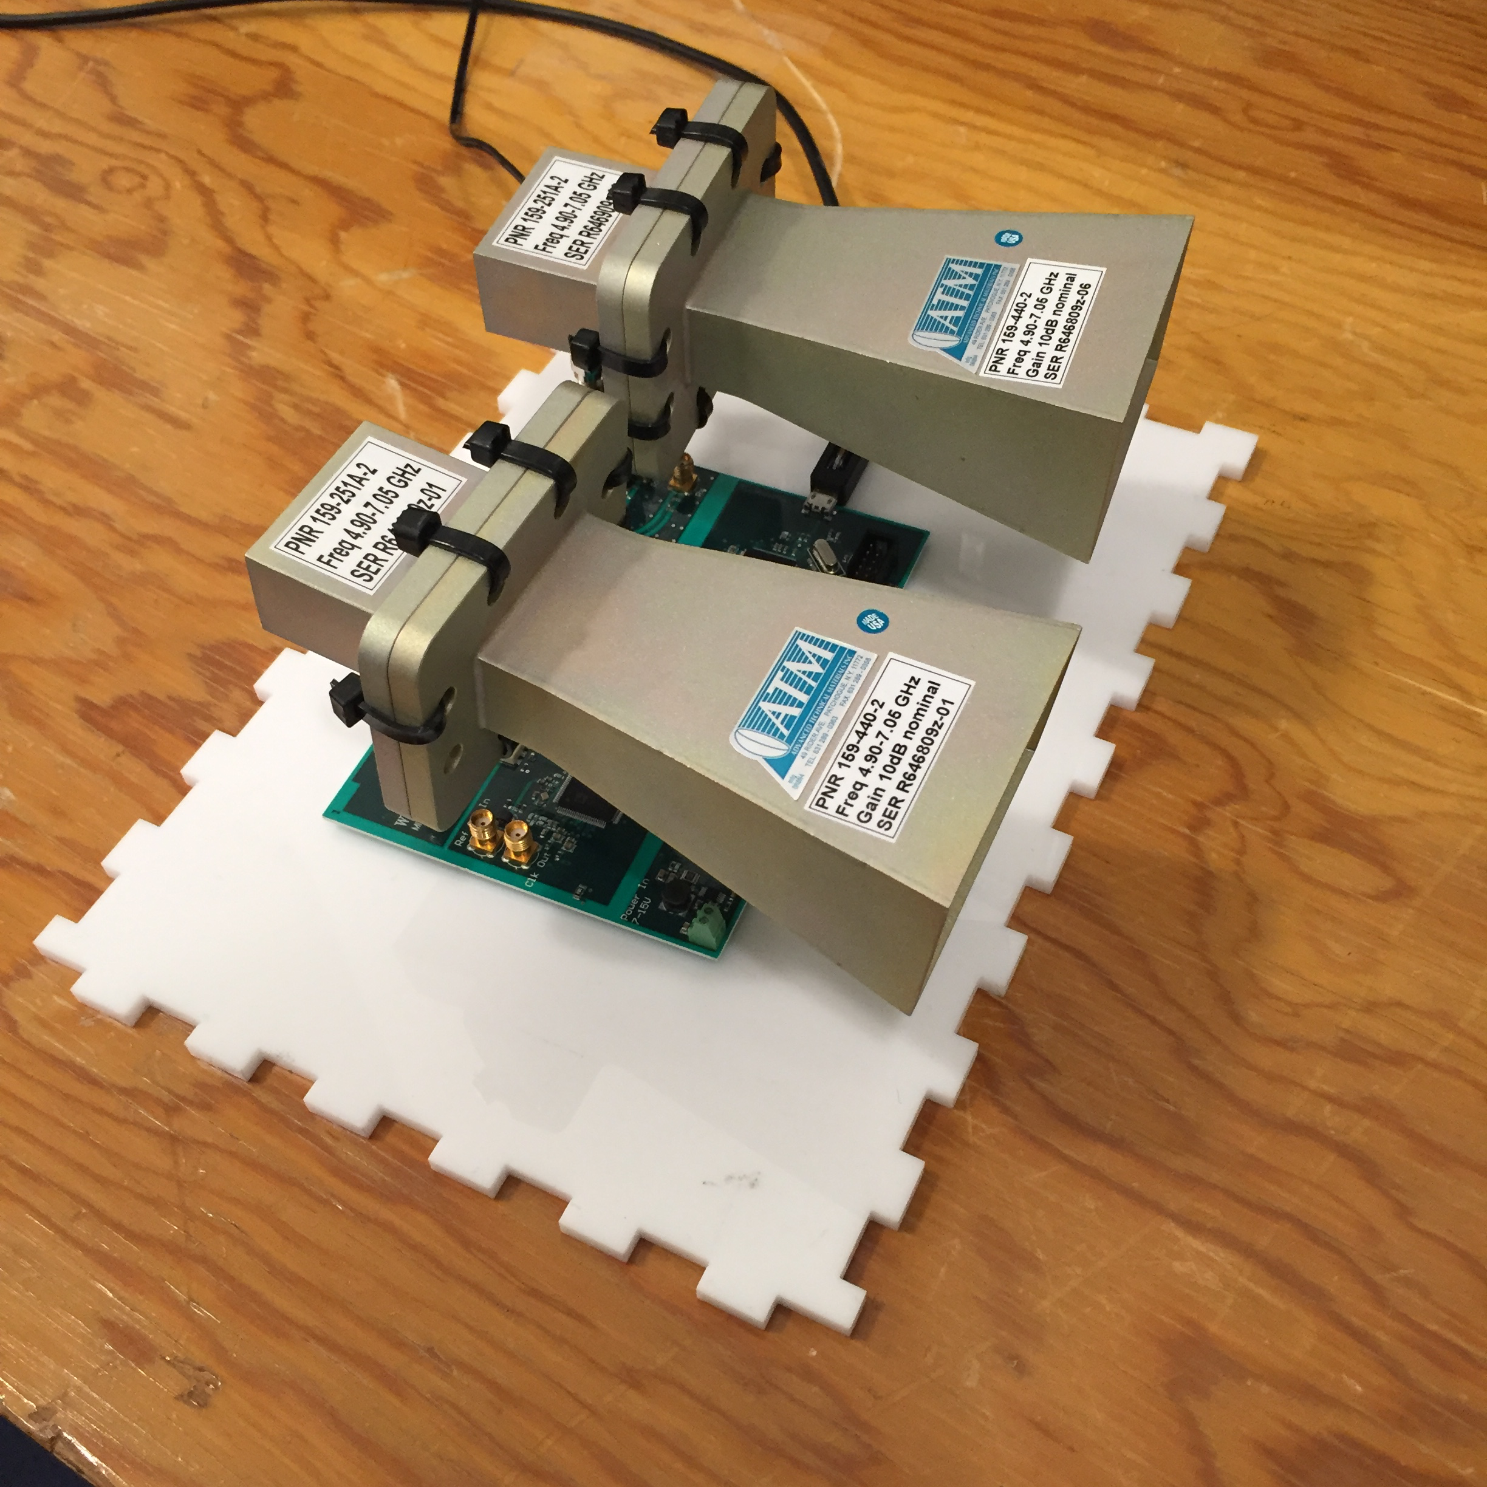
  Implementation
  FMCW radio
  5.5 GHz to 7.2 GHz
  sub-mW power

Slide 38
  Does EQ-Radio detect emotion accurately?
Experiment:
  12 subjects (6 female and 6 male)
  Prepare personal memories for each emotion
  Elicit certain emotion with prepared memories
  classify every 2 minutes to an emotional state
Ground truth: self-reported for each 2-min period

Slide 39
  Does EQ-Radio detect emotion accurately?
High Excitement
Anger
Joy
Negativity
Positivity
Sadness
Pleasure
Low Excitement

Slide 40
  Does EQ-Radio detect emotion accurately?
Anger
High Excitement
Joy
Negativity
Positivity
Sadness
Pleasure
Low Excitement

Slide 41
  Person-dependent Classification
Train and test on the same person (Dina)
Anger
High Excitement
Joy
Negativity
Positivity
Accuracy: 92.5%
Sadness
Pleasure
Low Excitement

Slide 42
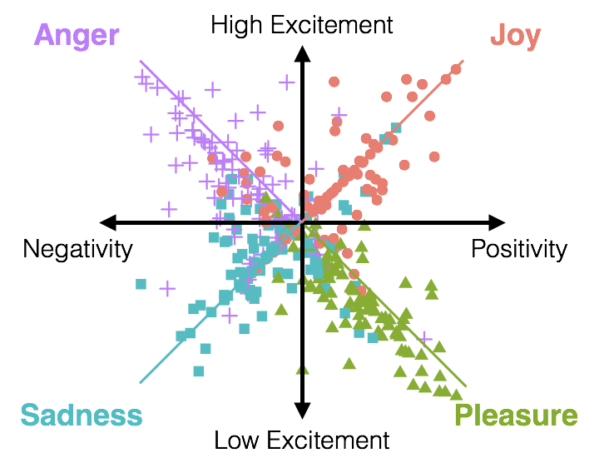
  Person-independent Classification
Train and test on the different person
We can recognize a person’s emotions
without having ever trained on him/her before
Accuracy: 72.3%

Slide 43
  Comparison with ECG-based system

Slide 44
Related Work
Emotion recognition:
  ECG: Requires body contact [Picard 2001; Kim 2008]
  Vision: Cannot recognize emotions when they don’t show on the face [Zheng 2009; Kahn 2015]
Extracting vital signs from RF reflections:
  Average heart rate [Droitcour 2009; Adib 2015]

Slide 45

  Conclusion
Emotion recognition using wireless signals
Joyful

