Slide 1


Learning Sleep Stages from Radio Signals:
A Conditional Adversarial Architecture
Mingmin Zhao
ICML 2017
Shichao Yue Dina Katabi Tommi Jaakkola Matt Bianchi

Slide 2
Wireless Signals
What if wireless signals can be used to understand:
  when you are dreaming
  when your brain is consolidating memory
  sleep stages

Slide 3

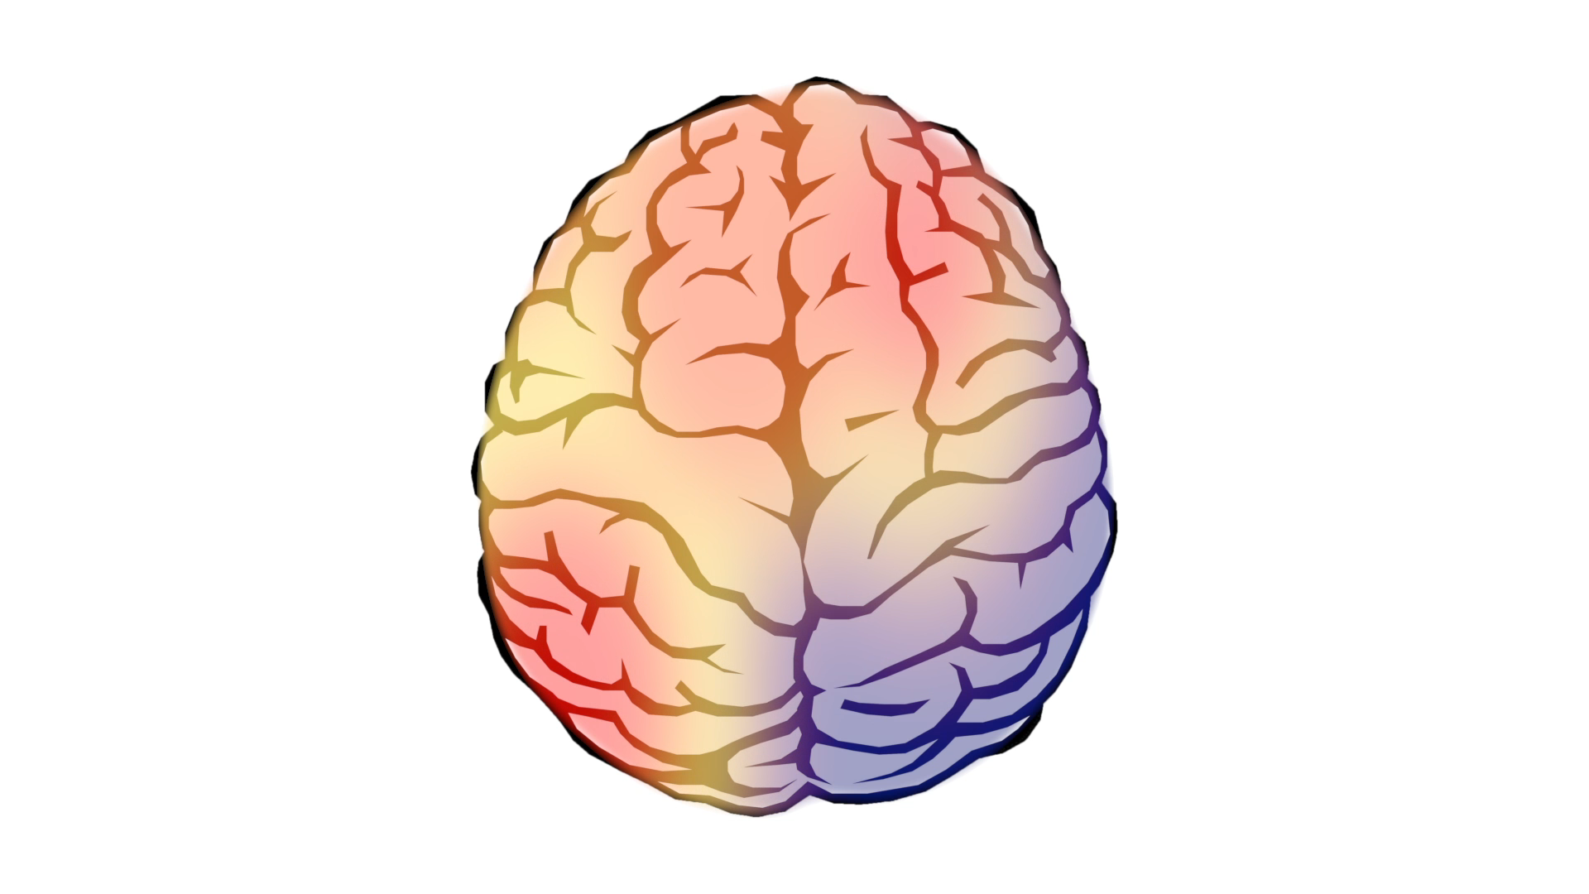
Background
Dreaming
Cognitive Processing
Memory Consolidation

Slide 4
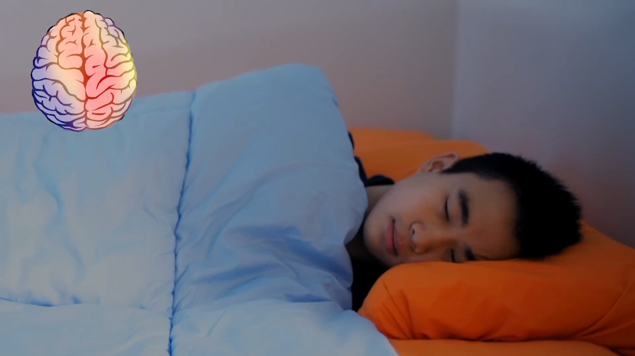

Slide 5
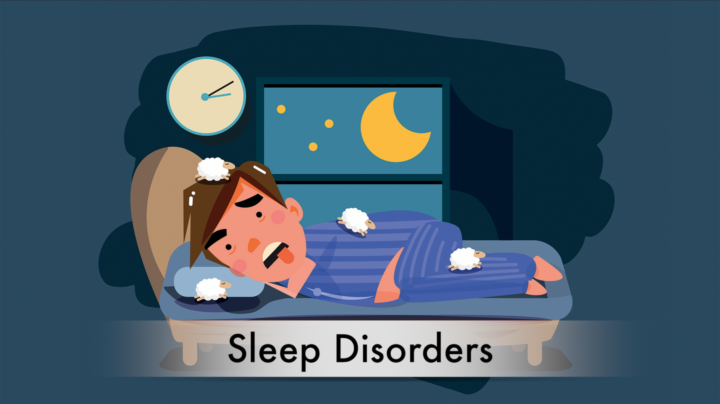


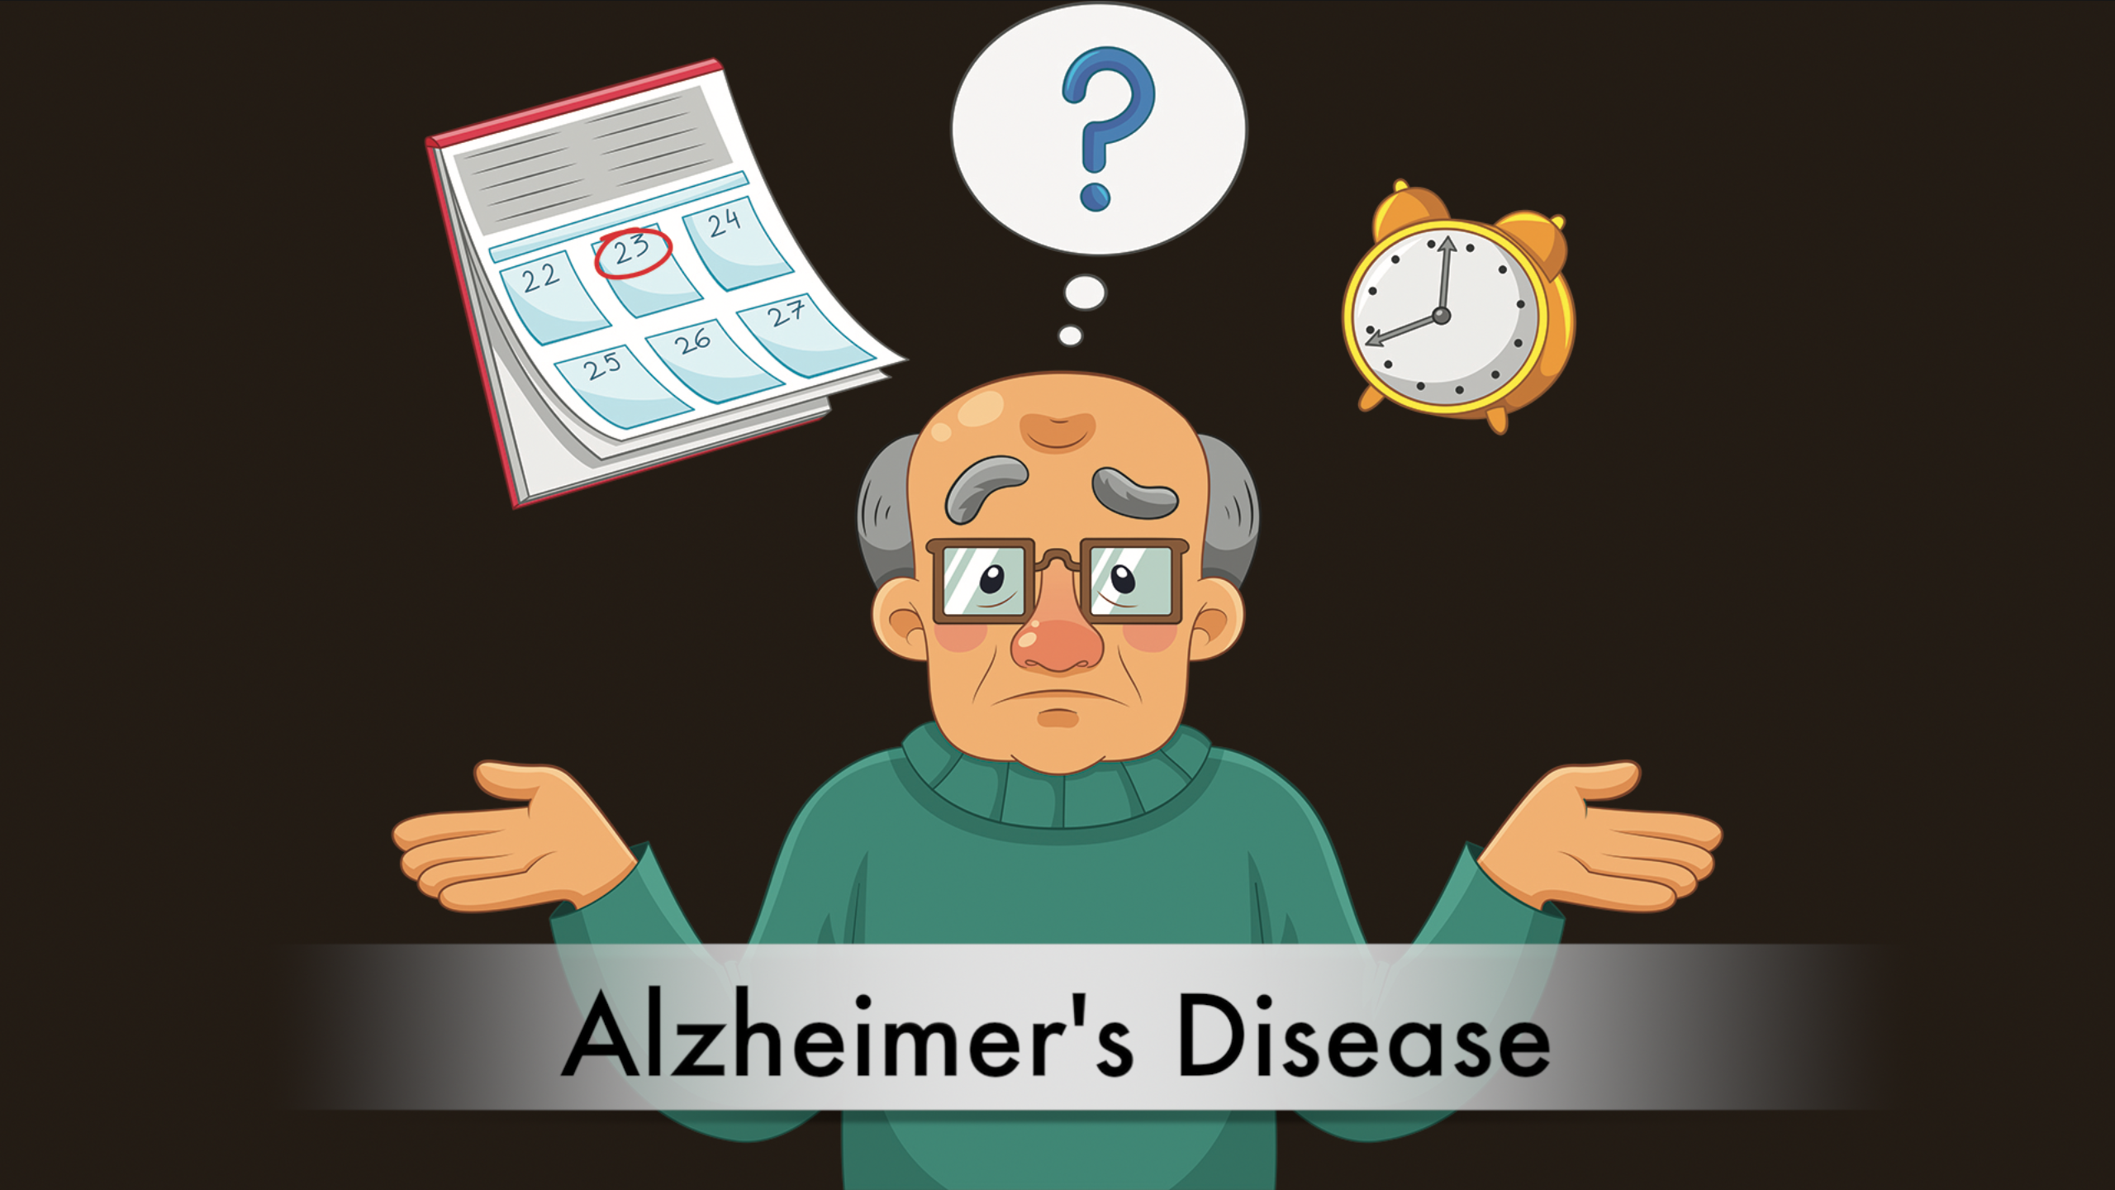
Understanding Diseases with Sleep Stages

Slide 6
But, monitoring sleep stages is difficult …
done in hospital with many electrodes on the body

Slide 7
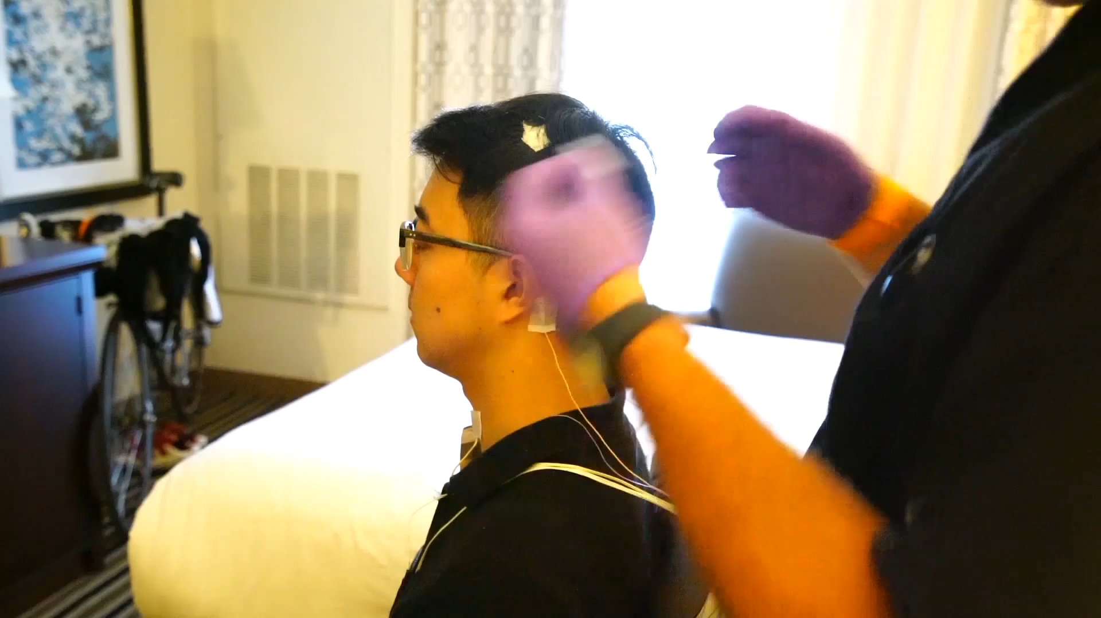
My Experience in Sleep Lab

Slide 8
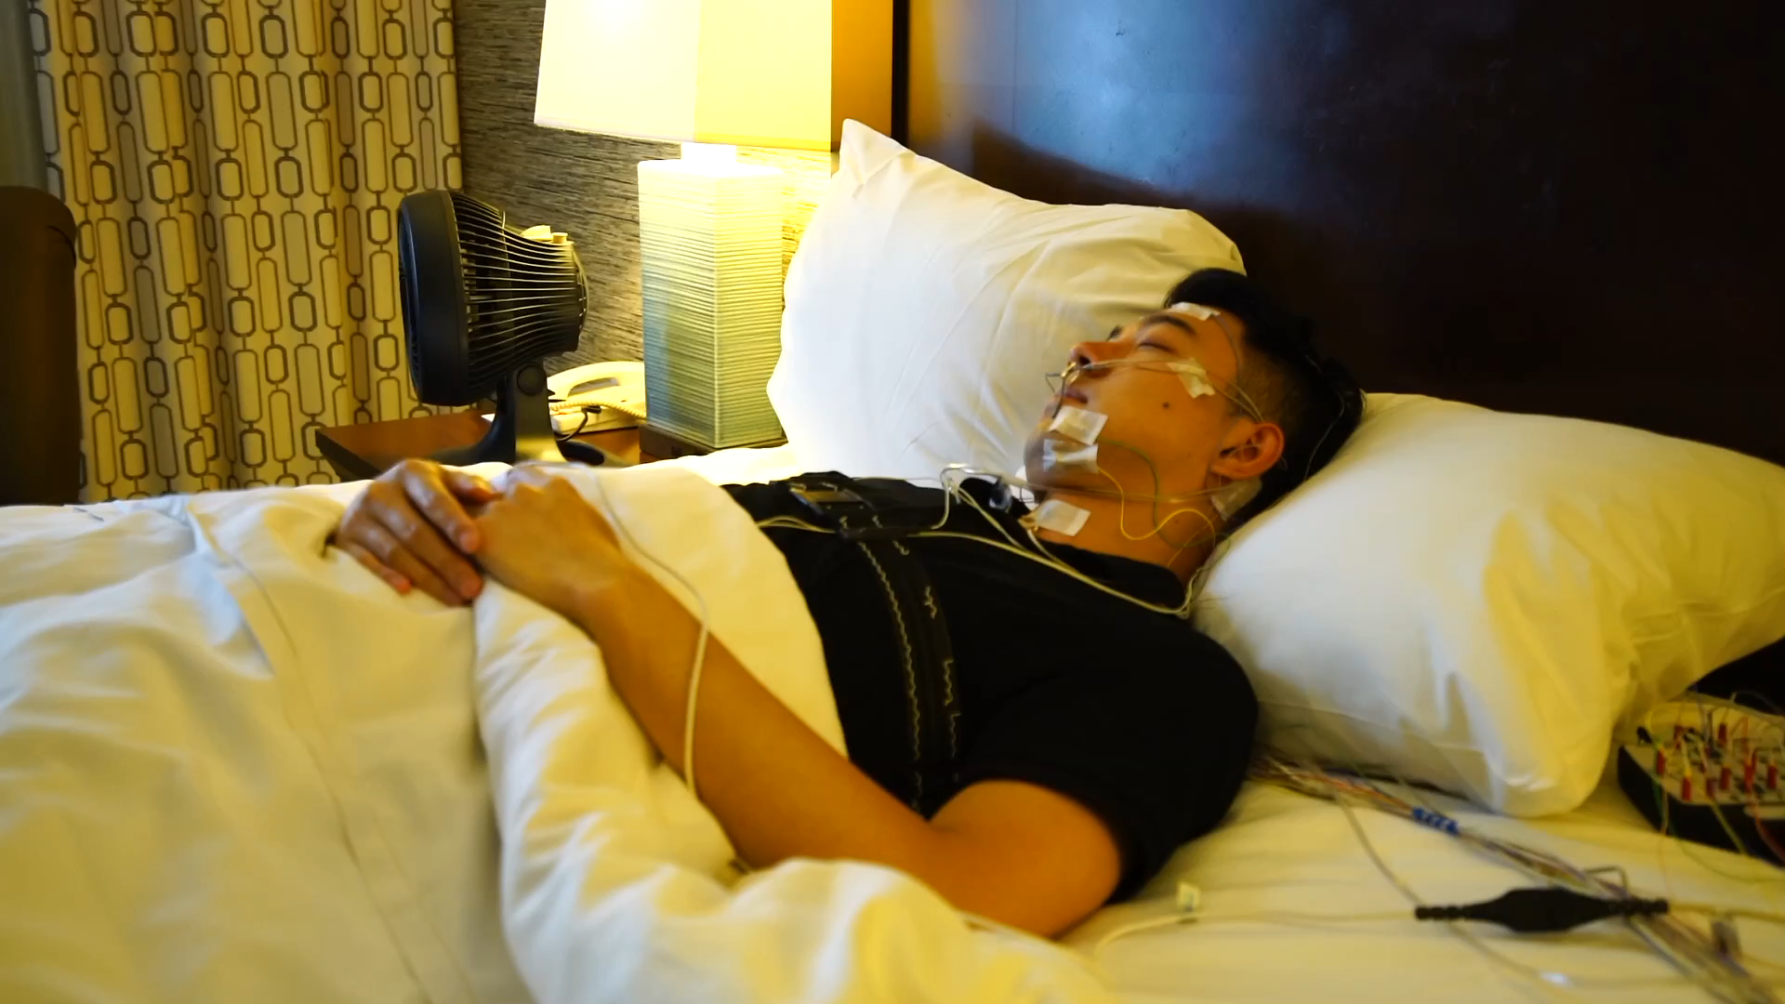
My Experience in Sleep Lab
Can we do it in bedroom without any electrodes?

Slide 9
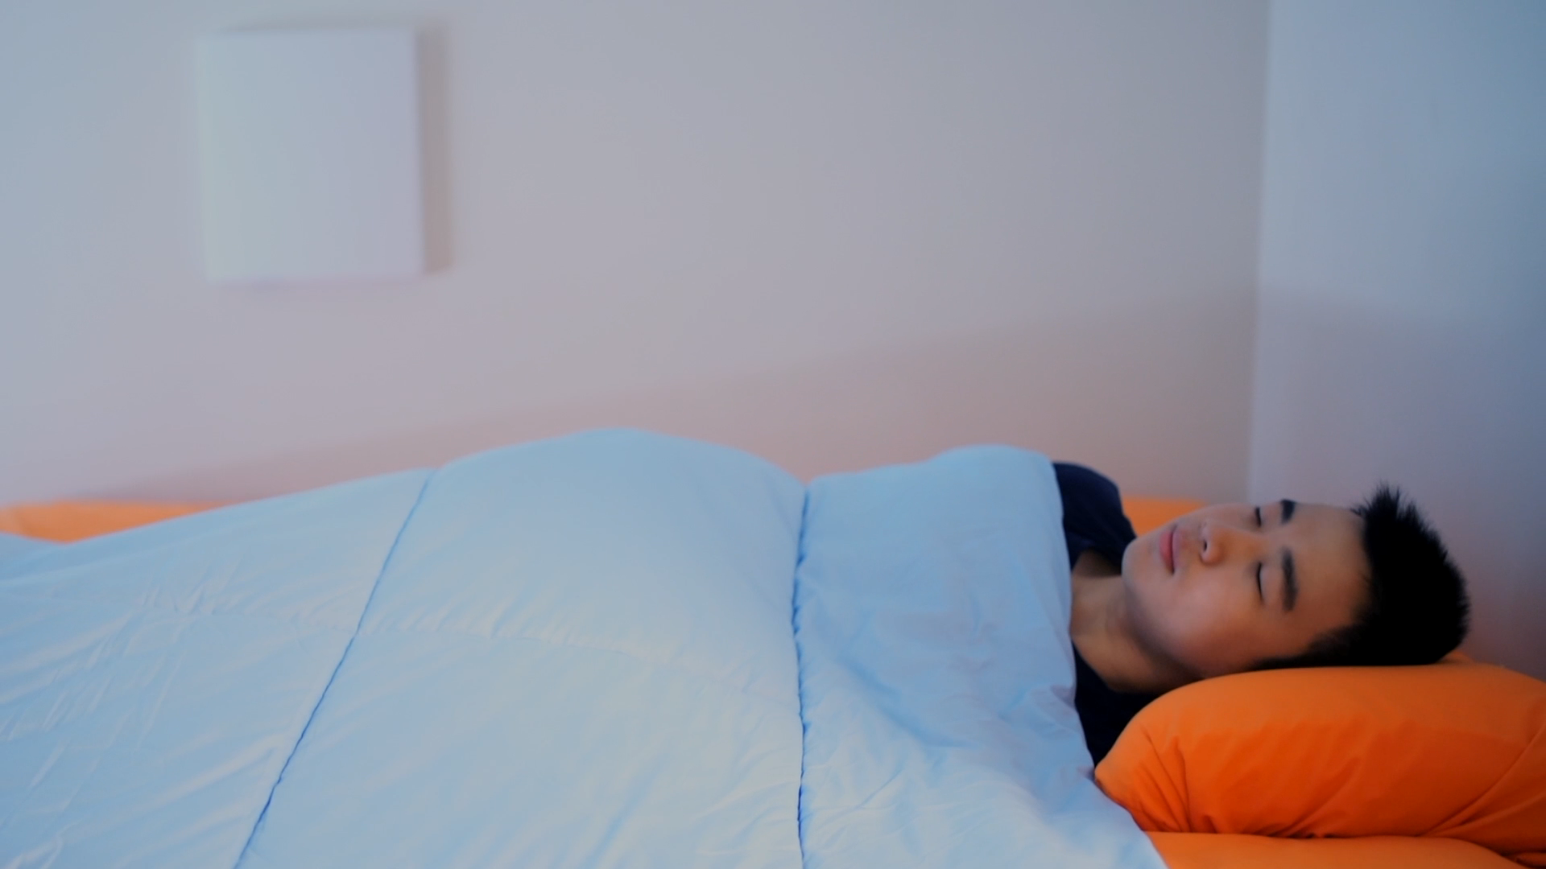
Our System
New Model

Slide 10
Contributions
Predict sleep stages from radio signals without contact
Conditional adversary for domain adaptation
User study and dataset of 100 night of sleep

Slide 11
Background on RF Sensing
RF signals reflect off body and change with physiological signals
Our objective: High accuracy on par with sleep lab, but in one’s bedroom and without electrodes on the body
But past work on using RF to monitor sleep (Zaffaroni et al.’14, Tataraidze et al’16), has low accuracy ~64%, mainly detects motion, and is limited to a single environment.

Slide 12
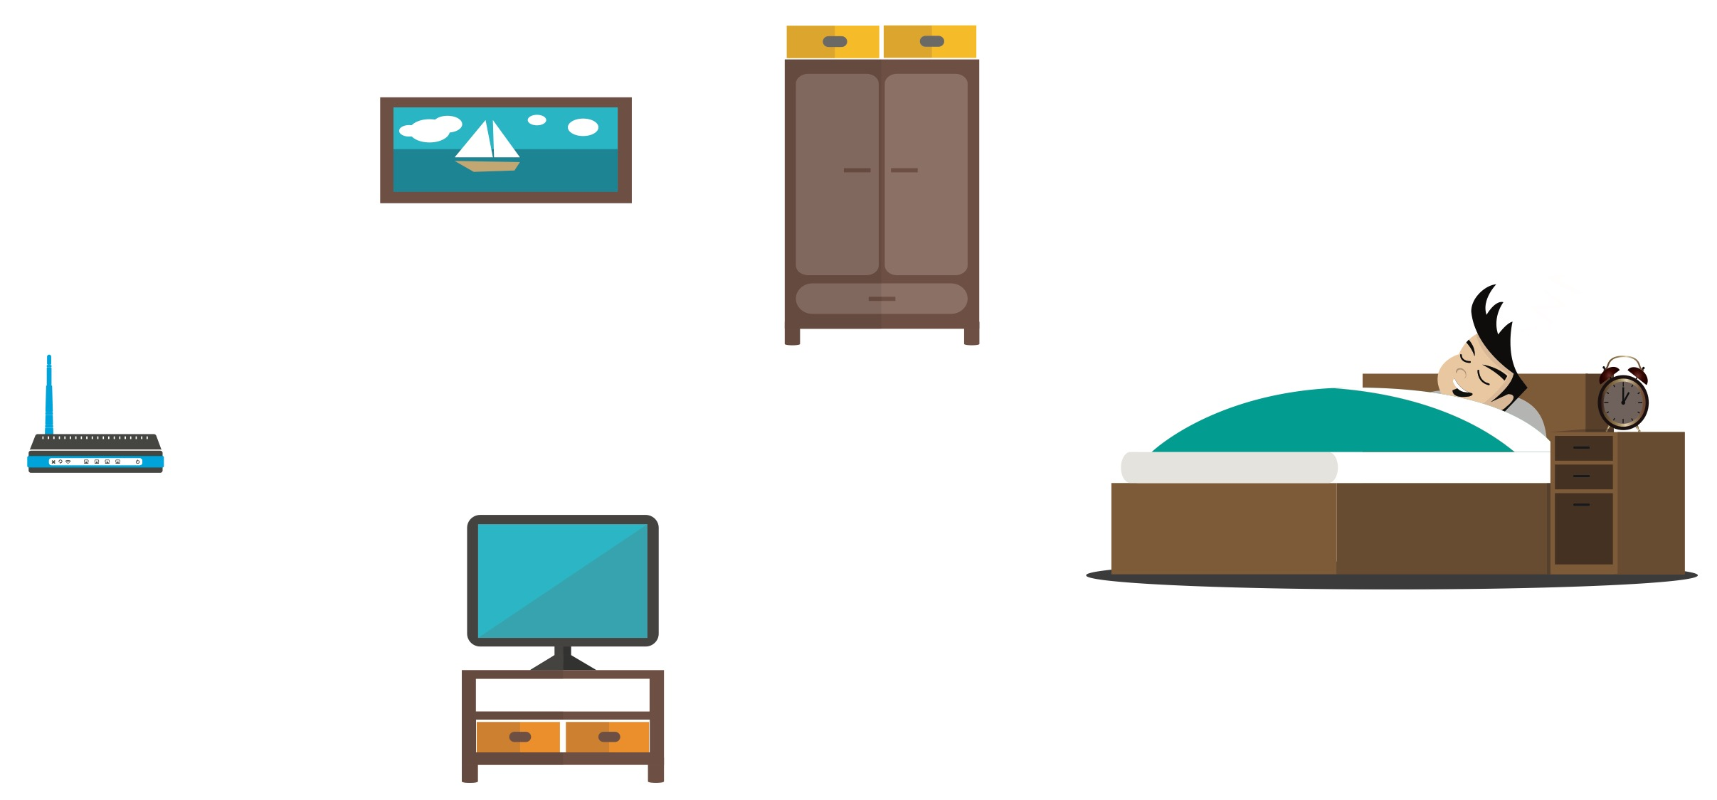
Key Challenge
RF reflections are highly dependent on the measurement conditions and the individuals.

Slide 13

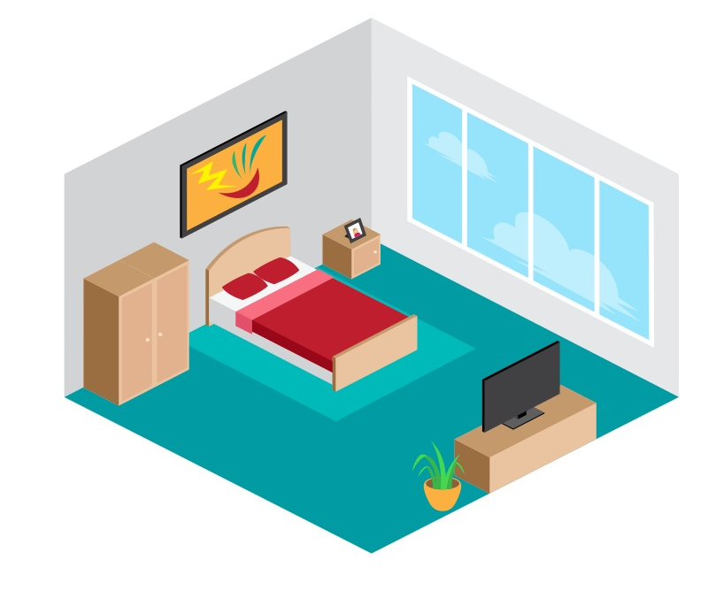




Key Challenge
Need to remove such extraneous information!
RF reflections are highly dependent on the measurement conditions and the individuals.

Slide 14
Multi-Source Domain Adaptation
domain = measurement condition + individual
Source domain A
Source domain B
Target domain C

Slide 15
Multi-Source Domain Adaptation
domain = measurement condition + individual
Source domain A
Source domain B
Target domain C

Slide 16
Initial Solution: Adversarial Domain Adaptation
Problem: Discriminator removes both extraneous and useful information
Value function of three-player game:
predictor loss
discriminator loss
want extraneous domain information to be removed

Slide 17
Conditional Adversary

Slide 18
Role of Adversary
Independence
Conditional-Independence

Slide 19
Not That Simple …
Does it work?
Solution: Condition Discriminator
on predicted label distribution
Posterior not available
when training!

Slide 20
It Works
Theorem (informal): Given enough capacity, the encoder at equilibrium discards all extraneous information specific to domains, while retaining the relevant information for the predictive task.

Slide 21
Evaluation
  25 different bedrooms and 100 nights
  Ground-truth: FDA-approved EEG-based sleep profiler provides sleep stage labels
  ~90k 30-sencond pairs of RF measurements and corresponding sleep stages

Slide 22
Accuracy
Labelling sleep stages is subjective
Accuracy of sleep lab
Inter-rater agreement: 83%
Our accuracy 79.8%
~83%
(Tested on new subjects not in training, i.e., new domains)
Previous solutions: 64%

Slide 23
Comparison with Past Work
Average and Cohen’s Kappa

Slide 24
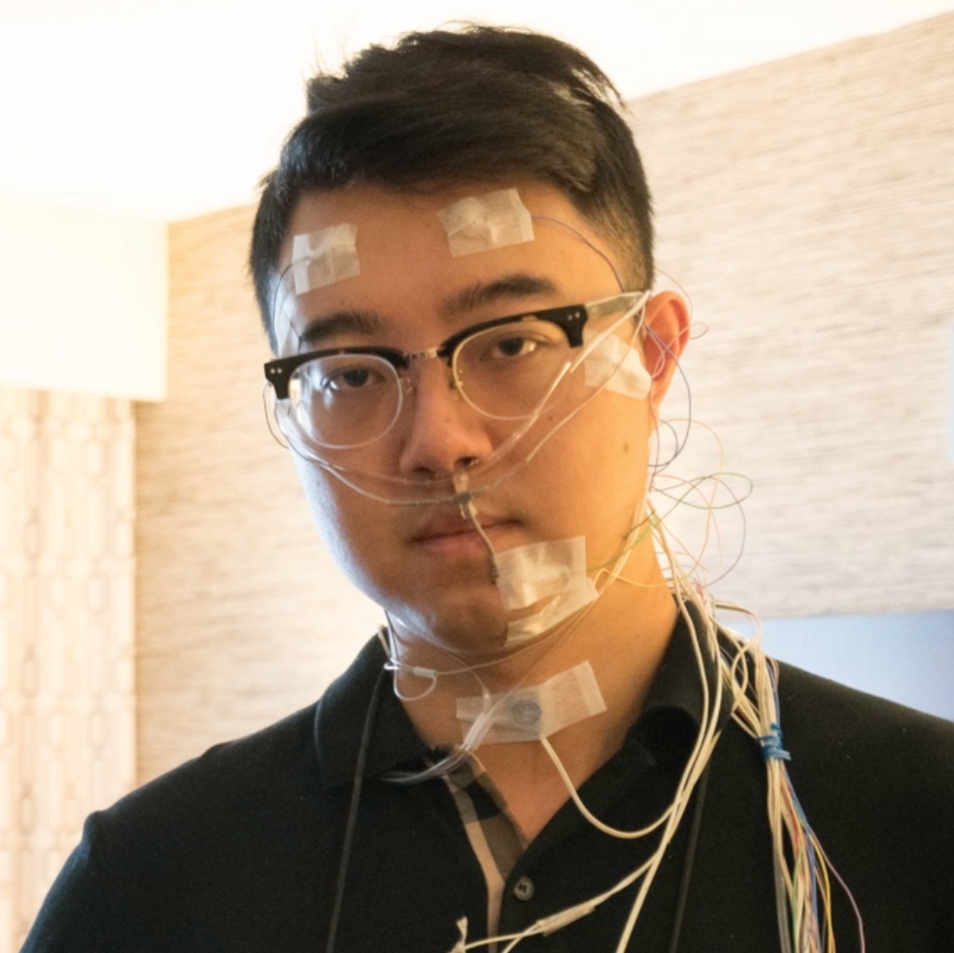

Representative Example
Acc = 80%
Ground-truth using EEG
Our Prediction

Slide 25
Accuracy for Different Subjects (Domains)
Accuracy
Subject

Slide 26

Conclusion
Learning sleep stages from wireless signals

Slide 27
Learning Sleep Stages from Radio Signals:
A Conditional Adversarial Architecture
Mingmin Zhao
ICML 2017
Shichao Yue Dina Katabi Tommi Jaakkola Matt Bianchi

