Slide 1

Limits of Data Structures
Mihai Pătraşcu
…until Aug’08

Slide 2
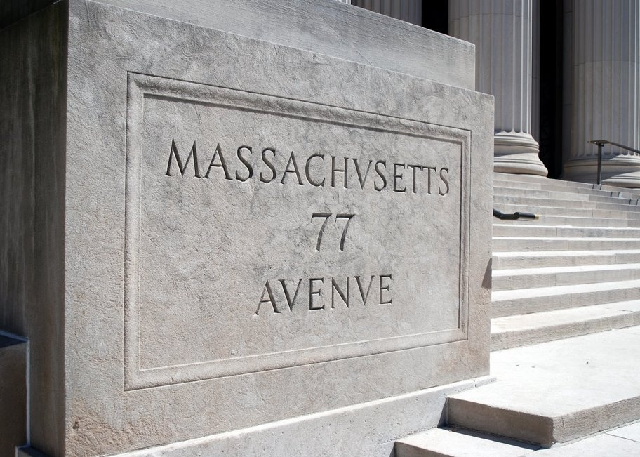
MIT: The beginning
Freshman year, 2002
… didn’t quite solve it ☹
“What problem could I work on?”
“P vs. NP”

Slide 3
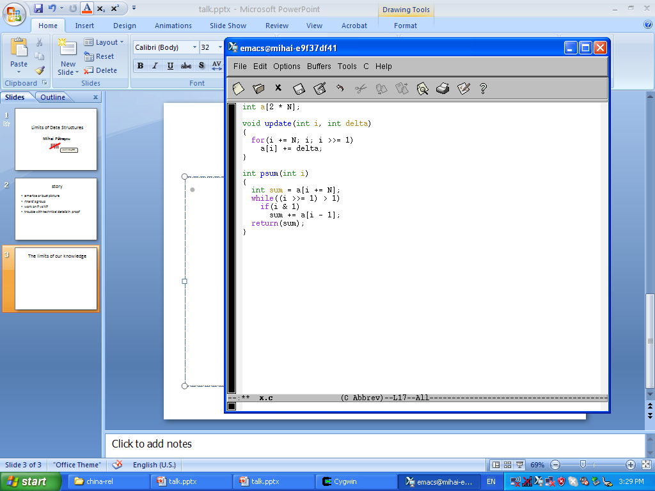
The partial sums problem
Here’s a small problem:
Textbook solution: “augmented” binary search trees
running time: O(lg n) / operation
Maintain an array A[n] under:
update(i, Δ): A[i] += Δ
sum(i): return A[0] + … + A[i]
+
+
+
+
+
+
+
+
+
+
+
+
A[0]
A[1]
A[2]
A[3]
A[4]
A[5]
A[6]
A[6]
A[7]
update(2, Δ )
sum(6)

Slide 4


Now show Ω(lg n) needed…
big open
See also:
[Fredman JACM ’81]
[Fredman JACM ’82]
[Yao SICOMP ’85]
[Fredman, Saks STOC ’89]
[Ben-Amram, Galil FOCS ’91]
[Hampapuram, Fredman FOCS ’93]
[Chazelle STOC ’95]
[Husfeldt, Rauhe, Skyum SWAT ’96]
[Husfeldt, Rauhe ICALP ’98]
[Alstrup, Husfeldt, Rauhe FOCS ’98]
Here’s a small problem:
Fact: Ω(lg n) was not known for any problem
Maintain an array A[n] under:
update(i, Δ): A[i] += Δ
sum(i): return A[0] + … + A[i]
So, you want to show SAT takes 2^{Ω(n)} time??

Slide 5
Results
[P., Demaine SODA’04] first Ω(lg n) lower bound (for p. sums)
[P., Demaine STOC’04] Ω(lg n) for many interesting problems
[P., Tarniţă ICALP’05] Ω(lg n) via epoch arguments
Best Student Paper
E.g. support both * list operations – concatenate, split, …
* array operations – index
Think Python:
0
1
2
3
0
1
2
3
4
Ω(lg n)
>>> a = [0, 1, 2, 3, 4]
>>> a[2:2] = [9, 9, 9]
>>> a
[0, 1, 9, 9, 9, 2, 3, 4]
>>> a[5]
2

Slide 6
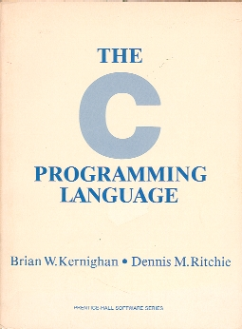
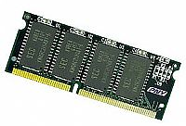
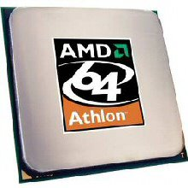
What kind of “lower bound”?
Lower bounds you can trust.TM
Model of computation ≈ real computers:
memory words of w > lg n bits (pointers = words)
random access to memory
any operation on CPU registers (arithmetic, bitwise…)
Just prove lower bound on # memory accesses
bottleneck

Slide 7
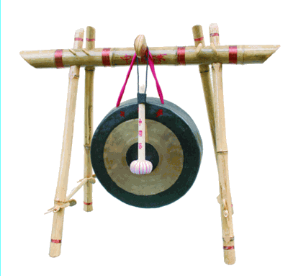
Begin Proof
A textbook algorithm deserves
a textbook lower bound

Slide 8
Maintain an array A[n] under:
update(i, Δ): A[i] += Δ
sum(i): return A[0] + … + A[i]
π
Δ₁
Δ₂
Δ₃
Δ₄
Δ₅
Δ₆
The hard instance:
π = random permutation
for t = 1 to n:
query: sum(π(t))
Δ_{t}= rand()
update(π(t), Δ_{t})
Δ₇
Δ₈
Δ₉
Δ₁₀
Δ₁₁
Δ₁₂
Δ₁₃
Δ₁₄
Δ₁₅
Δ₁₆
time

Slide 9
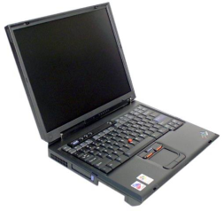


Δ₁
Δ₂
Δ₃
Δ₄
Δ₅
Δ₆
Δ₇
Δ₈
Δ₉
Δ₁₀
Δ₁₁
Δ₁₂
Δ₁₃
How can Mac help PC run ?
Δ₁₄
t = 9,…,12
Δ₁₆
Communication ≈ # memory locations
* read during
* written during
Δ₁₇
time
t = 9,…,12
t = 9,…,12
t = 5, …, 8
t = 5, …, 8

Slide 10



give me Mem[0x73A2]
Dude, it wasn’t written after t≥5
Mac begins by sending a Bloom filter of memory locations it has written
Communication ≈ # memory locations
* read during
* written during
“Negligible additional
communication”
t = 9,…,12
t = 5, …, 8
Notes:
I’m one of the only people on the planet who think Bloom filters are cool due to their theoretical applications, not due to their practical applications ☺

Slide 11
Δ₁
Δ₂
Δ₃
Δ₄
Δ₅
Δ₈
Δ₇
Δ₉
Δ₁+Δ₅+Δ₃
+Δ₇+Δ₂
Δ₁
Δ₁+Δ₅+Δ₃
How much information needs to be transferred?
Δ₁₃
Δ₁+Δ₅+Δ₃+Δ₇
+Δ₂ +Δ₈ +Δ₄
Δ₁₄
Δ₁₆
Δ₁₇
At least Δ₅ , Δ₅+Δ₇ , Δ₅+Δ₇+Δ₈
=> i.e. at least 3 words
(random values incompressible)
time

Slide 12
The general principle
Lower bound
= # down arrows
How many down arrows? (in expectation)
(2k-1) ∙ Pr[ ] ∙ Pr[ ]
= (2k-1) ∙ ½ ∙ ½ = Ω(k)
k operations
k operations

Slide 13
Recap
Communication = # memory locations
* read during
* written during
pink period
yellow period
Communication between periods of k items
= Ω(k)
* read during
* written during
pink period
# memory locations
= Ω(k)
yellow period

Slide 14
Putting it all together
aaaa
Ω(n/8)
Ω(n/4)
Every load instruction counted once
@ lowest_common_ancestor(
, )
Ω(n/8)
Ω(n/2)
write time
read time
Ω(n/8)
Ω(n/4)
Ω(n/8)
total Ω(n lg n)
time

Slide 15
Q.E.D.
Augmented binary search trees are optimal.
First “Ω(lg n)” for any dynamic data structure.

Slide 16

How about static data structures?
“predecessor search”
preprocess T = { n numbers }
given q, find: max { y є T | y < q }
“2D range counting”
preprocess T = { n points in 2D }
given rectangle R, count |T ∩ R|
packet forwarding
SELECT count(*)
FROM employees
WHERE salary <= 70000
AND startdate <= 1998
71000
70000
69000
68000

Slide 17
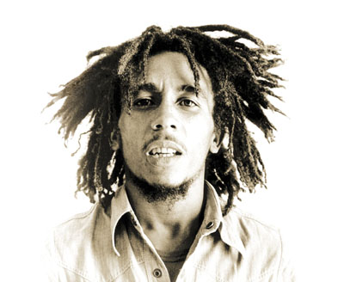

Lower bounds, pre-2006
Approach: communication complexity

Slide 18
Lower bounds Pre-2006
Then what’s the difference between
S=O(n) and S=O(n²) ?
Approach: communication complexity
lg S bits
1 word
lg S bits
1 word
database of size S

Slide 19
Between space S=O(n) and S=poly(n) :
lower bound changes by O(1)
upper bound changes dramatically
☹
space S=O(n²)
precompute all answers
query time = 1

Slide 20
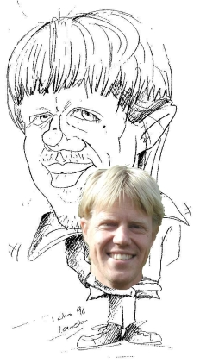
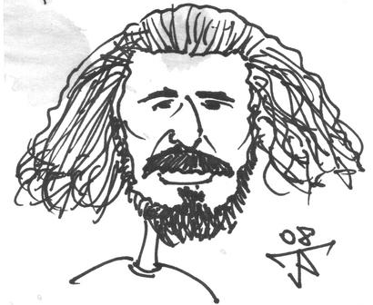
Between space S=O(n) and S=poly(n) :
lower bound changes by O(1)
upper bound changes dramatically
First separation between
space S=O(n) and S=poly(n)
☹
☺
[
,
STOC’06]

Slide 21


First separation between
space S=O(n) and S=poly(n)
Processor → memory bandwidth:
one processor: lg S
k processors: lg ( ) ≈ k lg
amortized lg(S/k) / processor
S
k
S
k
 | S=O(n) | S=O(n²)
k = 1 | lg n | 2lg n
k = n/lg n | lglg n | ~ lg n
Notes:
amortizing across many processor saves bandwidth

Slide 22
Since then…
predecessor search [P., Thorup STOC’06]
[P., Thorup SODA’07]
searching with wildcards [P., Thorup FOCS’06]
2D range counting [P. STOC’07]
range reporting [Karpinski, Nekrich, P. 2008]
nearest neighbor (LSH) [2008 ?]

Slide 23
Packet Forwarding/ Predecessor Search
Preprocess n prefixes of ≤ w bits:
➔ make a hash-table H with all prefixes of prefixes
➔ |H|=O(n∙w), can be reduced to O(n)
Given w-bit IP, find longest matching prefix:
➔ binary search for longest ℓ such that IP[0: ℓ] є H
[van Emde Boas FOCS’75]
[Waldvogel, Varghese, Turener, Plattner SIGCOMM’97]
[Degermark, Brodnik, Carlsson, Pink SIGCOMM’97]
[Afek, Bremler-Barr, Har-Peled SIGCOMM’99]
O(lg w)

Slide 24
Predecessor Search: Timeline
after [van Emde Boas FOCS’75]
… O(lg w) has to be tight!
[Beame, Fich STOC’99]
slightly better bound with O(n²) space
… must improve the algorithm for O(n) space!
[P., Thorup STOC’06]
tight Ω(lg w) for space O(n polylg n) !

Slide 25
Lower Bound Creed
stay relevant to broad computer science
(talk about binary search trees, packet forwarding,
range queries, nearest neighbor …)
never bow before the big problems
(first Ω(lg n) bound; first separation between
space O(n) and poly(n) ; …)
strive for the elegant solution

Slide 26
Change of topic: Quad-trees
excellent for “nice” faces (small aspect ratio)
☹ in worst-case, can have prohibitive size
infinite (??)

Slide 27
Quad-trees
Est. 1992
Big theoretical problem:
➔ use bounded precision in geometry
(like 1D: hashing, radix sort, van Emde Boas…)
[P. FOCS’06] [Chan FOCS’06]
➔ a “quad-tree” of guaranteed linear size

Slide 28
Theory
Practice
[P. FOCS’06] [Chan FOCS’06]
point location
[Chan, P. STOC’07]
3D convex hull
2D Voronoi
2D Euclidean MST
triangulation with holes
line-segment intersection
[Demaine, P. SoCG’07]
dynamic convex hull
O(√lg u)
☹
n∙2^{O(√lglg n)}

Slide 29
Other Directions…
Streaming algorithms:
[Chakrabarti, Jayram, P. SODA’08]
High-dimensional geometry:
[Andoni, Indyk, P. FOCS’06]
[Andoni, Croitoru, P. 2008]
Dynamic optimality:
[Demaine, Harmon, Iacono, P. FOCS’04]
+ manuscript 2008
Distributed Source Coding:
[Adler, Demaine, Harvey, P. SODA’06]
Dynamic graph algorithms:
[P., Thorup FOCS’07]
[Chan, P., Roditty 2008]
Hashing:
[Mortensen, Pagh, P. STOC’05]
[Baran, Demaine, P. WADS’05]
[Demaine, M.a.d.H., Pagh, P. LATIN’06]

Slide 30
Questions?

Slide 32
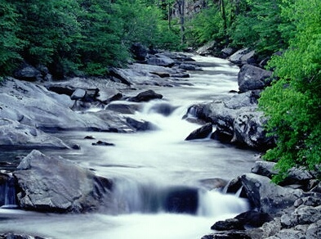
Distributed source coding (I)
x, y correlated
i.e. H(x) + H(y) << H(x, y)
Huffman coding: sensor 1 sends H(x)
sensor 2 sends H(y)
Goal: sensor 1 + sensor 2 send H(x, y)
x
y

Slide 33
Distributed source coding (II)
Goal: sensor 1 + sensor 2 send H(x, y)
Slepian-Wolf 1973:
☺ achievable, with unidirectional communication
☹ channel model (an infinite stream of i.i.d. x, y)
Adler-Mags FOCS’98:
☺ achievable for just one sample
☹ bidirectional communication;
needs i rounds with probability 2^{-i}
Adler-Demaine-Harvey-P. SODA’06
any protocol will need i rounds with probability 2^{-O(i∙lg i)}

Slide 34
Distributed source coding (III)
x, y correlated
i.e. H(x) + H(y) << H(x, y)
x
y
small Hamming distance
small edit distance
etc
?
High-dimensional
geometry
Network coding

