Slide 1


Joint Inference in Image Databases via Dense Correspondence
Michael Rubinstein
MIT CSAIL
(while interning at Microsoft Research)
Some slides borrowed from Ce Liu

Slide 2
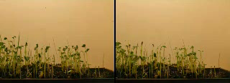
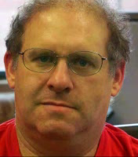
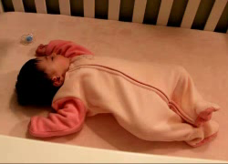
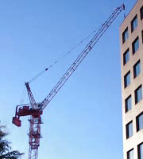
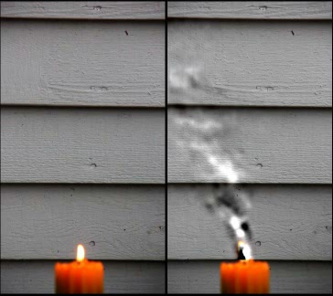
My work
Throughout the year (and my PhD thesis): Video Magnification
  Motion Denoising (CVPR’11)
  Eulerian Video Magnification (SIGGRAPH’12)
  Phase-based Video Motion Processing (SIGGRAPH’13)
This talk: what I work on during the summers
  Ce Liu’s (MSR) line of work on dense image correspondence and label transfer

Slide 3
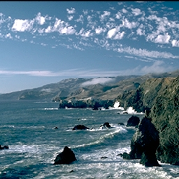
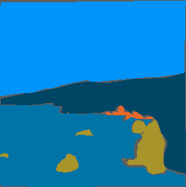
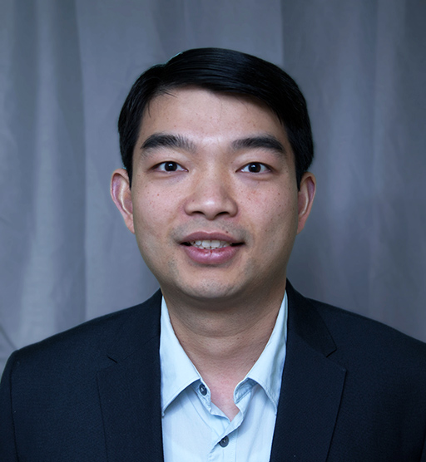
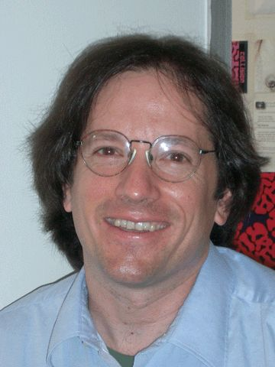
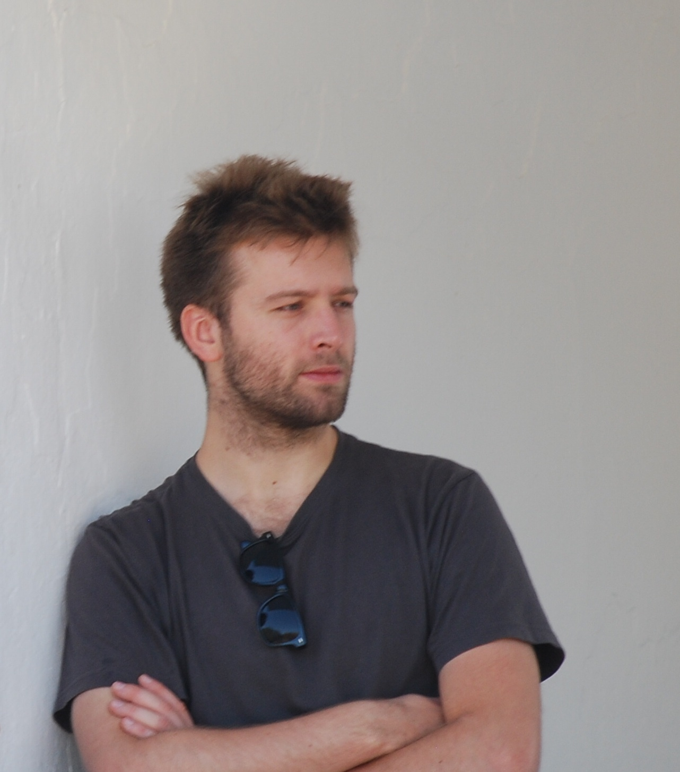
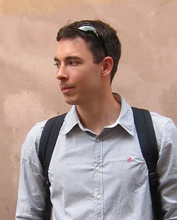
Joint Inference for Image Databases
Weakly supervised
Annotation Propagation in Large Image Databases via Dense Image Correspondence (ECCV 2012)
With Ce Liu, William T. Freeman
Unsupervised
Unsupervised Joint Object Discovery and Segmentation in Internet Images (CVPR 2013)
  With Armand Joulin, Johannes Kopf, Ce Liu
sky
mountain
sea
rock

Slide 4
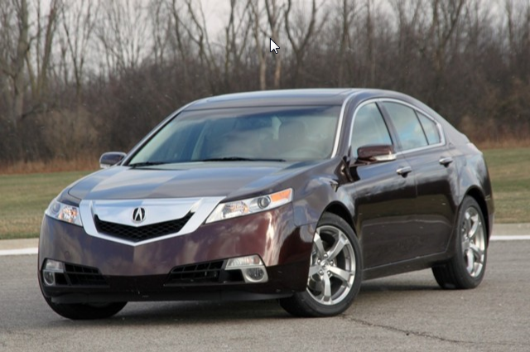
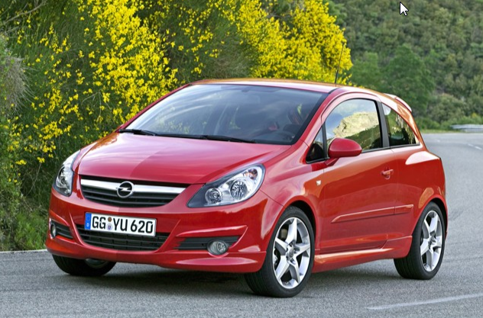
Videos vs. Image Datasets
Goal: we want to infer properties of pixels/regions
  Semantic segmentation, geometry (depth), image enhancement, …
Recent advances allow us to treat a set of images like videos!
  Correspondence between adjacent frames in videos: optical flow, layer models, tracking, …
  Correspondence between similar images in databases: Feature Matching, graph matching, Spatial Pyramid Matching (SPM), SIFT flow, …

Slide 5
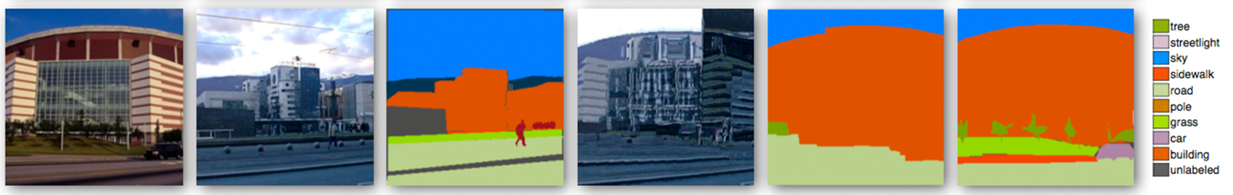
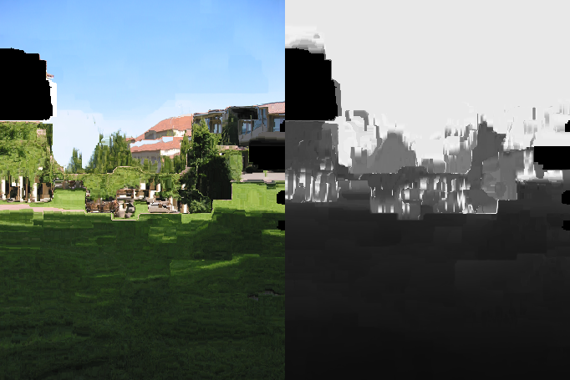
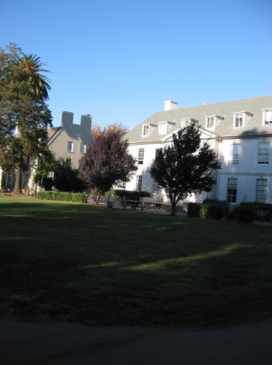
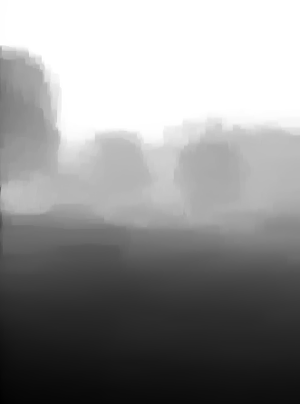
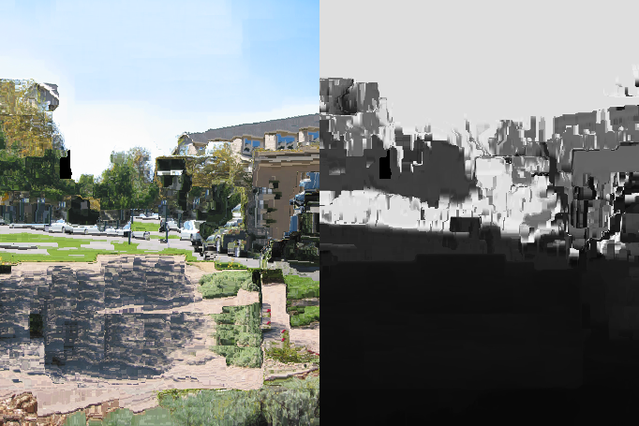
Correspondence-driven Approaches to Computer Vision
Scene parsing, Image Enhancement, Geometry (depth) inference, …
Annotation of
best match
Warp to
best match
Label
transfer
Query
Best match
Ground truth
Liu et al. TPAMI’11
Warped candidates
Query
Inferred depth
Karsch et al. ECCV’12

Slide 6
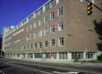
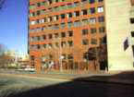
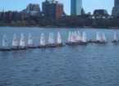
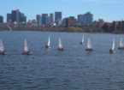
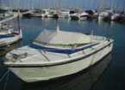
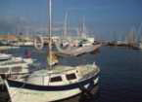
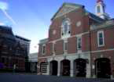
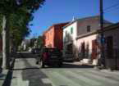
Dense Image Correspondence is Challenging...
Challenges of finding dense correspondences for images pairs
Changing perspective, occlusions
Multiple objects; no global transform
Background clutter
Intra-class variation

Slide 7
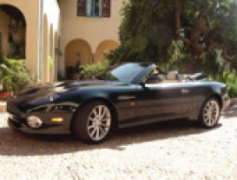
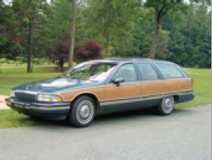
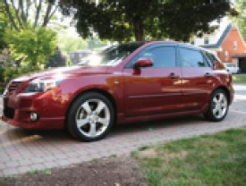
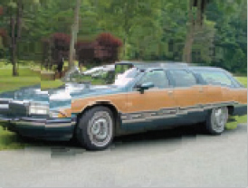
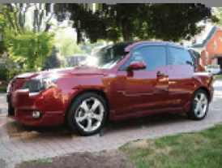
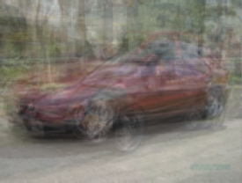
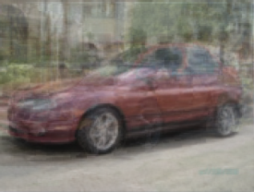
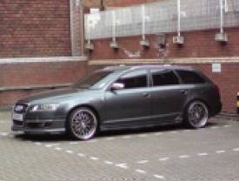
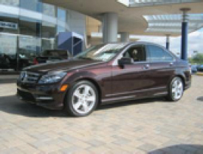
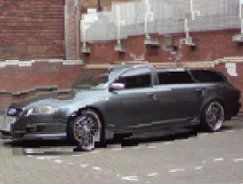
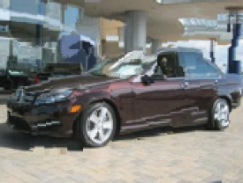
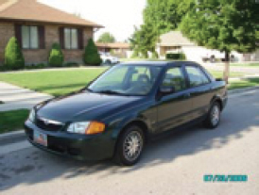
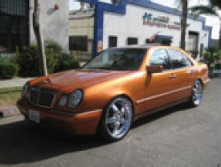

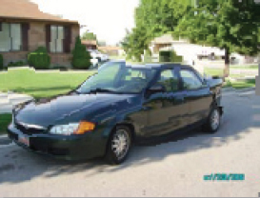
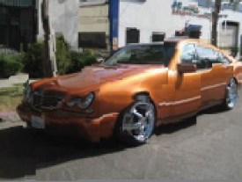
…but Good Solutions Exist
E.g. SIFT Flow [Liu et al. TPAMI 2011]
  Other algorithms exist, but this is the one we’ll use here
An image
Average
(before warping)
Average
(after warping)
Nearest neighbors
Flip (before warping)
Nearest neighbors (warped)
Flip (after warping)

Slide 8
How to densely label new images?
Annotated database
(label, depth, motion, …)
Well Explored
Image correspondence + information transfer
Query image
Image + transferred info
Image correspondence + joint inference
Less Explored
Unannotated (partially annotated) database
Database +propagated info

Slide 9
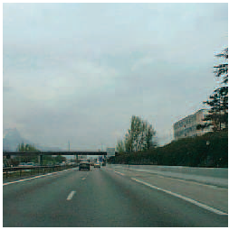
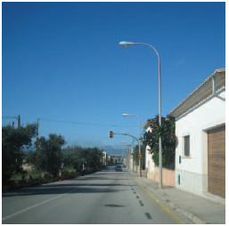
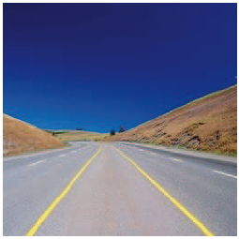
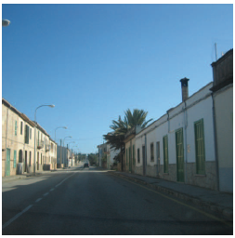
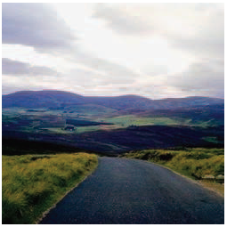
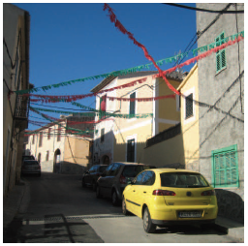
Joint Inference
sky
road
building
Images by Antonio Torralba

Slide 10
Joint Inference for Image Databases
Weakly supervised
Annotation Propagation in Large Image Databases via Dense Image Correspondence (ECCV 2012)
With Ce Liu, William T. Freeman
Unsupervised
Unsupervised Joint Object Discovery and Segmentation in Internet Images (CVPR 2013)
  With Armand Joulin, Johannes Kopf, Ce Liu
sky
mountain
sea
rock

Slide 11
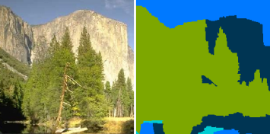
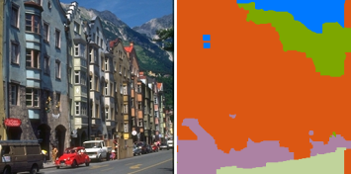
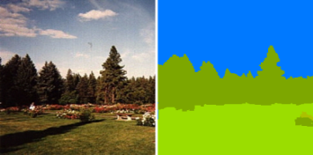









Annotation Propagation
Input: A large database of images where only some are tagged and very few are densely labeled
tree, sky, river
mountain
sky, mountain
tree
sidewalk, road, car
building, tree, sky
sky, river
building, bridge

Slide 12

Annotation Propagation
Output: The same database with all the pixels labeled and all the images tagged
tree, sky, river
mountain
tree, sky, road
car, building
tree, sky, plant
grass
mountain, field,
building, sky, tree
sky, mountain
tree
tree, sky, sidewalk
road, car, building
sidewalk, road, car
building, tree, sky
tree, sky, car
building
tree, staircase, sky
road, plant, door
sidewalk, car, building
tree, sky, river
person, mountain
sky, building
tree
sky, river
building, bridge

Slide 13



Dense pixel/region labeling is important!
Enhanced image search
  Mark region related to the user query
  Ensure versatility in the returned images
  More powerful queries E.g. “find images with a building occupying 30% of the image and located in the bottom right”
Constructing training sets for detectors/classifiers
PASCAL 2012

Slide 14

Annotation Propagation
Find $C$ that maximizes the probability
$$P(C|Ω,T_{t},C_{l})$$
Assumptions:
  Each word has distinct visual appearance
  Neighboring pixels in an image tend to have the same annotation
  Similar visual patterns across different images should have similar annotation
All pixel-wise
labels
Given pixel labels
(very few, maybe none)
Input image
database
Partial image
tags

Slide 15



Formulation
The objective function (in energy form)
$$E\left(C\right)=\sum_{i=1}^{N}{\sum_{p∈Λ_{i}}{\left[Φ_{p}\left(c_{i}\left(p\right)\right)+\sum_{q∈N_{p}}{Ψ_{int}\left(c_{i}\left(p\right),c_{i}\left(q\right)\right)}+\sum_{j∈N_{i}}{Ψ_{ext}(c_{i}\left(p\right),c_{j}}(p+w_{ij}\left(p\right)))\right]}}$$
Assumptions:
  Each word has distinct visual appearance
  Neighboring pixels in an image tend to have the same annotation
  Similar visual patterns across different images should have similar annotation
Local evidence
$\sim P$(word | $I(p)$)
Intra-image regularization
Inter-image regularization
$N_{p}$ - pixels neighboring $p$
$N_{i}$ - images similar to $I_{i}$
$w_{ij}$ - dense correspondence $I_{i}→I_{j}$

Slide 16




Relative to Previous Work
The objective function (in energy form)
$$E\left(C\right)=\sum_{i=1}^{N}{\sum_{p∈Λ_{i}}{\left[Φ_{p}\left(c_{i}\left(p\right)\right)+\sum_{q∈N_{p}}{Ψ_{int}\left(c_{i}\left(p\right),c_{i}\left(q\right)\right)}+\sum_{j∈N_{i}}{Ψ_{ext}(c_{i}\left(p\right),c_{j}}(p+w_{ij}\left(p\right)))\right]}}$$
Barnard et al. 2001
Duygulu et al. 2002
Blei et al. 2003
Feng et al. 2004
Barnard et al. 2005
Shotton et al. 2006
Shotton et al. 2008
Liu et al. 2009
Matching Words and Pictures [Barnard et al. 2003]
TextonBoost [Shotton et al. 2006]
Label Transfer [Liu et al. 2009]

Slide 17

Pixel-wise image graph

Slide 18

Text-to-Image Correspondence
Can use labeled images to train appearance model, but most of the images are tagged and not labeled
Utilize visual commonalities among images with similar tags
?
?
?
?
?
?
?
?
grass, mountain, sky, tree

Slide 19

Text-to-Image Correspondence
Image features (nothing new here; used what worked best…)
  Structure: SIFT (multiple scales) + HOG
  Color: 7x7 patches in L*a*b color space (unquantized)
  → 527D descriptor $D_{i}\left(p\right)$ for every pixel $p$ in image $I_{i}$
  We use PCA to reduce $D_{i}(p)$ to 50D, capturing approx. 80% of variance
Appearance Model (simple; others can be used)
$$P\left(D_{i}\left(p\right);Θ\right)=\sum_{l=1}^{L}{\left(ρ_{l}\sum_{k=1}^{M}{π_{l,k}N(D_{i}\left(p\right);μ_{l,k},Σ_{l,k})}\right)}+ρ_{ε}N(D_{i}\left(p\right);μ_{ε},Σ_{ε})$$
GMM for every word
(in descriptor space)
Noise model
(“unlabeled”)
$Θ=\left({\left\{ρ_{l}\right\}}_{l=1:L},ρ_{ε},θ_{1},…,θ_{L},θ_{ε}\right)$ – the parameters of the model

Slide 20






Appearance Model
MAP appearance
grass
mountain
sky
tree
LMO dataset [Russell et al. 2008] – 2688 images, 33 words, $(r_{t}=0.5,r_{l}=0.01)$

Slide 21






Appearance Model Results
LMO dataset [Russell et al. 2008] – 2688 images, 33 words, $(r_{t}=0.5,r_{l}=0.01)$

Slide 22

Optimization
EM-style coordinate descent, iterating between estimating the appearance model (learning) and tag propagation (inference)
Partition message passing into intra- and inter-image updates
  GrabCut-like process for intra-image message passing
  Parallel inter-image message passing
Appearance Modeling
Propagation

Slide 23
























Inference Results
Input image
MAP appearance
+ Intra-image reg.
+ Inter-image reg.
Input image local
evidence
Neighbors
Dense corr.
Neighbors warped
Neighbors local evidence warped

Slide 24







From stronger local evidence to weaker local evidence
Input image
Local evidence + intra-image reg.
+ Inter-image reg.
neighbors
warp

Slide 25












Results on SUN
SUN dataset [Xiao et al. 2010] - 9556 images, 522 words, $(r_{t}=0.5,r_{l}=0.05)$

Slide 26















Performance of other methods drops with very few labeled images
Comparison with Semantic Texton Forests (STF) [Shotton et al. 2008]
Input
STF
AP (ours)

Slide 27


Quantitative Evaluation
Labeling evaluated on $I\backslash I_{l}$
  $r$ = avg pixel recognition rate
  $\overline{r}$ = class-avg pixel recognition rate
Tagging evaluated on $I\backslash I_{t}$
  $P$ = precision (ratio of correctly inferred tags)
  $\overline{P}$ = class-avg precision
  R = recall (ratio of tags that were inferred)
  $\overline{R}$ = class-avg recall
Results on LMO
Results on SUN
AP-RF uses extremely randomized trees [Geurts et al. 2006]
AP-NN uses nearest neighbor matching using PatchMatch [Barnes et al. 2009]

Slide 28










Results on ESP and IAPR
ESP [Von Ahn and Dabbish, 2004] – 21,846 images, 269 words, $(r_{t}=0.9,r_{l}=0)$
IAPR [Grubinger et al., 2006] – 19,805 images, 291 words, $(r_{t}=0.9,r_{l}=0)$

Slide 29






Failures
Similar visual appearance (SUN)
Abstract words (IAPR)
Incorrect image correspondence (SUN)

Slide 30

Inter-image edges help!
And see our paper for more analysis…

Slide 31
Joint Inference for Large Image Databases
Weakly supervised
Annotation Propagation in Large Image Databases via Dense Image Correspondence (ECCV 2012)
With Ce Liu, William T. Freeman
Unsupervised
Unsupervised Joint Object Discovery and Segmentation in Internet Images (CVPR 2013)
  With Armand Joulin, Johannes Kopf, Ce Liu
sky
mountain
sea
rock

Slide 32



Object discovery and co-segmentation
Car
Query expansion & image search
Object discovery
Images downloaded from the Internet
Our automatic segmentation results
M. Rubinstein et al. Unsupervised joint object discovery and
Segmentation in Internet images. CVPR 2013 (to appear)
State of the art co-segmentation [Joulin et al. CVPR 2012]

Slide 33
Datasets with “noise”
Co-segmentation methods assume all images contain the object, but real-world datasets also contain objects that are visually different!
Somehow, need to figure out what’s “common” in the dataset.
State of the art co-segmentation [Joulin et al. CVPR 2012]

Slide 34

The image graph is your friend!
Image graph

Slide 35



Formulation is very similar!
A pixel belongs to the “common” object if:
  It is salient within its own image
  It has many similar pixels in other images (with respect to smooth transformations)
Recall: objective function for annotation propagation
$$E\left(C\right)=\sum_{i=1}^{N}{\sum_{p∈Λ_{i}}{\left[Φ_{p}\left(c_{i}\left(p\right)\right)+\sum_{q∈N_{p}}{Ψ_{int}\left(c_{i}\left(p\right),c_{i}\left(q\right)\right)}+\sum_{j∈N_{i}}{Ψ_{ext}(c_{i}\left(p\right),c_{j}}(p+w_{ij}\left(p\right)))\right]}}$$
All pixel-wise
labels
Txt2img$\sim P$(word | $I(p)$)
$$E\left(B\right)=\sum_{i=1}^{N}{\sum_{x∈Λ_{i}}{\left[Φ^{i}\left(x\right)+λ_{int}\sum_{y∈N_{x}^{i}}{Ψ_{int}\left(x,y\right)}+λ_{ext}\sum_{j∈N_{i}}{Ψ_{ext}^{ij}(x,}x+w_{ij}\left(x\right)))\right]}}$$
All binary masks
Foreground likelihood
$$Φ^{i}\left(x\right)=\left\{\begin{aligned}Φ_{saliency}^{i}\left(x\right)+Φ_{match}^{i}\left(x\right) \\ β\end{aligned}\right.\begin{matrix}b_{i}\left(x\right)=1 \\ b_{i}\left(x\right)=0\end{matrix}$$
The saliency measure we use:
Contrast-based saliency [Cheng et al. CVPR’11]

Slide 36
One of these things is not like the others
Source
Saliency
Warped
neighbor
Matching
Score
Segmentation

Slide 37
One of these things is not like the others
Source
Saliency
Warped
neighbor
Matching
Score
Segmentation

Slide 38
One of these things is not like the others
Horse = signal
Face = noise
Horse = noise
Face = signal

Slide 39
Evaluation on MSRC
14 object classes, ~30 images per class

Slide 40

Evaluation on iCoseg
30 object classes, varying number of images per class

Slide 41


Comparison with Object Co-segmentation [Vicente et al. CVPR’11]

Slide 42
Car

Slide 43
Horse

Slide 44
Airplane

Slide 45
Comparison on the Internet Dataset
Source
Joulin et al.
CVPR’10
Joulin et al.
CVPR’12
Kim et al.
ICCV’11
Ours
All “background”
All “foreground”

Slide 46


Conclusion
Joint inference over large-scale image databases through correspondence seems promising!
  Inference over HUGE graphical models becoming more and more feasible
  Dense image correspondence (SIFT flow, and others) is becoming a mature technology
Joint inference for weakly-labeled image databases
  Annotation Propagation: Partial tags + very few (possibly none) pixel labels
  Object discovery and segmentation: only assuming some underlying “common object”
tree, sky, river
mountain
tree, sky, road
car, building
tree, sky, plant
grass
mountain, field,
building, sky, tree
sky, mountain
tree
tree, sky, sidewalk
road, car, building
sidewalk, road, car
building, tree, sky
tree, sky, car
building
tree, staircase, sky
road, plant, door
sidewalk, car, building
tree, sky, river
person, mountain
sky, building
tree
sky, river
building, bridge

Slide 47
Thank you!
Michael Rubinstein
MIT CSAIL

Slide 48

Text-based Image Search

Slide 49

Large-scale Inference
Data term
$$Φ_{p}\left(c_{i}\left(p\right)=l\right)=−\log{P\left(c_{i}\left(p\right);Θ\right)−\log{P_{i}\left(l\right)}}−λ_{s}log{h_{l}^{s}\left(p\right)−}λ_{c}\log{h_{i,l}^{c}(p)}$$
$h_{l}^{s}$ - spatial prior (global)
$h_{i,l}^{c}$ - color prior (image)
Inter-Image regularization $I_{j}∈N_{i}, p∈Λ_{i}, r=p+w_{ij}(p)$
$$Ψ_{ext}\left(c_{i}\left(p\right)=l_{p}, c_{j}\left(r\right)=l_{r}\right)=δ\left[l_{p}≠l_{r}\right]exp\left(−λ_{ext}\left|S_{i}\left(p\right)−S_{j}\left(r\right)\right|\right)$$
Intra-image regularization $p,q∈Λ_{i}, q∈N_{p}$
  $$Ψ_{int}\left(c_{i}\left(p\right)=l_{p}, c_{j}\left(q\right)=l_{q}\right)=δ\left[l_{p}≠l_{q}\right]exp\left(−λ_{int}\left\|I_{i}\left(p\right)−I_{i}\left(q\right)\right\|\right)$$

Slide 50














Image-wise Word Prior
Without prior
With prior
Prior inspired by [Makadia et al. 2010], and is similar to the ILP in [Shotton et al. 2008]
$$P_{i}\left(l\right)=\frac{β}{\left|N_{i}\right|}δ\left[l∈t_{i}\right]+\frac{1−β}{Z}\sum_{j∈N_{i}}{\sum_{m∈t_{j}}{h^{o}\left(l,m\right)}}$$
$Z=\sum_{j∈N_{i}}{\left|t_{j}\right|}$
$$\max_{c_{i}}{P(c_{i}\left(p\right))}$$
$$\max_{c_{i}}\left\{P\left(c_{i}\left(p\right)=l\right)+P_{i}(l)\right\}$$
Neighbors $N_{i}$
$$h^{o}$$

Slide 51


Choosing Images for Human Annotation
Use “Image Hubs” that have many similar images in the image graph to propagate labels efficiently
Computed automatically over the image graph using visual pagerank [Jing and Baluja 2008]
Image graph for LMO dataset
Top-ranked image hubs + their pagerank score

Slide 52



Recognition rates on LMO
$→$ less frequent
True tag co-occurrence

Slide 53



Comparison to Makadia et al.
Results on ESP and IAPR
$F\left(r_{t},r_{l}\right)= \frac{2PR}{P+R}$
$r_{t}=0.1,0.2,…,0.9$, $r_{l}=0.1⋅r_{t}$
Labeling an image takes 50 sec on average [Vijayanarasimhan and Grauman 2011], and assume tagging takes 20 sec.
SUN dataset (9556 images)

Slide 54

Estimated Spatial Prior

Slide 55

Running Times
Parallel implementation using MATLAB and C++, running on a 3-node cluster with total 36 CPU cores
LMO: 19 hours (7 hours preprocess + 12 hours annotation propagation)
SUN: 41 hours (15 hours preprocess + 12 hours annotation propagation)
ESP: ~4.5 days
IAPR: ~4 days
Sparse inter-image edges

